Slide 1
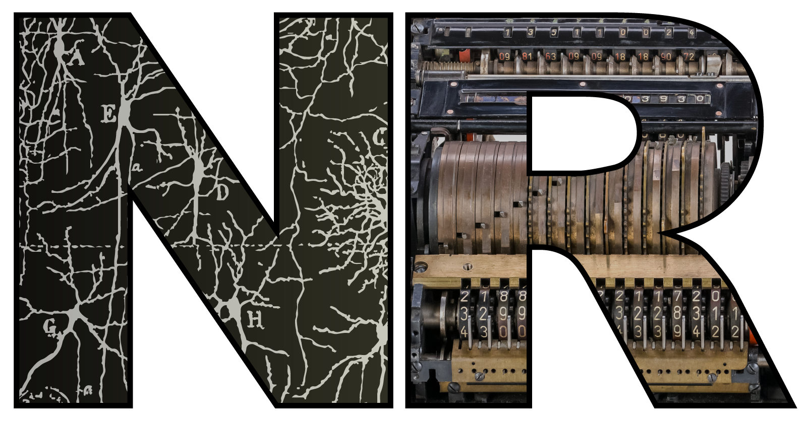

Spikes are cool again! What’s next?
Dan Goodman
Imperial College London
Department of Electrical and Electronic Engineering
neural-reckoning.org

Slide 2


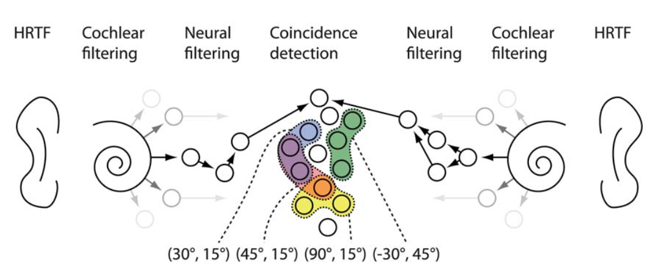

My own spike history
A mathematician says “wtf?”
First project with Romain Brette: plan = synfire chains
Instead built “Brian” SNN simulator
Next project: sound localisation with SNNs
Goodman and Brette (2010)
PLOS CB
Goodman and Brette (2010)
NeurIPS
Notes:
In a former life, I was a mathematician studying hyperbolic geometry, dynamical systems and fractals. I decided to switch to neuroscience and one of the first questions I hit on was why the brain uses spikes for communication and computation. As a mathematician and programmer, I was pretty familiar with both discrete and continuous systems, but spikes were like some wild combination of the two, so unlike anything we had designed ourselves. 18 years later I don’t feel much closer to an answer and I’m still convinced this is an important question. Today I’ll talk about this question from a personal perspective, as well as hopefully starting a conversation about what we want to do as a field.
My first neuroscience postdoc with Romain Brette we planned to look into synfire chains which were pretty trendy at the time, and still a pretty cool idea I think.
However, we got distracted building Brian, which I now think was probably for the better.
We did eventually get into doing some actual modelling work, using networks of coincidence detector neurons to implement a model of sound localisation. Probably many of you came across the Jeffress model, a classic model where you use an array of neural delays plus coincidence detector neurons. When the neural delays exactly compensate the arrival time difference of a sound between the two ears, the corresponding coincidence detector neurons fires at a maximal rate. This lets you work out the time difference and hence the sound location, as long as the sound is on the horizontal plane and in front of you. Our paper just extended this to the ability to localise sounds in 3d space by allowing for more complicated neural filtering that compensates for arbitrary directional filtering of sounds.

Slide 3



My own spike history 2
And that’s what SNN papers were like back then, until…
Machine learning happened.
I was a late convert.
My impression: SNNs went a bit dormant for a while?
2019: SPyTorch brought me back
Finally felt like I could do the two things I had wanted to do:
Study the brain when doing ‘real world’ tasks
Use spiking neural networks to do it.
SNN Cambrian explosion
SNUFA workshop: https://snufa.net
So: spikes are cool again!
Where do we go next with our cool new toys?
Zenke (2019)
Zenke, …, Goodman (2021)
Neuron
Notes:
That sort of paper was pretty common in computational neuroscience at that time…
but everything changed when machine learning exploded.
Incidentally, I was a pretty late convert to this. I went to NeurIPS in 2010 to present that paper and it was already taking off. I remember coming back from the conference and telling Romain not to bother with ML because it was just a way to sell adverts. I wasn’t entirely wrong, but I did miss a bit of an opportunity there.
So my impression is that SNNs went a bit dormant for a while, as people got more interested in the potential of backprop with artificial neural networks. Maybe that’s just me though?
In any case, my own interest was brought back to SNNs in a big way when I happened on Friedemann Zenke’s SPyTorch tutorial on surrogate gradient descent, which just blew my mind.
Any problem I threw at it, it would just train an SNN that could solve it.
And I think I wasn’t the only one, it felt like the field suddenly exploded.
Friedemann and I organised the SNUFA online workshop during COVID and we’ve been running it ever since with several hundred participants every year.
So yeah, from my perspective it feels like spikes are cool again. Every day there are new papers with new methods to train SNNs bigger and better, it’s actually hard to keep up it’s moving so fast.
So now I’m asking: what can we do with these awesome new toys? What I want to do with this talk is to start a conversation with you all about this, by talking about my own personal approach in a broad context, and seeing what you all think. I’m not here to tell you the way it is, and I’m very much aware that there are people in the audience here who have been doing SNNs for much longer than I have!

Slide 4
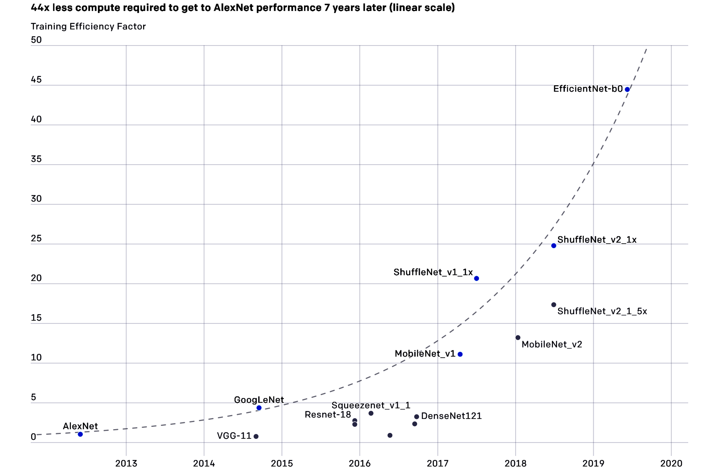
Why spikes?
Easy: power efficiency.
Important in biology
Important for neuromorphic
End of talk, we can all go home?
How sure are we that this will keep the field relevant?
2016 AlphaGo drew 100-1000 kW ~ 5k-50k human brains
2017 AlphaGo Zero drew 1-2 kW ~ 50-100 human brains
AlexNet level performance reduced by 44x in 7 years
Huge interest in reducing power:
Bit quantisation (e.g. DeepSeek)
Approximate computing
Can neuromorphic compete? (I’m not taking a stand – genuinely don’t know the answer!)
Notes:
So why might spikes be important?
The obvious answer is power efficiency.
We know this is a big part of the reason in biology,
and you all know much better than I do that this is true for neuromorphic computing as well.
So, end of talk, we can all go home?
But how sure are we that this reason will sustain our field both intellectually and in terms of relevance? Let me illustrate why I’m worried about that.
In 2016, AlphaGo drew somewhere between 100 kW and 1MW of power, thousands of times what our brains use. Looks like an obvious case for neuromorphic computing?
Well, a year later that came down to 1-2 kW. Still much less efficient, but that’s a dramatic reduction in only one year.
And you can do the same with efficient models that can perform at the same level as AlexNet. In the 7 years following that paper there was an exponential growth in efficiency with 44x less compute needed at the end.
Now of course we know that current LLMs are again drawing huge amounts of power, but there’s a big interest in reducing that.
For example, DeepSeek made it big partly because their use of efficient techniques like clever use of quantisation massively reduced power consumption.
There’s also a big line of work in approximate computing.
With all this, how sure are we that neuromorphic can continue to compete?
I should say, I’m not taking a stand against neuromorphic computing here! I’m just genuinely a bit worried about this and don’t feel confident to say one way or the other.

Slide 5

Why spikes? (2)
Power? ✅ biology ✅ neuromorphic
Reliability? ✅ biology ❓neuromorphic
Compactness?
Important biological constraint, but unique to spiking?
Important for neuromorphic?
Speed? ✅ biology (Thorpe et al.) ❓neuromorphic
Can we extend and formalise this? Memory bandwidth bottlenecks?
Noise robustness? ✅ biology ❓neuromorphic 🍸🥳 e.g. cocktail party problem
Sample efficiency?
Performance? ✅ biology ❌ no examples of SNNs doing better
Generalisation? ✅ biology ❌ no examples of SNNs doing better
So what could be a fundamental advantage of spiking?
Implementation
Thorpe and Imbert (1989)
Behaviour
Notes:
OK so let’s list some of the reasons why spikes might be important.
We’ve seen that power is important for both biology and neuromorphic computing.
We also know that reliability is important in biology, both because spike transmission down an axon is reliable, but also because globally computations are reliable even when individual synapses are not. I’m not sure if this is an issue for neuromorphic computing?
For the brain, compactness is an important biological constraint,
but I’m not sure if there is anything uniquely specific to spiking neurons here?
And I’m not sure how the neuromorphic community thinks about this either.
Speed of computation is another important point. We know from Simon Thorpe’s work that the brain can make decisions basically as quick as it’s possible to do given signal transmission speeds and the geometry and organisation of the brain, and this is at least partly because it uses spikes. I think this would be an interesting thing in neuromorphic computing too, but I’m not aware of the work done in this area.
What I’m wondering about is whether or not we can formalise Simon Thorpe’s arguments in a slightly more general context, to get confidence that spikes are actually essential for this rather than it just being the case that we know of one fast spiking implementation. Perhaps something could be done by thinking about memory bandwidth bottlenecks?
Noise robustness is important in real world environments, but again not sure that neuromorphic computing has yet shown a clear advantage over machine learning in this. A good benchmark for me would be the cocktail party problem, which we know that the machine learning approach still struggles with compared to humans, but I’m not aware of any spiking model that can do better.
Sample efficiency is another clear advantage of biology over machine learning, but I don’t know of any obvious reason why spikes would be relevant to this.
Generally speaking, biological systems still perform better than ML systems, but I’m not aware of any real world examples where spikes are better.
And the same is true for generalisation.
So where does this leave us? I’d divide these possible reasons into two groups. The first is primarily about implementation, and here I think we’ve made pretty good progress in understanding.
But I personally still feel as lost as ever as to whether or not there’s a fundamental reason that spiking computation should behave well compared to pure analogue or pure digital. So if there is one, what could the fundamental advantage of spiking be? In the next few slides I’ll talk about some of the guesses I think are likely with a few more recent examples of work in that direction.

Slide 6
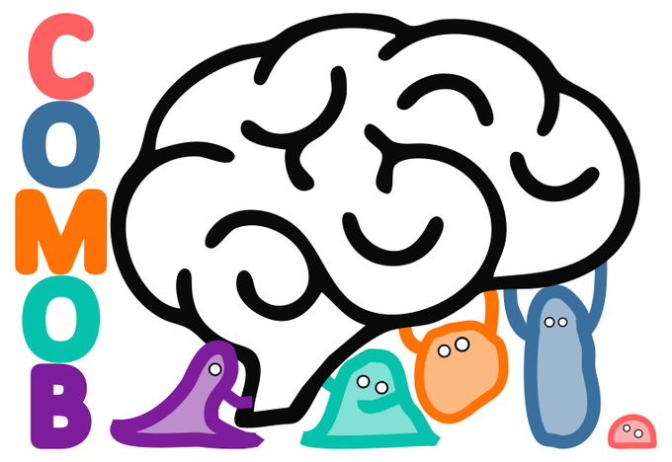

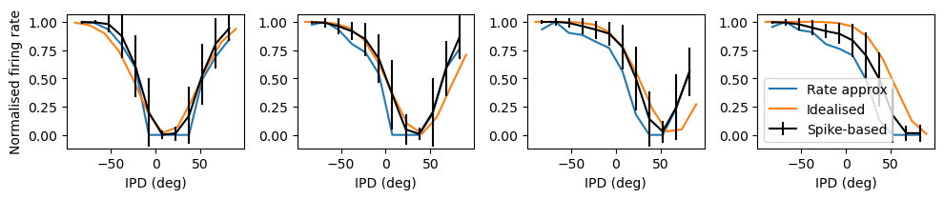
Nonlinearity and temporal dynamics
Coincidence detection
Sound localisation: Jeffress (1948)
Sound localisation: COMOB
Open, online collaboration (31 researchers)
New delay learning algorithm (Karim Habashy)
(Smaller time constants = better performance) ⇒ coincidence detection?
No, output well approximated by:
Output = inverted Gaussian tuning → Ricker wavelet weight matrix → sigmoidal activation
Ghosh et al. (2024 preprint)
Notes:
The first guess for me is easy: spiking neurons have interesting nonlinearities, which we know are important in a machine learning context, and they have temporal dynamics at fast time scales, which is something you don’t really see in ML.
One well known thing that this enables is coincidence detection, which has been understood to be important for a very long time.
It was a key part of Lloyd Jeffress’ sound localisation model in 1948, and even now I’m still exploring this question.
I wanted to mention COMOB, which stands for “collaborative modelling of the brain”, a project we ran over a couple of years to model learning to localise sounds using surrogate gradient descent.
The fun thing about this is that we ran it as an open, online collaboration. Anyone was free to join and apart from seeding it with a base model and a general set of questions that we found interesting, we didn’t impose any top down control on the directions people took.
Amazingly, despite this total lack of structure, we ended up with some interesting results, including a new algorithm for delay learning from Karim Habashy. I should mention the irony of this project. I started it to explore whether or not surrogate gradient descent could find new coincidence-detection based approaches.
For a long time we thought that’s exactly what we were finding because we had results showing that performance was better when time constants were smaller, exactly what you’d expect for coincidence detection.
However, right around the time we were preparing the paper to submit I found a way to analyse the solution the network had found and pretty convincingly showed that it was using a rate-based solution by approximating the behaviour of the network with a set of rate-only equations. Ah well. It does at least give a nice example of how difficult it is to understand what a network is doing even if you have full knowledge of it, and how easy it is to make the wrong inference from the results.

Slide 7


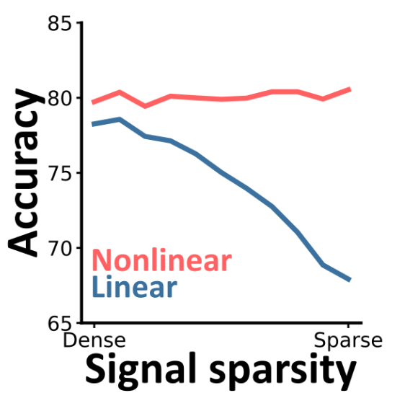




Nonlinearity and temporal dynamics
Coincidence detection
Sound localisation
Sensitivity to tiny population correlations
Computing in time
Processing multimodal signals
Advantage larger for sparser signals.
Rossant et al. (2011)
Ghosh et al. (2024)
Notes:
I wanted to mention another computation that makes use of coincidence detection. It’s not my work but it’s something I’d be interested in following up on. My first postdoc supervisor Romain Brette and his PhD student Cyrille Rossant looked into the sensitivity of a spiking neuron to correlations in the spike trains of its inputs and found that an input correlation as small as 0.01 could have huge effects on the ouput firing rate of the neuron, and verified this simulation-based results in real neurons with injected currents. This strikes me as important because it means that in all the experimental data we’ve ever looked at, there could be coordinated spike timing-based information that is too subtle for any of our noisy experimental measures to have picked up on. And, spiking neurons could be doing incredibly subtle and complicated computations on huge amounts of parallel information in this way. Even though this result is from way back in 2011 I still feel like it shows that there’s so much untapped depth in spiking neural networks.
Moving on, another aspect of spiking neurons having temporal dynamics is that they can compute in time in a more natural and direct way that an artificial neural network.
One example from our work is this paper on processing multimodal signals. Actually, in the end for this paper we ended up simplifying it sufficiently that we could study it with ANNs and even solve for ideal performance with a relatively simple equation. The original idea though was to look at how spiking neural networks could handle the subtle and complicated spatiotemporal patterns of information that arise in multimodal signals. The task we devised is a step up in temporal complexity from the standard multimodal task often studied in psychophysics and neuroscience.
A nice way to visualise it is to imagine you’re a predator hunting this mouse moving around a forest. Sometimes the mouse is out in the open and then it will be emitting both auditory and visual signals, and sometimes it’ll be hidden behind a tree and then it will be emitting neither. This means that the auditory and visual channels give non-independent, correlated information at certain unknown points in time, and the rest of the time give independent noise. Spiking neurons are naturally able to pick up on this and extract useful information, and indeed quite small networks can be trained to give close to ideal performance.
We looked at how much advantage you can get from a thresholding nonlinearity like that used by a spiking neuron over a purely linear network, and found that the sparser the signal the greater the advantage. This is baby steps, but it suggests that maybe spiking neural networks may have a particularly important role in extracting information that arrives sparsely in time. That’s a theme I’ll come back to shortly.

Slide 8
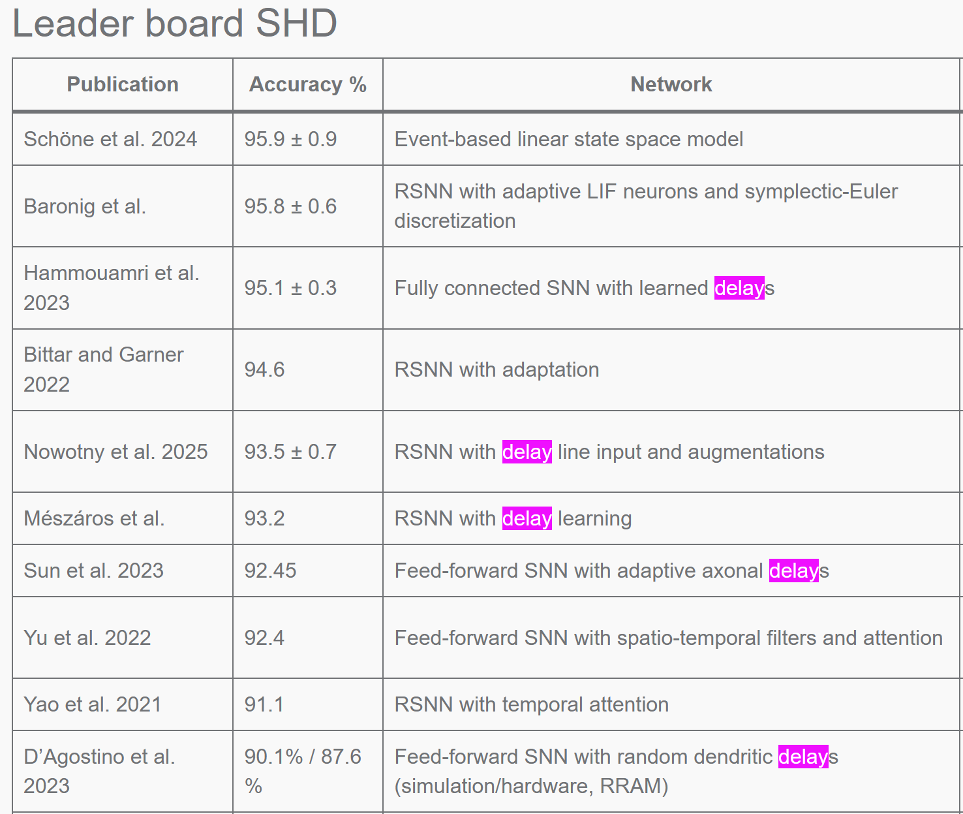

Nonlinearity and temporal dynamics
Coincidence detection
Sound localisation
Sensitivity to tiny population correlations
Computing in time
Processing multimodal signals
Delay networks and learning
Too much recent work to list it all
On temporal logic tasks: delays more important than weights
Ongoing work in our group on delays:
With Danyal Akarca and Pengfei Sun
Systematic approach to delays versus weights, quantisation, task structure, etc.
Habashy et al. (2024)
Notes:
But first I wanted to talk about delays,
which has become a pretty trendy topic in the last few years. Friedemann Zenke maintains a spiking auditory dataset and a leaderboard of which models perform best at it. The top of that leaderboard now has a lot of networks that use delay learning in some form, suggesting that the ability to make use of delays might be a pretty key component that makes spiking neural networks powerful.
This is also something we’re working on. I mentioned Karim Habashy earlier who came up with a new delay learning algorithm in our COMOB project. We also did a paper using neuroevolution to find spiking solutions to temporal logic problems and found that the ability to learn delays was more important than weights, which is quite cool.
We also have two new members in our group, Danyal Akarca and Pengfei Sun who are following up on this sort of thing, trying to be much more systematic in our approach with a wider range of tasks, training regimes, and looking at some neuromorphic aspects like the number of bits available for quantisation, etc.

Slide 9
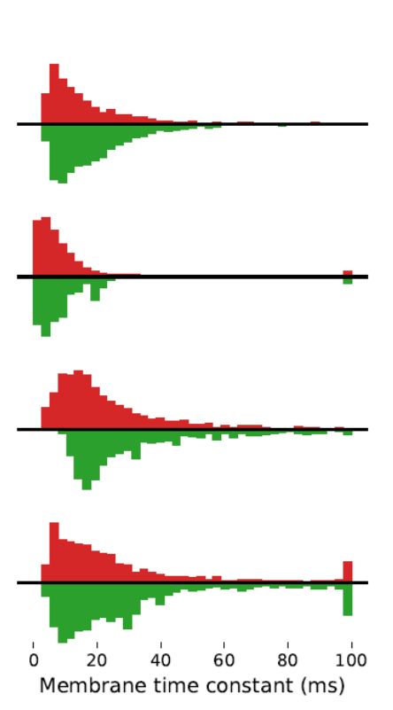
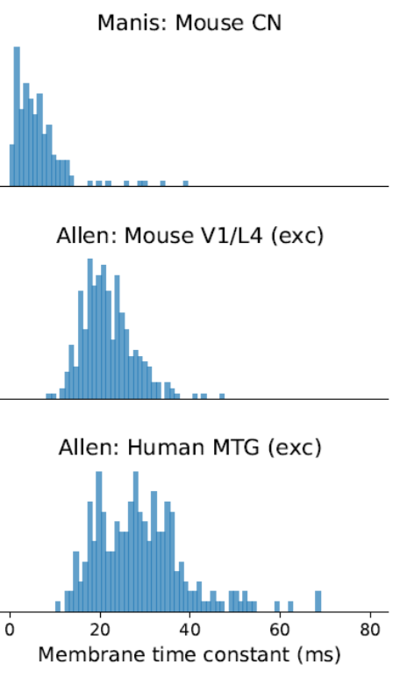

Heterogeneity
✅ Biology ❌ Artificial neural network
✅ Neuromorphic computing devices (some)
Perez et al. (2024)
Notes:
Another feature of biological brains compared to artificial neural networks is that they are much more heterogeneous, both in terms of their large scale and small scale structure.
Some types of neuromorphic devices also have this sort of heterogeneity as a natural and unavoidable feature of their substrate.
So is it helpful? One of the first things I asked myself once I’d got familiar with surrogate gradient descent is whether or not adding heterogeneity would improve task performance. We looked at the simplest possible thing we could: adding trainable time constants to each neuron.
For a tiny increase in the number of parameters we got a huge increase in performance, whereas just increasing the number of neurons to get the same level of performance would have required a huge increase in the number of parameters. The effect was strongest on those tasks with the most temporal structure: so we hardly saw any improvement for N-MNIST which is basically just saccades around static images, but a big effect on auditory datasets.
After training, we looked at histograms of the learned time constants and they had a very characteristic shape that looked a little like a gamma distribution or log-normal distribution.
So we extracted time constants from the large collections of recordings made by the Allen Institute and found very similar distributions there. I still don’t know if this is meaningful or just an almost unavoidable feature of the fact that these are positively valued with some stochasticity, but we did find that it learned these distributions even if we seeded it with homogeneous time constants.

Slide 10


Sparsity
Temporal sparsity (e.g. 100x faster training)
Spatial sparsity
Neuromorphic: memory bottlenecks and locality
Biology: wiring constraints, coordination between regions
Modularity
Perez and Goodman (2021)
Béna and Goodman (2025)
Notes:
Sparsity is another key feature of the brain and spiking neural networks specifically. That means both temporal sparsity in that spikes are relatively rare events, and spatial sparsity in that most pairs of neurons are not connected to each other.
My former student who is now working at DeepMind doing non-spiking stuff unfortunately, managed to get surrogate gradient descent running up to 100x faster by exploiting the temporal sparsity of spikes.
Spatial sparsity is not unique to spiking neurons,
but may be particularly interesting for neuromorphic computing anyway because it is closely tied in to the idea of memory bottlenecks and locality.
Of course, it’s also very important in biology because of wiring constraints – the majority of the space in the brain is used in wiring between neurons. And this raises some interesting questions because different regions of the brain need to coordinate their activity despite having very limited communication bandwidth with potentially high latency.
One of the main research activities in my group at the moment is various ways of thinking about this question: how, why, and to what extend does the brain divide into structurally and functionally distinct modules, and how do these coordinate their activity? I’ll talk briefly about our most recently published paper on this with my student Gabriel Béna. I should also add that Gabriel is coming to the end of his PhD and looking for postdoc positions in the next year, so if you want a really brilliant postdoc who will make your lab a better place, get in touch with him or me, or come and say hi at Capocaccia if you’re going.

Slide 11
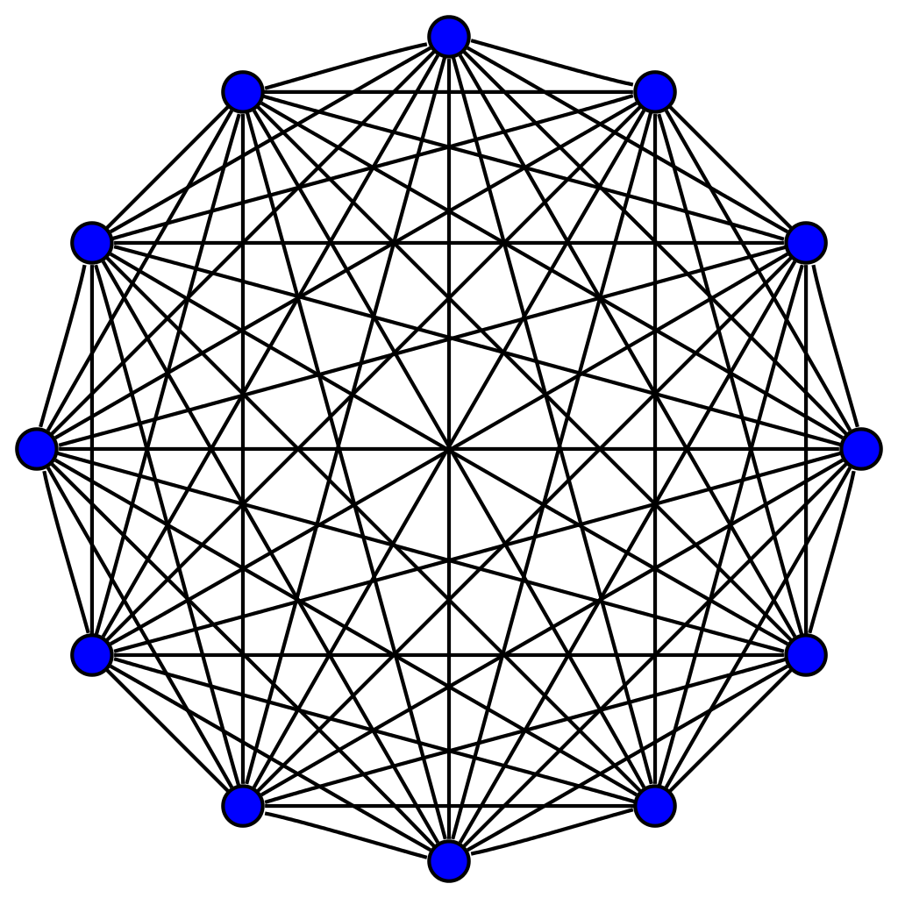
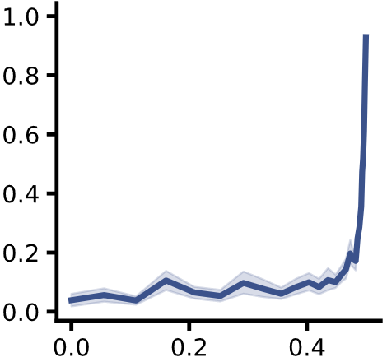
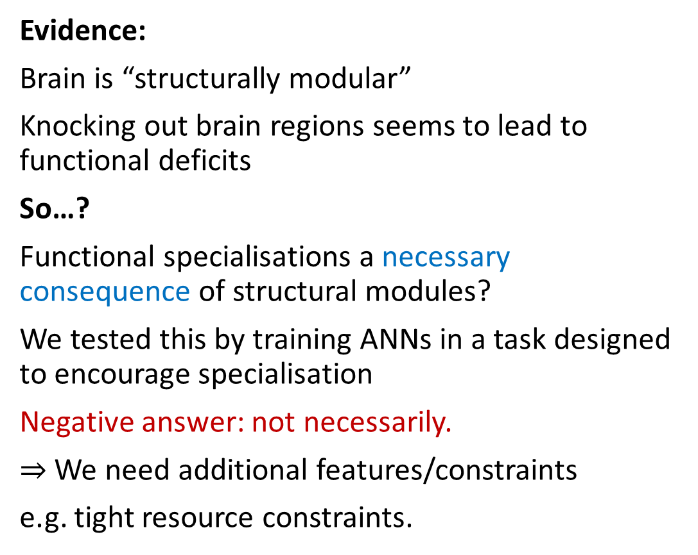
Why is there modular structure in the brain?
Within module:
Dense connections
Within module:
Dense connections
Evidence:
Brain is “structurally modular”
Knocking out brain regions seems to lead to functional deficits
So…?
Functional specialisations a necessary consequence of structural modules?
We tested this by training ANNs in a task designed to encourage specialisation
Negative answer: not necessarily.
$⇒$ We need additional features/constraints
e.g. tight resource constraints.
Between modules:
Sparse connections
Maximum modularity
seen in brain
Specialisation
Structural modularity

Slide 12
Challenges
No examples where SNNs are better
Naturalistic tasks with rich and sparse temporal structure
Scaling up SNN training
Algorithmic developments
Conceptual understanding of biological learning
Do we know if our algorithms are finding ‘spikey’ solutions?
Lacking a mathematical theory of hybrid systems
Generalisation of spiking
Notes:
This is my last slide and I wanted to briefly talk about some of the challenges I think we face collectively, or at least that I feel like I face in this sort of work.
The really outstanding one for me is that we don’t really have examples of where spiking neural networks do better than any alternative. It’s quite hard to convince people of the relevance of the topic without this.
One way I think we could address this is by designing and publicising tasks with rich and sparse temporal structure that ANN approaches are likely to struggle at. In a way this shouldn’t be hard, it’s a very natural condition. Of course, we’d also need to be able to train SNNs that can do these tasks well, either in terms of raw performance or power consumption, or ideally both.
Practically, an important challenge is scaling up training of SNNs. We’re many, many orders of magnitude away from what is possible with ANNs. I generally feel pretty positive about this one.
There are so many algorithmic developments happening at the moment that are improving this.
Arguably more important would be to improve our understanding of how biological brains manage to achieve such impressive learning, apparently based largely on local information only.
There’s an open question here for me: do we know if our training algorithms are finding all the solutions that are possible with a spiking neural network or are they biased to prefer certain types of information and therefore not fully exploring that space? I have an MSc student looking into what surrogate gradient descent can learn at the moment. It’s just started but he’s already shown it can learn to extract information that is only stored in interspike intervals, for example.
This relates to my next challenge: that we don’t have a fully satisfactory mathematical framework for thinking about hybrid systems. We can cobble some pieces together from discrete and continuous systems, and sometimes get them to work together, but it’s always a vast effort and very hard to get to really substantial results with wide applicability. I’m a mathematician originally so this really ought to be on me, but I have absolutely no idea how to go about this. One possibility is that it’s just not possible to have such a theory, because any system complex enough to generate intelligence will always be too rich in structure to be able to make any generalisations about. I don’t really believe that: I suspect we’ll be able to say something, but I’m not sure what that something will be.
Taking that one step further, maybe we’re limiting ourselves too much thinking just about spiking? Perhaps spiking is one particular solution that evolution found to solve certain sorts of problems, but you could just think of it as one example of a much wider class of solutions, some of which might be better suited to neuromorphic applications, for example. What might such a class of solutions look like? Again, it’s hard to say at this point but possibly a rich source of future work.

Slide 13







Thanks!
Gabriel Béna
PhD student 2021-
Danyal Akarca
Postdoc fellow 2024-
Marcus Ghosh
Postdoc fellow 2021-
Pengfei Sun
Postdoc fellow 2025-
All papers 👆
Swathi Anil
Visiting PhD (2024)
Nicolas Perez
PhD student 2018-2023
And thanks to you 🫵 for listening ❤️

