Slide 1
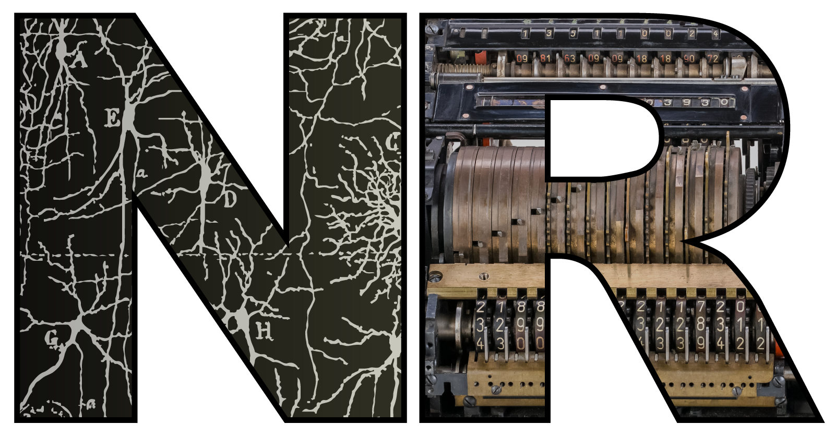

Theoretical and experimental challenges in understanding the brain
Dan Goodman
Imperial College London
Department of Electrical and Electronic Engineering
neural-reckoning.org

Slide 2
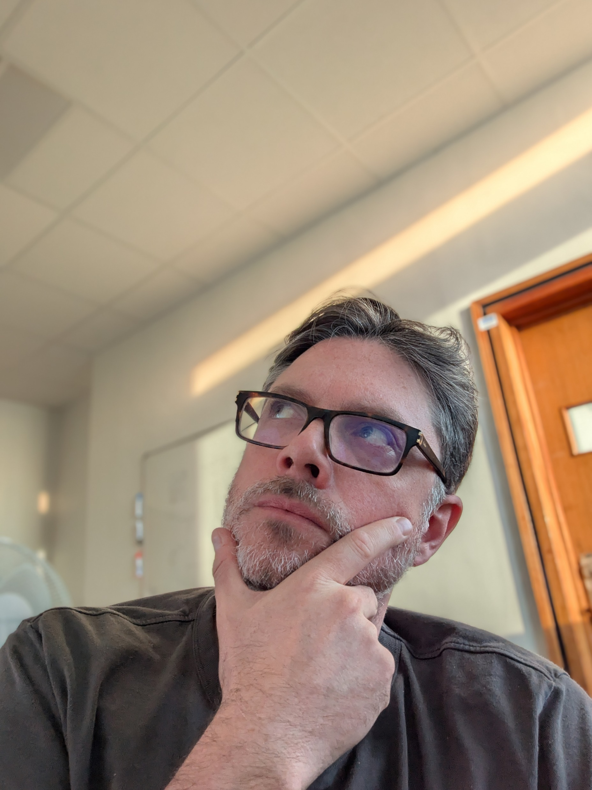

Outline
I'm introducing the panel discussion on "Will we ever understand the whole brain?"
So I have to say something at least moderately controversial...
💡TLDR: yes, but not if we keep doing neuroscience the way we are now.
Specifically:
Challenges in understanding whole brains
Why current methods may not meet these challenges
Can I dig myself out of this hole? Let's see. 😅

Slide 3
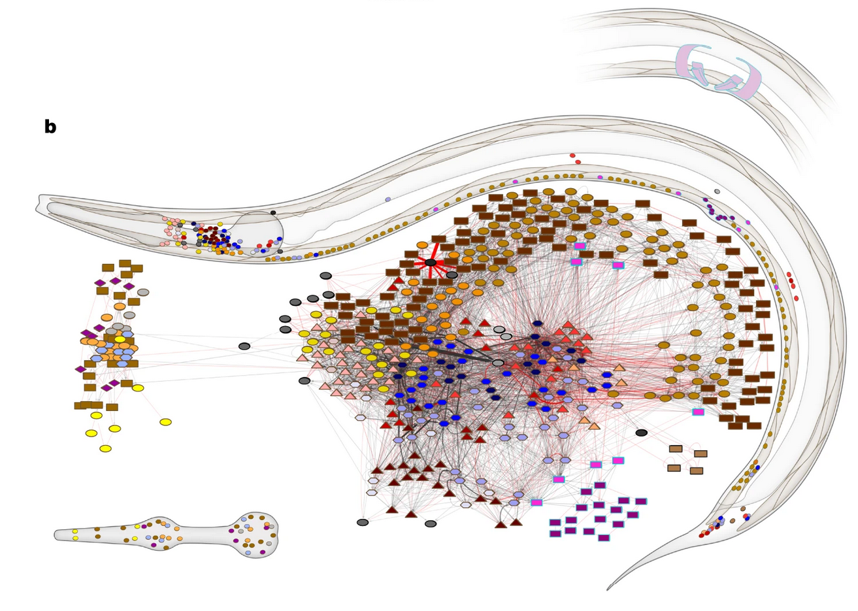
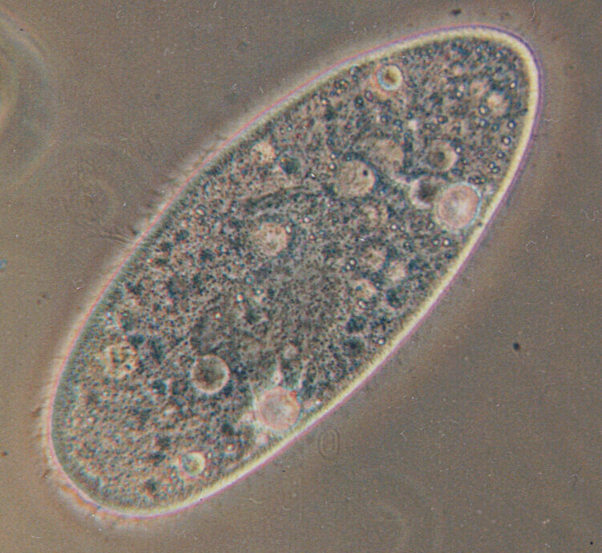
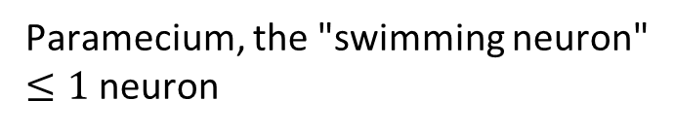
Uncontroversial (?): we're not there yet
C. elegans
302 neurons
Paramecium, the "swimming neuron"
$≤1$ neuron

Slide 4
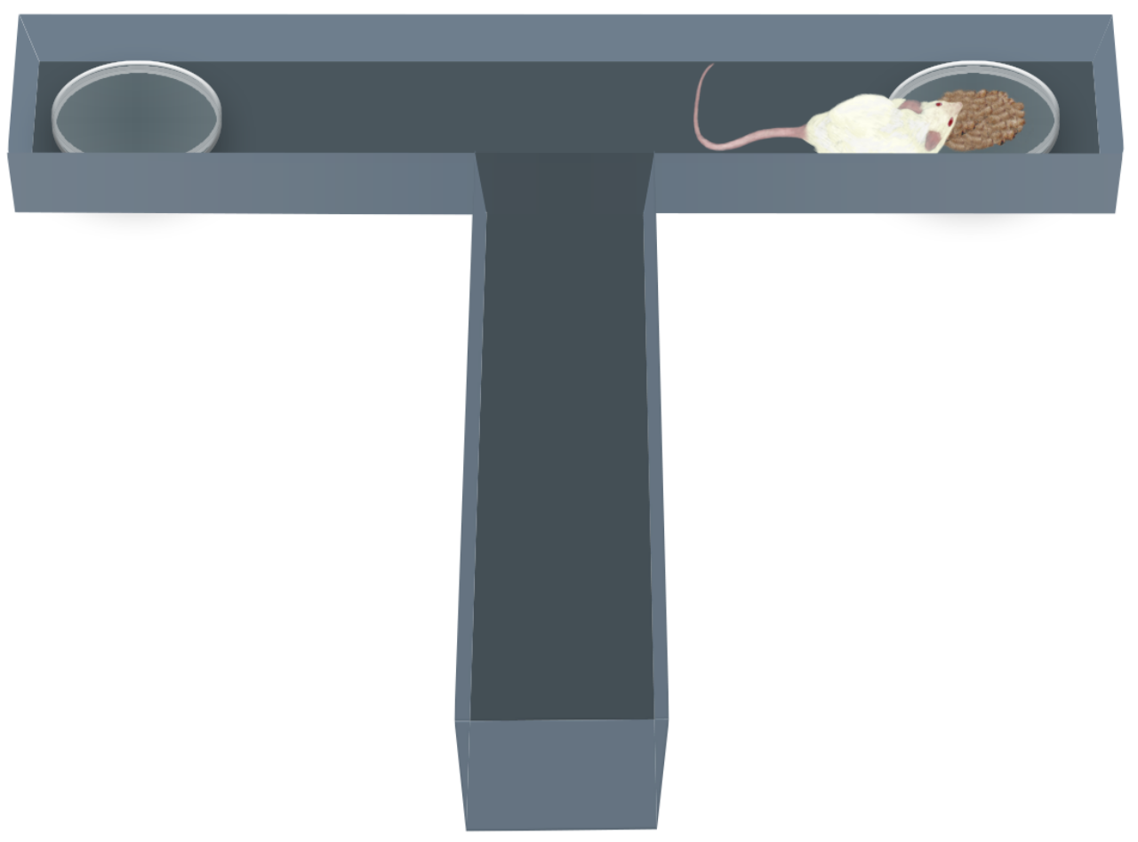
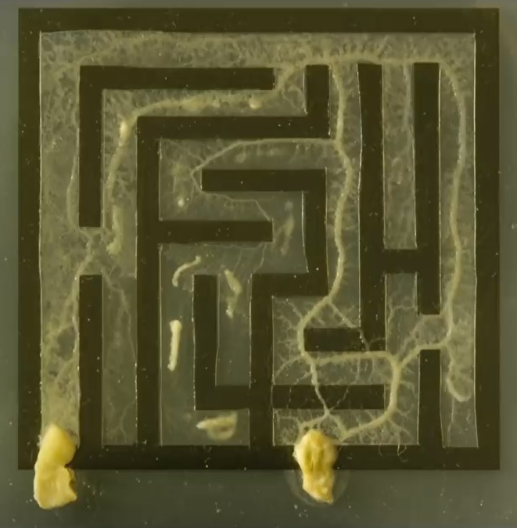
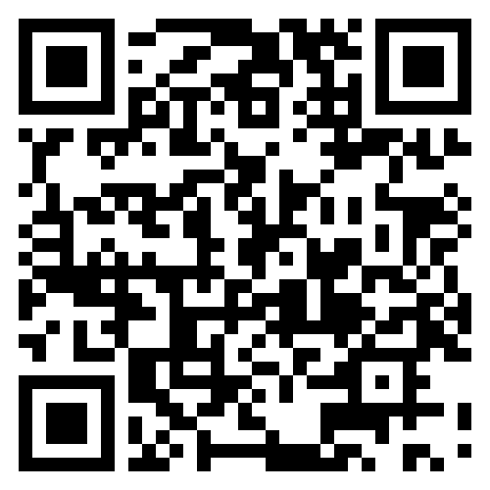
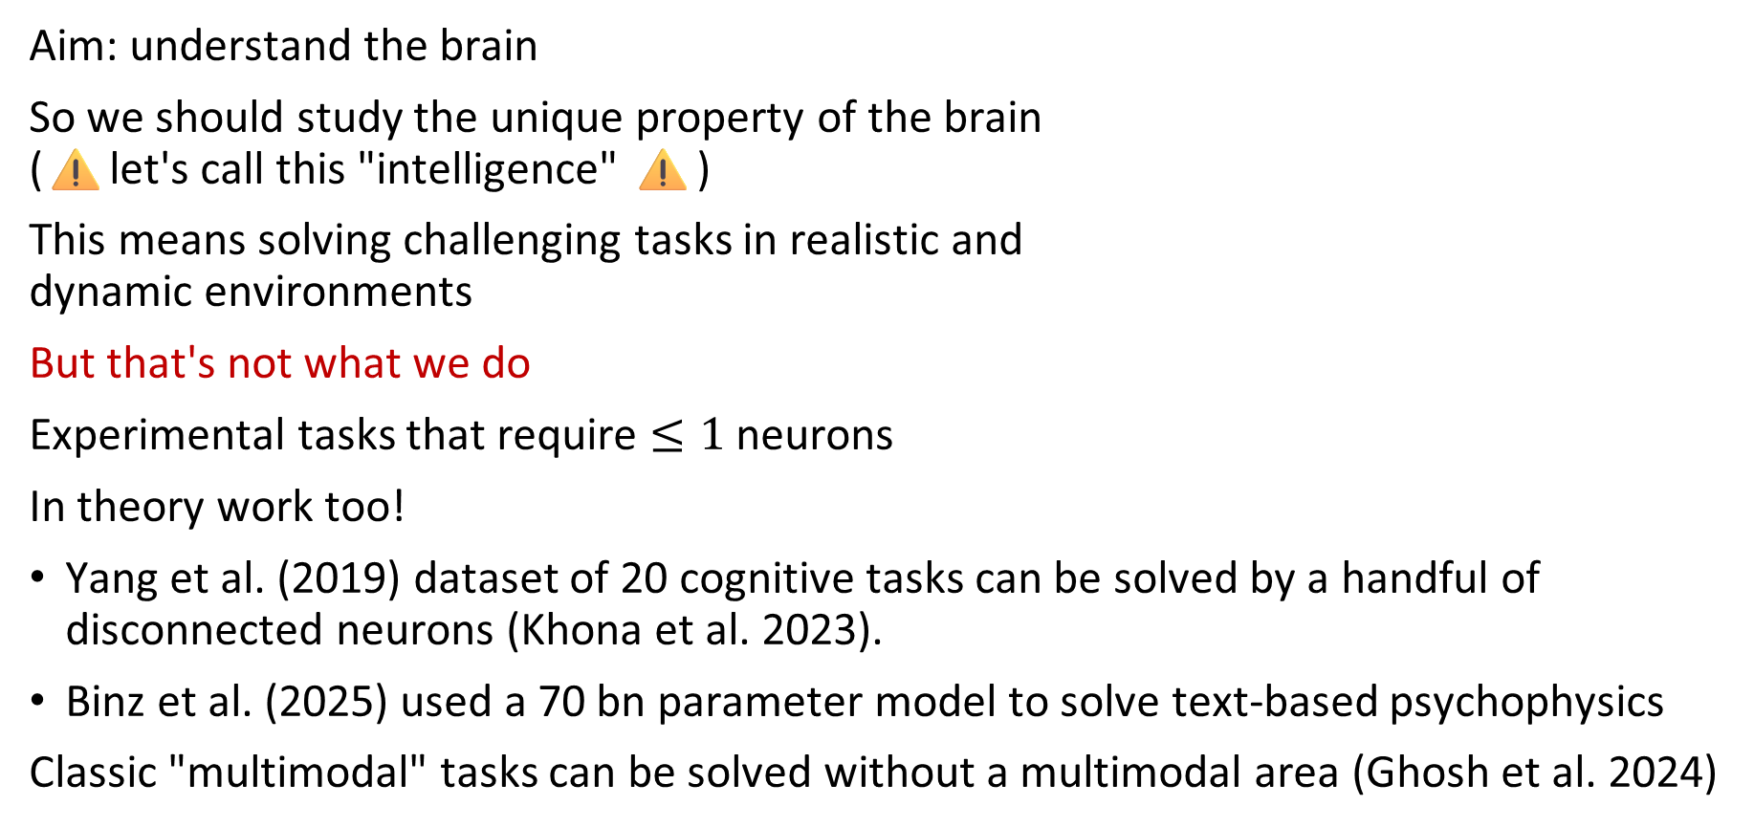
Challenge 1: we take on problems that are too easy
Aim: understand the brain
So we should study the unique property of the brain (⚠️let's call this "intelligence" ⚠️)
This means solving challenging tasks in realistic and dynamic environments
But that's not what we do
Experimental tasks that require $≤1$ neurons
In theory work too!
Yang et al. (2019) dataset of 20 cognitive tasks can be solved by a handful of disconnected neurons (Khona et al. 2023).
Binz et al. (2025) used a 70 bn parameter model to solve text-based psychophysics
Classic "multimodal" tasks can be solved without a multimodal area (Ghosh et al. 2024)
Has mouse
⇒
Must be neuroscience
Slime mould ⇒ not neuroscience
Recommended: "To understand decision-making, we need to truly challenge lab animals" (Chandrasekaran, The Transmitter)

Slide 5

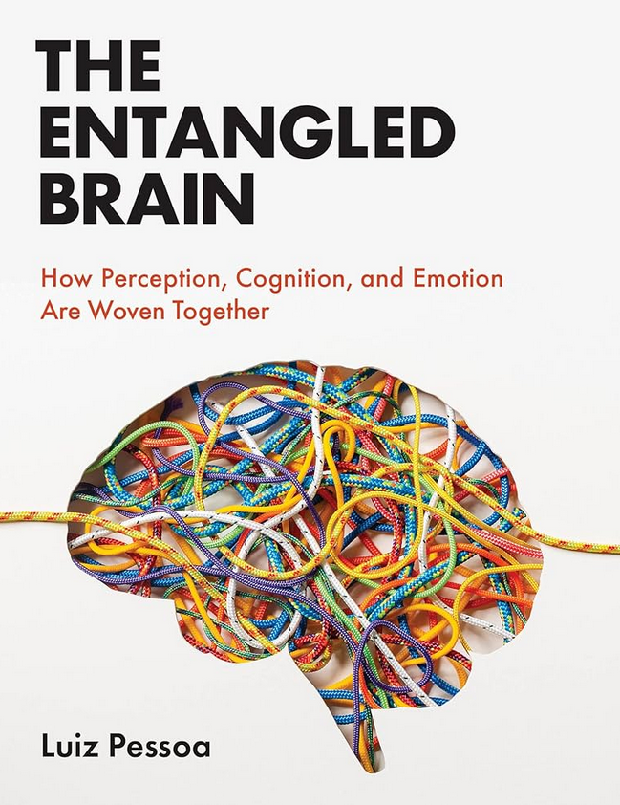
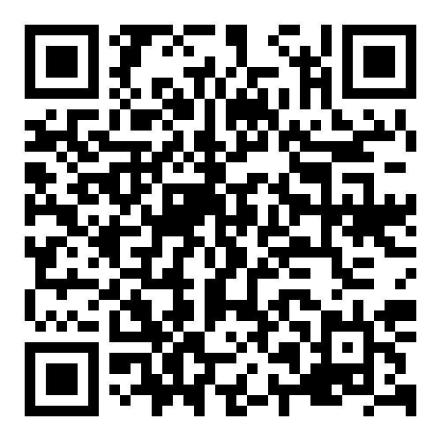
Challenge 2: our concepts don't scale
An old favourite: "What I cannot create, I do not understand." (Feynman)
Two main routes at the moment towards understanding "intelligence":
Machine learning / artificial intelligence
Neuroscience
Can these achieve Feynman's criteria? No!
Current ML requires too much data, compute, energy This limits scaling in terms of performance and understanding
More "brain-like" models don't scale in terms of performance
If the brain were modular, that would give us a route
But these modules appear to be entangled
Disentangling is challenging (Béna and Goodman 2025)
And maybe misguided ("Everything is everywhere" Hayden et al. 2025)

Slide 6

Challenge 3: our understanding is unstable
To build understanding of a whole brain, we need solid foundations.
Our basic understanding keeps getting challenged:
Synaptic turnover (many papers)
Representational drift (many papers)
"mRNA trafficking in the nervous system" (Fila et al. 2021)
I'm not complaining, this makes neuroscience fun!
On a more personal note:
When I started in neuroscience (~2007) I was drawn into the question of whether or not the brain used spike times or only rates
This question was already old then
We are no closer to an answer to this question now
Spikes?

Slide 7
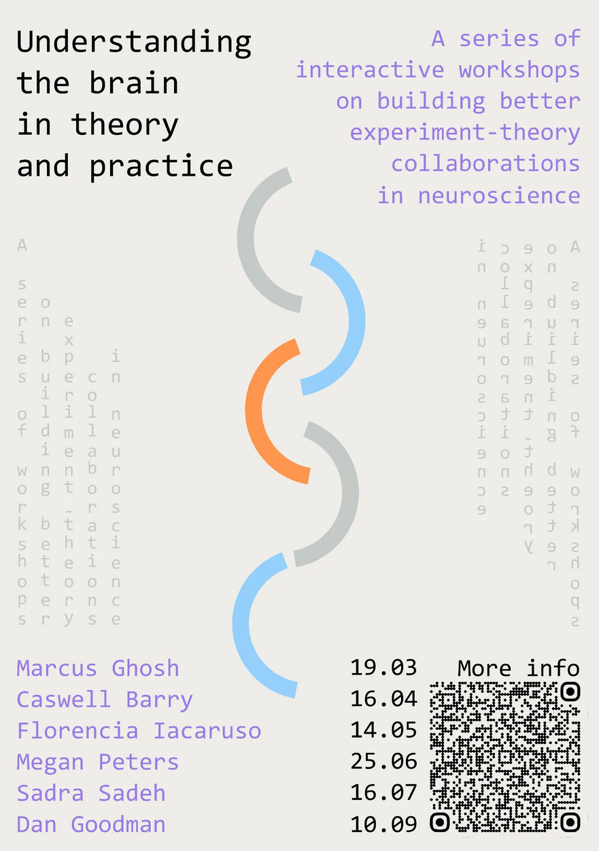
Challenge 4: doing theory and experiment together
Claim: we can't understand the brain by doing just experiments or just theory
In principle not controversial, but in practice: (here goes)
Most experimental and computational studies do not engage with the complexities of the other one
Experiments based on intuitive computational thinking
Computational studies that don't explore parameter spaces
Why do we do this?
Causal reasoning with complex nonlinear models is hard!
Career incentives to not engage with this: simple stories sell
Advert: Come to our Crick/Imperial seminar series and help us figure this out! (free food! 🥳🎉🪅)

Slide 8
So why the optimism? (note: last slide!)
The challenges I've raised can be addressed and they are being addressed
What does it mean to "understand" the brain?
Prediction?
Treat medical conditions?
My take: we will find answers to this question and this is part of neuroscience.
I'll finish by sticking my neck out and providing my probably wrong answer
Aim: a step towards "understanding" that respects these challenges
My approach: deeply explore theoretical models³ to show what biological mechanisms can contribute to² relevant hard computational functions¹ under what conditions
Current: neuromodulation, energy supply, heterogeneity - biological questions not AI⁴
Conclusion: we can understand the brain, but we need to think about what that understanding could look like, take on the hard challenges and address career incentives
Build AI?
Read / write thoughts from the brain?
Notes:
Challenge 1 - problems that are too easy
Challenge 2 - concepts don't scale
Challenge 3 - understanding is unstable
Challenge 4 - doing theory and experiment together

