Slide 1

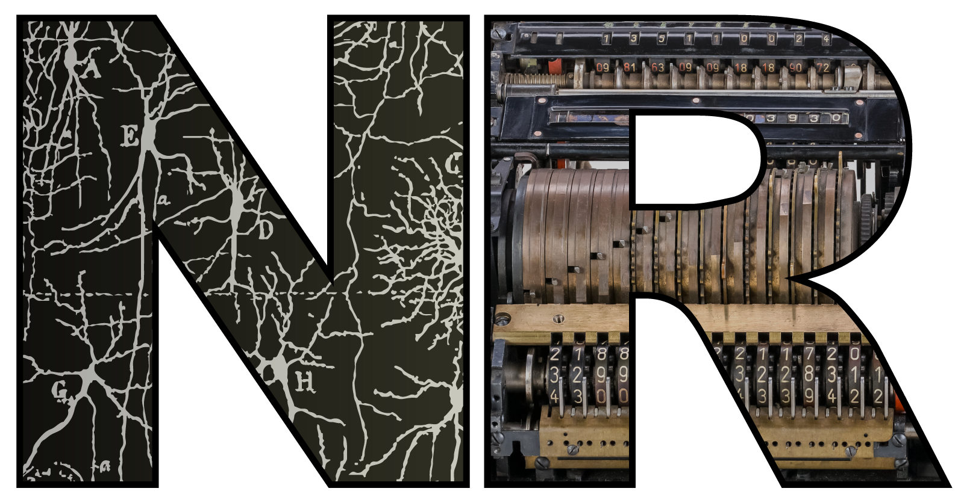

Learning with spikes FENS-Chen Institute summer school lecture
Slides and code available at this link, feel free to open on your laptop
https://github.com/neural-reckoning/cambridge-fens-chen-summer-school-2026
Dan Goodman
Imperial College London
Department of Electrical and Electronic Engineering
neural-reckoning.org

Slide 2
Plan for today
Why we should care about spiking neural networks (SNNs)
Short introduction to SNNs and how to train them
Live demo of training an SNN using Colab
While you try out the Colab code yourself, some of our SNN research
The computational role of neural heterogeneity
The computational role of neuromodulation
Finally, Q&A and practical session, answering your questions while you try using the Colab notebook
Finish with a competition: who managed to train their network to the best level of accuracy during the lecture?

Slide 3
Why spikes?
Neurons in the brain spike, so why am I even asking this question?
Trend is for non-spiking artificial neural network models
Assumption is that only spike rates matter
Still a controversial topic but: evidence doesn’t support this
Most of the energy used by the brain is about producing or recovering from spikes
Information theoretic analyses show spike times at least as important as rates
Many examples where spike timing is shown to be functionally important
My intuition is that the temporal dynamics of neurons are very important
ANN models miss this out
But my reason today:
I can add biophysical mechanisms to spiking models and see how they influence computations. This lets me discover the possible computational role of a mechanism.

Slide 4
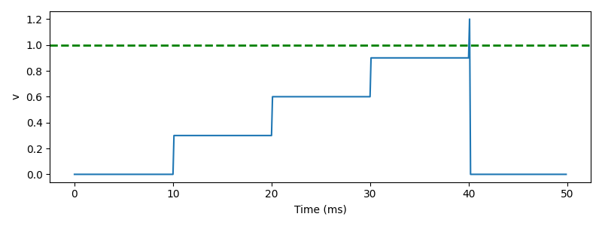




Simplest model of spiking neuron: integrate-and-fire
Membrane potential $v$
Incoming synapses with weights $w_{i}$
On presynaptic spike index $i$:
$v←v+w_{i}$
Threshold condition, fire a spike if:
$v>1$
Reset event, after a spike set:
$v←0$
$$w_{1}$$
$$w_{2}$$
$$w_{3}$$
Notes:
The simplest possible model you could have of that is called the “integrate and fire neuron”.
***
Here’s a plot of how it behaves.
Each time an incoming spike arrives, every 10 milliseconds here, the membrane potential instantaneously jumps by some fixed weight until it hits the threshold, at which point it fires a spike and resets.
We can write this down in a standard form as a series of event-based equations.
***
Firstly, when you receive an incoming spike, set the variable v to be v+wi
***
If the threshold condition v>1 is true, fire a spike
***
And after a spike, set v to 0.
You can see that already this captures part of what’s going on in a real neuron, but misses the fact that in the absence of new inputs, the membrane potential decays back to rest. Let’s add that.

Slide 5
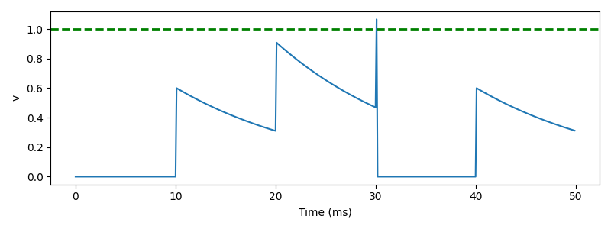


Leaky integrate and fire (LIF) neuron
Continuous evolution over time:
$τ\frac{dv}{dt}=−v$
On presynaptic spike index $i$:
$v←v+w_{i}$
Threshold condition, fire a spike if:
$v>1$
Reset event, after a spike set:
$v←0$
Solution is $v\left(t\right)=v\left(0\right)exp⁡(−t/τ)$
$$w_{1}$$
$$w_{2}$$
$$w_{3}$$
Notes:
We can model this decay by treating the membrane as a capacitor in an electrical circuit. Turning this into a differential equation, v evolves over time according to the differential equation tau dv/dt =-v, where tau is the membrane time constant we discussed in the last video.
***
You can solve this differential equation to see that in the absence of any input, v decreases exponentially over time with a time scale of tau.
***
Here’s how that looks.
You can see that after the instantaneous increase in membrane potential it starts to decay back to the resting value.
Although this doesn’t look like a great model, it turns out that very often this captures enough of what is going on in real neurons. You’ll see that in this week’s exercise, but I want to give one other reason why adding this leak might be important.

Slide 6


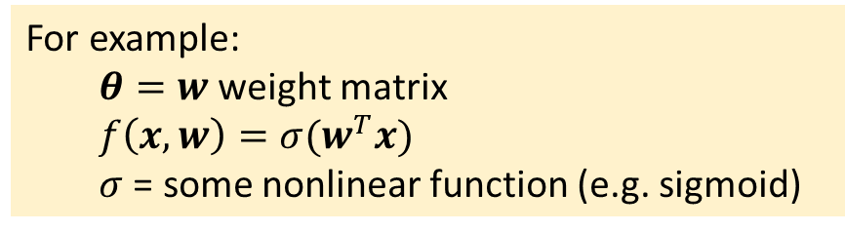
Training SNNs: What we want to do
Gradient descent for artificial neural networks
Write neural network as $y=f(x,θ)$
Parameters $θ$
Input $x$ leading to output $y$
Want to minimise loss:
Loss function $ℒ(y,y^{∗})$
Desired output $y^{∗}$
$θ^{∗}=\arg{\min_{θ}{ℒ(f\left(x,θ\right),y^{∗})}}$
Gradient descent:
$θ←θ−γ∇_{θ}ℒ(f\left(x,θ\right),y^{∗})$
Learning rate $γ$
Chain rule to compute $∇$ term
For example:
$θ=w$ weight matrix
$f\left(x,w\right)=σ(w^{T}x)$
$σ$ = some nonlinear function (e.g. sigmoid)
Computing the gradient:
Gradient ${(∇ℒ)}_{i}=\frac{∂ℒ}{∂θ_{i}}$
Vector chain rule:
${x∈ℝ}^{n}\underset{→}{f}y∈ℝ^{m}\underset{→}{g}{z∈ℝ}^{p}$
Jacobian matrix $J_{ij}^{f}=\frac{∂f_{i}}{∂x_{j}}$
Chain rule is $J^{g∘f}=J^{g}J^{f}$
Efficient: just matrix/ vector multiplications
So, let’s just do this with $f$ being a spiking neural network?
Notes:
What we’d like to do is to use the methods developed for artificial neural networks, because we know they work really well.
So let’s quickly recap how that goes. This isn’t going to be a complete or comprehensive guide, so if you haven’t encountered this before, stop now and read an introduction. I’ve put some recommendations in the reading list.
First we write the neural network as a function of inputs and parameters.
For example, for a one layer neural network the parameters could be the weights, and the function could be a sigmoid applied to the dot product of the weights and input vector.
We want to minimise some loss function that tells us how far the output of the network is from the desired output.
To do that, we apply gradient descent, moving in the reverse direction of the gradient of the loss function with respect to the parameters.
We can compute the gradient efficiently using vector and matrix multiplies using the vector chain rule.
So, can we just do this for a spiking neural network? It’s not quite so easy. Let’s see why.

Slide 7
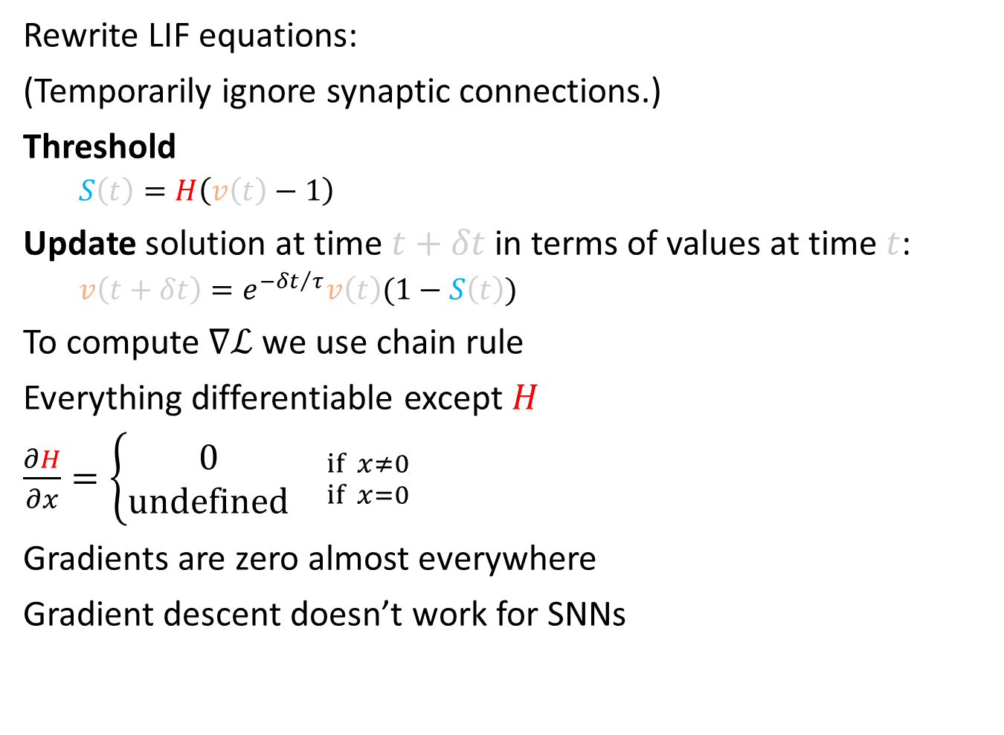
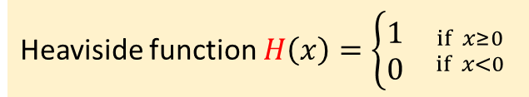
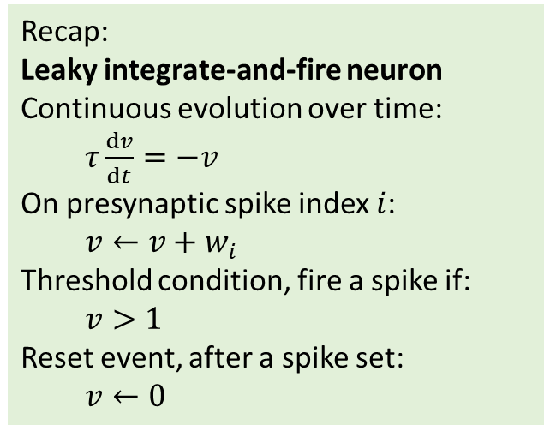
Why we can’t do it
Rewrite LIF equations:
(Temporarily ignore synaptic connections.)
Threshold
$S\left(t\right)=H\left(v\left(t\right)−1\right)$
Update solution at time $t+δt$ in terms of values at time $t$:
$v\left(t+δt\right)=e^{{−δt}/τ}v\left(t\right)(1−S\left(t\right))$
To compute $∇ℒ$ we use chain rule
Everything differentiable except $H$
$\frac{∂H}{∂x}=\left\{\begin{aligned}0 \\ undefined\end{aligned}{ \atop }{if x≠0 \atop if x=0}\right.$
Gradients are zero almost everywhere
Gradient descent doesn’t work for SNNs
Recap:
Leaky integrate-and-fire neuron
Continuous evolution over time:
$τ\frac{dv}{dt}=−v$
On presynaptic spike index $i$:
$v←v+w_{i}$
Threshold condition, fire a spike if:
$v>1$
Reset event, after a spike set:
$v←0$
Heaviside function $H\left(x\right)=\left\{\begin{aligned}1 \\ 0\end{aligned}\right.{ \atop }{if x≥0 \atop if x<0}$
Notes:
To see what goes wrong here, let’s start with a recap of the leaky integrate-and-fire neuron we’ve seen before.
Over time it evolves according to a differential equation, with instantaneous effects when a spike arrives. Whenever the membrane potential v crosses the threshold v>1 you fire a spike and instantly reset to 0.
We’re going to rewrite these equations, temporarily ignoring the synaptic connections for simplicity as you get the same problem and solution with that but it makes the notation more complicated.
The threshold we’ll write as S(t) being the Heaviside function of v(t)-1. So this will be equal to 1 if the neuron has spiked, otherwise 0.
Now we replace the differential equation with a discrete update rule. To get v at time $t+δt$ we multiply v at time t with this exponential term. We also fold in handling the spike reset by then multiplying this value by 1-S(t). So this means we multiply by 0 if it spiked, otherwise we multiply by 1. This is equivalent to setting it to 0 after a spike.
Now if we wanted to use gradient descent we'd have to compute the gradient using the chain rule.
That's unproblematic for every part of these equations except for the Heaviside function.
This function has derivative zero at every point except 0, where it's undefined.
That means the gradients are zero almost everywhere.
Which means that gradient descent will never change any parameters, making it useless for spiking neural networks.

Slide 8
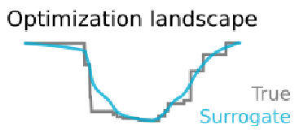
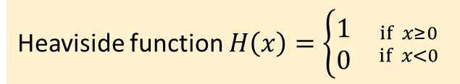
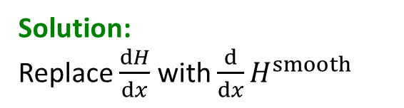

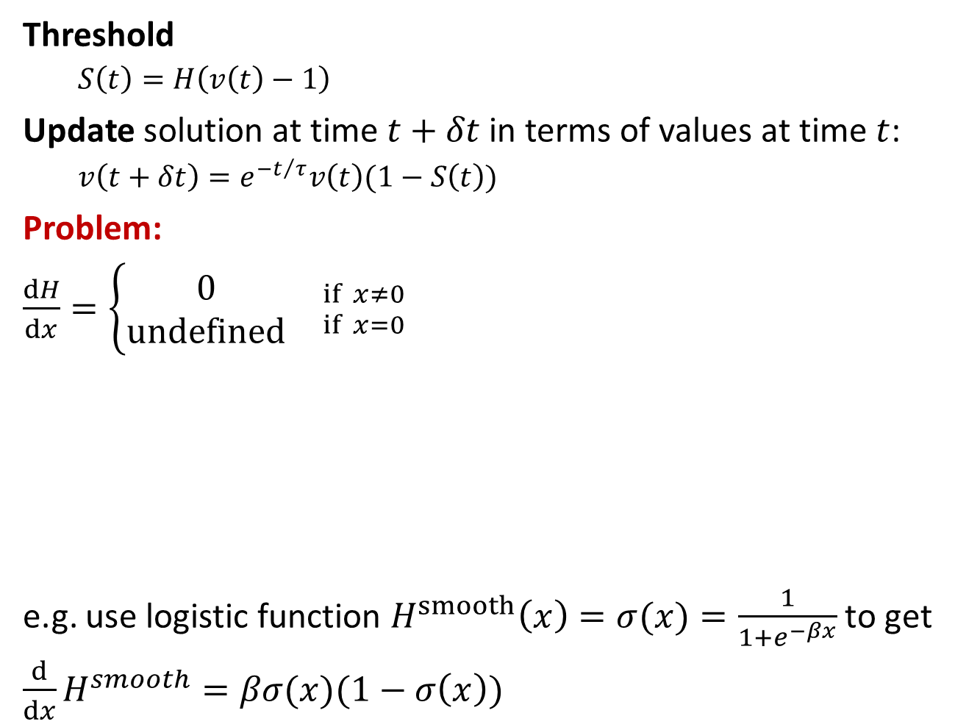
Spiking neurons: the surrogate gradient
Threshold
$S\left(t\right)=H\left(v\left(t\right)−1\right)$
Update solution at time $t+δt$ in terms of values at time $t$:
$v\left(t+δt\right)=e^{{−t}/τ}v\left(t\right)(1−S\left(t\right))$
Problem:
$\frac{dH}{dx}=\left\{\begin{aligned}0 \\ undefined\end{aligned}{ \atop }{if x≠0 \atop if x=0}\right.$
e.g. use logistic function $H^{smooth}\left(x\right)=σ(x)=\frac{1}{1+e^{−βx}}$ to get
$\frac{d}{dx}H^{smooth}=βσ(x)(1−σ\left(x\right))$
Recap:
Leaky integrate-and-fire neuron
Continuous evolution over time:
$τ\frac{dv}{dt}=−v$
On presynaptic spike index $i$:
$v←v+w_{i}$
Threshold condition, fire a spike if:
$v>1$
Reset event, after a spike set:
$v←0$
Solution:
Replace $\frac{dH}{dx}$ with $\frac{d}{dx}H^{smooth}$
Heaviside
Smoothed Heaviside
Heaviside function $H\left(x\right)=\left\{\begin{aligned}1 \\ 0\end{aligned}\right.{ \atop }{if x≥0 \atop if x<0}$
Robust to choice of function!
Zenke and Vogels (2021)
Notes:
Now let’s take this idea and apply it to a spiking neural network. I’m starting from the same recap of the leaky integrate and fire neuron from the first video this week, so make sure to watch that first if you haven’t already. The key point here is that we can write equations to update the internal network state from one time step to the next like the function $f_{θ}$ from the previous slide. This is entirely composed of nicely differentiable functions with one exception, the Heaviside function which is used in computing whether or not a neuron has crossed a threshold and fired a spike.
This function is discontinuous and has a derivative that is zero everywhere except at x=0, which means when we compute gradients using the chain rule or an autodifferentiation package, we’ll just get zeros and no updates will happen.
The solution, which is a little strange, is to keep the function H as it is in the forward pass, but whenever we see a derivative of H, we replace it with the derivative of a smoothed version of the Heaviside function.
The intuition here is that if we have a loss landscape with discontinuous jumps corresponding to when a change in gradients causes there to be one more or fewer spikes, then smoothing the Heaviside function will smooth out those jumps in the loss landscape.
An example function we can use is the logistic sigmoid function.
This has a nice simple derivative.
But it turns out that the choice of smoothing function doesn’t actually matter that much, the algorithm is very robust to a wide range of functions.

Slide 9
Implementation with PyTorch
Fortunately, PyTorch (and other libraries) make this easy:
class SurrogateHeaviside(torch.autograd.Function):
@staticmethod
def forward(ctx, input):
ctx.save_for_backward(input)
return torch.heaviside(input, 0)
@staticmethod
def backward(ctx, grad_output):
input, = ctx.saved_tensors
beta = 5
s = torch.sigmoid(beta*input)
grad = grad_output*beta*s*(1-s)
return grad
surrogate_heaviside = SurrogateHeaviside.apply
Derive from PyTorch to make the magic happen
Forward pass: just return Heaviside function
Backward pass:
Return gradient of sigmoid
Now just use this instead of
Heaviside function
Notes:
That all sounds nice in theory, but we have these lovely autodifferentiation functions and implementing this idea looks like it’ll be a nightmare.
But actually, it’s not as bad as it seems. PyTorch and other libraries allow you to overwrite the default implementation of the gradient computation. I don’t think this was designed for implementing surrogate gradients, but it does the job nicely. Let’s look at the code.
We start by defining a class SurrogateHeaviside. This derives from the PyTorch autograd Function class to make it compatible with PyTorch. We’ll use this to create a new magic surrogate version of the Heaviside function that will do exactly what we want.
PyTorch requires you to implement two methods. The first is what happens for the forward pass. We just want it to return the standard Heaviside function, and for our purposes this context save for backward is just boilerplate to make it play nicely with PyTorch.
The second method is the backward pass. It starts in the same way with some boilerplate that lets us get the input and the gradient of the output (because we’re going backwards).
Then we compute our new derivative. We set a parameter beta which specifies how steep the sigmoid function is, and then compute the derivative using the formula from the previous slide. Note that we multiply the derivative by the output gradient which was given us by PyTorch.
And that’s it. We instantiate this class and just use that instead of the Heaviside function. And now, by magic, our spiking neural network can be used with autodifferentiation and we can use any optimisation algorithm, like stochastic gradient descent, the Adam learning rule, etc.

Slide 10
Demo time!
Try it out yourself in your browser with Colab
https://github.com/neural-reckoning/cambridge-fens-chen-summer-school-2026

Slide 11
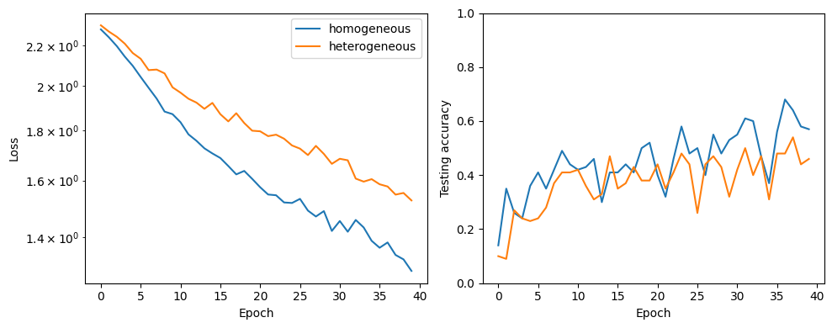
And here’s what I got with a longer training run
40 epochs with 40 batches of size 32 per epoch (51,200 simulations), learning rate 0.001
Took about an hour when I ran it on Colab, still hadn’t converged!
Was expecting the heterogeneous network to do better, but it did worse – ah well

Slide 12
Some of our research
Feel free to keep tinkering with the code during this next bit
You can always read the papers later 😉 TLDR:
Heterogeneity
For tasks with rich temporal dynamics, making time constants heterogeneous improves performance
Code change is very simple: write tau = nn.Parameter(torch.empty(n)) instead of tau = torch.empty(n)
Neuromodulation
Takes this one step further, let the network control its own parameters.
This is as simple as letting a spike change any parameter instead of just a membrane potential (but there’s more you can do too)

Slide 13
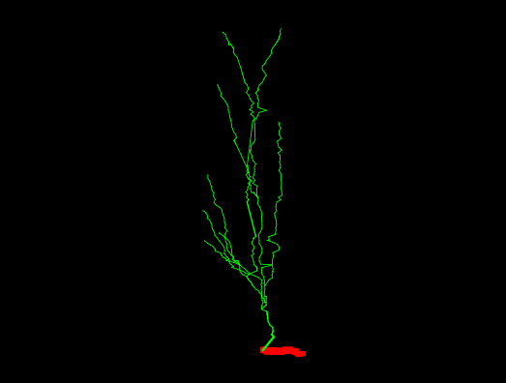
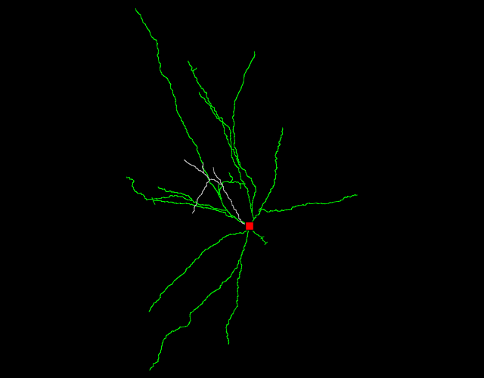
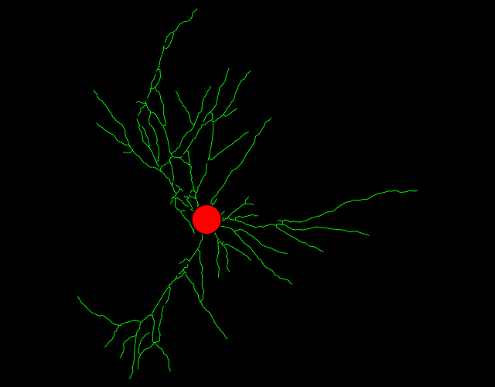
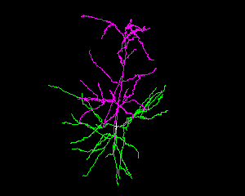
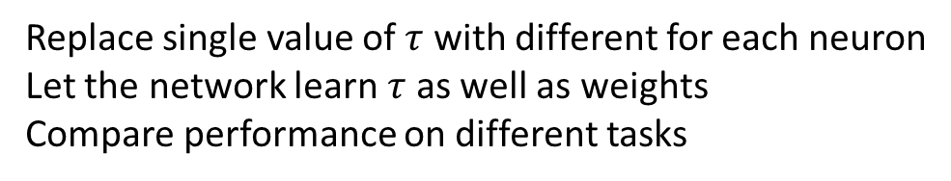
Why is the brain so heterogeneous?
What the brain is like
What our models are like
Some random neurons from neuromorpho.org
This study
Replace single value of $τ$ with different for each neuron
Let the network learn $τ$ as well as weights
Compare performance on different tasks
Notes:
Question of this talk is why is the brain so heterogeneous?
When you look at some randomly selected neurons you see huge differences.
Is it just a quirk of its evolutionary history or developmental noise?
Or does it play some important role?
By contrast, most of our models, and particularly the models that are able to actually perform complex tasks, use entirely undifferentiated neurons.

Slide 14
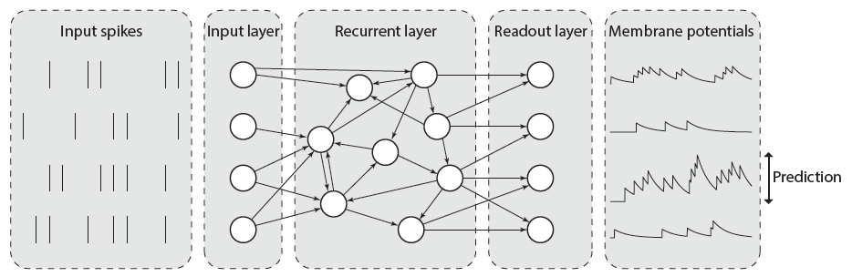
Methods: model architecture
Notes:
All our tasks were classification of patterns of input spike trains using spiking neural networks.
…
In other words, this is just about the simplest possible architecture that could feasibly do the job.
We’re not aiming at winning on machine learning benchmarks, but rather on finding out what the advantages of heterogeneity specifically could be.

Slide 15
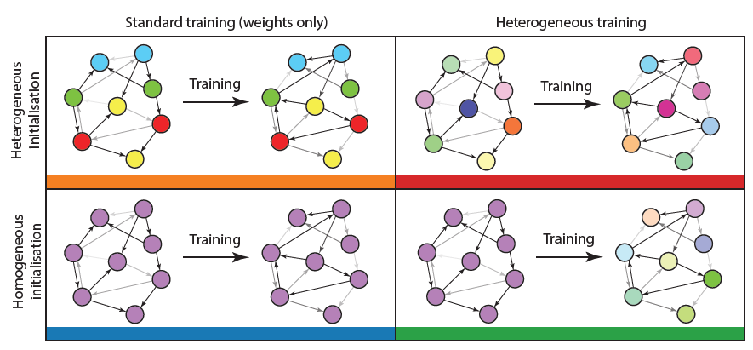
Methods: training
Notes:
We looked at four conditions. In every condition, the synaptic weights can be learned.
In the first condition, it is fully homogeneous. Time constants are the same for all neurons, cannot be learned during training.
The next one (orange) is where time constants are randomly initialised for each neuron, but can’t change with training.
Then, we consider both of these two conditions but allowing the training procedure to modify the time constants.
--- follow text on RHS ---

Slide 16
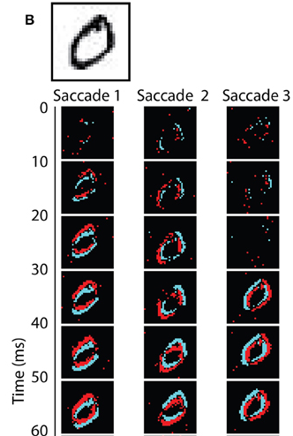
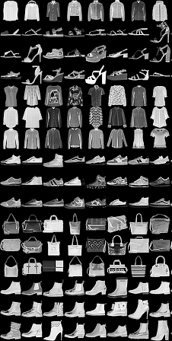
Methods: tasks
Visual
Auditory
N-MNIST
F-MNIST
DVS128
SHD and SSC
Increasing temporal structure
Notes:
Trained on 5 tasks of increasing temporal structure and difficulty.
N-MNIST is standard MNIST handwritten digits presented to a DVS (dynamic vision sensor), or event camera. It emits a ‘spike’ when the brightness of a pixel changes. In N-MNIST they moved the camera across the screen simulating saccades, so there’s temporal structure in the spike trains but not in the underlying stimulus.
F-MNIST is fashion MNIST, little pictures of clothes and bags. Convert to spike trains by treating pixel intensities as a current into an integrate and fire neuron, so neurons corresponding to brighter pixels fire earlier. Has temporal structure, but again not in the underlying stimulus.
DVS128 is gestures like hand waving in front of an event camera, and is the first one where the underlying stimulus has temporal structure. However, it’s sufficiently small that it’s often possible to guess the gesture by just taking an average.
We also have two auditory tasks where temporal structure is more important. SHD is “spiking Heidelberg digits” and is the auditory equivalent of MNIST, while SSC is spiking speech commands, like go, stop, etc.

Slide 17
Results: performance
Notes:
Top line is the baseline, fully homogeneous network. You have the colour key down here.
N-MNIST: no improvement with heterogeneity.
F-MNIST: you have some improvement but it’s not consistent. Most likely explanation for this is that heterogeneous initialisation helps it not get stuck in a local minimum.
DVS128: consistent improvements with heterogeneity added, but not huge.
SHD and SSC: big improvements with heterogeneity, improvements of around 10% in accuracy for SHD and SSC, which is pretty substantial when you consider the chance level is around 5 and 3%.
You can also see the improvement in test accuracy here.

Slide 18
Results: distribution of time constants
Notes:
On the left are the distributions before training, and in the middle after training.
At the top are the cases where the initial distribution is heterogeneous, and the bottom where all time constants start the same.
First result here is that regardless of whether or not you start homogeneous or heterogeneous, you end up with pretty much the same distribution, except in the case of DVS128 suggesting that there may be a few minima in this case.
The key result though is that these distributions really look similar to what you see when you plot experimentally observed distributions.
This is only possible thanks to some amazing datasets that have been made available lately.
The distributions have different parameters depending on cell type, area and species, but always look more or less the same.

Slide 19
Discussion / conclusions
Heterogeneity is metabolically / energetically efficient
Big performance gains with no increase in energy costs
Open questions
Does the brain optimise for this?
Do other forms of heterogeneity matter as much? (See next paper)
Can we find a rigorous theoretical explanation? (Still working on this!)
Notes:
Metabolically: doesn’t cost the brain anything to have heterogeneity. In fact, probably gets it for free.
Energetically: big performance gains for small increase in params.
To give an idea of this, for the auditory digits task SHD you need 10x as many homogeneous neurons with 100 times as many parameters to get the same improvement as adding heterogeneity, while adding heterogeneity only increases the number of parameters by less than 1%.
That’s relevant to engineering applications too.
For neuromorphic computing, sometimes you get this for free, e.g. in BrainScaleS.

Slide 20

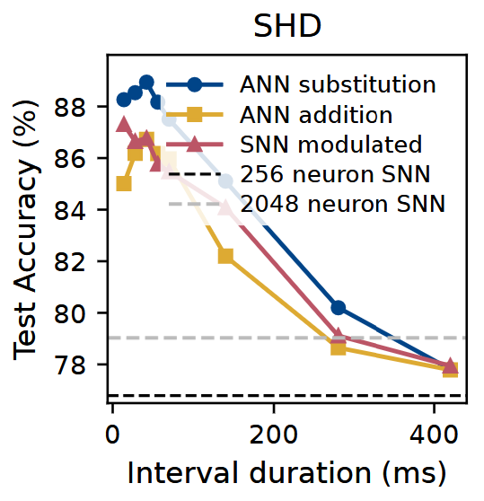
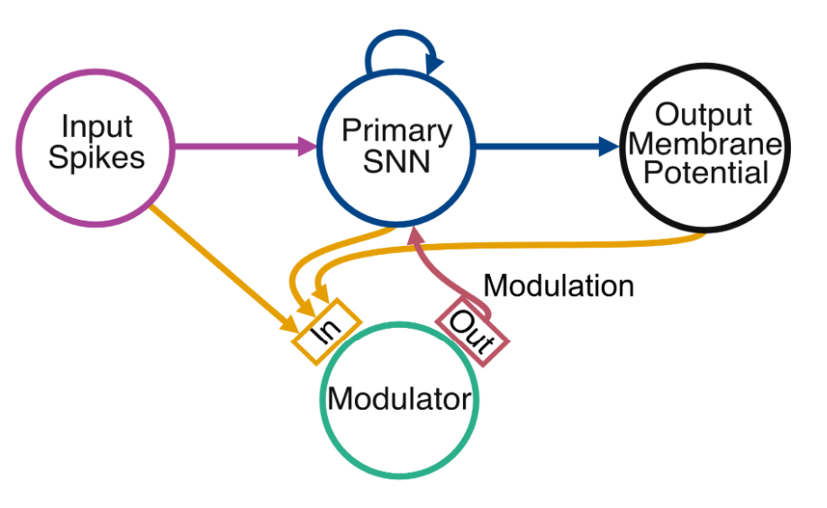
Neuromodulation
Hot off the press: preprint on this came out on Monday!
All code etc. available on GitHub (including simple tutorial)
Basic question can be framed in one of two ways, pick your favourite:
If making neurons heterogeneous in space is good, why not in time too?
We know the brain has neuromodulators, how could they help computationally?

Slide 21
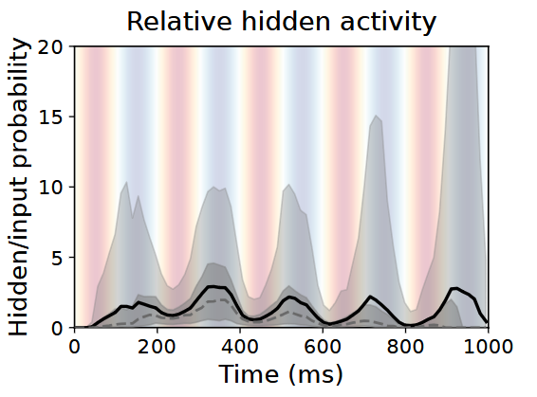
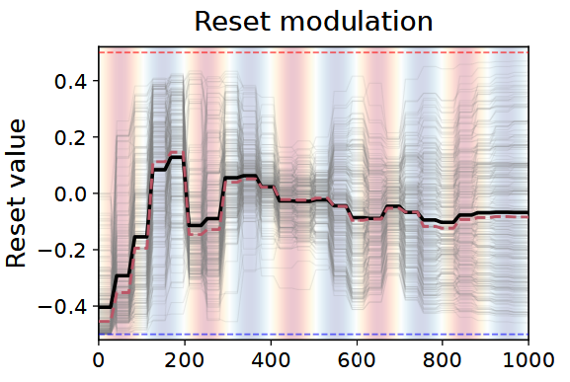
Learns dynamic gain control in fluctuating noise
Task: learn spoken digits in a fluctuating background noise

Slide 22
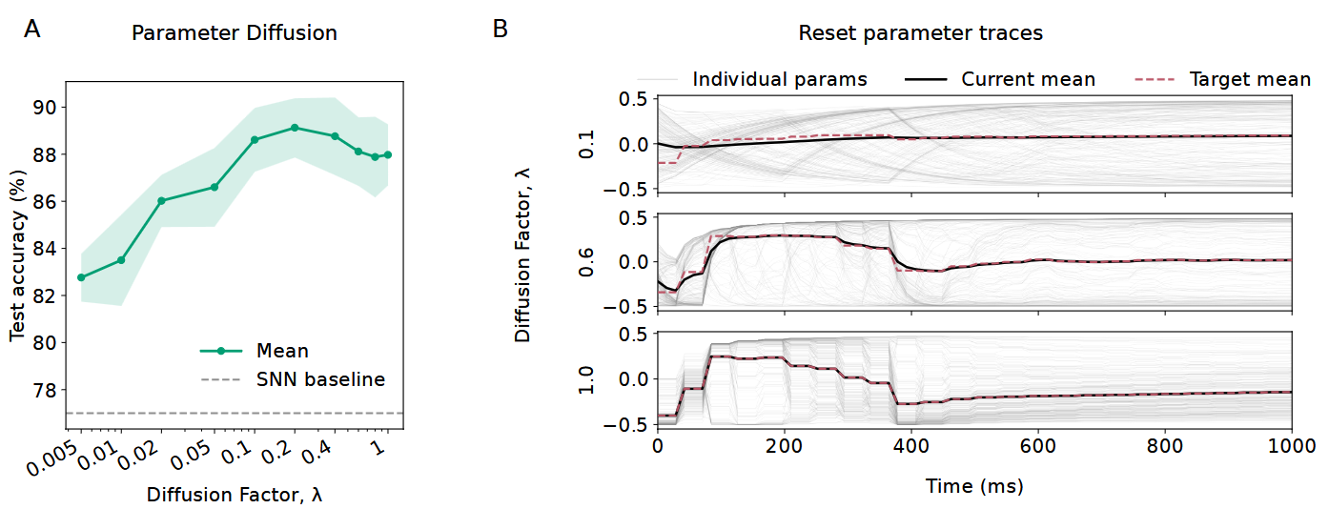
Temporal diffusion can help

Slide 23
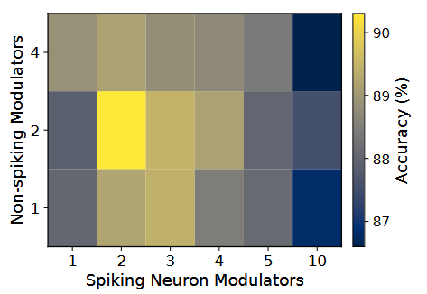
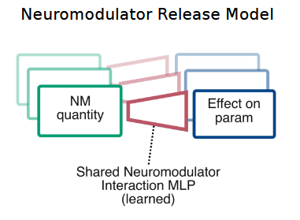
A small number of neuromodulator types is best

Slide 24
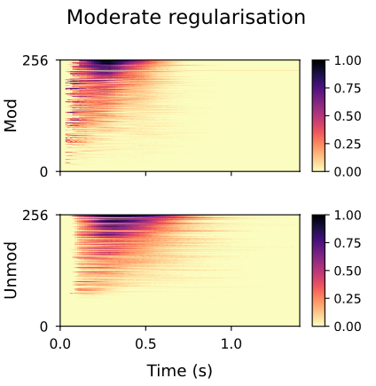
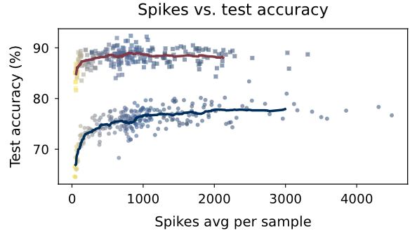
Can use many fewer spikes (lower energy cost)
Modulated
Unmodulated
Wasted neurons (never active)

Slide 25


Conclusions, Q&A, Competition
https://github.com/neural-reckoning/cambridge-fens-chen-summer-school-2026
Take home messages
SNNs are the way the brain works
We can test mechanism-function hypotheses using them
Heterogeneity in space and time (with neuromodulators) improve energy efficiency
It’s now very easy to write code like this!
Competition and Q&A:
Can you beat my accuracy at the task?
You can change the neuron params, learning params, architecture, model, etc.
Baseline: 90s training to get to about 35% accuracy, 30m to get to about 60% (20 neurons)
I’ll be around to help until the end of the session
Thank you!
And also…
Nicolas Perez
Heterogeneity
Now @ DeepMind
Abdal AlKilany
Neuromodulation
Full course available free at
https://neuro4ml.github.io

