Slide 1
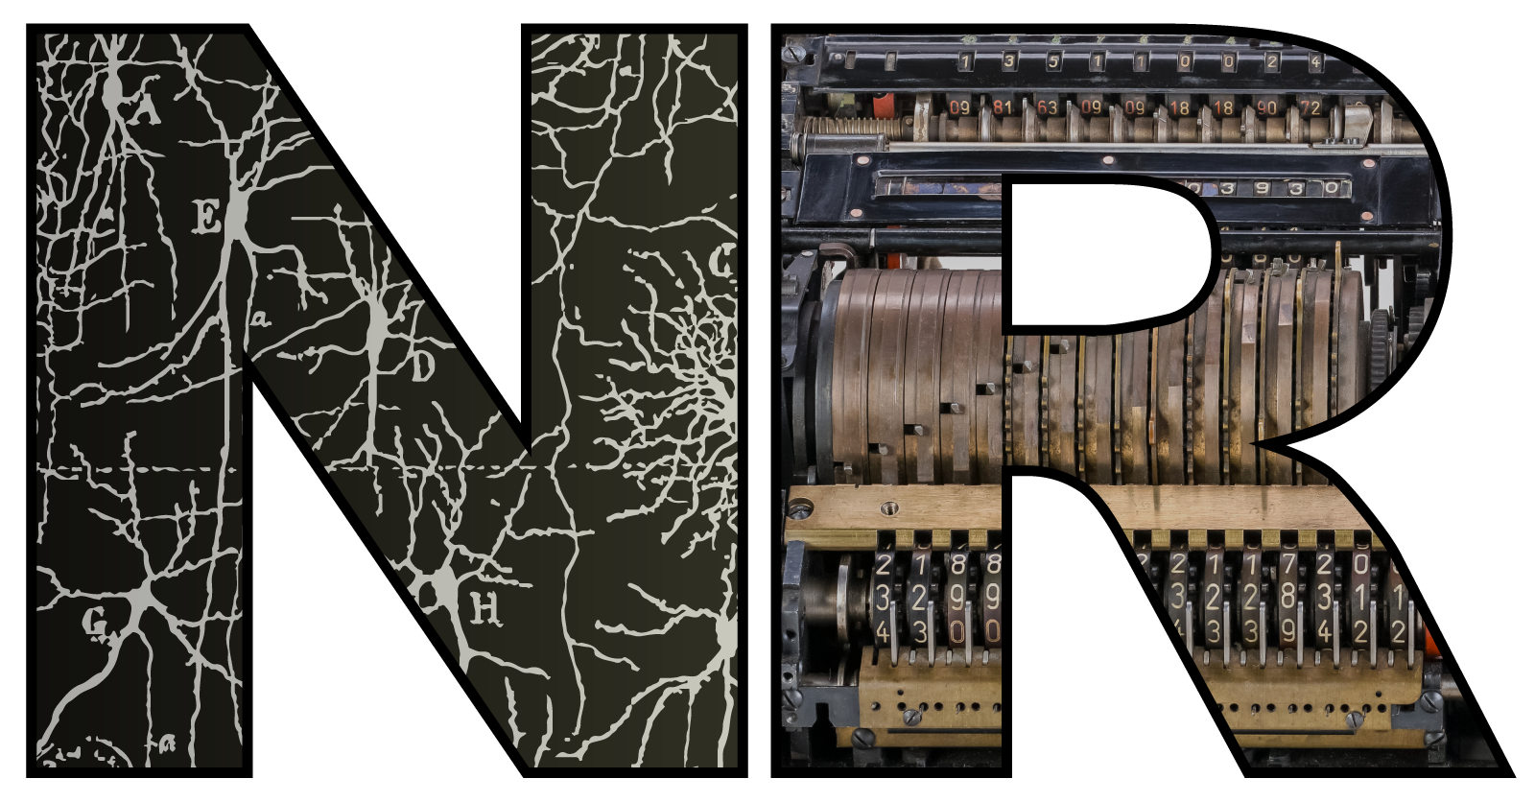

Untitled NeuroAI talk…
Dan Goodman
Imperial College London
Department of Electrical and Electronic Engineering
neural-reckoning.org

Slide 2
Starting with an apology
Dan… why doesn’t your talk have a title? 🤔
Specifically, why doesn’t it have the title listed? 🤔 🤔
Well…
I was supposed to give an introduction and history of NeuroAI, but…
I’m not sure I know what NeuroAI actually means.
Let’s try: NeuroAI =
Computational neuroscience with bigger models and trained with backpropagation?
This might be (A) a useful demystifying perspective, or (B) embittered snark
Assuming it’s roughly correct then there are:
Opportunities, challenges and potential pitfalls

Slide 3
Challenges
Challenges are not unique to NeuroAI, but some of them are particularly acute
Key challenge:
How do we know that a model has improved our understanding?
Key risk (I claim):
NeuroAI is particularly susceptible to the garden of forking paths

Slide 4


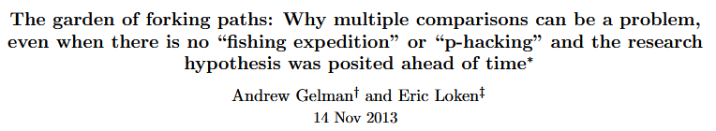
The garden of forking paths: a digression
P-Hacking: selecting data to get a statistically significant result
“Model hacking”: same thing but using a model
But these assume that the researcher is unethical
Garden of forking paths: the same thing can happen unconsciously
Origin: The Garden of Forking Paths (Borges, 1941)
Paper: Gelman and Loken (2013, unpublished)
Happens whenever researchers make data dependent design choices
This happens all the time in modelling and is unavoidable: we refine our model as we go
Is there a solution?
Maybe, we’ll come back to that.
This photo is not mine, but it’s from a hedge maze I used to go to as a child, on the Isle of Wight

Slide 5
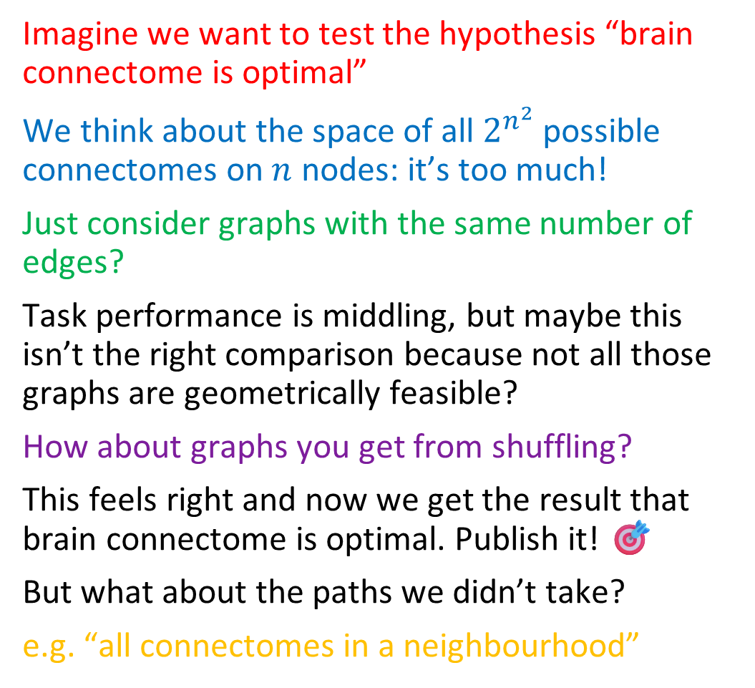
NeuroAI in the garden of forking paths
Imagine we want to test the hypothesis “brain connectome is optimal”
We think about the space of all $2^{n^{2}}$ possible connectomes on $n$ nodes: it’s too much!
Just consider graphs with the same number of edges?
Task performance is middling, but maybe this isn’t the right comparison because not all those graphs are geometrically feasible?
How about graphs you get from shuffling?
This feels right and now we get the result that brain connectome is optimal. Publish it! 🎯
But what about the paths we didn’t take?
e.g. “all connectomes in a neighbourhood”
Brain connectome
Same number of edges
Task performance
Neighbourhood
Shuffling
All possible connectomes

Slide 6


Possible solution: “Multiverse analysis” 🤔
Basic idea: test if result is true across all possible paths through the garden
O’Leary et al. (2015) suggest searching parameter spaces and looking for “sloppy” and “stiff” directions.
But large NeuroAI models limit how much of this is feasible.
“Stiff”: result depends on precise parameters
“Sloppy”: Result doesn’t change much
Boundary of region in parameter space where result is true

Slide 7
My take / advice / approach
There’s no perfect solution to this problem
🤠 With your reader’s hat on:
Prefer papers that suggest they’ve at least tried to address it
Red flags: only presenting one set of parameters and not talking about why
Green flags: several alternative choices, parameter sweeps, etc.
🤠 With your researcher’s hat on:
Think about alternative choices you could have made
Follow some of those paths, do parameter sweeps where feasible
Show the results for the unsuccessful paths in your paper
Consider using simpler models so you can go down all the paths
(Yes this is an advert for Marcus’ talk later on “Toy models”)
Or… consider making different kinds of claims (remainder of talk = example of this)
⚠️ Warning ⚠️
I don’t always do this even though I know I should.
It’s hard! 😅

Slide 8
Opportunities, optimism and advertising my work
So far I’ve focussed on the challenges and pitfalls, but NeuroAI is a huge opportunity too
If we want to understand the brain, we have to study how it does hard tasks
With small models or no backprop algorithms, this was very difficult
Now is the best possible time to be doing modelling in neuroscience
My approach:
Deep exploration of models (follow the paths)
Spend as much time trying to prove myself wrong as right (at least this is my ambition)
My aim:
Enrich our understanding of how various mechanisms can contribute to function
Examples in current work: neuromodulation, energy supply, heterogeneity
Today I’ll just talk about modularity

Slide 9
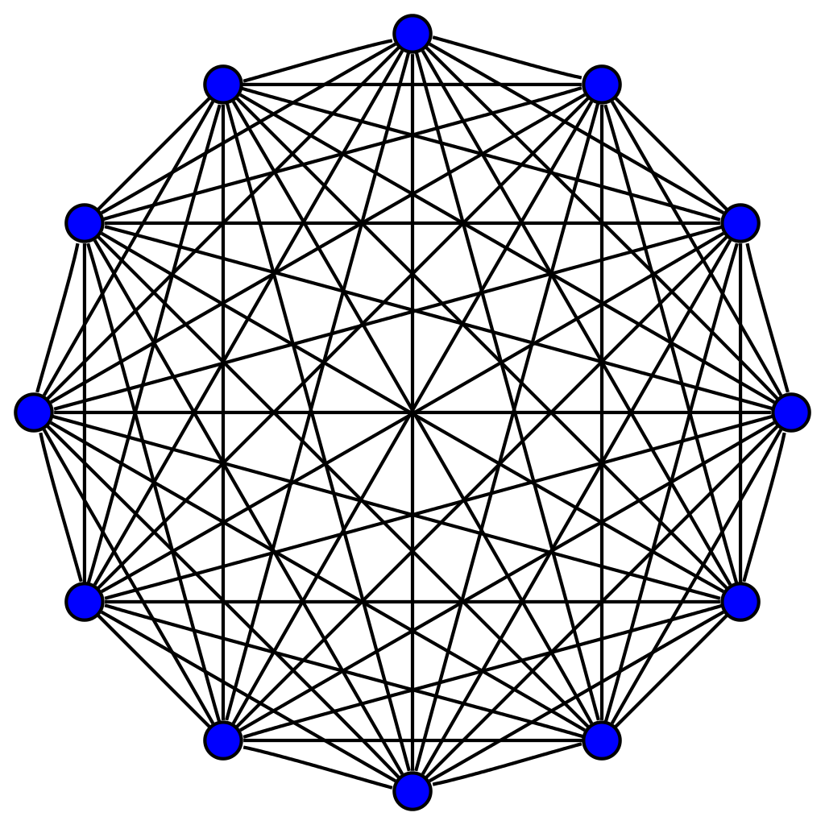
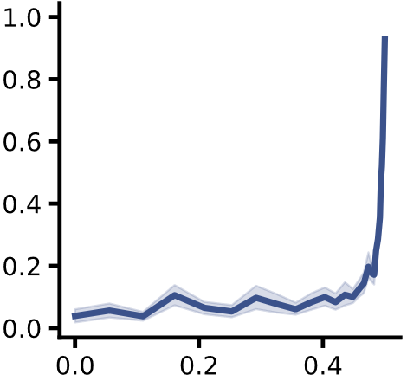

TL;DR version of the modularity project
Within module:
Dense connections
Within module:
Dense connections
Evidence:
Brain is “structurally modular”
Knocking out brain regions seems to lead to functional deficits
So…?
Functional specialisations a necessary consequence of structural modules?
Our hypothesis: yes!
We tested this using ANNs
Answer is not necessarily.
At least, for levels of modularity in brain.
Need additional mechanisms
Between modules:
Sparse connections
Maximum modularity
seen in brain
Specialisation
Structural modularity
Béna and Goodman (2025) Nature Comms
Notes:
Most of this project was spent proving ourselves wrong!

Slide 10

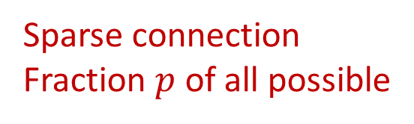
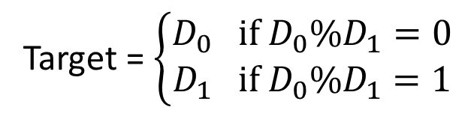


Task and model setup
Dense connections
Module 0
Decision 0
$$D_{0}=$$
Joint
Decision
Sparse connection
Fraction $p$ of all possible
$$D_{1}=$$
Module 1
Decision 1
Target = $\left\{\begin{aligned}D_{0} if D_{0}\%D_{1}=0 \\ D_{1} if D_{0}\%D_{1}=1\end{aligned}\right.$
Notes from the garden: we took other paths too, will come back to this
Notes:
Simplest case: digits, networks, sparse, decision, strongest decision
Task. Why? Maximise the chance the modules specialise on their digits.
They need to work together but only need to share 1 bit. Resource limited so nothing to waste. Decisions don’t interact.
Here’s the precise setup of the task and model in the simplest case. We have two handwritten digits that are fed into separate densely recurrent networks. These networks can communicate via a sparse connection with a fraction p of all possible connections. Each network makes a decision and then the strongest of these two decisions becomes the joint decision.
The task is a bit strange. The network has to return digit 0 if the two digits have the same parity, otherwise it has to return digit 1. Why did we design it like this? The idea for the whole setup is to maximise the chance that the two modules will specialise on their digits, but that they do need to work together to solve the task. However, they only need to share one bit to solve the task, the parity of their own digit. This setup encourages specialisation because each module only receives sensory input directly from one digit, suggesting it should specialise in processing that. Further, each module has a non-trivial task to solve, and we set the number of neurons so that it has close to the minimum needed to perform the task, so it doesn’t have resources to waste. To further help minimise the amount of interaction required between the modules, each makes a separate decision, which is a vector of values we can think of as the probabilities of each possible answer. The decision vector with the highest single probability is used as the joint decision, i.e. whichever module is more sure of its answer.
So you can see a solution to this problem with perfect specialisation would be for each module to solve for its digit, pass the parity of that to the other module, and based on the two parities either give its answer, or give a flat distribution to stop itself from being the module whose answer is the joint decision.
So that’s why the results from the previous slide are surprising. It’s only when the structural modularity gets really extreme – beyond what you see in the brain – that the functional specialisation emerges.

Slide 11
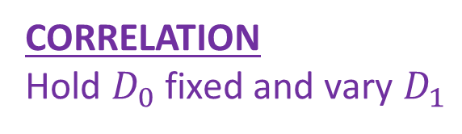
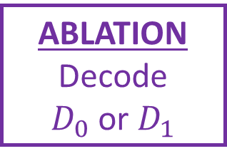
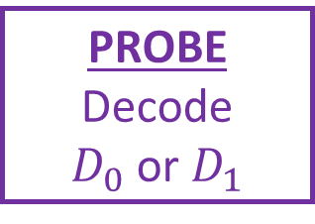
Measuring functional specialisation
PROBE
Decode
$D_{0}$ or $D_{1}$
Module 0
Decision 0
$$D_{0}=$$
CORRELATION
Hold $D_{0}$ fixed and vary $D_{1}$
Joint
Decision
$$D_{1}=$$
Module 1
Decision 1
ABLATION
Decode
$D_{0}$ or $D_{1}$
Multiverse analysis: three different ways of measuring the same idea, all give same conclusions
Notes:
Correlation = mean correlation of hidden state as you vary one digit only. Fodor separate modifiability.
Probe = sub function. Decode one digit well but not other.
Ablation. Fodor domain specificity.
In each case we get 4 values for each combination of digit and module, and normalised difference gives measure between 0 and 1.
Results qualitatively the same, so seems real.
It’s actually quite hard to measure how much a module has specialised on one function. To my knowledge, there’s no accepted definition. Our approach was to take three different definitions based on ideas that have been proposed in the literature, and show that they all give qualitatively similar results. If I have time, I’ll go through these three definitions now.
The first definition is based on correlation. If you correlate the hidden states of one module with itself when presented with different pairs of digits, holding one digit fixed and varying the other, it should be highly correlated if the module is specialised on the fixed digit, or weakly correlated if it is not specialised, because it is affected by both its own digit and the other digit. This is related to Fodor’s “separate modifiability” criterion of modularity.
The second definition is to directly test if the module is able to carry out the expected sub-function of the overall function. We freeze the trained network, and train a probe module to decode digit 0 or 1 from just one module’s hidden state. This should be possible with high accuracy for one digit but not the other if it is specialised on that digit.
The third definition is to do an ablation study. We train a single decoder that receives inputs from both modules, and then we ablate one or the other module. If the modules are specialised, then ablating the module that isn’t specialised on that digit should have little effect. This is related to Fodor’s criterion of “domain specificity”.
In each case, we get four different values from the measure on each choice of digit and module, and we use normalised differences of these to define a single specialisation metric that varies from 0 to 1.
And as I said, surprisingly they all give very similar results, so it seems as though in at least this case they are measuring something real and common.

Slide 12
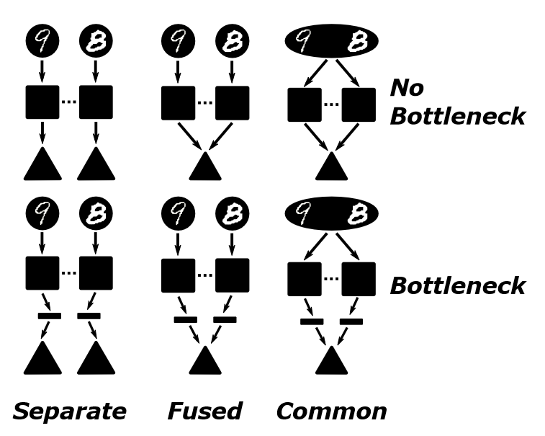
Model variants
6 variants on this model
Separate pathways
Fused output pathway
Common input and output
In each case, with and without bottleneck
Gardening: These are some of the other forks we took.
Multiverse analysis: all give more or less same results.
Showing unsuccessful: some give less strong results

Slide 13
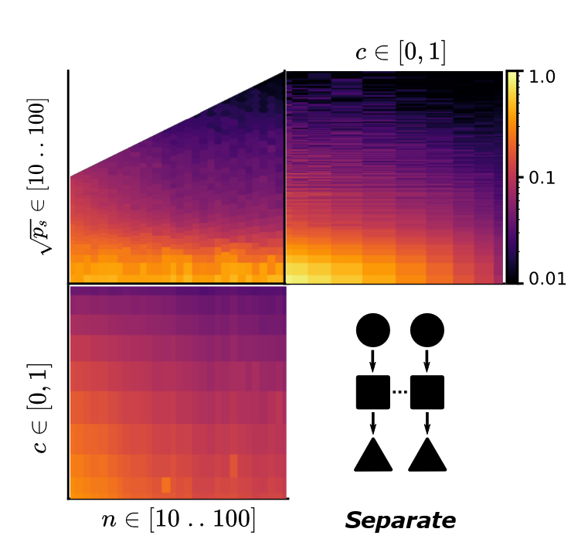
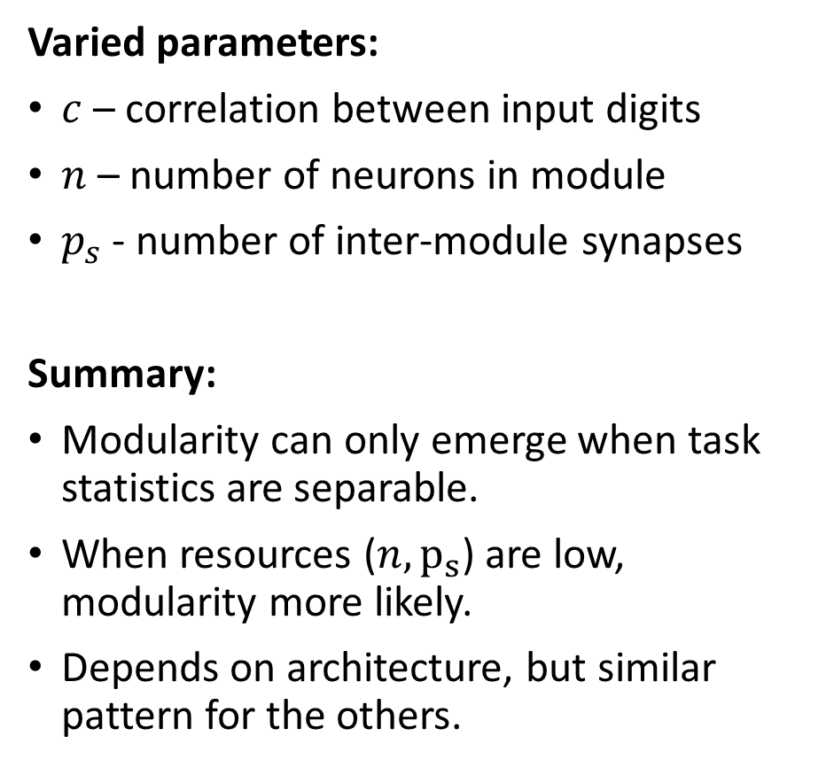
Detailed results
Varied parameters:
$c$ – correlation between input digits
$n$ – number of neurons in module
$p_{s}$ - number of inter-module synapses
Summary:
Modularity can only emerge when task statistics are separable.
When resources ($n, p_{s}$) are low, modularity more likely.
Depends on architecture, but similar pattern for the others.
Parameter sweeps! There are many more in the paper

Slide 14
Conclusions
The observed structural modularity in the brain does not guarantee functional modularity.
(Note from the advice page: we’re not making a strong claim about how the brain is)
However, that doesn’t mean they must be unrelated! We know they are.
But, we need more than just the structure to get that.
Resource constraints is one possibility.
But there may be others:
Learning rules. Environments (e.g. multi-task learning).
Training regimes. Architectures.
WIP: A spatially distributed blood / energy supply may encourage functional modularity
All of our measures of specialisation can be experimentally measured.
Notes:
Following up on architectures and environments at the moment, with a neuromorphic computing angle

Slide 15









Thanks to…
Béna and Goodman (2025) Nature Comms
Marcus Ghosh
Toy models and structure-function
Postdoc fellow 2021-2025
Now started his own research group at Imperial
Gabriel Béna
Modularity
PhD student 2021-2026
Now postdoc in Zurich
And thank you for listening
🫵
My current research group for working on all these ideas with me ❤️

