Slide 1

Understanding
the brain
in theory
and practice
A series of
interactive workshops
on building better experiment-theory collaborations in neuroscience

Slide 2
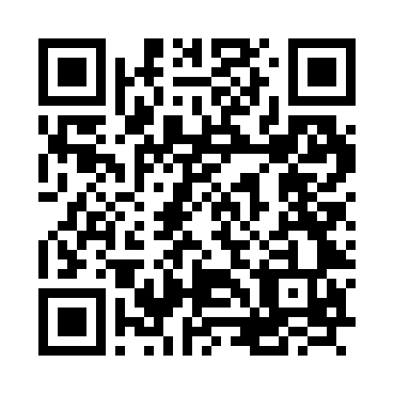
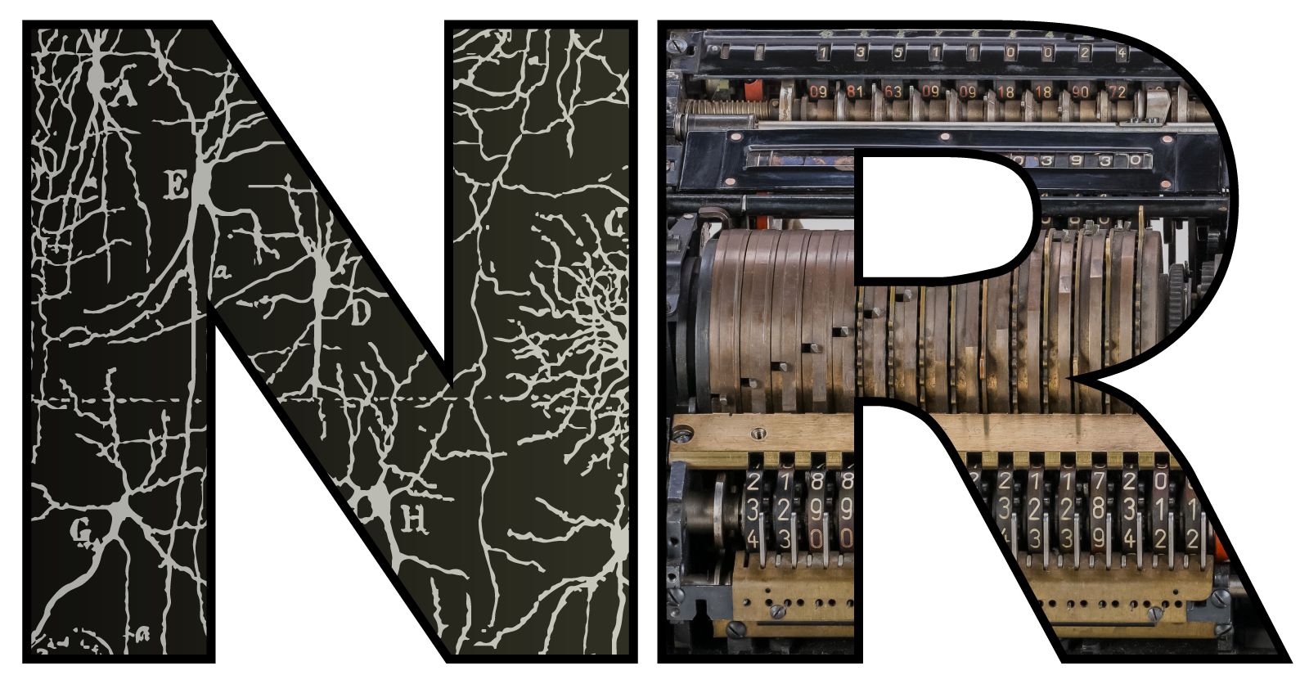

Does heterogeneity help the brain and how could we know if it did?
Perez et al. (2021)
Dan Goodman
Imperial College London
Department of Electrical and Electronic Engineering
neural-reckoning.org

Slide 3
Plan for today
Going to try something a bit different today
Will present some of our ‘pure theory’ research on neural heterogeneity, but…
Brainstorm how this work could be made to work better with experimental research
Discussion will be around these questions (so think about it as you listen):
Do we learn anything about the brain by evaluating how well models perform tasks?
Can we test theories about a multiply redundant brain?
How could we experimentally test theories about the function of neural heterogeneity?
Can theoretical work that can’t be tested contribute to understanding the brain?
Afterwards – discussion of whether to write an opinion paper based on this series?

Slide 4
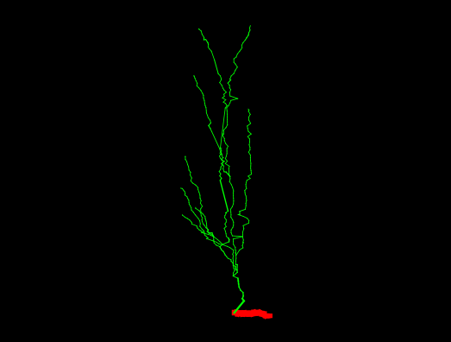
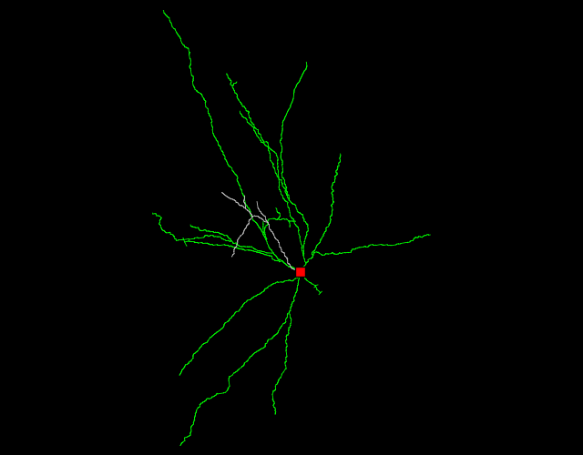
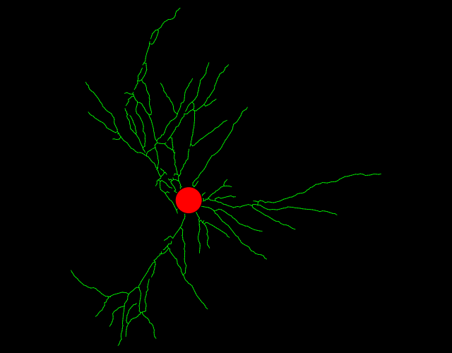
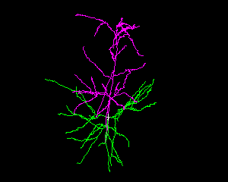
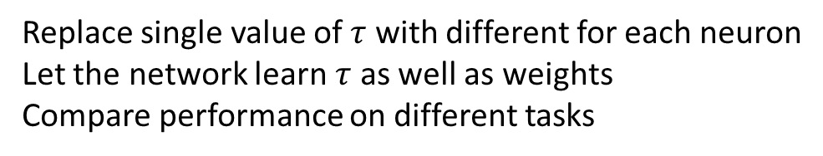
Why is the brain so heterogeneous?
What the brain is like
What our models are like
Some random neurons from neuromorpho.org
This study
Replace single value of $τ$ with different for each neuron
Let the network learn $τ$ as well as weights
Compare performance on different tasks
Notes:
Question of this talk is why is the brain so heterogeneous?
When you look at some randomly selected neurons you see huge differences.
Is it just a quirk of its evolutionary history or developmental noise?
Or does it play some important role?
By contrast, most of our models, and particularly the models that are able to actually perform complex tasks, use entirely undifferentiated neurons.

Slide 5
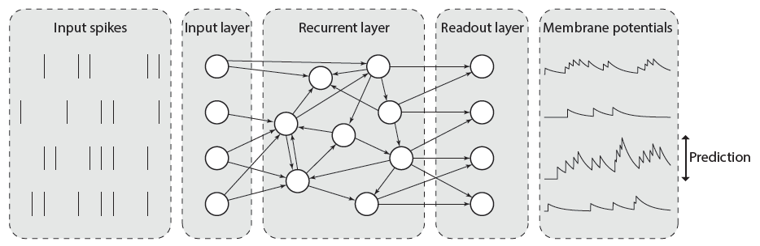
Methods: model architecture
Notes:
All our tasks were classification of patterns of input spike trains using spiking neural networks.
…
In other words, this is just about the simplest possible architecture that could feasibly do the job.
We’re not aiming at winning on machine learning benchmarks, but rather on finding out what the advantages of heterogeneity specifically could be.

Slide 6
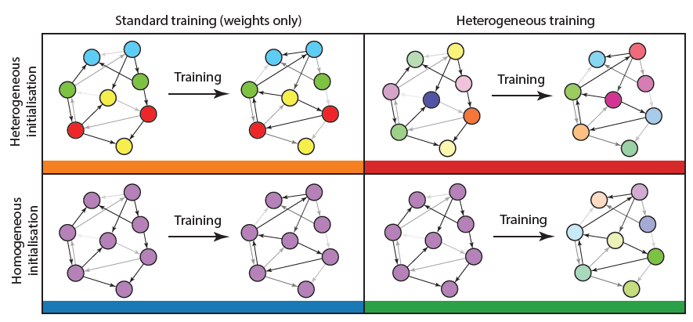
Methods: training
Notes:
We looked at four conditions. In every condition, the synaptic weights can be learned.
In the first condition, it is fully homogeneous. Time constants are the same for all neurons, cannot be learned during training.
The next one (orange) is where time constants are randomly initialised for each neuron, but can’t change with training.
Then, we consider both of these two conditions but allowing the training procedure to modify the time constants.
--- follow text on RHS ---

Slide 7
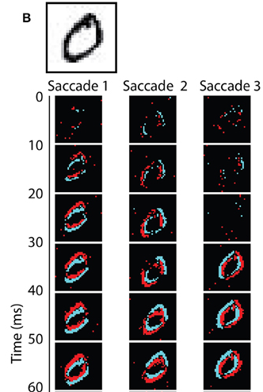
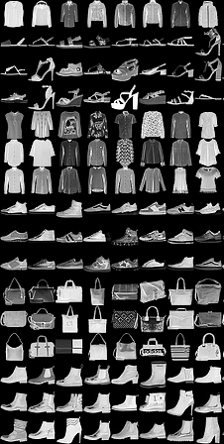
Methods: tasks
Visual
Auditory
N-MNIST
F-MNIST
DVS128
SHD and SSC
Increasing temporal structure
Notes:
Trained on 5 tasks of increasing temporal structure and difficulty.
N-MNIST is standard MNIST handwritten digits presented to a DVS (dynamic vision sensor), or event camera. It emits a ‘spike’ when the brightness of a pixel changes. In N-MNIST they moved the camera across the screen simulating saccades, so there’s temporal structure in the spike trains but not in the underlying stimulus.
F-MNIST is fashion MNIST, little pictures of clothes and bags. Convert to spike trains by treating pixel intensities as a current into an integrate and fire neuron, so neurons corresponding to brighter pixels fire earlier. Has temporal structure, but again not in the underlying stimulus.
DVS128 is gestures like hand waving in front of an event camera, and is the first one where the underlying stimulus has temporal structure. However, it’s sufficiently small that it’s often possible to guess the gesture by just taking an average.
We also have two auditory tasks where temporal structure is more important. SHD is “spiking Heidelberg digits” and is the auditory equivalent of MNIST, while SSC is spiking speech commands, like go, stop, etc.

Slide 8
Results: performance
Notes:
Top line is the baseline, fully homogeneous network. You have the colour key down here.
N-MNIST: no improvement with heterogeneity.
F-MNIST: you have some improvement but it’s not consistent. Most likely explanation for this is that heterogeneous initialisation helps it not get stuck in a local minimum.
DVS128: consistent improvements with heterogeneity added, but not huge.
SHD and SSC: big improvements with heterogeneity, improvements of around 10% in accuracy for SHD and SSC, which is pretty substantial when you consider the chance level is around 5 and 3%.
You can also see the improvement in test accuracy here.

Slide 9
Results: distribution of time constants
Notes:
On the left are the distributions before training, and in the middle after training.
At the top are the cases where the initial distribution is heterogeneous, and the bottom where all time constants start the same.
First result here is that regardless of whether or not you start homogeneous or heterogeneous, you end up with pretty much the same distribution, except in the case of DVS128 suggesting that there may be a few minima in this case.
The key result though is that these distributions really look similar to what you see when you plot experimentally observed distributions.
This is only possible thanks to some amazing datasets that have been made available lately.
The distributions have different parameters depending on cell type, area and species, but always look more or less the same.

Slide 10
The conclusions we want to make
Would like to conclude that:
Heterogeneity is valuable in terms of task performance, energy efficiency, robustness
Likely that the brain makes use of heterogeneity in these ways
Possible that evolution has (optimally) tuned heterogeneity for this

Slide 11
But can we make these conclusions?
Would like to conclude that:
Heterogeneity is valuable in terms of task performance, energy efficiency, robustness
Likely that the brain makes use of heterogeneity in these ways
Possible that evolution has (optimally) tuned heterogeneity for this
But:
How much does it matter that we only try one architecture?
Only 5 tasks?
The brain has to do a lot more than this!
But what else can we do apart from limited tests such as these?

Slide 12
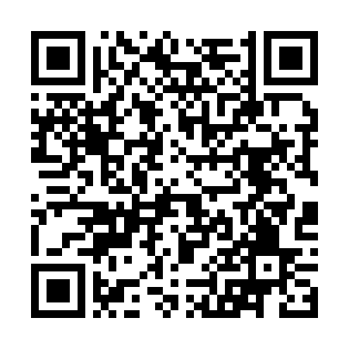
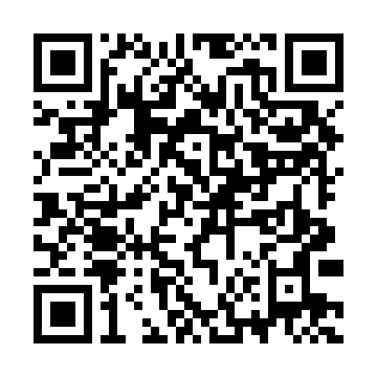
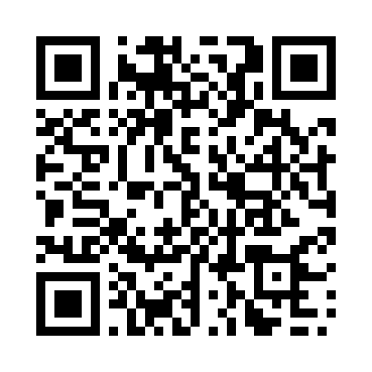
But can we make these conclusions?
Would like to conclude that:
Heterogeneity is valuable in terms of task performance, energy efficiency, robustness
Likely that the brain makes use of heterogeneity in these ways
Possible that evolution has (optimally) tuned heterogeneity for this
But:
The brain has many mechanisms that can achieve the same thing
Indeed in our models we have seen that we can achieve the same results using several mechanisms:
  Tunable (or even random) axonal delays
  Neuromodulation
  A low dimensional, slow memory state
So can we conclude the brain uses heterogeneity?
Sun et al. (2025)
AlKilany and Goodman (2026)
Sun et al. (2026)

Slide 13
But can we make these conclusions?
Would like to conclude that:
Heterogeneity is valuable in terms of task performance, energy efficiency, robustness
Likely that the brain makes use of heterogeneity in these ways
Possible that evolution has (optimally) tuned heterogeneity for this
But:
Just because the brain has this mechanism available, doesn’t mean it’s tuned for it
Does the similarity of the time constant distributions tell us anything?
If not, how could we experimentally test this idea?
Wouldn’t we need to create an alternative reality and re-run evolution to test it?
If we can’t test it, can it tell us something about the brain anyway?

Slide 14



Thanks!
Nicolas Perez
Heterogeneity
Now @ DeepMind
Perez et al. (2021)
Abdal AlKilany
Neuromodulation
And thank you for listening to me expressing my existential doubts about my work ❤️
AlKilany and Goodman (2026)
Pengfei Sun
Delay-based SNNs
Sun et al. (2025)
Sun et al. (2026)

Slide 15
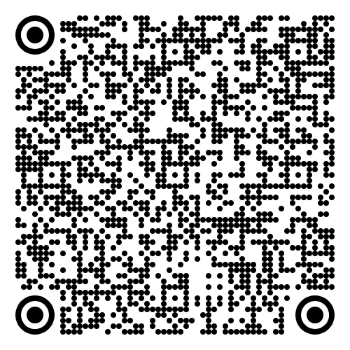
Before networking + food
Please complete this survey from the Crick Networking Fund (5m)
Come and find one of the organisers if you’re interested in discussing / contributing to an opinion paper

Slide 16
Group discussion (1h)
Potential outline
Introduce yourselves
Do we learn anything about the brain by evaluating how well models perform tasks?
Can we test theories about a multiply redundant brain?
How could we experimentally test theories about the function of neural heterogeneity?
Can theoretical work that can't be tested contribute to understanding the brain?
Menti.com
Code: 8443 4177

