Slide 1

The Neuron Migration
Lifeware Challenge · Neural Wave AI Hackathon
Reverse-engineering 30 years of insurance logic into code an auditor can check
TEAM NAMA
Mohammad Javad Amin · Nava Biglar · Malihe Ghasemian · Emad Aghajani
Notes:
Hello, we are team NAMA from USI: Mohammad Javad Amin, Nava Biglar, Malihe Ghasemian and Emad Aghajani. Our challenge was the Neuron migration: rebuilding thirty years of insurance logic as code that an auditor can check. We show how we did it, and why the same method also worked on a task without any answers.

Slide 2
Match Neuron to the cent, without its code
NeuralWave Life moves its unit-linked policies from the legacy system Neuron to Lifeware
Neuron grew from COBOL to Java since 1994; the developers are gone, the documentation is incomplete
Only the data is left, and Neuron's results for part of the policies
5,000
6.8 M
policies since 1994
unit bookings
27
0
legacy tables
lines of source code
A value counts only if it is exact: to the cent and to the day.
Notes:
NeuralWave Life wants to move its unit-linked policies from its legacy system Neuron to Lifeware. Neuron has run since 1994, first in COBOL and later in Java. The developers are gone and there is no source code. What we have is the export: 27 tables, 5,000 policies, almost seven million fund bookings, and the values Neuron calculated for part of the policies. And the bar is high: a value only counts if it matches to the cent and to the day.

Slide 3




AI is the detective, code is the answer
1 Decode
2 Guess
3 Explain the misses
4 Encode
One loader for all 27 tables, driven by the data dictionary NRDICT
The simplest rule the task text suggests
Decision-tree rule finder, convention search, booking-by-booking checks
Plain Python with exact decimals, one small module per task
Machine learning shows where a rule breaks. The submission contains no model: every cent can be explained to an auditor.
Notes:
So we used AI as the detective, not as the calculator. One loader decodes all 27 tables from the old data dictionary. For each task we wrote the simplest rule and compared it with Neuron's numbers. Where it failed, machine learning told us why: a shallow decision tree on the wrong rows, a search over rounding and date conventions, and for the fund accounting a check of every single booking. Every finding became plain Python with exact decimals, so every cent can be explained.

Slide 4





One loop, six generic tools
Rule finder
Change points
Residuals
Where is a rule wrong? → drifting due dates before 2007
When did the system change? → 2007-08-11
What do the differences say? → 31/360, cut-off cents
Convention search
Weak labels
Learned calendar
Which convention is it? → Actual/360, charge order
No targets? Learn from the legacy bookings → t7
Business days from the price days → Ticino holidays
None of them knows anything about insurance: notebook 06 shows each one rediscovering one of our rules.
Notes:
What makes this a method and not a one-off is the toolkit. Each tool answers a question that every migration has: where is the rule wrong, on which day did the system change, what do the differences say, which convention is it, and how do we learn when there are no targets. None of them knows anything about insurance. In notebook six each tool rediscovers one of our rules on its own, for example the conversion date in August 2007.

Slide 5


Neuron is really two systems
 | COBOL, until 2007 | Neuron NG, Java
Rounding | truncate | half up
Insured age | days since birth ÷ 365 | nearest birthday
Management charge | rate × days ÷ 360 | rate ÷ 12
Due dates | drift 31 → 30 → 28 | anchored, no drift
Also hidden in the data
The 01:30 charge run sees only units traded before the day
Each fund buys on its own first day with a price
Lowercase currency codes, impossible birth dates
Notes:
Our biggest discovery: Neuron is really two systems. Until the conversion in August 2007, COBOL truncated every amount, computed the age as days since birth divided by 365, charged the management fee by the day, and let due dates drift from the 31st to the 28th. Neuron NG rounds half up, uses the nearest birthday and charges a twelfth of the yearly rate. We also found operational details: the charge run at 1:30 in the morning only sees units traded before that day, and each fund buys on its own first price day.

Slide 6
Ignore the two systems and the numbers break
100 %
of the offers of the COBOL era are wrong with the Neuron NG rules alone
17 %
of the 2025 statements are still wrong: old errors live on in the balances
0 %
with our era rules, apart from the manual corrections
Notes:
How do we know this matters? We ran our own code once more, but moved the conversion to 1900, so the Neuron NG rules apply to every year. Then every offer of the COBOL era is wrong, and the statements stay wrong long after 2007, because the old errors live on in the fund balances: still 17 percent in 2025. With our era rules both lines drop to zero.

Slide 7
Results: 88.80 % on the public leaderboard
PUBLIC LEADERBOARD, EXACT ROWS
t0 Commission
t1 Due dates
t2 Maturity
t3 Surrender
t4 Statement
t7 Tax annual
t7 Tax payout
100 %
100 %
100 %
99.93 %
99.99 %
29 / 30
10 / 40
88.80 %
11 → 29
55
average of the seven scores, up from 77.01 % before the t7 rules
of 30 t7 annual rows after fitting one rule per mismatch
hand-edited values found automatically (t5): all 38 listed and 17 new
3 of 7 tasks perfect · every remaining t0–t4 miss is a manual correction · 5,024,847 fund bookings recalculated · t0–t5 run in 45 s
Notes:
Here are our results on the public leaderboard: t0, t1 and t2 are perfect, t3 and t4 are at 99.93 and 99.99 percent, and every remaining difference there is a value someone changed by hand. Our outlier detection for task five finds them automatically: 55 values, all 38 from the official list and 17 that nobody had listed. On the surprise tax audit we reach 29 of 30 rows in the annual tax table and 10 of 40 payouts, which brings our average to 88.80 percent, up from 77 percent before. The next slides show how we found the tax rules.

Slide 8

Surprise t7: from guesses to exact rules
1 Weak labels
2 Leaderboard splits
3 One rule per mismatch
4 The law decides
Neuron's tax bookings say which tax it charged: the gates match 498 of 498 countries
Each half of the policies gets a different rule; the count says which one was right
On the organisers' samples every wrong row got its own rule, checked on all 110 rows
Where no sample shows the case, the rule follows Swiss, Italian and German law
No targets at first, two examples, and a leaderboard of 40 payouts and 30 policy years.
Notes:
Then came the surprise: a tax audit for three countries since 1994, with no target values at all. We found the rules in four steps. First, weak labels: Neuron's own tax bookings have no amounts, but they say which tax it charged, so our gates match them exactly. Second, the leaderboard as an instrument: we gave each half of the policies a different rule, so one upload tested two ideas. Third, when the organisers published two samples, we traced every wrong row to its own rule and kept a rule only if it held on all 110 rows. And fourth, where no sample shows a case, the rule follows the law.

Slide 9
One mismatch, one rule
Mismatch we saw | Rule we found | Rows
Swiss payouts without tax still have a base | Base = amount paid in CHF; elsewhere 0.00; no date without tax | 33
31 Dec 2017 vs 3 Jan 2018 | A deadline on a closed day moves to the next business day (2 January closed) | 6
Italian tax above 26 % | Each rate on the gain earned while it was valid (2012, 2014 rate changes) | 10
German tax 28.71, not 29.36 | Capital gains tax reduced by church tax, cents cut off | 3
Italian duty one day short | Days up to and including the payout day, over the days of that year | 7
One cent off in 2019 | The 2019 correction is one booking, rounded once | 4
A tax in the wrong year | A withheld tax counts in the year it was paid to the tax office | 5
Notes:
This is the core of the method. Each wrong row in the published samples pointed to one specific rule. Swiss payouts without tax still report the amount paid as base. A deadline on a weekend or holiday moves to the next business day, and in Switzerland 2 January is closed. Italian tax above 26 percent showed that the rate changes of 2012 and 2014 split the gain. German church members pay less capital gains tax, and German cents are cut off. Each rule was kept only if it held on every one of the 110 sample rows.

Slide 10
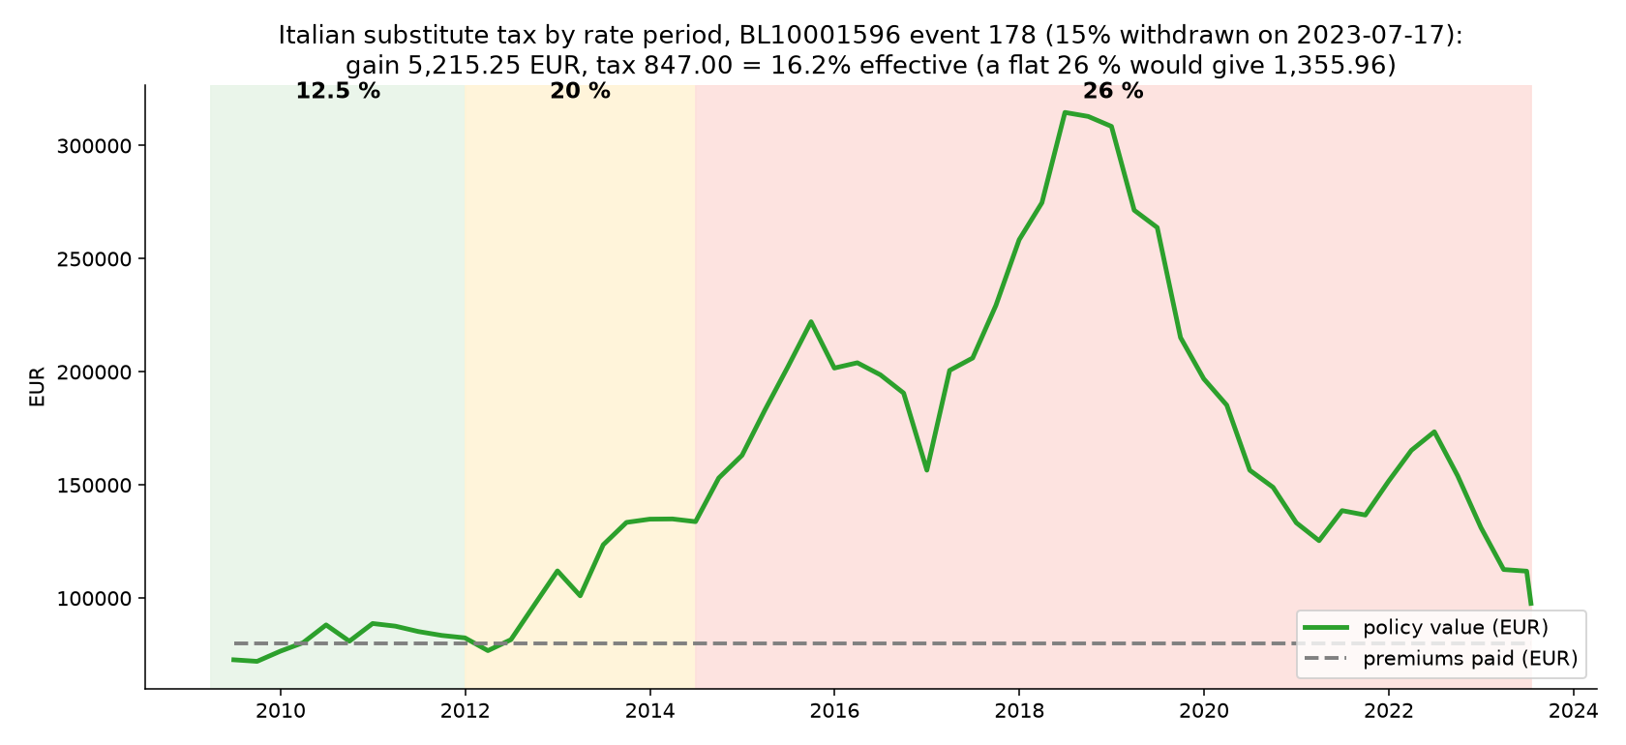
The Italian tax, period by period
Notes:
Here is one real payout. The policy started in 2009, and Italy taxed its gain at 12.5, then 20, then 26 percent. Neuron does not apply today's rate to the whole gain: it values the policy on the last day of each rate period and taxes each part of the gain at the rate of its period. So this 15 percent withdrawal pays 847 euros, not the 1,356 of a flat 26 percent, exactly as in the audit sample.

Slide 11
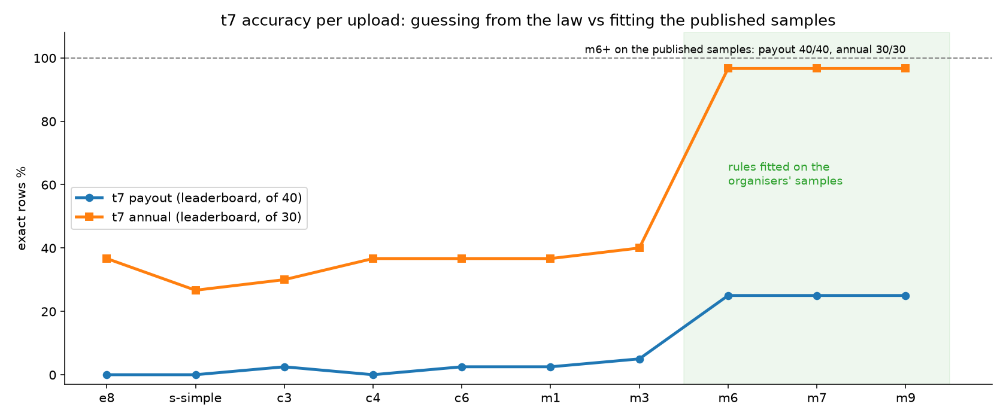
t7 results: annual 11 → 29 of 30
29 / 30
annual rows on the leaderboard
109 / 110
published sample rows exact (one off by a cent)
88.80 %
The leaderboard credits our dated payout rows; the undated ones we match exactly in the published samples are not credited there.
average accuracy, from 77.01 %
Notes:
The effect on the leaderboard: the annual table went from 11 to 29 of 30 rows, and our average from 77 to almost 89 percent. On the two samples the organisers published we match every one of the 110 rows, one of them off by a single cent. One honest caveat: the leaderboard credits only our payout rows that carry a remittance date; the undated rows we match exactly in the published samples are not credited there.

Slide 12
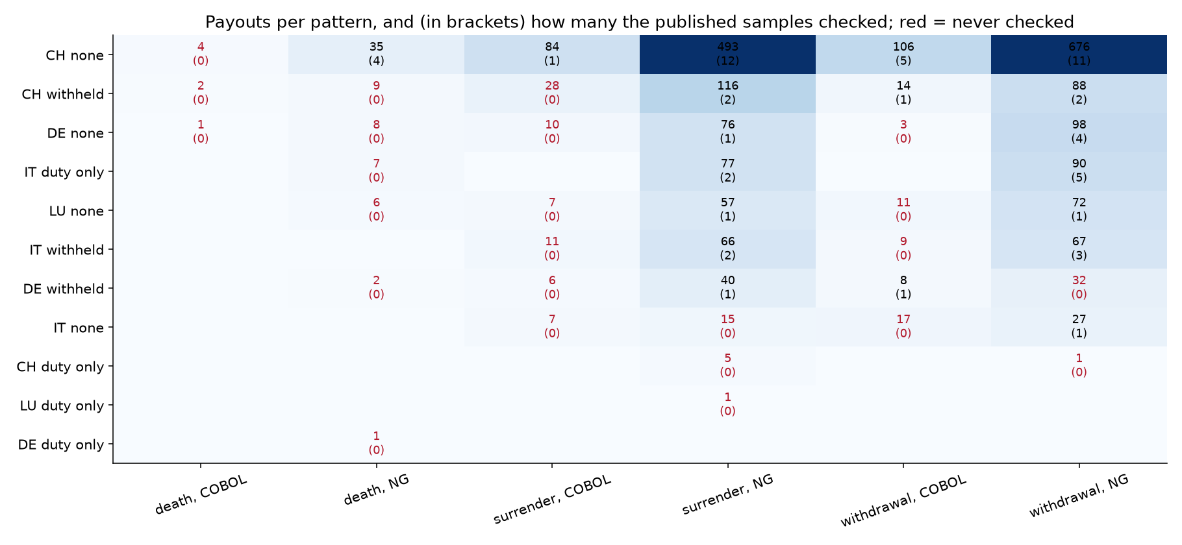
Where the samples are silent, the law decides
Red cells: patterns no sample ever checked
Swiss tax is due 30 days after the end of the month (Art. 16 VStG)
Dates count from the month the money was paid (PD_PAYDAY, the one field no other task uses)
Each choice keeps all 110 sample rows exact
Notes:
The samples covered only part of the patterns: the red cells here were never checked. There we let the law decide, as long as every sample row stays exact: Swiss withholding tax is due thirty days after the end of the month, and deadlines count from the month the money was paid, using the payout days of the product table, the one field no other task uses.

Slide 13
Thank you
Questions are welcome
TEAM NAMA
Mohammad Javad Amin · Nava Biglar · Malihe Ghasemian · Emad Aghajani
Notes:
To sum up: no model runs in our submission, every rule is plain code backed by an exact test, and the discovery tools know nothing about insurance, so they are ready for the next migration. Thank you, we are happy to take your questions.

