Slide 1

Measuring the
Italian Sentiment on the Economy
An application of Deep Learning to Sentiment Analysis
Authors: Mauro Bruno, Elena Catanese, Francesco Pugliese, Luca Stefanelli

Slide 2

Objective
We propose a statistical Index that measures the sentiment about economy in Italy using Twitter data

Slide 3
Existing research in the field: the SMEI
The Social Mood on Economy Index (SMEI) is developed by ISTAT
Measures the Italian sentiment on economy
Extracts the sentiment from Twitter data
The sentiment analysis is conducted using a lexicon-based, unsupervised, approach

Slide 4
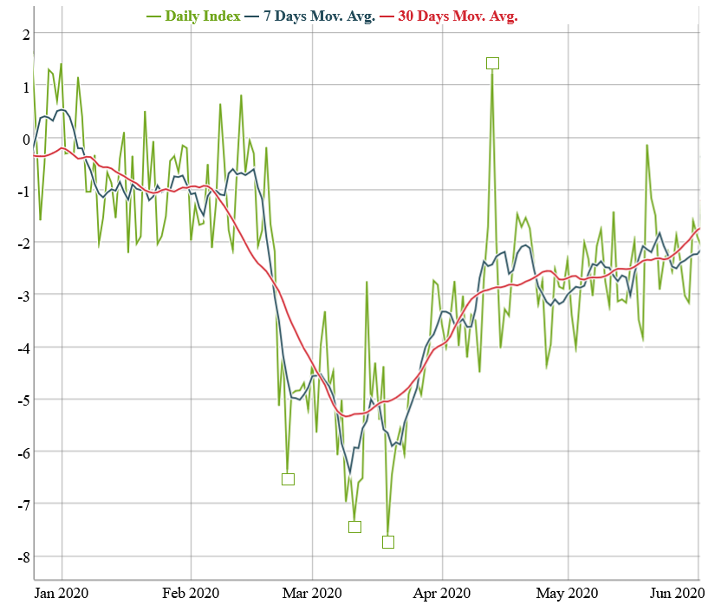
ISTAT’s SMEI
January-May 2020: the Covid outbreak in Italy

Slide 5
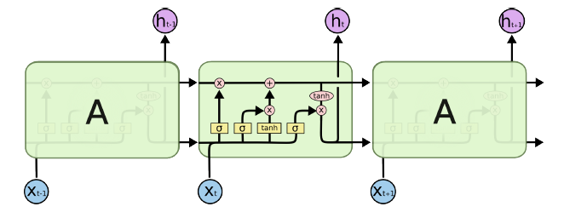
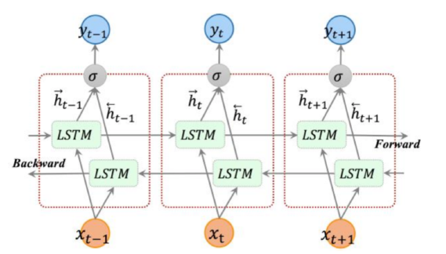
Materials and Methods: BiLSTM
Our classification model is a Bidirectional Long short-term memory (BiLSTM). LSTMs are a type of RNN able to process long sequences of data whereas BiLSTM are able to understand the left context and right context of sequences.
A LSTM memory cell is composed of 4 units exactly: an input gate, an output gate, a forget gate and a self-recurrent neuron.

Slide 6
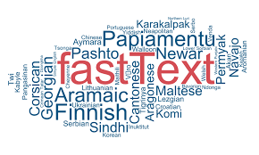
Materials and Methods: FastText
Our Word Embeddings Model is FastText which is an evolution of Word2Vec.
FastText enables to quickly train models on large corpora
FastText make use of hierarchical soft-max based which is able to noticeably drop computational complexity and can be trained on more than one billion words in less than ten minutes using a standard multicore CPU.

Slide 7
Why a new Index?
ISTAT’s Index (SMEI) needed a revision to deal with new events (Covid pandemic)
The proposed model may have a higher adaptability to new information
The proposed model is a neural network that has been trained on a set of labelled Tweets that do not contain references to the pandemic

Slide 8
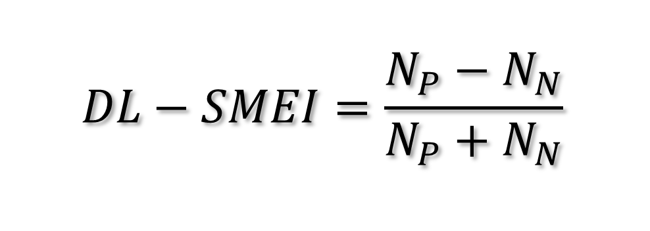
Computed daily using the sentiment predicted by the model on a set of tweets
The sentiment is predicted using a neural network
The set of tweets is the same used by ISTAT for the SMEI
Computed for the first half of 2020
The proposed Index:
DL-SMEI
$$DL−SMEI=\frac{N_{P}−N_{N}}{N_{P}+N_{N}}$$

Slide 9
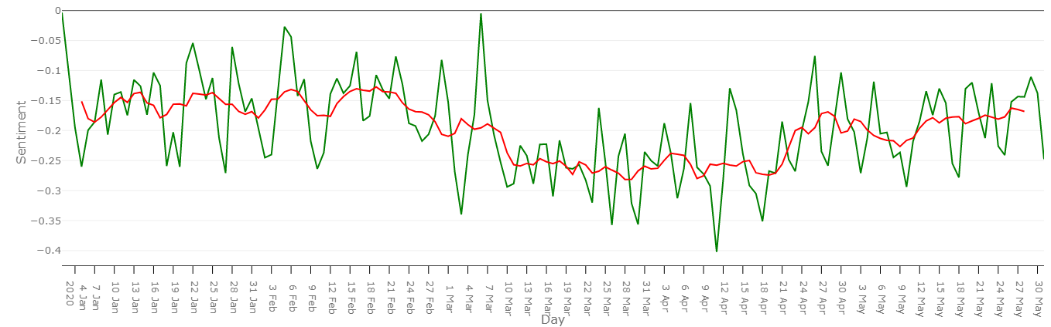
The proposed Index (DL-SMEI)
+ 10.3% negatives
-0.157
-0.260
-0.190
Notes:
Capture a persistent decline in the sentiment following the imposition of lockdown on 7th March 2020
Highlights three macro-periods with different levels of sentiment
Is always negative

Slide 10
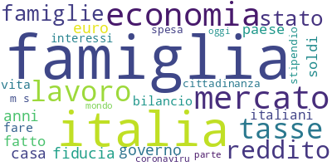
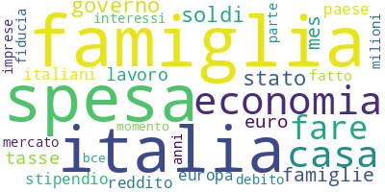
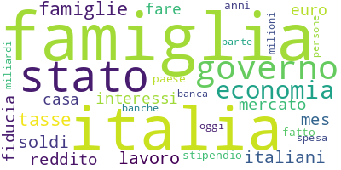
1st January – 7th March
8th March – 21st April
22nd April – 31st May

Slide 11
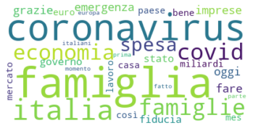
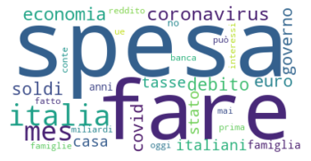
Focus on second period (8th March – 21st April)
Positive words
Negative words

Slide 12
Maximum and Minimum points
Notes:
To find furhter confirmation about this evidence, we should look at the minimum and maximum points

Slide 13
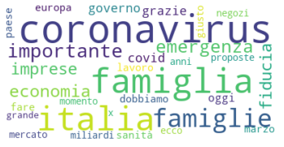
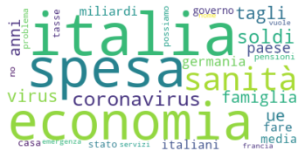
Second Maximum on the 6th March
Positive words
Negative words

Slide 14
Limitations
Misclassification of Covid: updated training set may increase accuracy
Unrepresentativeness of Social Media data
Difficult to evaluate the accuracy of the Index: need of a reference measure
Future Directions
Label a more accurate Istat's training set
Adopt more powerful and "state-of-art" models in Sentimen Analysis such as Bert and its derivations.

Slide 15
Conclusion
The Index is able to capture a decline in the sentiment following the Covid outbreak in Italy
It is a timely indicator of the public opinion on social media
Deep learning is a powerful tool that can be useful also in Official (experimental) Statistics

