Slide 1
Simulated Annealing for a Real-Life TSP: Blood Deliveries in Cagayan de Oro City
Assigned algorithm: Simulated Annealing (Luna-Garcia, Candano & Caga-anan, 2024, Algorithm 2.5)
1
Hans Matthew Del Mundo
Slides 1–2
2
Gerald Helbiro Jr.
Slides 3–4
3
Vin Marcus Gerebise
Slides 5–6
4
Ira Chloie Narisma
Slides 7–8
Computer Science CS4A · CS414 Graph Theory · [Instructor] · [Date]
Notes:
SPEAKER: Hans Matthew Del Mundo · about 0:15
Good day. We are Hans Matthew Del Mundo, Gerald Helbiro Jr., Vin Marcus Gerebise and Ira Chloie Narisma. Our assigned algorithm is Simulated Annealing, from "Performance Analysis of Classical Algorithms for the Traveling Salesman Problem" by Luna-Garcia, Candano and Caga-anan. We use it to solve a real routing problem in Cagayan de Oro City.
Fill in [Instructor] and [Date] before presenting.

Slide 2
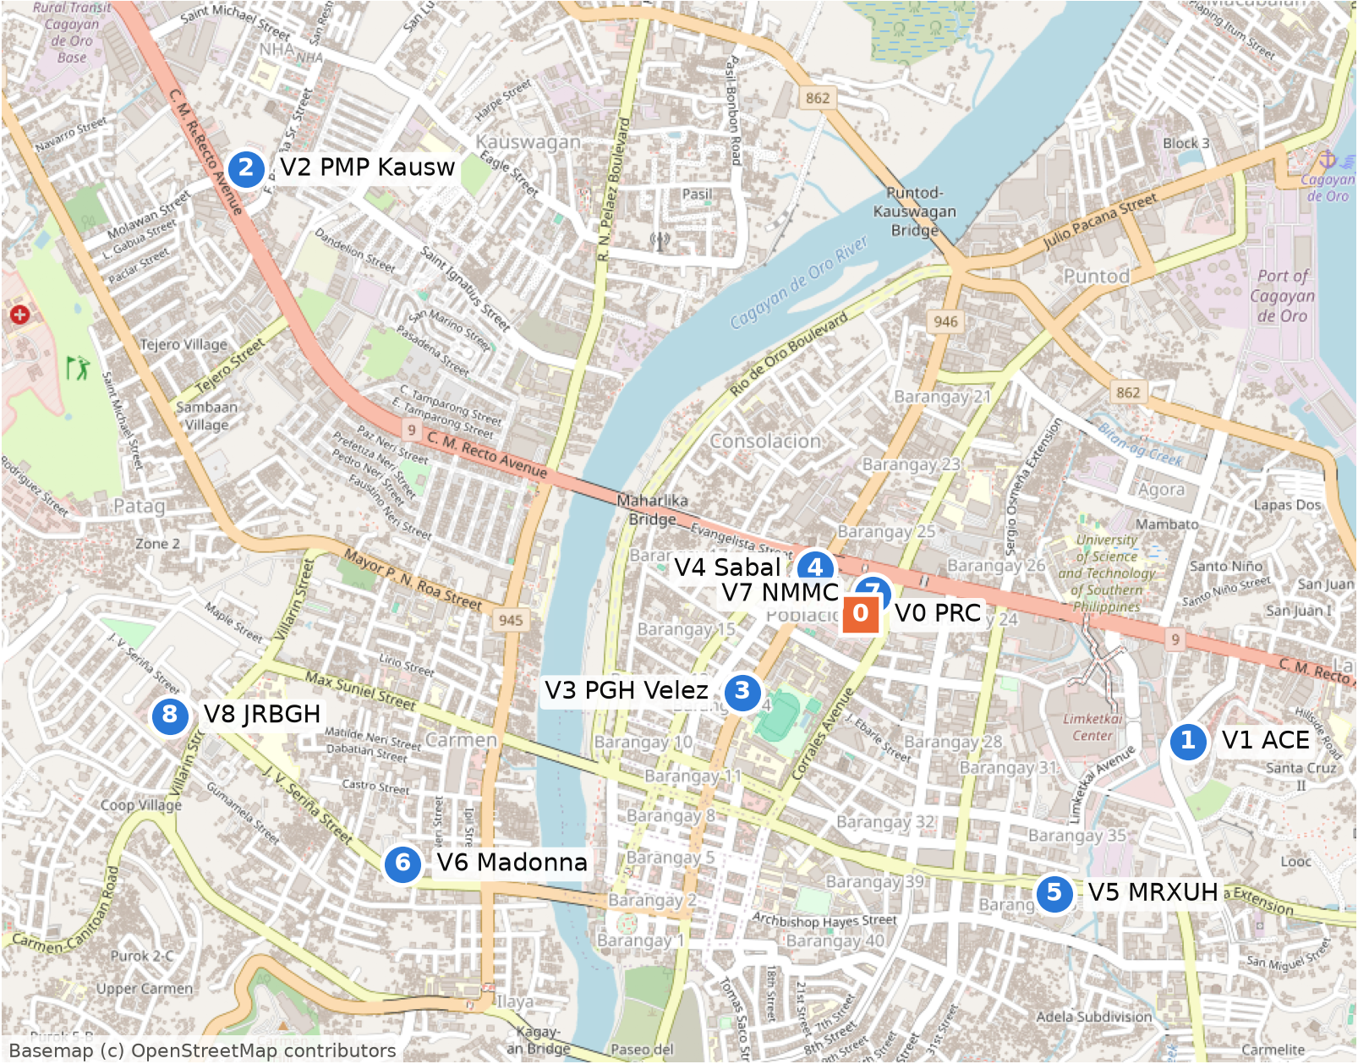
Problem & Objective
1
A Philippine Red Cross courier (illustrative scenario) leaves the chapter office, delivers blood units to 8 hospitals, each exactly once, and returns.
Start (depot): V0 Red Cross CDO Chapter
V1 ACE Medical Center
V2 Polymedic Med. Plaza
V3 Polymedic Gen. Hospital
V4 Sabal Hospital
V5 Maria Reyna-XU Hospital
V6 Madonna and Child
V7 N. Mindanao Med. Center
V8 J.R. Borja Gen. Hospital
Objective: minimise total driving km
min d(V0,π1) + d(π1,π2) + … + d(π8,V0) over every order π of the 8 hospitals
The 9 locations on OpenStreetMap (orange square = depot V0)
Constraints start and end at V0 · each hospital exactly once · roads only
Assumptions 1 vehicle, no capacity limit · stop time ignored · fixed distances, no traffic
Speaker: Hans Matthew Del Mundo
Notes:
SPEAKER: Hans Matthew Del Mundo · 0:15–1:45
- Scenario (illustrative but realistic): a Philippine Red Cross Misamis Oriental courier leaves the chapter office with blood units, delivers to 8 hospitals in Cagayan de Oro City, each exactly once, and returns to base. One vehicle, fixed stops, a closed tour, a total length to minimise: that is the TSP.
- Why it matters: a shorter route means blood arrives sooner and the vehicle uses less fuel.
- Locations: V0 is the Red Cross Misamis Oriental-CDO Chapter (Capitol Compound), the start and end. V1–V8 are the hospitals. Coordinates come from OpenStreetMap; every place in data/locations.csv also has its address and a Google Maps link.
- Objective: minimise total DRIVING distance in km.
- Constraints: start and end at V0, every hospital exactly once, roads only.
- Assumptions: one vehicle with no capacity limit, time at each stop ignored, fixed distances (no traffic).
- Deliberate change from the paper: the paper uses straight-line distances between (x, y) points; we use real road distances, which can differ by direction because of one-way streets.

Slide 3
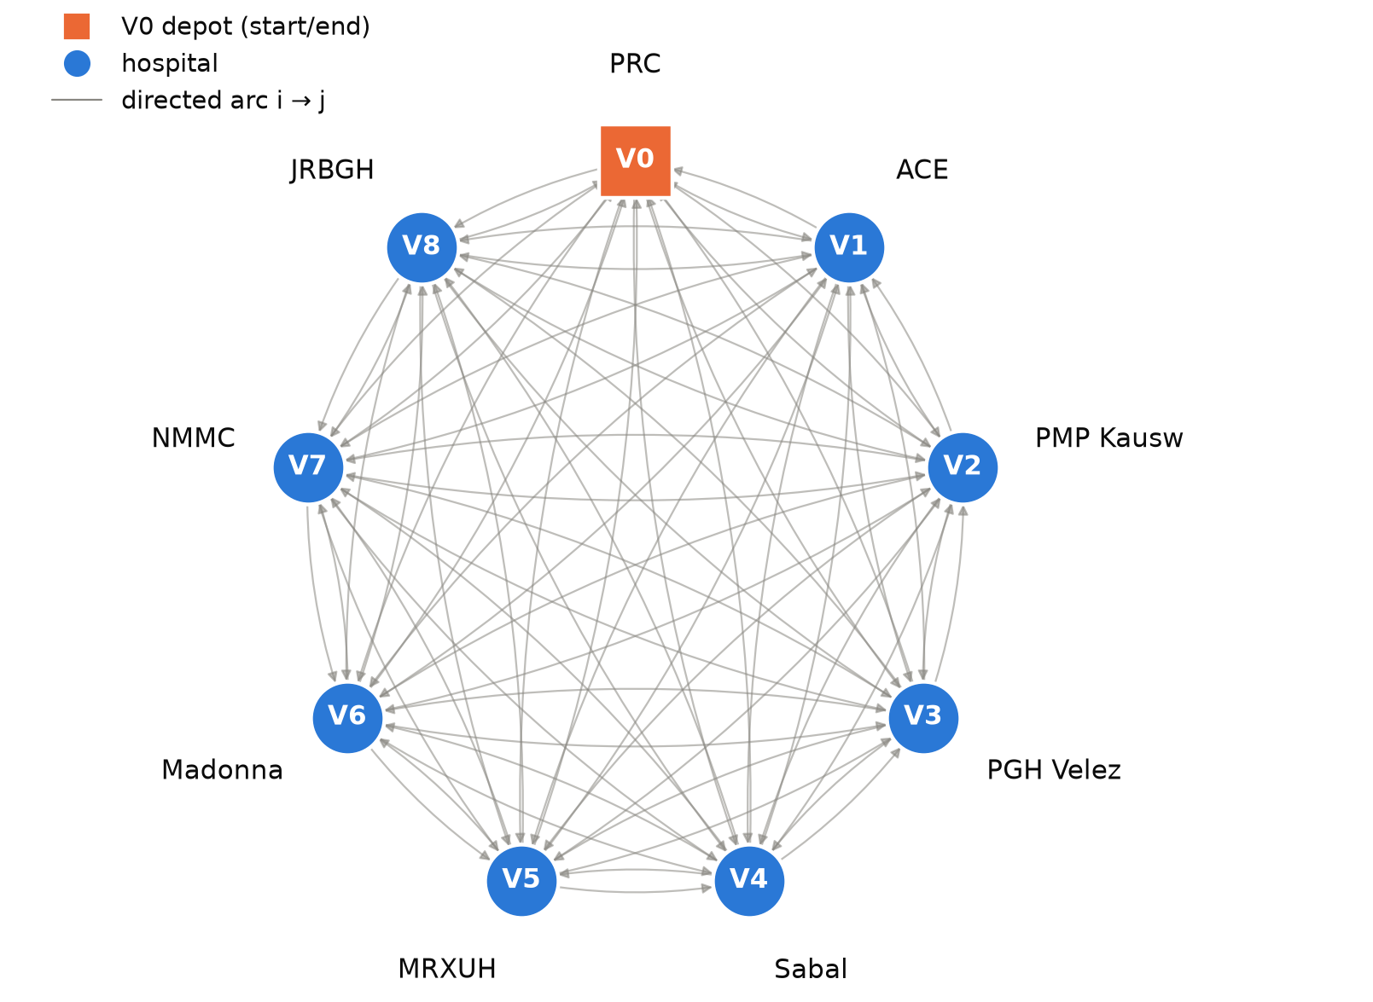
Graph & Dataset
2
from \ to | V0 | V1 | V2 | V3 | V4 | V5 | V6 | V7 | V8
V0 | – | 1.67 | 2.81 | 0.60 | 0.23 | 1.62 | 2.46 | 0.14 | 3.23
V1 | 1.87 | – | 4.22 | 2.20 | 1.69 | 1.26 | 4.06 | 1.89 | 4.63
V2 | 2.94 | 4.35 | – | 3.25 | 2.74 | 4.58 | 3.57 | 3.00 | 3.71
V3 | 0.82 | 2.36 | 3.37 | – | 0.73 | 1.96 | 1.85 | 1.03 | 2.37
V4 | 0.23 | 1.68 | 2.63 | 0.51 | – | 1.91 | 2.37 | 0.29 | 3.05
V5 | 1.66 | 1.21 | 4.48 | 1.63 | 1.95 | – | 2.71 | 1.63 | 3.22
V6 | 2.43 | 4.01 | 3.35 | 1.85 | 2.33 | 2.62 | – | 2.62 | 1.00
V7 | 0.14 | 1.62 | 2.87 | 0.80 | 0.29 | 1.62 | 2.66 | – | 3.29
V8 | 3.23 | 4.65 | 3.63 | 2.37 | 3.03 | 3.21 | 1.04 | 3.29 | –
Weights in km, row = FROM, column = TO. Source: OSRM car router on OpenStreetMap roads, one request per direction, 2026-10-17 (data/data_sources.csv)
9
vertices: depot V0 + 8 hospitals
72
directed arcs, every ordered pair
km
edge weight = driving distance
29 / 36
pairs differ by direction
72 / 72
ACTUAL values, 0 ASSUMED
Speaker: Hans Matthew Del Mundo
Notes:
SPEAKER: Hans Matthew Del Mundo · 1:45–3:15
- Graph model: G = (V, A), a complete DIRECTED weighted graph. V = {V0..V8}: 9 vertices. A = every ordered pair (i, j), i ≠ j: 72 arcs, each the drive from i to j.
- Weight w(i, j) = driving distance in kilometres.
- Why directed: 29 of the 36 pairs have different distances in the two directions (one-way streets, U-turns, bridges).
- Matrix (right): row = FROM, column = TO.
- Data source: the length of the route chosen by the OSRM car router on the OpenStreetMap road network, one request per direction, obtained 2026-10-17 (18:15–18:18, Philippine time). Coordinates: OpenStreetMap (Nominatim / Overpass).
- Actual vs assumed: all 72 values are ACTUAL (data/data_sources.csv); 0 are assumed. Assumed cells would be hatched and starred in the matrix.
- Before anything runs, our validator checks: square matrix, zero diagonal, positive distances, labels match locations.csv, matrix equals data_sources.csv. It also flags 6 triangle-inequality breaks above 0.1 km, which are plausible on real one-way roads.

Slide 4
Assigned Algorithm: Simulated Annealing
3
current ← random tour; best ← current # step 2
T ← T0 # step 3
while T > T_stop: # step 12
repeat 200 times: # inner loop
new ← swap two cities # step 4
Δ ← cost(new) − cost(current) # step 5
if Δ < 0 or random() < e^(−Δ/T): # 6–10
current ← new
if shorter: best ← current
T ← α · T # step 11
return best # step 13
Advantages
Escapes local optima by sometimes accepting worse tours
Simple: one short loop, no problem-specific rules
Works on asymmetric (one-way) distances
Limitations
Sensitive to parameters (T0, α, moves per level, stop rule)
Random: different seeds can give different tours
No optimality guarantee in practice
Pseudocode of Algorithm 2.5 with the inner loop of the paper's Appendix 4.5 code
Optimality: approximate (heuristic). SA returns the best tour it found, not a proven optimum. Convergence is proven only for logarithmic cooling, far too slow to use.
Complexity (Theorem 2.5): each move costs O(n), so I moves cost O(I·n); with the paper's assumption I = O(n²), T(n) = O(n³).
Speaker: Gerald Helbiro Jr.
Notes:
SPEAKER: Gerald Helbiro Jr. · 3:15–5:15
- Origin: annealing in metallurgy. Heat a metal, then cool it slowly so its atoms settle into a low-energy state. Metropolis et al. (1953) gave the acceptance rule; Kirkpatrick, Gelatt & Vecchi (1983) made it an optimisation method; Černý (1985) applied it to the TSP.
- Analogy: state = a tour; energy = its length in km; temperature T = how willing we are to accept a longer tour; slow cooling = T ← αT.
- Procedure (Algorithm 2.5): (1) input distances; (2) random tour and its length; (3) high initial T; (4) swap two cities; (5) length of the new tour; (6–10) accept if shorter, otherwise accept with P = e^(−Δ/T); (11) cool T ← αT; (12) stop when T is low or nothing improves; (13) return the best tour found.
- The paper's code (Appendix 4.5) adds an inner loop: many moves at the same temperature, then cool. Ours does 200 moves per level.
- Advantages and limitations as on the slide.
- Optimality: SA is a heuristic. It gives an approximate solution and does not guarantee the optimum. Theorem 2.5's O(n³) relies on the authors' assumption I = O(n²); in practice I is set by the parameters (our run: 56,200 moves).

Slide 5
Methodology
4
CSV data
data/*.csv
Validate
data_loader.py
Directed graph
graph_model.py
Simulated Annealing
simulated_annealing.py
Verify route
verify.py
Brute force, greedy, 30 runs
baselines.py
Parameters (src/config.py)
Key calculation from our trace (T = 6.61 km)
Parameter | Value | Why
T0 | 6.61 km | avg worse move accepted w.p. 0.8
α | 0.98 | T ← αT after each level
moves / level | 200 | inner loop
T_stop | 0.001 km | stop: worse moves ~never accepted
patience | 228 levels | stop: no new best while T falls 100×
seed | 1 | reproducible run
Move 2: Δ = 15.61 − 15.37 = +0.24 km
P = e^(−0.24/6.61) = 0.9643; r = 0.2100 < P → ACCEPT
Move 3: Δ = 17.34 − 15.61 = +1.73 km
P = e^(−1.73/6.61) = 0.7697; r = 0.8933 ≥ P → REJECT
Graph representation in code
9 × 9 matrix D (row = from, column = to) + networkx DiGraph. Tour = list of vertices, depot fixed first; cost = sum of its 9 arcs.
Speaker: Gerald Helbiro Jr.
Notes:
SPEAKER: Gerald Helbiro Jr. · 5:15–6:45
- Workflow: the CSV files are validated, turned into a directed graph, solved with Simulated Annealing, then checked: the route is verified edge by edge, compared with brute force and greedy on the same matrix, and SA is repeated with 30 seeds.
- Graph representation: a 9 × 9 matrix D (row = from, column = to) plus a networkx DiGraph. A tour is a list with the depot fixed at position 0; its cost is the sum of its 9 arcs, including the return to V0.
- Parameters: T0 is calibrated to our units, so an average worse move (1.47 km) is accepted with probability 0.8 at the start. α = 0.98 was chosen with a sensitivity study (100 runs per value). We stop at T = 0.001 km or after 228 levels with no new best.
- Key calculation (from outputs/trace.csv): Move 2 makes the tour 0.24 km longer, P = 0.9643, the random number r = 0.21 is below P, so the worse tour is accepted. That is how SA escapes local optima. Move 3 is 1.73 km worse, P = 0.7697, r = 0.8933 is above P, so it is rejected.
- Why not the paper's defaults (T0 = 1000, α = 0.995, 1000 moves/level, T_stop = 1e-8)? T0 = 1000 ignores the km scale, and one run needed about 5 million moves.

Slide 6
Python Demonstration (live)
5
python main.py --trace
for _ in range(params.iterations_per_temperature):
new_tour, positions = make_move(current, rng) # 4
new_cost = tour_cost(new_tour, D) # 5
delta = new_cost - current_cost
accepted, p, r = metropolis(delta, T, rng) # 6-10
if accepted:
current, current_cost = new_tour, new_cost
if current_cost < best_cost: # 13
best, best_cost = current.copy(), current_cost
T *= params.alpha # 11
1
Show the input
data/locations.csv, data/distance_matrix.csv
2
Run the code
validation, inputs, parameters, first 5 moves
3
Read the output
best tour, total km, verification, brute force
Core loop of src/simulated_annealing.py (comments = Algorithm 2.5 steps)
Main code components (src/)
4
Show the route
outputs/route_map.html and convergence plot
data_loader · graph_model · simulated_annealing · verify · baselines (brute force, greedy) · experiments · maps
Speaker: Vin Marcus Gerebise
Notes:
SPEAKER: Vin Marcus Gerebise · 6:45–10:15 (screen recording of the real run)
Switch to the terminal or VS Code (font at least 18 pt).
1. Open data/locations.csv and data/distance_matrix.csv: "This is our input data exactly as collected: the locations with coordinates, and the directed distance matrix in km."
2. Type: python main.py --trace
3. Scroll slowly: validation PASS → input tables → SA parameters → the first 5 moves (current tour, swap, new tour, Δ, T, P, r, decision; the same numbers as the worked example) → SIMULATED ANNEALING RESULT → VERIFICATION → OPTIMALITY CHECK → 30 INDEPENDENT SA RUNS.
4. Open outputs/route_map.html, then outputs/fig4_convergence.png.
5. Show src/simulated_annealing.py: the inner loop proposes a swap, metropolis() applies the acceptance rule, T *= alpha cools, and every line is commented with its Algorithm 2.5 step number.
Alternative: run demo.ipynb with Kernel → Restart & Run All; it calls the same functions.
Keep the result consistent with slide 6: the run must print 14.1 km with seed 1.

Slide 7
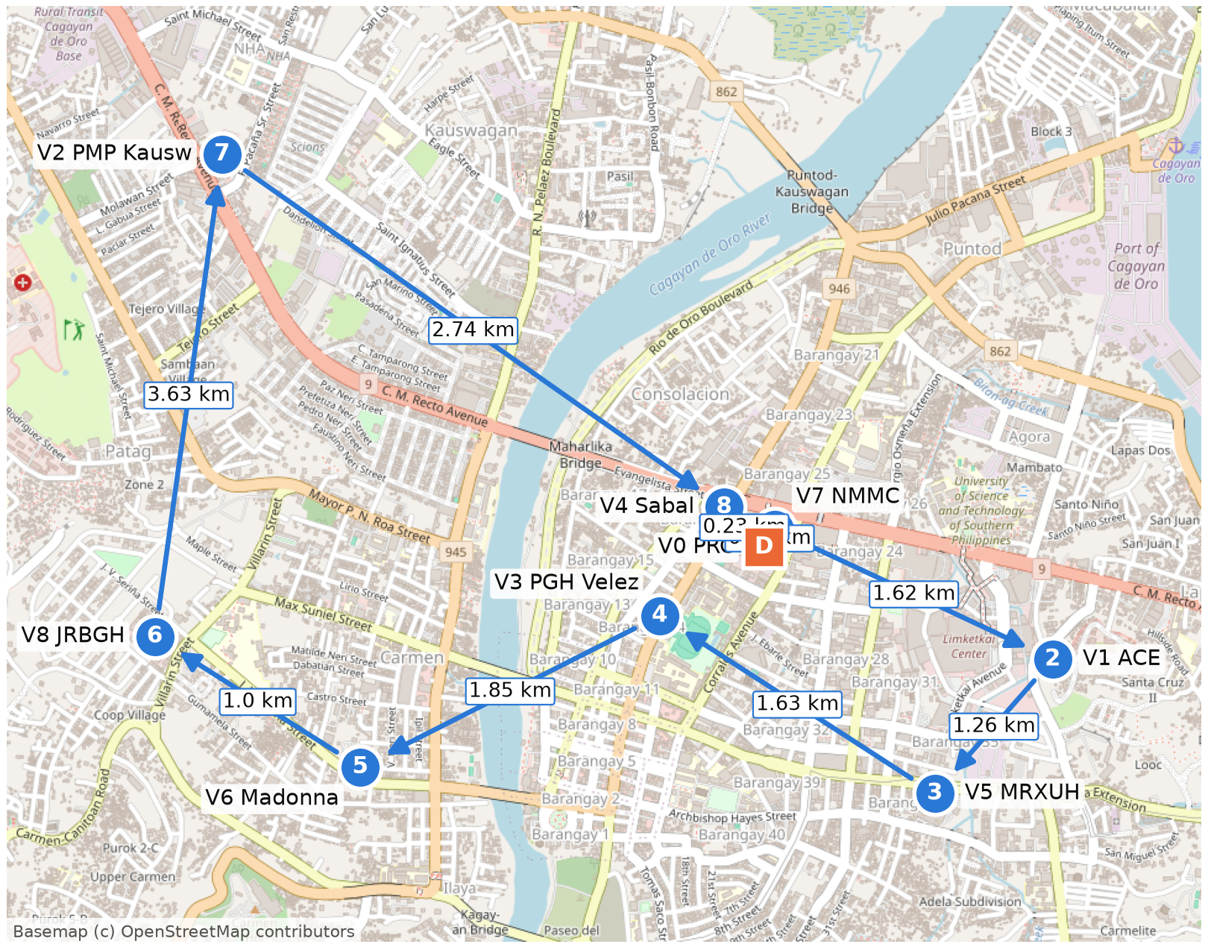
Results & Verification
6
14.1 km total driving distance, closed tour
V0 → V7 → V1 → V5 → V3 → V6 → V8 → V2 → V4 → V0
PRC → NMMC → ACE → MRXUH → PGH Velez → Madonna → JRBGH → PMP Kausw → Sabal → PRC
Verification (src/verify.py): PASS
0.14 + 1.62 + 1.26 + 1.63 + 1.85 + 1.00 + 3.63 + 2.74 + 0.23 = 14.10 km
= SA's reported total. Starts and ends at V0; every hospital exactly once.
Proven optimal for this instance
Brute force checked all 40,320 tours: minimum = 14.1 km. The proof is the exhaustive search, not SA.
Speaker: Vin Marcus Gerebise
Notes:
SPEAKER: Vin Marcus Gerebise · 10:15–11:30
- Result: V0 → V7 → V1 → V5 → V3 → V6 → V8 → V2 → V4 → V0, i.e. PRC → NMMC → ACE → MRXUH → PGH Velez → Madonna → JRBGH → PMP Kausw → Sabal → PRC. Total 14.1 km. The random starting tour was 16.32 km.
- Verification: the route starts and ends at the depot, has 10 entries, and visits every hospital exactly once. Re-adding the 9 edges from the graph gives 14.1 km, equal to SA's reported total.
- Optimal? SA alone cannot tell us. Brute force on the same matrix checked all 40,320 tours: the minimum is 14.1 km and the optimal tour is unique, so our route is optimal for this instance. The proof comes from the exhaustive search.
- Comparison: greedy nearest neighbour 15.37 km (+9.0%), average random tour 20.79 km, worst tour 25.52 km.
- Reliability: in 30 independent runs (paper's Table 2 format), SA reached the 14.1 km optimum 30 out of 30 times.
- Honest note: at n = 9 brute force is still cheap; SA matters as n grows (20 stops = 19! ≈ 1.2 × 10^17 tours).

Slide 8
Conclusion
7
14.1 km
optimal closed tour, proven by brute force
−32%
vs an average random order (20.79 km)
−8.3%
vs the greedy route (15.37 km)
Objective achieved: the courier's route visits all 8 hospitals once, returns to the Red Cross office, and has the shortest possible driving distance on our data. SA found it; brute force proved it optimal.
Limitations
Possible improvements
Static distances: no traffic, time of day or closures
No time windows; a single vehicle
Depends on OpenStreetMap data and OSRM's route choice
Small n (needed for the brute-force proof)
Minimise travel time with live traffic
Time windows for urgent hospitals
Several vehicles (vehicle routing problem)
SA + 2-opt hybrid; adaptive cooling; larger n
Speaker: Ira Chloie Narisma
Notes:
SPEAKER: Ira Chloie Narisma · 11:30–12:45
- The courier should drive PRC → NMMC → ACE → MRXUH → PGH Velez → Madonna → JRBGH → PMP Kausw → Sabal → PRC: 14.1 km. That is 6.69 km (32%) shorter than an average random order and 1.27 km (8.3%) shorter than the greedy route.
- The route makes sense on the map: it leaves the Capitol compound via NMMC next door, swings east to ACE (Lapasan) and south to Maria Reyna (Camaman-an), comes back through downtown at Polymedic on Velez Street, crosses the river to Carmen where Madonna and J.R. Borja are 1 km apart, goes north to Polymedic in Kauswagan, the most remote stop, and returns via Sabal, 0.23 km from the Red Cross office.
- Optimality: proven for this instance because brute force checked every tour. SA itself does not guarantee it.
- Limitations and improvements as on the slide.

Slide 9
References
8
Algorithm and theory
Data and software
[1] R. Luna-Garcia, T. M. C. Candano, R. L. Caga-anan, "Performance analysis of classical algorithms for the traveling salesman problem," The Mindanawan Journal of Mathematics, 6(2), 79–111, 2024. doi:10.62071/tmjm.v6i2.716. Algorithm 2.5, Theorem 2.5; our code adapts its Appendix 4.5.
[2] N. Metropolis et al., "Equation of state calculations by fast computing machines," J. Chem. Phys., 21(6), 1087–1092, 1953.
[3] S. Kirkpatrick, C. D. Gelatt, M. P. Vecchi, "Optimization by simulated annealing," Science, 220(4598), 671–680, 1983.
[4] V. Černý, "Thermodynamical approach to the traveling salesman problem," J. Optim. Theory Appl., 45(1), 41–51, 1985.
[5] B. Hajek, "Cooling schedules for optimal annealing," Math. Oper. Res., 13(2), 311–329, 1988.
[6] OpenStreetMap contributors, OpenStreetMap road network data (ODbL). openstreetmap.org/copyright. Routing queried 2026-10-17.
[7] D. Luxen, C. Vetter, "Real-time routing with OpenStreetMap data," ACM SIGSPATIAL GIS '11, 513–516, 2011. OSRM demo server, car profile.
[8] Nominatim, OpenStreetMap geocoder. nominatim.org (location coordinates).
[9] A. A. Hagberg, D. A. Schult, P. J. Swart, "Exploring network structure, dynamics, and function using NetworkX," SciPy 2008.
[10] J. D. Hunter, "Matplotlib: A 2D graphics environment," Comput. Sci. Eng., 9(3), 2007. [11] C. R. Harris et al., "Array programming with NumPy," Nature, 585, 2020.
[12] Folium and Pillow (Python libraries). Dataset and code: data/*.csv, main.py, demo.ipynb.
Speaker: Ira Chloie Narisma
Notes:
SPEAKER: Ira Chloie Narisma · 12:45–13:15
(Ira also does the final check of the slides and submission files: video, demo.ipynb / main.py, data/*.csv, references.)
Our references: the assigned paper, whose Algorithm 2.5 and Appendix 4.5 code are the basis of our implementation; the original Simulated Annealing papers; OpenStreetMap, OSRM and Nominatim as our data sources; and the Python libraries we used. The full list with versions is in REFERENCES.md, and the dataset is in data/*.csv. Thank you.

