Slide 1
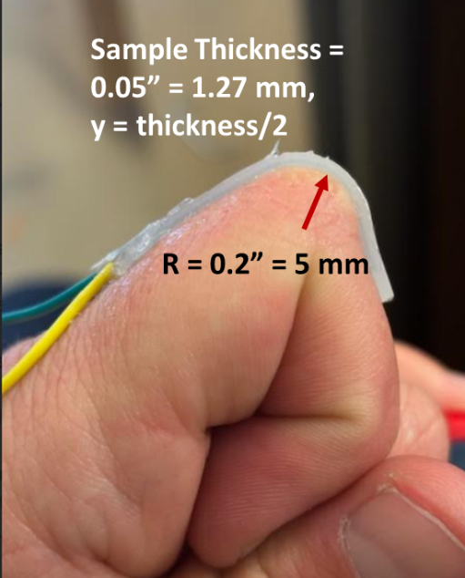
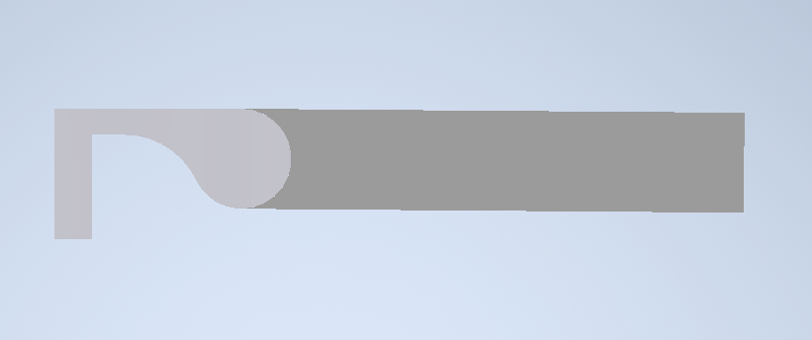


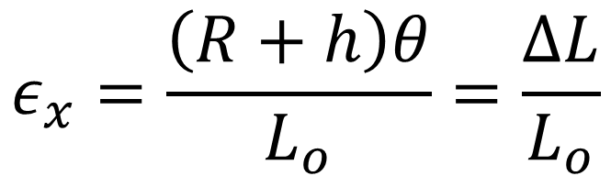
Human Knuckle Model
$$L_{o}=1.67"$$
h = 0.05” (1.27 mm)
R = 0.125”
$$θ$$
Measured Strain on finger with sample abs_100
(using strings)
~ 0.1677 or 16.8%
$$ε_{x}=\frac{\left(R+h\right)θ}{L_{o}}=\frac{ΔL}{L_{o}}$$

Slide 2


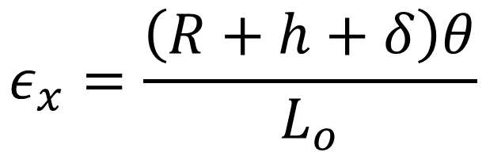
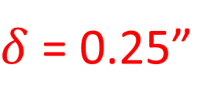
Auto Bender Model
h
R
$δ$ = 0.25”
$$θ$$
Measured Strain on sample abs_100 on AutoBender
~ 0.4 or 40%
$$ε_{x}=\frac{\left(R+h+δ\right)θ}{L_{o}}$$

Slide 3
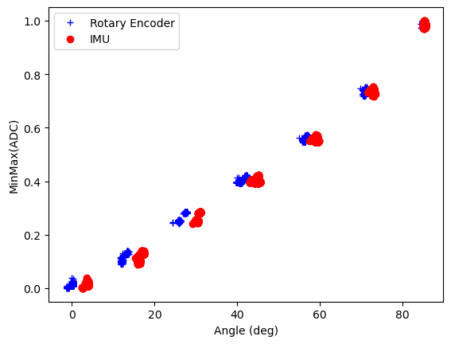
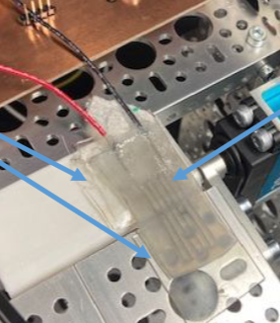
As a reminder….Sample ABS_100
40% elongation

Slide 4
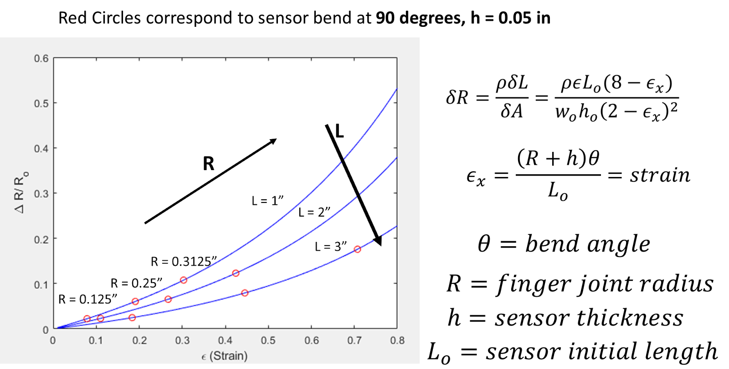

$$L_{o}=length of LM channel$$
Sample Length (not LM channel length)
Previous slide results strained to 40% elongation at L = 1.67”

Slide 5
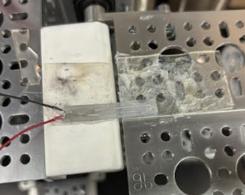
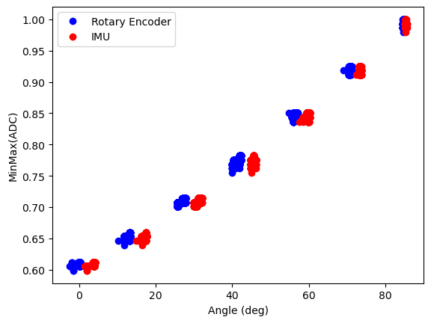
New Sample 11_21_2024
Wire Lead Gauge size CHANGED TO = 30 (from 28)
44.5% elongation
0.25” width
1.5” sample length
0.02” x 0.02” square cross-section channels

Slide 6
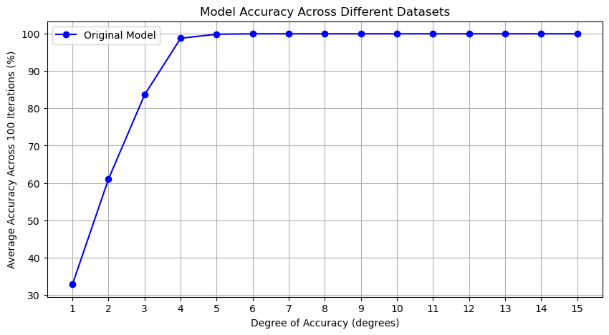

Slide 7
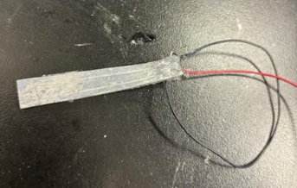
Sample 2.27” Long -> will test Monday

