Slide 1
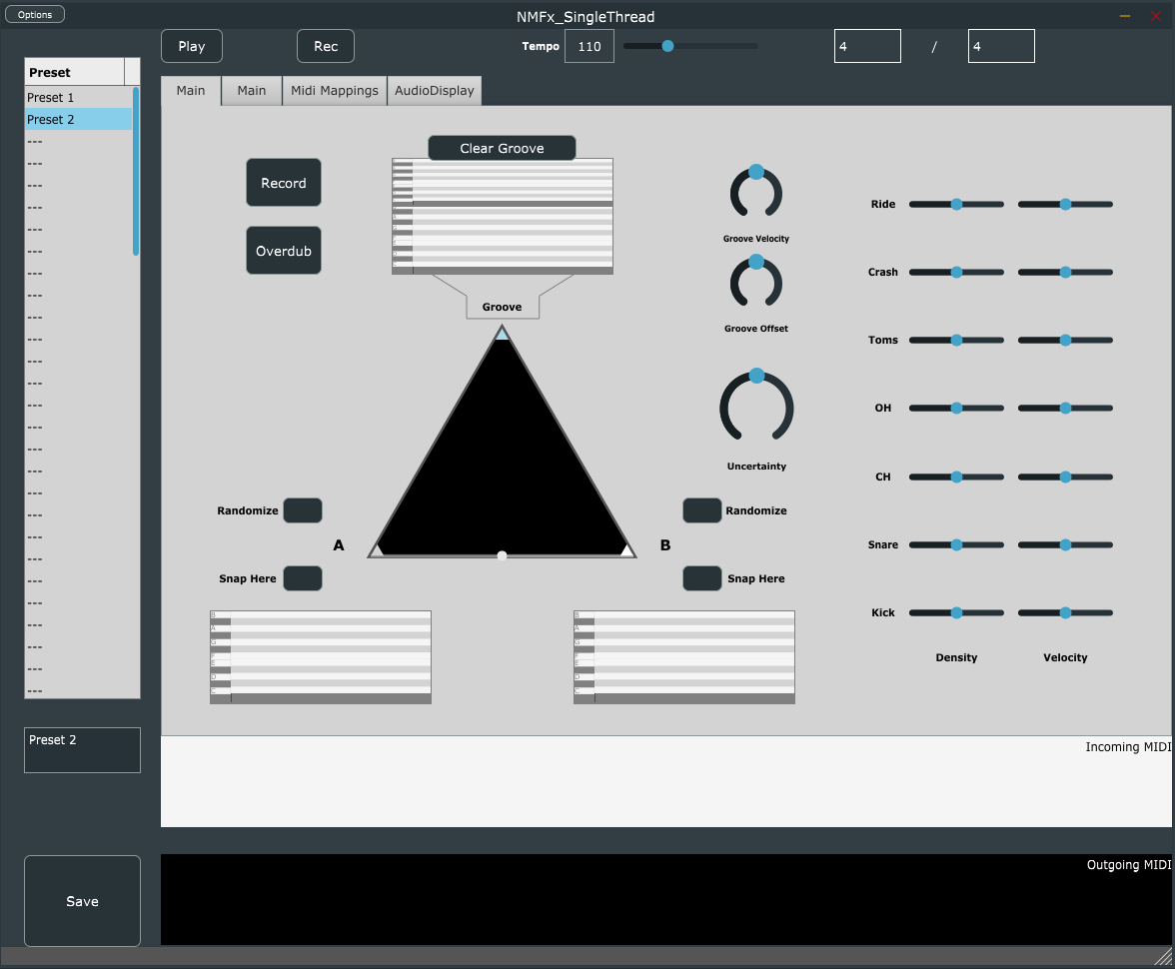
PluginCode/settings.json:
“"StandaloneTransportPanel"
PluginCode/settings.json:
“UI“: ”Tabs”:…
PluginCode/settings.json:
“UI“: ” MidiInVisualizer”:…
Preset Manager
(Always Visible)
PluginCode/settings.json:
“UI“: ” GeneratedContentVisualizer”:…
Info Pane (Always Visible)

