Slide 1





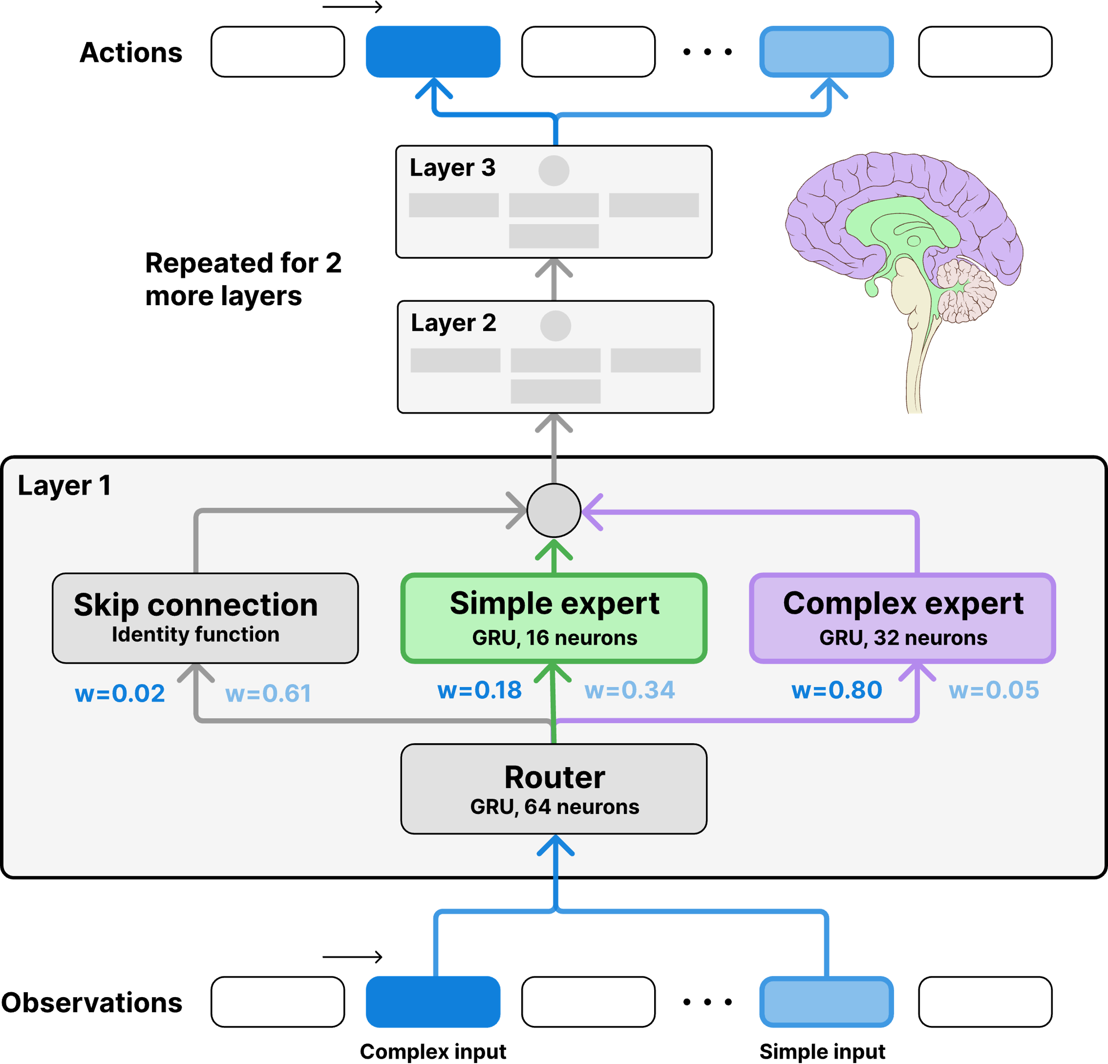
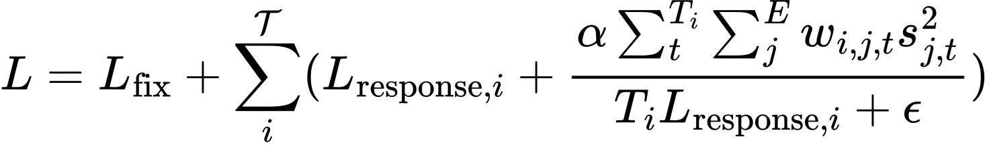
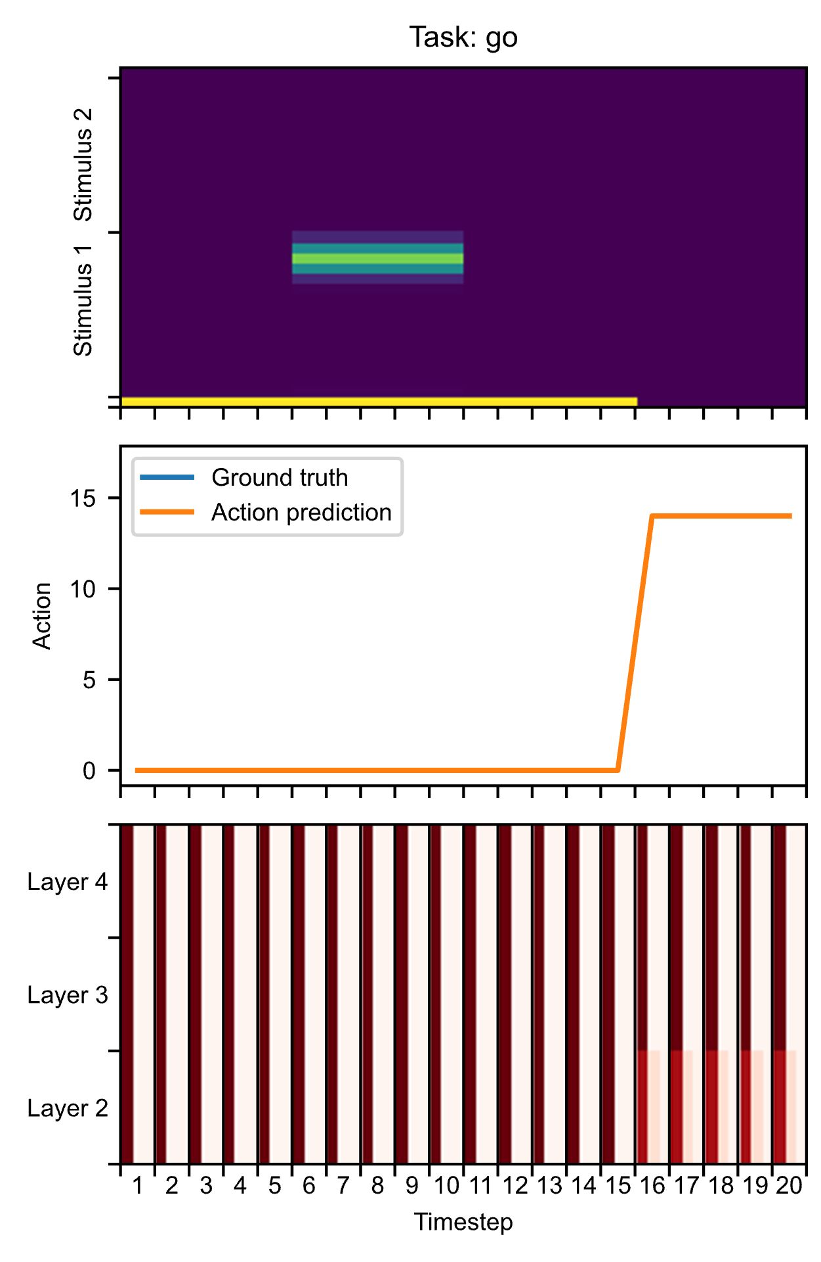
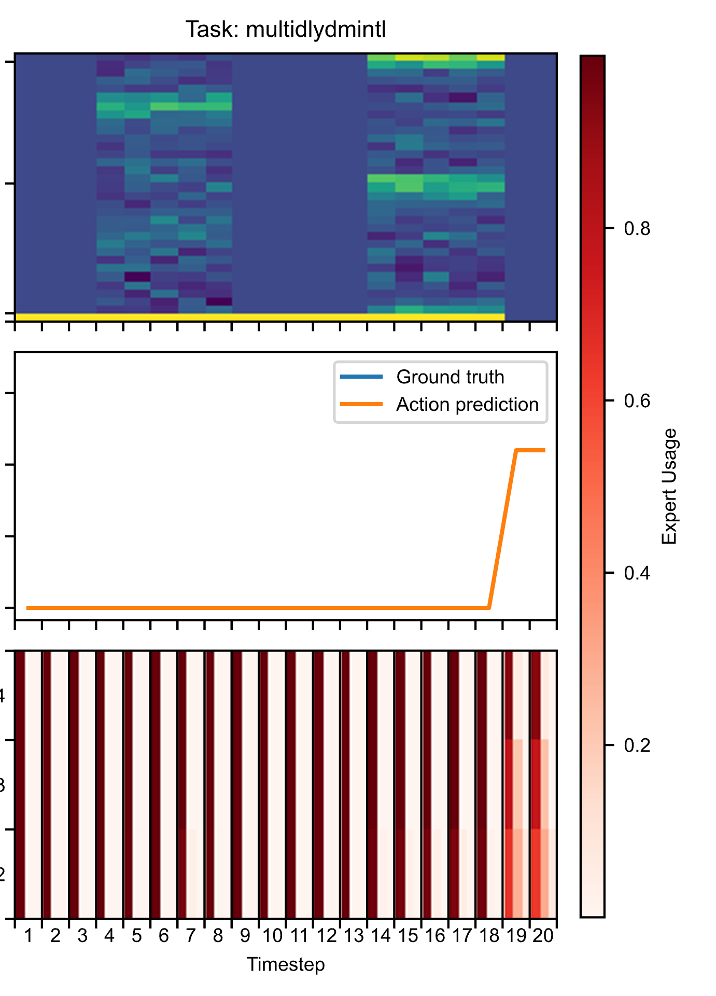
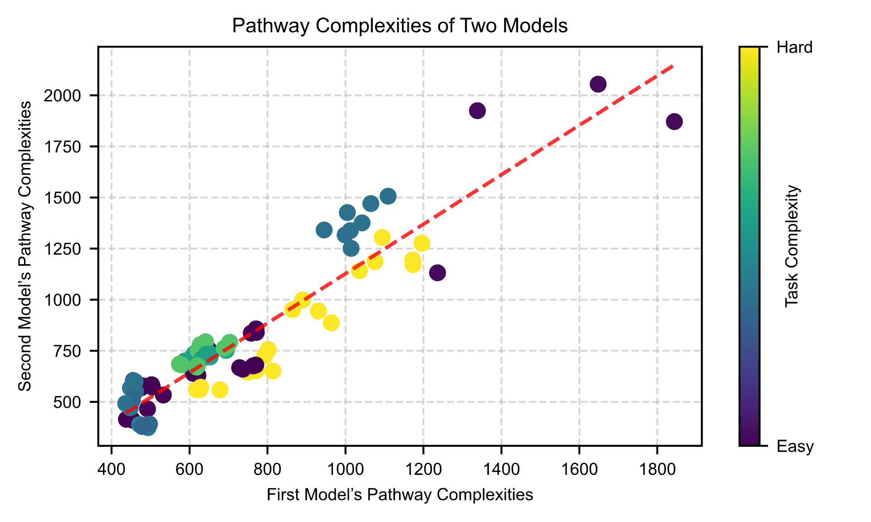
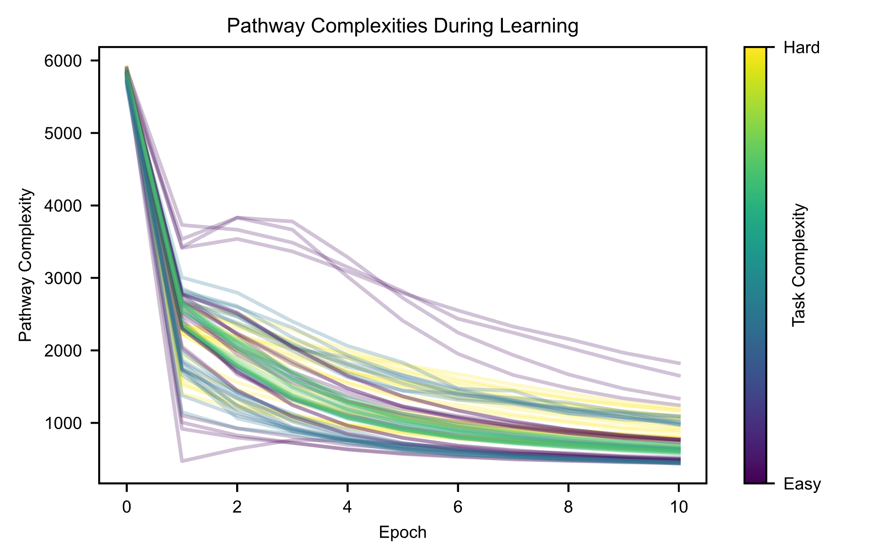
Centre
for Neural
Circuits and
Behaviour
Brain-like pathways form in models with heterogeneous experts
Jack Cook¹, Danyal Akarca², Rui Ponte Costa¹, Jascha Achterberg¹
Neural & Machine Learning Group, Department of Physiology, Anatomy and Genetics, University of Oxford
Department of Electrical and Electronic Engineering, Imperial College London
Corresponding author: jack.cook@dpag.ox.ac.uk
1 | Background & question
The brain has many processing pathways that reliably emerge during learning. We find that these pathways form due to specific architectural features in the brain, which we model in this work.
Our “Mixture of Pathways” model shows:
The brain is a vast collection of heterogeneous functional and anatomical structures, which, remarkably, are connected in a way that is relatively stable across primate brains. Notable examples of stable pathways include the MD system and DMN [1], cortical-subcortical pathways [2], and the ventral and dorsal streams [3]. But despite their large role in cognition, how these pathways form in the brain remains poorly understood.
How can we model the formation of pathways between different brain regions?
Consistency with three key criteria for pathway formation
Biologically plausible architectural features required for pathways to emerge
Tasks progressively solved by simpler pathways over the course of learning
Simpler tasks solved by simpler pathways at inference time
2 | Our approach
Scan to learn more:
Heterogeneous mixture-of-expert models [4] dynamically route information to heterogeneous experts at each layer of the network, enabling us to study the emergence of brain-like pathways.
We train and test these models on a suite of 82 foundational neuroscience tasks [5] to perform our analysis.
3 | Pathway formation criteria
4 | Architectural requirements
We outline three criteria that must be fulfilled to identify the emergence of pathways in a model:
Pathway consistency Models trained on the same tasks should solve each task with similar routing patterns.
Self-sufficiency of pathways Disabling experts that are not part of an active pathway should minimally impact the model’s performance.
Distinct pathways across and within tasks Meaningful patterns of expert usage should be apparent across tasks and timescales.
We found that to meet these criteria, our model needed to be trained with three key features: cost-based expert usage loss, task-performance loss scaling, and dropout.
5 | Brain-like learning with simple and complex pathways
6 | Brain-like usage of simple and complex pathways
7 | Conclusions and outlook
Like the MD system [1], our “Mixture of Pathways” model learns to solve simpler tasks with simpler experts, and more complex tasks with more complex experts.
During training, our model first learns to solve each task well before learning to solve it with simpler pathways, in a similar fashion to habit formation in cortical-subcortical networks [2].
Pathways between heterogeneous experts don’t develop on their own: they require several specific architectural features.
Our proposed architectural features are biologically plausible, and furthermore, we replicate key findings in our model that have been observed in pathways in the brain. In the coming weeks, we plan to further analyze our model’s behavior and the dimensionality of expert usage signals.
[1] Duncan. Neuropsychologia. 2025.
[2] LeDoux & Pine. Am. Journ. Psychiatry. 2012.
[3] Dolan & Dayan. Neuron. 2013.
[4] Wang, et al. arXiv. 2024.
[5] Khona, et al. arXiv. 2022.

