Slide 1



Balancing biased data samples with the 'balance' Python package
ISA conference 2023-06-01
Presentors: Tal Galili & Tal Sarig
With: Roee Eilat, Daniel Haimovich, Steve Mandala

Slide 2
Outline of the talk
Market ecosystem
Survey Methodology context
Total survey error
Assumptions
Estimation: Post-stratification
Propensity Score and Estimation
Diagnostics tools
balance End-to-End workflow
Hands-on example

Slide 3
Acknowledgements / People​
The balance package is actively maintained by people from the Central Applied Science team (in Tel Aviv and Boston), by Tal Sarig, Tal Galili and Steve Mandala.
The balance package was (and is) developed by many people, including: Roee Eilat, Tal Galili, Daniel Haimovich, Kevin Liou, Steve Mandala, Adam Obeng (author of the initial internal Meta version), Tal Sarig, Luke Sonnet, Sean Taylor, Barak Yair Reif, and others. If you worked on balance in the past, please email us to be added to this list.
The balance package was open-sourced by Tal Sarig, Tal Galili and Steve Mandala in late 2022.
Branding created by Dana Beaty, from the Meta AI Design and Marketing Team. For logo files, see here.

Slide 4

Released to github on Nov 2022 (>600 stars)
https://import-balance.org

Slide 5
balance offers a simple workflow and methods for dealing with biased data samples when looking to infer from them to some population of interest.
Biased samples often occur in survey statistics when respondents present non-response bias or survey suffers from sampling bias (that are not missing completely at random).

Slide 6
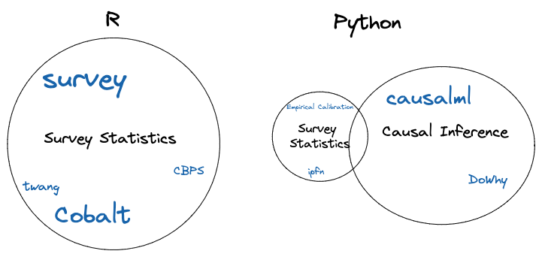
Survey weighting alternatives - market ecosystem

Slide 7
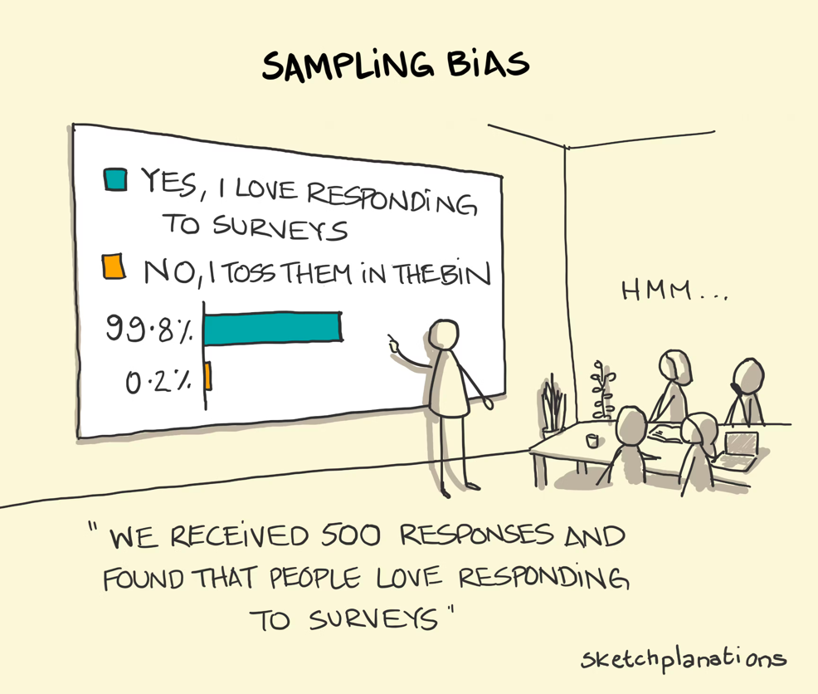
Survey Bias
Source: https://sketchplanations.com/sampling-bias (license: CC-BY-NC)

Slide 8
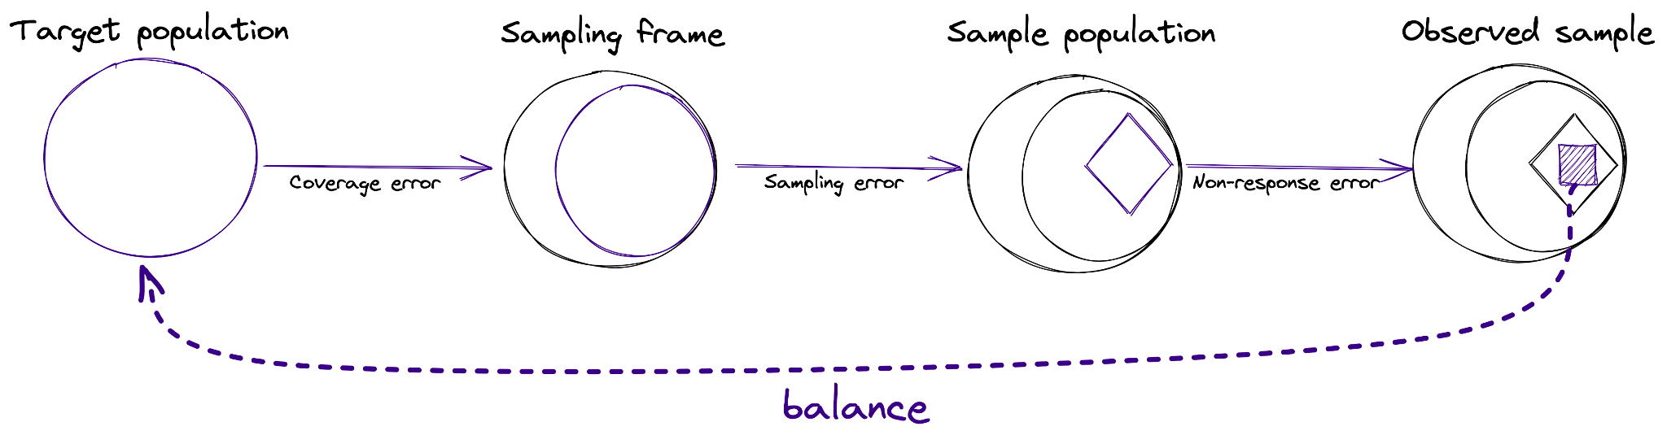
Total survey error framework - representation error: [Groves et al. 2010]
Research goal: Estimate descriptive statistics of interest for a population.

Slide 9
Notations
Let Y be the survey response (observed only for the sample of respondents).
Let R be an indicator of whether unit i responded to the survey (inclusion in sample).
Let X be an auxiliary data (observed for sample and target!)

Slide 10
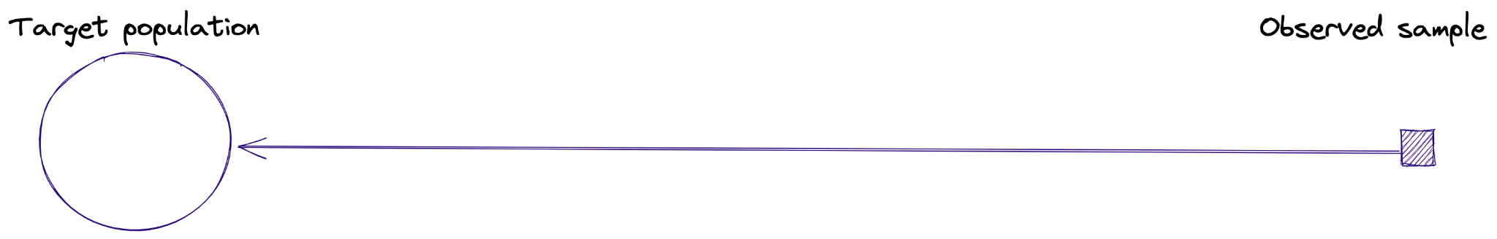
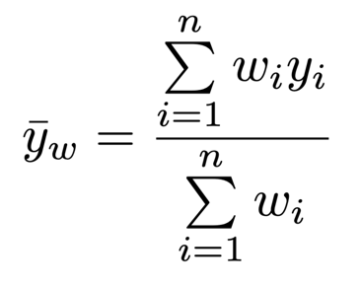
How can we mitigate survey bias? weights
Weights
If a person is “more likely” to respond -> give a small weight.
If a person is “less likely” to respond -> give a large weight.

Slide 11
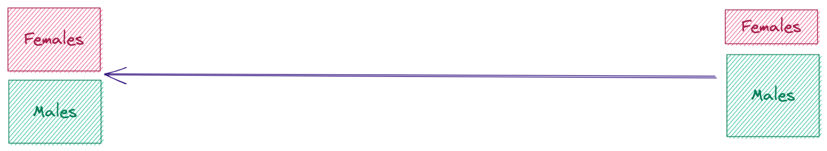
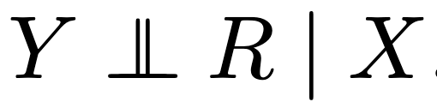

How do we estimate weights? Assumptions
More/less likely - based on what? Covariates...
MAR (Missing At Random) assumption [Rubin, 1976]: The response mechanism is independent of the survey responses conditional on the auxiliary data:
Positivity:
(Also known as strong ignorability (or unconfoundedness in causal inference))

Slide 12
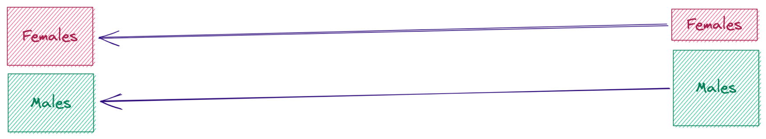
Estimation: Post-Stratification [Little, 1993]
Can be used with several covariates given the joint distribution (E.g.: Age, Gender, State)
Limitation:
We must have “enough” respondents in each bucket.
Must know the joint distribution→ raking (iterative process based on marginal distributions)

Slide 13
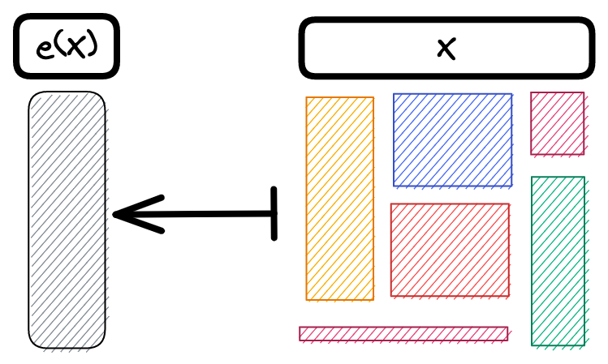





Propensity Score [Rosenbaum & Rubin, 1983]
The assumptions:
Strong ignorability:
Positivity:
Implies:
Strong ignorability given the propensity score:
The propensity score is the “coarsest” balancing score (e.g. the lowest dimension score B(X) such that )

Slide 14
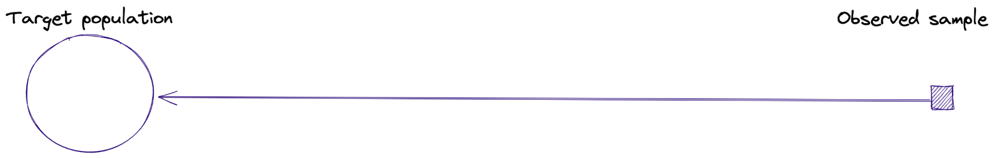
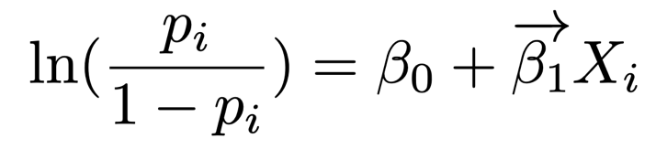

Estimation: Inverse Propensity Score Weighting (IPW or IPSW)
Estimate the propensity score using logistic regression:
balance uses regularized logistic regression (LASSO) (to remove covariates that are not predictive for non-response).
Alternative model is Covariate Balancing Propensity Score [Imai & Ratkovic, 2014], optimizing both the propensity score and the balance of the covariates.
Estimate the weights:

Slide 15
When do survey weights help?
When:
(a) the non-response pattern is strongly related to the measurable covariates,
(b) the covariates are accurately represented in (and fixed by using) the fitted propensity score model, and
(c) the survey weights correlate (strongly “enough”) with the outcome of interest
Diagnostics measure are available to (at least partially) measure the above assumptions.

Slide 16
When do survey weights help?
When:
(a) the non-response pattern is strongly related to the measurable covariates,
ASMD values, and distribution plots
(b) the covariates are accurately represented in (and fixed by using) the fitted propensity score model, and
ASMD values, and distribution plots (before/after fitting the weights)
(c) the survey weights correlate (strongly “enough”) with the outcome of interest
Kish’s design effect (other quantiles of the weights), and the weighted mean (and their CI)
Diagnostics measure are available to (at least partially) measure the above assumptions.

Slide 17
Workflow in practice
The main workflow of balance includes three steps:
(1) Understanding the initial bias in the data relative to a target we would like to infer about
(2) Adjusting the data to correct for the bias by producing weights for each unit in the sample based on propensity scores
s
(3) Evaluating the final bias and the variance inflation after applying the fitted weights

Slide 18
Workflow in practice
The main workflow of balance includes three steps:
(1) Understanding the initial bias in the data relative to a target we would like to infer about
Checking the covariates of sample vs target (plots, ASMD)
(2) Adjusting the data to correct for the bias by producing weights for each unit in the sample based on propensity scores
Fitting a weighting model (IPW, CBPS, post-stratification, raking)
(3) Evaluating the final bias and the variance inflation after applying the fitted weights
Checking the covariates of sample (with/without weights) vs target (plots, ASMD) + weights diagnostics + the outcome (with/without weights)

Slide 19
Workflow in practice
The main workflow of balance includes three steps:
(1) Understanding the initial bias in the data relative to a target we would like to infer about
Checking the covariates of sample vs target (plots, ASMD)
(2) Adjusting the data to correct for the bias by producing weights for each unit in the sample based on propensity scores
Fitting a weighting model (IPW, CBPS, post-stratification, raking)
(3) Evaluating the final bias and the variance inflation after applying the fitted weights
Checking the covariates of sample (with/without weights) vs target (plots, ASMD) + weights diagnostics + the outcome (with/without weights)

Slide 20
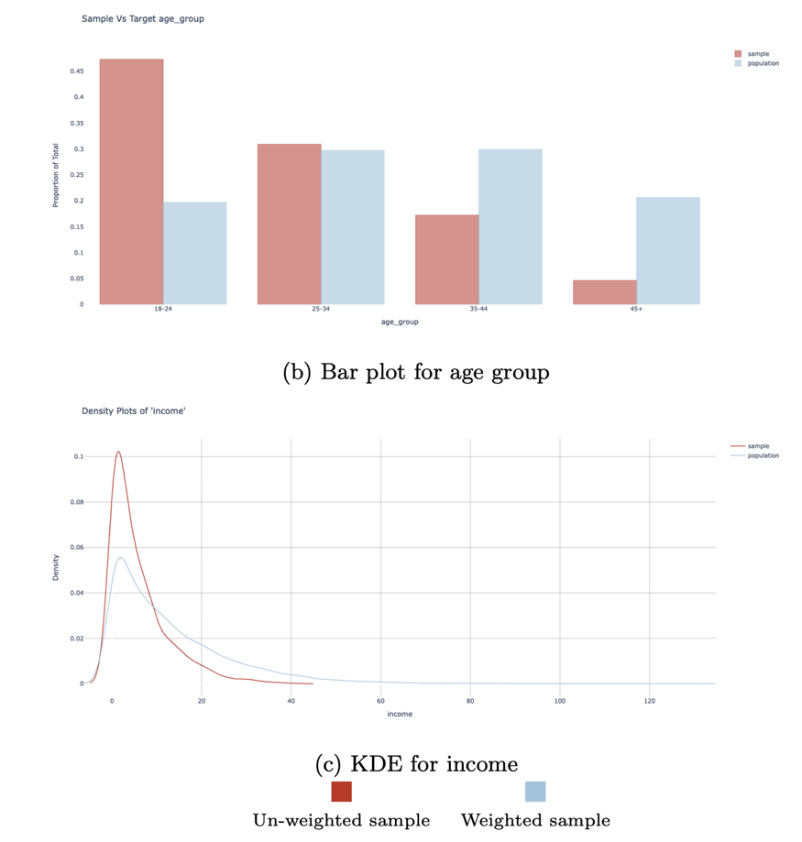
Visualizing Distributions with Distribution Plots

Slide 21
Workflow in practice
The main workflow of balance includes three steps:
(1) Understanding the initial bias in the data relative to a target we would like to infer about
Checking the covariates of sample vs target (plots, ASMD)
(2) Adjusting the data to correct for the bias by producing weights for each unit in the sample based on propensity scores
Fitting a weighting model (IPW, CBPS, post-stratification, raking)
(3) Evaluating the final bias and the variance inflation after applying the fitted weights
Checking the covariates of sample (with/without weights) vs target (plots, ASMD) + weights diagnostics + the outcome (with/without weights)

Slide 22
Adjustment
Researcher may choose between 4 adjustment models (IPW, CBPS, raking and post-stratification) - also - balance utilizes a few best practices when modeling:
Feature engineering - balance will automatically apply transformations to the covariates to better adjust their distribution.
“Model selection” - balance applies regularized logistic regression in IPW in order to reduce the “non-significant” inflation of the variance created by the weights.
Weights trimming - balance applies trimming of the weights to reduce the influence of extreme observations.

Slide 23
Workflow in practice
The main workflow of balance includes three steps:
(1) Understanding the initial bias in the data relative to a target we would like to infer about
Checking the covariates of sample vs target (plots, ASMD)
(2) Adjusting the data to correct for the bias by producing weights for each unit in the sample based on propensity scores
Fitting a weighting model (IPW, CBPS, post-stratification, raking)
(3) Evaluating the final bias and the variance inflation after applying the fitted weights
Checking the covariates of sample (with/without weights) vs target (plots, ASMD) + weights diagnostics + the outcome (with/without weights)

Slide 24
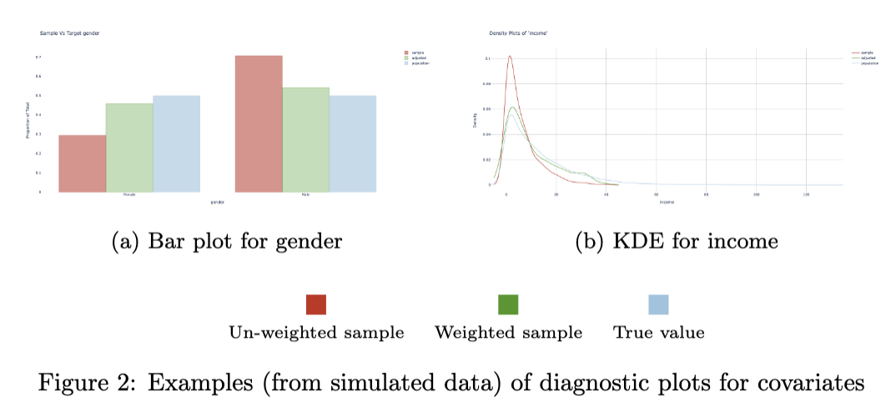
Visualizing Distributions with Distribution Plots

Slide 25
Workflow in practice
The main workflow of balance includes three steps:
(1) Understanding the initial bias in the data relative to a target we would like to infer about
Checking the covariates of sample vs target (plots, ASMD)
(2) Adjusting the data to correct for the bias by producing weights for each unit in the sample based on propensity scores
Fitting a weighting model (IPW, CBPS, post-stratification, raking)
(3) Evaluating the final bias and the variance inflation after applying the fitted weights
Checking the covariates of sample (with/without weights) vs target (plots, ASMD) + weights diagnostics + the outcome (with/without weights)

Slide 26
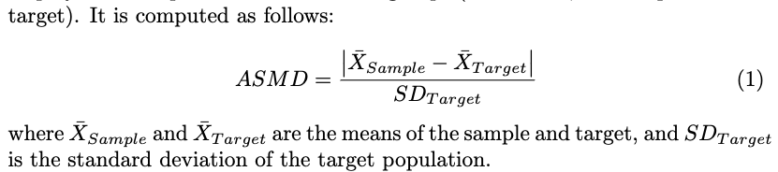
Absolute Standardized Mean Deviation (ASMD)

Slide 27

Absolute Standardized Mean Deviation (ASMD)

Slide 28
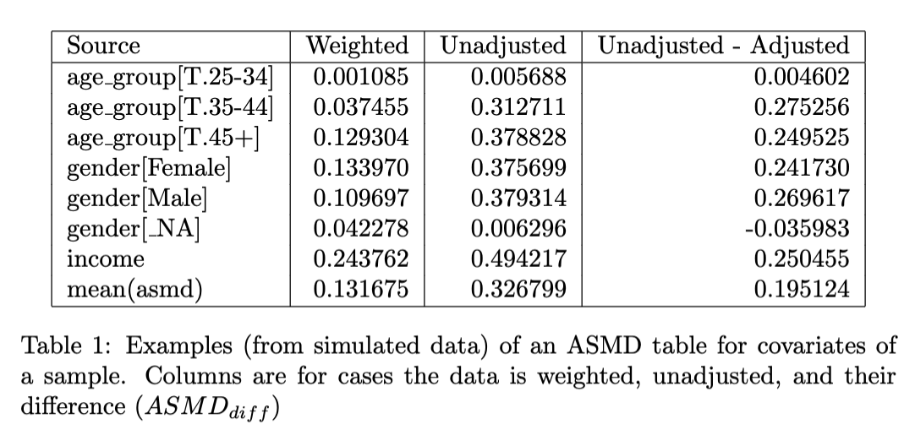
Absolute Standardized Mean Deviation (ASMD)

Slide 29
Absolute Standardized Mean Deviation (ASMD)
Pros
Standardized measure (comparable across features)
Easy comparison over many features and alternative weighting options
Cons
Hard to interpret in absolute terms (how much ASMD is “good”?)
Sensitive to outliers while being indifferent to distributional differences
Less applicable to categorical variables (we currently use dummy variables, but aggregation leads to an even less obvious interpretation)

Slide 30
Workflow in practice
The main workflow of balance includes three steps:
(1) Understanding the initial bias in the data relative to a target we would like to infer about
Checking the covariates of sample vs target (plots, ASMD)
(2) Adjusting the data to correct for the bias by producing weights for each unit in the sample based on propensity scores
Fitting a weighting model (IPW, CBPS, post-stratification, raking)
(3) Evaluating the final bias and the variance inflation after applying the fitted weights
Checking the covariates of sample (with/without weights) vs target (plots, ASMD) + weights diagnostics + the outcome (with/without weights)

Slide 31

Weights diagnostics: Kish’s design effect
A design effect measures the increase in variance of an estimate due to the use of survey weights compared to an equal probability sample of the same size. Theoretically, it is calculated as follows:
(e.g.: Deff=2 means the variance is double when using weights As compared to NOT using weights)

Slide 32

Weights diagnostics: Kish’s design effect
A design effect measures the increase in variance of an estimate due to the use of survey weights compared to an equal probability sample of the same size. Theoretically, it is calculated as follows:
(e.g.: Deff=2 means the variance is double when using weights As compared to NOT using weights)
The effective sample size is:

Slide 33
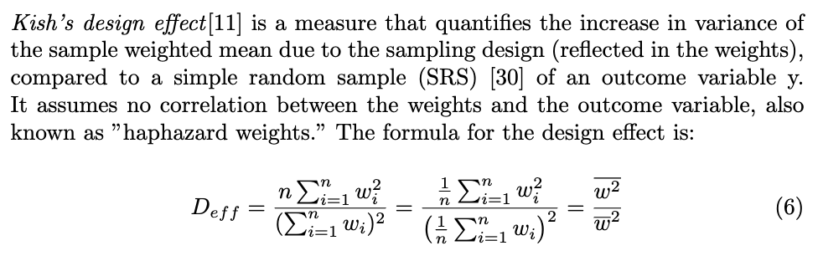
Weights diagnostics: Kish’s design effect

Slide 34

Weights diagnostics: quantiles of weights
For weights diagnostics, it’s helpful to look at weights that are normalized to sum to the sample size, i.e.:
This allows us to check:
Quantiles
Proportion of weights above/below some values (this helps identify extreme values, or odd behaviors)

Slide 35
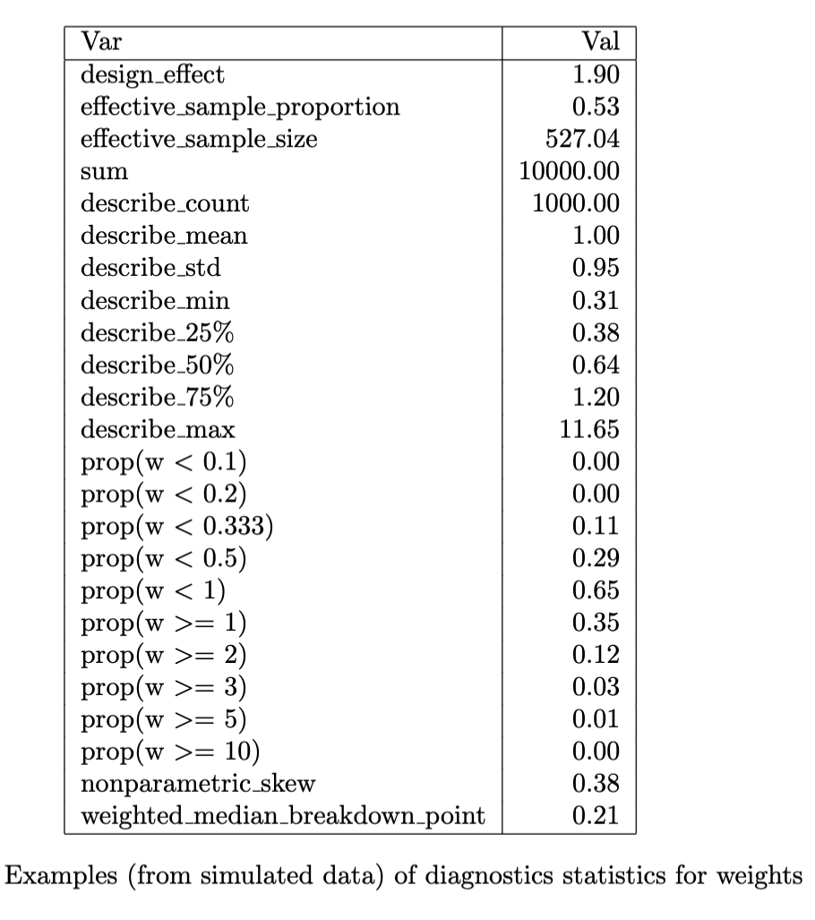
Weights diagnostics

Slide 36
Workflow in practice
The main workflow of balance includes three steps:
(1) Understanding the initial bias in the data relative to a target we would like to infer about
Checking the covariates of sample vs target (plots, ASMD)
(2) Adjusting the data to correct for the bias by producing weights for each unit in the sample based on propensity scores
Fitting a weighting model (IPW, CBPS, post-stratification, raking)
(3) Evaluating the final bias and the variance inflation after applying the fitted weights
Checking the covariates of sample (with/without weights) vs target (plots, ASMD) + weights diagnostics + the outcome (with/without weights)

Slide 37
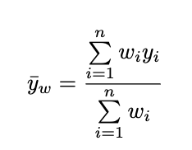
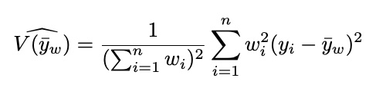

Outcome diagnostics
Weighted mean:
Variance of the weighted mean:
Confidence intervals for the weighted mean:

Slide 38
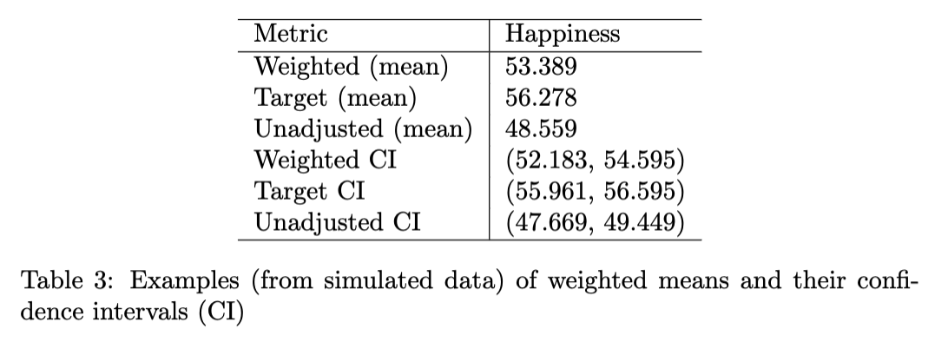
Outcome diagnostics

Slide 39
Outcome diagnostics
The variance of the weighted mean
(required for the CI)
Assumes:
y is fixed and known.
w is fixed and known.
The randomness comes from the selection indicator.

Slide 40
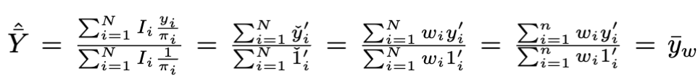
Outcome diagnostics
The variance of the weighted mean
(required for the CI)
Assumes:
y is fixed and known.
w is fixed and known.
The randomness comes from the selection indicator.

Slide 41
Outcome diagnostics
The variance of the weighted mean formula assumes that the weights are known and fixed quantities.
It does not account for the uncertainty that is introduced from the estimation of the weights.
An end-to-end bootstrap simulation can be performed to account for this variance.

Slide 42
Example: simulated data
Source https://import-balance.org/docs/tutorials/quickstart/

Slide 43
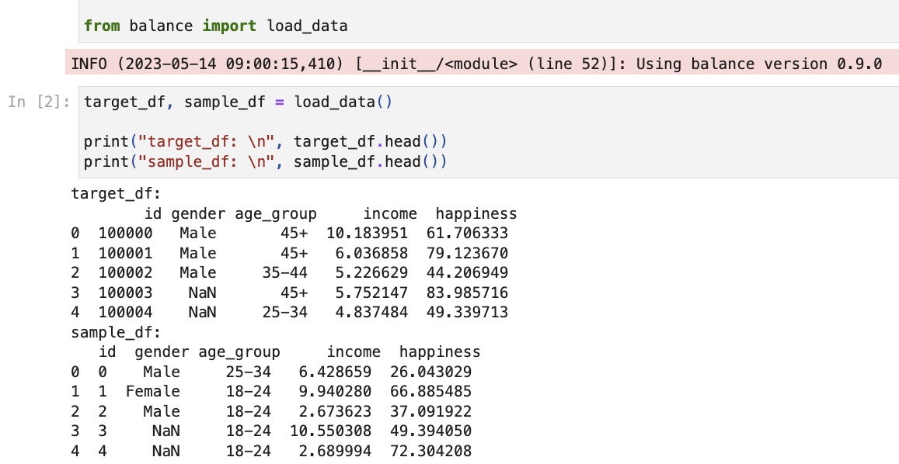
Example: simulated data
Getting simulated data (stored in balance)

Slide 44
Example: simulated data
Loading the simulated data into an instance of ‘Sample’ class (from balance )

Slide 45
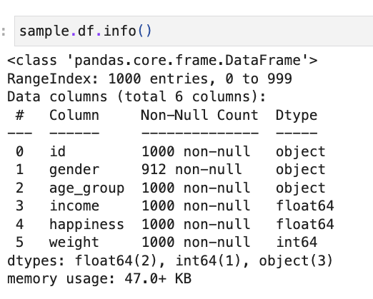
Example: simulated data
The ‘sample’ object has
Many methods, attributes and
Properties.
E.g.: using “.df” will get us The DataFrame stored in the object.

Slide 46
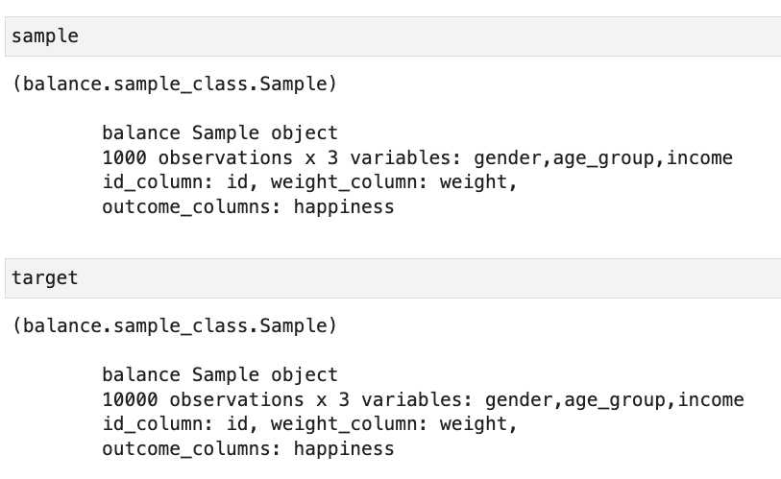
Example: simulated data
Each Sample object
has a print-out
with information
about what’s stored.

Slide 47
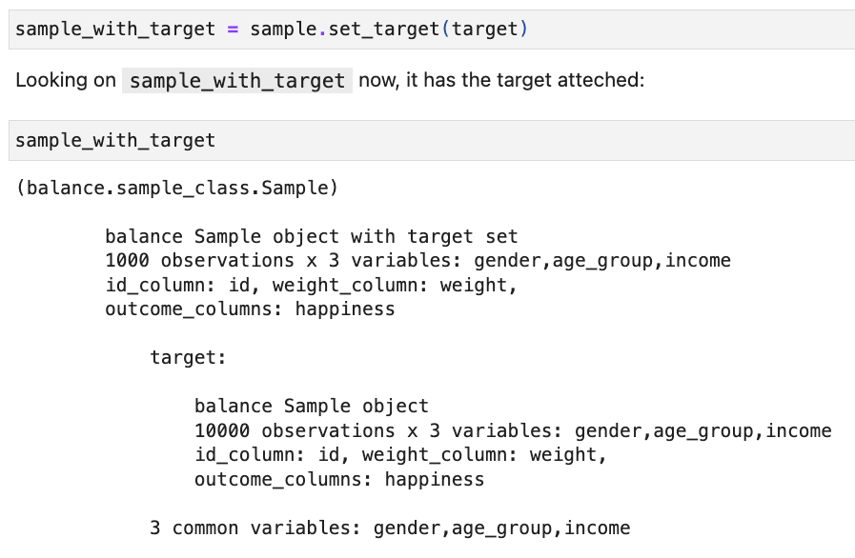
Example: simulated data
Using “.set_target” we can connect the target Sample with the sample Sample

Slide 48
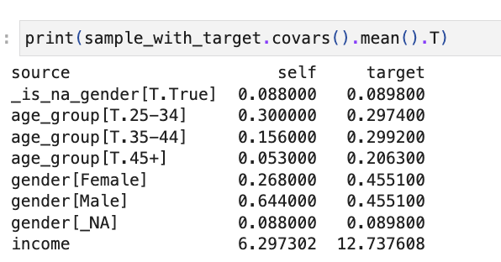
Example: simulated data
Comparing means

Slide 49
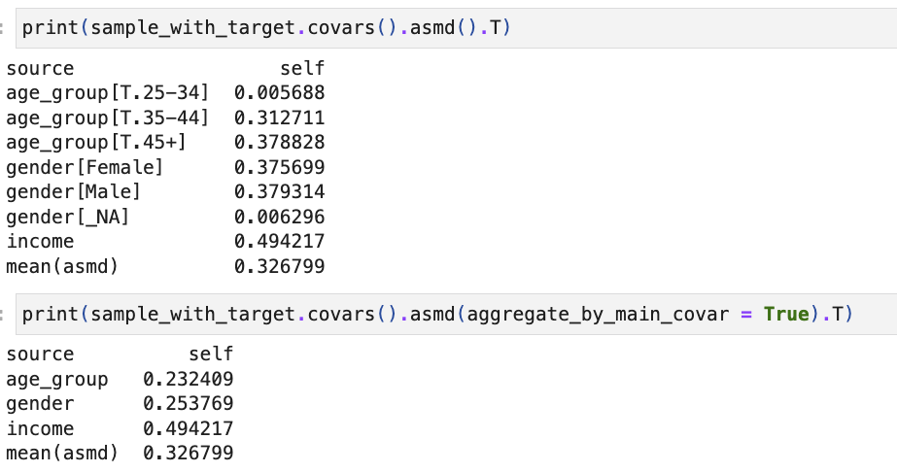
Example: simulated data
Looking at ASMD

Slide 50

Example: simulated data
And we can get plots for all covariates

Slide 51
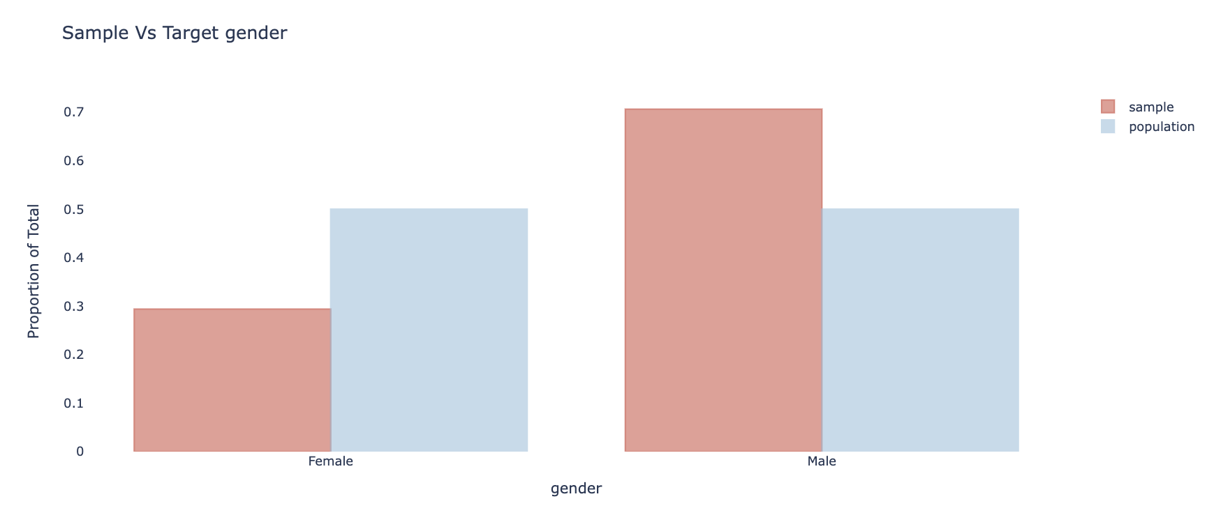
Example: simulated data

Slide 52
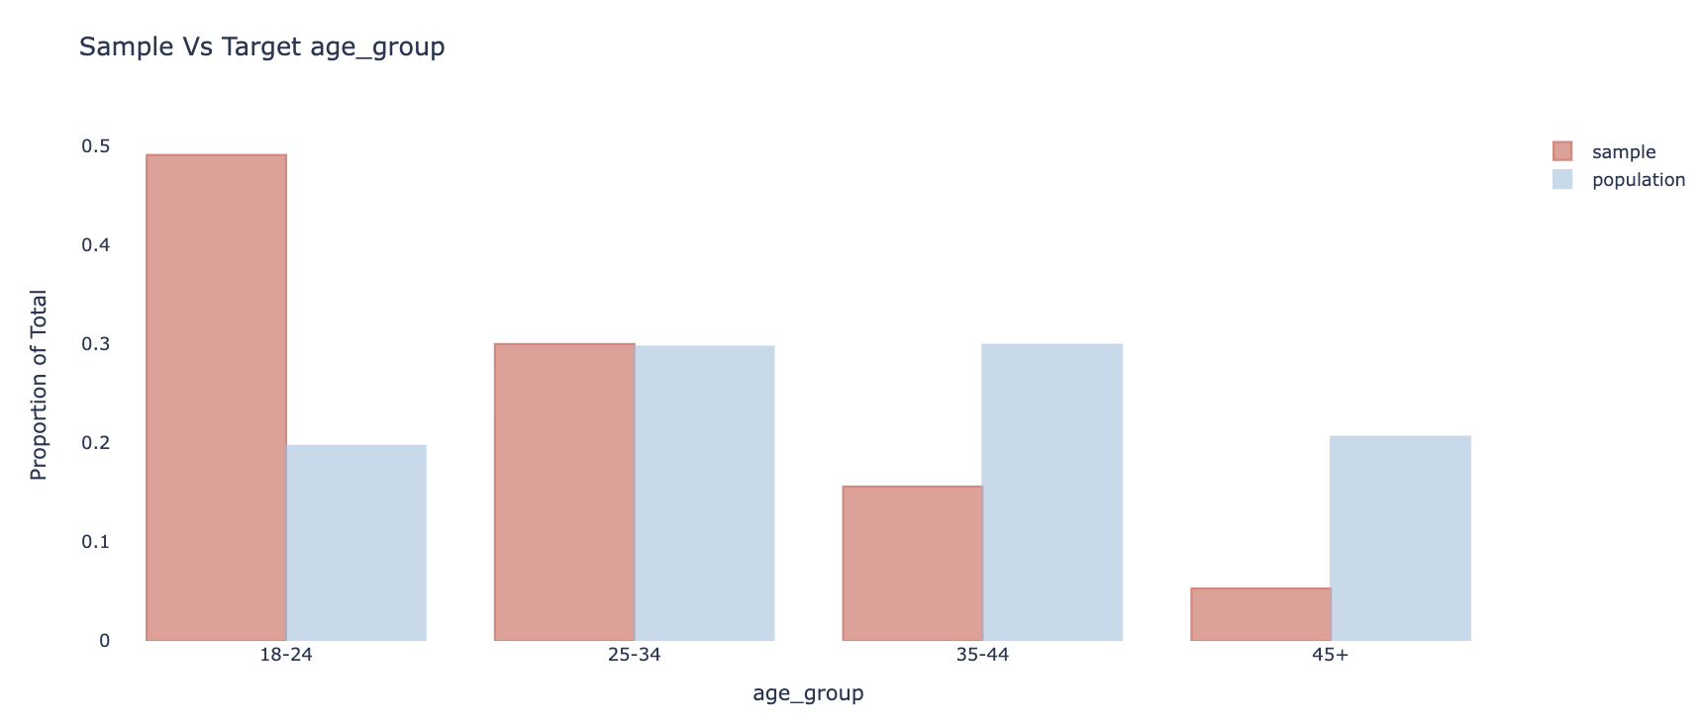
Example: simulated data

Slide 53
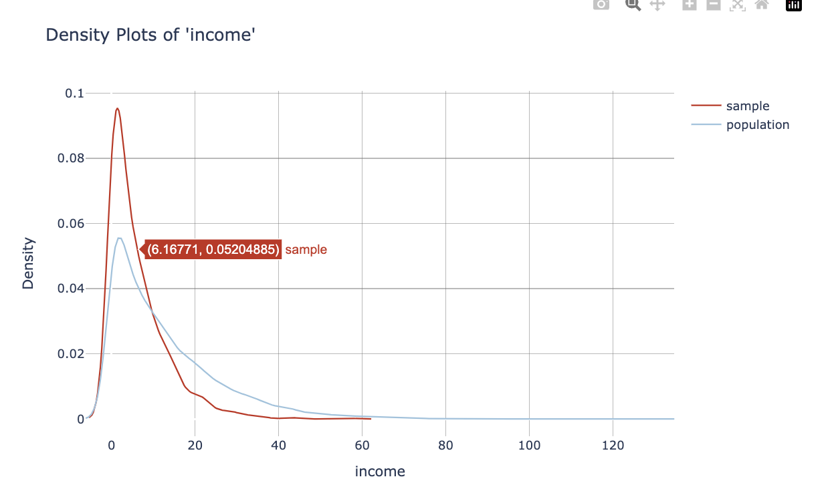
Example: simulated data

Slide 54
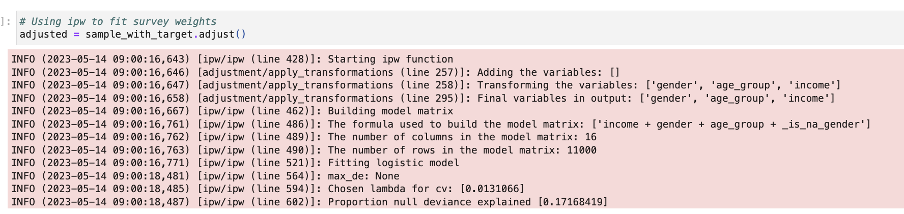
Example: simulated data
We use “.adjust()” to fit a model (e.g.: IPW, CBPS, raking, or post-stratification)

Slide 55
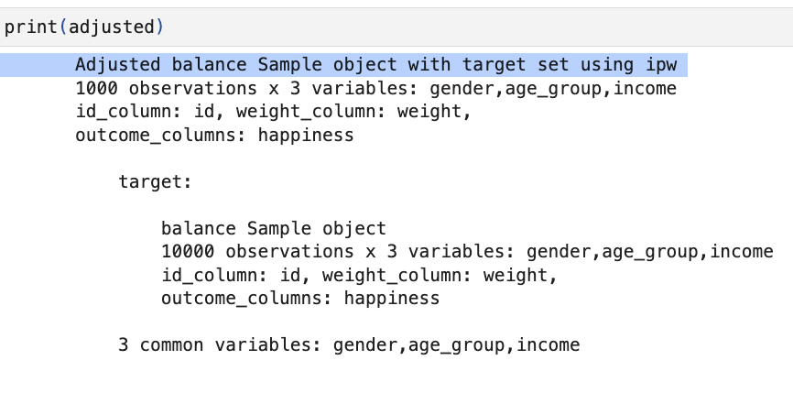
Example: simulated data
The print-out tells us what we got in the object

Slide 56
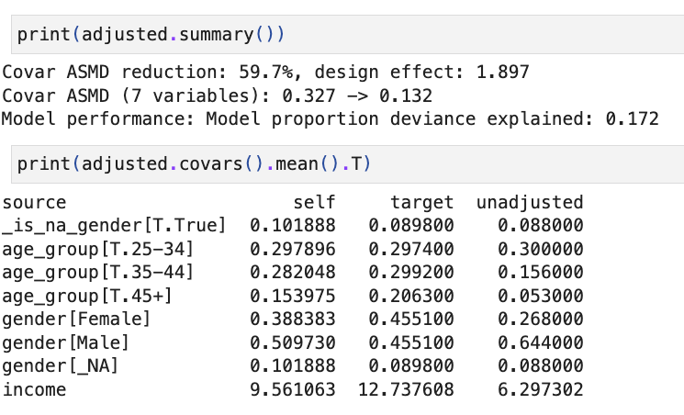
Example: simulated data
We can evaluate the results

Slide 57
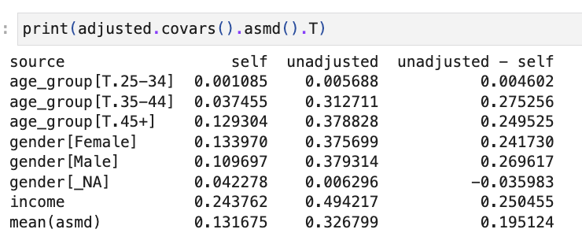
Example: simulated data
We can look at the effect of weighting on the ASMD:

Slide 58

Example: simulated data
And we can plot our data again (seeing the effect of weighting on the covariates)

Slide 59
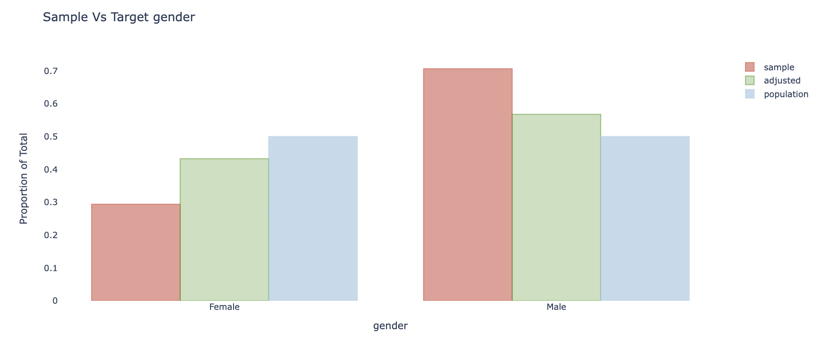
Example: simulated data

Slide 60
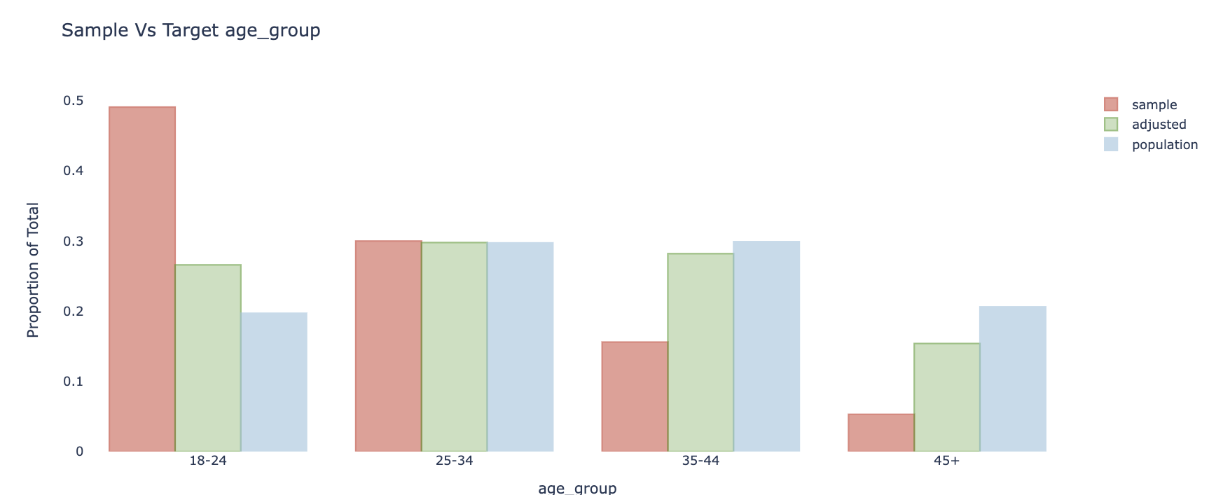
Example: simulated data

Slide 61
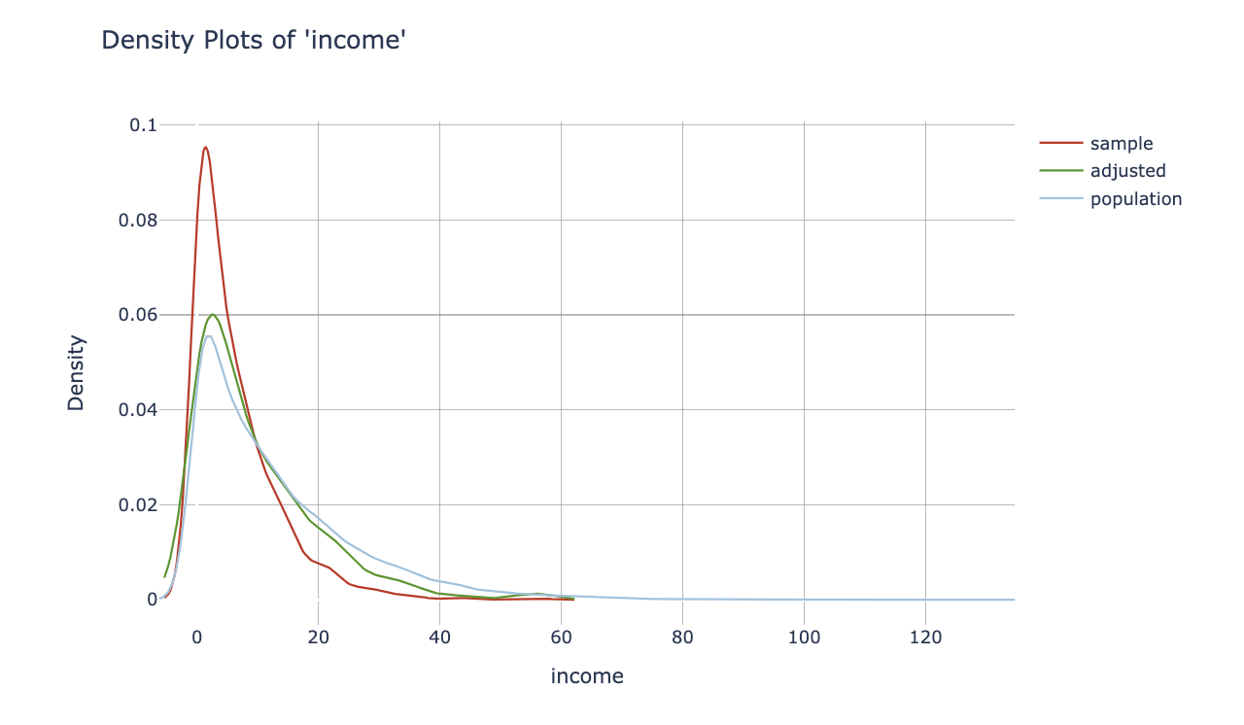
Example: simulated data

Slide 62
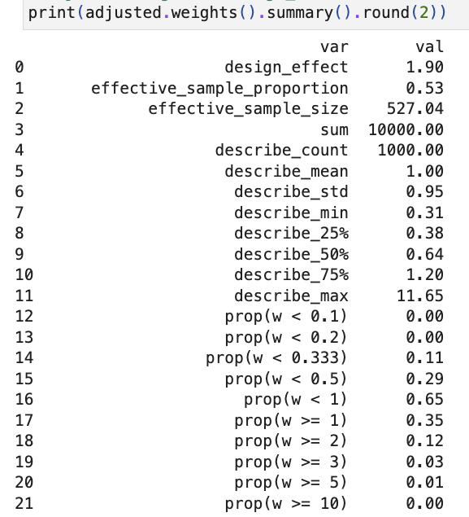
Example: simulated data
Weight diagnostics

Slide 63
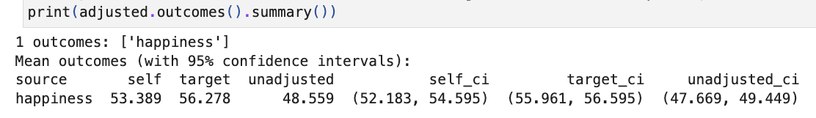
Example: simulated data
Outcome - weighted means

Slide 64
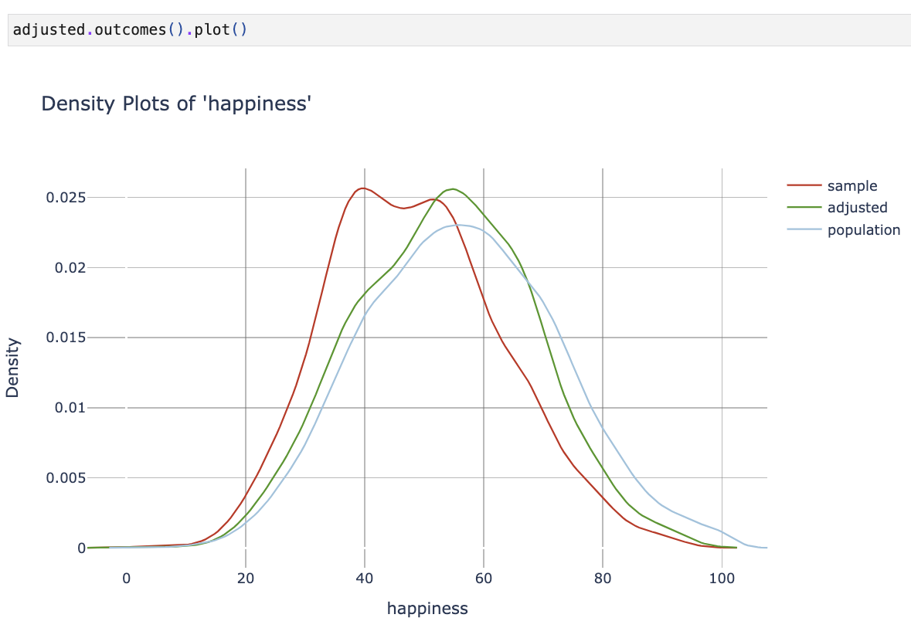
Example: simulated data
Outcome

Slide 65
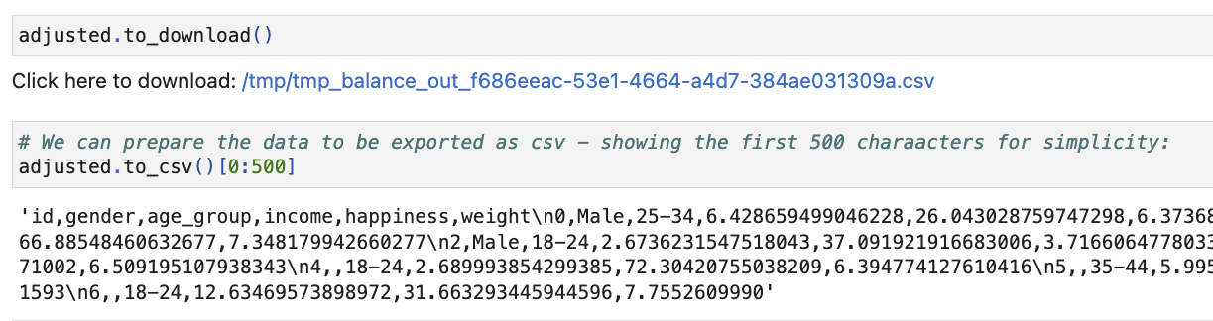
Example: simulated data
Downloading the results

Slide 66


Thanks!
Questions?
Tal Sarig Tal Galili

Slide 67
References
Donald B Rubin. Inference and missing data. Biometrika, 63(3):581–592, 1976.
Kosuke Imai and Marc Ratkovic. Covariate balancing propensity score. Journal of the Royal Statistical Society: Series B: Statistical Methodology, pages 243–263, 2014
Leslie Kish. Survey Sampling. John Wiley Sons, Inc., New York, 1965.
Leslie Kish and J. Official Stat. Weighting for unequal π. Journal of Official Statistics, 8:183–200, 1992.
Paul R Rosenbaum and Donald B Rubin. The central role of the propensity score in observational studies for causal effects. Biometrika, 70(1):41–55, 1983.
Robert M Groves and Lars Lyberg. Total survey error: Past, present, and future. Public opinion quarterly, 74(5):849–879, 2010.
Roderick JA Little. Post-stratification: a modeler’s perspective. Journal of the American Statistical Association, 88(423):1001–1012, 1993.
Siegfried Gabler, Sabine H ̈ader, and Partha Lahiri. A model based justification of kish’s formula for design effects for weighting and clustering. Survey Methodology, 25:105–106, 1999.

Slide 68
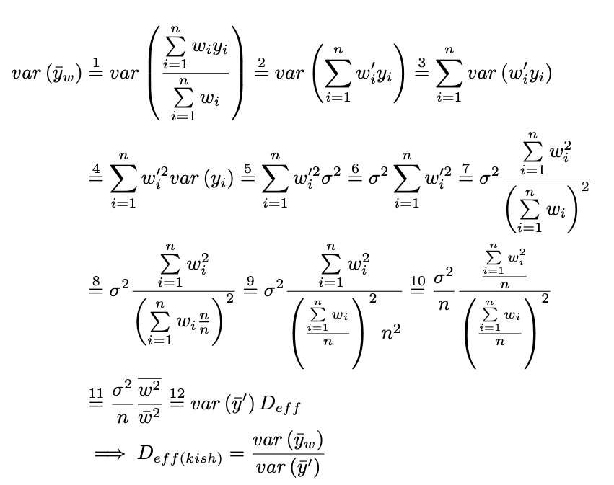
Proof for Kish’s design effect

Slide 69
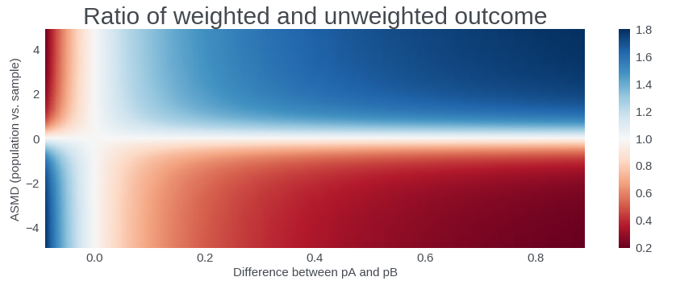
Why the relation between the response and the weighting variable is important?
Given a fixed amount of imbalance between the sample of respondents and the population in the weighting variables, the potential effect of correcting the bias depends on the correlation between the variable and the response. The higher the correlation is the larger the effect is.
This is demonstrated in a simple analytic case: Assume we have two groups A and B, where the probability for True in each group is pA and pB, respectively. In addition, assume that the two groups are balanced in the sample, but not in the population, where the percentage of group “A” in the population is p and for group “B” 1-p.
The difference in the responses between the two groups can be measured with pB-pA and is plotted on the X-axis (assuming pA=0.1). The imbalance between the groups is measured by ASMD, and can be written as (0.5-p)/sqrt(p(1-p)). We consider the ratio of the prefect weighted average response pA*p+pB(1-p) and the unweighted average response 0.5pA+0.5pB.
As expected, when the asmd is zero, i.e. when there is no imbalance between the groups, the weighted and unweighted reponses are the same. Similarly, when pA and pB are the same and there is no difference in the response between the groups, the weighted and unweighted responses are also the same. When the asmd increases, or when the difference in response between the groups increases, the ratio becomes larger, meaning the importance of weighting increases.

