Slide 1

Biophysical neuron models
Notes:
This video is going to be much shorter than the last one. I don’t want to go deep into models that are more biophysically realistic, but I do want to mention them.

Slide 2
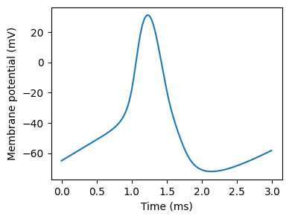

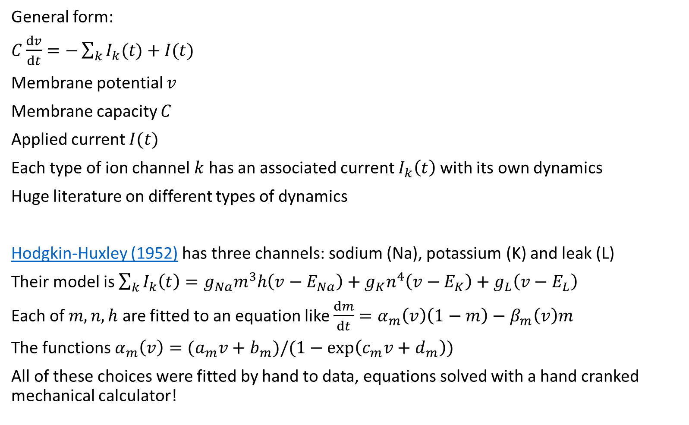
Hodgkin-Huxley type neuron
General form:
$C\frac{dv}{dt}=−\sum_{k}{I_{k}(t)}+I(t)$
Membrane potential $v$
Membrane capacity $C$
Applied current $I(t)$
Each type of ion channel $k$ has an associated current $I_{k}\left(t\right)$ with its own dynamics
Huge literature on different types of dynamics
Hodgkin-Huxley (1952) has three channels: sodium (Na), potassium (K) and leak (L)
Their model is $\sum_{k}{I_{k}\left(t\right)}=g_{Na}m^{3}h\left(v−E_{Na}\right)+g_{K}n^{4}\left(v−E_{K}\right)+g_{L}\left(v−E_{L}\right)$
Each of $m, n, h$ are fitted to an equation like $\frac{dm}{dt}=α_{m}\left(v\right)\left(1−m\right)−β_{m}\left(v\right)m$
The functions $α_{m}\left(v\right)=(a_{m}v+b_{m})/(1−\exp\left(c_{m}v+d_{m}\right))$
All of these choices were fitted by hand to data, equations solved with a hand cranked mechanical calculator!
Notes:
We’ll start with the famous Hodgkin-Huxley neuron.
***
You can see an action potential plotted with this model here.
***
These models are derived by treating the cell membrane as an electrical circuit consisting of a capacitor and a number of voltage-dependent resistors corresponding to the different ion channels.
Each ion channel has its own dynamics, and there are many different types.
Actually, there are thousands of papers on different types of ion channels and their associated dynamics.
***
In the original paper by Hodgkin and Huxley they considered just three channels corresponding to sodium, potassium and a leak.
***
By hand – quite literally as they used a hand cranked mechanical calculator to solve the equations over several weeks – they found a series of functions that approximated these dynamics quite well.
Ultimately, this comes down to a nonlinear differential equation with four dynamic variables and a lot of choices of functions and constants to fit to data.
It’s also a bit of a nasty one to simulate, either requiring very small time steps or a specific numerical integration method.
OK, this has just been a very quick glimpse at this type of model.
You can see an example of the code to simulate these in the notebook accompanying this video, and I’ve given a link to further reading if you’re interested in knowing more.

Slide 3
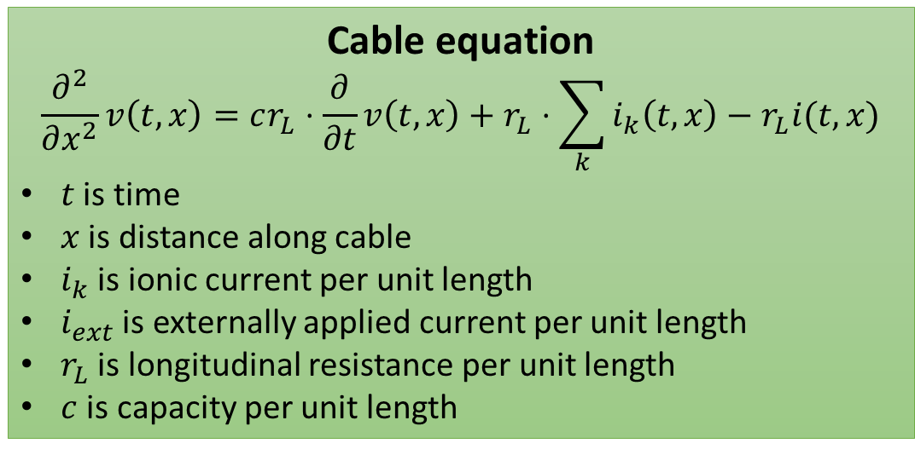
Spatial / multicompartmental neuron
Cable equation
$$\frac{∂^{2}}{∂x^{2}}v\left(t,x\right)=cr_{L}⋅\frac{∂}{∂t}v\left(t,x\right)+r_{L}⋅\sum_{k}{i_{k}\left(t,x\right)}−r_{L}i(t,x)$$
$t$ is time
$x$ is distance along cable
$i_{k}$ is ionic current per unit length
$i_{ext}$ is externally applied current per unit length
$r_{L}$ is longitudinal resistance per unit length
$c$ is capacity per unit length
Useful for ML?
See for example
Pagkalos et al. (2023)
Notes:
One thing we’ve totally ignored so far in all the models we’ve talked about is that neurons have a very complex spatial structure, with dendrites and axons and – as you can see in the picture – activity that travels around the cell.
***
We can capture this by thinking of the dendrites and axons as cylinders.
***
We then break these cylinders into a number of short cylindrical segments that are relatively uniform.
***
We then think of each as being nodes in an electrical circuit as we did with the Hodgkin-Huxley neuron.
***
If we take this approach and follow the mathematical analysis through, we get the cable equation, a second order partial differential equation.
This can be simulated by breaking the cable into compartments as above, but as you can imagine it gets quite heavy quite quickly, as real neurons can have thousands of these compartments that need to be simulated.
The question is: does any of this matter in terms of how the network as a whole functions or is this just implementation details?
***
We don’t know, but it has been argued that it may be important and it’s an active area of research, for example see this recent paper.
The problem is that it’s too computationally demanding to be used in a machine learning setup, or indeed in a large network without huge computational resources.

Slide 4
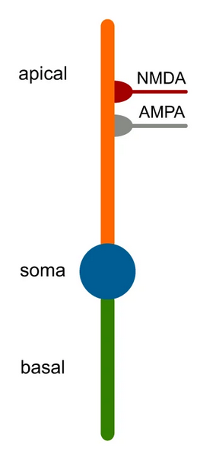
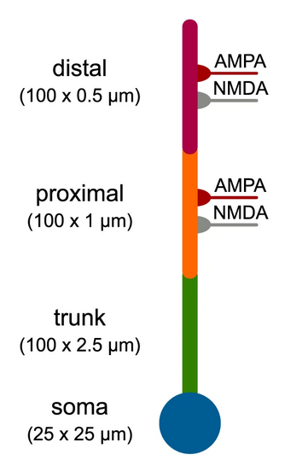
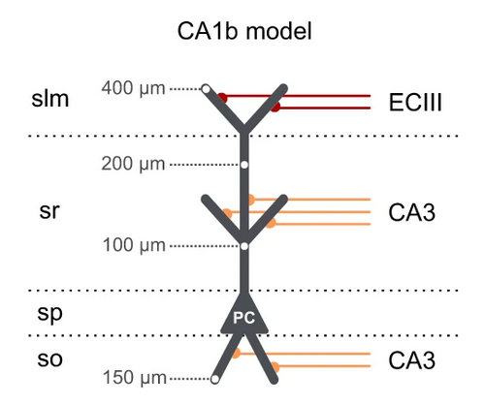
Dendrify
https://dendrify.readthedocs.io/en/latest/
Notes:
That’s where Dendrify comes in. It’s a relatively new software package to automatically simplify these very complex models into something that can be easily simulated while still capturing a lot of the relevant dynamics, like these examples here. If you’re interested in exploring what dendritic structure could add to network level computations, this package is probably worth a look.

Slide 5
Next steps
Next video:
Introduction to this week’s coding exercises on neurons
Next week:
Synapses and networks
Notes:
OK, that’s the end of the videos on modelling neurons. The next video will be an introduction to this week’s coding exercise, and then next week we’ll move on to synapses and networks.

