Slide 1

Synapses 1
Notes:
Hi,
Last week, we covered how ionic movements enable neurons to generate their resting membrane potential and spikes.
Linker:
In this video, we're going to talk about how neurons signal to each other, starting from our single neuron diagram.

Slide 2
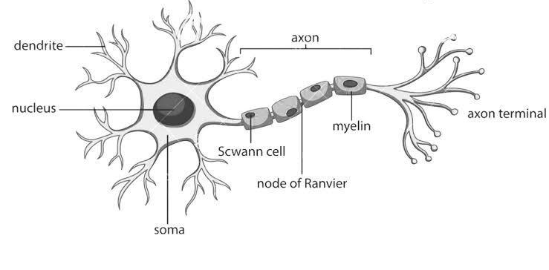
Saltatory conduction
Voltage-gated
ion channels
Axon hillock
Notes:
Inputs, at the neurons dendrites, cause sodium channels to open, and following their concentration gradient these ions diffuse into the cell, and spread along the dendrites to the soma and the axon hillock – an area rich with voltage-gated channels.
Low amounts of input, won't raise the membrane potential enough to trigger the opening of these channels (remember the gate threshold from last time). But, large amounts of input may, in which case more sodium will flow into the neuron and then begin to diffuse down the axon.
However, without any help this signal would just dissipate as it travelled the length of the axon.
So how do neurons prevent this?
The solution is to insulate the axon using a fatty substance called myelin. However, even insulating the whole length may not be enough, so instead there are:
Insulated blocks,
Separated by gaps, known as nodes of Ranvier, which are rich in voltage-gated channels. These effectively boost the signal as it travels along the axon, and generate what we call saltatory or jumping conduction.
Linker:
So what happens once this signal reaches the neuron's axon terminals?

Slide 3
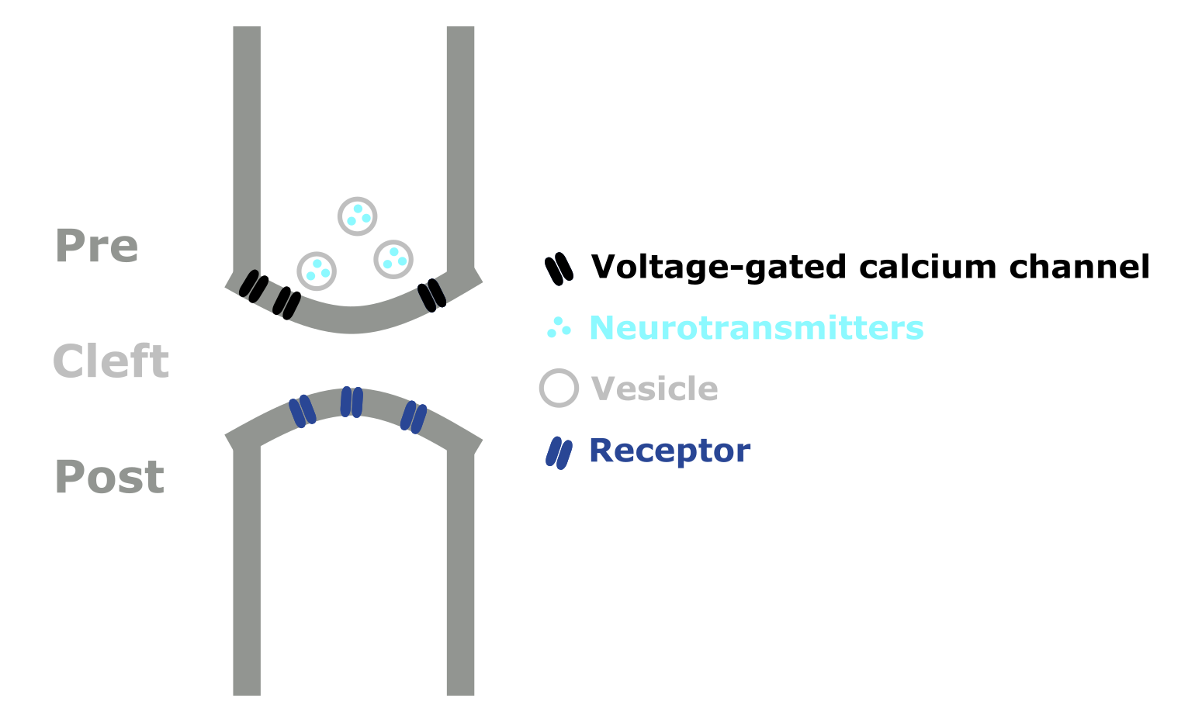
Chemical synapses
Notes:
Well if we zoom in on one of these terminals we can see that this is where our neuron connects to another. We call this connection a synapse, and term the neurons either side the pre- and post-synaptic neurons.
These connections can be either:
Electrical – known as gap junctions, or
Chemical – like this one.
So what makes up a chemical synapse?
The pre-synaptic neuron has vesicles, 3d spheres, filled with chemical messengers known as neurotransmitters.
The post-synaptic neuron has proteins embedded in its membrane, known as receptors, which the neurotransmitters can bind to.
Then the gap between the two is known as the synaptic cleft. And while it's often drawn like a gap, there are actually proteins which reach across the cleft and hold the junction together.
Linker:
When an action potential reaches the axon terminal

Slide 4
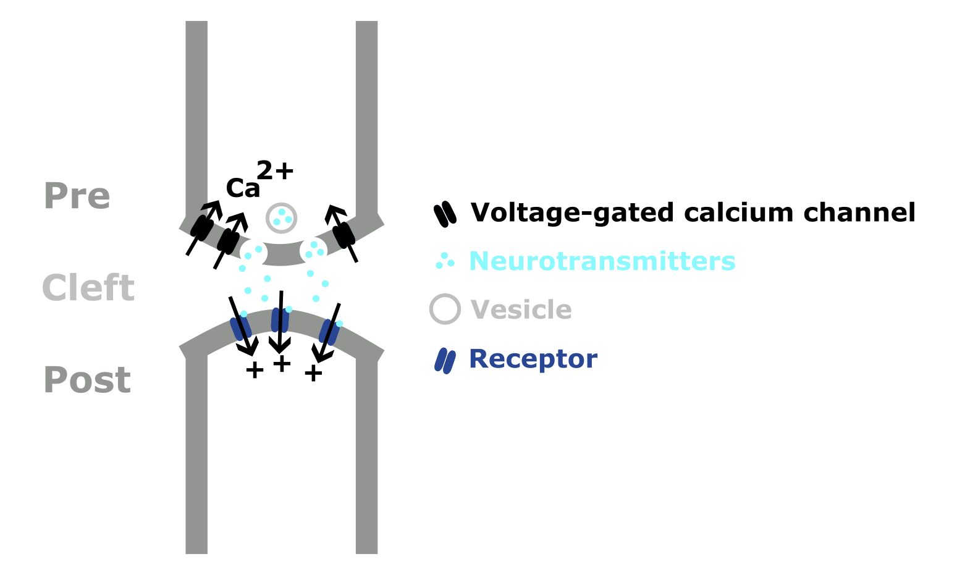
Chemical synapses
Notes:
The influx of ions depolarizes the membrane, and causes voltage-gated calcium channels to open and calcium to flow into the cell.
This causes the synaptic vesicles to fuse with the cell membrane, and release their neurotransmitters into the cleft.
The neurotransmitters then diffuse across the cleft and bind to the post-synaptic receptors, triggering different effects. In the diagram here, binding causes an ion channel to open and positive ions to flow into the post-synaptic neuron raising it's membrane potential. So we would describe this as an excitatory synapse, as a pre-synaptic action potential will make the post-synaptic neuron more likely to fire a spike. Conversely, inhibitory synapses reduce the post-synaptic neurons membrane potential and so make spiking less likely.
So how does this signal terminate? Well some neurotransmitter molecules simply diffuse away from the cleft, some are broken down by enzymes and some are actually taken back up into the pre-synaptic neuron.
An interesting side note here, is that there is a whole class of drugs for treating depression, which work by inhibiting this sort of reuptake channel. These are known as selective-serotonin reuptake inhibitors and a common example is Prozac.
Linker:
Now, let's discuss neurotransmitters in more detail.

Slide 5
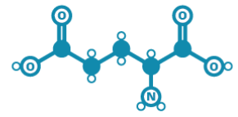
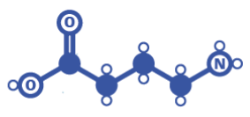
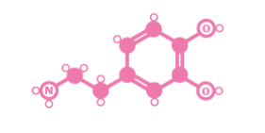
Neurotransmitters
Glutamate
GABA
Dopamine
Notes:
Neurotransmitters are molecules synthesized by neurons, which are used to signal to other neurons.
There are hundreds of known neurotransmitters which are thought to have different functions, so I'm just going to give you three examples:
Glutamate – is the main excitatory neurotransmitter in vertebrate nervous systems.
GABA – is the main inhibitory neurotransmitter and,
Dopamine – is often thought of as a pleasure signal, but it probably best described as signaling valence.
Interestingly, individual neurons tend to contain and release multiple transmitters. For example a single neuron may use both GABA and Dopamine.
Linker:
Though in general neurons release the same set of transmitters at all of their synapses.
https://www.ncbi.nlm.nih.gov/pmc/articles/PMC6352749/
Image from:
https://i0.wp.com/www.compoundchem.com/wp-content/uploads/2015/07/Chemical-Structures-of-Neurotransmitters-2015.png?ssl=1

Slide 6
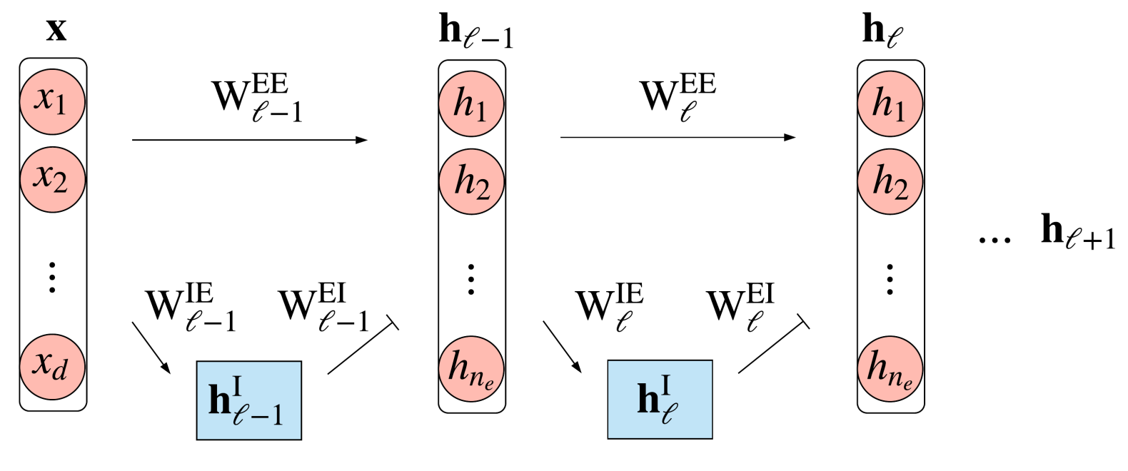
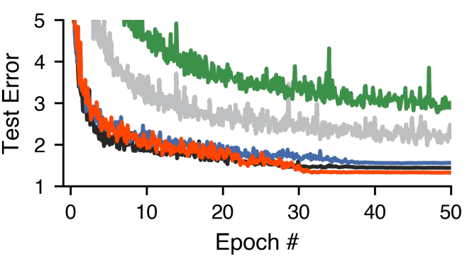
Dale's principle
Cornford et al., 2021 (ICLR)
Notes:
This is known as Dale's principle, and set's up an interesting contrast between biological and artificial neural networks.
Again, biological neurons will release the same set of neurotransmitters to all of their partners.
But in artificial neural networks, single units have both positive and negative output weights. So their activation sends different signals to different units.
So is this a limitation of biology or an advantage? To explore this question, Jonathan Cornford and colleagues built ANNs in which each unit was either excitatory or inhibitory. Shown on the left in pink and blue.
It turns out that these networks are difficult to train with standard gradient descent, and end up performing worse than a standard ANN. You can see this on the right graph, where the black curve shows the performance of a standard ANN and the green shows a simple implementation of Dale's principle.
So, they introduced some corrections and were able to get networks which respect Dale's principle and match the performance of standard ANNs. This improved implementation of Dale's principle is shown in red.
But, as they're only able to match standard ANNs, and no one has shown better results by following Dale's principle. Why neurons tend to follow Dale's principle remains an open question.
Linker:
Okay, back to neurotransmission.
https://twitter.com/tyrell_turing/status/1349815543449186306
https://openreview.net/forum?id=eU776ZYxEpz

Slide 7
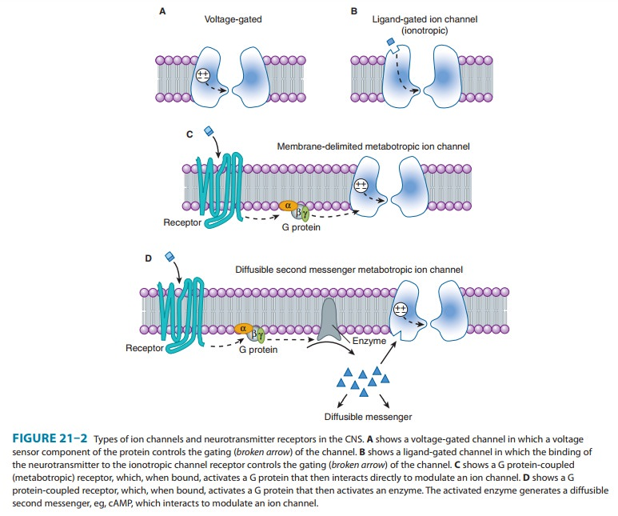
Receptors
Notes:
Once released, neurotransmitters diffuse across the synaptic cleft, bind receptors embedded in the cell membrane and trigger different effects.
There are hundreds of receptors which are specific to different neurotransmitters, but there are just two major types:
Ionotropic receptors, shown on the top, – are receptors where neurotransmitter binding triggers a change in structure which opens an ion channel.
Metabotropic receptors – are receptors where binding triggers signaling cascades within the post-synaptic neuron, which may open ion channels or cause other effects.
Linker:
Hopefully this has given you a better idea of how synapses work.
In the next video we're going to cover how synapses can adjust their strength or weight, and a few other details.
Image from:
https://www.brainkart.com/article/Ion-Channels---Neurotransmitter-Receptors_24662/

