Slide 1

Networks
Notes:
Hi again,
In the last two videos we learnt about how neurons synapse with and signal to each other.
In this video we're going to learn a bit about how neurons connect together to form networks or circuits.
To do that, I'm going to give you two examples of networks found in biology.
Linker:
But first, how do neuroscientists map biological circuits?

Slide 2
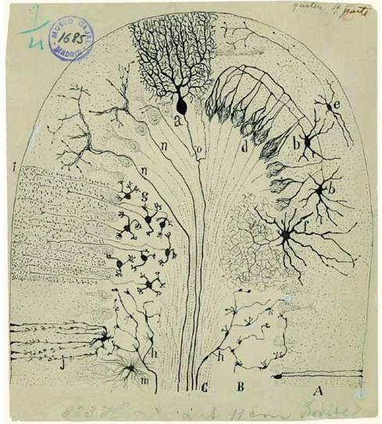
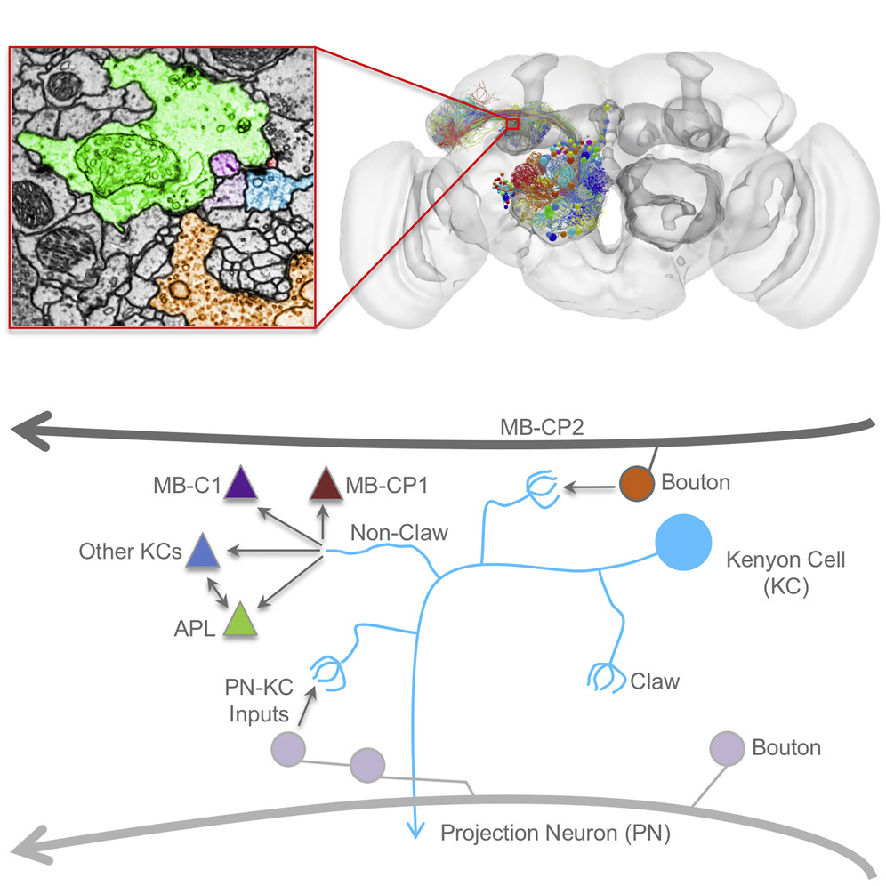
Circuit mapping
Cajal 1894
Zheng et al.,
2018 (Cell)
Notes:
Well, broadly, you need to: dissect out an animal's brain, slice it very thinly, stain it, view it under a microscope and then analyze the images.
Historically, this was all done by hand: like this drawing from Cajal in 1894, but everything from the data acquisition to the analysis is being automated and it's an exciting space to watch.
Linker:
Okay, lets look at our first circuit.
Papers:
https://doi.org/10.1038/nrn1010
https://doi.org/10.1016/j.cell.2018.06.019

Slide 3
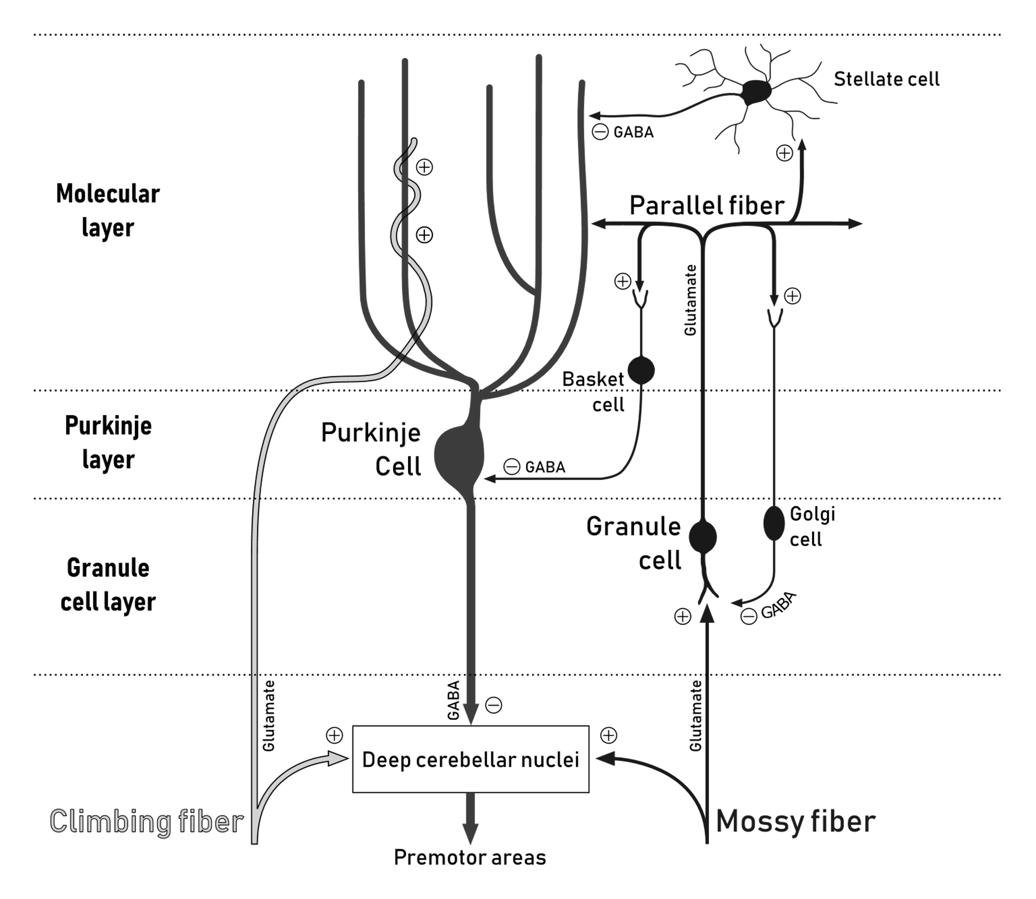
The cerebellum
Notes:
The cerebellum is an area of the brain involved in coordinating movement, and it's composed of circuits which look something like this diagram.
There are three things to note here:
The cells are found in three layers, which are labelled on the left.
The major cell types are labelled, like the granule and Purkinje cells, and
The connections between the different cell types are marked as either excitatory or inhibitory depending on what neurotransmitters they use.
So how does information flow through this network?
In the mossy fiber pathway, on the right, inputs synapse with granule cells. When then send their outputs up into the layer above where they branch out and spread through the Purkinjie cell dendritic arbors – forming thousands of excitatory synapses. Because of their structure these granule cell outputs are known as parallel fibres. The Purkinje cells then send inhibitory connections to the circuits outputs – the deep cerebellar nuclei.
In a second pathway, on the left, the climbing fibre pathway: other inputs skip straight to the Purkinje cells.
Hopefully you can also see that there are other interesting connections in the circuit too, like the direct connections from both input pathways (the mossy and climbing fibres) to the outputs (the deep cerebellar nuclei).
Linker:
So how can we think about or model this network's function?
Image from:
https://commons.wikimedia.org/wiki/File:Cerebellar_Circuit.svg

Slide 4
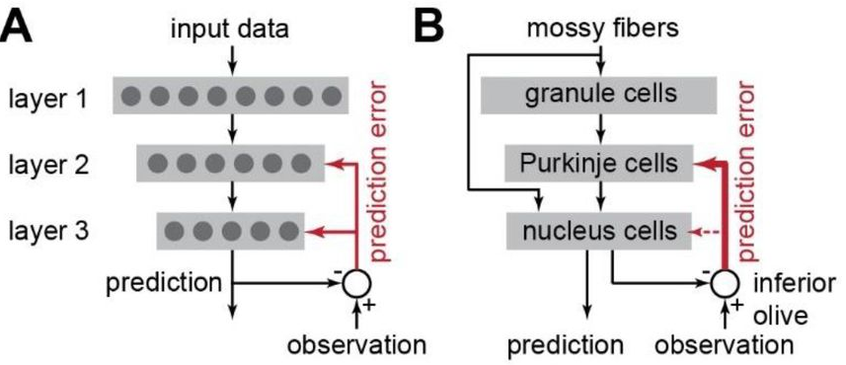
The cerebellum
Reza Shadmehr 2020 (JNP)
Notes:
Well models have been proposed for over 50 years, but one simplified way to think about it is as a three-layer network with the two pathways we just discussed.
Inputs arrive via the mossy fibers, which connect to both the first and third layers, the granule and nucleus cells. Then there are feedforward connections through network and the third layer generates output predictions.
These outputs are then compared to input observations, and the difference between the two is fed back to the network as an error signal, via the climbing fiber pathway – which is shown in red.
If you're interested to learn more about this model, this paper focuses on a really interesting question, which is how the network can learn, when the connections conveying the error signal to the third layer are relatively weak (shown by thin red arrow).
Linker:
Okay, onto our second circuit.
Papers:
https://doi.org/10.1113%2Fjphysiol.1969.sp008820
https://doi.org/10.1113%2Fjphysiol.2009.180307
https://doi.org/10.1152%2Fjn.00449.2020

Slide 5
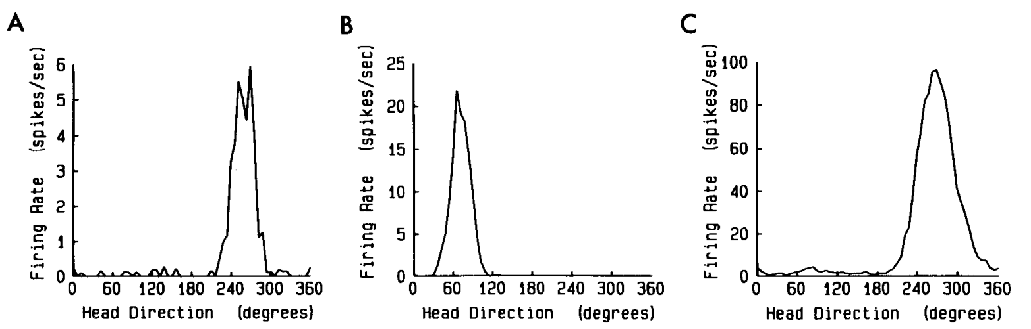
Head direction cells
Taube et al., 1990 (JoN)
Notes:
Around thirty years ago researchers were recording the activity of individual neurons in the rat brain, when they discovered cells which seemed to encode the animals heading direction, and so named them head direction cells.
Here for example, are three neurons firing rates (in spikes per second) as a function of the animals head direction, and you can see that each neuron is very specific.
This and later work, would show that as a population neurons evenly tile the space of heading directions, and that the activity of these cells depends on both visual and vestibular (balance) inputs.
Linker:
To better understand these results,
Paper:
https://doi.org/10.1523/JNEUROSCI.10-02-00420.1990

Slide 6
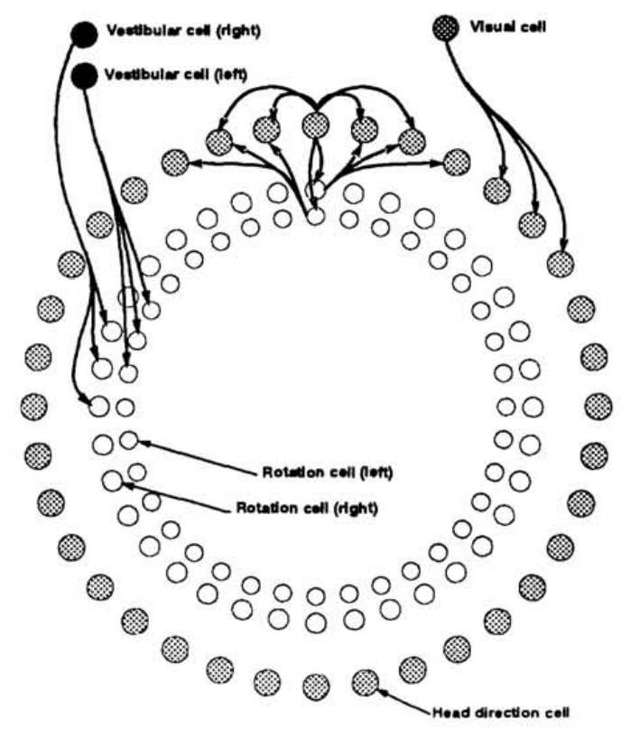
Ring attractors
Skaggs et al., 1995 (NeurIPS)
Notes:
A team proposed an attractor model in 1995, which they drew as a series of rings, with the head direction cells in the outer ring, and visual and vestibular inputs in the inner rings.
There are lots of details, but the most salient one is that:
There are strong excitatory connections between neighboring head direction cells, and strong inhibitory connections between distant cells.
This means that there will be just one cluster of active cells at any time,
And either visual or vestibular inputs to the head direction cells will cause the peak to shift around the ring.
Interestingly the authors thought of this as a somewhat abstract model, and wrote:
it is helpful to think of the network as a set of circular layers; this does not reflect the anatomical organization of the corresponding cells in the brain
Linker:
Though recently experiments in fruit-flies
Papers:
https://pubmed.ncbi.nlm.nih.gov/11539168/

Slide 7
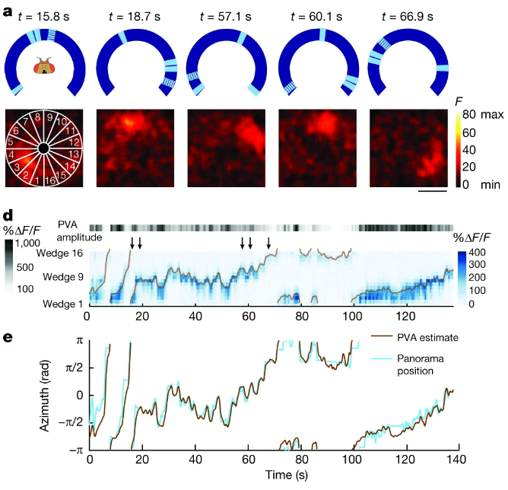
Ring attractors
Seelig & Jayaraman 2015 (Nature)
Notes:
Revealed a group of neurons arranged in a ring, with a single bump of activity which tracks the fruit-flies heading direction.
In this experiment, the authors essentially have a fruit-fly walk on a rotating tread-mill while the fly watches a screen with landmarks on – the blue ring in panel a.
They're also recording the fly's brain activity, which is shown in the black and red boxes below. We'll explain the recording technique they're using later in the course, but for now it's enough to know that red indicates more neural activity. What you can hopefully see is that there is a single bump of activity, which rotates around the ring as the fly navigates around, And the panels below, in d and e, show that this bump accurately tracks the flies heading direction.
So, in sum, ring attractors are a nice example of where experiments and theory came full circle.
Linker:
Okay, that's all about networks from me.
In the next videos Dan will talk about modelling synapses and networks in more detail.
Papers:
https://www.nature.com/articles/521165a
https://doi.org/10.1038/nature14446
https://doi.org/10.1126/science.aal4835
https://www.nature.com/articles/s41593-023-01308-5

