Slide 1

Synapse models
Notes:
Like last week, we just hit you with a lot of detailed biology, and now we’re going to see how to turn that into relatively simple equations.

Slide 2
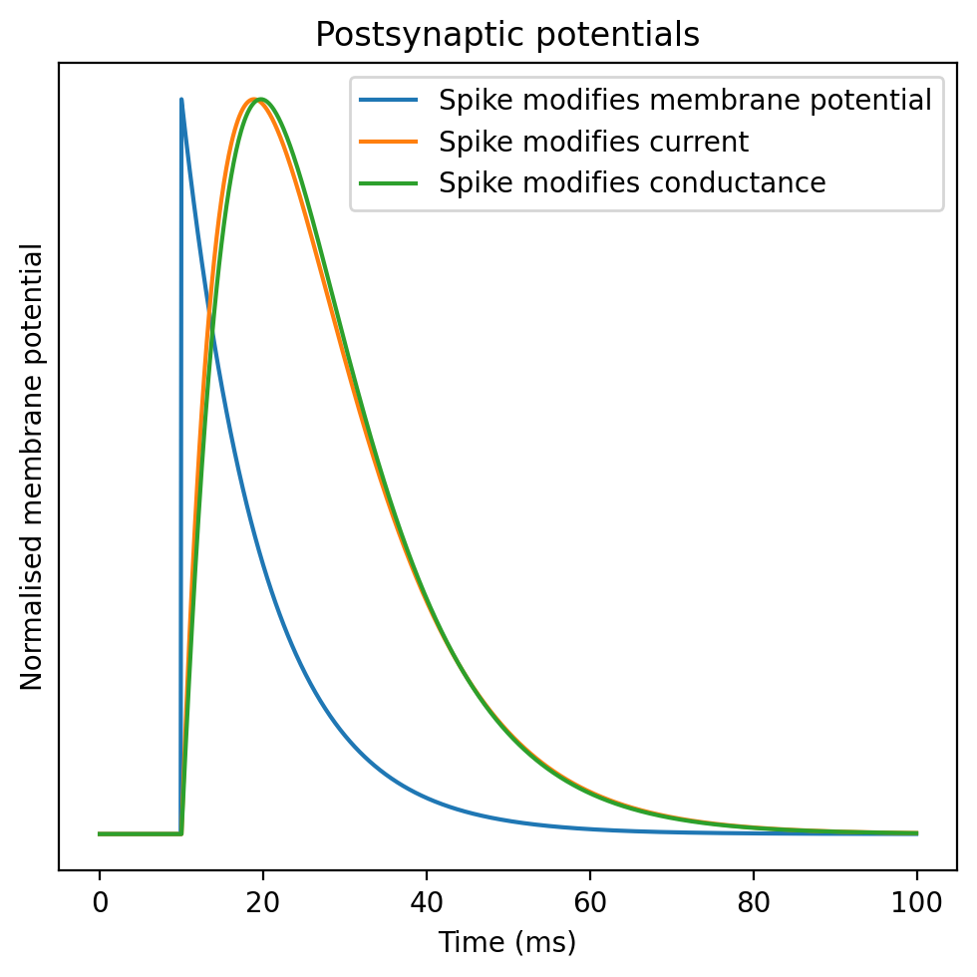

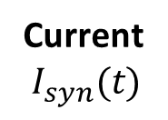



Level of abstraction
Q: Are these changes fast enough to ignore?
Neurotransmitter
release and binding
changes
Q: Are we modelling this level of detail?
Conductance
$$g_{syn}(t)$$
changes
$$I_{syn}\left(t\right)=g_{syn}\left(t\right)( V\left(t\right)−E_{syn} )$$
Current
$$I_{syn}(t)$$
changes
$$CV^{′}\left(t\right)=I_{syn}\left(t\right)−V\left(t\right)+…$$
Membrane potential
$$V(t)$$
Notes:
Marcus explained how when a spike arrives at a transmitting synapse, neurotransmitter is released.
***
This neurotransmitter causes a change in the conductance of the receiving cell because of the opening of an associated ion channel.
***
In turn, this leads to an input current following the same sort of equations we saw for the Hodgkin-Huxley formalism last week.
***
Which in turn leads to a change in membrane potential for either the Hodgkin-Huxley or leaky integrate-and-fire type neurons.
***
Just as we did for neurons, we need to decide what level of detail we want to include in our synapse model.
***
One reason we might want to leave out some of this detail is that some of these changes will happen fast enough that modelling their temporal dynamics won’t change much at the scale we’re looking at.
***
A helpful picture to draw is the postsynaptic potential, sometimes referred to simply as a PSP. This shows the increase in the membrane potential of the receiving cell as a result of a spike arriving at that cell. In this figure you can see a model synapse at three levels of detail. In blue, we model the synapse as an instantaneous increase in the membrane potential. In orange, we model it as an instantaneous increase in a current, which then decays exponentially back to rest. And in green, the same but the instantaneous increase is to the conductance.

Slide 3
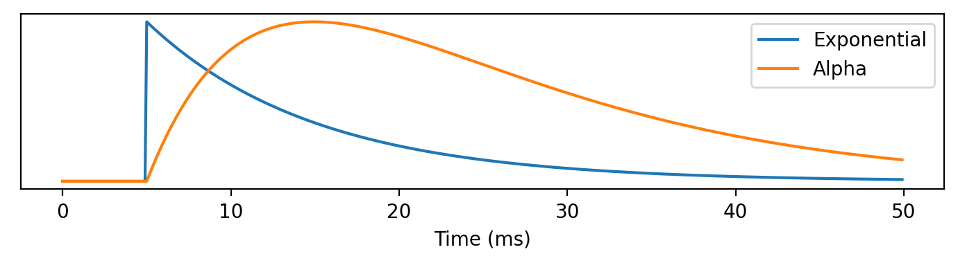
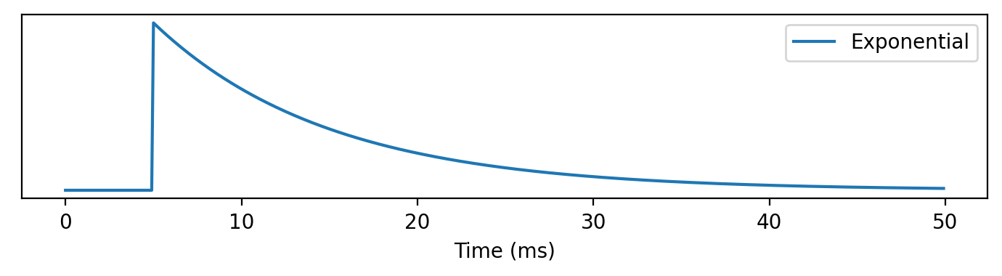
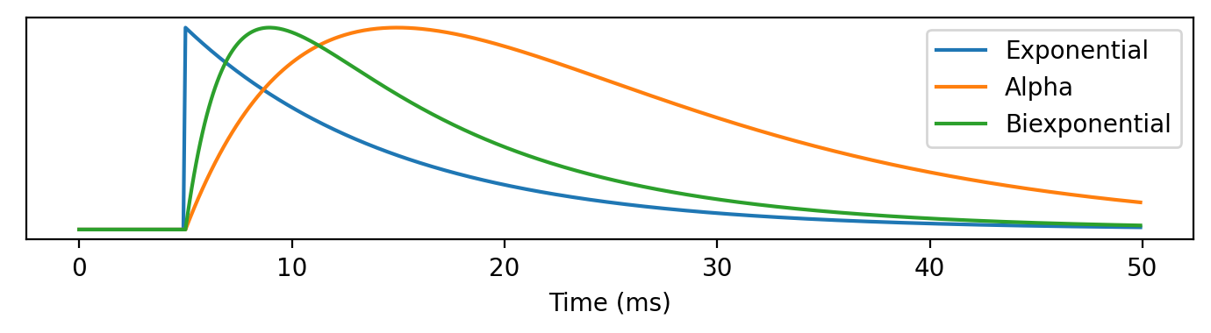
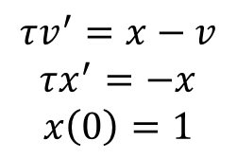
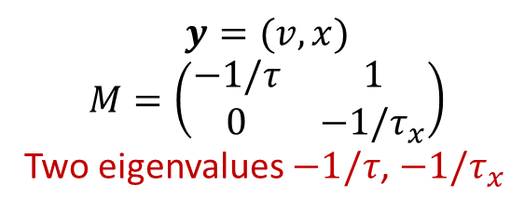
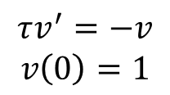
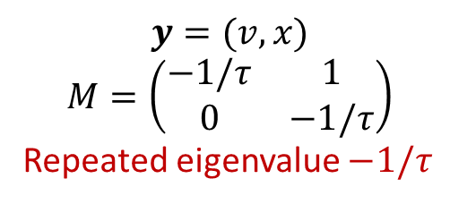
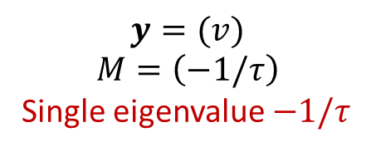
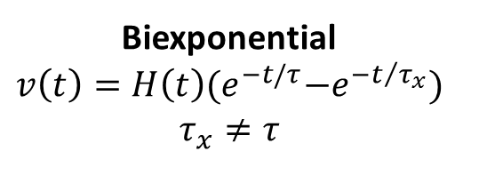
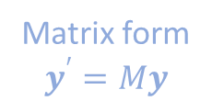
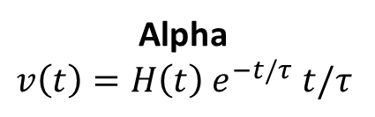
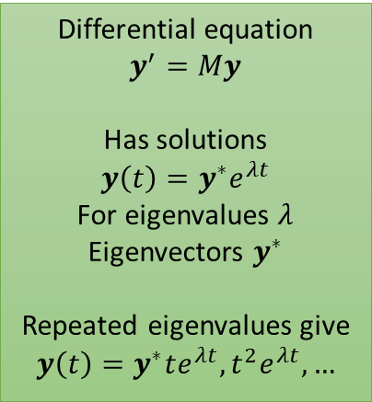
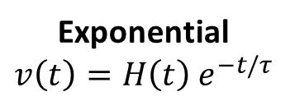
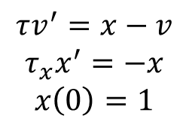
Synapse time course
Postsynaptic potential form
Differential equation form
(ignoring constants)
Matrix form
$$y^{′}=My$$
$$y=(v)$$
$$M=\left(−1/τ\right)$$
Single eigenvalue $−1/τ$
Exponential
$$v\left(t\right)=H\left(t\right){ e}^{−t/τ}$$
$$τv^{′}=−v$$
$$v\left(0\right)=1$$
Differential equation
$$y^{′}=My$$
Has solutions
$$y\left(t\right)={y^{∗}e}^{λt}$$
For eigenvalues $λ$
Eigenvectors $y^{∗}$
Repeated eigenvalues give
$$y\left(t\right)=y^{∗}te^{λt}, t^{2}e^{λt}, …$$
$$y=(v,x)$$
$$M=\left(\begin{matrix}−1/τ & 1 \\ 0 & −1/τ\end{matrix}\right)$$
Repeated eigenvalue $−1/τ$
$$τv^{′}=x−v$$
$$τx^{′}=−x$$
$$x\left(0\right)=1$$
Alpha
$$v\left(t\right)=H\left(t\right){ e}^{−t/τ} t/τ$$
$$y=(v, x)$$
$$M=\left(\begin{matrix}−1/τ & 1 \\ 0 & −1/τ_{x}\end{matrix}\right)$$
Two eigenvalues $−1/τ$, $−1/τ_{x}$
Biexponential
$$v\left(t\right)=H\left(t\right){(e}^{−t/τ}−e^{−t/{τ_{x}}})$$
$$τ_{x}≠τ$$
$$τv^{′}=x−v$$
$$τ_{x}x^{′}=−x$$
$$x\left(0\right)=1$$
Notes:
Let’s start by talking about how we can directly model the dynamics in terms of conductance, current or membrane potential, and we’ll come back to talking more about neurotransmitter release dynamics in a moment.
A common approach is to decide the key synaptic variable and model it with one of three classes of functions.
There’s an explanation as to why these three classes come up that I’ll return to in a moment.
For the sake of simplicity, I’ll describe each of these as postsynaptic membrane potentials, although they can also be used to model currents or conductances.
***
The first class is the exponential function. We can write this as the product of an exponential decay with some time constant, and a Heaviside function H(t) that returns 0 if t is less than 0, or 1 otherwise.
***
A step up in complexity is the alpha function which we haven’t seen before. In this equation, we multiply the exponential decay by t so that it rises continuously before decaying.
***
A further step up is the biexponential function, which lets us separately control the rise and fall time with two different time constants.
***
Each of these can also be expressed as a linear time invariant differential equations with constant coefficients.
This makes a certain sort of sense because we’d expect time invariance in a model of a physical system, and having linearity and constant coefficients is just the simplest thing you can do.
***
We can take that argument a bit further by putting these equations into matrix form and calculating their eigenvalues.
These three forms are essentially the only possibilities for a 1 or 2-dimensional system that is linear, time invariant and has constant coefficients.
The exponential is the only possibility for 1 dimension, and in 2 dimensions you either get the alpha or biexponential depending on whether or not the eigenvalue is repeated.

Slide 4
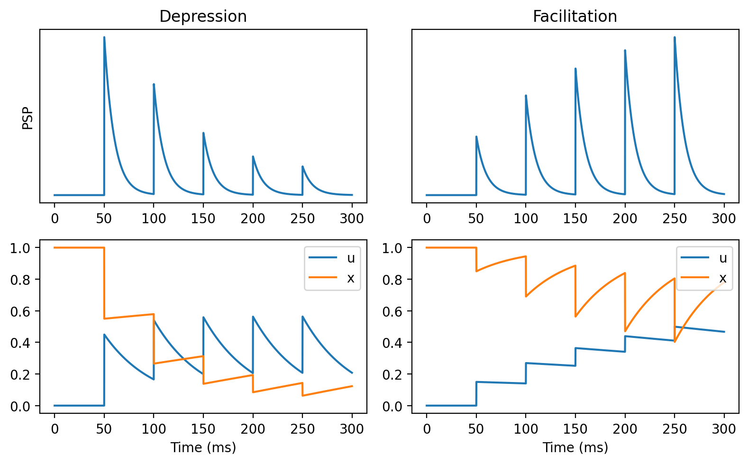
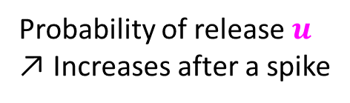
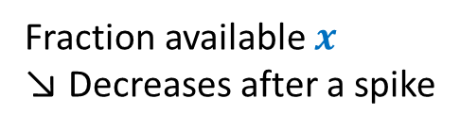
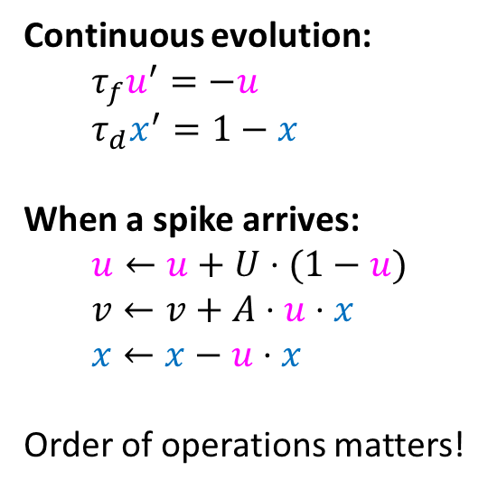
Short term plasticity
Unavailable
Available
Fraction available $x$
↘ Decreases after a spike
Continuous evolution:
$τ_{f}u^{′}=−u$
$τ_{d}x^{′}=1−x$
When a spike arrives:
$u←u+U⋅(1−u)$
$v←v+A⋅u⋅x$
$x←x−u⋅x$
Order of operations matters!
Probability of release $u$
↗ Increases after a spike
Notes:
So far we’ve looked at memoryless models of synapses, where previous activity doesn’t affect what they do, but this isn’t quite right.
***
Neurotransmitter is released in vesicles, and after being released some fraction of them will be unavailable if another spike comes along.
This means that later spikes will likely have a smaller effect than earlier spikes. We call this short term synaptic depression.
We can model it by adding an extra variable x that tracks what fraction of vesicles are available.
***
However, it turns out that you also see cases where each subsequent spike has a bigger effect than previous spikes, which we call facilitation.
***
A simple model that encapsulates both effects is to add an extra variable u that represents the probability that an available vesicle will be released, and allow this to increase after each spike.
***
Combining these two ideas in the simplest way possible, we get this model.
In the absence of any spikes, the pool of available vesicles will increase exponentially until all vesicles are available.
At the same time, the probability of spiking will decay to 0.
We can control the rate of these processes with facilitation and depression time constants tau_f and tau_d.
When a spike arrives, we first increase u, the probability of vesicle release. Note that we do this first because otherwise the first spike would release 0 vesicles.
Next, we release an amount of vesicles proportional to u times x, because there are x available and we release with probability u. In this model I’ve had this directly modify the membrane potential v, but as in previous slides it could modify other variables.
Finally, since we’ve released u times x vesicles, we now have to remove those from the available pool by subtracting that from x.
***
Here’s what those variables look like in these two cases.
So what does this do in terms of function? As usual, we don’t have a complete answer to that. One thing for sure is that it gives synapses a longer memory than they would otherwise have, which is likely to be useful in many cases.
It can also allow the neuron to have richer spike frequency dynamics, allowing them to act as low, high or band pass filters, and do gain control.
There’s a bunch of other ideas people have suggested, and I’ve put some links in the reading list for where you can read more about this and other models of short term plasticity.

Slide 5
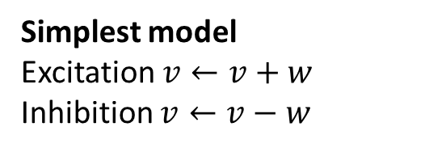
Channel types: excitation and inhibition
Dendrite
Channel types include:
Inhibitory:
GABA_{A} fast
GABA_{B} slow
Excitatory:
AMPA fast
NMDA slow
Shunting inhibition
Conductance increases locally
Reversal potential near resting potential
No effect on its own
Reduces effect of passing excitatory currents
Excitatory
Reduced effect
Shunting inhibition
No direct effect
Excitatory
Unchanged
Soma
Simplest model
Excitation $v←v+w$
Inhibition $v←v−w$
NMDA
Highly nonlinear
Depends on postsynaptic membrane potential being high
Notes:
As Marcus mentioned, synapses can be either excitatory or inhibitory.
There are a range of different ion channels and dynamics giving rise to different sorts of excitatory or inhibitory synapses.
***
The simplest model is just that excitatory synapses lead to an increase in some variable, while inhibitory synapses lead to a decrease.
***
However, when synapses are modelled with detailed ion channel dynamics and spatial structure, things can get more interesting.
Shunting inhibition is a good example. In shunting inhibition, a spike causes a local increase in conductance but with a reversal potential near to the resting potential. This means that on its own in the absence of other input, you wouldn’t observe any effect on the membrane potential. However, it will reduce the effect of an excitatory synapse on the dendrite while having no effect on an excitatory synapse on the soma or on a different dendritic branch. This means that it can have a selective, divisive effect on excitatory inputs, something you wouldn’t easily be able to achieve otherwise.
***
Another interesting channel type is NMDA, which can’t be modelled linearly. The effect of NMDA requires the receiving neuron’s membrane potential to have recently been high. This may be important in learning.

Slide 6
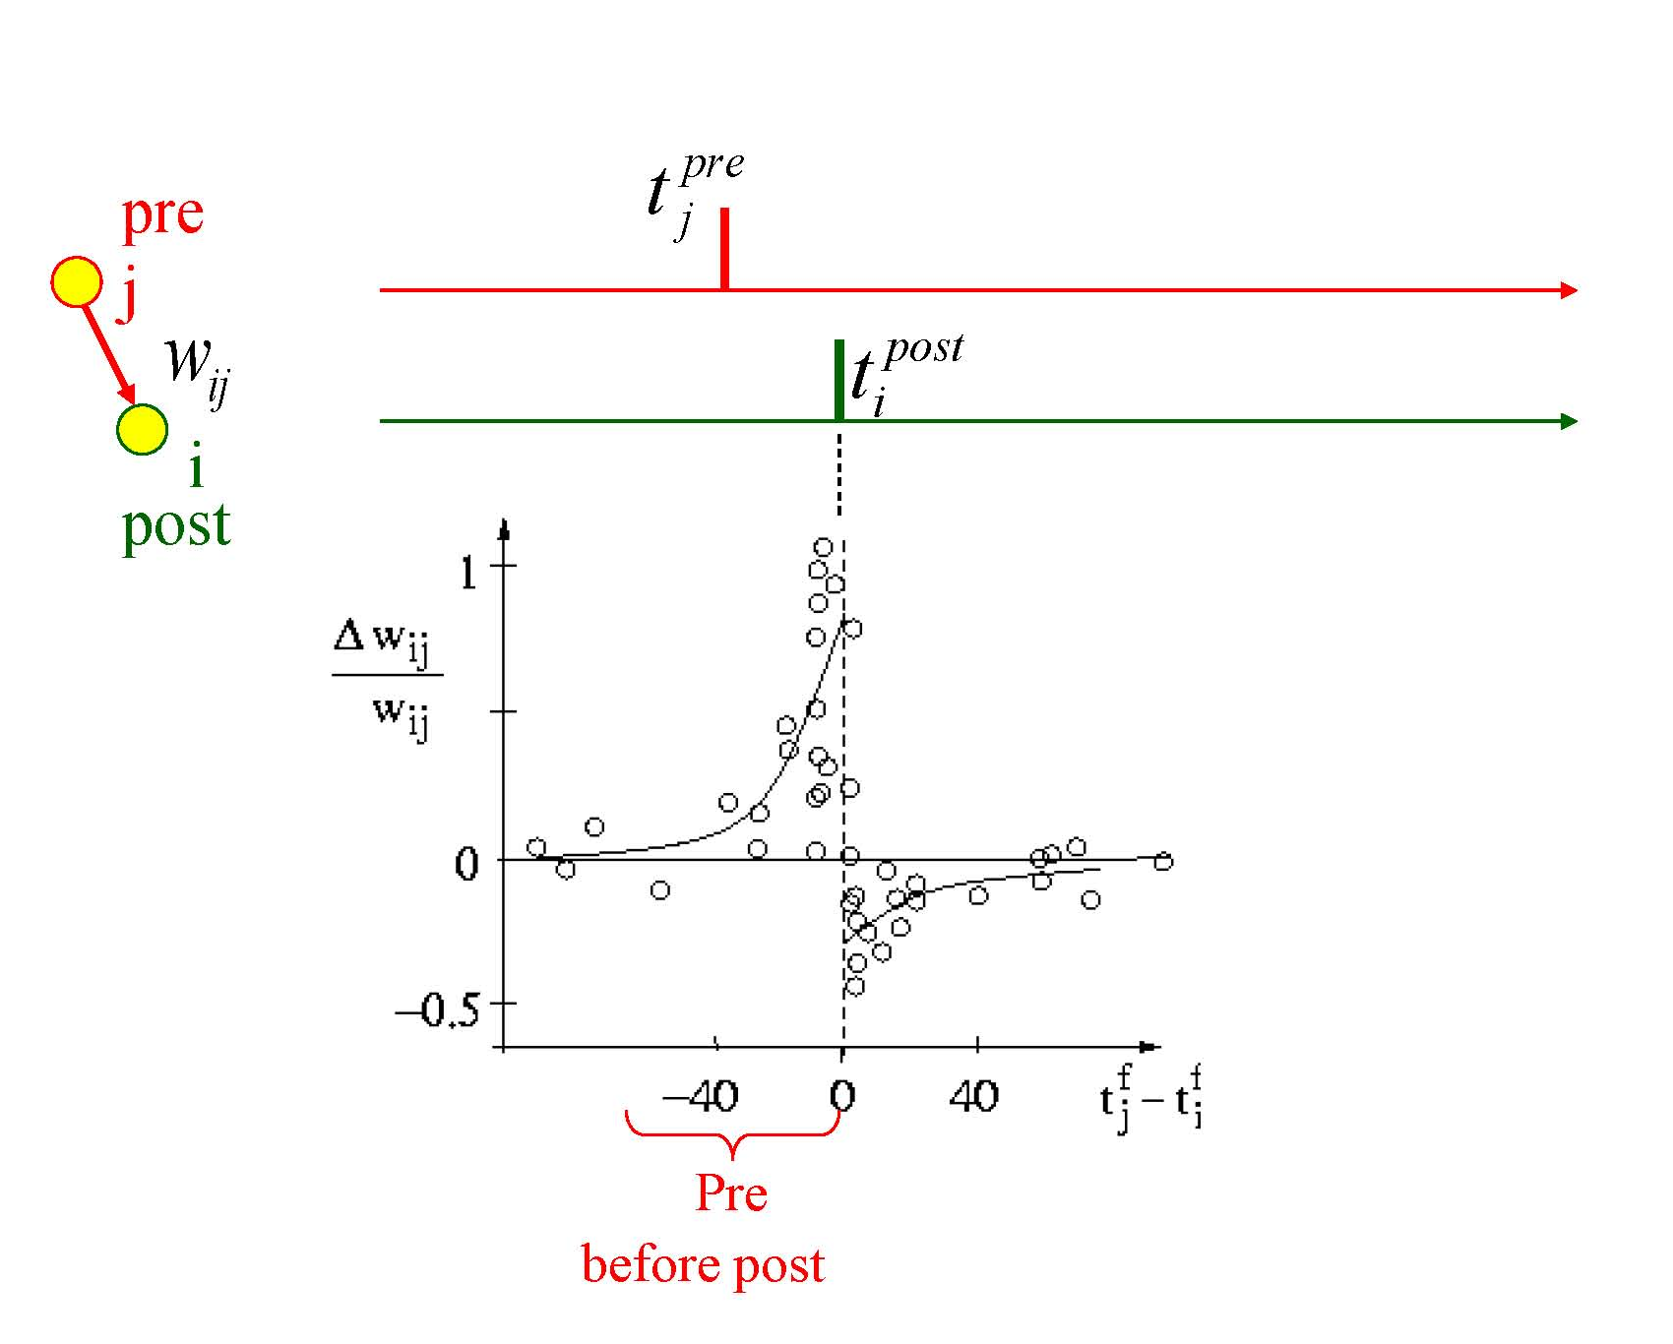
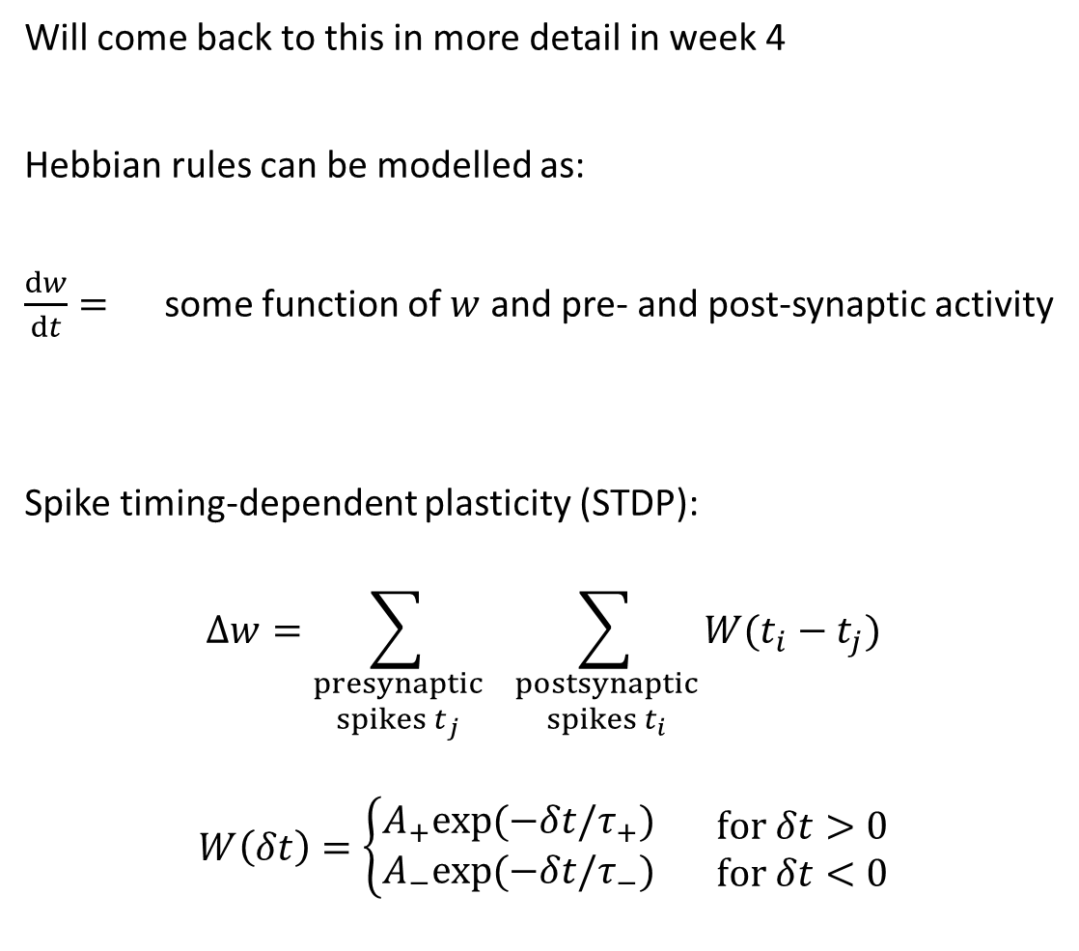
Long term plasticity
Will come back to this in more detail in week 4
Hebbian rules can be modelled as:
$\frac{dw}{dt}=$ some function of $w$ and pre- and post-synaptic activity
Spike timing-dependent plasticity (STDP):
$$Δw=\sum_{\begin{aligned}presynaptic \\ spikes t_{j}\end{aligned}}{ \sum_{\begin{aligned}postsynaptic \\ spikes t_{i}\end{aligned}}{W(t_{i}−t_{j})}}$$
$$W\left(δt\right)=\left\{\begin{aligned}A_{+}exp⁡(−δt/τ_{+}) \\ A_{−}exp⁡(−δt/τ_{−})\end{aligned} \begin{matrix}for δt>0 \\ for δt<0\end{matrix}\right.$$
Notes:
Talking of learning, I should mention long term plasticity here, but only briefly because that’s the main topic of week 4.
***
Marcus mentioned Hebbian rules, and you can generally model them by adding some differential equation for the synaptic weight w as a function of the activity of the presynaptic and post-synaptic neurons. We’ll talk about some of the particular models later.
***
There’s also spike timing-dependent plasticity, or STDP.
It has been observed experimentally that particular pairings of pre- and post-synaptic spike times can lead synapses to get stronger or weaker. We can model this by increasing the weight by some delta W that depends on the timing difference, and it can be made a reasonable fit to experimental data. This particular curve where the synapse gets stronger if presynaptic spikes tend to come before postsynaptic spikes could be thought of as encouraging networks to care about temporal causality.
That’s all I’ll say for now about that, but we’ll be seeing much more about all this later in the course.

Slide 7
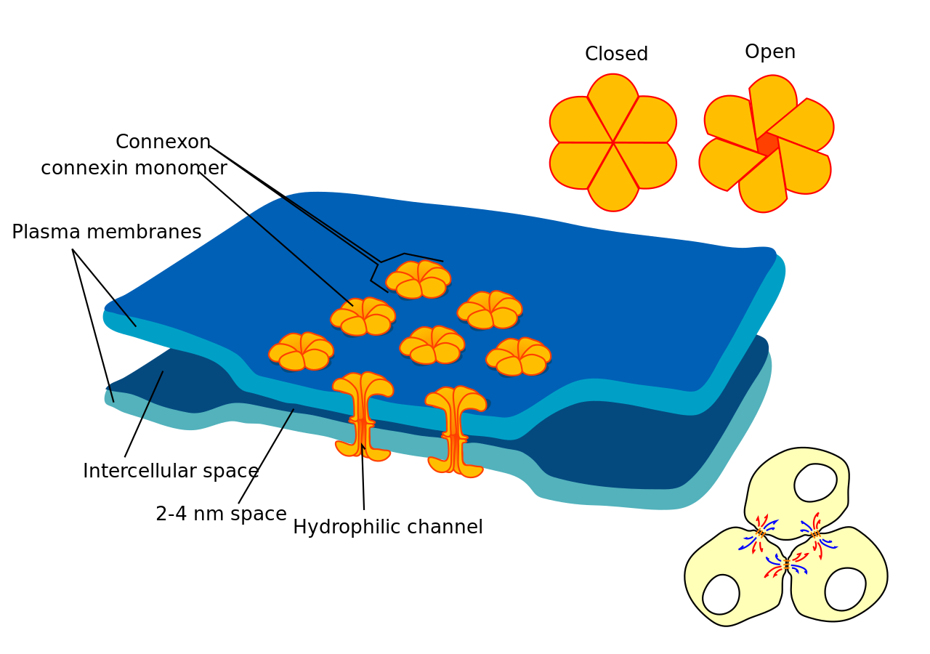
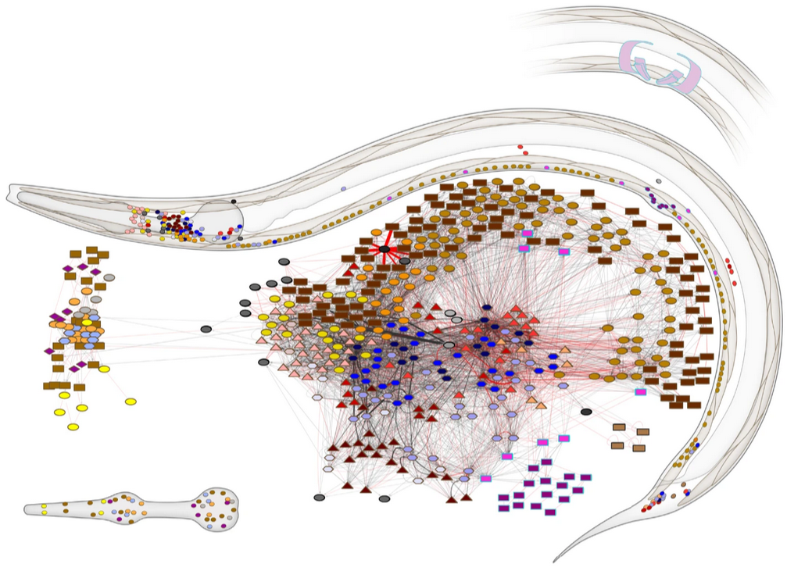

More synaptic fun
Synaptic failure
$v←v+w$ (with probability $p$)
Gap junctions
For example…
$τv^{′}=I_{gap}−v$
$I_{gap}=w\left(v_{pre}−v_{post}\right)$
C. Elegans
Precisely 302 neurons
Always the same pattern
Mostly non-spiking, using gap junctions instead
Notes:
As always, there’s a lot more that could be said about modelling synapses. I’ll just briefly mention two before closing this video out.
***
The first is synaptic failure. It’s easy to model by just adding a chance of failure to each synaptic event.
***
The second is gap junctions, when two neurons form a direct electrical connection rather than a chemical synapse.
These can again be straightforwardly modelled as just another current proportional to the difference in membrane potentials.
There are – of course – more complicated models too.
***
Gap junctions occur in many species, but a particularly interesting example is the tiny worm C elegans. Neuroscientists love it because it always has precisely 302 neurons with the same pattern of connections. It’s unusual though because they are mostly non-spiking, using gap junctions to communicate instead.
OK, that’s all for synapses. In the next video we’ll look at modelling networks.

