Slide 1

Synapses 2
Notes:
Hi,
In the last video we covered synapses, neurotransmitters and receptors.
In this video, we're going to cover how synapses can adjust their strength or weight.
Linker:
So in general, we train artificial neural networks by adjusting their connection weights according to a learning rule, but what is the equivalent in biology?

Slide 2
Hebbian learning
1949
"When an axon of cell A is near enough to excite a cell B and repeatedly or persistently takes part in firing it, some growth process or metabolic change takes place in one or both cells such that A’s efficiency, as one of the cells firing B, is increased."
Cells that fire together
wire together
& Cells that fire out of sync
lose their link
Notes:
Well as early as 1949 Donald Hebb proposed a relevantly simple learning rule:
"When an axon of cell A is near enough to excite a cell B and repeatedly or persistently takes part in firing it, some growth process or metabolic change takes place in one or both cells such that A’s efficiency, as one of the cells firing B, is increased."
At the time this was just a theory, but experimental evidence confirmed it around 20 years later.
This is often summarized as Cells that fire together wire together, and conversely Cells that fire out of sync lose their link
Though this misses the fact that cell A must spike first to contribute to B's firing and so the relative timing matters.
Linker:
Just to expand on that a bit

Slide 3
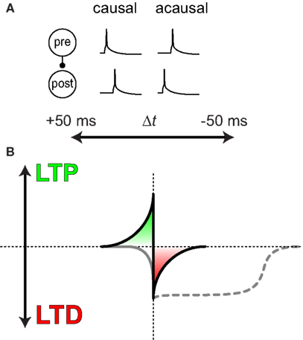
Spike-timing-dependent plasticity
Markram et al., 2011 (Frontiers)
Notes:
Let's consider a pair of neurons.
Panel A show if the pre-synaptic neuron's spikes tend to occur before or after the post-synaptic neuron, and so if their relationship is causal or acausal.
Panel B, shows how this synapses strength (on the y-axis), will be adjusted depending on the difference in spike timing between the two neurons.
If the relationship is causal, so pre-precedes-post, the strength will be increased or potentiated (shown in green).
While if it is acausal, i.e. pre tends to follow post, the strength will be decreased (shown in red).
This is known as spike-timing-dependent plasticity, and it tends to induce long-term changes in synaptic strength – via processes known as long-term potentiation (LTP) and long-term depression (LTD).
Linker:
So what changes at the synapse to cause this change in weight?
Paper:
https://doi.org/10.3389/fnsyn.2011.00004

Slide 4
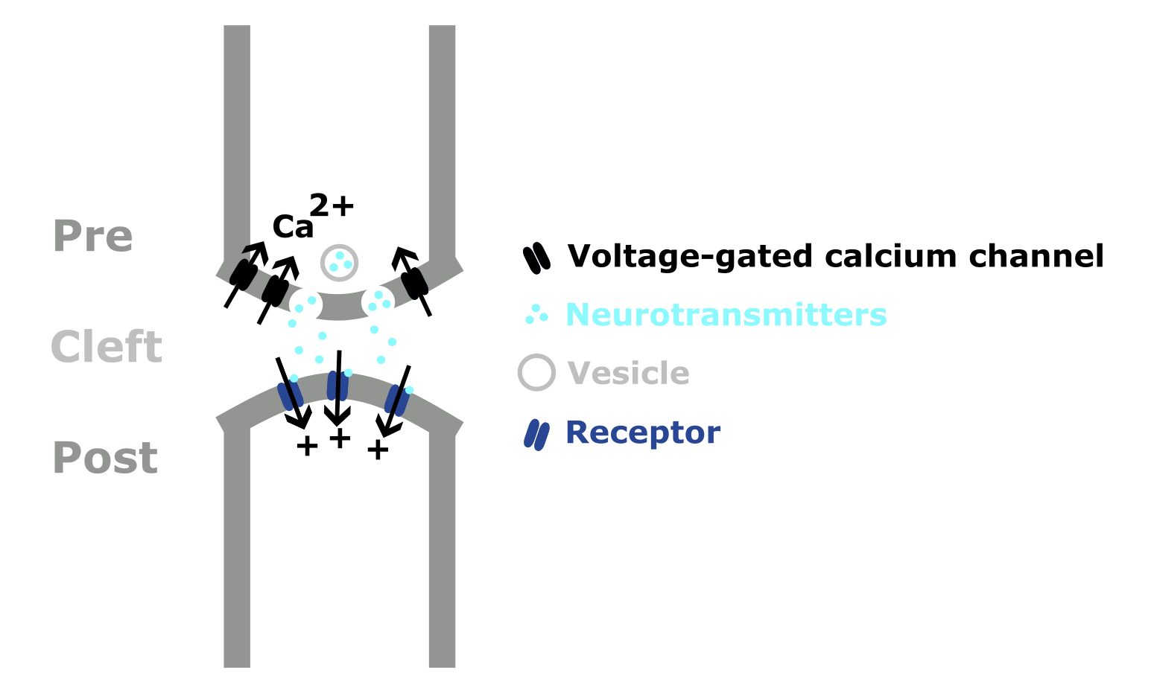
Altering synapses
Notes:
Well if we think about the structure of the synapse – then we can see that there are many possibilities for changing the connection strength – like:
Increasing the number of synaptic vesicles or density of neurotransmitters within
Increasing the number of post-synaptic receptors
Increasing the surface area of the synapse or even adding an additional synapse between the two neurons.
Linker:
But these are all long-term changes, and synaptic weights can also change on much quicker timescales on the order of hundreds to thousands of ms.

Slide 5
Short-term plasticity
Facilitation
Increased Ca⁺
Depression
Decreased neurotransmitter
Tsodyks & Wu 2013 (Scholarpedia)
Notes:
This is known as short-term plasticity, and it describes how synaptic strength dynamically changes with the level of presynaptic activity.
Broadly,
Short-term facilitation – is caused by the higher levels of calcium at the axon terminal after spiking, which increase the probability of neurotransmitter release.
Short-term depression – is caused by the lower levels of neurotransmitters available at the synapse, and in an extreme case it's possible that the synapse will fail to send a signal at all.
So, short-term plasticity shows how a neurons recent activity, and so the state of it's synapses, influences it's weight dynamically.
Linker:
Going back a step, the fact that synapses will sometimes fail to send a signal may remind some of you of drop-out in machine learning, though here it's individual connections which are failing, not the entire unit, and actually Yann Le Cun and colleagues explored this difference in a paper.
Paper:
http://www.scholarpedia.org/article/Short-term_synaptic_plasticity

Slide 6
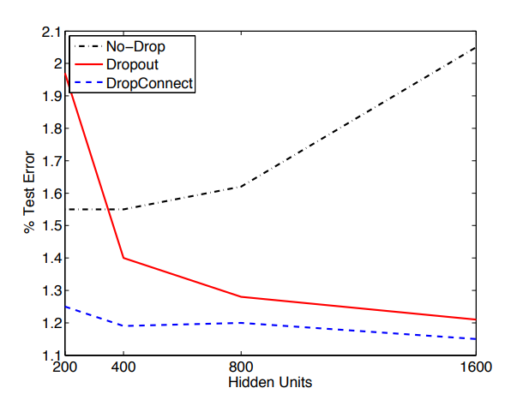
DropConnect
Wan et al., 2013 (PMLR)
Notes:
Just to be explicit:
With dropout – you randomly silence units during training, which reduces over-fitting
With dropconnect – you randomly silence weights
Just to give you a quick comparison between the two. The graph shows the text error on MNIST as a function of the network size:
With no drop, in black, the error increases with size, as the networks increasingly overfit
With dropout in red, the error decreases with size
With dropconnect, in blue, the error is lower and more stable.
If you're interested, the paper provides more empirical and theoretical results which suggest that DropConnect may be advantageous.
Linker:
Okay, that's all for this video In the next video we'll discuss how neurons synapse together to form networks.
Paper:
https://proceedings.mlr.press/v28/wan13.html

