Slide 1
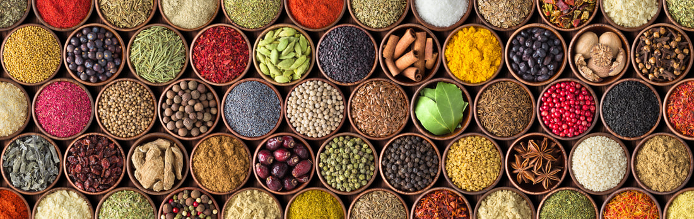


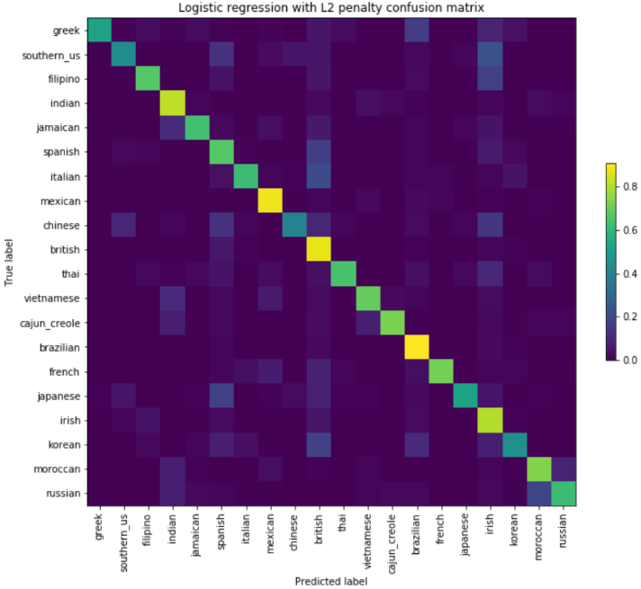
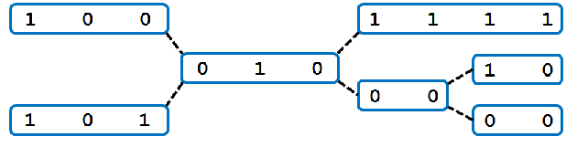
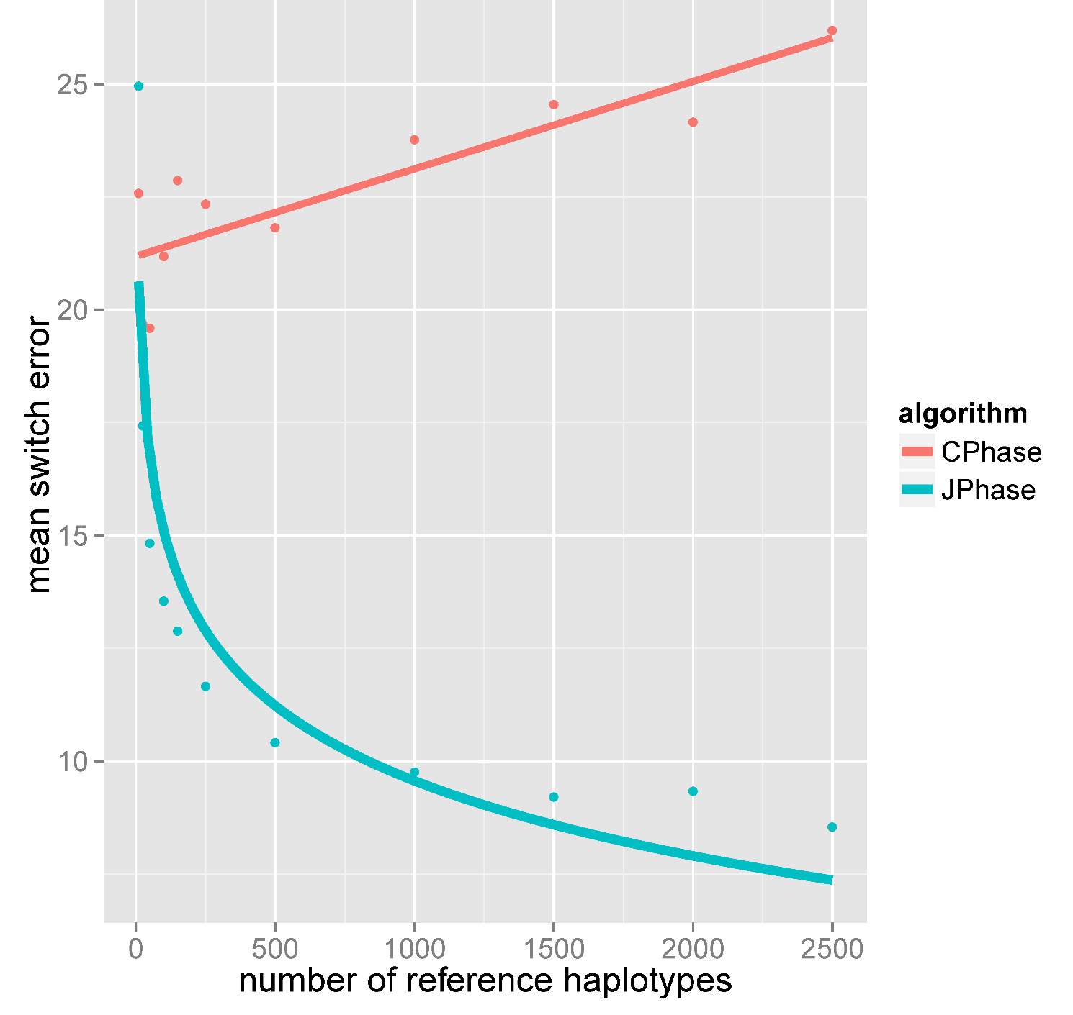
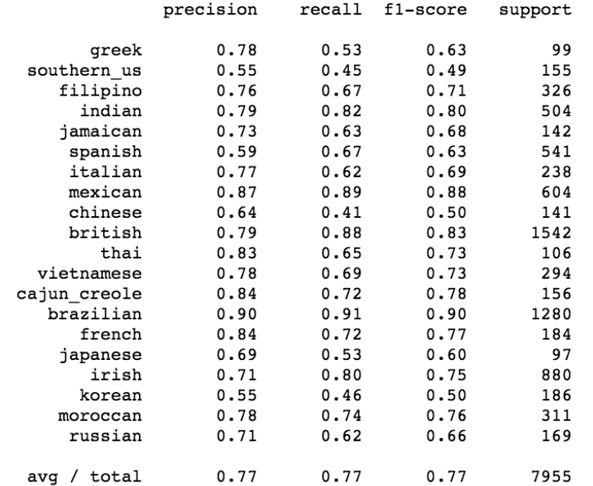
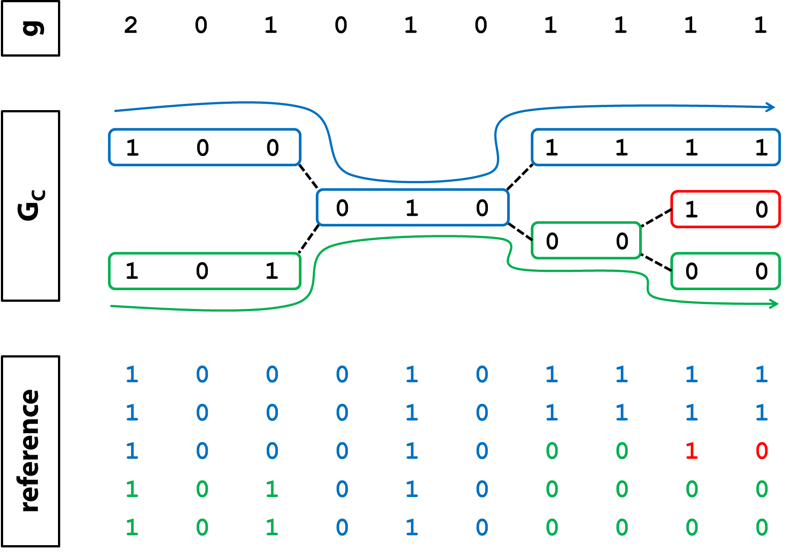
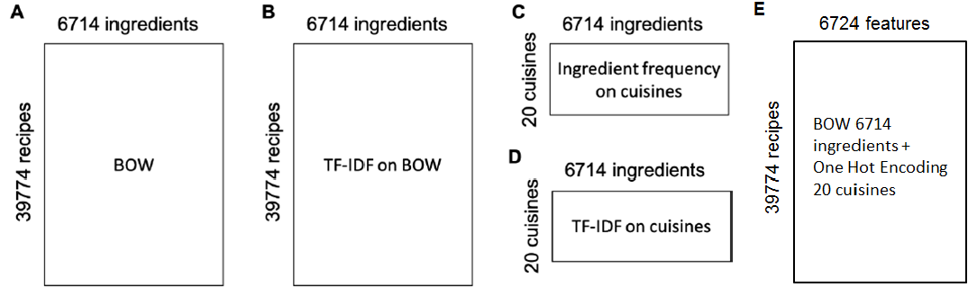
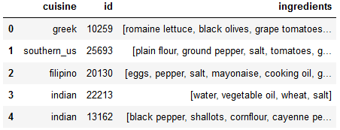
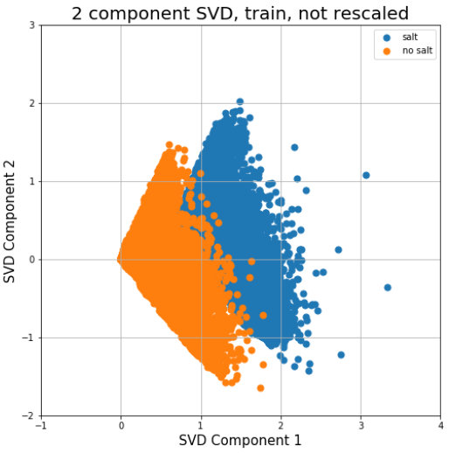
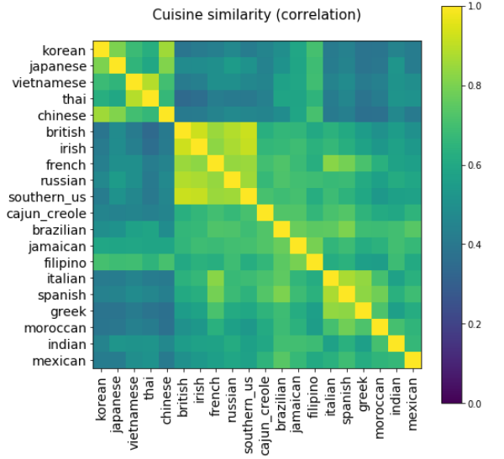
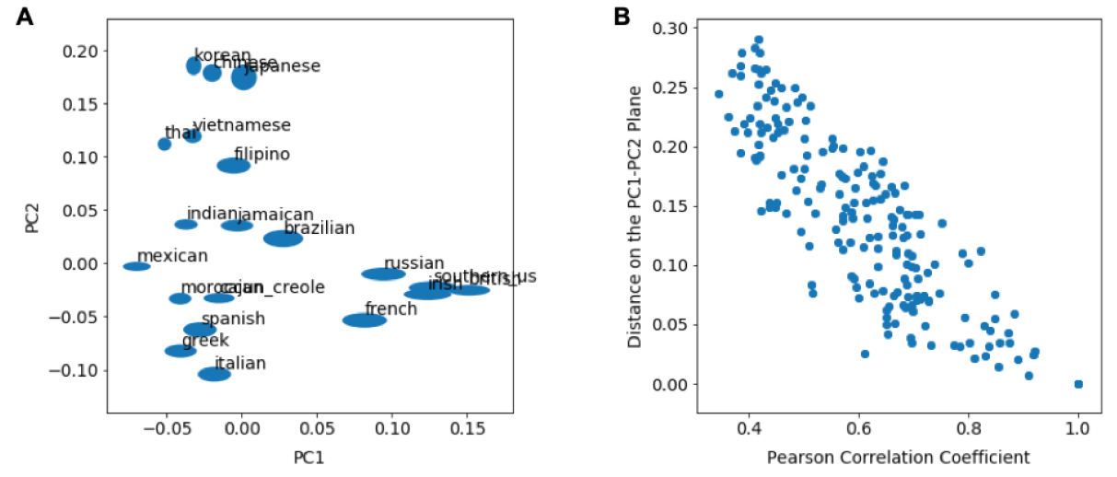
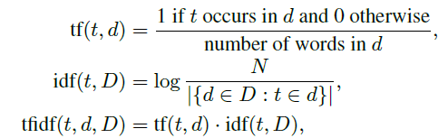
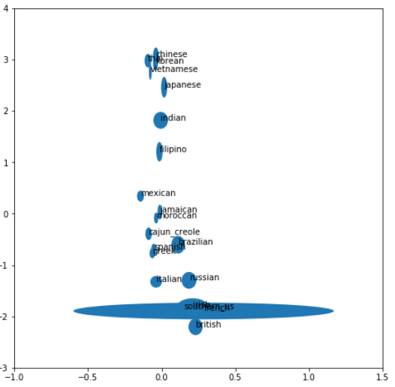
Recipe Ingredients Inform Cuisine of Origin
Collins Metto¹, Christopher Criscitiello², Lili Cai³, Mingyu Song³ Princeton University, Department of ¹ Computer Science, ² Mathematics, ³ Neuroscience
Ground cumin
Ground turmeric
Kimchi | Korean
Mirin | Japanese
Rice vinegar | Chinese/Korean/Japanese
Sake | Japanese
Sesame oil | Chinese, Korean
Soy sauce | Chinese, Korean
ABSTRACT
SUPERVISED LEARNING: Features selected matches signature ingredients, most predictive cuisines are dissimilar to others based on correlation analysis
Can recipe ingredients inform their cuisine of origin, and if so, which ingredients are most predictive? Can unsupervised learning pick up latent cuisines?
The “What’s Cooking” dataset has 39.5k recipes from 20 cuisines. Each recipe has 1 to 65 ingredients from 6714 possible ingredients.
The Kaggle 2015 challenge: use supervised learning to classify these 20 cuisines. We aim to reproduce their leaderboard results within reason. We achieved their baseline result of .77 accuracy.
We extend the challenge by using unsupervised learning to look at ingredient relationships, cuisine relationships, and if natural clusters emerge based on recipe ingredients. We find key relationships within and across ingredients and cuisines. Topic models were able to recover latent cuisines.
Features Selected
Log Reg Accuracy: .77 Overall
haplotype threading
construct haplotype cluster graph G_{C}
Mean switch error for chromosome 22, 1000 Genome Project data, across all populations
Top Features | Matching Cuisine
Gochujang base | Korean
Cachaca | Brazilian
Cajun seasoning | Cajun_creole
Coconut milk | Indian
Corn starch | Chinese
Corn tortillas | Mexican
Couscous | Moroccan
Cumin seed | Indian
Feta cheese crumbles | Greek
Fish sauce | Thai
Garam masala | Indian
Grated parmesan cheese | Italian
Used SVD to extract 1000 top features, accuracy: .77
On original 6714 features, run time took too long
Best performing cuisines: Brazilian, Mexican, followed by British, Indian, Irish
Could be due to large number of recipes + unique ingredients
High quality reference haplotype data is phased from pedigree and sequence data and used to infer haplotype cluster graph . A genotype g is then resolved by computing paths through a hidden Markov model (HMM) computed from .
HMM on
cluster size
haplotype
transitions
DATA EXPLORATION AND PREPROCESSING
1 | 0 | 0
1 | 0 | 1
0 | 1 | 0
Raw Dataset
Preprocessed Dataset
Compute phasing of on
# Recipes | 39,774
# Cuisines | 20
# Ingredients | 6,714
# Ingredients/cuisine | 1 to 65
6734 features
UNSUPERVISED LEARNING:
thread paths simultaneously
Each point denotes 100 MCMC runs. The average number of errors made decreases exponentially with more samples.
Ingredient Clustering
Latent Cuisines
Cuisines Correlations
LDA on TF-IDF recovers Latent Cuisines
Hierarchical Clustering on Cuisine TF-IDF
finds correlated groups of cuisines
Cuisine | # Recipes | Top 5-10 Ingredients based on BOW | Top 5-10 Signature Ingredients based on TF-IDF on cuisines (Representation D) | Mean # Ing/Recip
Italian | 7838 | salt, olive oil, garlic cloves, grated parmesan cheese, garlic, ground black pepper | lasagna noodles, ricotta cheese, prosciutto, marinara sauce, fresh parmesan cheese | 9.9
Mexican | 6438 | salt, onions, ground cumin, garlic, olive oil, chili powder, jalapeno chilies, avocado | refried beans, enchilada sauce, corn tortillas, tomatillos, salsa | 10.9
Southern US | 4320 | salt, butter, all-purpose flour, sugar, large eggs, baking powder, buttermilk | grits, collard greens, buttermilk, bourbon whiskey, yellow corn meal | 9.6
Indian | 3003 | salt, onions, garam masala, water, ground, turmeric, garlic, cumin seed, ground | garam masala, curry leaves, paneer, ghee, coriander powder, cumin seed | 12.7
Chinese | 2673 | soy sauce, sesame oil, salt, corn starch, sugar, garlic, water, green onions | Shaoxing wine, oyster sauce, sesame oil, hoisin sauce, dark soy sauce | 11.9
French | 2646 | salt, sugar, all-purpose flour, unsalted butter, olive oil, butter, water, large eggs | gruyere cheese, grated Gruyre cheese, chopped fresh thyme, fresh tarragon | 9.8
Cajun Creole | 1546 | salt, onions, garlic, green bell pepper, butter, olive oil, cayenne pepper, cajun | cajun seasoning, andouille sausage, creole seasoning, file powder, crawfish | 12.6
Thai | 1539 | fish sauce, garlic, salt, coconut milk, vegetable oil, soy sauce, sugar, water | fish sauce, Thai red curry paste, red curry paste, kaffir lime leaves, beansprouts | 12.5
Japanese | 1423 | soy sauce, salt, mirin, sugar, water, sake, rice vinegar, vegetable oil, scallions | mirin, sake, dashi, nori, konbu, sushi rice, dried bonito flakes | 9.7
Greek | 1175 | Salt, olive oil, dried oregano, garlic cloves, feta cheese crumbles | feta cheese crumbles, dried oregano, greek seasoning, pitted kalamata olives | 10.2
Spanish | 989 | salt, olive oil, garlic cloves, extra-virgin, olive oil, onions, water, tomatoes | saffron threads, chorizo sausage, spanish chorizo, serrano ham, manchego cheese | 10.4
Korean | 830 | soy sauce, sesame oil, garlic, green onions, sugar, salt, water, sesame seeds | Gochujang base, kimchi, sesame oil, gochugaru, toasted sesame seeds | 11.3
Vietnamese | 825 | fish sauce, sugar, salt, garlic, water, carrots, soy sauce, shallots, garlic cloves | fish sauce, beansprouts, rice paper, rice noodles, thai basil | 12.7
Moroccan | 821 | salt, olive oil, ground cumin, onions, garlic cloves, ground cinnamon, water | couscous, ras el hanout, preserved lemon, saffron threads | 12.9
British | 804 | salt, all-purpose flour, butter, milk, eggs, unsalted butter, sugar, onions | stilton cheese, suet, beef drippings, stilton, golden syrup | 9.7
Filipino | 755 | salt, garlic, onions, water, soy sauce, pepper, oil, sugar, carrots, black pepper | fish sauce, calamansi juice, lumpia wrappers, calamansi, lumpia skins | 10.0
Irish | 667 | salt, all-purpose flour, butter, onions, potatoes, sugar, baking soda, baking powder | Irish whiskey, Guinness Beer, irish cream liqueur, corned beef, irish bacon | 9.2
Jamaican | 526 | salt, onions, water, garlic, ground allspice, pepper, scallions, dried thyme, black | scotch bonnet chile, jamaican jerk season, ackee, callaloo, jerk seasoning | 12.2
Russian | 489 | salt, sugar, onions, all-purpose flour, sour cream, eggs, water, butter | sauerkraut, buckwheat flour, pierogi, dill, fresh dill, farmer cheese | 10.2
Brazilian | 467 | salt, onions, olive oil, lime, water, garlic cloves, garlic, cachaca, sugar, tomatoes | cachaca, aai, manioc flour, palm oil, chocolate sprinkles | 9.5
SVD on BOW
(informed by KMeans)
KMeans on BOW
partitions by common ingredients
LDA (on dataset B) (n=6) | Latent Cuisine
Soy sauce, sesame oil, fish sauce, rice vinegar, scallions, green onions, sugar | Korean
Avocado, jalapeno chilies, fresh lime juice, chopped cilantro, purple onion, lime, white onion | Mexican
All-purpose flour, buttermilk, baking powder, milk, warm eggs, baking soda | Southern US
Ground cumin, curry powder, ground coriander, ground cinnamon, chickpeas, ground ginger, olive oil | Indian
extra-virgin olive oil, fresh lemon juice, olive oil, garlic cloves, purple onion, ground cumin, ground black pepper | Italian
(1) test each cluster independently for association
(2) infer a distribution of ARGs from and test mutation and recombination events for association
haplotype cluster graph informs ancestry
ancestral recombination graph
1 | 0 | 0 | 0 | 0 | 0
K | Ingredients
2 | Salt
3 | Salt, onions
4 | Salt, onions, olive oil
5 | Salt, onions, olive oil, soy sauce
1 2 2.5 3 4 5 6 position
3,4,5,6
2
1 | 0 | 0 | 0 | 0 | 0
3→2 →1 →0
2 →1 →0
1 | 1 | 0 | 0 | 0 | 0
5
Pearson Correlation Coefficient
1 | 1
1 | 1 | 1 | 1
1 | 0 | 1 | 1 | 1 | 1
1 | 1 | 0 | 0 | 1 | 0
BMF on BOW recovers both ingredients and cuisines
2 →1 →0
2.5
Market Basket Analysis on BOW
Sugar, all-purpose flour, large eggs, unsalted butter, butter, baking powder, milk | Southern US
Onions, garlic, tomatoes, ground cumin, chili powder, carrots, vegetable oil | Indian
Olive oil, garlic cloves, ground black better, kosher salt, extra-virgin olive oil, grated parmesan cheese, purple onion | Italian
water | -
Soy sauce, sesame oil, green onions, garlic, sugar, vegetable oil, scallions | Asian
1 | 0
0 | 0
1 | 0
1 | 1 | 0 | 0 | 0 | 0
2.5
1 | 0 | 1 | 1 | 1 | 1
Finds relationship btwn ingredients
3→2 →1
4 → 3→2 →1
0 | 0
1 | 1 | 0 | 0 | 0 | 0
1 | 1 | 1 | 1 | 1 | 1
1 | 0 | 1 | 1 | 1 | 1
1 | 0 | 0 | 0 | 1 | 0
1 | 1 | 0 | 0 | 1 | 0
1 | 0 | 0 | 0 | 0 | 0
Antecedents | Consequents | Confidence
Onions, carrots, pepper | Salt | 1
Baking powder, white sugar, eggs | All-purpose flour | .98
Baking pwder, white sugar, all-purpose flour | Eggs | .94
2 →1
CLASSIFIERS USED
PCA on TF-IDF Ingredients matches HC correlation
Supervised Learning
Antecedents | Consequents | Lift
Active dry yeast | Warm water | 39.1
Baking soda | Baking pwder, buttermilk, salt | 29.2
Clove | Cinnamon sticks | 22.9
Garlic Powder | Onion powder | 20.4
Salt | Dijon mustard | 1.0
Olive oil | Garlic, water | 1.0
PCA on TF-IDF recovers similarity btwn cuisines
Statistical framework learns
The number of clusters at each locus
Strength of dependence between adjacent markers
Rates of fragmentation and coagulation
Similarity between haplotype cluster graphs
Model | Parameters | Input Data | Rationale
Logistic Regression | C=1, L2-penalty | A, A’ reduced features | Known for multiclass, high features
Random Forest | N_estimators=100, depth=20, 100 | A | Known for multiclass, high features
Gradient Boost | N_estimators=200, depth=20 | A | Known for multiclass, high features
,
0.25 | 0.25 | 0.92 | 0.90
0.25 | 0.50 | 0.67 | 0.93
0.25 | 1.0 | 0.53 | 0.97
0.50 | 1.0 | 0.66 | 0.87
Finds relationship btwn ingredients and cuisines (On BOW + Cuisine OHC)
Unsupervised Learning
Antecedents | Consequents | Confidence
Corn tortillas | Mexican | .98
salsa | Mexican | .95
Garam Masala | Indian | .93
(similarity of two haplotype cluster graphs) is computed as the number of pairwise haplotype cluster memberships in with prior preserved in with prior. The number of haplotypes and variants considered was 5008 and 500 respectively.
Model | Parameters | Input Data | Rationale
KMeans | n_components = 2, 3 | A | Ingredient clustering
SVD | n_components = 2, 3 | A | Ingredient clustering
Market Basket | min_support=.01, .005 | A, E | Relationship btwn ingredients and cuisine
LDA | n_components = 2,6,15 | A, B | Latent cuisines
BMF | n_components = 2,6,15 | A | Latent cuisines
PCA | n_components = 2 | B | Latent cuisines, distance btwn cuisines
Hierarchical clustering | method=‘complete’ | D | Correlation (distance) btwn cuisines
,
CONCLUSIONS:
Supervised and unsupervised learning extracts similar features, which match “top 10 signature ingredients” by cuisine
Supervised learning performed best on cuisines that are most dissimilar to others based correlation analysis
Latent topic models can extract cuisines
KMeans partitions groups based on most common ingredients
PCA on TF-IDF ingredients yields similar cuisine similarity as Hierarchical Clustering directly on TF-IDF cuisines
Questions for TAs/Prof:
Do we need LL, BIC metrics for unsupervised learning, given findings are so different?
Why does standardizing data make PCA results look weird? (bc of binary nature of data?)
How to look at Market Basket Analysis to extract relevant information?
ACKNOWLEDGEMENTS
TF-IDF Supplementary
We thank Barbara Engelhardt and the COS424 AI staff for a fantastic class, feedback and comments.
Works Cited
Kaggle “What’s Cooking” Dataset. https://www.kaggle.com/c/whats-cooking/data
SciKit Learn Python Toolbox
t = term
d = document
D = set of all documents
Haplotype cluster graph G_{C}
Learned from high quality reference sequence data [2]
Can we infer this structure without a known shared ancestry?
Our Bayesian nonparametric FCP statistical framework captures the full complexity of haplotype structure among genomic samples by inferring a haplotype cluster graph from high quality reference data. Inference relies on (1) Markov Chain Monte Carlo for exact inference; and (2) Maximization Expectation for approximate inference.
fragmentation
marginal partitioning
~
coagulation
partition-valued
overlapping blocks

