Slide 1
SIMPLEX Project Overview – TA1
From RAGs to Riches:
Utilizing Richly Attributed Graphs to Reason from Heterogeneous Data
Johns Hopkins University
Joshua T. Vogelstein
Carey Priebe & Randal Burns

Slide 2
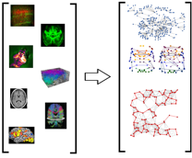
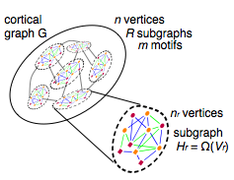
Impact Slide
Current bottleneck in neuroscientific discovery is scalable methods for inference and analysis of large complicated populations of neurographs
We will build open-source Web-services that enable
1-click tera-edge neurograph inference from tera-voxel neuroimages
Analytics and visualization capabilities on said neuroimages & neurographs
Cross-domain Impact: scalable image and graph analytics may be applied in a wide variety of domains

Slide 3
Key Technical Insights
DEFINITIONS
Basic graphs: simple graphs, weighted graphs, directed graphs
Richly Attributed Graphs (RAGs): populations of edge/vertex/graph attributed graphs
BACKGROUND
There exists literature on math/stat & computation for basic graphs
Much limited math/stat theory & methods and scalable implementations for large RAGs.
Open Connectome Project only supported Electron Microscopy data
 | n | |V| | |E|
Dataset 1 | 10² | 10⁶ | 10⁹
…
Dataset 10 | 10² | 10⁶ | 10⁹
Total | 10³ | 10⁶ | 10¹²

Slide 4
Key Technical Insights
Goals
Task 1 | Joint embedding of populations of graphs
Task 2 | Extend image database to enable estimating RAGs
Task 3 | Ingest & align multimodal data using optimized methods
Task 4 | Constructing, summarizing, and exploiting RAGs

Slide 5
Key Technical Insights
TECHNICAL APPROACH
Extend basic graph embedding theory & methods to RAG embedding
Extend FlashGraph to support matrix operations such as eigs, svd, kmeans, etc.
Extend Open Connectome to support multiscale data
WHAT’S NEW?
Statistical models of RAGs that admit inference algorithms with provable convergence properties
Single machine scalable algorithms to implement such algorithms
Big neuroscience data across scales
WHY WILL THIS HAVE IMPACT?
Dearth of existing tools
Said tools currently require compute clusters
We make Web-services to eliminate this bottleneck

Slide 6
Task 1: Mathematical Formalism
Overview & Timeline
 | Joint embedding of populations of graphs
Phase I | Theory & methods
Phase II | Scalable implementations
Phase III | Applications to statistical testing

Slide 7
Task 1 Phase I:
 | Theory and methods for joint graph embedding
Opportunity | Lots of populations of attributed graphs available in neuroscience
Challenge | Arrays constituting populations of graphs are high-dimensional, and non-Euclidean
Action | We develop several different approaches to joint embedding with different pros and cons
Resolution | Joint embedding yields more parsimonious models of populations of graphs than independent embedding

Slide 8
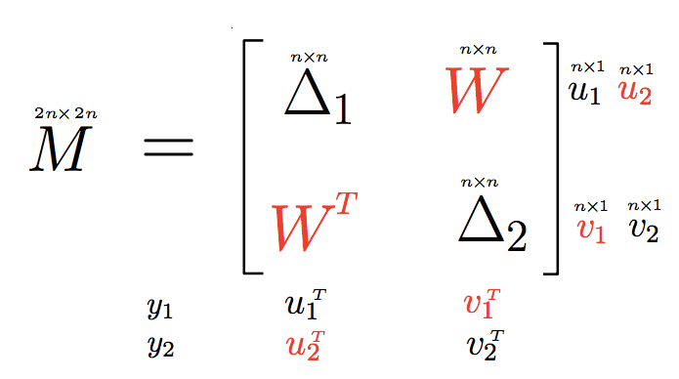
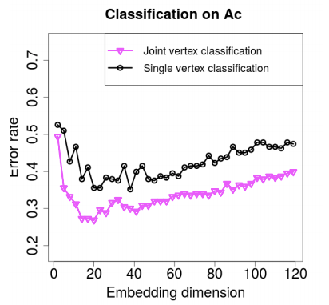
1.I.A) Joint Omnibus Adjacency Matrix Embedding
Key Idea: jointly embed m sparse adjacency matrices
Pro: Computationally efficient and improved accuracy over independent embeddings
Con: Must impute off-diagonal blocks
Reference: A Joint Graph Inference Case Study: the C.elegans Chemical and Electrical Connectomes. http://arxiv.org/abs/1507.08376

Slide 9
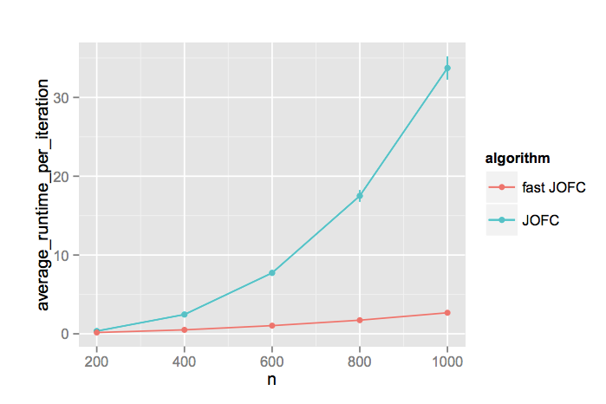
1.I.B) Joint Omnibus Dense Dissimilarity Matrix Embedding
Key idea: jointly embed dense dissimilarity matrices, ignoring missing data
Pros: Improved algorithmic efficiency over naive implementation
Cons: Still not scalable to massive data
Reference: Fast Embedding for JOFC Using the Raw Stress Criterion. http://arxiv.org/abs/1502.03391

Slide 10
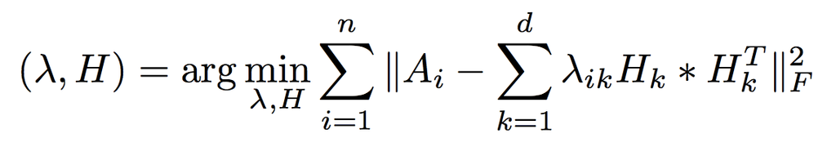
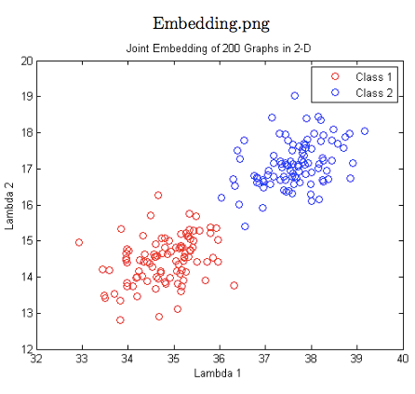
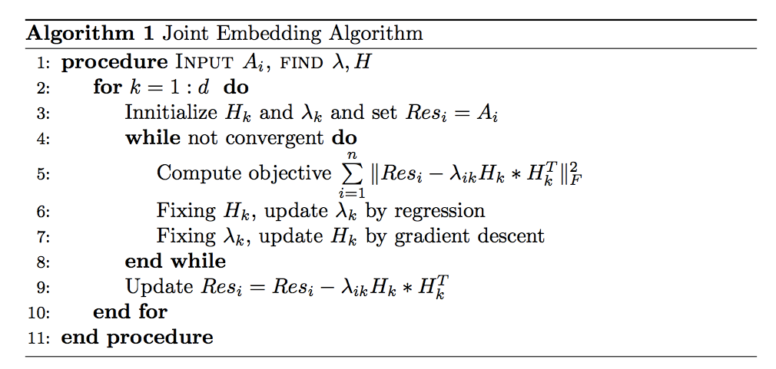
1.I.C) Eigen-Graphs
Key idea: Model based inference algorithm where graphs are linear combinations of eigengraphs
Pro: fastest & best
Con: newest & least well understood

Slide 11
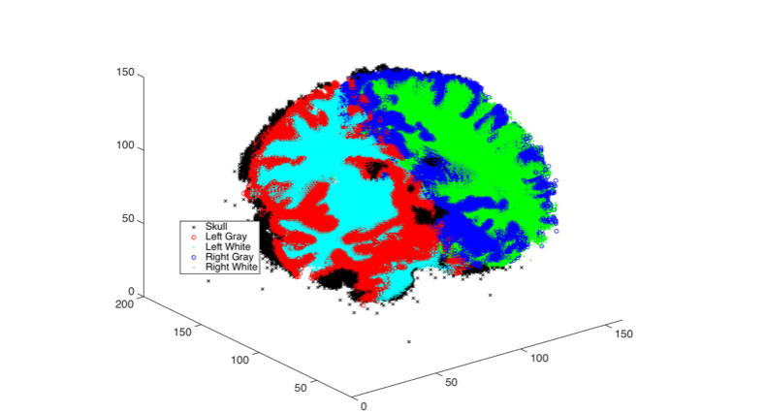
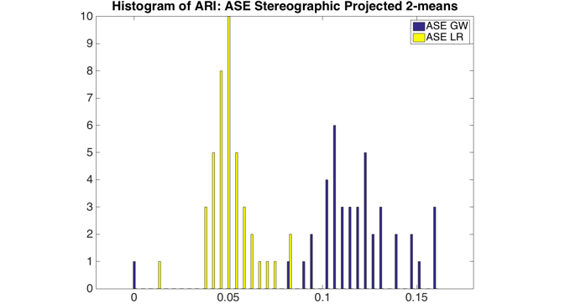
1.I.D) Benchmarking
Independent embedding: ASE vs Laplacian yields different results
ASW: GW
Laplacian: LR
Both are approximately equally fast

Slide 12
Task 1 Phase II:
 | Computational implementations for joint graph embedding
Opportunity | Phase I develops novel methods, we require scalable implementations of those methods
Challenge | FlashGraph operates only on graphs, and in particular only traversal algorithms, not matrix algebra
Action | Extend FlashGraph to support matrix algebra primitives which are used to scale the embedding methods
Resolution | Methods are highly scalable, with R bindings, and now support attributed graphs

Slide 13
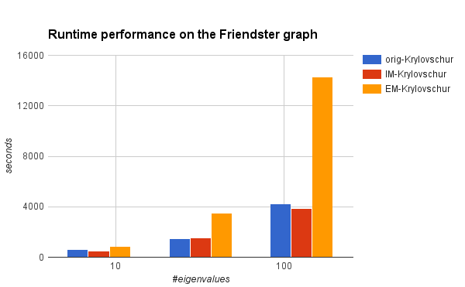
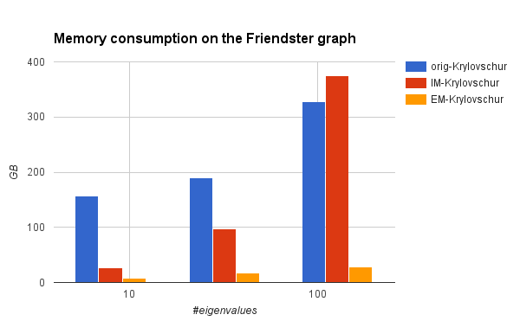
1.II.A) FlashMatrix Factorization
svd & eigs implemented for large sparse matrices
Friendster graph
65 million nodes, 1.8 billion edges
Nearly constant memory consumption for different numbers of eigenvalues.
Page graph
3.5 billion nodes, 128 billion edges
Required 6 hours and 167GB to compute first 8 eigenvectors.
singular values | residual
10563 | 4.067819E-13
10442 | 1.044935E-13
9531 | 2.527054E-13
7905 | 9.656768E-14

Slide 14
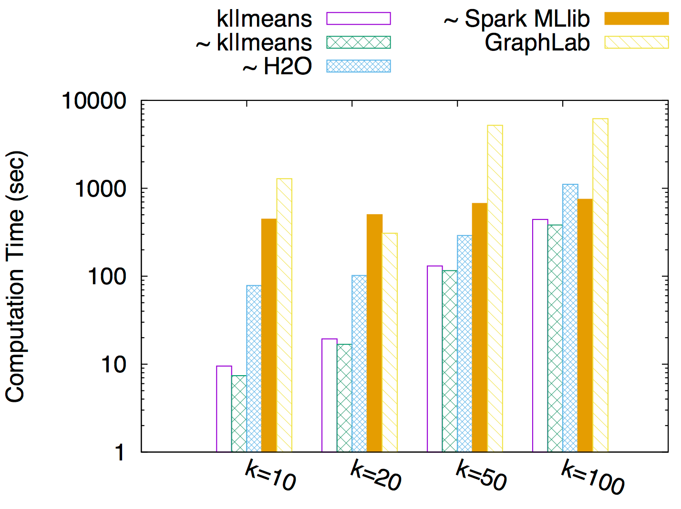
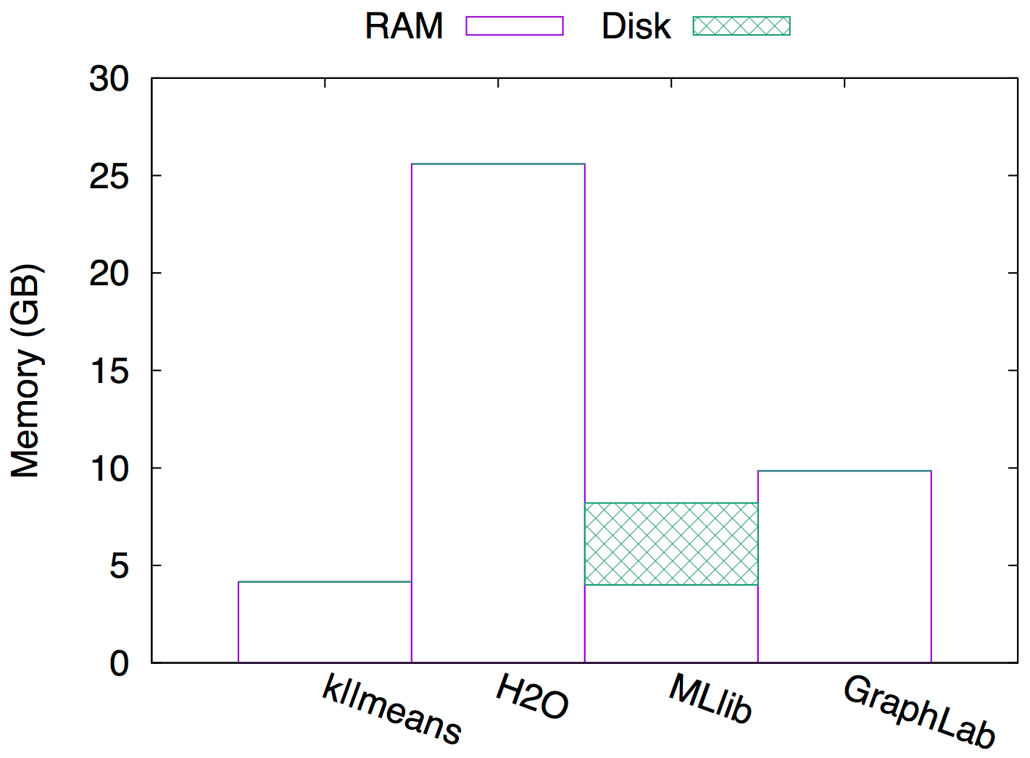
1.II.A) FlashMatrix k-means
Friendster eigen matrix embedding dim: 65,608,366 x 8 double point floating precision ≈ 4GB
With (without) “~" is a convergence tolerance of 1e-6 (0, i.e., no cluster changes from iteration n-1 to n).
FlashMatrix k||means is faster and uses less memory than others in preliminary tests

