Slide 1
SIMPLEX Monthy Report
October 2015
From RAGs to Riches:
Utilizing Richly Attributed Graphs to Reason from Heterogeneous Data
Johns Hopkins University
Joshua T. Vogelstein
Carey Priebe & Randal Burns

Slide 2
1.A) Eigen-Graphs
Manuscript documenting eigendecomposition in progress
should be submitted this month
we will send manuscript when ready
Non-negative matrix factorization
work with columbia is a special case with a particular penalty
we are investigating 2 different R packages, PMA vs. NMF, to determine which of those will be better to back-end
both should enable penalized matrix decompositions at scale on a single machine

Slide 3
2.A) Dense Arrays
Replacing previous compression with blosc, which is much faster
Added preliminary versioning to backend to enable “undo”
Added auto-ingest so that anybody can now upload data

Slide 4
2.B) Sparse Arrays
New repo: https://github.com/openconnectome/NeuroDataViz
Code now runs stand-alone
Added dataviews

Slide 5
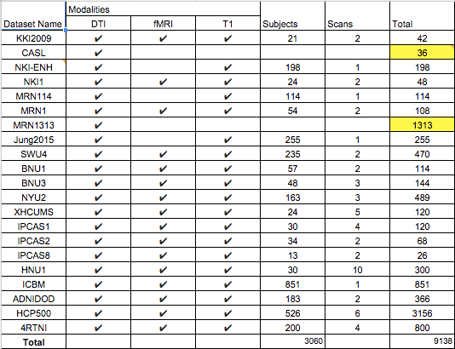
3.A) Diffusion MRI
Counted: we have access now to 9,000+ DTI scans
Setting up AWS to run all of them

Slide 6
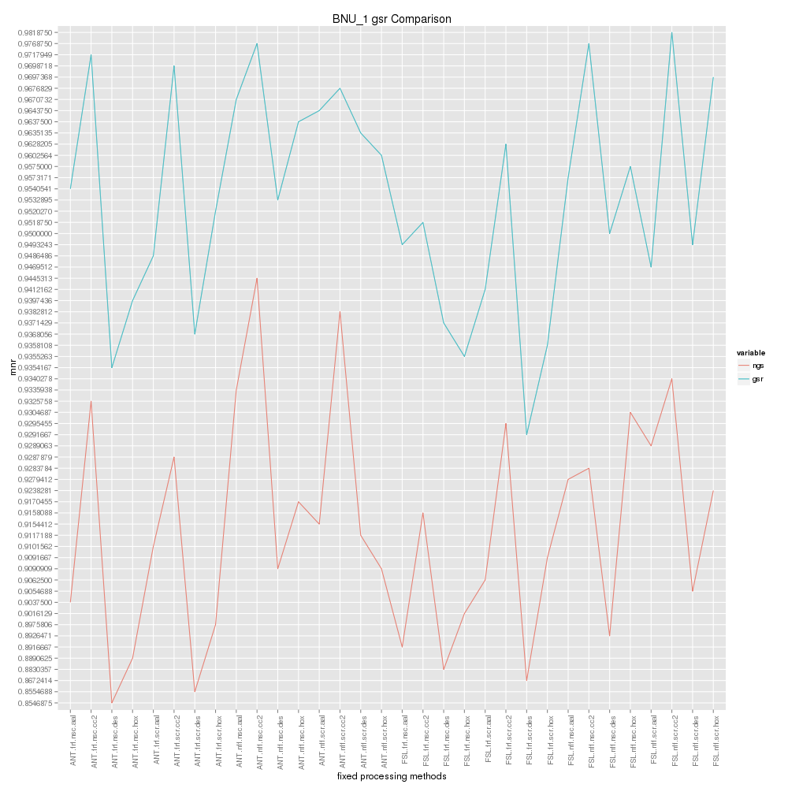
3.B) Functional MRI
Finished processing 6 datasets, results are seeming to be consistent

Slide 7
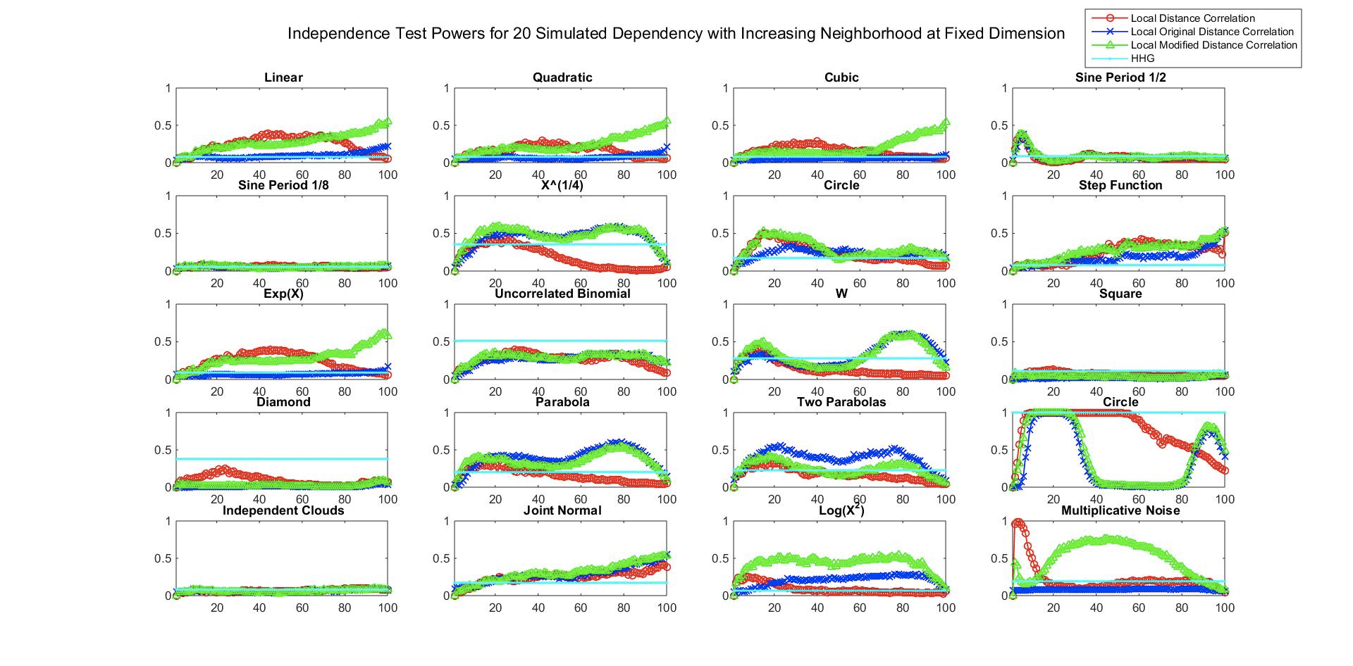
4.A) Graph Sparsification MRI
locality is key, we can efficiently find the best sparsification, in both low & high dimensional data

