Slide 1
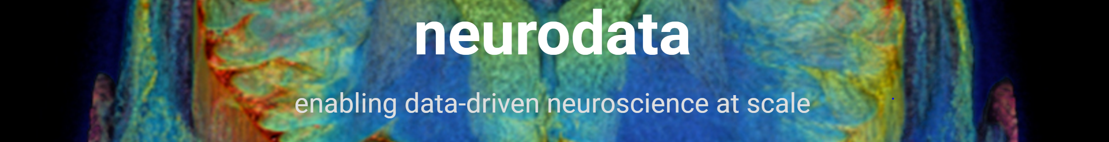
DARPA SIMPLEX Report Computation Engines
PI: Joshua Vogelstein
N66001-15-C-4041
Presented by: Randal Burns (co-PI), Da Zheng, Disa Mhembere

Slide 2
Semi-external memory compute engines
Doing more (work) with less (hardware, energy)
For graph algorithms = FlashGraph (GRAPHS)
New formulation of semi-external
From functional graph computations to algorithmic state
For generalized matrix operations = FlashR, FlashEigen, Flash???
Notes:
Web-services categorized. Read and write spatial data.
Neuroscience ontology--to represent structures and their relationships. E.g., synapses, segments, neurons.
All volumetric and spatial queries build on this capabaility
Designed for computer vision, not biology. Is extensible.

Slide 3
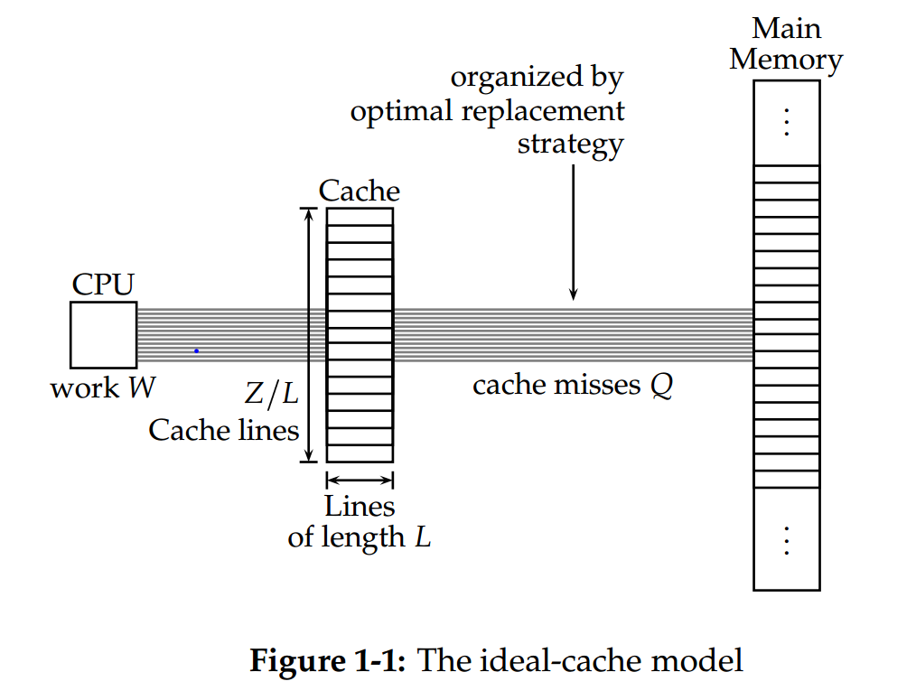
Semi-External Memory
Derivative from external memory (EM)
EM is a cost model for algorithms based on the number of transfers of block aligned storage
A better measure than algorithmic complexity big-O for all I/O bound problems
Permutation lower bound: many linear problems take sort(n)=nlogn I/Os
Semi-external memory (SEM)
Abello et al. A Functional Approach to Graph Algorithms, 1998: “…semi-external model for graph problems, in which the vertices but not the edges fit in memory”
True for most graphs (including sparse, natural graphs)
FlashGraph (GRAPHS)
A semi-external memory graph processing engine
Fast, compact, and power efficient
In contrast to distributed, in-memory computing
Notes:
Web-services categorized. Read and write spatial data.
Neuroscience ontology--to represent structures and their relationships. E.g., synapses, segments, neurons.
All volumetric and spatial queries build on this capabaility
Designed for computer vision, not biology. Is extensible.

Slide 4
FlashGraph Scalability
Largest graph we found: 3.5B vertices and 129B edges.
Previous Results:
Google Pregel used 300 multi-core machines for SSSP in +10 min on 1B vertex and 127B edge graph.
Microsoft Trinity used 14 12-core machines for BFS in +10 min on 1B vertex and 13B edge graph.
Algorithm | Runtime (min) | Memory (GB)
BFS | 5 | 22
Betweenness | 10 | 81
Triangle | 130 | 55
WCC | 8 | 47
PageRank | 34 | 46
Scan statistic | 6 | 83
FlashGraph uses one machine with 32 CPU cores.
Notes:
This is NOT direct performance comparison, but it gives you some sense what the performance number means.
With this comparison, I think we can conclude that FlashGraph is a very promising technique for large-scale graph analysis.

Slide 5
Why is SEM so effective?
Technology trends have made it more relevant
Processor speed increases have made memory access the bottleneck, i.e. no scaling from parallelism
Solid-state storage devices has made it more realistic to do I/O:
Faster than network messages (better to go SEM than distributed)
Random I/O possible (when done asynchronously)
Many algorithms much faster in SEM than EM
Why is SEM so important?
Scalability of algorithms without
Power consumption: fewer processors, SSDs more efficient than RAM
Resources: bigger problems on less hardware
Must improve scale (particularly power) to realize exascale
Overcome Dennard scaling limitations
Notes:
Web-services categorized. Read and write spatial data.
Neuroscience ontology--to represent structures and their relationships. E.g., synapses, segments, neurons.
All volumetric and spatial queries build on this capabaility
Designed for computer vision, not biology. Is extensible.

Slide 6
SEM Recast
Change formulation for semi-external memory
From “the vertices but not the edges fit in memory”
To “algorithmic state fits in memory, but the input data does not”
Definition consistent with graph notion, but generalizes
Sparse matrix multiplication
Keep a small dense matrix and multiplication results in memory
Access the large sparse matrix from SSD
Other SEM algorithms
K-means – keep the centroids (and pruning data in memory)
Visualization: isosurfaces/isovolumes, streamlines, volume rendering
Future directions – Is there a generalized cache-oblivious framework for semi-external memory algorithms?
robust to mutli-level cache hierarchies and cache line size parameters?
Notes:
Web-services categorized. Read and write spatial data.
Neuroscience ontology--to represent structures and their relationships. E.g., synapses, segments, neurons.
All volumetric and spatial queries build on this capabaility
Designed for computer vision, not biology. Is extensible.

