Slide 1
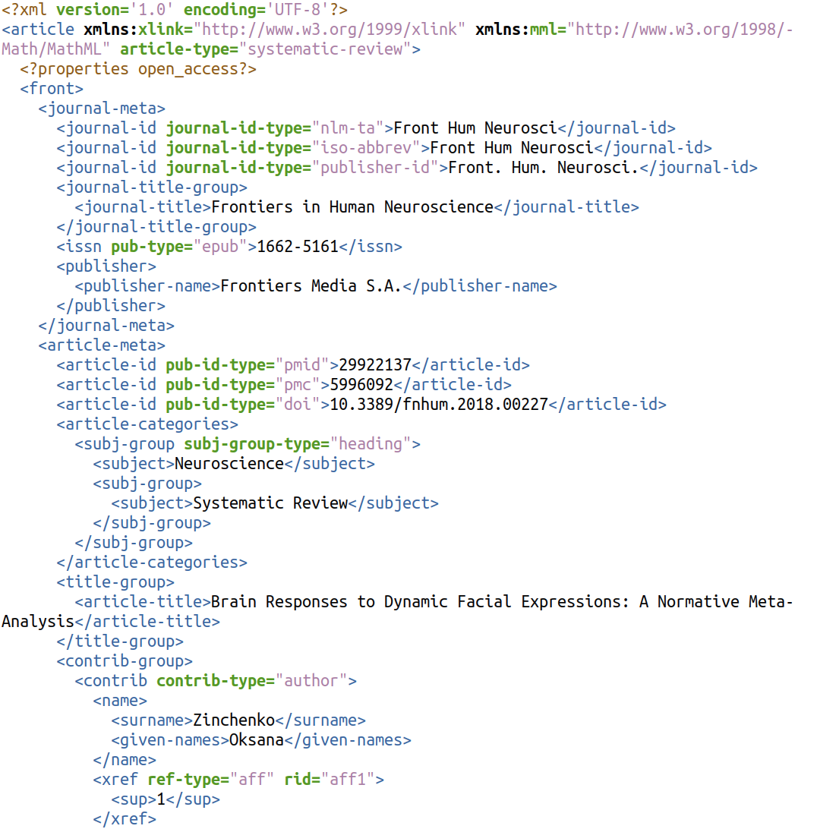
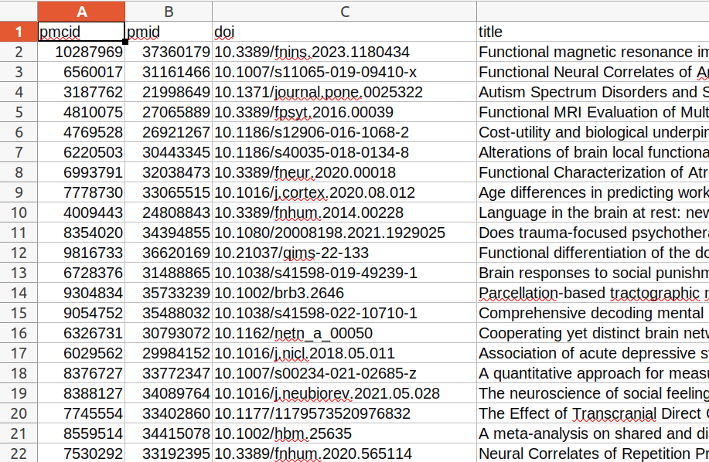
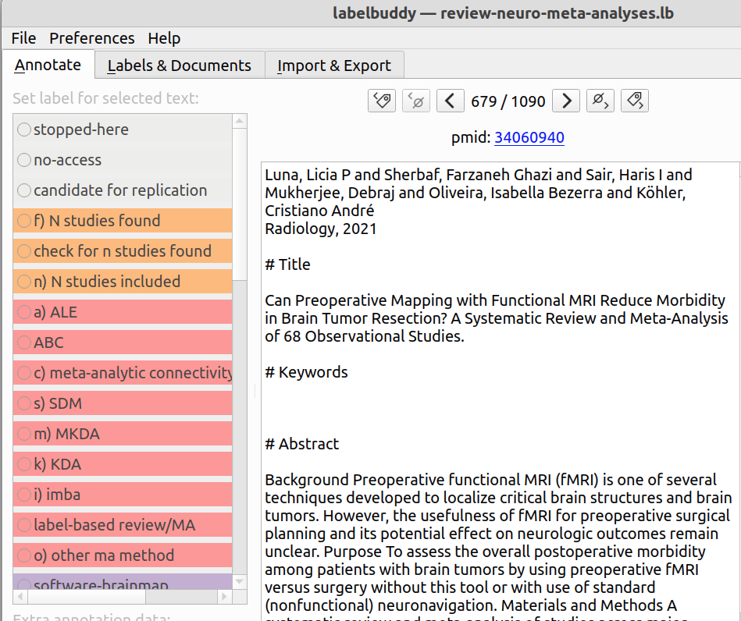
Topic:
Music fMRI
USER
A) Format query
Understand PMC search syntax
Query:
“Music[Title] AND (fMRI[Abstract] OR functional magnetic resonance imaging[Abstract])”
B) Format URL
Understand how to format URLs with the Entrez E-utilities
URL:
https://eutils.ncbi.nlm.nih.gov/entrez/eutils/esearch.fcgi?db=PMC&term=Music[Abstract]+AND+(fMRI[Abstract]+OR+functional+magnetic+resonance+imaging[Abstract])&usehistory=y
C) Retrieve nested results in XML
Sequence URL requests
Handle network errors
Time the requests
Chunk the results
PUBGET
D) Extract flat tabular data and
annotation-ready texts
Parse nested XML
Account for various XML formats for different journals
Extract unstructured data with NLP

Slide 2
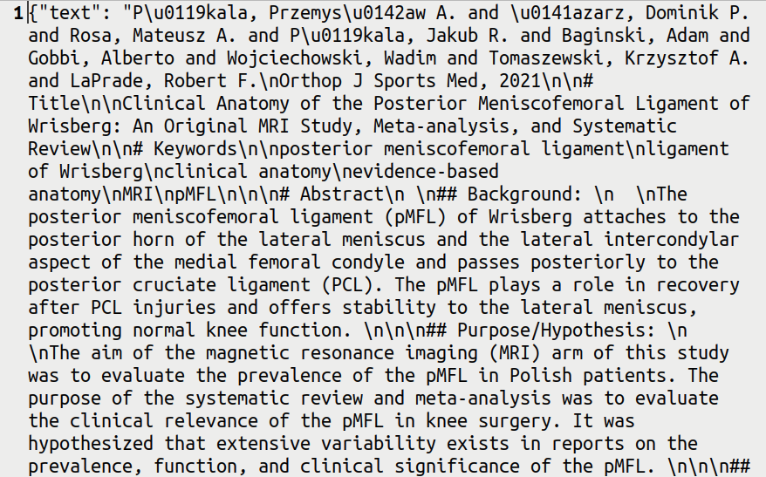
PMC
Build query
“Music[Title] AND (fMRI[Abstract] OR functional magnetic resonance imaging[Abstract])”
PUBGET
Format URL
https://eutils.ncbi.nlm.nih.gov/entrez/eutils/esearch.fcgi?db=PMC&term=Music[Abstract]+AND+(fMRI[Abstract]+OR+functional+magnetic+resonance+imaging[Abstract])&usehistory=y
Retrieve journal articles as nested XML
Journal article in XML format:
Journal article in XML format:
Output tabular data
Output texts ready for annotation
labelbuddy
(using labelbuddy)
Import & annotate texts
(using labelbuddy-annotations)
Transform to tabular data
(using custom code)
Analyze data

Slide 3
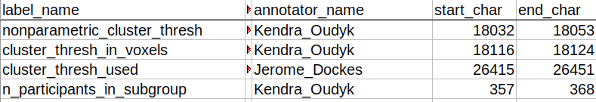
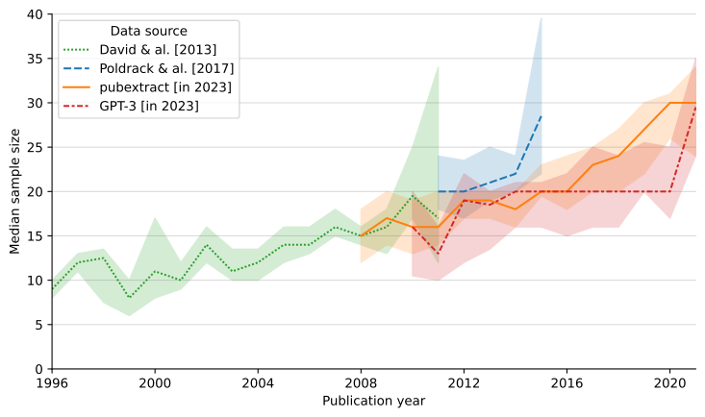
PMC website
Build query
“Music[Title] AND (fMRI[Abstract] OR functional magnetic resonance imaging[Abstract])”
pubget
Format URL
https://eutils.ncbi.nlm.nih.gov/entrez/eutils/esearch.fcgi?db=PMC&term=Music[Abstract]+AND+(fMRI[Abstract]+OR+functional+magnetic+resonance+imaging[Abstract])&usehistory=y
Retrieve journal articles as nested XML
Journal article in XML format:
Journal article in XML format:
Output tabular data
Output texts ready for annotation
labelbuddy
Import & annotate texts
labelbuddy-annotations
Transform to tabular data
custom code
Analyze data

Slide 4
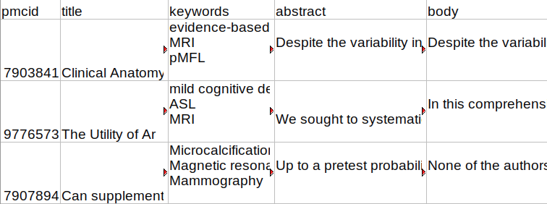
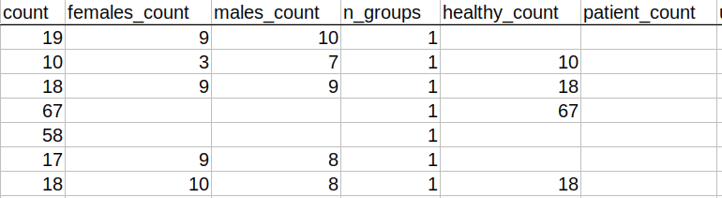
PMC website
Build query
“Music[Title] AND (fMRI[Abstract] OR functional magnetic resonance imaging[Abstract])”
pubget
Format URL
https://eutils.ncbi.nlm.nih.gov/entrez/eutils/esearch.fcgi?db=PMC&term=Music[Abstract]+AND+(fMRI[Abstract]+OR+functional+magnetic+resonance+imaging[Abstract])&usehistory=y
Retrieve journal articles as nested XML
Journal article in XML format:
Journal article in XML format:
Output tabular data
Output texts ready for annotation
pubextract
Train/test/use methods for extracting further data
labelbuddy
Import & annotate texts
labelbuddy-annotations
Transform to tabular data
custom code
Analyze data

Slide 5
PMC website
Build query
“Music[Title] AND (fMRI[Abstract] OR functional magnetic resonance imaging[Abstract])”
pubget
Format URL
https://eutils.ncbi.nlm.nih.gov/entrez/eutils/esearch.fcgi?db=PMC&term=Music[Abstract]+AND+(fMRI[Abstract]+OR+functional+magnetic+resonance+imaging[Abstract])&usehistory=y
Retrieve journal articles as nested XML
Journal article in XML format:
Journal article in XML format:
Output tabular data
Output texts ready for annotation
pubextract
Train/test/use methods for extracting further data
labelbuddy
Annotate texts
Ground truth
custom code
Analyze data

Slide 6
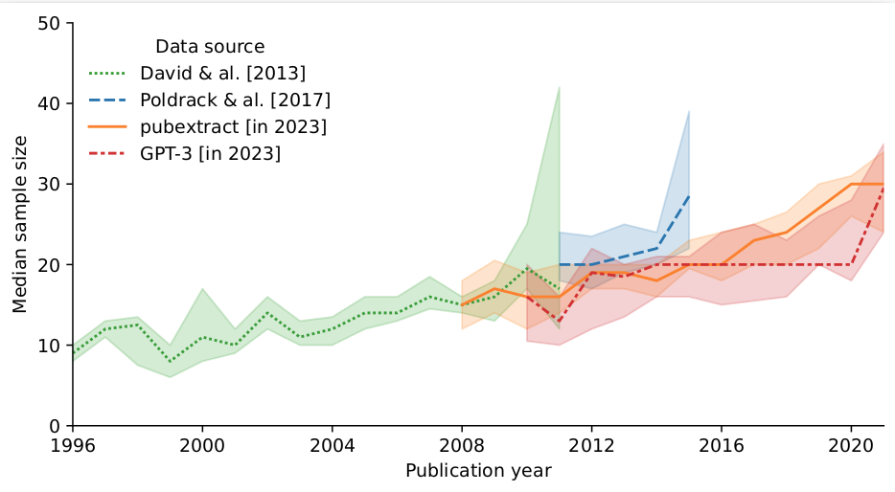
PMC website
Build query
“Music[Title] AND (fMRI[Abstract] OR functional magnetic resonance imaging[Abstract])”
pubget
Format URL
https://eutils.ncbi.nlm.nih.gov/entrez/eutils/esearch.fcgi?db=PMC&term=Music[Abstract]+AND+(fMRI[Abstract]+OR+functional+magnetic+resonance+imaging[Abstract])&usehistory=y
Retrieve journal articles as nested XML
Journal article in XML format:
Journal article in XML format:
Output tabular data
Output texts ready for annotation
pubextract
Train/test/use methods for extracting further data
“...We had 19 healthy participants in this study (10 male; age range 20-28...”
labelbuddy
Annotate texts
Ground truth
custom code
Analyze data

Slide 7
PMC website
Build query
“Music[Title] AND (fMRI[Abstract] OR functional magnetic resonance imaging[Abstract])”
pubget
Format URL
https://eutils.ncbi.nlm.nih.gov/entrez/eutils/esearch.fcgi?db=PMC&term=Music[Abstract]+AND+(fMRI[Abstract]+OR+functional+magnetic+resonance+imaging[Abstract])&usehistory=y
Retrieve journal articles as nested XML
Journal article in XML format:
Journal article in XML format:
Output tabular data
Output texts ready for annotation
labelbuddy
Annotate texts
Ground
truth
pubextract
Train/test/use methods for extracting further data
“...We had 19 healthy participants in this study (10 male; age range 20-28...”
custom code
Analyze data

