Slide 1
interim NBM sim results
24-06-13

Slide 2
contents
updates
safety indices
uncertainties in code
next steps

Slide 3
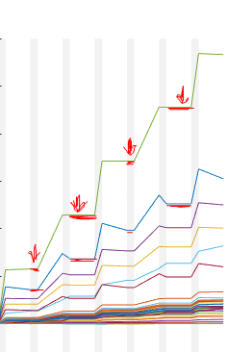
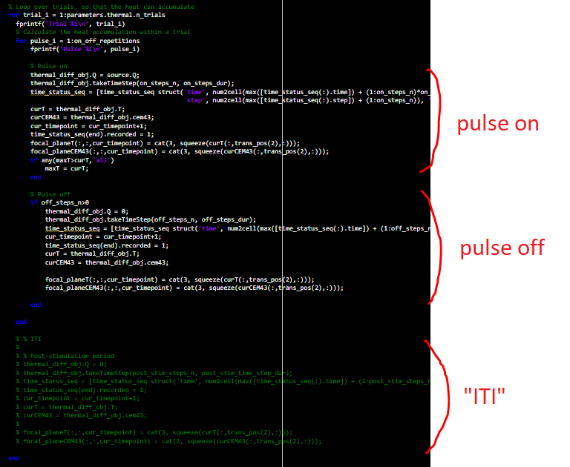
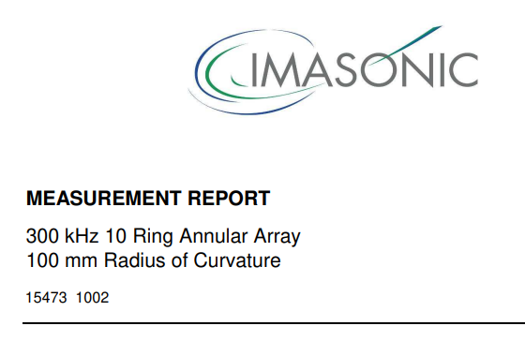
updates
resolved “heating timeline bug”:
integration of Imasonic transducers into configs
(chose 100 mm RoC for deeper geometric focus)
initial sim results with Imasonic on NBM in one sbj

Slide 4
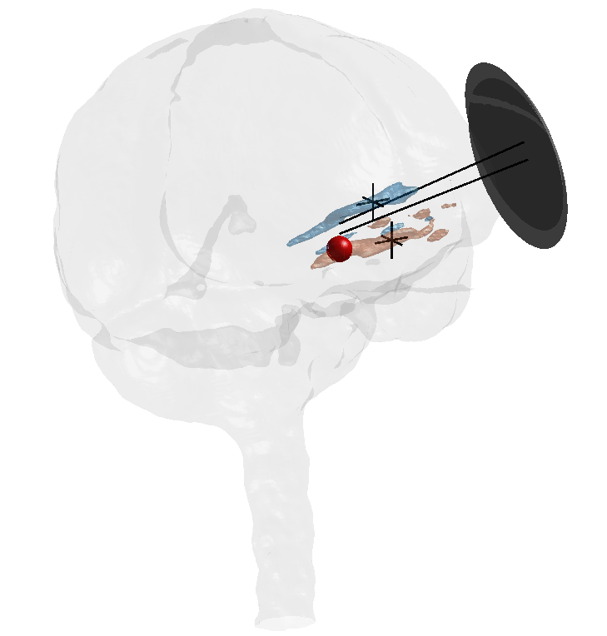
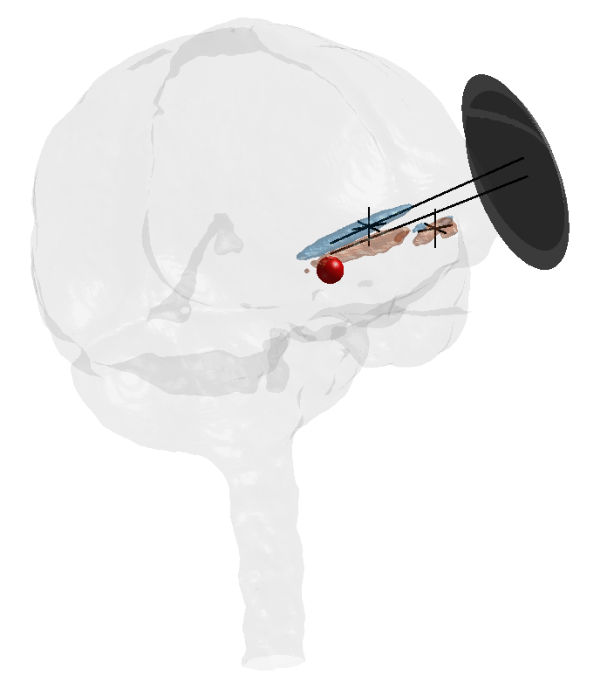
Isppa pattern CTX500 vs. Imasonic
(TODO:
bowls should be differently sized)
80s
45% DC
5 Hz PRF
CTX500
Imasonic
(see matlab Figure 1)
(see matlab Figure 2)
free water intensity: | 62.2421 W/cm^2 | 62.2421 W/cm^2
max Isppa: | 1.3104 W/cm^2 | 2.0302 W/cm^2

Slide 5
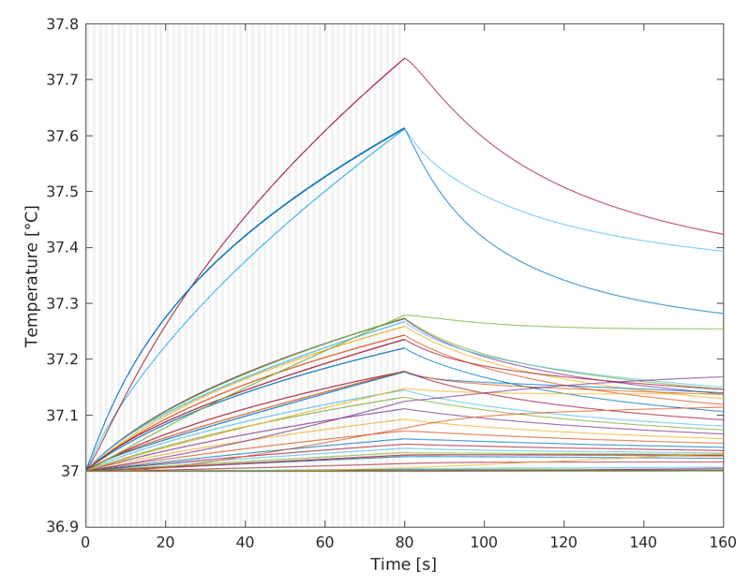
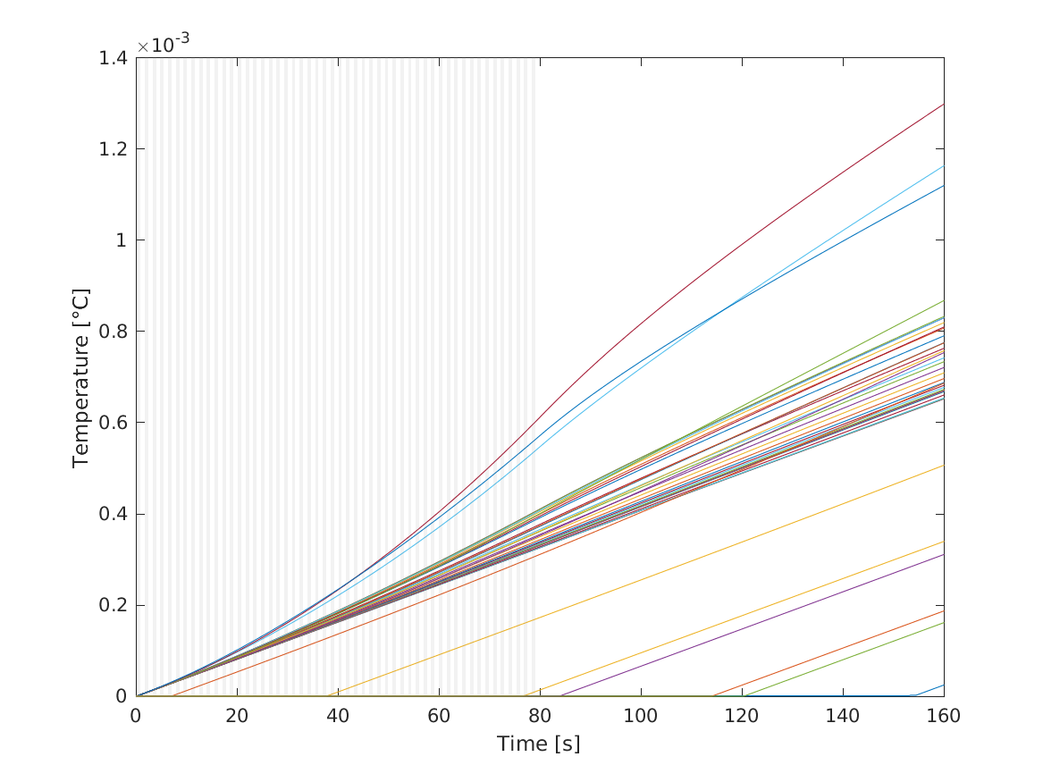
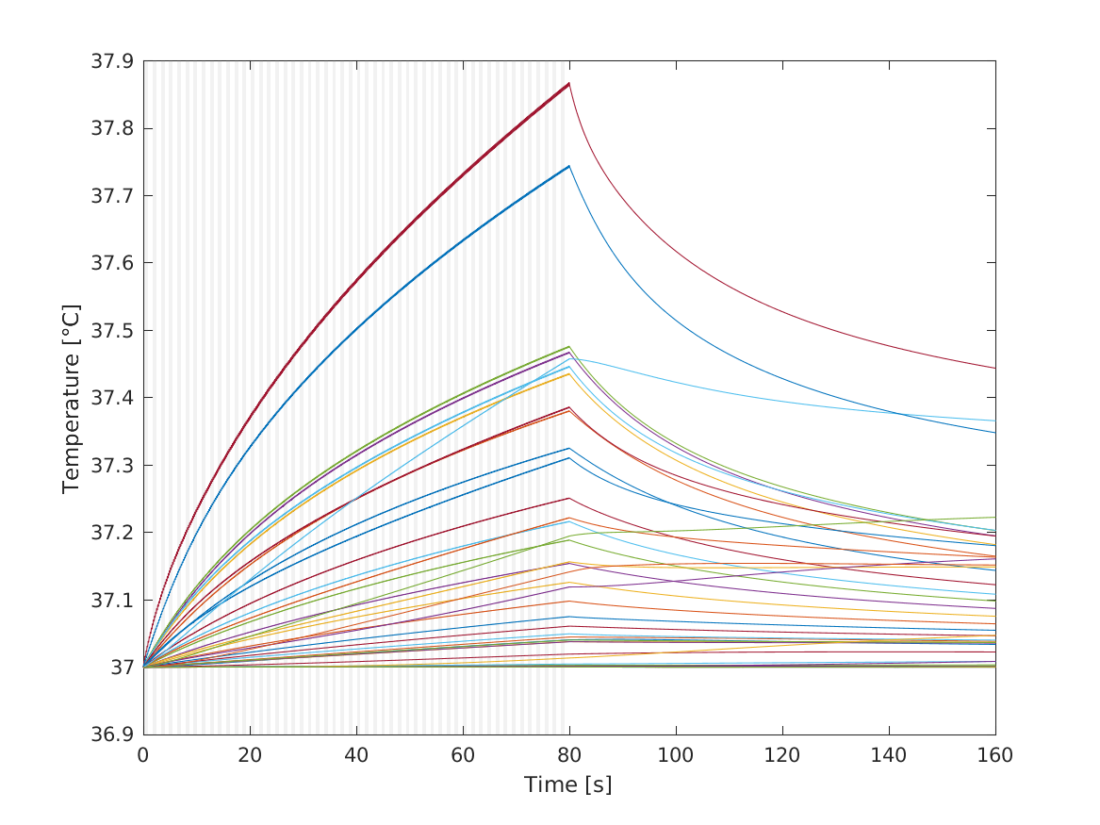
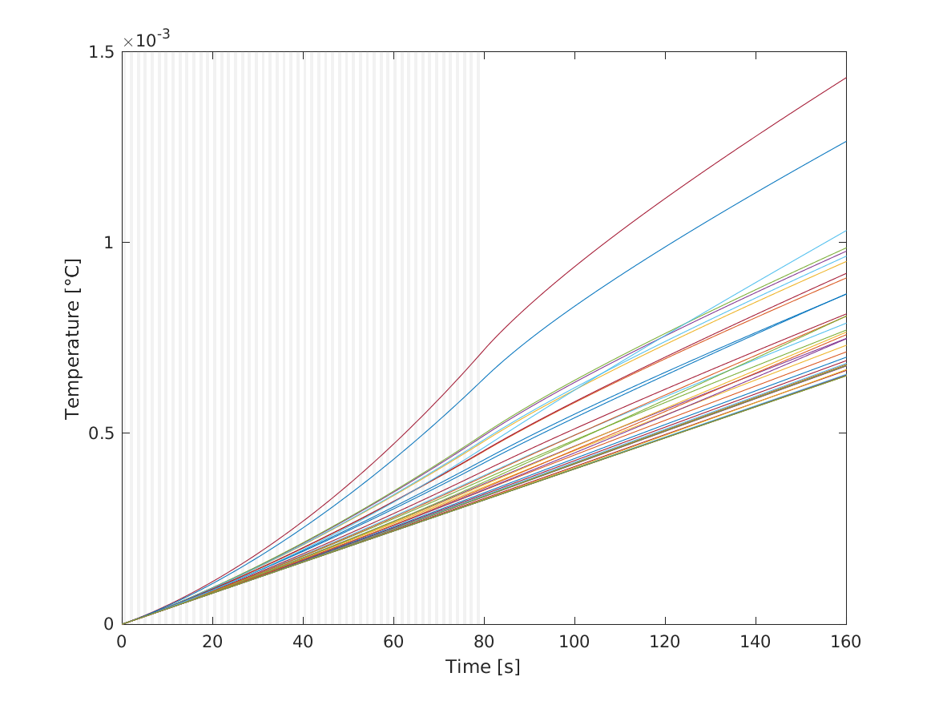
heating timelines
T
CEM43°C
Imasonic
free water intensity: | 62.2421 W/cm^2

Slide 6
safety indices
according to ITRUSST consensus
(currently still running:
deeper steering AND
free water I: 225 W/cm²
eta: 1 hour)
Imasonic
free water intensity: | 62.2421 W/cm^2
max Isppa | max_Isppa skull | max_Isppa brain | max_pressure skull | max_pressure brain | max_MI skull | max_MI brain | isppa at_target | avg_isppa around_target | maxT | maxT brain | maxT skull
13.43416 | 3.797333 | 1.303077 | 627219 | 205291.3 | 1.14514 | 0.374809 | 0.7191563 | 0.3278622 | 37.99302 | 37.32696 | 37.94737
8.619675 | 4.125885 | 2.079949 | 653790.2 | 259365.4 | 1.193652 | 0.4735342 | 1.416319 | 0.5046679 | 38.0135 | 37.48237 | 37.98834

Slide 7
Imasonic position variations
(TODO:
bowl should be larger)
Imasonic
free water intensity: | 62.2421 W/cm^2 | 62.2421 W/cm^2
max Isppa: | 1.3104 W/cm^2 | 2.0302 W/cm^2

Slide 8
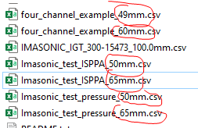
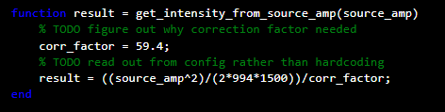

uncertainties in code
“expected_focal_distance_mm”?
transducer-target-dist? value in profiles?
calculation pressure to intensity (from source_amp) correct?
does center PCD need modeling? - NO
correct profile chosen?
“source_phase_deg” in configs?

Slide 9
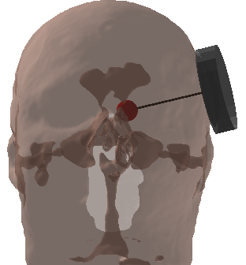
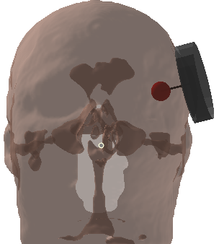
next steps
sims of control region (shallow steering) !!!
currently running in HPC (eta 5 hours)
resolve uncertainties in code
optimize spatial intensity pattern for NBM via target-transducer coords adjustments
requires few small script adjustments for quick iteration cycles
sims of more subjects for control region variability estimates
apply probabilistic NBM mask for more useful visualization
NBM
control

Slide 10
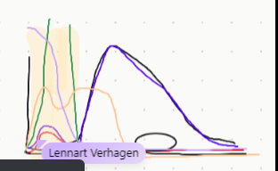
updated next steps
free water intensity confirmation
adapt source_amp for at least 30 W/m²
ask Matthias for: (3 things)
expected_focal_distance: computed on the fly?
correct profile chosen?
source_phase_deg ok to set to all 0?
targeting
iterate until mostly correct
near-field only – optimization attempt

Slide 11
problems/bottlenecks
communication – meetings with Martin in future
roadmap to regaining trust in community?

