Slide 1
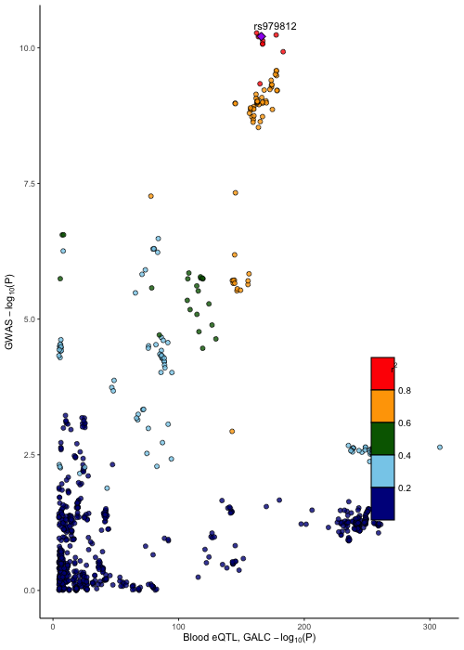
MS OR=1.35
PD OR=1.06
rs116899835 is in LD with potential coding/splicing variant of GALC
rs11552556
D’=0.9552, R2=0.855
GWAS signal is a relatively nice QTL signal for GALC expression in blood (Vosa et al)

