Slide 1
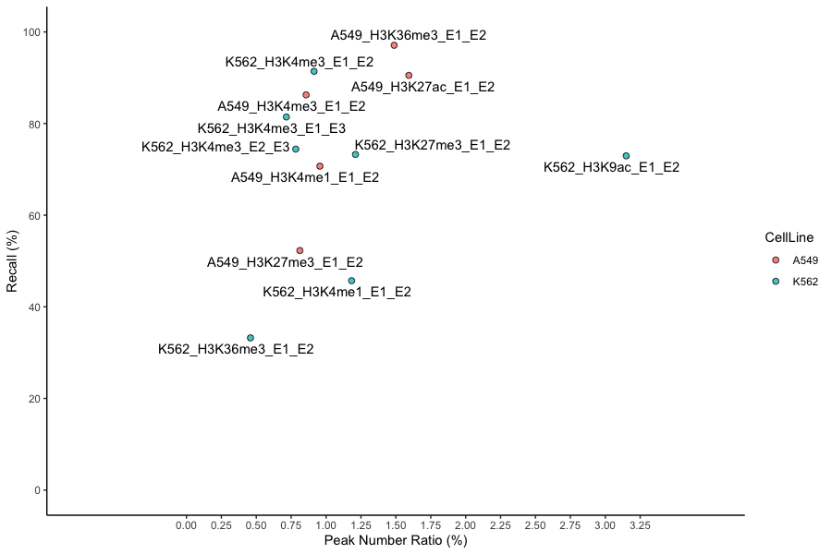

Slide 2
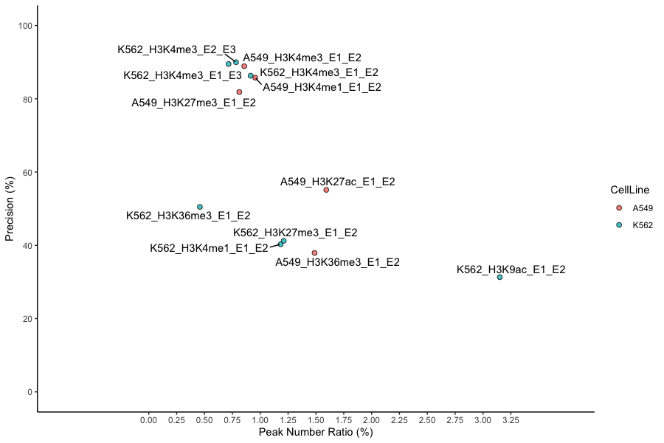

Slide 3
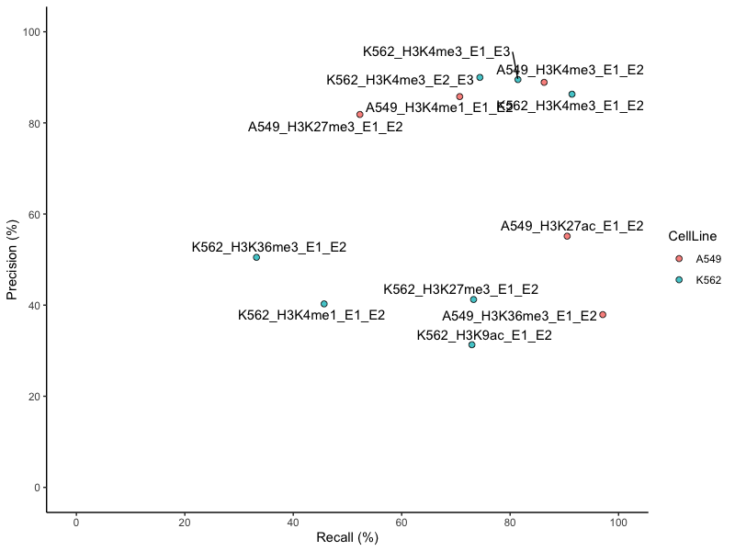

Slide 4
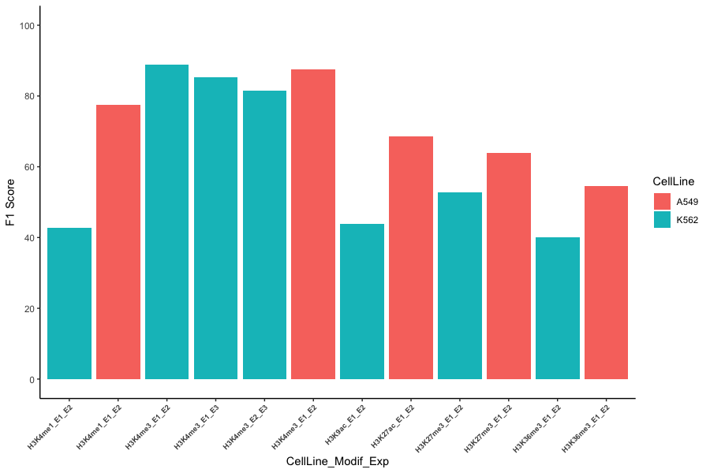

Slide 5
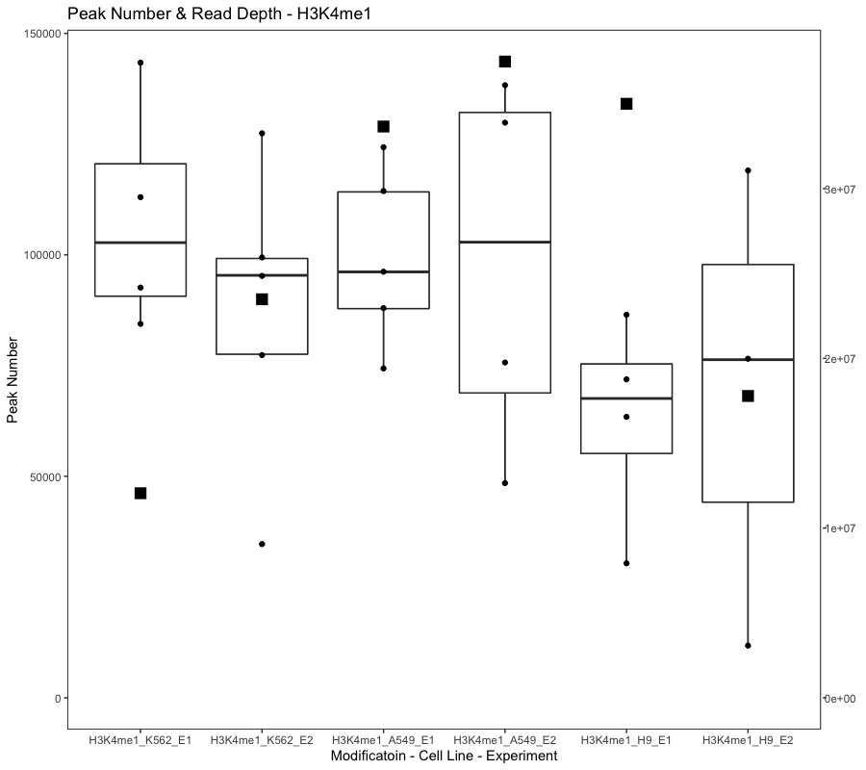
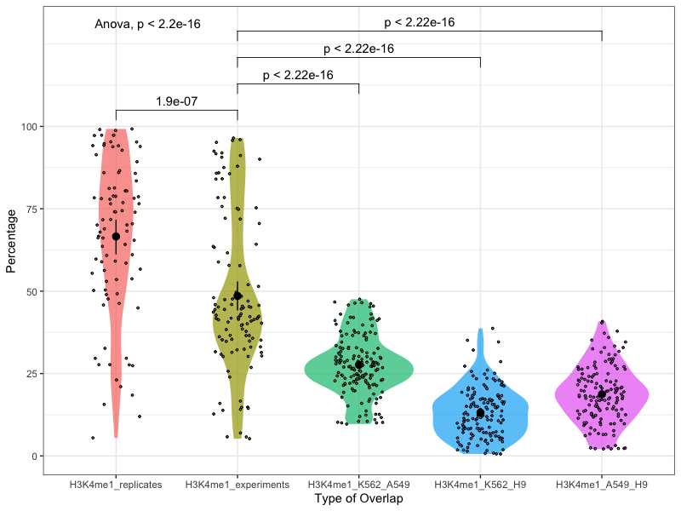
Notes:
H3K4me1
Annotation: enhancers
The recommended value is > 45 million, but > 35 million is acceptable.
K562_E1: Insufficient read depth; Control insufficient read depth;
K562_E2: Insufficient read depth; Control insufficient read depth;
A549_E2: Insufficient read depth;

Slide 6
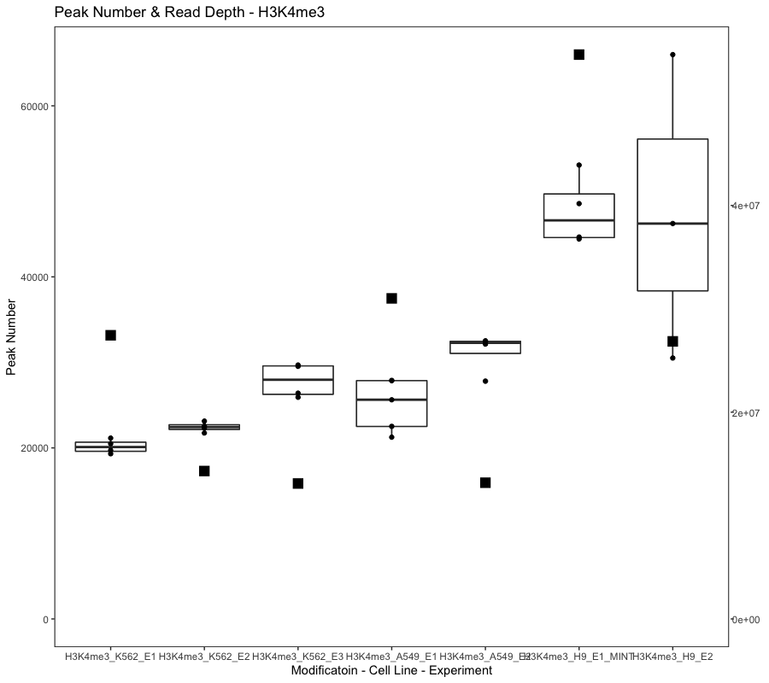
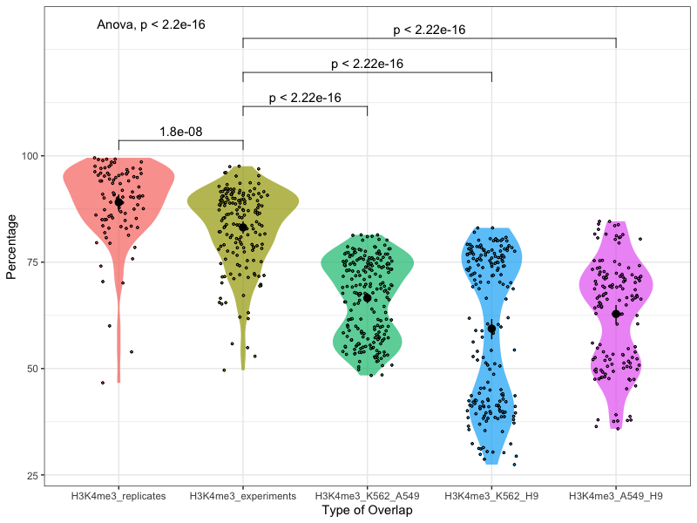
Notes:
H3K4me3
Annotation: promoters
The recommended value is > 20 million, but > 10 million is acceptable.

Slide 7
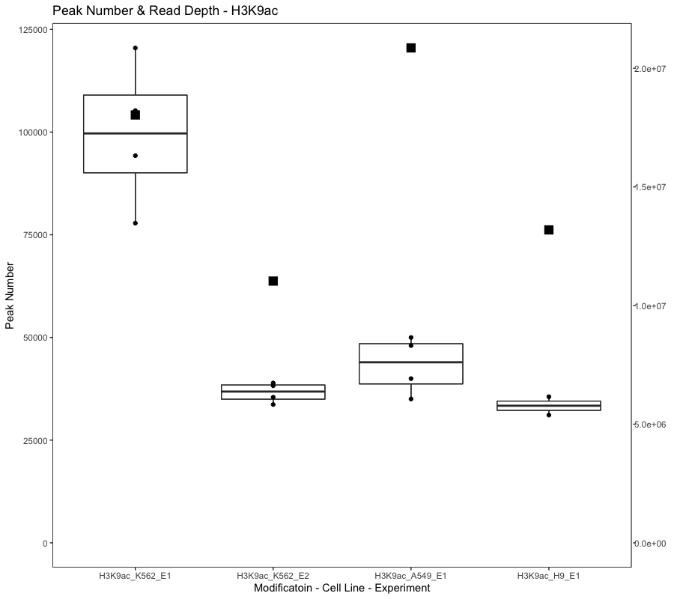
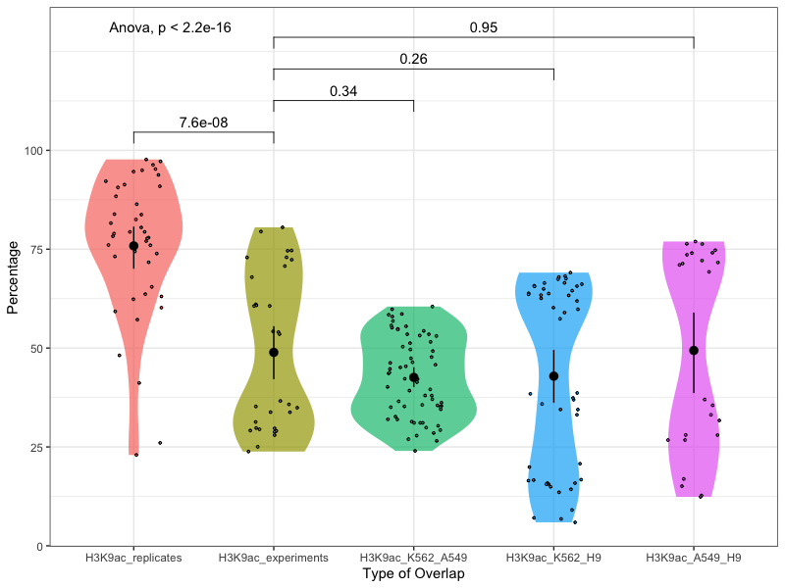
Notes:
H3K9ac
Annotation: active regulatory regions
The recommended value is > 20 million, but > 10 million is acceptable.
K562_E2: Insufficient read depth;
A549_E1: Insufficient read depth; Poor library complexity; Severe bottlenecking;

Slide 8
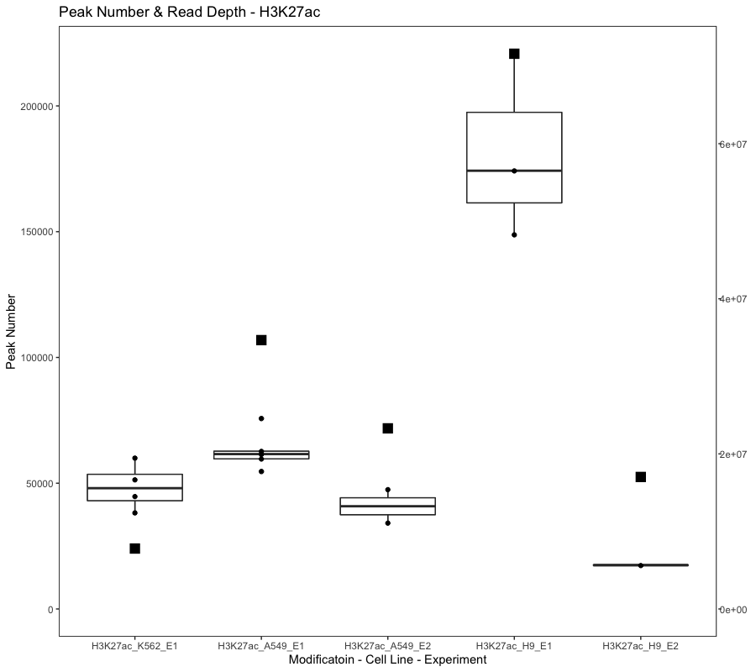
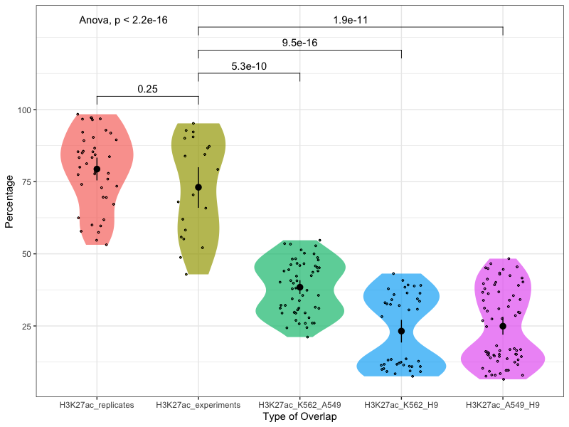
Notes:
H3K27ac
Annotation: active regulatory regions
The recommended value is > 20 million, but > 10 million is acceptable.
K562_E1: Extremely low read depth; and only experiment for K562 H3K27ac

Slide 9
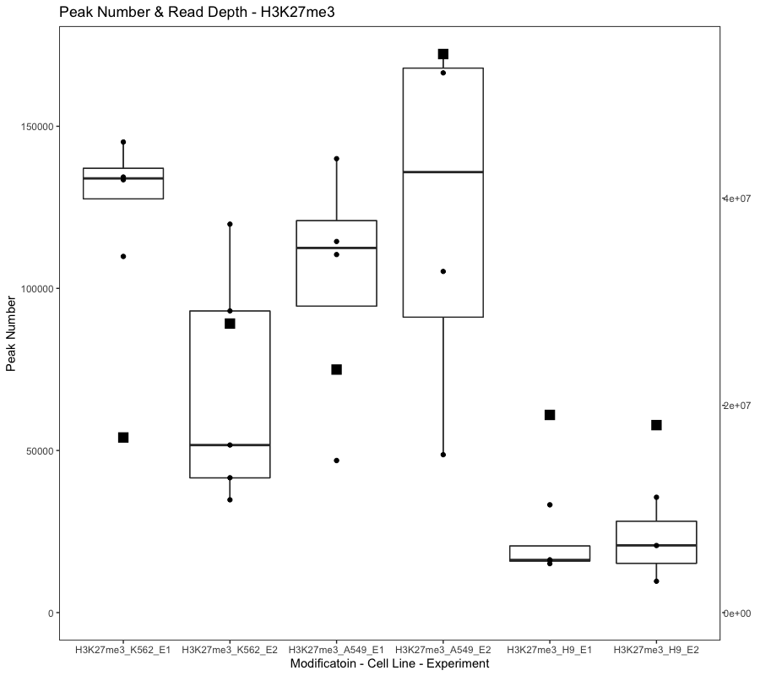
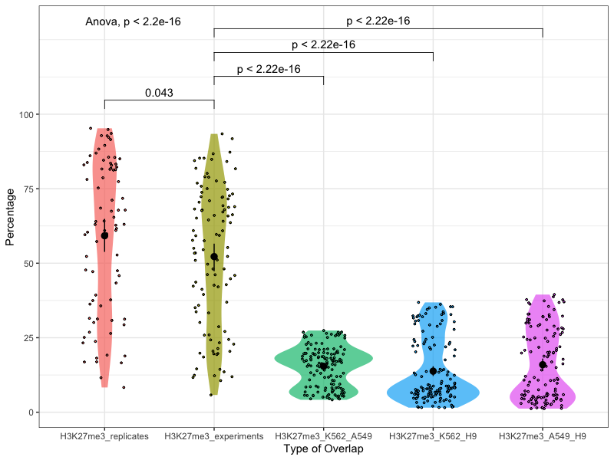
Notes:
H3K27me3
Annotation: Polycomb-repressed regions
The recommended value is > 45 million, but > 35 million is acceptable.
K562_E1: Insufficient read depth; Control insufficient read depth;
K562_E2: Insufficient read depth; Control insufficient read depth;
A549_E1: Insufficient read depth;
A549_E2: Insufficient read depth;

Slide 10
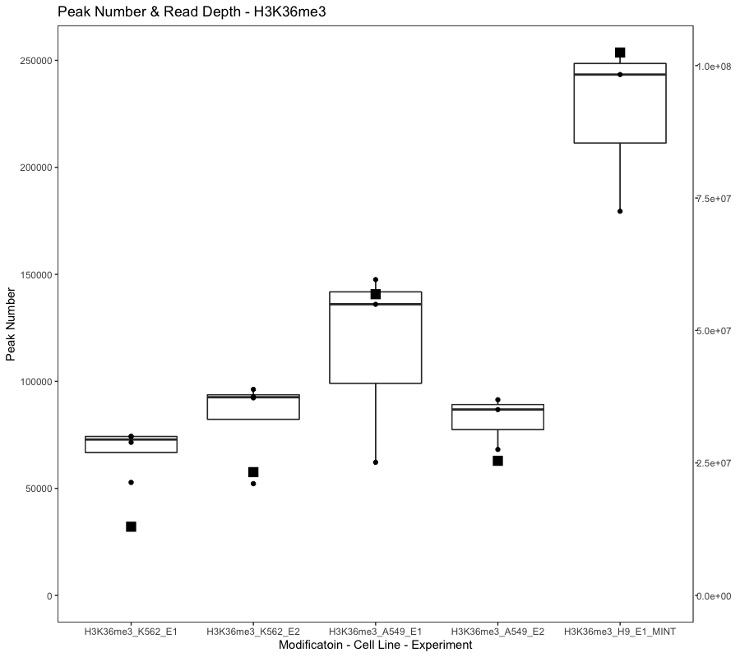
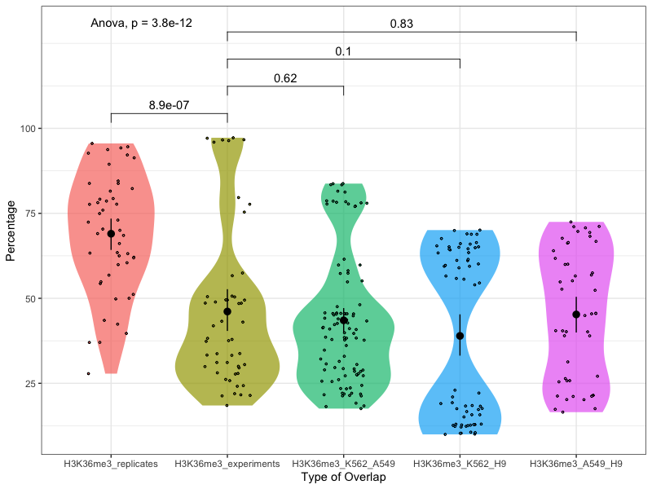
Notes:
H3K36me3
Annotation: transcribed regions
The recommended value is > 45 million, but > 35 million is acceptable.
K562_E1: Insufficient read depth; Control insufficient read depth;
K562_E2: Insufficient read depth; Control insufficient read depth;
A549_E1: Insufficient read depth;
A549_E2: Insufficient read depth;

