Slide 1
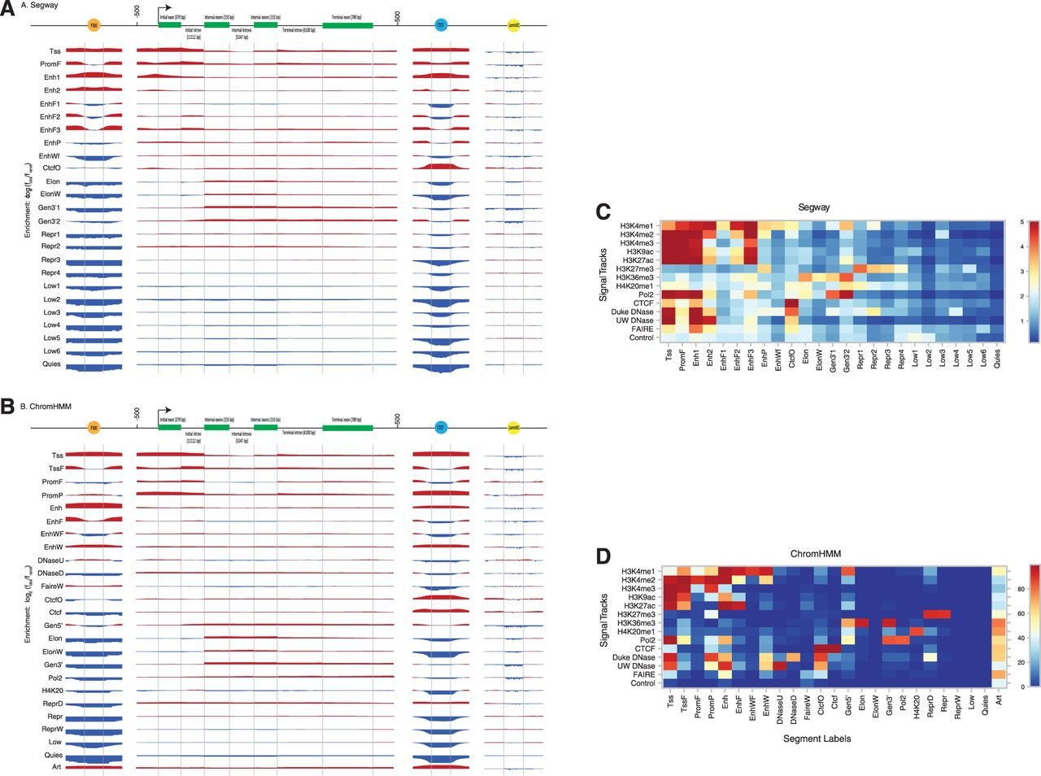

Figure 1. Enrichment of various segment labels (vertically, labeled by green panels) from (A) Segway and (B) ChromHMM ...
Notes:
Figure 1. Enrichment of various segment labels (vertically, labeled by green panels) from (A) Segway and (B) ChromHMM K562 segmentations over positions on an idealized p300 binding site, gene, CTCF binding site, and LaminB1 binding site. We calculated enrichment as the base-2 logarithm of the observed frequency of a label at a particular position along an annotation divided by the expected frequency of the label from its prevalence in the genome overall. Enriched positions are shown in red, and depleted positions are shown in blue. The labels for idealized gene components at the top include the mean length of that component in parentheses. (C) Heat map of parameters from Segway training for 14 GM12878 signal tracks against 25 segment labels. Color indicates the mean of a Gaussian according to the color bar on the right. (D) Heat map of parameters from ChromHMM concatenated training on 84 signal tracks from 6 ENCODE Tier 1–2 cell types. Color indicates the probability of a present mark, as a percentage, according to the color bar on the right.
Unless provided in the caption above, the following copyright applies to the content of this slide: © The Author(s) 2012. Published by Oxford University Press.This is an Open Access article distributed under the terms of the Creative Commons Attribution License (http://creativecommons.org/licenses/by-nc/3.0/), which permits non-commercial reuse, distribution, and reproduction in any medium, provided the original work is properly cited. For commercial re-use, please contact journals.permissions@oup.com.© The Author(s) 2012. Published by Oxford University Press.

