Slide 1



Strategies for documentation and sharing of data analyses
April 7th 2021
Brian M. Schilder
Neurogenomics Lab
UK Dementia Research Institute
Department of Brain Sciences
Imperial College London

Slide 2
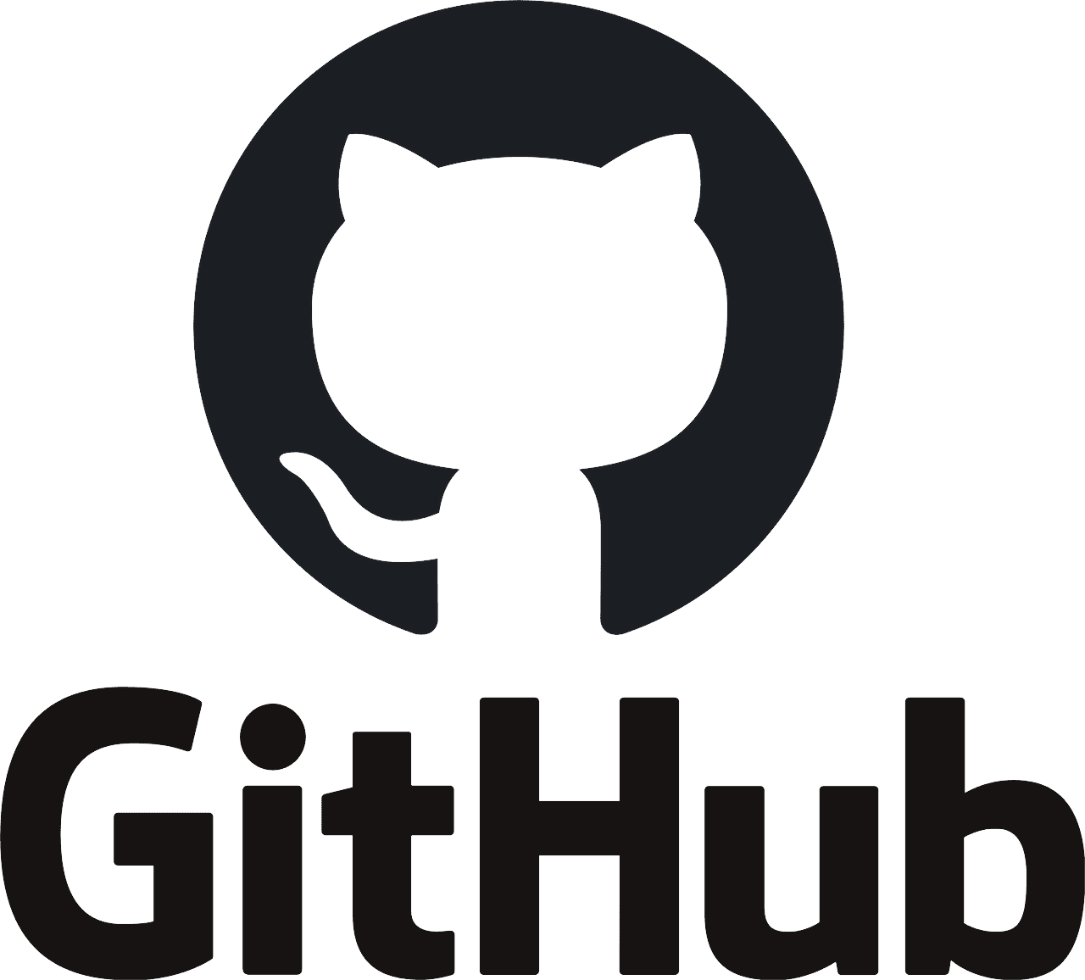
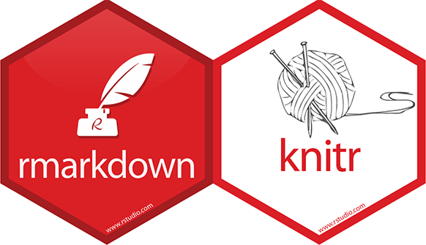


Outline
GitHub
Rmarkdown
Jupyter
Plotly

Slide 3
GitHub

Slide 4
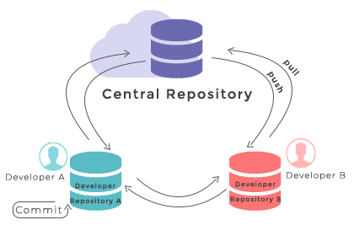
What is GitHub?
Git is a software for version control of code and data.
GitHub is a free web service that stores projects in remote repositories (i.e. “repos”).
Advantages:
Free!
Version control
Collaboration
Conflict handling
Computer synchronization
Software package hosting
Disadvantages
Learning curve
Can’t store large files (>100Mb) for free
API creation

Slide 5
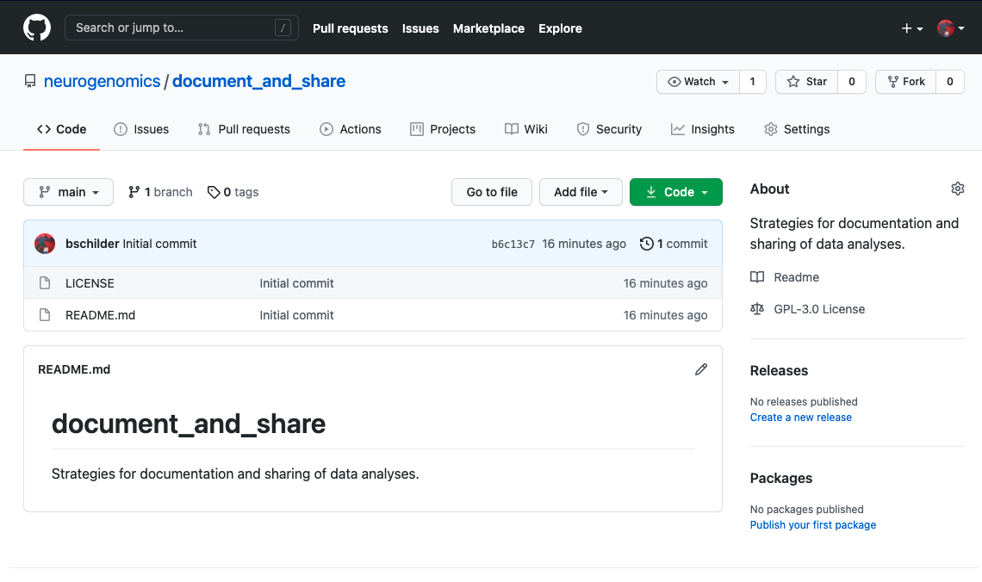
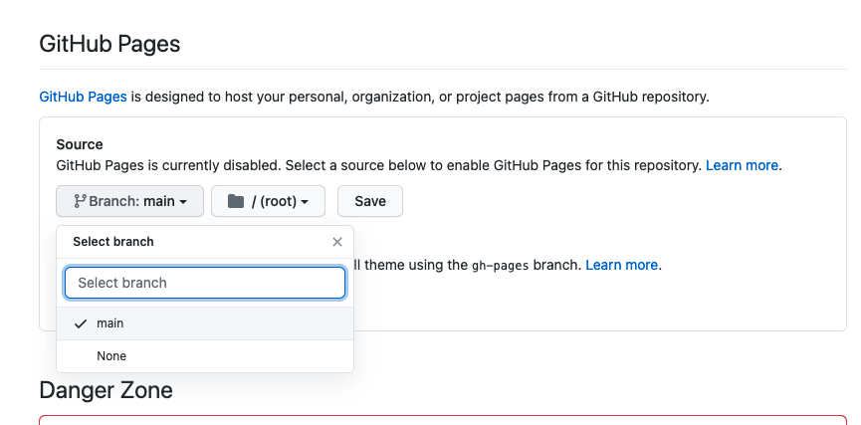
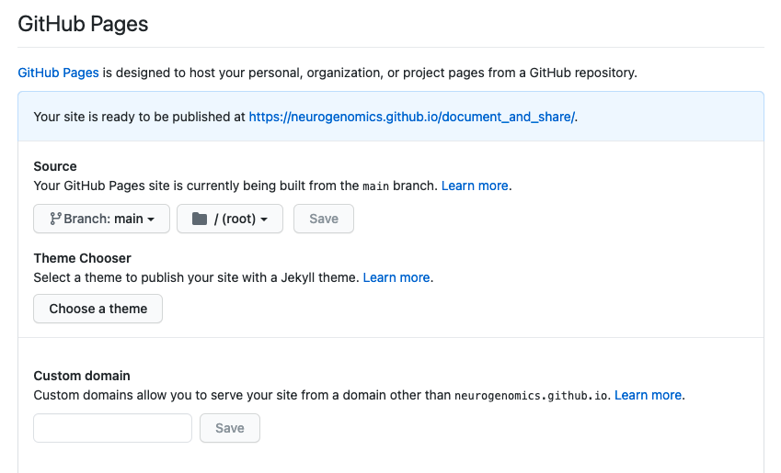
GitHub Pages
1. Click Settings tab
2. Enable GitHub Pages
2. Enable GitHub Pages
Share your results as links.
https://neurogenomics.github.io/document_and_share
Can be markdown (.md) or web pages (.html).
Share any file in private repo.

Slide 6
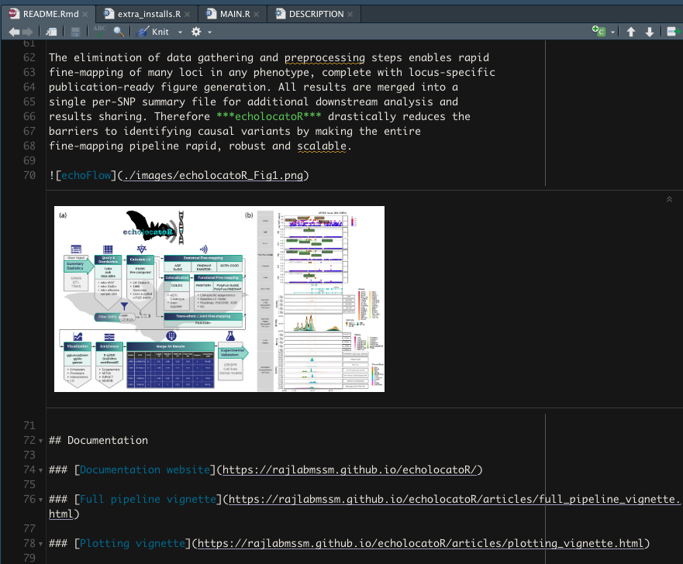
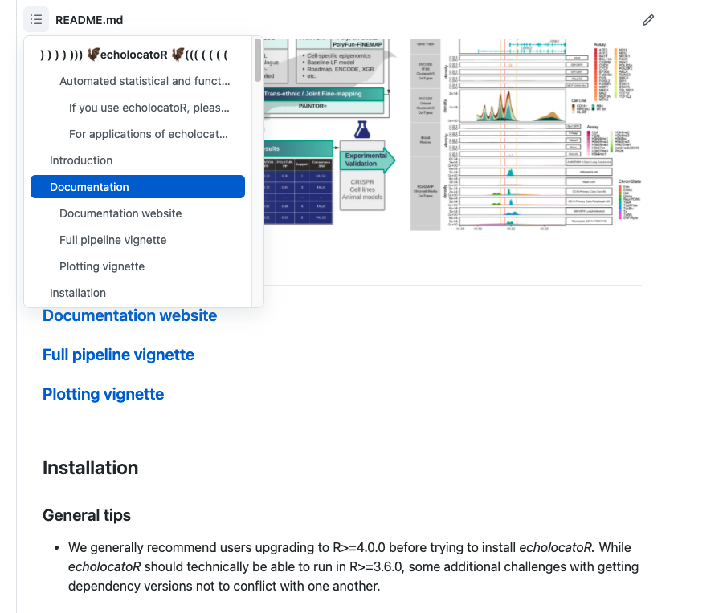
README
Add links to your README file
[caption](url)
Can also add images, code chunks, and more!
Can create README from rmarkdown.
Floating ToC now automatically added!
Putting additional READMEs in subfolders is a good idea.

Slide 7
Download links

Slide 8
Rmarkdown & knitr

Slide 9
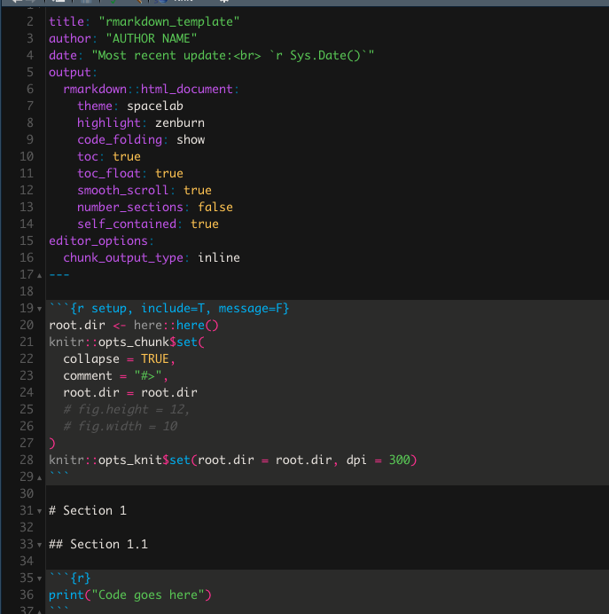
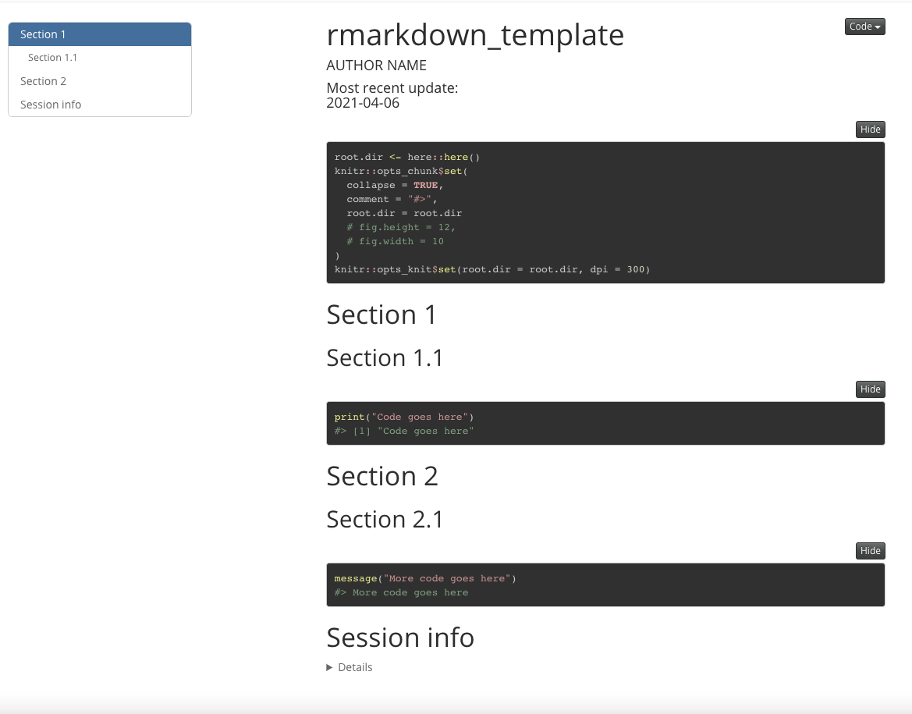

Rmarkdown + GitHub Pages workflow
Code
Knit
Push
Share
git add .
git commit –m “New DeGA celltype results”
git push

Slide 10
Organize and share your code/results
Advantages
Organize your code hierarchically
Take notes as you code
Disadvantages
Sometimes code runs in chunks but not when knitted
All code must run in one go to knit
Navigate code quickly
Export into multiple formats (html, md, pdf) and share
Code in R or python
Workarounds
Caching
Save intermediate files
here package
Explicit package calling
{r setup, error=TRUE}

Slide 11
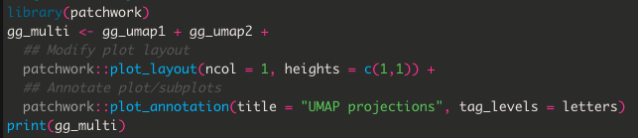
Composite plots
Patchwork: https://patchwork.data-imaginist.com
Flexible and easy-to-use package to combine (gg)plots

Slide 12
Jupyter

Slide 13

Jupyter notebooks
Advantages
Organize your code hierarchically
Take notes as you code
Disadvantages
Navigate code quickly
Export into multiple formats (html, md, pdf) and share
Code in R, python, and many other languages
IDEs still lacking full functionality
Requires more setup (e.g. tab completion)
Fully utilizes conda
Workarounds
Use default Jupyter with nbextensions
Template

Slide 14
Conda
Install conda
Tutorials
Via brew: https://medium.com/ayuth/install-anaconda-on-macos-with-homebrew-c94437d63a37
Build conda env
Add conda env to Jupyter
Includes
Python essentials
R essentials
Jupyter + nbextensions
Tutorial
Via main site: https://conda.io/projects/conda/en/latest/user-guide/install/download.html
https://medium.com/@nrk25693/how-to-add-your-conda-environment-to-your-jupyter-notebook-in-just-4-steps-abeab8b8d084
In command line
conda env create -f https://github.com/neurogenomics/document_and_share/raw/main/templates/env.yml
python -m ipykernel install --user --name=pyre

Slide 15
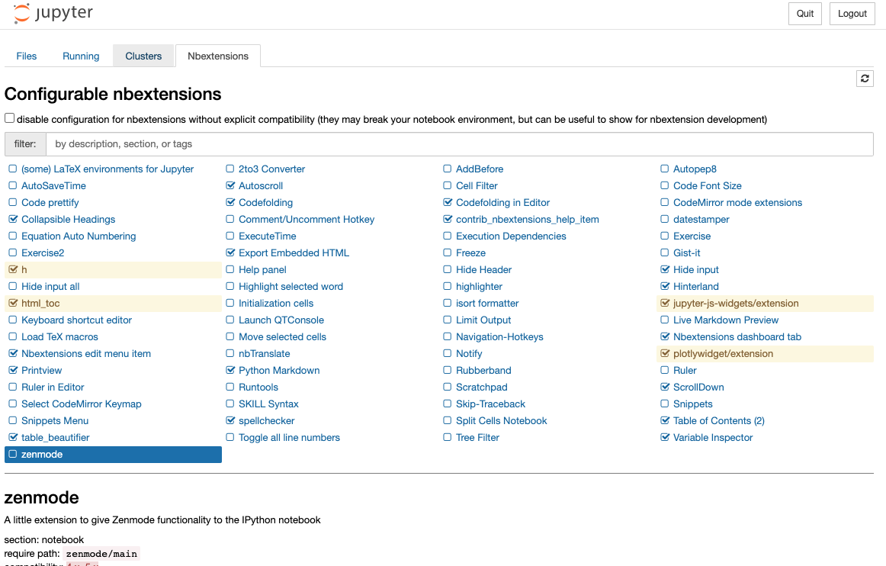
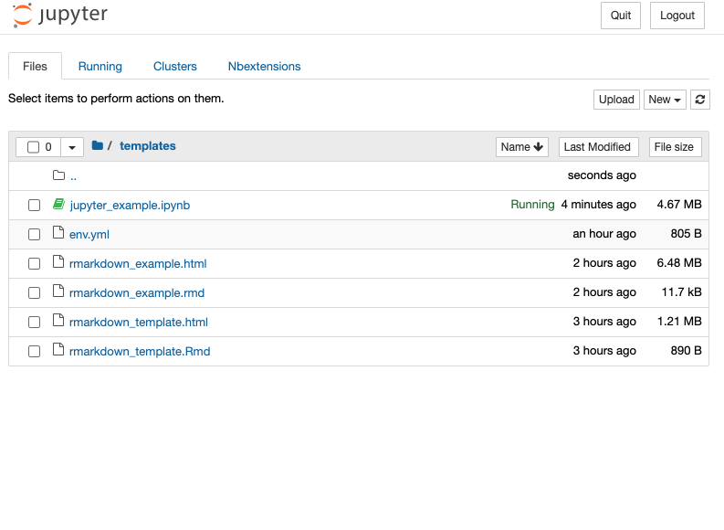
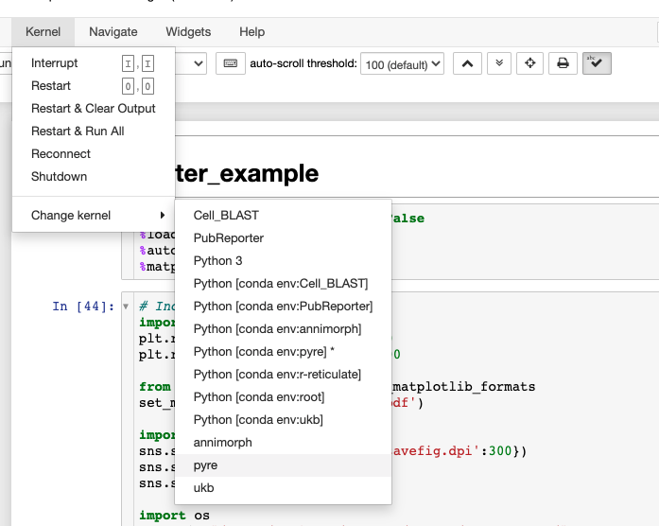
Getting started
Activate conda env
Launch jupyter
Open notebook
Change kernel
Activate nbextensions
conda activate pyre
jupyter notebook
jupyter nbextensions_configurator enable --user
= only 1st time

Slide 16
Download links

Slide 17
Plotly

Slide 20
Resources
Neurogenomics Lab GitHub: https://github.com/neurogenomics
Templates: https://github.com/neurogenomics/document_and_share
Intro to GitHub:
GitHub Pages: https://pages.github.com
Rmarkdown: https://rmarkdown.rstudio.com
Jupyter: https://jupyter.org
R + Python in Jupyter: https://anderfernandez.com/en/blog/how-to-program-with-python-and-r-in-the-same-jupyter-notebook
Plotly: https://plotly.com
patchwork: https://patchwork.data-imaginist.com
here: https://github.com/r-lib/here

