Slide 1




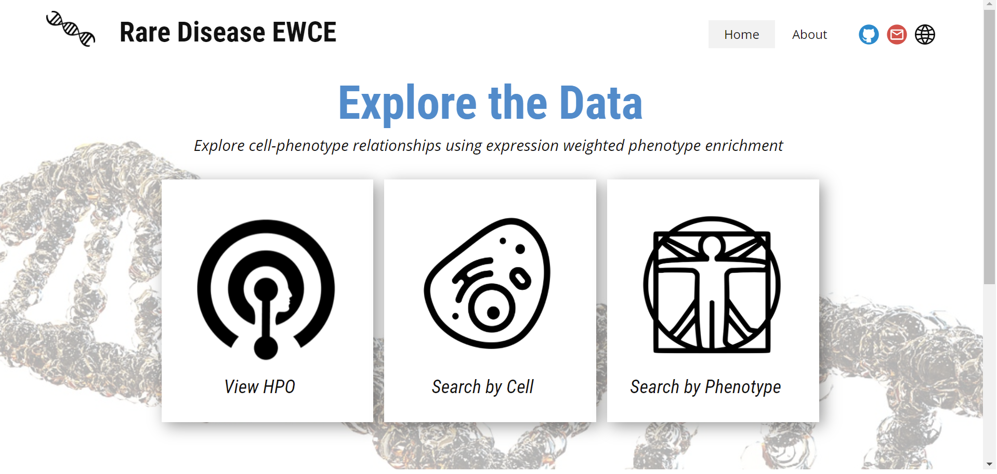


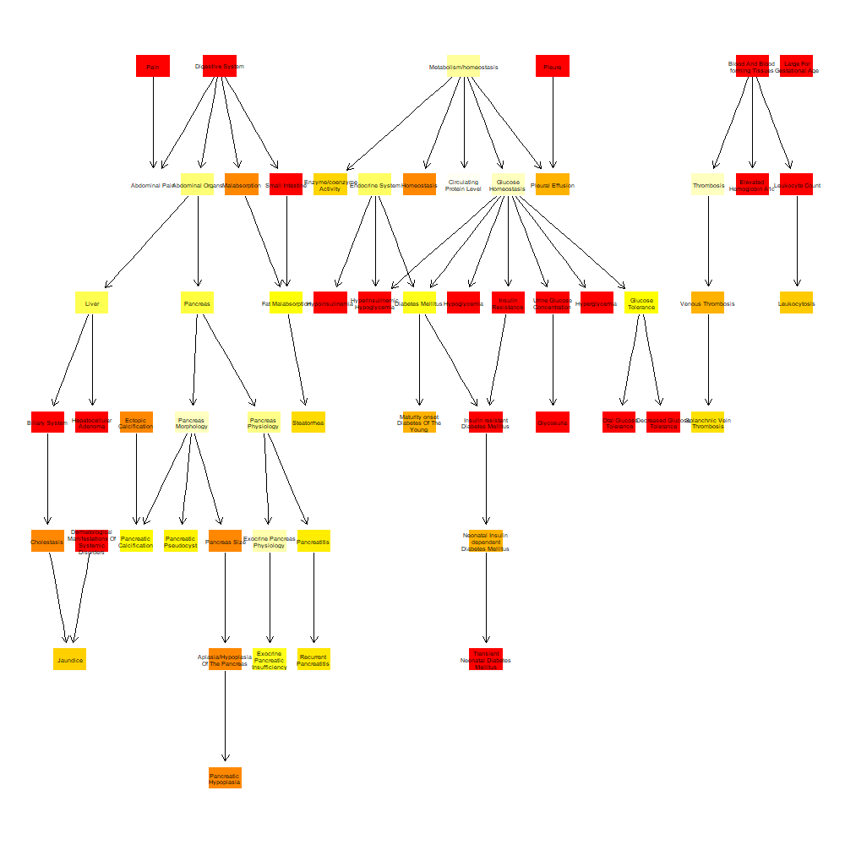

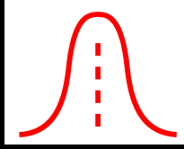
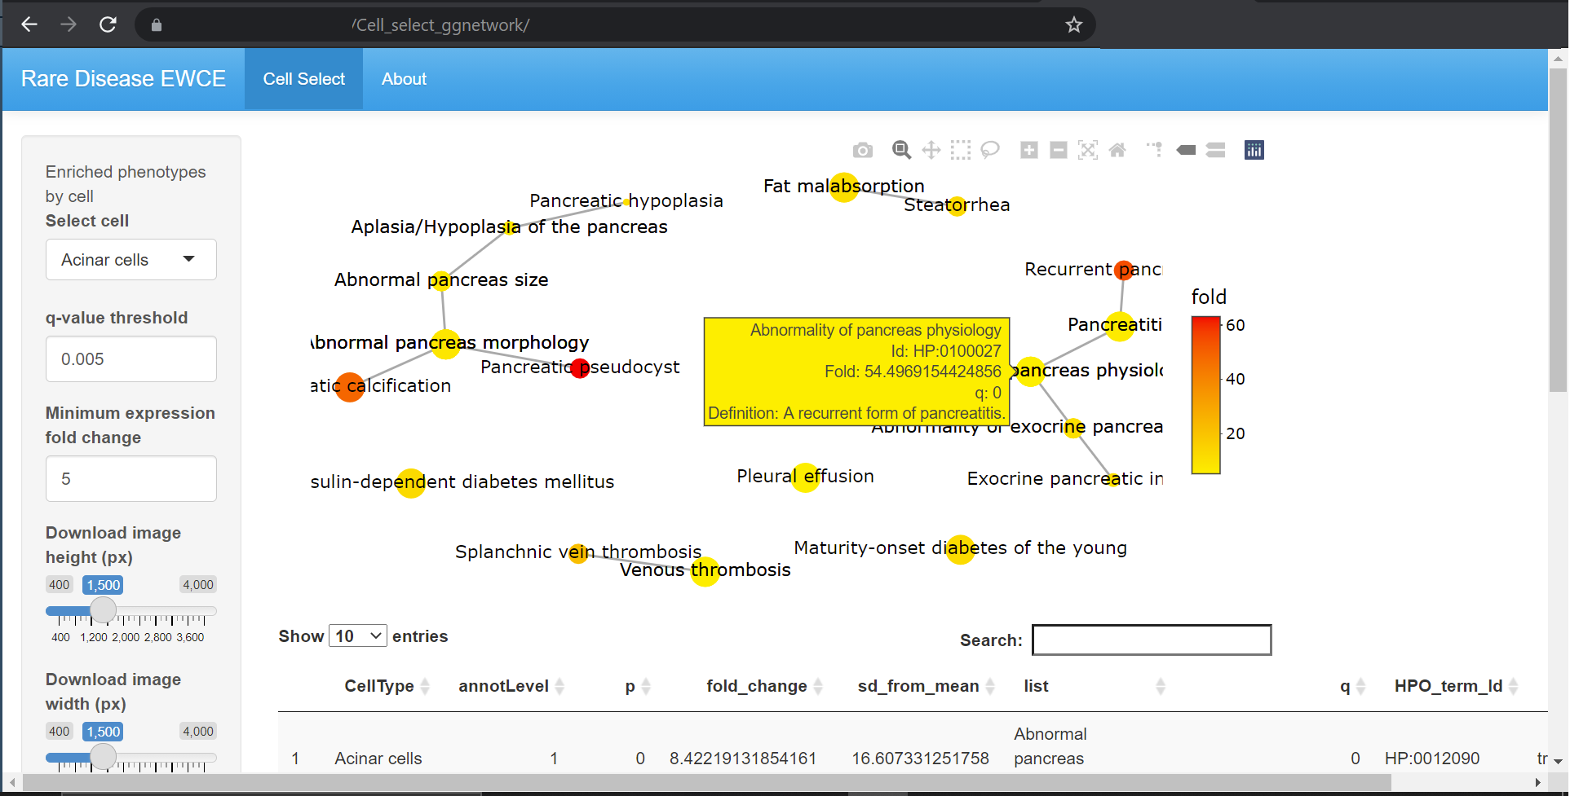
Frequency
Gene-cell specificity
Enrichment analysis
Genomic and phenotypic data
Results portal

Slide 2
A
B
C
Frequency
Gene-cell specificity
Enrichment analysis
Results portal
Genomic and phenotypic data

