Slide 1




+
Descartes Human
Human Cell Landscape
+
Evidence for Gene 1 causing Phenotype A
 | Weight |  | Studies |  | Score
No Known | 0 | x | 0 | = | 0
Refuted | 0 | x | 0 | = | 0
Disputed | 1 | x | 1 | = | 1
Limited | 2 | x | 0 | = | 0
Supportive | 3 | x | 2 | = | 6
Moderate | 4 | x | 1 | = | 4
Strong | 5 | x | 3 | = | 15
Definitive | 6 | x | 1 | = | 6
Total |  |  |  | = | 32
Gene expression specificity in Cell type Z
Sum
 | Cell Z1 | Cell Z2 | Cell Z3 | Mean | … | Sum (all cell types) | Specificity
Gene 1 | 0 | 0 | 0 | 0 | … | / 5 | = 0
Gene 2 | 0 | 1 | 0 | 0.33 | … | / 33 | = 0.01
Gene 3 | 9 | 7 | 11 | 9 | … | / 10 | = 0.90
… | … | … | … | … | … |  | …
Phenotype x gene evidence score matrix
Cell type x gene expression specificity matrix
 | Phenotype A | Phenotype B | Phenotype C | …
Gene 1 | 32 | 0 | 1 | …
Gene 2 | 0 | 16 | 0 | …
Gene 3 | 2 | 12 | 10 | …
… | … | … | … | …
 | Cell type X | Cell type Y | Cell type Z | …
Gene 1 | 0.50 | 0 | 0 | …
Gene 2 | 0 | 0.95 | 0.01 | …
Gene 3 | 0 | 0.02 | 0.90 | …
… | … | … | … | …
Generalised Linear Regression Tests
…
Phenotype-cell type association results
Phenotype | Cell type | P-value | FDR | Z-score
A | X | 0.005 | 0.05 | 0.25
A | Y | 0.98 | 1 | 0
A | Z | 0.001 | 0.01 | 0.90
B | X | 1 | 1 | 0
B | Y | 0.0004 | 0.004 | 0.75
B | Z | 1 | 1 | 0.01
C | X | 0.003 | 0.03 | 0.20
C | Y | 1 | 1 | 0
C | Z | 0.0007 | 0.007 | 0.98
… | … | … | … | …

Slide 2
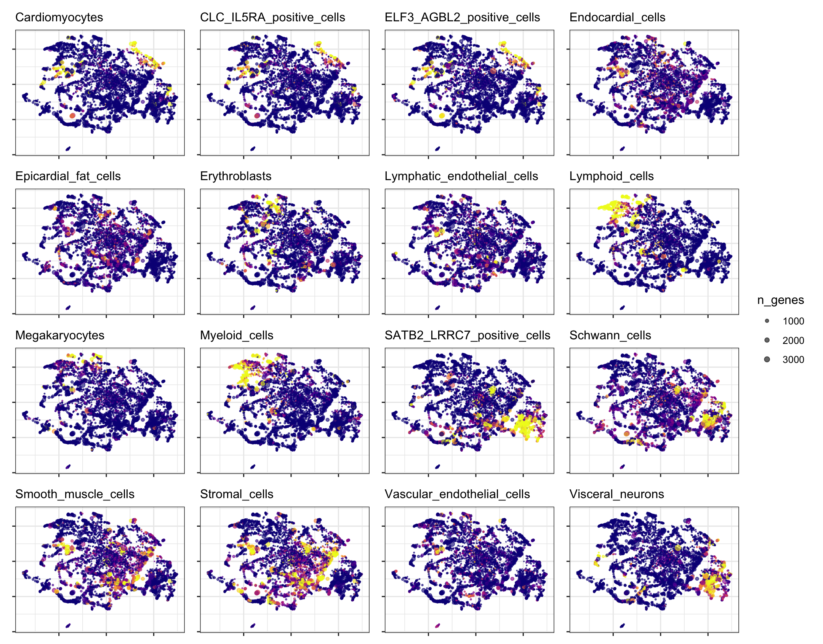
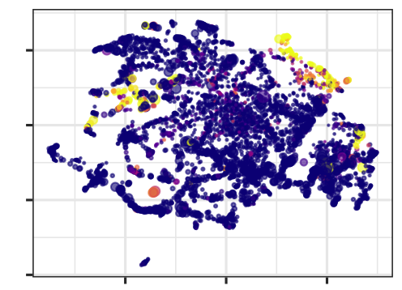
A
B
+
+
Descartes
Human
Human Cell
Landscape
Phenotype x gene evidence score matrix
Cell type x gene expression specificity matrix
 | Phenotype A | Phenotype B | Phenotype C | …
Gene 1 | 32 | 0 | 1 | …
Gene 2 | 0 | 16 | 0 | …
Gene 3 | 2 | 12 | 10 | …
… | … | … | … | …
 | Cell type X | Cell type Y | Cell type Z | …
Gene 1 | 0.50 | 0 | 0 | …
Gene 2 | 0 | 0.95 | 0.01 | …
Gene 3 | 0 | 0.25 | 0.60 | …
… | … | … | … | …
Dimensionality Reduction
Generalized Linear Regression Models
C
D
Phenotype-cell type association results
Phenotype | Cell type | P-value | FDR | Z-score
A | X | 0.005 | 0.05 | 0.25
A | Y | 0.98 | 1 | 0
A | Z | 0.001 | 0.01 | 0.90
B | X | 1 | 1 | 0
B | Y | 0.0004 | 0.004 | 0.75
B | Z | 1 | 1 | 0.01
C | X | 0.003 | 0.03 | 0.20
C | Y | 1 | 1 | 0
C | Z | 0.0007 | 0.007 | 0.98
… | … | … | … | …
E
Patient Care
Therapeutics Development
Diagnosis
Prognosis
Treatment
Biological Discovery
Multi-scale disease mechanisms
Models
Targets
Vectors
UMAP 2
Applications
UMAP 2
Cardiomyocyte enrichment
UMAP 1
UMAP 1
Notes:
Phenome-wide investigation of the

