Slide 1
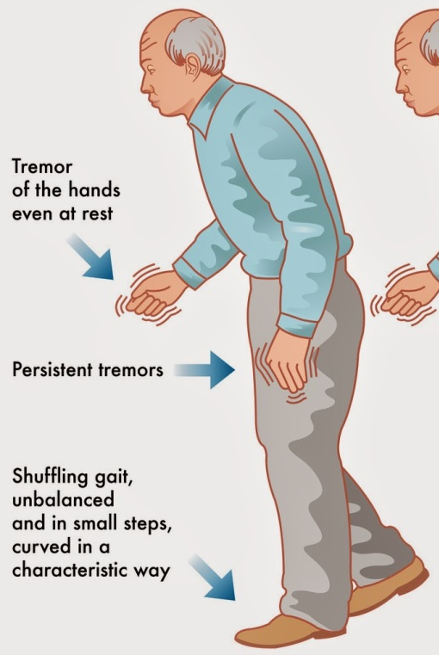




Stride length estimation from an ankle-worn IMU in Parkinson's disease
R. Romijnders*, M. Abedinifar*, K. Saegner*, C. Hansen*, W. Maetzler*
* Universitätsklinikum Schleswig-Holstein, Kiel, Deutschland
Gait and balance disturbances are common and important clinical manifestations of Parkinson’s disease (PD)
Stride length is among the gait parameters most sensitive to levodopa-based treatment of Parkinson’s disease
Inertial measurement units (IMUs) allow to measure mobility in free-living environments (e.g., at home, at work)
Can we determine stride length from an ankle-worn IMU in people with Parkinson’s disease?
eP1-05
Curtze et al. Mov Disord. 2015. doi: 10.1002/mds.26269

Slide 2




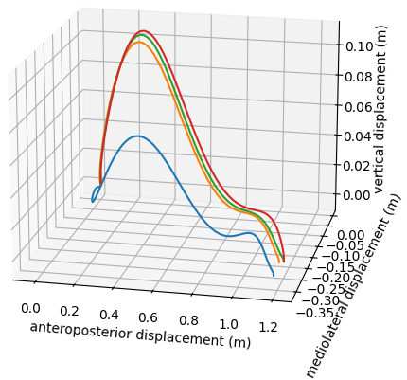

Stride length estimation from an ankle-worn IMU in Parkinson's disease
R. Romijnders*, M. Abedinifar*, K. Saegner*, C. Hansen*, W. Maetzler*
* Universitätsklinikum Schleswig-Holstein, Kiel, Deutschland
Reference system:
12-camera Qualisys system
optical motion capture (OMC)
slow
preferred
fast
N = 34 participants
21 male, 13 female
Age: 41 – 85 years
5 meter
eP1-05
preprocessing
event detection
stride segmentation
trajectory estimation
Warmerdam et al. Sensors (Basel). 2021. doi: 10.3390/s21175833; Warmerdam et al. Data. 2022. doi: 10.3390/data7100136; Salarian et al. IEEE Trans Biomed Eng. 2004. doi: 10.1109/TBME.2004.827933; Hori et al. Front Physiol. 2020. doi: 10.3389/fphys.2019.01530

Slide 3
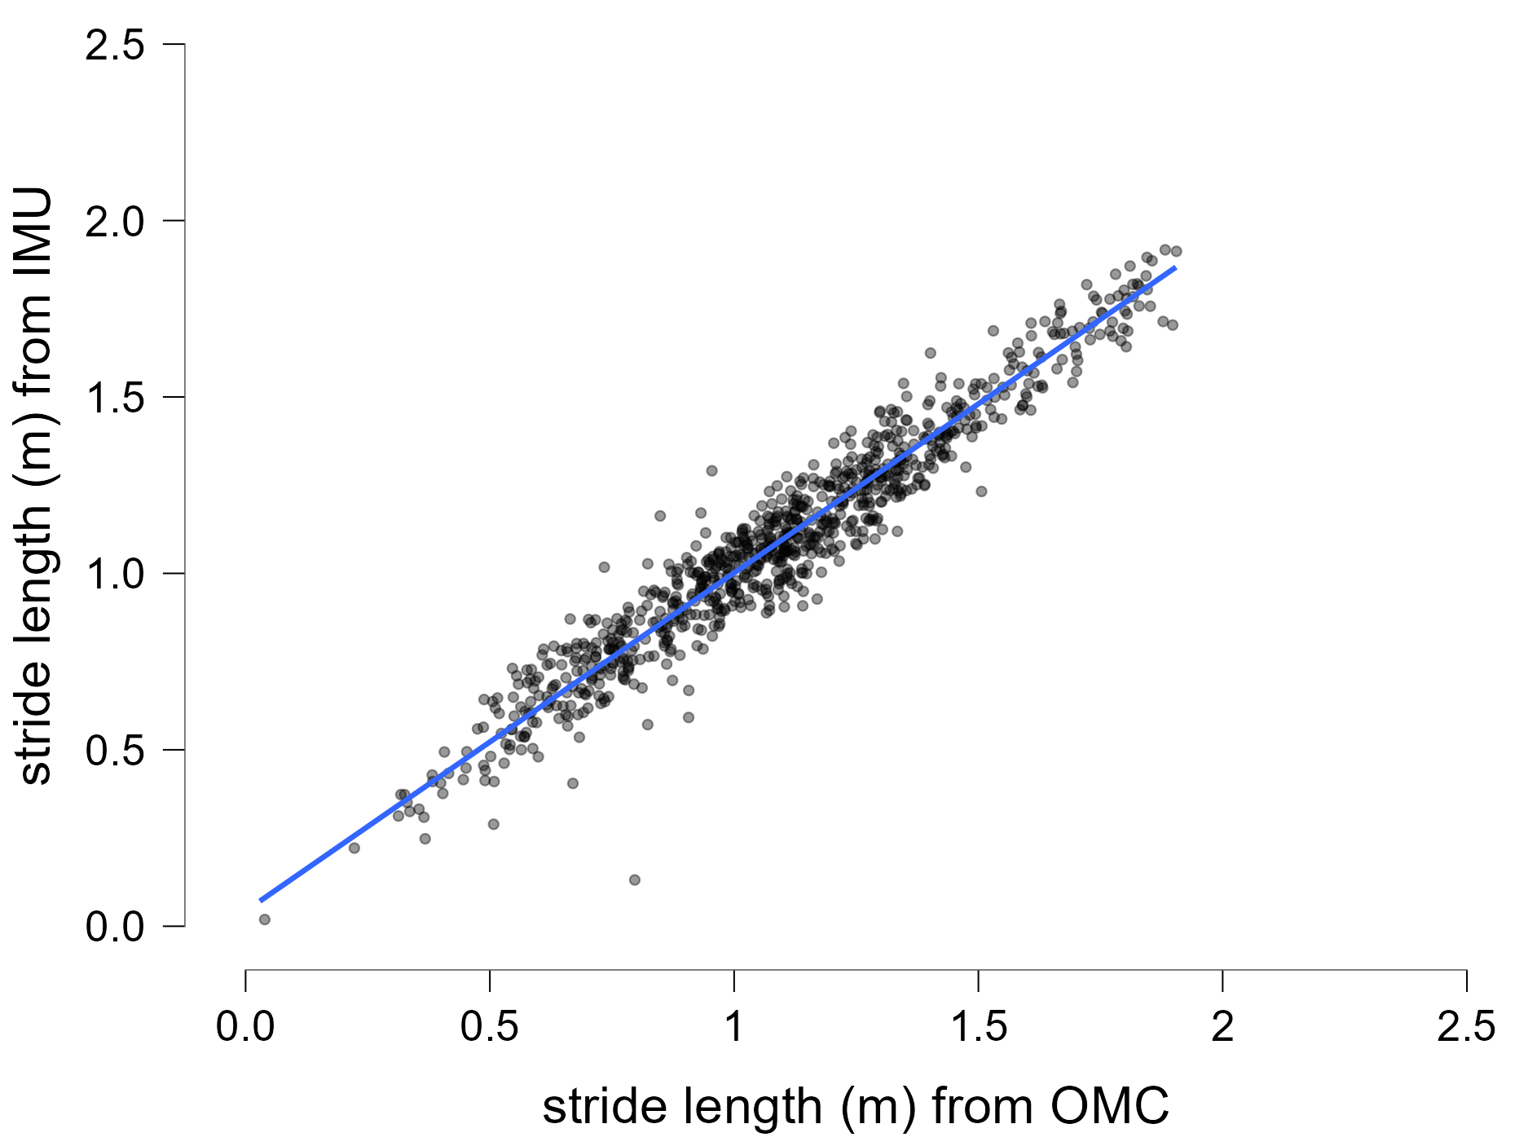
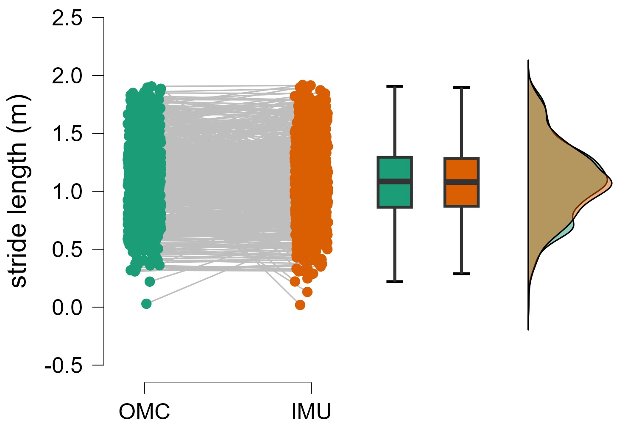
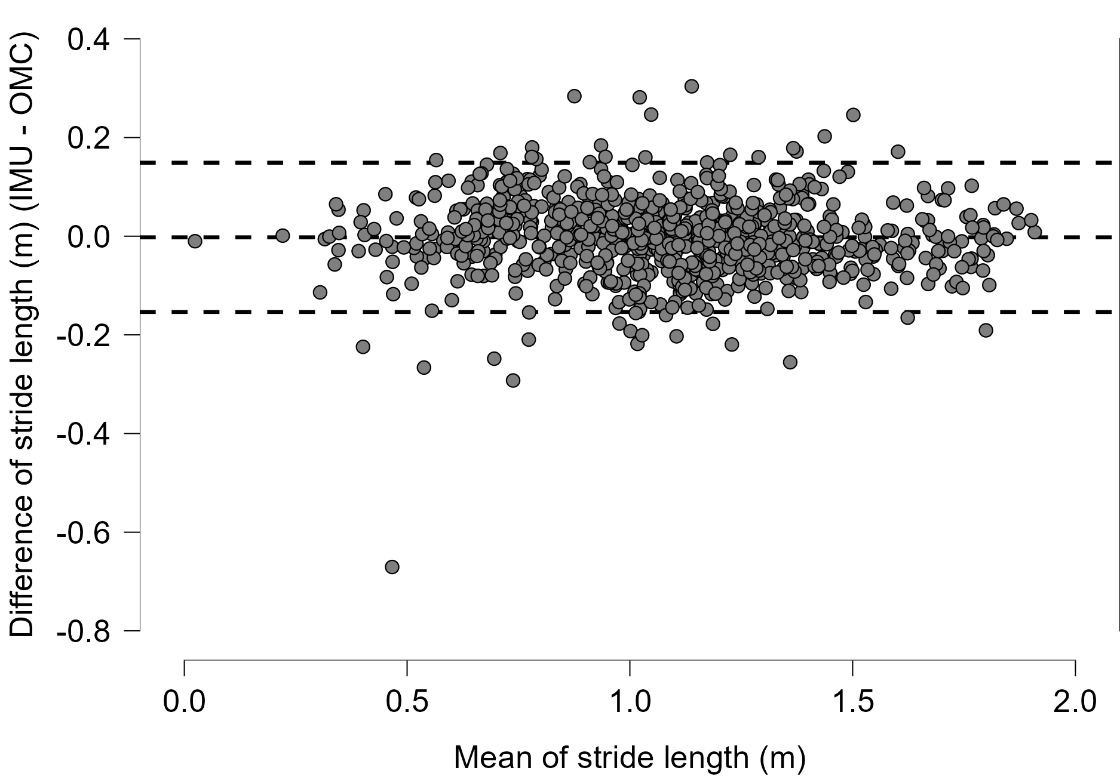
Stride length estimation from an ankle-worn IMU in Parkinson's disease
R. Romijnders*, M. Abedinifar*, K. Saegner*, C. Hansen*, W. Maetzler*
* Universitätsklinikum Schleswig-Holstein, Kiel, Deutschland
eP1-05
A relatively small underestimation of stride length is found (i.e., on average 0.2 cm)
An excellent ICC_{3,1} correlation coefficient, i.e., 95% confidence interval: [0.968, 0.975]
Stride length estimation seems not to depend on the length of the stride itself
Can we determine stride length from an ankle-worn IMU in people with Parkinson’s disease?
YES, we can!
Shrout and Fleiss. Psychol Bull. 1979. doi: 10.1037//0033-2909.86.2.420; Koo and Li. J Chiropr Med. 2016. doi: 10.1016/j.jcm.2016.02.012

