Slide 1

Cloud Shapes
Event-Driven Database
CNCF Serverless WG – 02/13/25

Slide 2


Presented by
Charles d’Avernas
Founder @ Neuroglia – Brussels BE
Serverless Workflow Specification
Serverless Workflow .NET SDK
Serverless Workflow Rust SDK
Synapse WFMS
Cloud Shapes
Cloud Streams
…

Slide 3
Agenda
1. Shaping Event-Driven Data with Cloud Shapes
2. Defining Data: The Role of Projection Types
3. Shaping Data: Schema & Validation
4. Triggering State Changes: How CloudEvents Power Projections
5. Connecting Data: Relationships Between Projections
6. Evolving Data Model: Schema Evolution & Live Migrations
7. Why Cloud Shapes? Unlocking Key Benefits
8. Cloud Shapes in Action: Real-World Use Cases
9. Live Demo: Cloud Shapes in Motion
10. Q&A

Slide 4
Shaping Event-Driven Data with Cloud Shapes
What is Cloud Shapes?
A database built for event-driven architectures
Uses Projection Types to manage data transformations
Relies on CloudEvents for real-time state updates
Supports schema evolution and dynamic relationships
Why Event-Driven?
React in real-time to CloudEvents
Decouple services by relying on immutable projections
Ensure consistency with validate data models

Slide 5
Defining Data: The Role of Projection Types
What is a Projection Type?
“A blueprint for shaping and managing projections” It defines:
✅ Data structure (JSON Schema)
✅ Event triggers (Create, Update, Delete)
✅ Relationships to other projections
✅ Indexes to optimize data retrieval and lookup performance

Slide 6

Shaping Data: Schema & Validation
Why Schema Matters?
Ensures data integrity and consistency
Prevents malformed or incomplete data
Allows evolvability, ensuring future-proof data structures
Documents expected state
Why JSON Schema?
Widely adopted standard for structured data validation
Flexible and extensible, allowing easy modifications
Machine-readable, making it ideal for automation

Slide 7

Triggering State Changes: How CloudEvents Power Projections
Why Use CloudEvents?
Standardized format for event-driven architectures
Interoperability across cloud providers and services
Decoupled event processing, allowing projections to react dynamically
Scalability, as projections evolve asynchronously in response to events

Slide 8

Triggering State Changes: How CloudEvents Power Projections
From Event to Projection: The Processing Flow
The application listens and enqueues all incoming CloudEvents
Upon consumption, it checks for all Projection Types with triggers matching the event’s type, and (optionally) source
A correlation key is extracted/resolved from the event using:
A specific context attribute (e.g. subject, id)
A runtime expression (jq or javascript)

Slide 9



Triggering State Changes: How CloudEvents Power Projections
Trigger Actions: What Happens Next?
Depending on the type of trigger matched, the CloudEvent results in:
✅Create a Projection
A new projection is instantiated
The correlation key becomes its ID
The initial state is determined via the configured runtime expression
✅Update an existing Projection
The projection is identified via the correlation key
Its state is modified by replacing it, or by using one of three supported patching strategies:
JSON Patch: Fine-grained, operation-based modifications
JSON Merge Patch: Overwrites fields while preserving unspecified data
JSON Strategic Merge Patch: Merges nested objects intelligently
✅Delete an existing Projection
The projection matching the correlation key is deleted

Slide 10

Connecting Data: Relationships Between Projections
Why Relationships Matter?
Allows dynamic inclusion and update of related projections
Ensures structured, interconnected data
Supported Relationship Types
1️⃣ One-to-One: Embed a single related projection
2️⃣ One-to-Many: Include multiple related projections dynamically.

Slide 11

Evolving Data Model: Schema Evolution & Live Migrations
The Challenge of Schema Evolution
Data models change over time, but changes can break things
Migrating data manually is a time vortex, and is error prone
Cloud Shapes Approach
✅ Patch-oriented updates, granting fine-grained control ✅ Automatic migration of existing projections ✅ Ensures smooth transitions without data loss

Slide 12


Why Cloud Shapes? Unlocking Key Benefits
Event-Driven and Scalable
CloudEvents-based architecture ensures real-time updates.
Projections allow immutable, queryable states.
Schema-Validated and Reliable
Ensures data integrity via enforced schemas.
Flexible relationships keep data structured.
Live Migration & Adaptability
Modify schemas without downtime.
Dynamic inclusion of related projections.
Developer-Friendly
Supports JavaScript & jq expressions.
Works seamlessly in event-driven ecosystems.

Slide 13
Cloud Shapes in Action: Real-World Use Cases
📌 Real-Time Analytics
Auto-updated projections for log processing & monitoring.
📌 Data Synchronization
Keeping projections updated based on cloud infrastructure events.
📌 Event-Driven Microservices
Decoupling services with immutable, queryable projections.
📌 Event Sourcing & CQRS
Using projections to represent historical states of an entity.

Slide 14
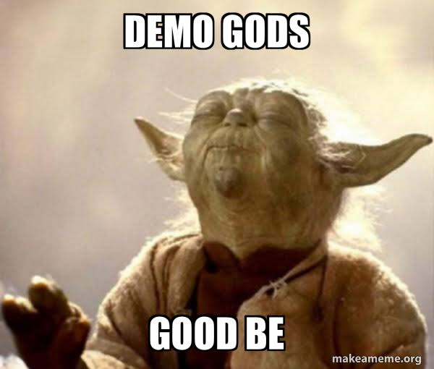
Live Demo: Cloud Shapes in Motion

Slide 15
Q&A
🗣 Q&A Session 💡 Ask Anything About Cloud Shapes!
Thank you for your time! 🚀

Slide 16

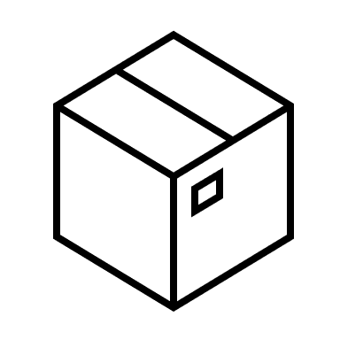

Get Involved
Contributions Welcome! We welcome new contributors, bug reports, and feature suggestions. Your input makes this project better.
Take a Look at the Project Check out our code, issues, and roadmap at https://github.com/neuroglia-io/cloud-shapes.
Show Some Love If you like what you see, please give the project a star on GitHub.

Slide 17

Thank you!

Slide 18
Cloud Shapes
Event-Driven Database

