Slide 1
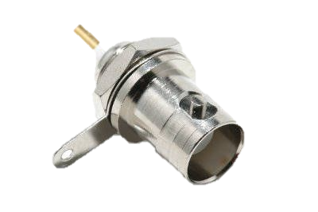
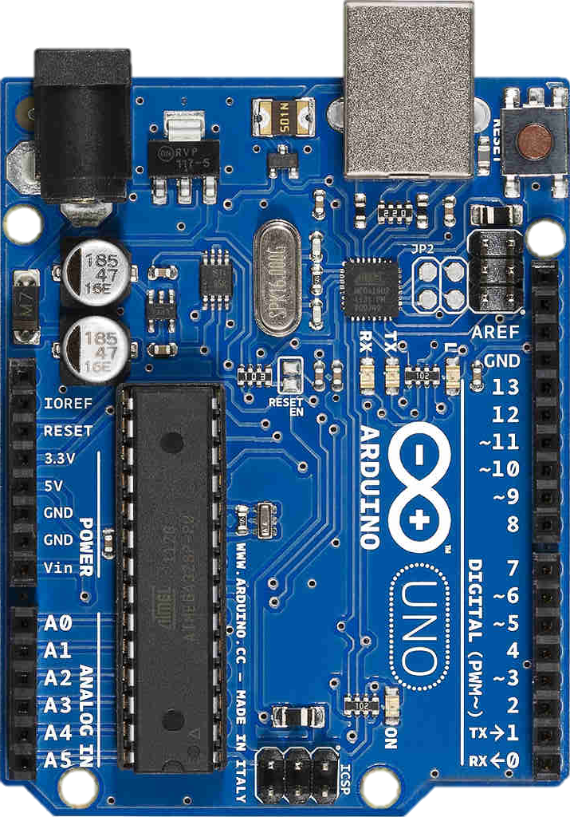
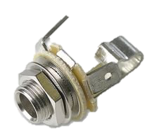
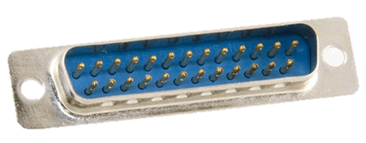
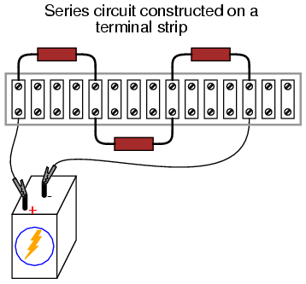
To AB USB
From button
BNC Female
TTL to audio & video
TRS Female
DB25 Female
TTL to EEG 1
DB25 Female
TTL to EEG 2
Ground
TTL Output
Terminal strip
Input from button

