Slide 2

What do you call a guy who keeps cutting himself while shaving?

Slide 3
Nik!

Slide 4
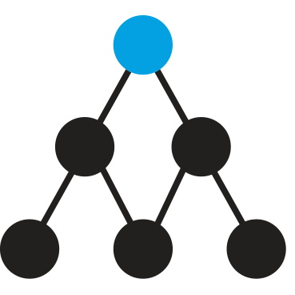
Project NIK

Slide 5
Project NIK
NIK = Numenta Inverse Kinematics

Slide 6
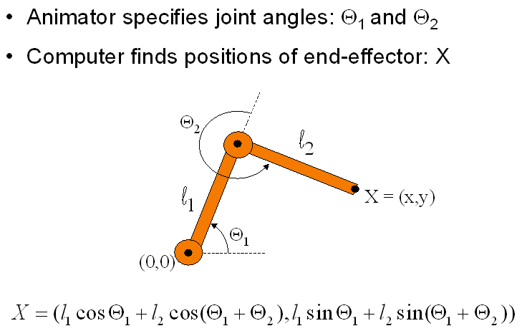
Forward kinematics

Slide 7
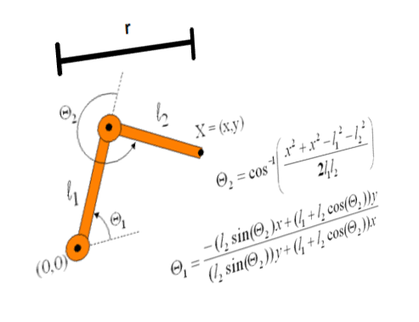
Inverse kinematics
Problems:
Math is complex (above is just for two links!)
Math changes if you change the system
Often no unique solution

Slide 8
Can we learn IK with HTM?

Slide 9
Let’s meet Nik!
(switch to Unity)

Slide 10
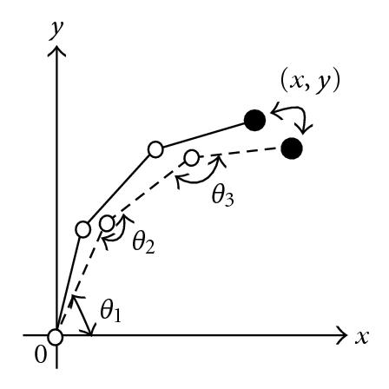
How do we train NIK with HTM?
(Δx, Δy, θ_{t-1,} θ_{t-1})
(Δx, Δy)
(θ_{t,} θ_{t})
Eye saccade will drive joint angles
Want HTM to learn the mapping:
(Δx, Δy, θ_{t-1,} θ_{t-1}) -> (θ_{t,} θ_{t})

Slide 11
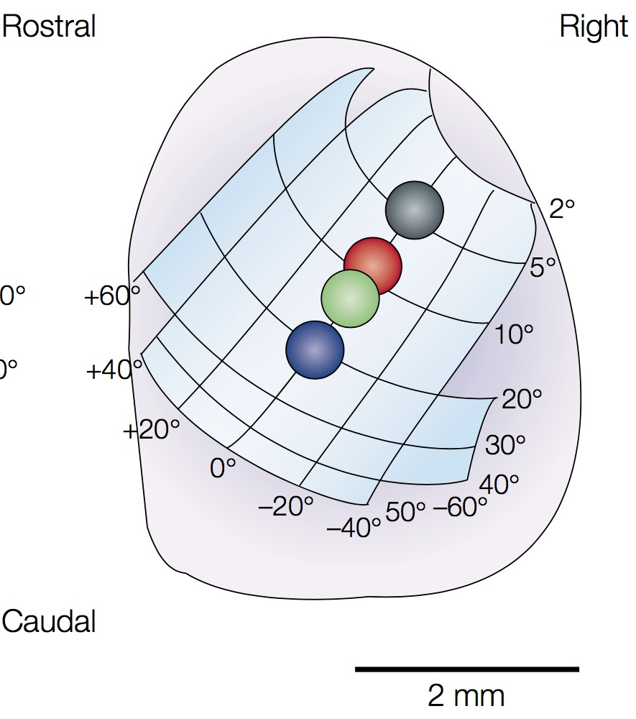
Neurons in SC encode saccade direction as a population code
Created 2D encoding with a 5x5 cloud around (Δx, Δy)
Outer product of two scalar encoders
Similar encoding for (θ_{t,} θ_{t})
Makes it easier for neuron to learn mapping

Slide 12
Does it work?
(switch to Unity)

Slide 13
Details
Extended temporal memory, no code changes
10,000 columns, 1 cell per col
External distal input + lateral distal connections within layer
Feed-forward input represents current pose
Trained with a flailing arm: single sequence of 50,000 consecutive random movements generated in Unity
One-step delay during learning
Input is current pose plus (Δx, Δy) to get to current pose
During inference we feed in (Δx, Δy) to distal plus current pose as feed-forward input and read out predicted cells
48,000 segments created (5 per cell)

Slide 14
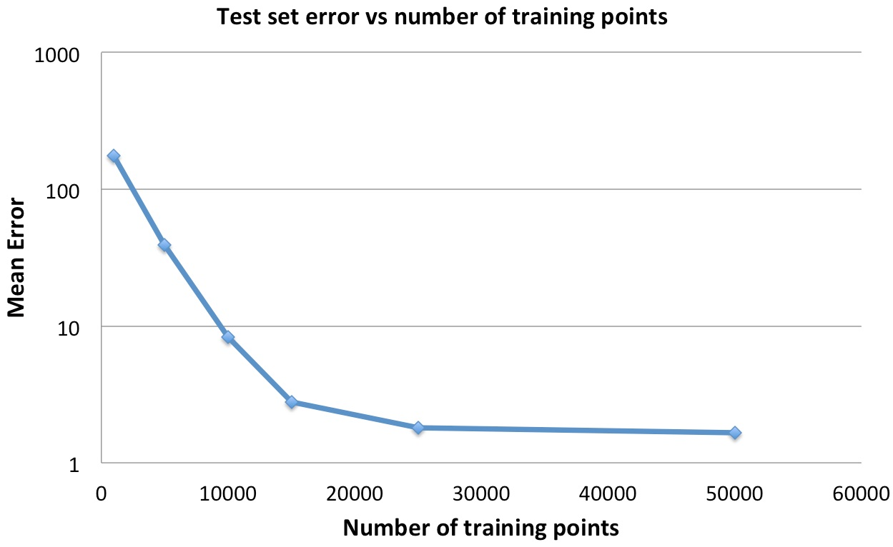
Training curve

Slide 15
Issues
Scaling to more joints and degrees of freedom when there are dependencies
Requires active prediction for inference, but not for learning
Requires one-step delay for learning but not for inference
Random flailing inefficient training scheme

Slide 16
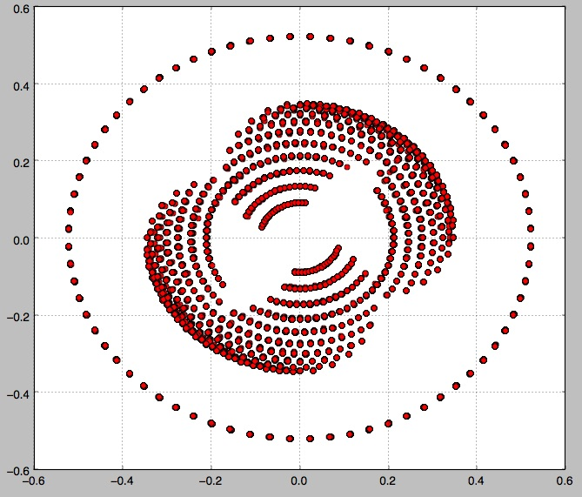
Range of (Δx, Δy) covered randomly

Slide 17
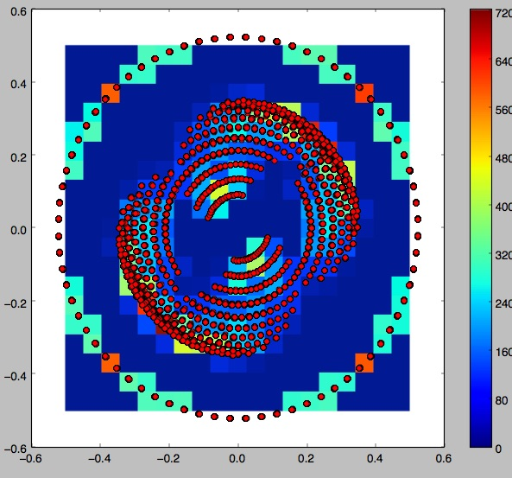
Distribution of (Δx, Δy) covered

Slide 18
Summary
Showed we can learn inverse kinematics using network of pyramidal neurons
Uses smooth sequence of movements
Unsupervised learning
Demonstrated flexible mapping
Use HTM to learn a multivariate function f(x)
Dendrites used to form a basis in input space

