Slide 1
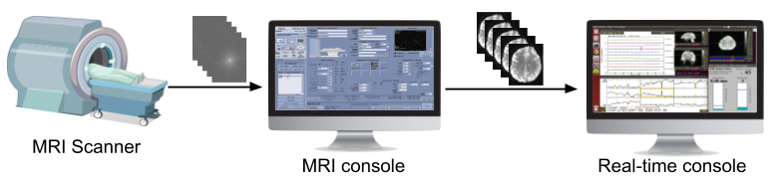
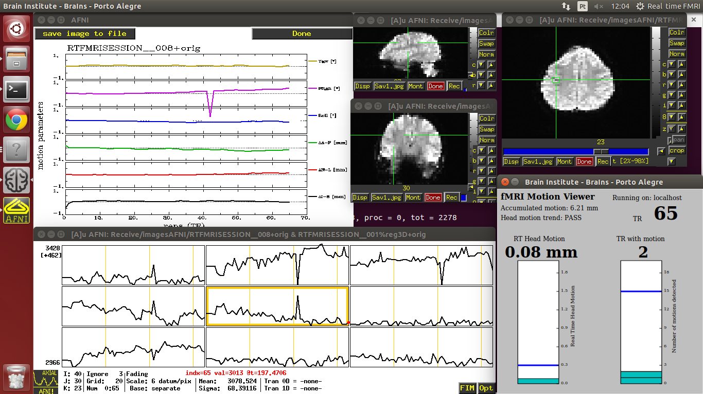
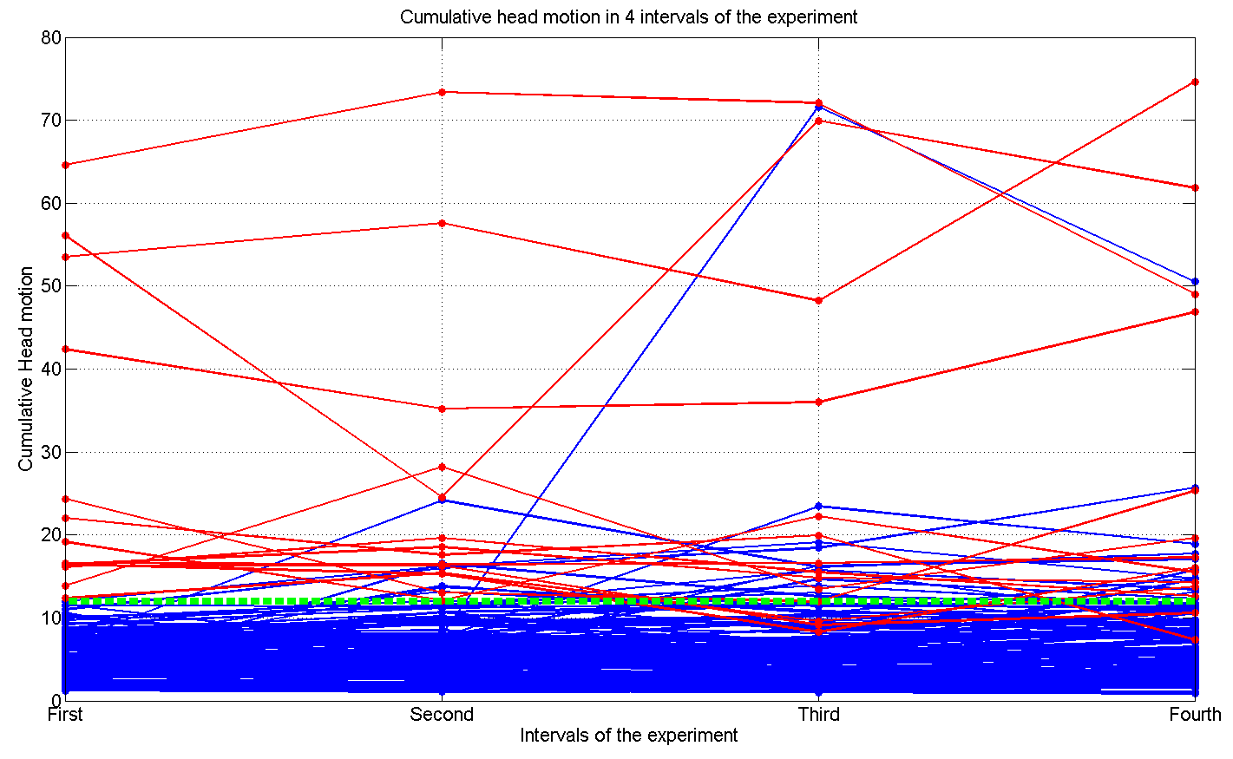
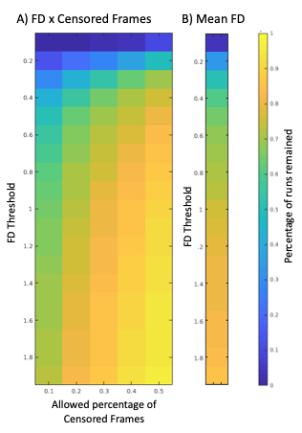







Real-time fMRI Motion Tracking: Should I Stop and Restart the Scan?
#4824
Nathalia Bianchini Esper^{1,2}, Maicon Much¹, Dario Azevedo¹, Augusto Buchweitz^{1,2}, Michael Milham^{3,4}, Alexandre Rosa Franco^{3,4,*}
¹ PUCRS, Porto Alegre, Brazil, ² Brain Institute of Rio Grande do Sul, Brazil, ³ Child Mind Institute, New York, NY, ⁴ Nathan Kline Institute for Psychiatric Research, Orangeburg, NY, *Corresponding author: alexandre.franco@nki.rfmh.org
INTRODUCTION
RESULTS (cont.)
Excessive head motion is the main reason to discard fMRI data [1-2].
Does using a real time system help to reduce head motion and data loss [3,4]?
If you detect head motion during the scan, should you stop the scan?
If so, how should you decide to interrupt the run and remind the subject not to move their head?
Can you predict if a scan will be discarded or not, at the beginning of a run?
Our group developed a real-time software that warns researchers if a scan should be interrupted or not based on head motion.
METHODS
Imaging Data: 738 subjects of the Healthy Brain Network [5] with two resting state fMRI runs. These data include children aged 6-21. Each run has a duration of 5 min with a TR=0.8s.
Motion Estimation:
Motion estimation was calculated through FD by Power's method [6] by using the C-PAC [7]. Subject data was labeled based on whether it would be discarded or not due to excessive head motion. The first method measured at each frame if it passed a specified FD threshold. If more than X percent of the time-series is above this threshold, the entire run would be discarded. The second method discarded the run if the average FD is above a specific threshold.
Use of ROC analysis assesses to test if it is possible to predict if a run would be discarded based on data from the beginning of each run.
Figure 3: ROC curves by discarding data based on censoring (A) or by mean FD (B). Each panel indicates the percentage of the 1476 runs that would be discarded by that threshold. Colored lines indicate the amount of time necessary to make a prediction if a run would be correctly interrupted or not.
Software Development:
Programming Language: Python, Shell Scripting and AFNI’s real time system [8,9]. Tested and validated on a GE HDxt MRI with 10 healthy participants. TR=2s, 4min 40s, two tasks, 1) requesting participant stay still and 2) requesting to move head.
Figure 4: Screenshot of the motion detection tool. On the left, a configuration screen. On the right, the warning of when a run should be interrupted.
Figure 1: Real-time fMRI fluxogram. MRI Scanner sends the k-space images to MRI console. The real-time console received DICOM files and estimates head motion during the functional run.
RESULTS
A)
B)
Figure 5: Screenshot of full motion detection toolbox. Toolbox correctly detected excessive head motion in all 10 test subjects
CONCLUSIONS
Figure 2: A) Showing cumulative head motion in each quartile of the run. Red lines represent participants that moved excessively during the first quartile of the run and blue represents subjects that did not present excessive motion during the first quartile. The y-axis represents the sum of FD for that quartile. B) Showing percentage of runs that would be discarded based on threshold applied, FD and percentage of censored frames or Mean FD.
Excessive head motion detected early in the run can predict if data will be discarded , i.e. “once a mover, always a mover”.
Toolbox developed correctly identifies head motion and assists researchers if run should be interrupted or not.
Can be used for resting state and task based functional runs.
Code and Demo
References: [1] N. A. Thacker, et. al, “The effects of motion on parametric fMRI analysis techniques,” Physiol. Meas., vol. 20, no. 3, pp. 251–263, 1999. [2] T. T. Liu, “Reprint of ‘Noise contributions to the fMRI signal: An Overview,’” Neuroimage, vol. 154, pp. 4–14, 2017. [3] N. U. F. Dosenbach, et. al, “Real-time motion analytics during brain MRI improve data quality and reduce costs,” Neuroimage, vol. 161, no. August, pp. 80–93, 2017. [4] S. Yang, et. al, “Head motion suppression using real-time feedback of motion information and its effects on task performance in fMRI,” Neuroimage, vol. 27, no. 1, pp. 153–162, 2005. [5] L. M. Alexander, et. al, “Data Descriptor: An open resource for transdiagnostic research in pediatric mental health and learning disorders,” Sci. Data, vol. 4, pp. 1–26, 2017. [6] J. D. Power, et. al , “Spurious but systematic correlations in functional connectivity MRI networks arise from subject motion.,” Neuroimage, vol. 59, no. 3, pp. 2142–54, Feb. 2012. [7] C. Craddock, et. al, “Towards Automated Analysis of Connectomes: The Configurable Pipeline for the Analysis of Connectomes (C-PAC),” Front. Neuroinform., 2013. [8] R. W. Cox, et al, “Real-time 3D image registration for functional MRI,” Magn. Reson. Med., vol. 42, no. 6, pp. 1014–1018, Dec. 1999. [9] R. W. Cox, “AFNI: what a long strange trip it’s been.,” Neuroimage, vol. 62, no. 2, pp. 743–7, Aug. 2012.

