Slide 1
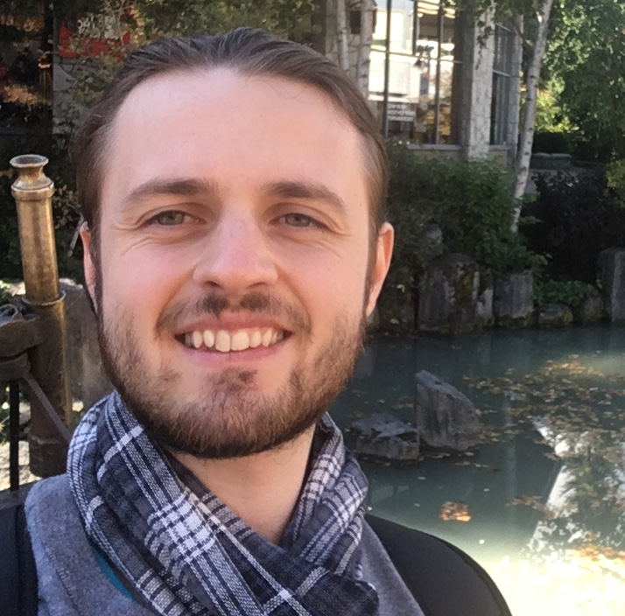

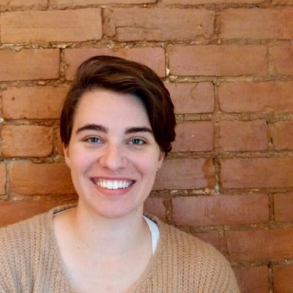




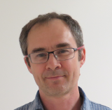
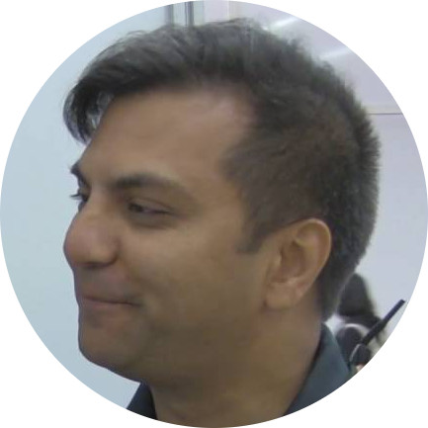

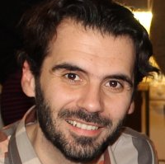

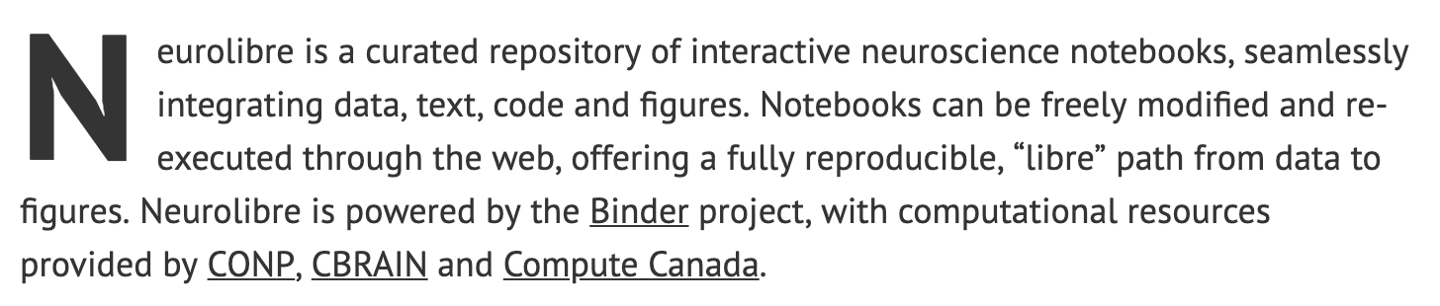
Loic Tetrel
Mathieu Boudreau
Elizabeth DuPre
Agah Karakuzu
FA Fortin
Darcy Quesnel
Shawn Brown
JB Poline
Samir Das
Pierre Bellec
Nikola Stikov
Introducing
neurolibre.conp.ca

Slide 2

CONP
Communication
Outreach
Pierre Bellec
Samir Das
Nikola Stikov
Interactive science communication: We will create an open environment featuring bite-sized interviews, editorials and multimedia content
Next generation publishing: We will create a publishing platform that encourages data curation and data/software sharing, based on the principles of reproducible science
Publishing
AIM 8: CONP Communication Platform

Slide 3
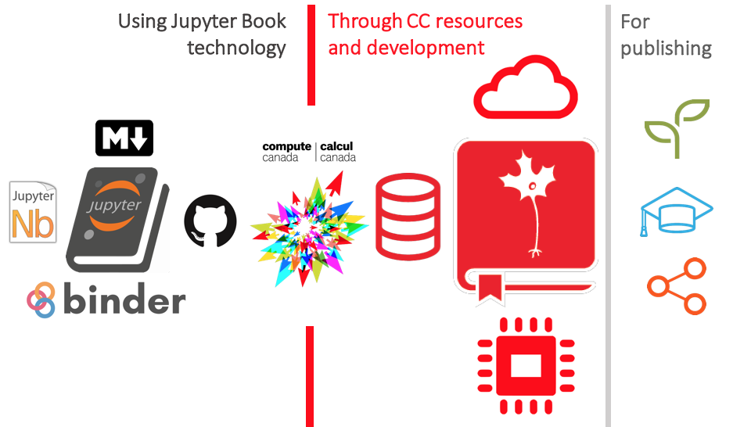

neurolibre.conp.ca

Slide 4
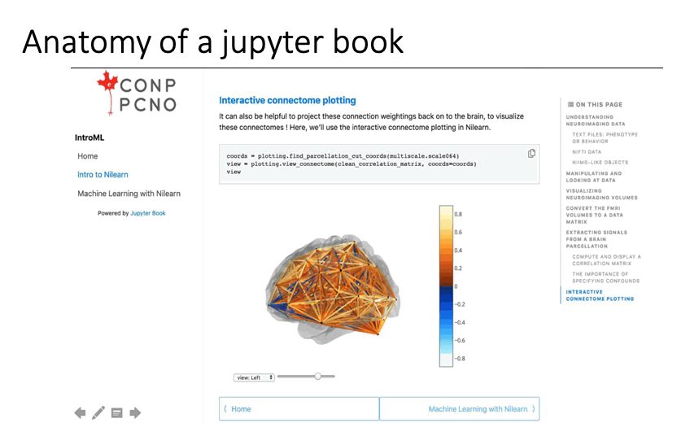
neurolibre.conp.ca

Slide 5
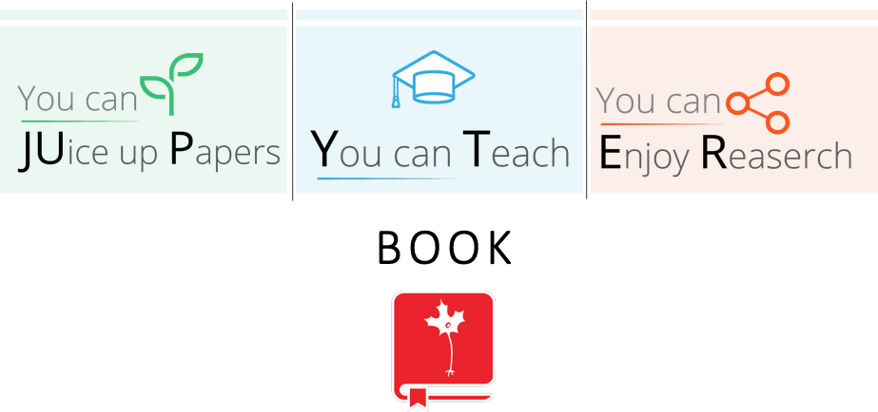
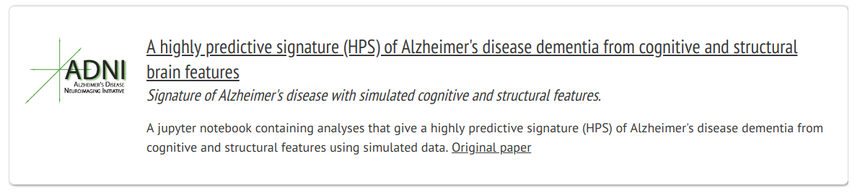
A Tam, C Dansereau, Y Iturria-Medina, S Urchs, P Orban, J Breitner, P Bellec, Alzheimer’s Disease Neuroimaging Initiative
neurolibre.conp.ca

Slide 6
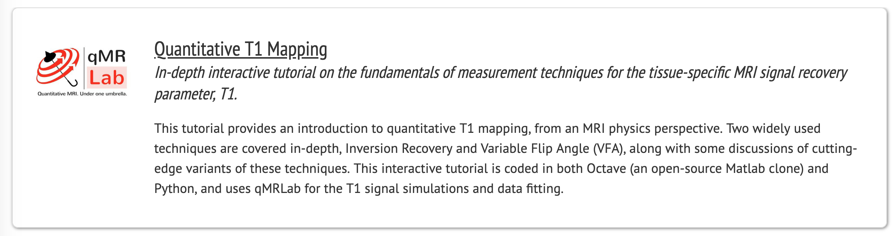
Mathieu Boudreau, Agah Karakuzu, and Nikola Stikov
neurolibre.conp.ca

Slide 7
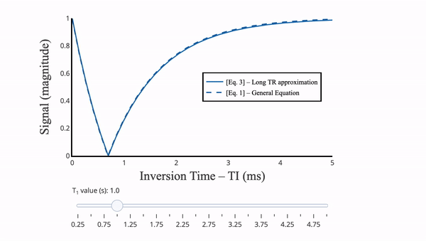
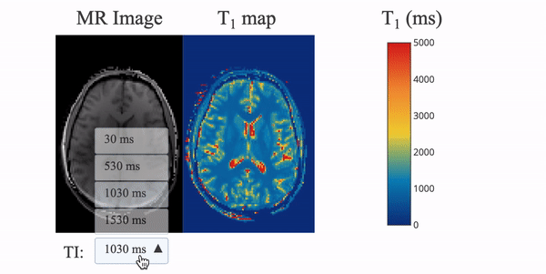
T1 mapping tutorial
You can
explore the phenomenon.
You can
interact with
the real-world data.
neurolibre.conp.ca

Slide 8
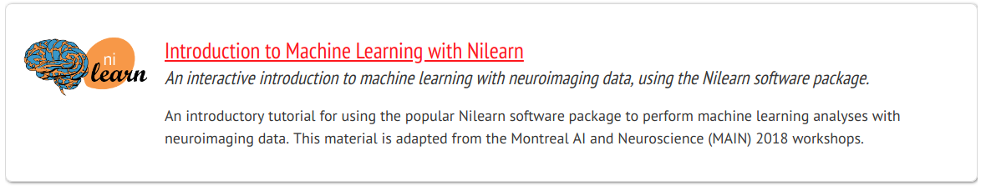
Jacob Vogel, Elizabeth M Dupré, Loic Tetrel and Gaël Varoquaux
neurolibre.conp.ca

Slide 9
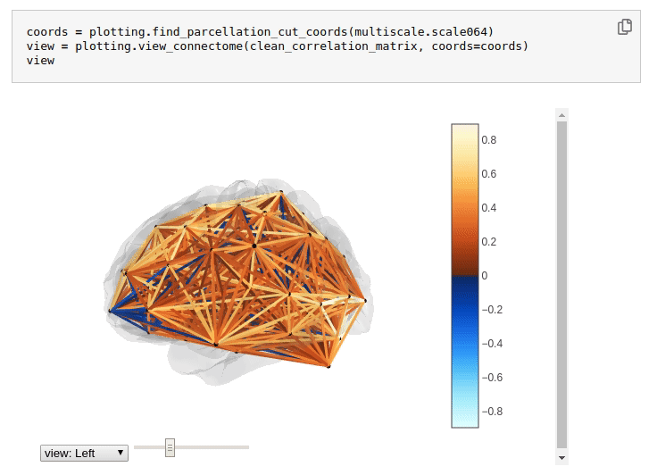
Nilearn tutorial
neurolibre.conp.ca

Slide 10

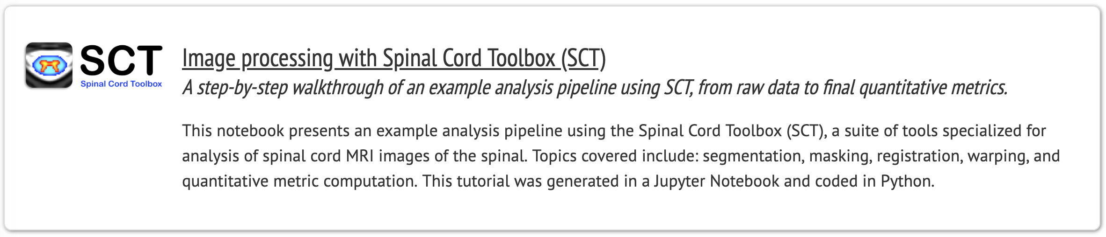
Mathieu Boudreau and Julien Cohen-Adad
neurolibre.conp.ca

Slide 11


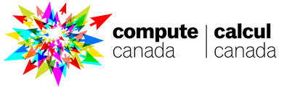
NeuroLibre powered by:
neurolibre.conp.ca

Slide 12
What’s next?
Create a submission system for all CONP members.
Add peer-review through github?
Partner with Aperture? Other journals?
Access CONP data directly through NeuroLibre.
Create a private, uncurated cloud for CONP members?
neurolibre.conp.ca

