Slide 1
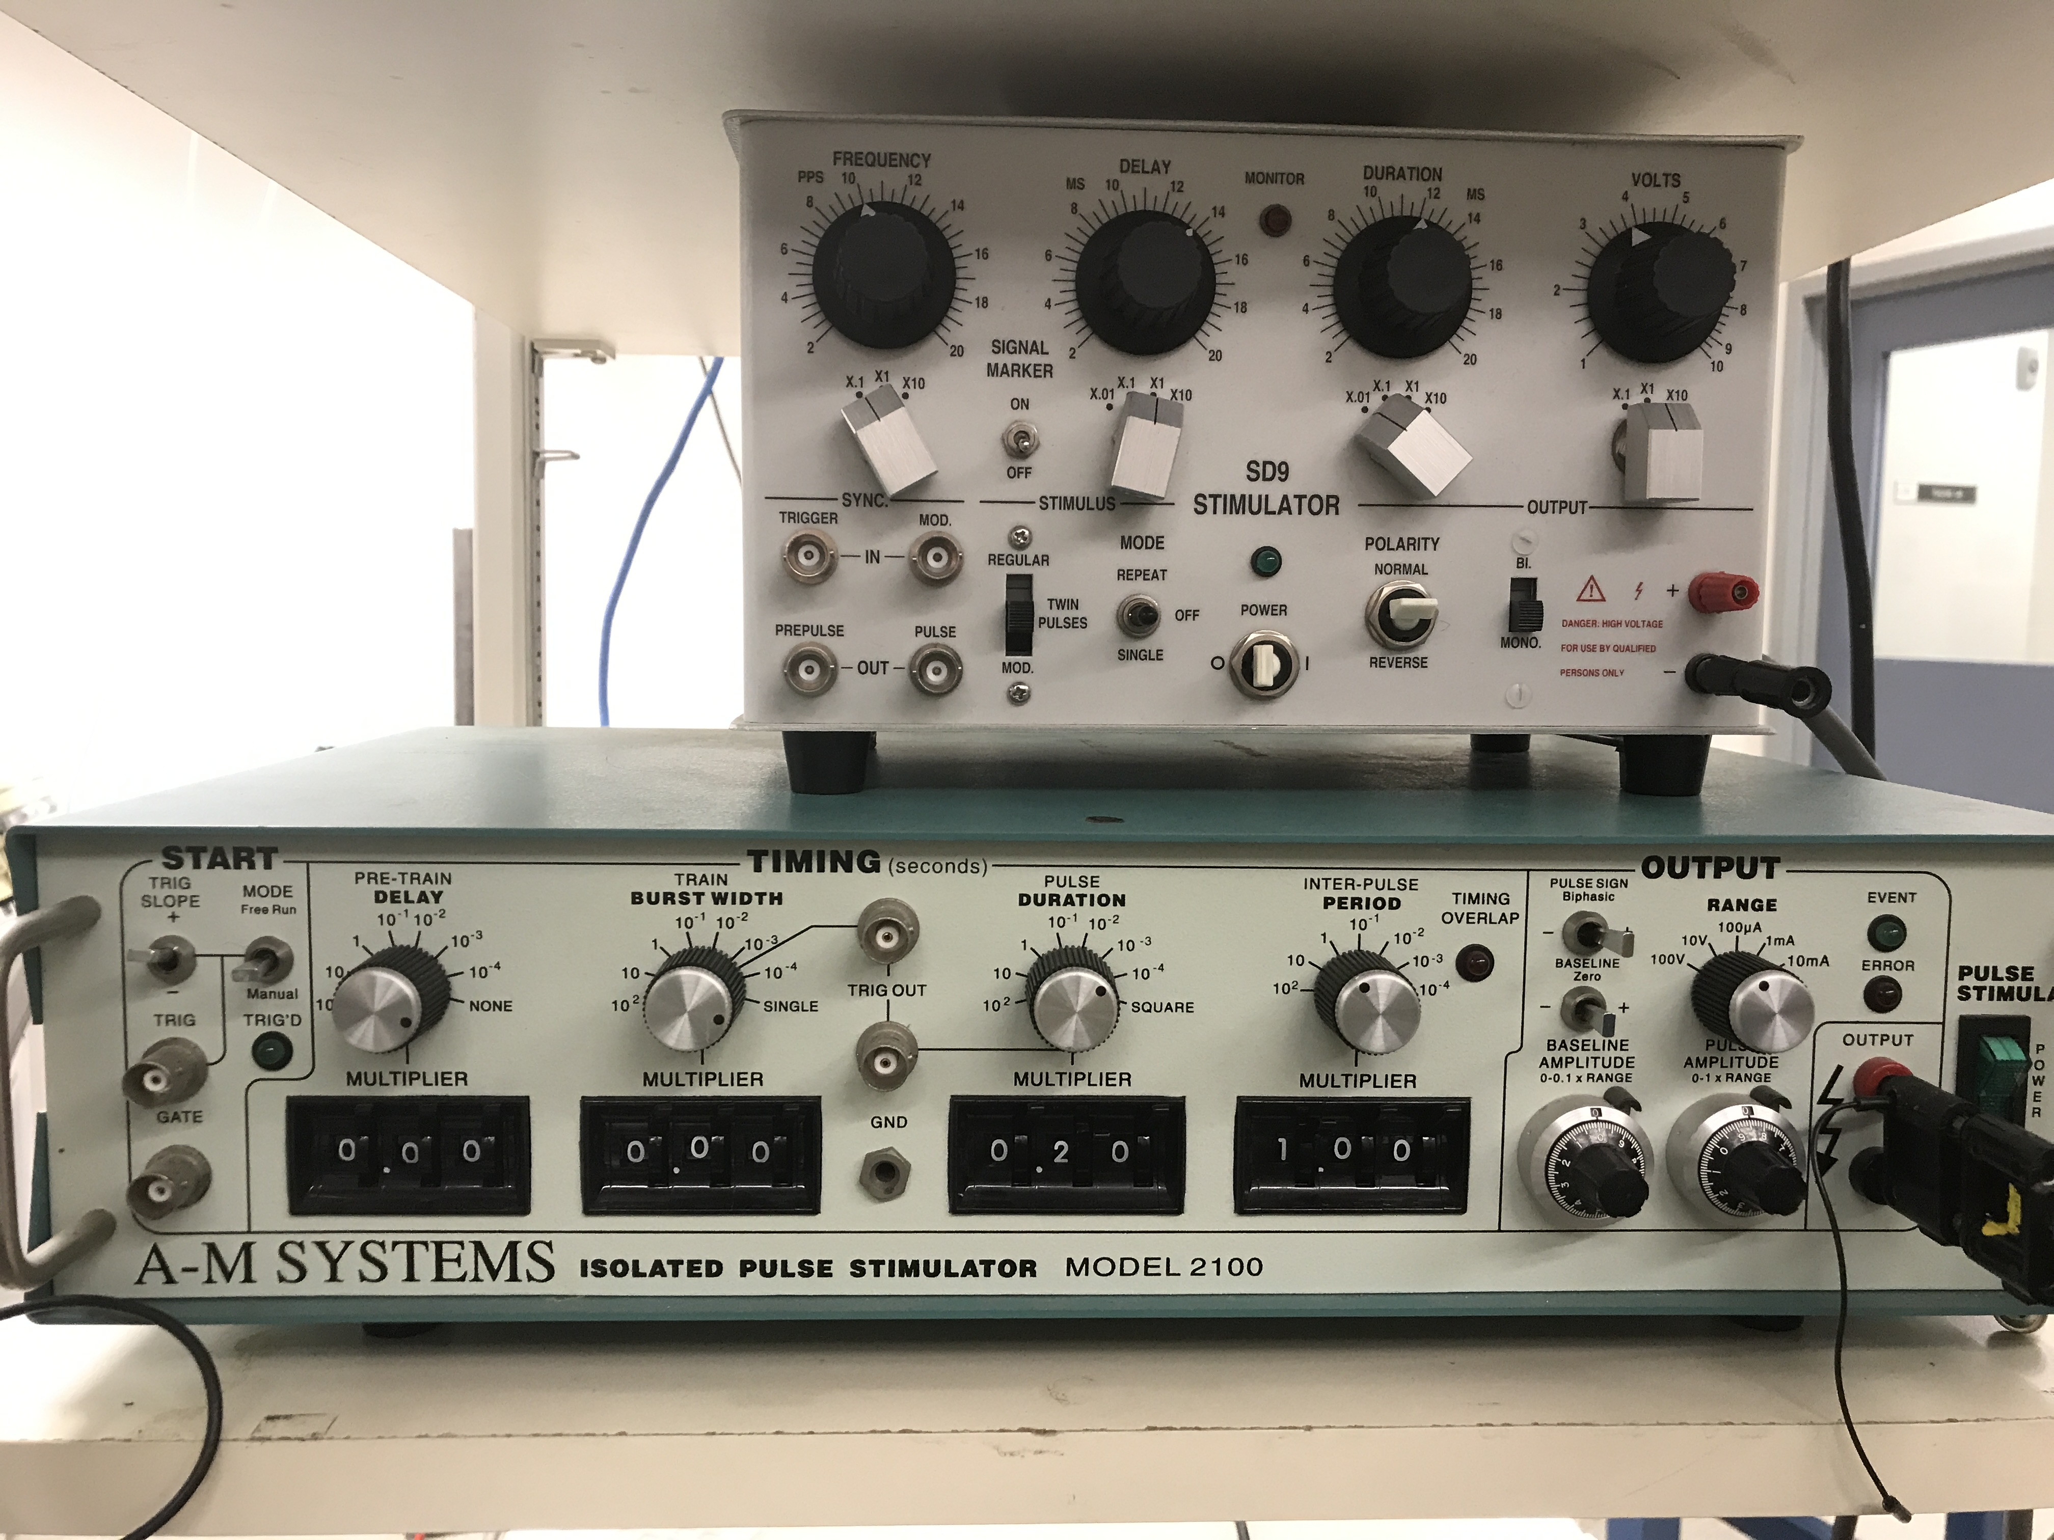
~1Hz pulse rate (IPP=1 sec) in FreeRun Mode seems good for monitoring stimulus thresholds
PULSE SIGN
Biphasic = +
Baseline = Zero
Stimulus output is a floating source (use ADC NRSE 10V range)
Start with 3 msec duration and 0 V.
Step 1: Slowly increase the amplitude until above spike threshold.
Step 2: Decrease duration until below spike threshold.
Repeat steps 1 and 2, recording the duration-amplitude pair at each spike threshold. Stop once you reach a short duration for which spike threshold would >9 V. DO NOT EXCEED 9V.
DURATION
MULTIPLIER = 10⁻³ recommended so that the scroll wheel values are in milliseconds.
SCROLL WHEEL = 3 to 0.01 msec
RANGE SELECTOR = 10 Volts
(DO NOT USE Amps)
PULSE AMPLITUDE = 0-9 Volts
(DO NOT EXCEED (VOLTS!)

Slide 2
I recommend using MANUAL trigger mode because of all the knob and wheel spinning that needs to happen to change IPI between trials
PULSE SIGN
Biphasic = +
Baseline = Zero
Stimulus output is a floating source (use ADC NRSE 10V range)
For all pulses, set AMPLITUDE above spike threshold at a Pulse DURATION of 200 microseconds (0.2 msec)
inter-pulse-interval on each trial is controlled by PERIOD. Experimentally range: 100 - 1 msec.
NUMBER OF PULSES per trial is controlled by the TRAIN BURST WIDTH. Set the burst width to between 1 to 2 times the IPI to get 2 pulses per trial. If burst width exceeds 2*IPI, then there will be more than two pulses per trial.

Slide 3
DELAY is the time between pulses. Experimentally range: 100 - 1 msec
If using REPEAT mode, I recommend ~1Hz IPI
For all pulses, set AMPLITUDE above spike threshold at a Pulse DURATION of 200 microseconds (0.2 msec)
Stimulus output is a floating source (use ADC NRSE 10V range)
Must be in TWIN PULSES mode
You can either trigger each trial manually so that you test discrete sets of ipi instead or you can ‘repeat’ for a continuous range.

