Slide 1
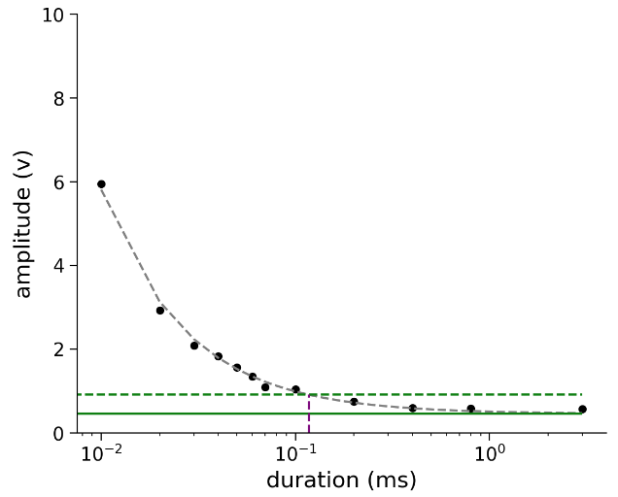
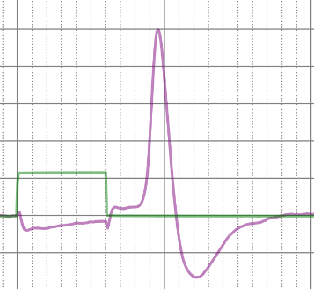
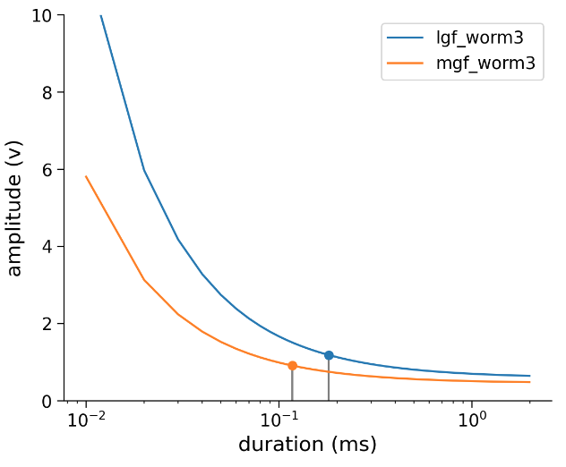
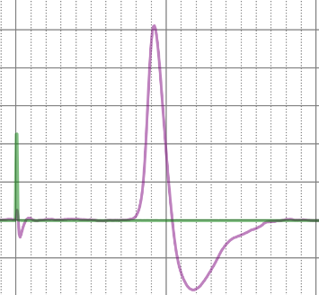
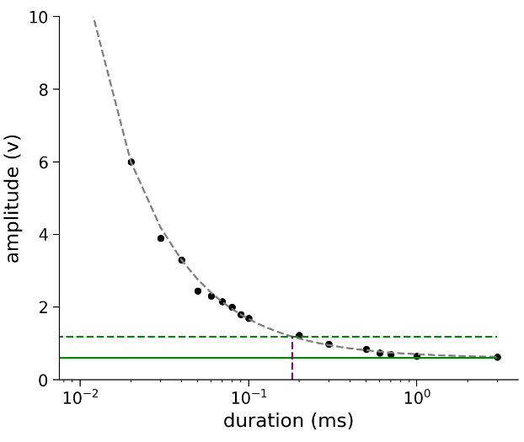
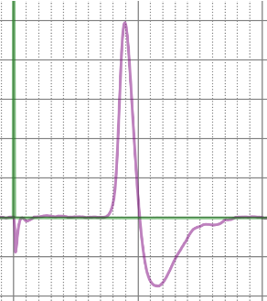
A
C
3 ms
0.56 V
Medial Giant
B
Lateral Giant
Medial Giant
117 μsec
0.06 ms
1.35 V
0.457 V
Lateral Giant
0.01 ms
5.95 V
177 μsec
0.594 V
1mV
5msec

Slide 2
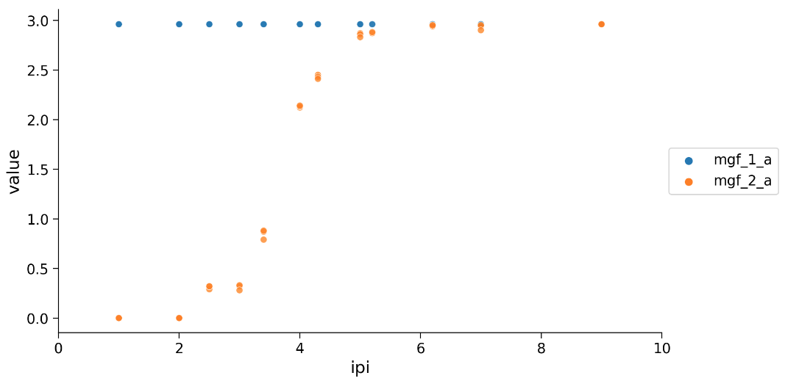
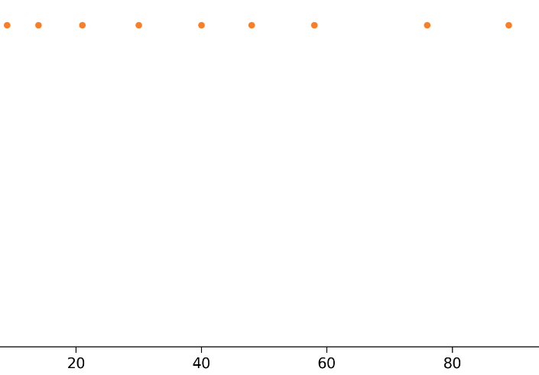
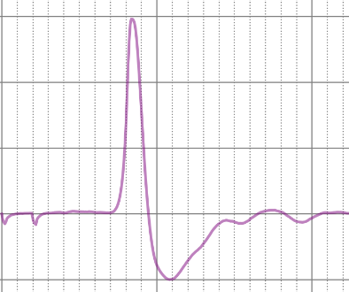
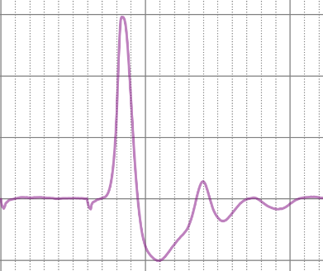
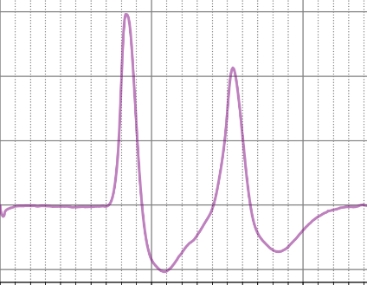
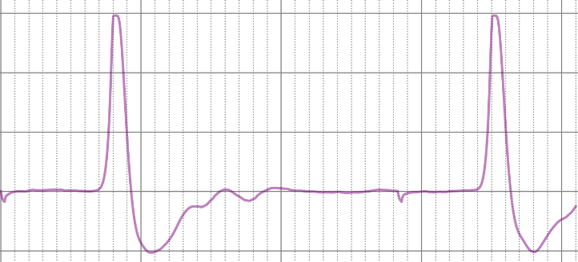
A
iv
First
Second
iii
mV
ii
i
10
msec
B
i
*
ii
*
iii
*
iv
*
*
*
*
1mV
5msec

Slide 3
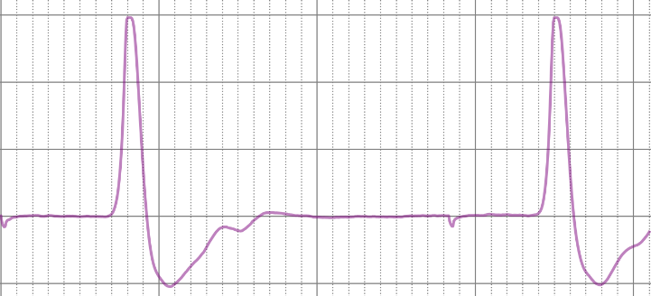
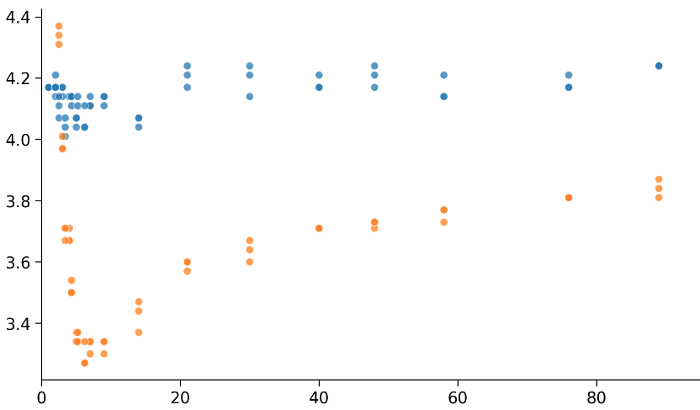
A
latency
latency
1mV
isi
B
5msec
stimulus-spike latency (msec)
First
Second
inter-spike-interval (msec)

