Slide 1
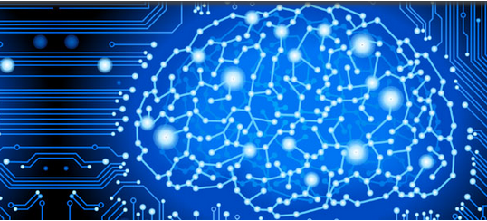

NeuroMiner®
pattern recognition for
neurodiagnostic applications
V1.05
elessar
© Nikolaos Koutsouleris, 2020
The development of this software has been funded by the European Commission under the 7th Framework Programme / Grant Agreement No. 602152

