Slide 1
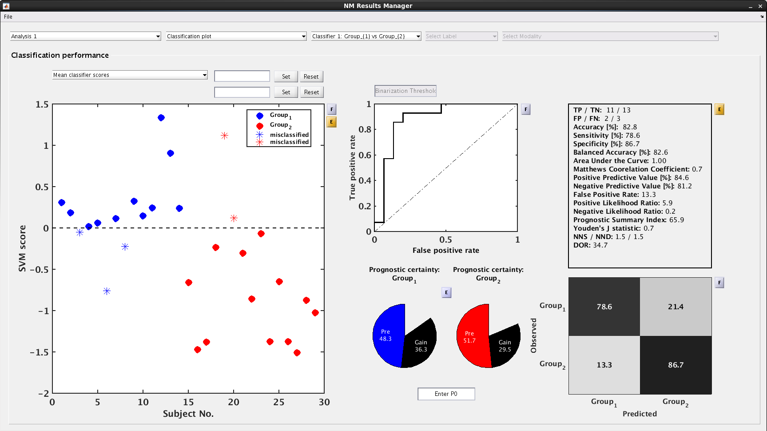
Select your analysis
Select a plot to view
Select your classifier
Select what data to plot
Use “F” buttons to open in figure window
Use “E” buttons to export the data
Set the x-axis by entering a workspace variable
ROC Display
Prediction metrics
Prediction results display
Confusion matrix
Pie charts of the pre-test probability of correct classification based on the frequency of targets in each group. The gain after analysis is indicated in black. You can enter a different pre-test probability (e.g., from literature) into the box.

