Slide 1
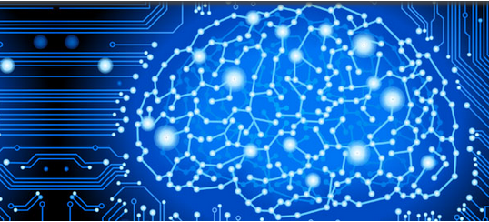

NeuroMiner®
pattern recognition for
neurodiagnostic applications
V1.3
curufin
{devel}
© Nikolaos Koutsouleris, Clara Vetter, Ariane Wiegand, Lisa Hahn, Sergio Mena
The development of this software has been supported by the European Commission under the 7th Framework Programme / Grant Agreement No. 602152

