Slide 1
AZ-104T00A Module 01: Identity

Slide 2
Module Overview
Lesson 01: Azure Active Directory
Lesson 02: Users and Groups
Lesson 03: Module 01 Lab and Review

Slide 3
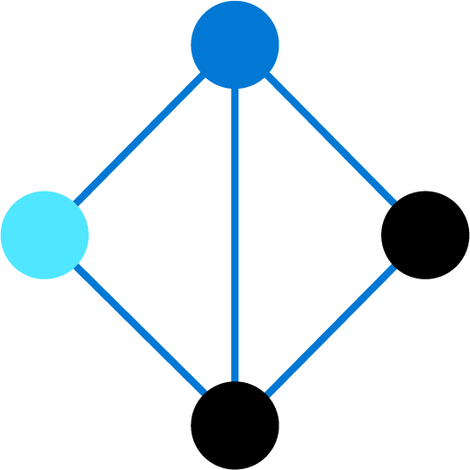
Lesson 01: Azure Active Directory

Slide 4
Azure Active Directory Overview
Azure Active Directory
Azure AD Concepts
AD DS vs. Azure Active Directory
Azure Active Directory Editions
Azure AD Join
Self-Service Password Reset
Notes:
Manage Azure identities and governance (15-20%)
Manage Azure AD objects
Configure Azure AD join
Configure self-service password reset

Slide 5
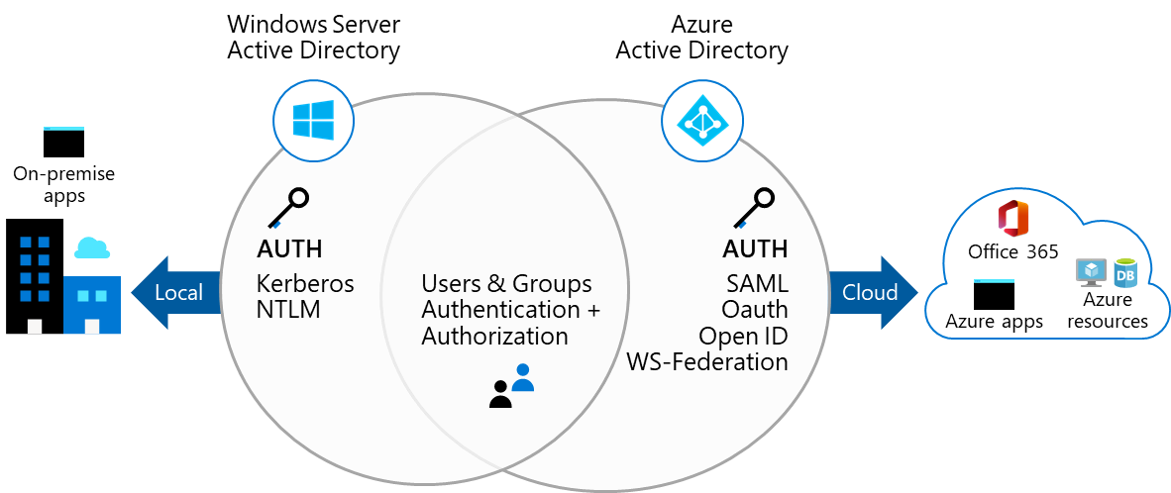
Azure Active Directory
A cloud-based suite of identity management capabilities that enables you to securely manage access to Azure services and resources for your users
Provides application management, authentication, device management, and hybrid identity
Notes:
What is Azure Active Directory? - https://docs.microsoft.com/en-us/azure/active-directory/fundamentals/active-directory-whatis

Slide 6
Azure AD Concepts
Concept | Description
Identity | An object that can be authenticated
Account | An identity that has data associated with it
Azure AD account | An identity created through Azure AD or another Microsoft cloud service
Azure AD tenant/directory | A dedicated and trusted instance of Azure AD, a Tenant is automatically created when your organization signs up for a Microsoft cloud service subscription​ ​ Additional instances of Azure AD can be created​ Azure AD is the underlying product providing the identity service​ The term Tenant means a single instance of Azure AD representing a single organization​ The terms Tenant and Directory are often used interchangeably​
Azure subscription | Used to pay for Azure cloud services
Notes:
Azure AD Terminology - https://docs.microsoft.com/en-us/azure/active-directory/fundamentals/active-directory-whatis#terminology

Slide 7
AD DS vs Azure Active Directory
Azure AD is primarily an identity solution, and designed for HTTP and HTTPS communications
Queried using the REST API over HTTP and HTTPS. Instead of LDAP
Uses HTTP and HTTPS protocols such as SAML, WS-Federation, and OpenID Connect for authentication (and OAuth for authorization). Instead of Kerberos
Includes federation services, and many third-party services (such as Facebook)
Azure AD users and groups are created in a flat structure, and there are no Organizational Units (OUs) or Group Policy Objects (GPOs)
Notes:
Compare Active Directory to Azure Active Directory - https://docs.microsoft.com/en-us/azure/active-directory/fundamentals/active-directory-compare-azure-ad-to-ad
✔️ Azure AD is a managed service. You only manage the users, groups, and policies. Deploying AD DS with virtual machines using Azure means that you manage the deployment, configuration, virtual machines, patching, and other backend tasks. Do you see the difference? How are they similar?

Slide 8
Azure Active Directory Editions
Feature | Free | Microsoft 365 Apps | Premium P1 | Premium P2
Directory Objects | 500,000 objects | No object limit | No object limit | No object limit
Single Sign-On | Unlimited | Unlimited | Unlimited | Unlimited
Core Identity and Access | X | X | X | X
B2B Collaboration | X | X | X | X
Identity & Access for O365 |  | X | X | X
Premium Features |  |  | X | X
Hybrid Identities |  |  | X | X
Advanced Group Access |  |  | X | X
Conditional Access |  |  | X | X
Identity Protection |  |  |  | X
Identity Governance |  |  |  | X
Notes:
Azure AD Pricing Editions - https://azure.microsoft.com/en-us/pricing/details/active-directory/
✔️ Did you look through the pricing list to determine which features your organization needs and to compare edition capabilities?

Slide 9
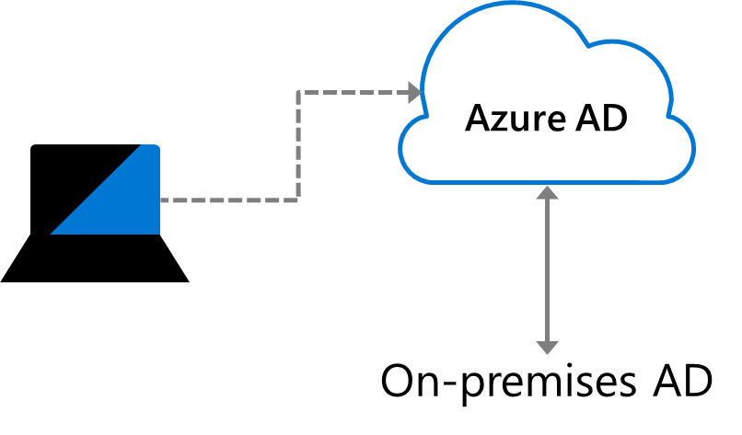
Azure AD Join
Single-Sign-On to your Azure managed SaaS apps and services
Enterprise state roaming of user settings across joined devices
Access to Microsoft Store for Business
Windows Hello support
Restriction of access to apps from only compliant devices
Seamless access to on-premises resources
Notes:
Azure AD joined devices - https://docs.microsoft.com/en-us/azure/active-directory/devices/concept-azure-ad-join
✔️ Although AD Join is intended for organizations that do not have on-premises Windows Server Active Directory infrastructure it can be used for other scenarios like branch offices.

Slide 10
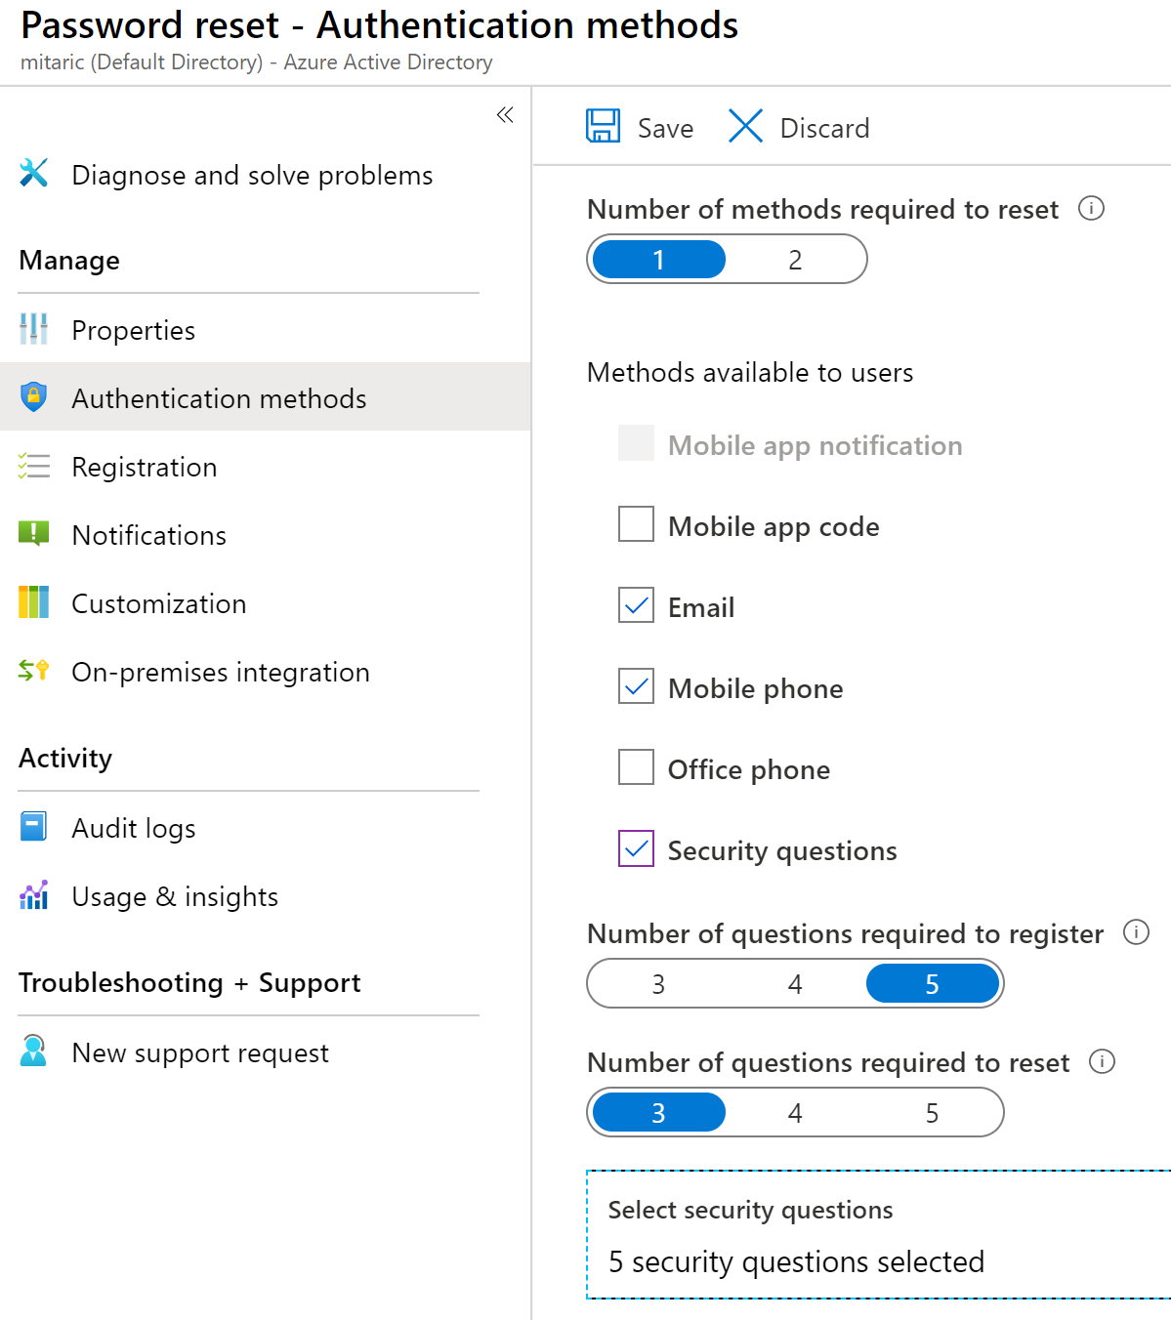
Self-Service Password Reset
Determine who can use self-service password reset
1
2
Choose the number of authentication methods required and the methods available (email, phone, questions)
3
You can require users to register for SSPR (same process as MFA)
Notes:
Plan an Azure Active Directory self-service password reset deployment - https://docs.microsoft.com/en-us/azure/active-directory/authentication/howto-sspr-deployment

Slide 11
Lesson 02: Users and groups

Slide 12
Users and Groups Overview
User Accounts
Managing User Accounts
Bulk User Accounts
Group Accounts
Managing Multiple Directories
Demonstration – Users and Groups
Notes:
Manage Azure identities and governance (15-20%)
Manage Azure AD objects
Create users and groups
Manage user and group properties
Perform bulk user updates
Manage guest accounts

Slide 13
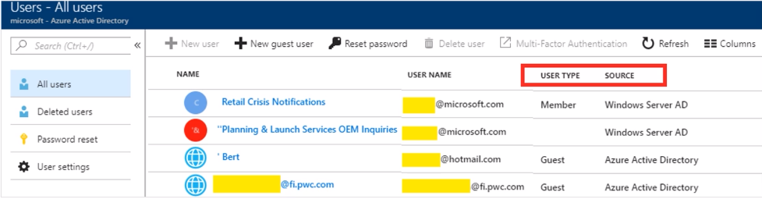
User Accounts
All users must have an account
The account is used for authentication and authorization
Identity Sources: Cloud, Directory-synchronized, and Guest
Notes:
✔️ Have you given any thought as to the type of users you will need?

Slide 14
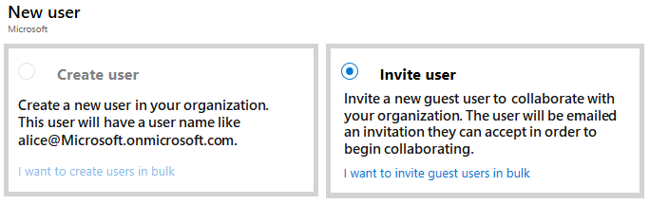
Managing User Accounts
Must be Global Administrator or User Administrator to manage users
User profile (picture, job, contact info) is optional
Deleted users can be restored for 30 days
Sign in and audit log information is available
Notes:
Add or delete users using Azure Active Directory - https://docs.microsoft.com/en-us/azure/active-directory/fundamentals/add-users-azure-active-directory

Slide 15
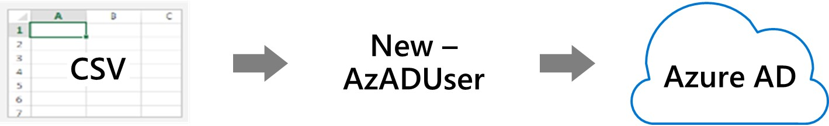
Bulk User Accounts
Create the comma-separated values (CSV) file with the list of all the users and their properties
Loop through the file processing each user
Consider error handling, duplicate users, initial password settings, empty properties, and when the account is enabled
Notes:
Bulk create users in Azure Active Directory - https://docs.microsoft.com/en-us/azure/active-directory/users-groups-roles/users-bulk-add
✔️ Establish or implement a naming convention for usernames, display names and aliases. The password for the new users needs to conform to the password complexity rules you have set for your directory. User parameters include User Principal Name, Display Name, Given Name, Department, and Job Title.

Slide 16
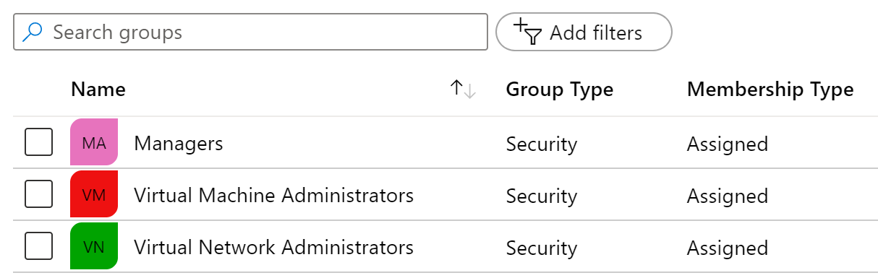
Group Accounts
Group Types
Security groups
Microsoft 365 groups
Assignment Types
Assigned
Dynamic User
Dynamic Device (Security groups only)
Notes:
Manage app and resource access using Azure Active Directory groups – https://docs.microsoft.com/en-us/azure/active-directory/fundamentals/active-directory-manage-groups
Quickstart: View your organization's groups and members in Azure Active Directory - https://docs.microsoft.com/en-us/azure/active-directory/fundamentals/active-directory-groups-view-azure-portal
✔️ Have you given any thought to which groups you need to create? How will you assign users to groups?

Slide 17
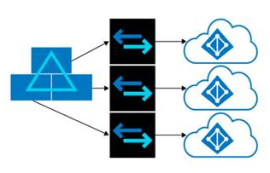
Managing Multiple Directories
Each Azure AD organization is fully independent: a peer that is logically independent from the other Azure AD organizations you manage
There is no parent-child relationship between organizations
Independence includes:
Resource independence
Administration independence
Synchronization independence
Notes:
Understand how multiple Azure Active Directory organizations interact - https://docs.microsoft.com/en-us/azure/active-directory/users-groups-roles/licensing-directory-independence

Slide 18
Demonstration – Users and Groups
Determine domain information
Explore user accounts
Explore group accounts
Explore PowerShell for group management
Notes:
✔ Always consider having students walk-through the demonstrations themselves. Also, consider the overlap with the formal labs and your best use of time.

Slide 19
Lesson 03: Module 01 Lab and Review

Slide 20
Lab 01 – Manage Azure Active Directory identities
Lab scenario
In order to allow Contoso users to authenticate by using Azure AD, you have been tasked with provisioning users and group accounts. Membership of the groups should be updated automatically based on the user job titles. You also need to create a test Azure AD tenant with a test user account and grant that account limited permissions to resources in the Contoso Azure subscription.
Objectives
Task 1: Create and configure Azure AD users
Task 2: Create Azure AD groups with assigned and dynamic membership
Task 3: Create an Azure Active Directory (AD) tenant
Task 4: Manage Azure AD guest users
Next slide for an architecture diagram
Notes:
LAB 01 - Manage Azure Active Directory Identities - ESTIMATED DURATION 30 MIN
AZ-104 Lab Repository - https://microsoftlearning.github.io/AZ-104-MicrosoftAzureAdministrator/

Slide 21



Lab 01 – Architecture diagram
Task 1, Task 2
Task 3
Default Azure AD tenant
IT Cloud Administrators
Membership type: Dynamic User
IT System Administrators
Membership type: Dynamic User
New Azure AD tenant
Contoso Lab
Cloud user
Cloud user
az104-01a-aaduser1
Role: User administrator
Job title: Cloud Administrator
Department: IT
az104-01a-aaduser2
Job title: System Administrator
Department: IT
Cloud user
az104-01b-aaduser1
Job title: System Administrator
Department: IT
IT Lab Administrators
Membership type: Assigned
Task 4
Guest user
az104-01b-aaduser1
Job title: Lab Administrator
Department: IT

Slide 22
Module Review
Module Review Questions
Microsoft Learn Modules (docs.microsoft.com/Learn)
Create Azure users and groups in Azure Active Directory
Manage users and groups in Azure Active Directory
Secure Azure Active Directory users with Multi-Factor Authentication
Allow users to reset their password with Azure Active Directory self-service password reset
Secure your application by using OpenID Connect and Azure AD
Notes:
Learn - https://docs.microsoft.com/en-us/learn/browse/

Slide 23
End of presentation

