Slide 1
AZ-104T00A Module 02: Governance and Compliance

Slide 2
Module Overview
Lesson 01: Subscriptions and Accounts
Lesson 02: Azure Policy
Lesson 03: Role-Based Access Control
Lesson 04: Module 02 Lab and Review

Slide 3
Lesson 01: Subscriptions and Accounts

Slide 4
Subscriptions and Accounts Overview
Regions
Azure Subscriptions
Getting a Subscription
Subscription Usage
Cost Management
Resource Tags
Cost Savings
Notes:
Manage Azure identities and governance (15-20%)
Manage subscriptions and governance
• Manage subscriptions
• Configure Cost Management

Slide 5
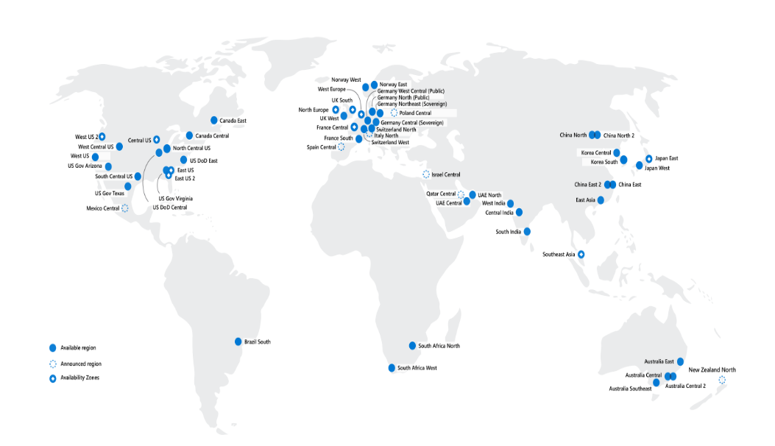
Regions
A region represents a collection of datacenters
Provides flexibility and scale
Preserves data residency
Select regions close to your users
Be aware of region deployment availability
There are global services that are region independent
Worldwide there are 60+ regions representing 140 countries
Regions are paired for high availability
Notes:
A list of regions and their locations is available at https://azure.microsoft.com/en-us/global-infrastructure/locations/

Slide 6
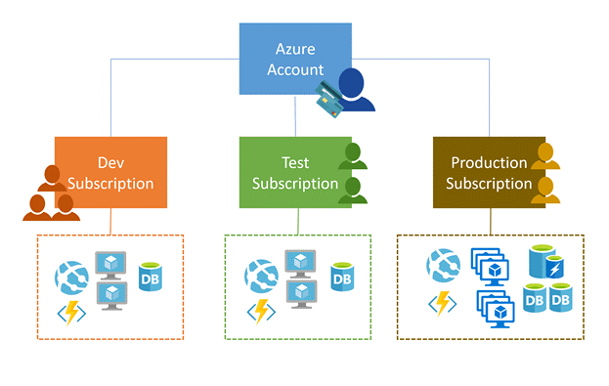
Azure Subscriptions
Only identities in Azure AD or in a directory that is trusted by Azure AD can create a subscription
Logical unit of Azure services that is linked to an Azure account
Security and billing boundary
Notes:
Create an additional Azure subscription - https://docs.microsoft.com/en-us/azure/cost-management-billing/manage/create-subscription
Change your Azure subscription to a different offer - https://docs.microsoft.com/en-us/azure/cost-management-billing/manage/switch-azure-offer
✔️ Do you know how many subscriptions your organization has?
Clarification on the last bullet - Only Identities in Azure Active Directory (Azure AD) or in a directory that is trusted by Azure AD (such as a work or school organization) can create a Subscription. For example, Account Owner role can be used to create a Subscription in an Enterprise Agreement.

Slide 7
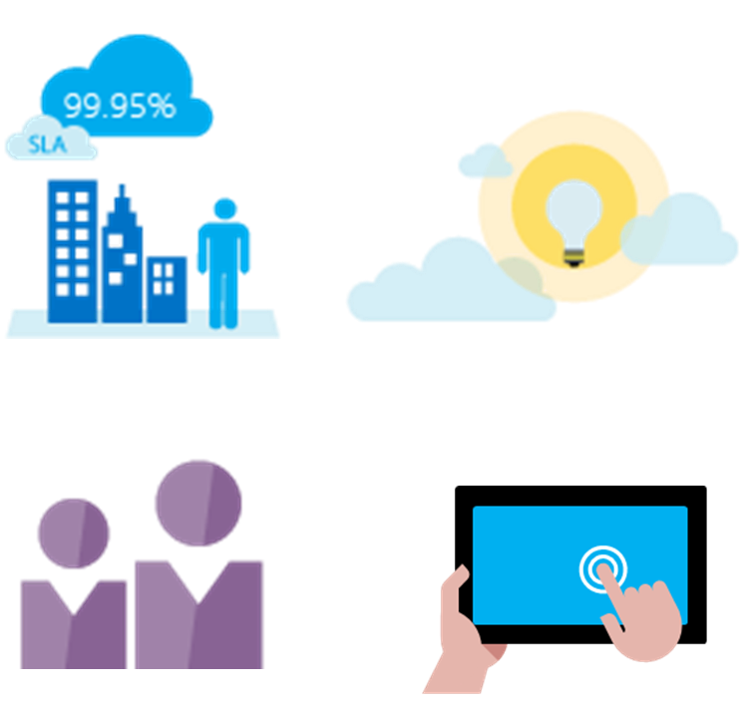
Getting a Subscription
Enterprise Agreement customers make an upfront monetary commitment and consume services throughout the year
Resellers provide a simple, flexible way to purchase cloud services
Partners can design and implement your Azure cloud solution
Personal free account – Start right away
Notes:
Subscription decision guide - https://docs.microsoft.com/en-us/azure/cloud-adoption-framework/decision-guides/subscriptions/
✔️ Which subscription model are you most interested in?

Slide 8
Subscription Usage
Subscription | Usage
Free | Includes a $200 credit for the first 30 days, free limited access for 12 months
Pay-As-You-Go | Charges you monthly
CSP | Agreement with possible discounts through a Microsoft Cloud Solutions Provider Partner – typically for small to medium businesses
Enterprise | One agreement, with discounts for new licenses and Software Assurance – targeted at enterprise-scale organizations
Student | Includes $100 for 12 months – must verify student access
Notes:
Credit card information is used for identity verification only. You won’t be charged for any services until you upgrade.

Slide 9
Cost Management
Conduct cost analysis
Create a budget
Review recommendations
Export the data
Notes:
What is Azure Cost Management and Billing? - https://docs.microsoft.com/en-us/azure/cost-management-billing/cost-management-billing-overview
Quickstart: Explore and analyze costs with cost analysis - https://docs.microsoft.com/en-us/azure/cost-management-billing/costs/quick-acm-cost-analysis
Analyze costs and create budgets with Azure Cost Management - https://docs.microsoft.com/en-us/learn/modules/analyze-costs-create-budgets-azure-cost-management/

Slide 10
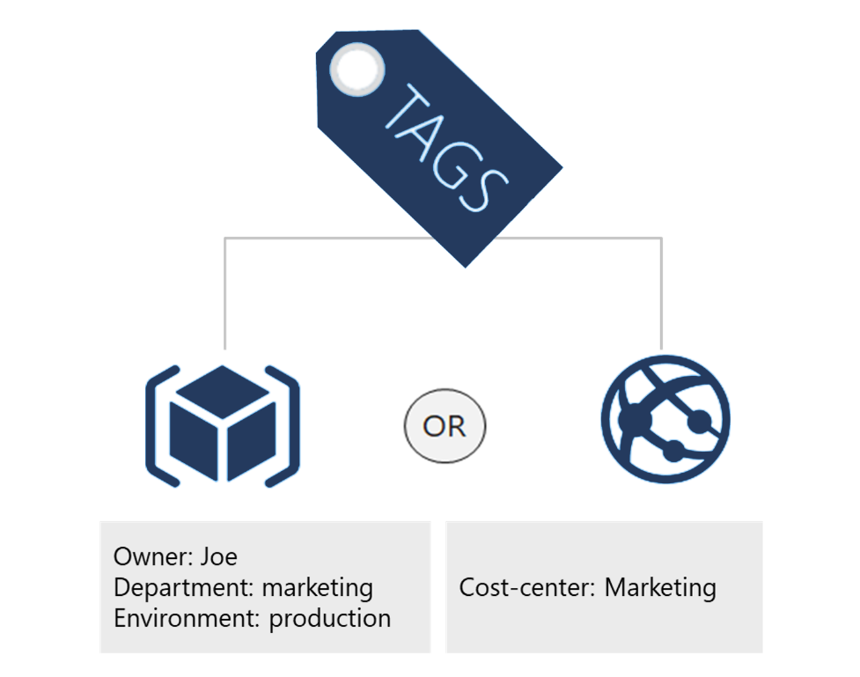
Resource Tags
Provides metadata for your Azure resources
Logically organizes resources into a taxonomy
Consists of a name-value pair
Very useful for rolling up billing information
Notes:
Resource naming and tagging decision guide - https://docs.microsoft.com/en-us/azure/cloud-adoption-framework/decision-guides/resource-tagging
✔️ If you need to create a lot of tags you will want to do that programmatically. You can use PowerShell or the CLI.

Slide 11
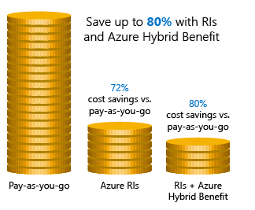
Cost Savings
Azure Reservations – Helps you save money by pre-paying for services
Azure Hybrid Benefits – Use Windows Server and SQL Server on-premises licenses with Software Assurance
Azure Credits – Monthly credit benefit that allows you to experiment with, develop, and test new solutions on Azure
Regions – Choose low-cost locations and regions
Notes:
Cost savings - https://docs.microsoft.com/en-us/learn/modules/predict-costs-and-optimize-spending/4-save-on-infrastructure-costs

Slide 12
Lesson 02: Azure Policy

Slide 13
Azure Policy Overview
Management Groups
Azure Policy
Implementing Azure Policy
Policy Definitions
Create Initiative Definitions
Scope the Initiative Definition
Determine Compliance
Demonstration – Azure Policy
Notes:
Manage Azure identities and governance (15-20%)
Manage subscriptions and governance
Configure Azure policies
Apply tags
Configure management groups

Slide 14
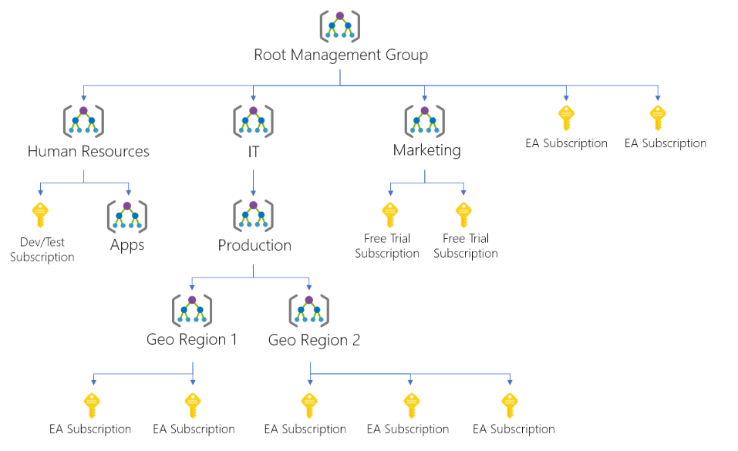
Management Groups
Provides a level of scope above subscriptions
Targeting of policies and spend budgets across subscriptions and inheritance down the hierarchies
Compliance and cost reporting by organization (business/teams)
Notes:
Create management groups for resource organization and management - https://docs.microsoft.com/en-us/azure/governance/management-groups/create
Manage your resources with management groups - https://docs.microsoft.com/en-us/azure/governance/management-groups/manage

Slide 15
Azure Policy
Azure Policy is a service in Azure that you use to create, assign and, manage policies
Usage Cases
Allowed resource types – Specify the resource types that your organization can deploy
Allowed virtual machine SKUs – Specify a set of virtual machine SKUs that your organization can deploy
Allowed locations – Restrict the locations your organization can specify when deploying resources
Require tag and its value – Enforces a required tag and its value
Azure Backup should be enabled for Virtual Machines – Audit if Azure Backup service is enabled for all Virtual machines
Azure Policy runs evaluations and scans for non-compliant resources
Advantages:
Enforcement and compliance
Apply policies at scale
Remediation
Notes:
What is Azure Policy? - https://docs.microsoft.com/en-us/azure/governance/policy/overview
Quickstart: Create a policy assignment to identify non-compliant resources - https://docs.microsoft.com/en-us/azure/governance/policy/assign-policy-portal

Slide 16
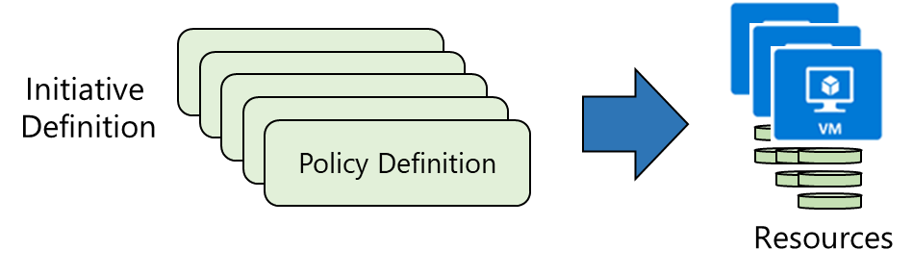
Implementing Azure Policy
Browse Policy Definitions
Create Initiative Definitions
Scope the Initiative Definition
View Policy evaluation results
Notes:
Tutorial: Create and manage policies to enforce compliance - https://docs.microsoft.com/en-us/azure/governance/policy/tutorials/create-and-manage
Apply and monitor infrastructure standards with Azure Policy (Learn) - https://docs.microsoft.com/learn/modules/intro-to-governance/
The next topics step you through creating an Azure policy.
✔ Even if you have only a few Policy Definitions, we recommend creating an Initiative Definition.

Slide 17
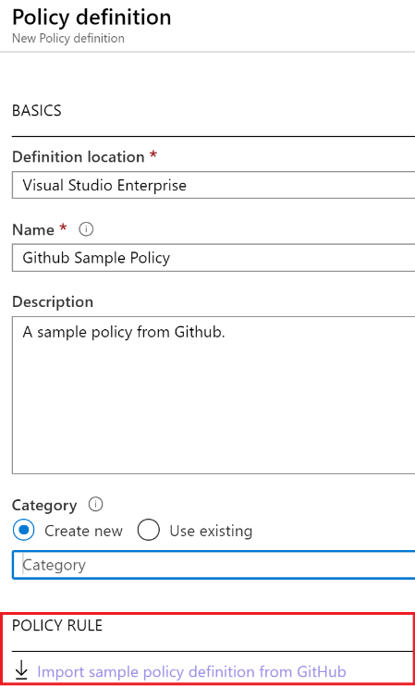
Policy Definitions
Many policy definitions are available
You can import policies from GitHub
Policy Definitions have a specific JSON format
You can create custom policy definitions
Notes:
Azure Policy built-in policy definitions - https://docs.microsoft.com/en-us/azure/governance/policy/samples/built-in-policies
✔️ Policy Definitions have a specific JSON format. As an Azure Administrator you will not need to create files in this format, but you may want to review, so you are familiar. Review the available definitions in the portal and in GitHub.

Slide 18
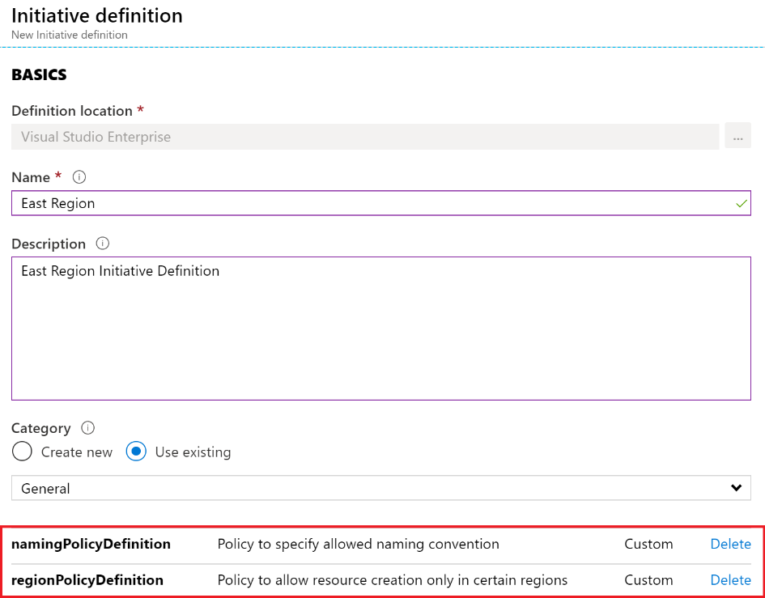
Create Initiative Definitions
Group policy definitions
Include one or more policies
Requires planning
Notes:
Azure Policy built-in initiative definitions - https://docs.microsoft.com/en-us/azure/governance/policy/samples/built-in-initiatives
✔️ Can you see how this will require some planning to organize your policies?

Slide 19
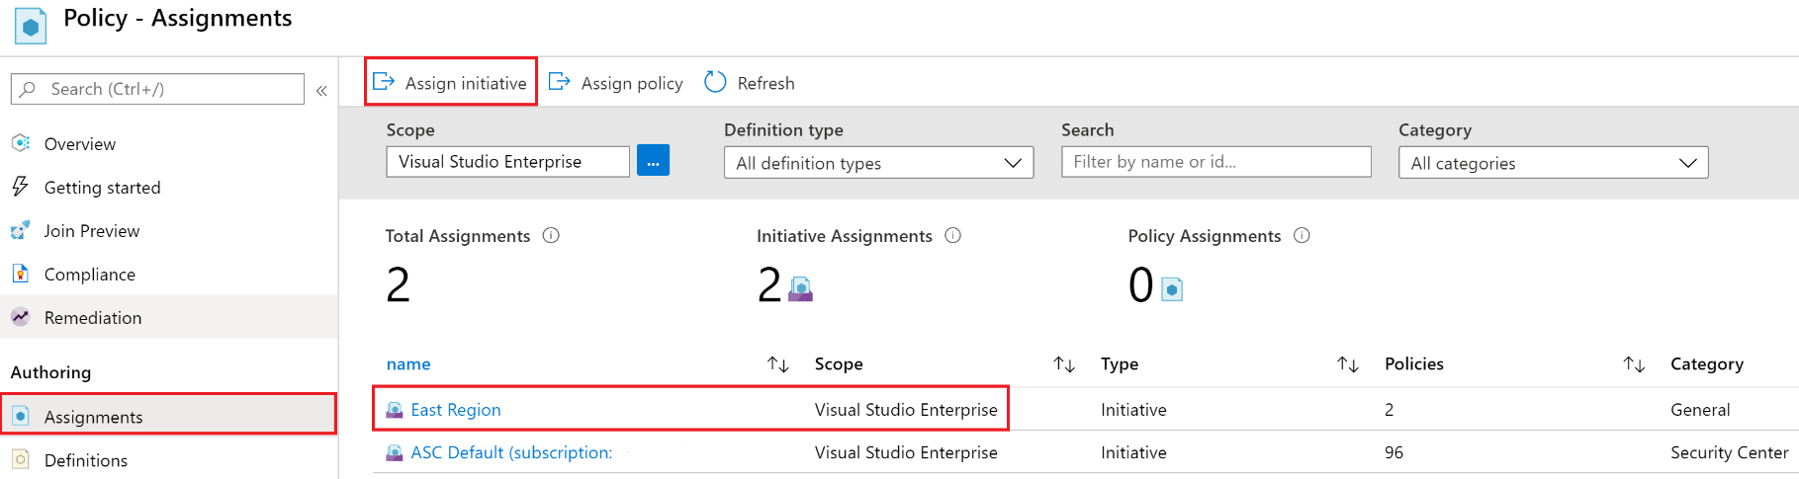
Scope the Initiative Definition
Assign the definition to a scope
The scope enforces the policy
Select the subscription, and optionally the resource group

Slide 20
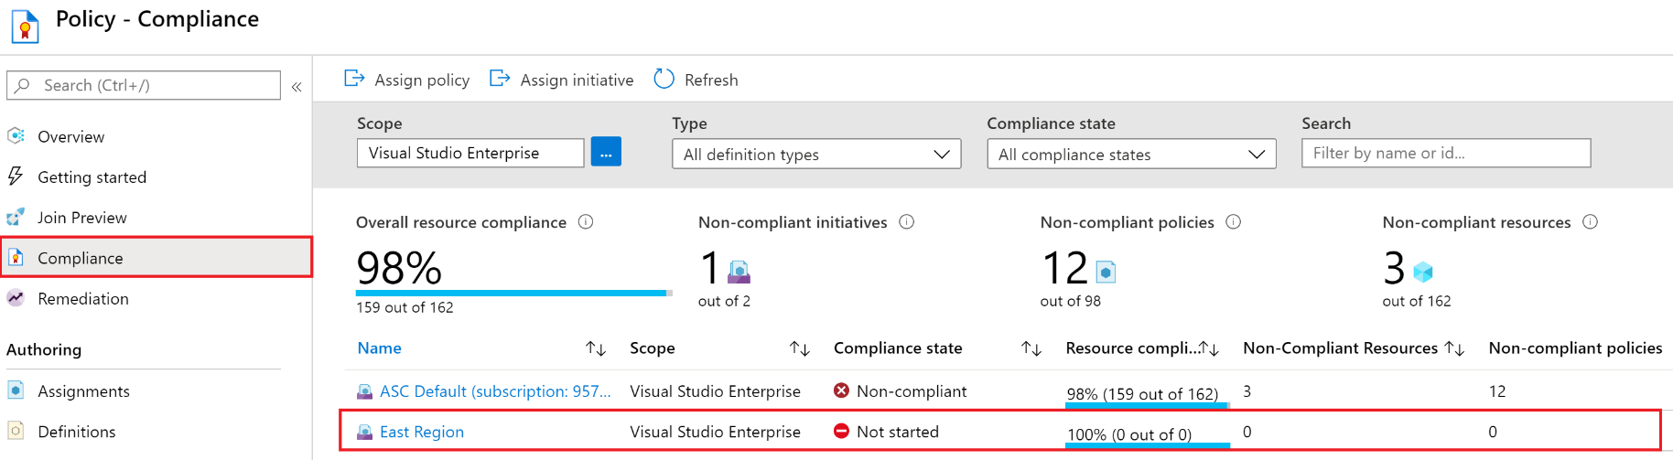
Determine Compliance
Non-compliant initiatives
Non-compliant policies
Non-compliant resources
Notes:
✔️ Policy evaluation happens about once an hour, which means that if you make changes to your policy definition and create a policy assignment then it will be re-evaluated over your resources within the hour.

Slide 21
Demonstration – Azure Policy
Assign a policy
Create and assign an initiative definition
Check for compliance
Check for remediation tasks
Remove your policy and initiative
Notes:
✔ Always consider having students walk-through the demonstrations themselves. Also, consider the overlap with the formal labs and your best use of time.

Slide 22
Lesson 03: Role-Based Access Control

Slide 23
Role-Based Access Control Overview
Role-Based Access Control
Role Definition
Role Assignment
Azure RBAC Roles vs Azure AD Administrator Roles
RBAC Authentication
Azure RBAC Roles
Demonstration – RBAC Roles
Notes:
Manage Azure identities and governance (15-20%)
Manage role-based access control (RBAC)
Create a custom role
Provide access to Azure resources by assigning roles (subscriptions, resource groups. resources)
Interpret access assignments

Slide 24
Role-Based Access Control
Provides fine-grained access management of resources in Azure​
Concepts​
Built on Azure Resource Manager
Segregate duties within your team ​
Grant only the amount of access to users that they need to perform their jobs​
Security principal. Object that represents something that is requesting access to resources​
Role definition. Collection of permissions that lists the operations that can be performed​
Scope. Boundary for the level of access that is requested​
Assignment. Attaching a role definition to a security principal at a particular scope​:
Users can grant access described in a role definition by creating an assignment​
Deny assignments are currently read-only and are set by Azure Blueprints and Azure Managed Apps
Notes:
What is role-based access control (RBAC) for Azure resources? - https://docs.microsoft.com/en-us/azure/role-based-access-control/overview

Slide 25
Role Definition
Collection of permissions that lists the operations that can be performed
Contributor
Owner
Contributor
Reader
…
Backup Operator
Security Reader
User Access Administrator
Virtual Machine Contributor
"Actions": [
"*"
],
"NotActions" : [
"Authorization/*/Delete",
"Authorization/*/Write",
"Authorization/elevateAccess/Action"
],
"DataActions" : [],
"NotDataActions": [],
"AssignableScopes" : [
"/"
]
Built-in
Reader Support Tickets
Virtual Machine Operator
Custom
Notes:
List role definitions in Azure RBAC - https://docs.microsoft.com/azure/role-based-access-control/role-definitions-list
Create custom roles for Azure resources with role-based access control - https://docs.microsoft.com/learn/modules/create-custom-azure-roles-with-rbac/

Slide 26




Role Assignment
Process of binding a role definition to a user, group, or service principal at a scope for the purpose of granting access
1
Security principal
User
Group
Service principal
2
Role definition
Role assignment
3
Scope
Owner
Contributor
Reader
…
Backup Operator
Security Reader
Contributor
"Actions": [
"*"
],
"NotActions": [
"Auth/*/Delete",
"Auth/*/Write",
"Auth/elevate"
]
Management group
Marketing group
Subscription
Resource group
Pharma-sales Resource group
Reader Support Tickets
Virtual Machine Operator
Contributor
Resource
Notes:
Add or remove role assignments using Azure RBAC and the Azure portal - https://docs.microsoft.com/azure/role-based-access-control/role-assignments-portal
Explain that the role assignment completes the process of implementing RBAC and combining service principals, a role definition, and a scope.

Slide 27

Azure RBAC Roles vs. Azure AD Roles
Azure and Azure AD offer two types of roles
Azure RBAC roles | Azure AD roles
Manage access to Azure resources | Manage access to Azure AD objects
Scope can be specified at multiple levels | Scope is at the tenant level
Role information can be accessed in the Azure portal, Azure CLI, Azure PowerShell, Azure Resource Manager templates, REST API | Role information can be accessed in Azure portal, Microsoft 365 admin portal, Microsoft Graph, Azure Active Directory PowerShell for Graph
Classic administrator roles should be avoided if using Azure Resource Manager

Slide 28





RBAC Authentication
Azure AD
Admin roles
Azure Active
Directory tenant
Global admin
Application admin
Application developer
Billing admin …
Global admin/User access admin (elevated access)
Root
Azure RBAC
roles
Root management group
Owner
Contributor
Reader
User access admin
…
Management group
Subscription
Azure RBAC
roles
Resource group
Azure account
Owner
Contributor
Reader
User access admin
…
Resource
Notes:
Manage access to an Azure subscription by using Azure role-based access control - https://docs.microsoft.com/learn/modules/manage-subscription-access-azure-rbac/3-elevate-your-access-user-access-admin

Slide 29
Azure RBAC Roles
RBAC role in Azure | Permissions | Notes
Owner | Has full access to all resources and can delegate access to others | The Service Administrator and Co-Administrators are assigned the Owner role at the subscription scope. This applies to all resource types
Contributor | Creates and manages all types of Azure resources but cannot grant access to others | This applies to all resource types
Reader | Views Azure resources | This applies to all resource types
User Access Administrator | Manages user access to Azure resources | This applies to managing access, rather than to managing resources
Notes:
Custom roles for Azure resources - https://docs.microsoft.com/azure/role-based-access-control/custom-roles

Slide 30
Demonstration – Azure RBAC
Locate the Access Control blade
Review role permissions
Add a role assignment
Explore PowerShell commands
Notes:
✔ Always consider having students walk-through the demonstrations themselves. Also, consider the overlap with the formal labs and your best use of time.

Slide 31
Lesson 04: Module 02 Lab and Review

Slide 32
Lab 02a – Manage Subscriptions and Azure RBAC
Lab scenario
To improve the management of Azure resources in Contoso, you have been tasked with implementing the following functionality:
Using management groups for the Contoso’s Azure subscriptions
Granting user permissions for submitting support requests. This user would only be able to create support request tickets and view resource groups
Objectives
Task 1: Implement Management Groups
Task 2: Create custom RBAC roles
Task 3: Assign RBAC roles
Next slide for an architecture diagram
Notes:
LAB 02a - Manage Subscriptions and RBAC - ESTIMATED DURATION 30 MIN
Lab Repository - https://microsoftlearning.github.io/AZ-104-MicrosoftAzureAdministrator/

Slide 33





Lab 02a – Architecture diagram
Task 1
Tenant Root Group
Default Azure AD tenant
az104-02-rg1
Task 2
Task 3
az104-02a-customRoleDefinition.json
{
"Name": "Support Request Contributor (Custom)",
"IsCustom": true,
"Description": "Allows to create support requests",
"Actions": [
"Microsoft.Resources/subscriptions/resourceGroups/read",
"Microsoft.Support/*"
],
"NotActions": [
],
"AssignableScopes": [
"/providers/Microsoft.Management/managementGroups/az104-02-mg1",
"/subscriptions/SUBSCRIPTION_ID"
]
}
Azure pass subscription
az104-02-aaduser1
customRoleDefinition

Slide 34
Lab 02b – Manage Governance via Azure Policy
Lab scenario
To improve management of Azure resources in Contoso, you have been tasked with implementing the following functionality:
Tagging resource groups that include only infrastructure resources
Ensuring that only properly tagged infrastructure resources can be added to infrastructure resource groups
Remediating any non-compliant resources
Objectives
Task 1: Create and assign tags via the Azure portal
Task 2: Enforce tagging via an Azure Policy
Task 3: Apply tagging via an Azure Policy
Next slide for an architecture diagram
Notes:
LAB 02b - Manage Governance via Azure Policy - ESTIMATED DURATION 30 MIN
Lab Repository - https://microsoftlearning.github.io/AZ-104-MicrosoftAzureAdministrator/

Slide 35




Lab 02b – Architecture diagram
Task 1
Name: Role
Value: Infra
Task 2
Cloud Shell Storage
Resource Group
Azure policy
Require a tag and its value on resources
Cloud Shell Storage Account
Task 3
Azure policy
Inherit a tag from the resource group if missing
New Storage Account

Slide 36
Module Review
Module Review Questions
Microsoft Learn Modules (docs.microsoft.com/Learn)
Analyze costs and create budgets with Azure Cost Management
Predict costs and optimize spending for Azure
Control and organize Azure resources with Azure Resource Manager
Apply and monitor infrastructure standards with Azure Policy
Create custom roles for Azure resources with role-based access control (RBAC)
Manage access to an Azure subscription by using Azure role-based access control (RBAC)
Secure your Azure resources with role-based access control (RBAC)
Notes:
Learn - https://docs.microsoft.com/en-us/learn/browse/

Slide 37
End of presentation

