Slide 1
AZ-104T00A Module 03: Azure Administration

Slide 2
Module Overview
Lesson 01: Resource Manager
Lesson 02: Azure Portal and Cloud Shell
Lesson 03: Azure PowerShell and CLI
Lesson 04: ARM Templates
Lesson 05: Module 03 Lab and Review

Slide 3
Lesson 01: Resource Manager

Slide 4
Resource Manager Overview
Resource Manager
Terminology
Resource Group Deployments
Resource Manager Locks
Moving Resources
Removing Resources and Resource Groups
Resource Limits
Demonstration – Resource Groups
Notes:
Manage Azure identities and governance (15-20%)
Manage subscriptions and governance
Configure resource locks
Create and manage resource groups (move and remove)

Slide 5
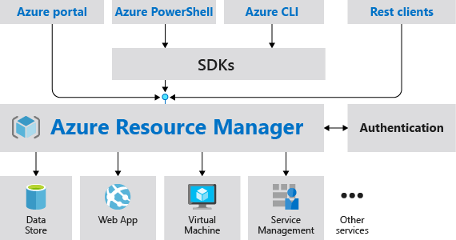
Resource Manager
Provides a consistent management layer
Enables you to work with the resources in your solution as a group
Deploy, update, or delete in a single, coordinated operation
Provides security, auditing, and tagging features
Choose the tools and APIs that work best for you
Notes:
What is Azure Resource Manager? - https://docs.microsoft.com/en-us/azure/azure-resource-manager/management/overview

Slide 6
Terminology
A resource is simply a single service instance in Azure
A resource group is a logical grouping of resources
An Azure Resource Manager template is a JSON file that allows you to declaratively describe a set of resources
A declarative syntax is what a template uses to state what you intend to create
A resource provider is service that supplies the resources you can deploy and manage through Resource Manager

Slide 7
Resource Groups
Resources can only exist in one resource group
Resources grouped (Web + DB, VM, Storage) in one group
Groups cannot be renamed
Groups can have resources of many different types (services)
OR
Web and DB resource group
Virtual machine resource group
Storage resource group
Groups can have resources from many different regions
Deployments are incremental
Notes:
Manage Azure Resource Manager resource groups by using the Azure portal - https://docs.microsoft.com/en-us/azure/azure-resource-manager/management/manage-resource-groups-portal

Slide 8
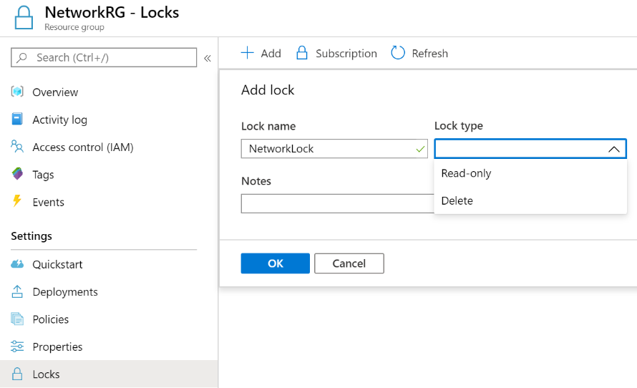
Resource Manager Locks
Associate the lock with a subscription, resource group, or resource
Locks are inherited by child resources
Read-Only locks prevent any changes to the resource
Delete locks prevent deletion
Notes:
Lock resources to prevent unexpected changes: https://docs.microsoft.com/en-us/azure/azure-resource-manager/resource-group-lock-resources
Control and organize Azure resources with Azure Resource Manager - https://docs.microsoft.com/learn/modules/control-and-organize-with-azure-resource-manager/
✔ Only Owner and User Access Administrator roles can create or delete management locks.

Slide 9
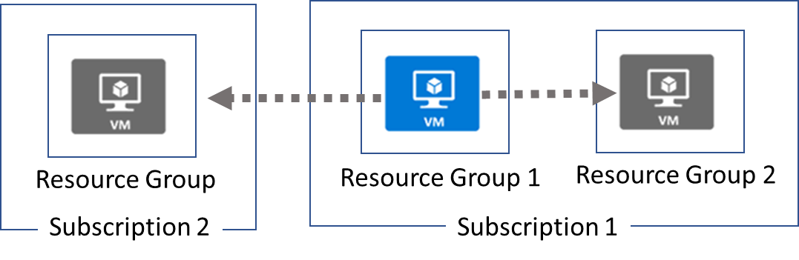
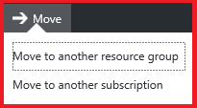
Moving Resources
When moving resources, both the source group and the target group are locked during the operation
Services that cannot be moved: Azure AD Domain Services, ExpressRoute, and Site Recovery. Other restrictions apply
Notes:
Move resources to new resource group or subscription - https://docs.microsoft.com/en-us/azure/azure-resource-manager/resource-group-move-resources
✔ Just because a service can be moved doesn’t mean there aren’t restrictions. For example, you can move a virtual network, but you must also move its dependent resources, like gateways. Learn more at the reference link.

Slide 10
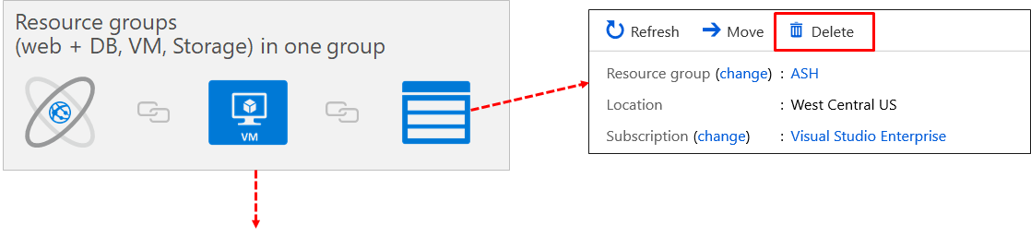
Removing Resources and Resource Groups
Remove Azure resources that you no longer use
Ensures you will not see unexpected charges
Remove individual resources or remove the resource group
Notes:
Manage Azure Resource Manager resource groups by using the Azure portal - https://docs.microsoft.com/en-us/azure/azure-resource-manager/management/manage-resource-groups-portal
Move Azure resources to another resource group - https://docs.microsoft.com/learn/modules/move-azure-resources-another-resource-group/

Slide 11
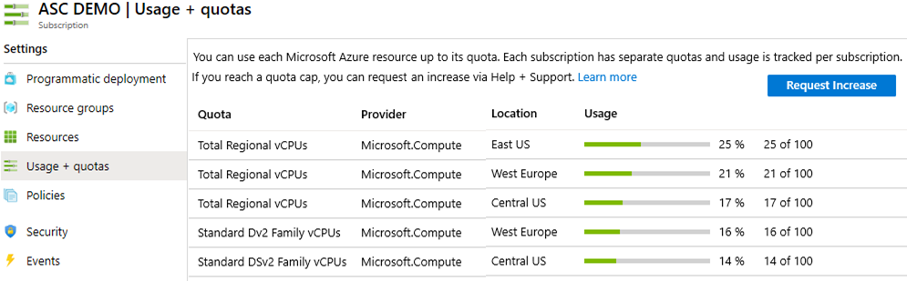
Resource Limits
Resources have a default limit also known as quota
Helpful to track current usage, and plan for future use
You can open a free support case to increase limits to published maximums
Notes:
Azure subscription and service limits, quotas, and constraints - https://docs.microsoft.com/en-us/azure/azure-resource-manager/management/azure-subscription-service-limits

Slide 12
Demonstration – Resource Groups
Manage resource groups in the portal
Manage resource groups with PowerShell
Notes:
✔ Always consider having students walk-through the demonstrations themselves. Also, consider the overlap with the formal labs and your best use of time.

Slide 13
Lesson 02: Azure Portal and Cloud Shell

Slide 14
Azure Portal and Cloud Shell overview
Azure Portal
Demonstration – Azure Portal
Azure Cloud Shell
Demonstration – Cloud Shell
Notes:
This lesson is not directly related to any certification objectives. However, using the tools will be necessary to complete the hands-on portion of the exam.

Slide 15
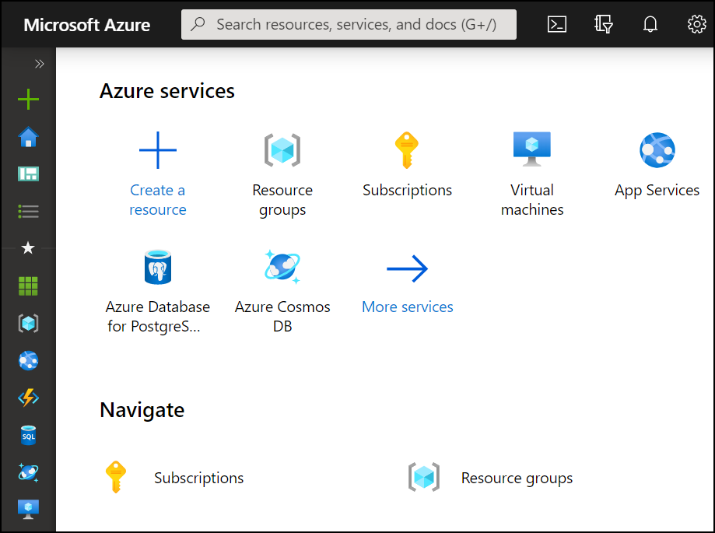
Azure Portal
Search resources, services, and docs
Manage resources
Create customized dashboards and favorites
Access the Cloud Shell
Receive notifications
Notes:
Azure Portal Overview - https://docs.microsoft.com/en-us/azure/azure-portal/azure-portal-overview

Slide 16
Demonstration – Azure Portal
Help and keyboard shortcuts
Customizing your experience
Notes:
✔ Always consider having students walk-through the demonstrations themselves. Also, consider the overlap with the formal labs and your best use of time.

Slide 17
Azure Cloud Shell
Interactive, browser-accessible shell
Offers either Bash or PowerShell
Is temporary and provided on a per-session, per-user basis
Requires a resource group, storage account, and Azure File share
Authenticates automatically
Integrated graphical text editor
Is assigned one machine per user account
Times out after 20 minutes
Notes:
Overview of Azure Cloud Shell - https://docs.microsoft.com/en-us/azure/cloud-shell/overview

Slide 18
Demonstration – Cloud Shell
Configure the Cloud Shell
Experiment with Azure PowerShell
Experiment with Bash shell
Experiment with the Cloud Editor
Notes:
✔ Always consider having students walk-through the demonstrations themselves. Also, consider the overlap with the formal labs and your best use of time.

Slide 19
Lesson 03: Azure PowerShell and CLI

Slide 20
Azure PowerShell and CLI Overview
Azure PowerShell
PowerShell Cmdlets and Modules
Demonstration – Working with PowerShell locally
Azure CLI
Demonstration – Working with Azure CLI locally
Notes:
This lesson is not directly related to any certification objectives. However, using the tools will be necessary to complete the hands-on portion of the exam.

Slide 21
Azure PowerShell
New-AzVm `
-ResourceGroupName "CrmTestingResourceGroup" `
-Name "CrmUnitTests" `
-Image "UbuntuLTS" `
...
Connect to your Azure subscription and manage resources
Adds the Azure-specific commands
Available inside a browser via the Azure Cloud Shell
Available as a local installation on Linux, macOS, or Windows
Has an interactive and a scripting mode
Notes:
Get started with Azure PowerShell - https://docs.microsoft.com/en-us/powershell/azure/get-started-azureps?view=azps-4.3.0
Ask about the classes experience with PowerShell and Azure PowerShell.

Slide 22
PowerShell Cmdlets and Modules
Get-Module
# Output
ModuleType Version Name
---------- ------- ----
Manifest 3.1.0.0 Microsoft.PowerShell.Management
Manifest 3.1.0.0 Microsoft.PowerShell.Utility
Binary 1.0.0.1 PackageManagement
Script 1.0.0.1 PowerShellGet
Script 2.0.0 PSReadline
Cmdlets follow a verb-noun naming convention; shipped in modules
Modules are a DLL file with the code to process each cmdlet
Load cmdlets by loading the module containing them
Use Get-Module to see a list of loaded modules

Slide 23
Demonstration – Working with PowerShell
Install the Az module
Install NuGet (if needed)
Trust the repository
Connect to Azure and view your subscription information
Create resources
Notes:
✔ Always consider having students walk-through the demonstrations themselves. Also, consider the overlap with the formal labs and your best use of time.

Slide 24
Azure CLI
az vm restart -g MyResourceGroup -n MyVm
Cross-platform command-line program
Runs on Linux, macOS, and Windows
Can be used interactively or through scripts
Commands are structured in _groups_ and _subgroups_
Use find to locate commands
Use --help for more detailed information
Notes:
Get started with Azure CLI - https://docs.microsoft.com/en-us/cli/azure/get-started-with-azure-cli?view=azure-cli-latest
Ask about the students experience with CLI.

Slide 25
Demonstration – Working with the CLI
Install the CLI
Verify the CLI installation
Login to Azure
Create a resource group
Verify the resource group
Notes:
✔ Always consider having students walk-through the demonstrations themselves. Also, consider the overlap with the formal labs and your best use of time.
Note: If at any time you receive errors about *running scripts is disabled* be sure to set the execution policy:
Set-ExecutionPolicy -ExecutionPolicy RemoteSigned -Scope LocalMachine
Note: You may need to run this code in PowerShell to enable TLSv2:
[Net.ServicePointManager]::SecurityProtocol = [Net.SecurityProtocolType]::Tls12

Slide 26
Lesson 04: ARM templates

Slide 27


ARM Templates Overview
Template Advantages
Template Schema
Template Parameters
QuickStart Templates
Demonstration – QuickStart Templates
Demonstration – Run Templates with PowerShell

Slide 28
Template Advantages
Improves consistency
ARM
Template
Express complex deployments
Reduce manual, error prone tasks
Development
Express requirements through code
Production
Promotes reuse
Modular and can be linked
Quality
Assurance
Simplifies orchestration
Notes:
What are ARM templates? - https://docs.microsoft.com/en-us/azure/azure-resource-manager/templates/overview

Slide 29
Template Schema
Defines all the Resource manager resources in a deployment
{
"$schema": "http://schema.management.
azure.com/schemas/2019-04- 01/deploymentTemplate.json#",
"contentVersion": "",
"parameters": {},
"variables": {},
"functions": [],
"resources": [],
"outputs": {}
}
Written in JSON
A collection of key-value pairs
Each key is a string
Each values can be a string, number, Boolean expression, list of values, object
Notes:
Understand the structure and syntax of ARM templates - https://docs.microsoft.com/en-us/azure/azure-resource-manager/templates/template-syntax

Slide 30
Template Parameters
Specify which values are configurable when the template runs
"parameters": {
"adminUsername": {
"type": "string",
"metadata": {
"description": "Username for the VM."
}
},
"adminPassword": {
"type": "securestring",
"metadata": {
"description": "Password for the VM."
}
}
}
This example has two parameters: one for a VM’s username (adminUsername), and one for its password (adminPassword)
Notes:
Parameters in Azure Resource Manager templates - https://docs.microsoft.com/en-us/azure/azure-resource-manager/templates/template-parameters

Slide 31
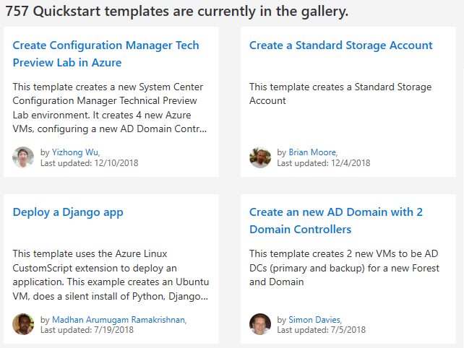
QuickStart Templates
Resource Manager templates provided by the Azure community
Provides everything you need to deploy your solution or serves as a starting point for your template
https://azure.microsoft.com/en-us/resources/templates/
Notes:
QuickStart Templates - https://azure.microsoft.com/en-us/resources/templates/

Slide 32
Demonstration – QuickStart Templates
Explore the QuickStart gallery
Explore a template
Notes:
✔ Always consider having students walk-through the demonstrations themselves. Also, consider the overlap with the formal labs and your best use of time.

Slide 33
Demonstration – Run Templates with PowerShell
Connect to your subscription
Create the resource group
Deploy the template into the resource group
Verify the template deployed
Notes:
✔ Always consider having students walk-through the demonstrations themselves. Also, consider the overlap with the formal labs and your best use of time.

Slide 34
Lesson 05: Module 03 Lab and Review
Notes:
Pick the lab(s) most appropriate for your audience.

Slide 35
Lab 03a – Manage Azure resources with the Azure portal
Lab scenario
You need to explore the basic Azure administration capabilities associated with provisioning resources and organizing them based on resource groups, including moving resources between resource groups. You also want to explore options for protecting disk resources from being accidentally deleted, while still allowing for modifying their performance characteristics and size
Objectives
Task 1: Create resource groups and deploy resources to resource groups
Task 2: Move resources between resource groups
Task 3: Implement and test resource locks
Next slide for an architecture diagram
Notes:
LAB 03a - Manage Azure resources by Using the Azure Portal - ESTIMATED DURATION 20 MIN
GitHub Repository - https://microsoftlearning.github.io/AZ-104-MicrosoftAzureAdministrator/

Slide 36



Lab 03a – Architecture diagram
Task 1
Task 2
az104-03a-rg1
az104-03a-rg2
Move resource
az104-03a-disk1
az104-03a-disk1
Task 3
az104-03a-rg3
az104-03a-delete-lock
Type: Delete
az104-03a-disk2

Slide 37
Lab 03b – Manage Azure resources with templates
Lab scenario
Now that you explored the basic Azure administration capabilities associated with provisioning resources and organizing them based on resource groups by using the Azure portal, you need to carry out the equivalent task by using Azure Resource Manager templates
Objectives
Task 1: Review an ARM template for deployment of an Azure managed disk
Task 2: Create an Azure managed disk by using an ARM template
Task 3: Review the ARM template-based deployment of the managed disk
Next slide for an architecture diagram
Notes:
LAB 03b - Manage Azure resources by Using ARM Templates - ESTIMATED DURATION 20 MIN
GitHub Repository - https://microsoftlearning.github.io/AZ-104-MicrosoftAzureAdministrator/

Slide 38

Lab 03b – Architecture diagram
Task 1
Task 2
az104-03a-rg1
JSON
Edit Template
JSON
Deploy
az104-03b-rg1
Template
New Template
az104-03a-disk1
az104-03b-disk1

Slide 39
Lab 03c – Manage Azure resources with PowerShell (optional)
Lab scenario
Now that you explored the basic Azure administration capabilities associated with provisioning resources and organizing them based on resource groups by using the Azure portal and Azure Resource Manager templates, you want the equivalent tasks with Azure PowerShell. To avoid installing Azure PowerShell modules, you will leverage the Azure Cloud Shell
Objectives
Task 1: Start a PowerShell session in Azure Cloud Shell
Task 2: Create a resource group and an Azure managed disk with Azure PowerShell
Task 3: Configure the managed disk by using Azure PowerShell
Next slide for an architecture diagram
Notes:
LAB 03c - Manage Azure resources by Using Azure PowerShell - ESTIMATED DURATION 20 MIN
GitHub Repository - https://microsoftlearning.github.io/AZ-104-MicrosoftAzureAdministrator/

Slide 40
Lab 03c – Architecture diagram
Task 1, Task 2, Task 3
az104-03c-rg1
az104-03c-disk1

Slide 41
Lab 03d – Manage Azure resources with the Azure CLI (optional)
Lab scenario
Now that you explored the basic Azure administration capabilities associated with provisioning resources and organizing them based on resource groups by using the Azure portal, Azure Resource Manager templates, and Azure PowerShell, you need to carry out the equivalent task by using Azure CLI. To avoid installing Azure CLI, you will leverage Bash environment available in Azure Cloud Shell
Objectives
Task 1: Start a Bash session in Azure Cloud Shell
Task 2: Create a resource group and a managed disk by using Azure CLI
Task 3: Configure the managed disk by using Azure CLI
Next slide for an architecture diagram
Notes:
LAB 03d - Manage Azure resources by Using Azure CLI - ESTIMATED DURATION 20 MIN
GitHub Repository - https://microsoftlearning.github.io/AZ-104-MicrosoftAzureAdministrator/

Slide 42
Lab 03d – Architecture diagram
Task 1, Task 2, Task 3
az104-03d-rg1
az104-03d-disk1

Slide 43
Module Review
Module Review Questions
Microsoft Learn Modules (docs.microsoft.com/Learn)
Core Cloud Services – Manage services with the Azure portal
Control and organize Azure resources with Azure Resource Manager
Build Azure Resource Manager templates
Automate Azure tasks using scripts with PowerShell
Manage virtual machines with the Azure CLI
Notes:
Learn - https://docs.microsoft.com/en-us/learn/browse/

Slide 44
End of presentation

