Slide 1
AZ-104T00A Module 04: Virtual Networking

Slide 2
Module Overview
Lesson 01: Virtual Networks
Lesson 02: IP Addressing
Lesson 03: Network Security Groups
Lesson 04: Azure Firewall
Lesson 05: Azure DNS
Lesson 06: Module 04 Lab and Review
Notes:
Module overview

Slide 3
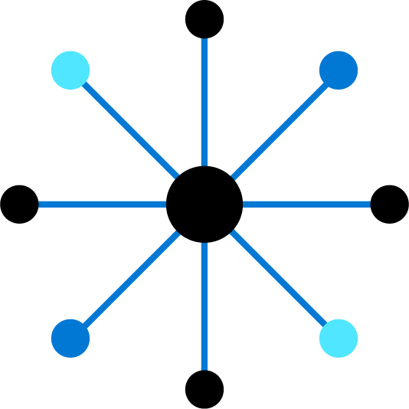
Lesson 01: Virtual Networks

Slide 4
Virtual Networks Overview
Azure Networking Components
Virtual Networks
Subnets
Implementing Virtual Networks
Demonstration – Creating Virtual Networks
Notes:
Configure and manage virtual networking (30-35%)
Implement and manage virtual networking
• Configure private and public IP addresses, network routes, network interface, subnets, and virtual network

Slide 5
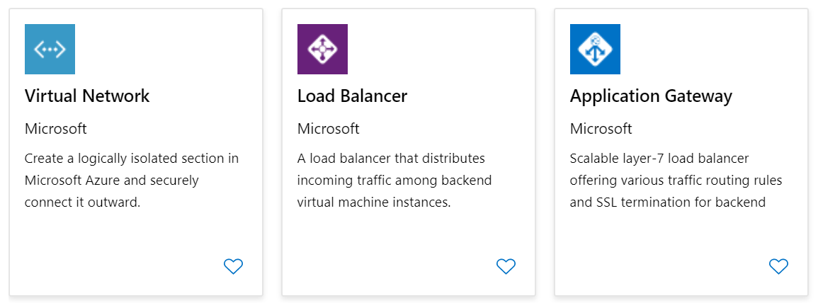
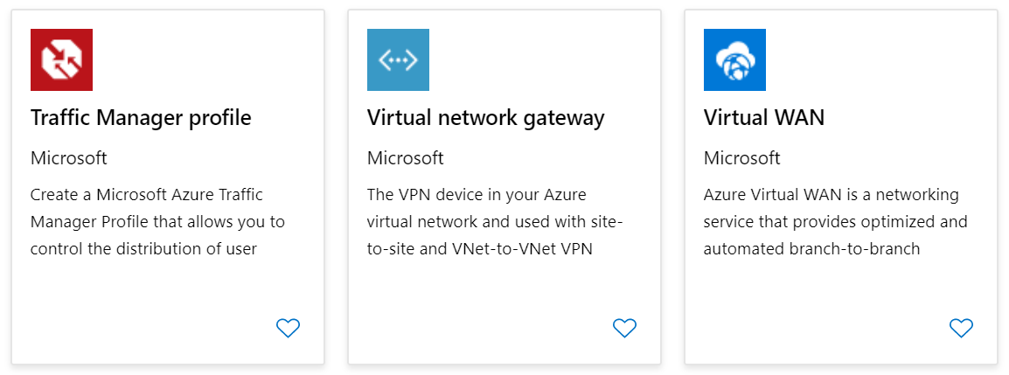
Azure Networking Components
Adopting cloud solutions can save time and simplify operations
Azure requires the same types of networking functionality as on-premises infrastructure
Azure networking offers a wide range of services and products
Notes:
Azure networking documentation - https://docs.microsoft.com/en-us/azure/networking/

Slide 6
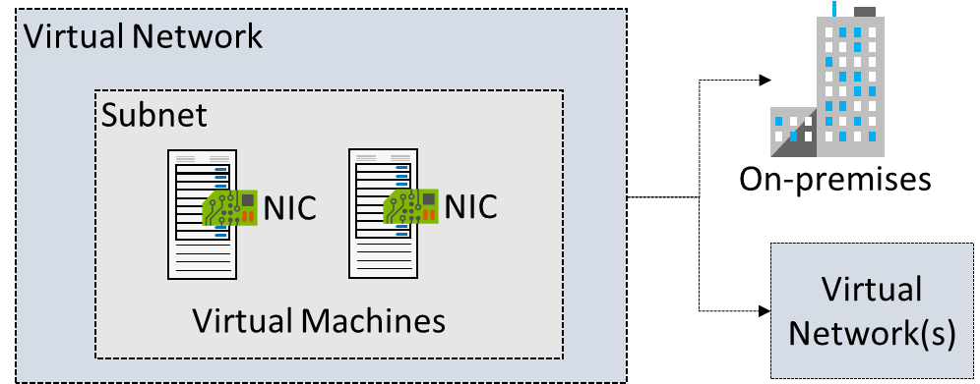
Virtual Networks
Logical representation of your own network
Create a dedicated private cloud-only virtual network
Securely extend your datacenter with virtual networks
Enable hybrid cloud scenarios
Notes:
Azure Virtual Networks - https://azure.microsoft.com/en-us/services/virtual-network/
What is Azure Virtual Network? - https://docs.microsoft.com/en-us/azure/virtual-network/virtual-networks-overview

Slide 7
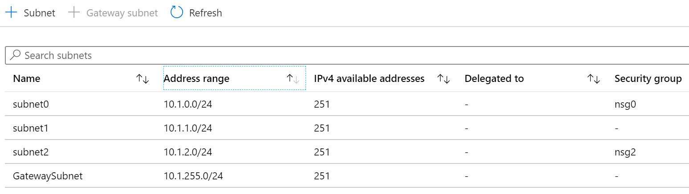
Subnets
A virtual network can be segmented into one or more subnets
Subnets provide logical divisions within your network
Subnets can help improve security, increase performance, and make it easier to manage the network
Each subnet must have a unique address range – cannot overlap with other subnets in the virtual network in the subscription
Notes:
✔️ Azure reserves 5 IP addresses within each subnet.
x.x.x.0: Network address
x.x.x.1: Reserved by Azure for the default gateway
x.x.x.2, x.x.x.3: Reserved by Azure to map the Azure DNS IPs to the VNet space
x.x.x.255: Network broadcast address

Slide 8
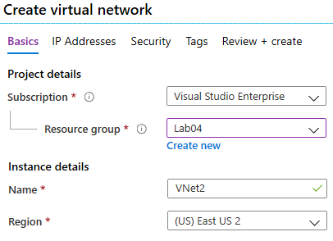
Implementing Virtual Networks
Create new virtual networks at any time
Add virtual networks when you create a virtual machine
Need to define the address space, and at least one subnet
Be careful with overlapping address spaces
Notes:
QuickStart: Create a virtual network using the Azure portal - https://docs.microsoft.com/en-us/azure/virtual-network/quick-create-portal
✔️ Always plan to use an address space that is not already in use in your organization, either on-premises or in other VNets. Even if you plan for a VNet to be cloud-only, you may want to make a VPN connection to it later. If there is any overlap in address spaces at that point, you will have to reconfigure or recreate the VNet. The next lesson will focus on IP addressing.

Slide 9
Demonstration – Creating Virtual Networks
Create a virtual network in the portal
Create a virtual network with PowerShell
Notes:
✔ Always consider having students walk-through the demonstrations themselves. Also, consider the overlap with the formal labs and your best use of time.

Slide 10
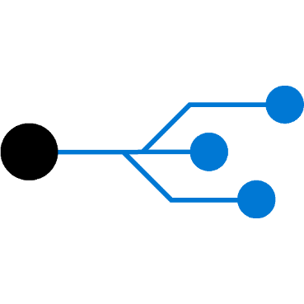
Lesson 02: IP Addressing

Slide 11
IP Addressing Overview
IP Addressing
Creating IP Addresses
Public IP Addresses
Private IP Addresses
Notes:
Configure and manage virtual networking (30-35%)
Implement and manage virtual networking
• Configure private and public IP addresses, network routes, network interface, subnets, and virtual network

Slide 12
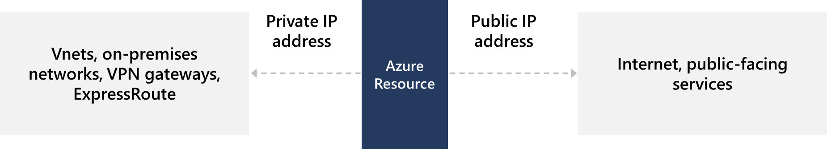
IP Addressing
Private IP addresses - used within an Azure virtual network (VNet), and your on-premises network, when you use a VPN gateway or ExpressRoute circuit to extend your network to Azure
Public IP addresses - used for communication with the Internet, including Azure public-facing services
Notes:
Design an IP addressing schema for your Azure deployment – https://docs.microsoft.com/learn/modules/design-ip-addressing-for-azure
✔️ As a best practice you may decide to separate dynamically and statically assigned IP resources into different subnets. And, IP Addresses are never managed from within a virtual machine.

Slide 13
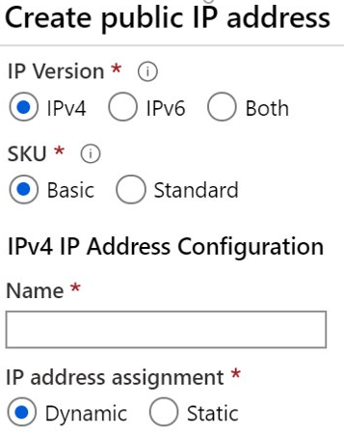
Creating Public IP Addresses
Available in IPv4 or IPv6 or both
Basic vs Standard SKU
Available in Dynamic, Static or both (depending on SKU):
Zone redundant
Not mixable or immutable
Range of contiguous addresses available as a prefix
Notes:
Create, change, or delete IP addresses - https://docs.microsoft.com/en-us/azure/virtual-network/virtual-network-public-ip-address

Slide 14
Public IP Addresses
Public IP addresses | IP address association | Dynamic | Static
Virtual Machine | NIC | Yes | Yes
Load Balancer | Front-end configuration | Yes | Yes
VPN Gateway | Gateway IP configuration | Yes | Yes*
Application Gateway | Front-end configuration | Yes | Yes*
A public IP address resource can be associated with virtual machine network interfaces, internet-facing load balancers, VPN gateways, and application gateways
*Static IP addresses only available on certain SKUs.
Notes:
Public IP addresses - https://docs.microsoft.com/en-us/azure/virtual-network/public-ip-addresses

Slide 15
Private IP Addresses
Private IP Addresses | IP address association | Dynamic | Static
Virtual Machine | NIC | Yes | Yes
Internal Load Balancer | Front-end configuration | Yes | Yes
Application Gateway | Front-end configuration | Yes | Yes
Dynamic (default). Azure assigns the next available unassigned or unreserved IP address in the subnet’s address range
Static. You select and assign any unassigned or unreserved IP address in the subnet's address range
Notes:
Private IP addresses - https://docs.microsoft.com/en-us/azure/virtual-network/private-ip-addresses

Slide 16
Lesson 03: Network Security Groups

Slide 17
Network Security Groups Overview
Network Security Groups (NSG)
NSG Rules
NSG Effective Rules
Creating NSG Rules
Demonstration – NSGs
Notes:
Configure and manage virtual networking (30-35%)
Secure access to virtual networks
Create security rules
Associate an NSG to a subnet or network interface
Evaluate effective security rules

Slide 18
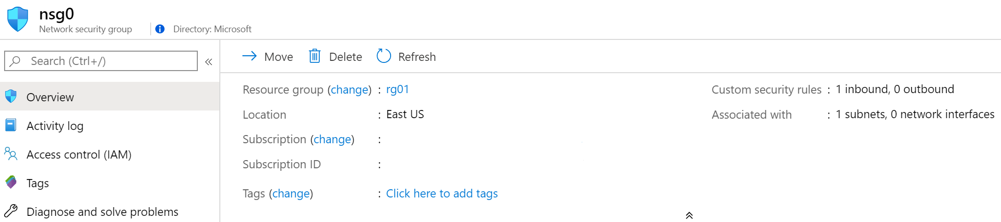
Network Security Groups
Limits network traffic to resources in a virtual network
Lists the security rules that allow or deny inbound or outbound network traffic
Associated to a subnet or a network interface
Can be associated multiple times
Notes:
Network Security Groups - https://docs.microsoft.com/en-us/azure/virtual-network/security-overview#network-security-groups
✔️ To simplify management of security rules, it's recommended that you associate a network security group to individual subnets, rather than individual network interfaces within the subnet.

Slide 19
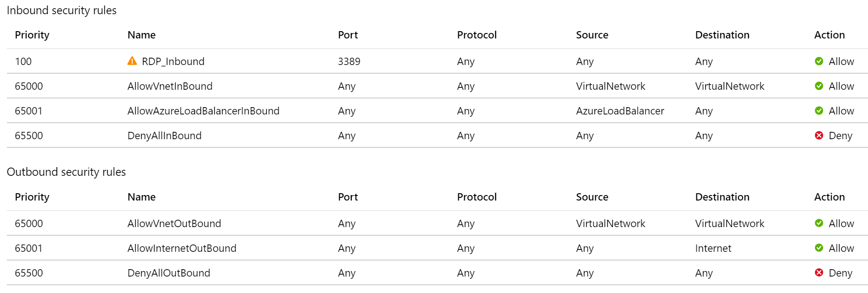
NSG Rules
Security rules in NSGs enable you to filter network traffic that can flow in and out of virtual network subnets and network interfaces
There are default security rules. You cannot delete the default rules, but you can add other rules with a higher priority
Notes:
Create, change, or delete a network security group -https://docs.microsoft.com/en-us/azure/virtual-network/manage-network-security-group

Slide 20
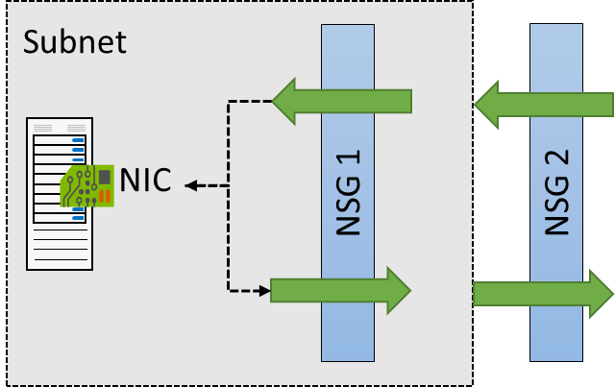
NSG Effective Rules
NSGs are evaluated independently for the subnet and NIC
An “allow” rule must exist at both levels for traffic to be admitted
Use the Effective Rules link if you are not sure which security rules are being applied

Slide 21
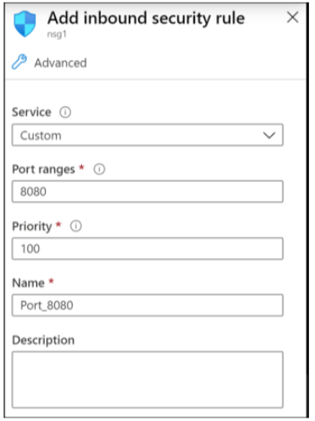
Creating NSG rules
Select from a large variety of services
Service – The destination protocol and port range for this rule
Port ranges – Single port or multiple ports
Priority – The lower the number, the higher the priority
Notes:
Tutorial: Filter network traffic with a network security group using the Azure portal - https://docs.microsoft.com/en-us/azure/virtual-network/tutorial-filter-network-traffic
Secure and isolate access to Azure resources by using network security groups and service endpoints - https://docs.microsoft.com/learn/modules/secure-and-isolate-with-nsg-and-service-endpoints/

Slide 22
Demonstration – Network Security Rules
Access the NSGs blade
Add a new NSG
Explore inbound and outbound rules
Notes:
✔ Always consider having students walk-through the demonstrations themselves. Also, consider the overlap with the formal labs and your best use of time.

Slide 23
Lesson 04: Azure Firewall

Slide 24
Azure Firewall Overview
Azure Firewall
Implementing Firewalls
Firewall Rules
Notes:
Configure and manage virtual networking (30-35%)
Secure access to virtual networks
Deploy and configure Azure Firewall

Slide 25
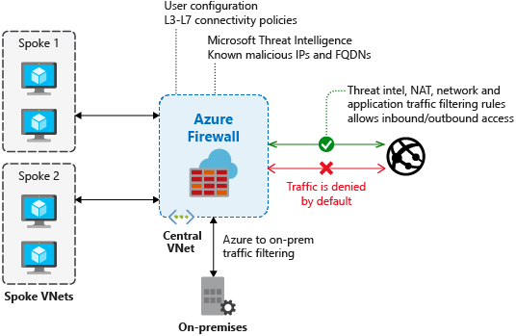
Azure Firewall
Stateful firewall as a service
Built-in high availability with unrestricted cloud scalability
Create, enforce, and log application and network connectivity policies
Threat intelligence-based filtering
Fully integrated with Azure Monitor for logging and analytics
Support for hybrid connectivity through deployment behind VPN and ExpressRoute Gateways
Notes:
Azure Firewall documentation - https://docs.microsoft.com/en-us/azure/firewall/

Slide 26
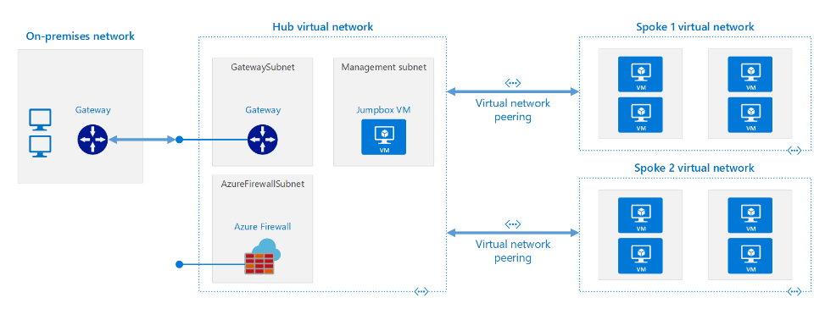
Implementing Firewalls
A Hub-Spoke network topology is recommended
Shared services are placed in the hub virtual network
Each environment is deployed to a spoke to maintain isolation
Notes:
Hub-spoke network topology in Azure - https://docs.microsoft.com/en-us/azure/architecture/reference-architectures/hybrid-networking/hub-spoke

Slide 27
Firewall Rules
NAT rules. Configure DNAT rules to allow incoming connections
Network rules. Configure rules that contain source addresses, protocols, destination ports, and destination addresses
Application rules. Configure fully qualified domain names (FQDNs) that can be accessed from a subnet

Slide 28
Lesson 05: Azure DNS

Slide 29
Azure DNS Overview
Domains and Custom Domains
Verifying Custom Domain Names
Azure DNS Zones
DNS Delegation
DNS Record Sets
DNS for Private Domains
Private Zones Scenarios
Demonstration – DNS Name Resolution
Notes:
Configure and manage virtual networking (30-35%)
Configure name resolution
Configure Azure DNS
Configure custom DNS settings
Configure a private or public DNS zone

Slide 30
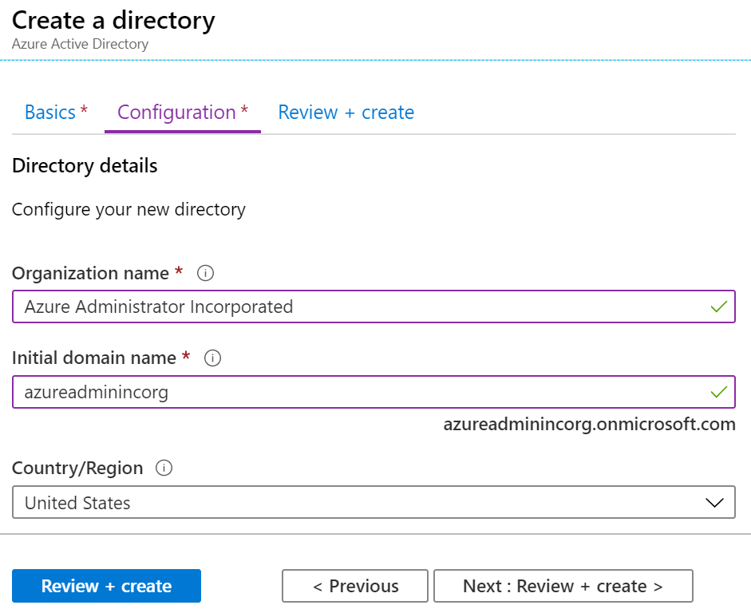
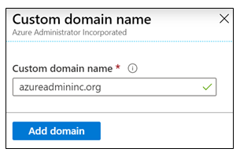
Domains and Custom Domains
When you create an Azure subscription an Azure AD domain is created for you
The domain has initial domain name in the form domainname.onmicrosoft.com
You can customize/change the name
After the custom name is added it must be verified (next topic)
Notes:
What is Azure DNS? - https://docs.microsoft.com/en-us/azure/dns/dns-overview

Slide 31
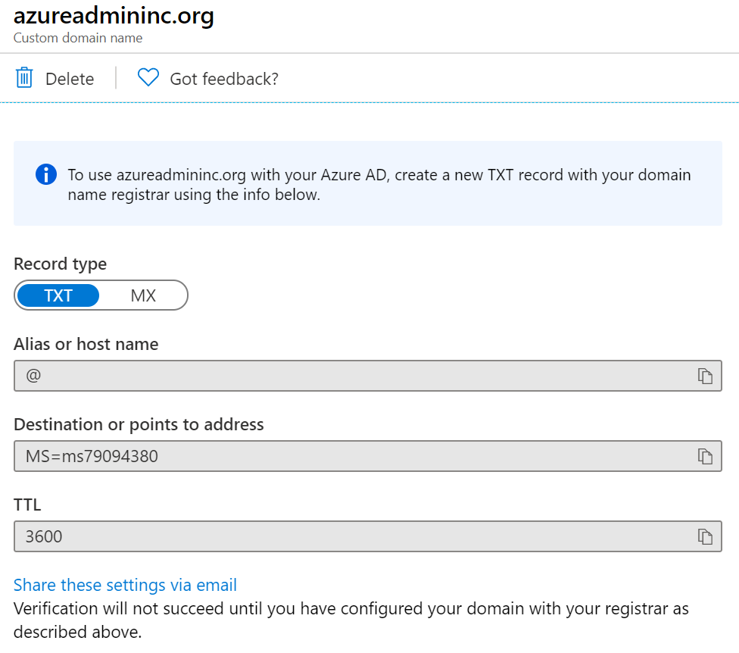
Verify the Custom Domain Name
Verification demonstrates ownership of the domain name
Add a DNS record (MX or TXT) that is provided by Azure into your company’s DNS zone
Azure will query the DNS domain for the presence of the record
This could take several minutes or several hours
Notes:
QuickStart: Create an Azure DNS zone and record using the Azure portal - https://docs.microsoft.com/en-us/azure/dns/dns-getstarted-portal

Slide 32
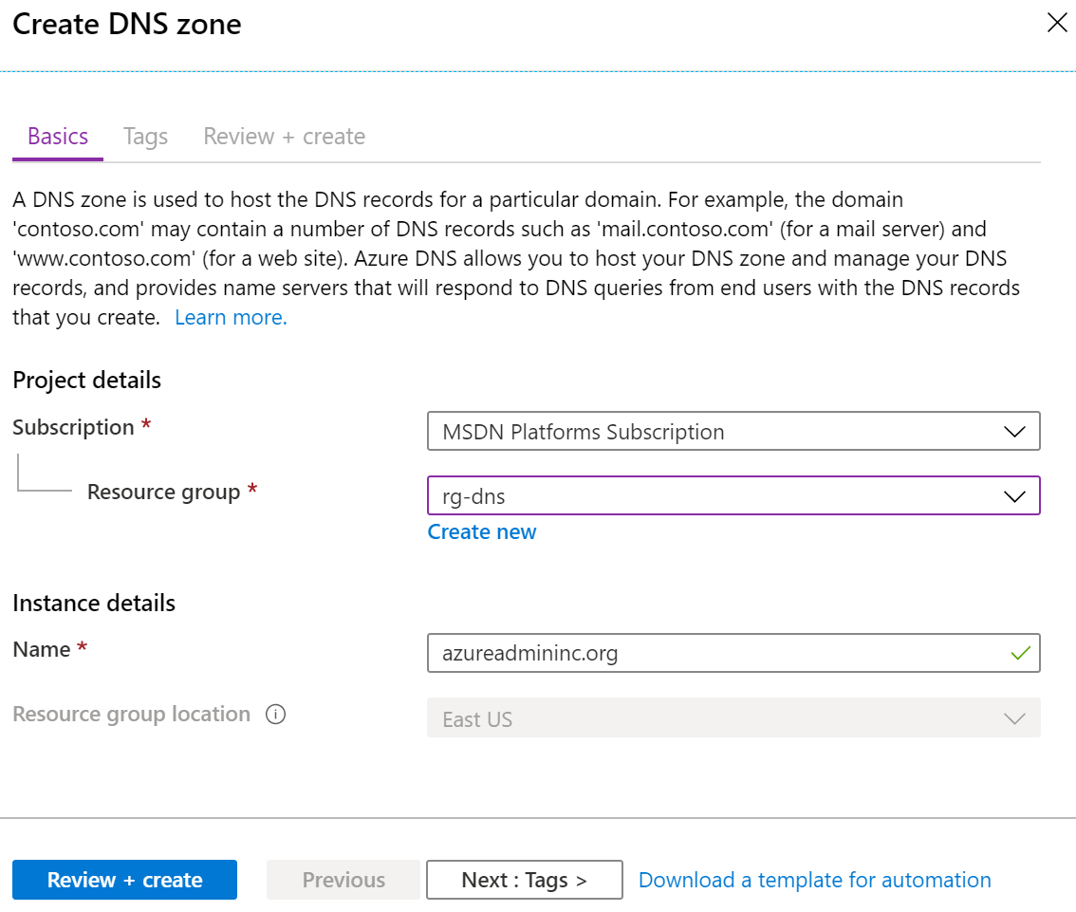
Azure DNS Zones
A DNS zone hosts the DNS records for a domain
The name of the zone must be unique within the resource group
Where multiple zones share the same name, each instance is assigned different name server addresses
Root/Parent domain is registered at the registrar and pointed to Azure NS
Notes:
DNS Zones - https://docs.microsoft.com/en-us/azure/dns/dns-zones-records#dns-zones
✔️ You do not have to own a domain name to create a DNS zone with that domain name in Azure DNS. However, you do need to own the domain to configure the domain.

Slide 33
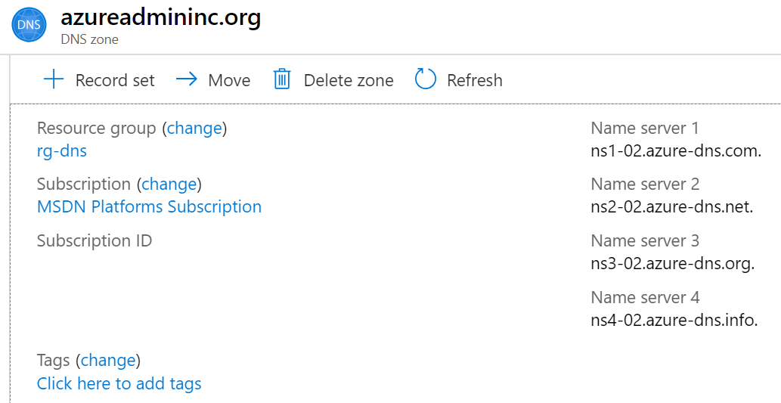
DNS Delegation
When delegating a domain to Azure DNS, you must use the name server names provided by Azure DNS – use all four
Once the DNS zone is created, update the parent registrar
For child zones, register the NS records in the parent domain
Notes:
Host your domain on Azure DNS - https://docs.microsoft.com/learn/modules/host-domain-azure-dns/

Slide 34
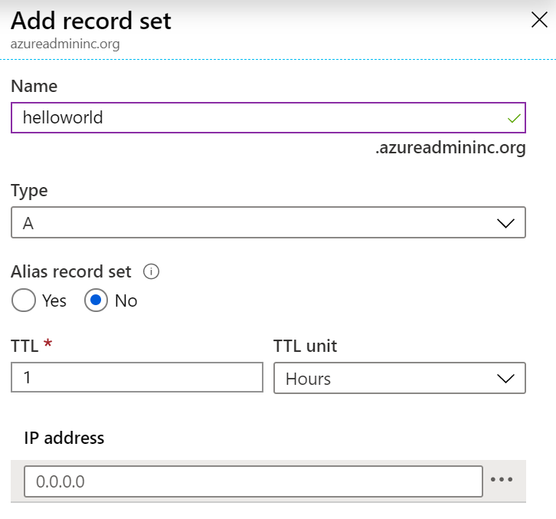
DNS Record Sets
A record set is a collection of records in a zone that have the same name and are the same type
You can add up to 20 records to any record set
A record set cannot contain two identical records
Changing the drop-down Type, changes the information required

Slide 35
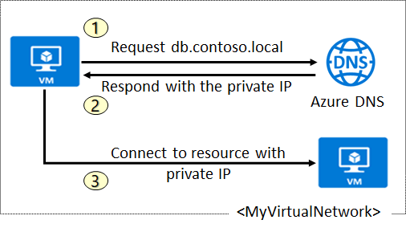
DNS for Private Domains
Use your own custom domain names
Provides name resolution for VMs within a VNet and between VNets
db.contoso.lab
Automatic hostname record management
Removes the need for custom DNS solutions
Use all common DNS records types
Available in all Azure regions
Notes:
QuickStart: Create an Azure private DNS zone using the Azure portal - https://docs.microsoft.com/en-us/azure/dns/private-dns-getstarted-portal

Slide 36
Private Zone Scenarios
Query:VM2.contoso.lab
Response:VM2.contoso.lab
DNS resolution in VNet1 is private and not accessible from the Internet
DNS queries across the virtual networks are resolved
Reverse DNS queries are scoped to the same virtual network

Slide 37
Demonstration – DNS Name Resolution
Create a DNS zone
Add a DNS record set
Use PowerShell to view DNS information
View your name servers
Test the resolution
Explore DNS metrics
Notes:
✔ Always consider having students walk-through the demonstrations themselves. Also, consider the overlap with the formal labs and your best use of time.

Slide 38
Lesson 06: Module 04 Lab and Review

Slide 39
Lab 04 – Implement Virtual Networking
Lab scenario
You plan to create a virtual network in Azure that will host a couple of Azure virtual machines. You will deploy them into different subnets of the virtual network. You also want to ensure that their private and public IP addresses will not change over time. To comply with Contoso security requirements, you need to protect public endpoints of Azure virtual machines accessible from Internet. Finally, you need to implement DNS name resolution for Azure virtual machines both within the virtual network and from Internet.
Objectives
Task 1: Create and configure a virtual network
Task 2: Deploy virtual machines into the virtual network
Task 3: Configure private and public IP addresses of Azure VMs
Task 4: Configure network security groups
Task 5: Configure Azure DNS for internal name resolution
Task 6: Configure Azure DNS for external name resolution
Next slide for an architecture diagram
Notes:
LAB 04 - Implement Virtual Networking - ESTIMATED DURATION 40 MIN
Lab Repository - https://microsoftlearning.github.io/AZ-104-MicrosoftAzureAdministrator/

Slide 40







Lab 04 – Architecture diagram
Task 1, Task 2
az104-04-rg1
az104-04-vnet1 10.40.0.0/20
Subnet0 10.40.0.0/24
Subnet1 10.40.1.0/24
Task 5
Private DNS zone
az104-04-vm0
az104-04-vm1
contoso.org
az104-04-nic0
10.40.0.4
az104-04-nic1
10.40.1.4
Task 3
Task 6
az104-04-pip0
az104-04-pip1
DNS zone
Task 4
az104-04-nsg01

Slide 41
Module Review
Module Review Questions
Microsoft Learn Modules (docs.microsoft.com/Learn)
Networking Fundamentals – Principals
Design an IP addressing schema for your Azure deployment
Secure and isolate access to Azure resources by using network security groups and service endpoints
Notes:
Learn - https://docs.microsoft.com/en-us/learn/browse/

Slide 42
End of presentation

