Slide 1
AZ-104T00A Module 05: Intersite Connectivity

Slide 2
Module Overview
Lesson 01: VNet Peering
Lesson 02: VPN Gateway Connections
Lesson 03: ExpressRoute and Virtual WAN
Lesson 04: Module 05 Lab and Review
Notes:
Module overview

Slide 3
Lesson 01: VNet Peering

Slide 4
VNet Peering Overview
VNet Peering
Gateway Transit and Connectivity
Configure VNet Peering
Service Chaining
Demonstration – VNet Peering
Notes:
Configure and manage virtual networking (30-35%)
Implement and manage virtual networking
• Create and configure VNET peering

Slide 5
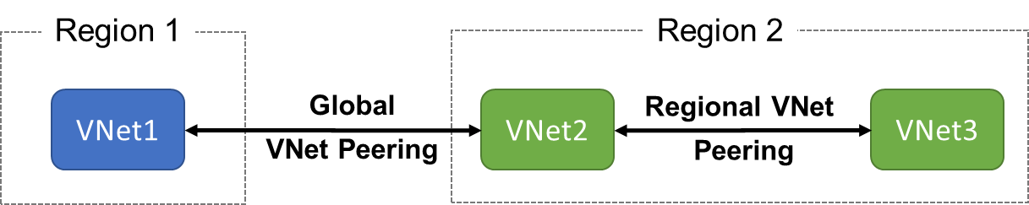
VNet Peering
VNet peering connects two Azure virtual networks
Two types of peering: Regional and Global
Peered networks use the Azure backbone for privacy and isolation
You can peer across subscriptions and tenants
Easy to setup, seamless data transfer, and great performance
Notes:
Virtual network peering - https://docs.microsoft.com/en-us/azure/virtual-network/virtual-network-peering-overview

Slide 6
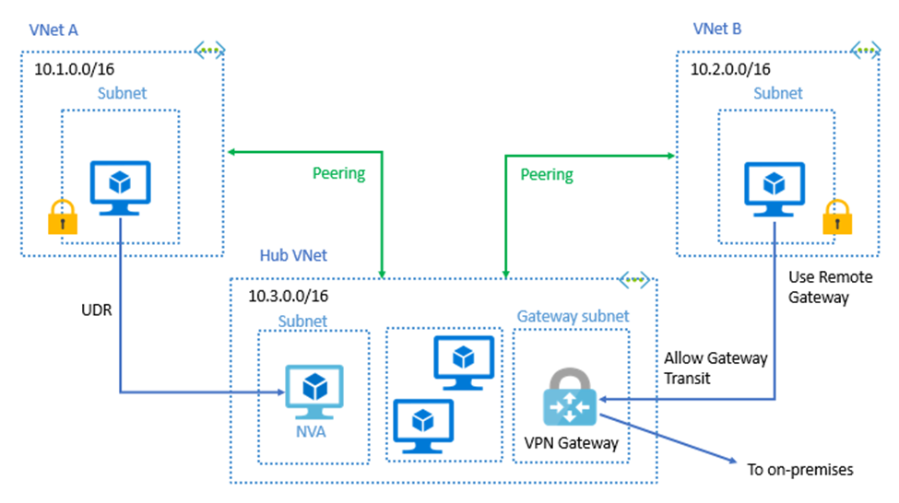

Gateway Transit and Connectivity
Gateway transit allows peered virtual networks to share the gateway and get access to resources
No VPN gateway is required in the peered virtual network
Default VNet peering provides full connectivity
IP address spaces of connected networks can't overlap
Notes:
Azure Virtual Network frequently asked questions (FAQ) VNet Peering - https://docs.microsoft.com/en-us/azure/virtual-network/virtual-networks-faq

Slide 7
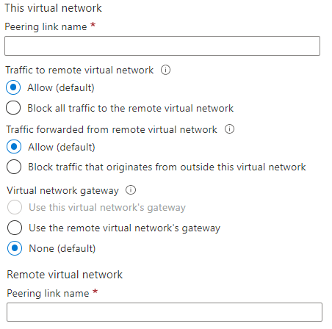
Configure VNet Peering
Allow virtual network access settings
Configure forwarded traffic settings
Notes:
Create, change, or delete a virtual network peering - https://docs.microsoft.com/en-us/azure/virtual-network/virtual-network-manage-peering#requirements-and-constraints
Tutorial: Connect virtual networks with virtual network peering using the Azure portal - https://docs.microsoft.com/en-us/azure/virtual-network/tutorial-connect-virtual-networks-portal
✔️ When you add a peering on one virtual network, the second virtual network configuration is automatically added.

Slide 8
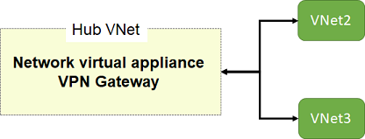
Service Chaining
Leverage user-defined routes and service chaining to implement custom routing
Implement a VNet hub with a network virtual appliance or a VPN gateway
Service chaining enables you to direct traffic from one virtual network to a virtual appliance, or virtual network gateway, in a peered virtual network, through user-defined routes
Notes:
Distribute your services across Azure virtual networks and integrate them by using virtual network peering - https://docs.microsoft.com/learn/modules/integrate-vnets-with-vnet-peering

Slide 9
Demonstration – VNet Peering
Configure VNet peering on the first virtual network
Configure a VPN gateway
Allow gateway transit
Confirm VNet peering on the second virtual network
Notes:
✔ Always consider having students walk-through the demonstrations themselves. Also, consider the overlap with the formal labs and your best use of time.

Slide 10
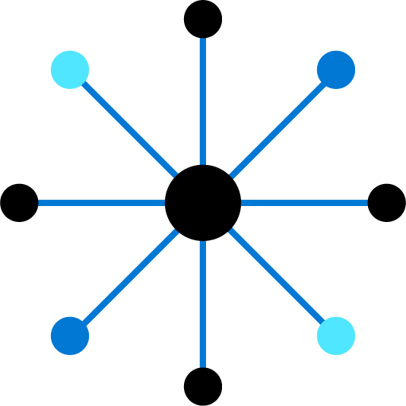
Lesson 02: VPN Gateway Connections

Slide 11
VPN Gateway Connections Overview
VPN Gateways
Create the Local Network Gateway
Implement Site-to-Site VPN Connections
Configure the On-premises VPN Device
Create the Gateway Subnet
Create the VPN Connection
VPN Gateway Configuration
High Availability Scenarios
VPN Gateway Types
Demonstration – VPN Gateway
VPN Gateway SKU and Generation
Notes:
Configure and manage virtual networking (30-35%)
Integrate an on-premises network with an Azure virtual network
• Create and configure Azure VPN Gateway
• Create and configure VPNs

Slide 12
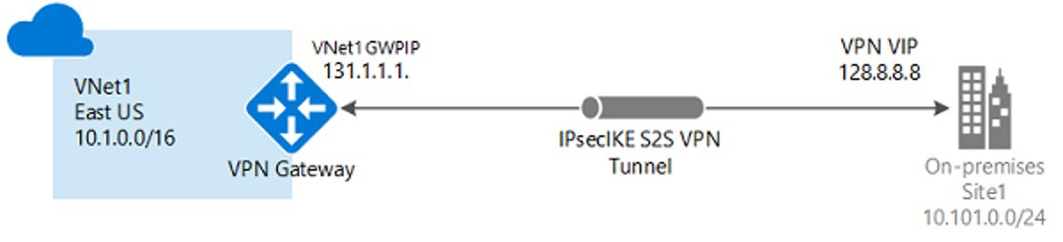
VPN Gateways
Site-to-site connections connect on-premises datacenters to Azure virtual networks
VNet-to-VNet connections connect Azure virtual networks (custom)
Point-to-site (User VPN) connections connect individual devices to Azure virtual networks
Notes:
What is VPN Gateway? - https://docs.microsoft.com/en-us/azure/vpn-gateway/vpn-gateway-about-vpngateways

Slide 13
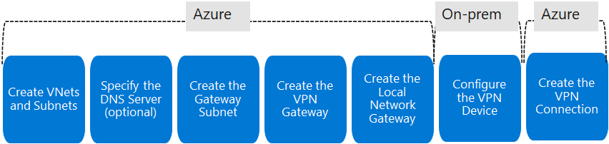
Implement Site-to-Site VPN Connections
Take time to carefully plan your network configuration
The on-premises part is necessary only if you are configuring Site-to-Site
Always verify and test your connections
Notes:
Connect your on-premises network to Azure with VPN Gateway - https://docs.microsoft.com/learn/modules/connect-on-premises-network-with-vpn-gateway/
Create a route-based VPN gateway using the Azure portal - https://docs.microsoft.com/en-us/azure/vpn-gateway/create-routebased-vpn-gateway-portal

Slide 14

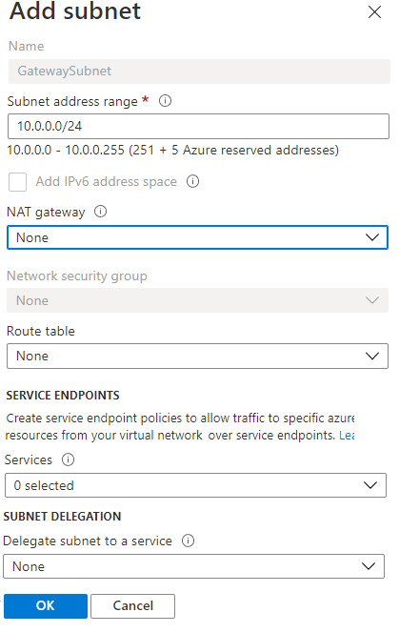
Create the Gateway Subnet
The gateway subnet contains the IP addresses; if possible, use a CIDR block of /28 or /27
When you create your gateway subnet, gateway VMs are deployed to the gateway subnet and configured with the required VPN gateway settings
Never deploy other resources (for example, additional VMs) to the gateway subnet

Slide 15
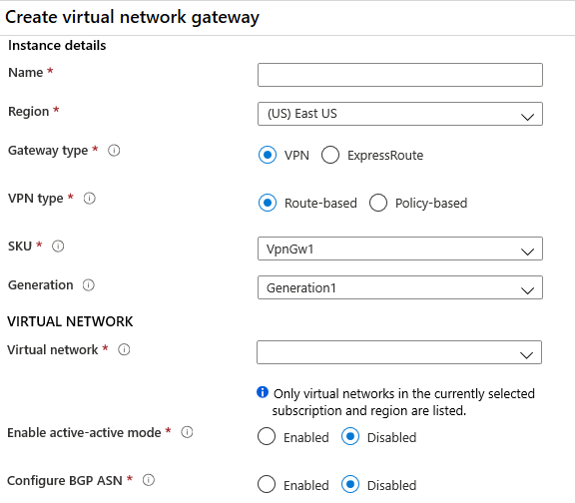
VPN Gateway Configuration
Most VPN types are Route-based
Your choice of gateway SKU affects the number of connections you can have and the aggregate throughput benchmark
Associate a virtual network that includes the gateway subnet
The gateway needs a public IP address
It can take up to 45 minutes to provision the VPN gateway

Slide 16

VPN Gateway Types
Route-based VPNs use routes in the IP forwarding or routing table to direct packets:
Support for IKEv2
Can use dynamic routing protocols
Policy-based VPNs encrypt and direct packets through IPsec tunnels based on the IPsec policies:
Support for IKEv1 only
Legacy on-premises VPN devices
Most VPN gateway configurations require a Route-based VPN

Slide 17
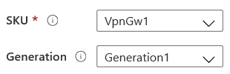
Gateway SKU and Generation
Sampling of available SKUs
Gen | SKU | S2S/VNet-to-VNet Tunnels | P2S IKEv2 Connections | Throughput Benchmark
1 | VpnGw1/Az | Max. 30 | Max. 250 | 650 Mbps
1 | VpnGw2/Az | Max. 30 | Max. 500 | 1.0 Gbps
2 | VpnGw2/Az | Max. 30 | Max. 500 | 1.25 Gbps
1 | VpnGw3/Az | Max. 30 | Max. 1000 | 1.25 Gbps
2 | VpnGw3/Az | Max. 30 | Max. 1000 | 2.5 Gbps
2 | VpnGw4/Az | Max. 30 | Max. 5000 | 5.0 Gbps
The Gateway SKU affects the connections and the throughput
Resizing is allowed within the generation
The Basic SKU (not shown) is legacy and should not be used
Notes:
About VPN Gateway configuration settings - https://docs.microsoft.com/en-us/azure/vpn-gateway/vpn-gateway-about-vpn-gateway-settings
This table is just a sample of the SKUs that are available. There are many more.

Slide 18
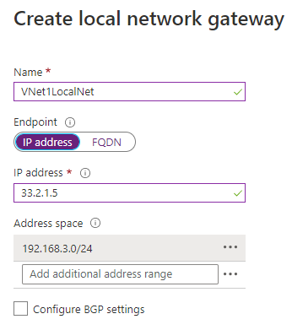
Create the Local Network Gateway
Defines the on-premises network configuration
Give the site a name by which Azure can refer to it
Use a public IP address or FQDN for Local Network Gateway Endpoint
Specify the IP address prefixes that will be routed through the gateway to the VPN device

Slide 19
Configure the On-premises VPN Device
Consult the list of supported VPN devices (Cisco, Juniper, Ubiquiti, Barracuda Networks)
A VPN device configuration script may be available
Remember the shared key for the Azure connection (next step)
Specify the public IP address (previous step)
Notes:
About VPN devices and IPsec/IKE parameters for Site-to-Site VPN Gateway connections - https://docs.microsoft.com/en-us/azure/vpn-gateway/vpn-gateway-about-vpn-devices

Slide 20
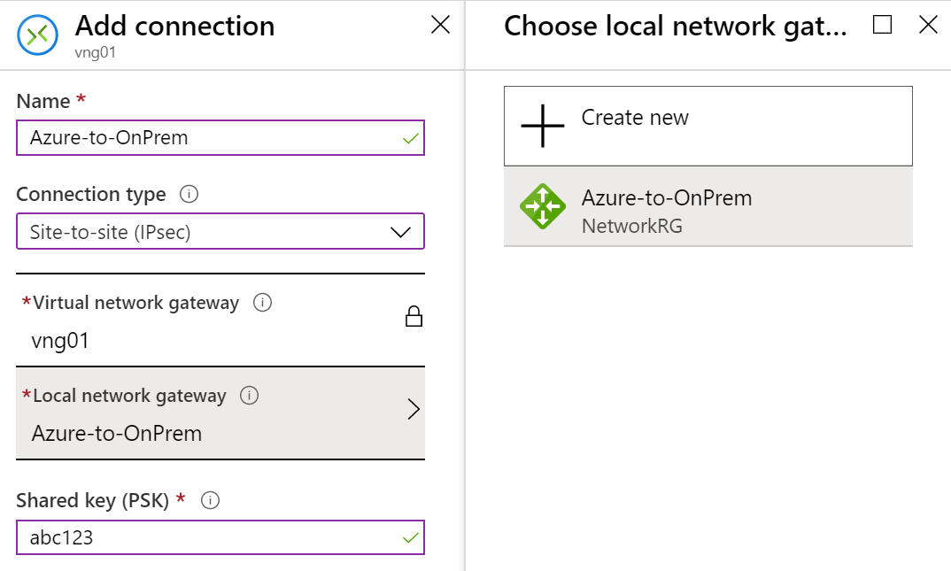
Create the VPN Connection
Once your VPN gateways is created and the on-premises device is configured, create a connection object
Configure a name for the connection and specify the type as Site-to-site (IPsec)
Select the VPN gateway and the Local Network Gateway
Enter the Shared key for the connection

Slide 21
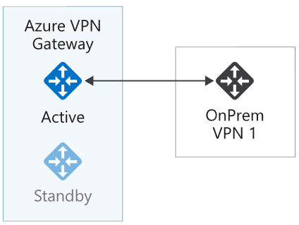
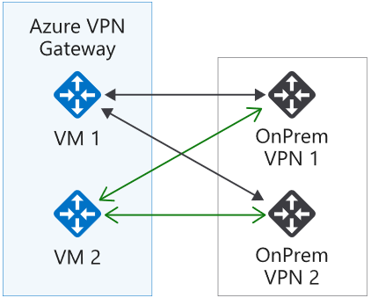
High Availability Scenarios
Active/standby (default)
Active/active
VPN gateways are deployed as two instances
Enable active/active mode for higher availability
Notes:
Highly Available Cross-Premises and VNet-to-VNet Connectivity - https://docs.microsoft.com/en-us/azure/vpn-gateway/vpn-gateway-highlyavailable

Slide 22
Demonstration – VPN gateways
Explore the Gateway subnet blade
Explore the Connected Devices blade
Explore adding a virtual network gateway
Explore adding a connection between the virtual networks
Notes:
✔ Always consider having students walk-through the demonstrations themselves. Also, consider the overlap with the formal labs and your best use of time.

Slide 23
Lesson 03: ExpressRoute and Virtual WAN

Slide 24
ExpressRoute and Virtual WAN Overview
ExpressRoute
ExpressRoute Capabilities
Coexisting Site-to-Site and ExpressRoute
Intersite Connection Comparisons
Virtual WANs
Notes:
Configure and manage virtual networking (30-35%)
Integrate an on-premises network with an Azure virtual network
Configure ExpressRoute
Configure Azure Virtual WAN

Slide 25
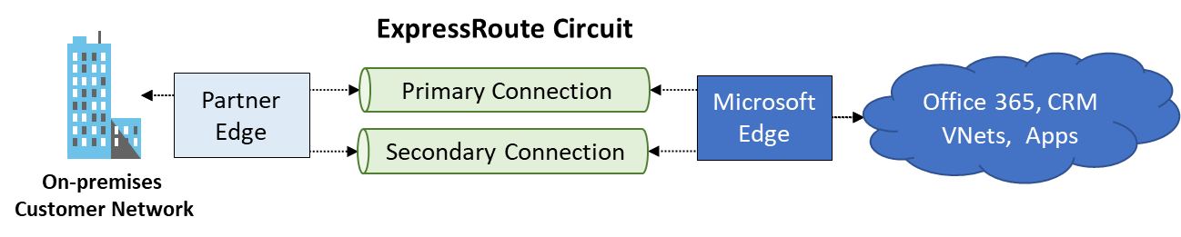
ExpressRoute
Private connections between your on-premises network and Microsoft datacenters
Connections do not go over the public Internet – Partner network
Secure, reliable, low latency, high speed connections
Notes:
ExpressRoute - https://azure.microsoft.com/en-us/services/expressroute/

Slide 26
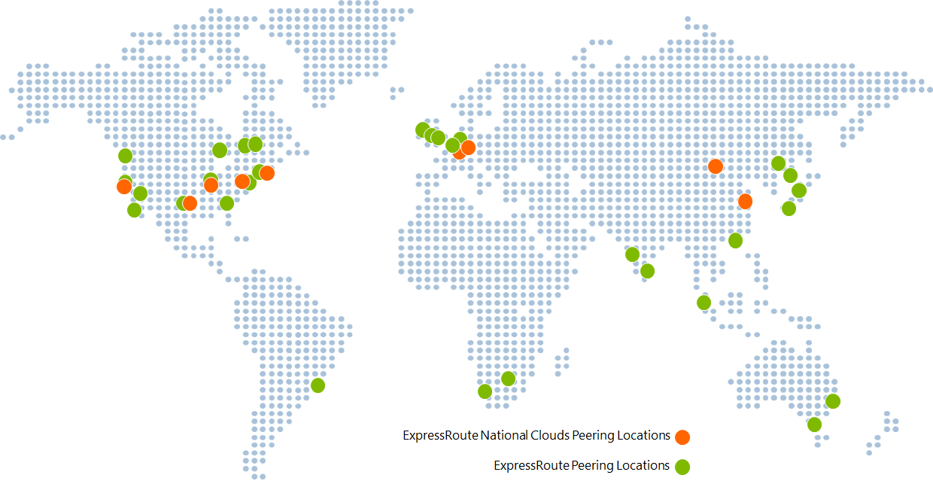
ExpressRoute Capabilities
Layer 3 connectivity with redundancy
Connectivity to all regions within a geography
Global connectivity with ExpressRoute premium add-on
Across on-premises connectivity with ExpressRoute Global Reach
Bandwidth options – 50 Mbps to 100 Gbps
Billing models – Unlimited, metered, premium
Notes:
ExpressRoute overview - https://docs.microsoft.com/en-us/azure/expressroute/expressroute-introduction

Slide 27
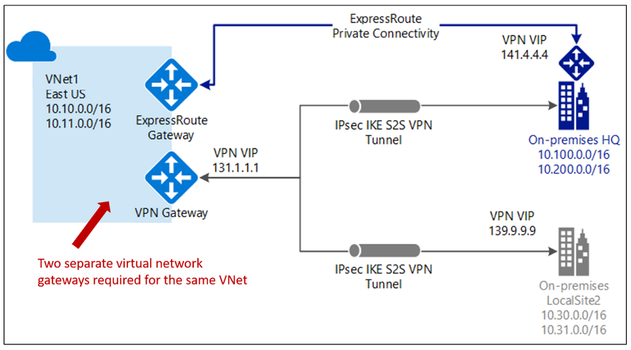
Coexisting Site-to-Site and ExpressRoute
Use S2S VPN as a secure failover path for ExpressRoute
Use S2S VPNs to connect to sites that are not connected with ExpressRoute
Notice two VNet gateways for the same virtual network
Notes:
Tutorial: Create and modify an ExpressRoute circuit - https://docs.microsoft.com/en-us/azure/expressroute/expressroute-howto-circuit-portal-resource-manager
Connect your on-premises network to the Microsoft global network by using ExpressRoute - https://docs.microsoft.com/en-us/learn/modules/connect-on-premises-network-with-expressroute/
Two gateways (VPN & Expressroute) can be enabled on the same gateway subnet by using PowerShell.

Slide 28
Intersite Connections Comparison
Connection | Azure services supported | Bandwidth | Protocols | Typical use case
Virtual network, point-to-site | Azure IaaS services, Azure Virtual Machines | Based on the gateway SKU | Active/passive | Dev, test, and lab environments for cloud services and virtual machines
Virtual network, site-to-site | Azure IaaS services, Azure Virtual Machines | Typically <1 Gbps aggregate | Active/passive Active/active | Dev, test, and lab environments. Small-scale production workloads and virtual machines
ExpressRoute | Azure IaaS and PaaS services, Microsoft 365 services | 50 Mbps up to 100 Gbps | Active/active | Enterprise-class and mission-critical workloads. Big data solutions

Slide 29
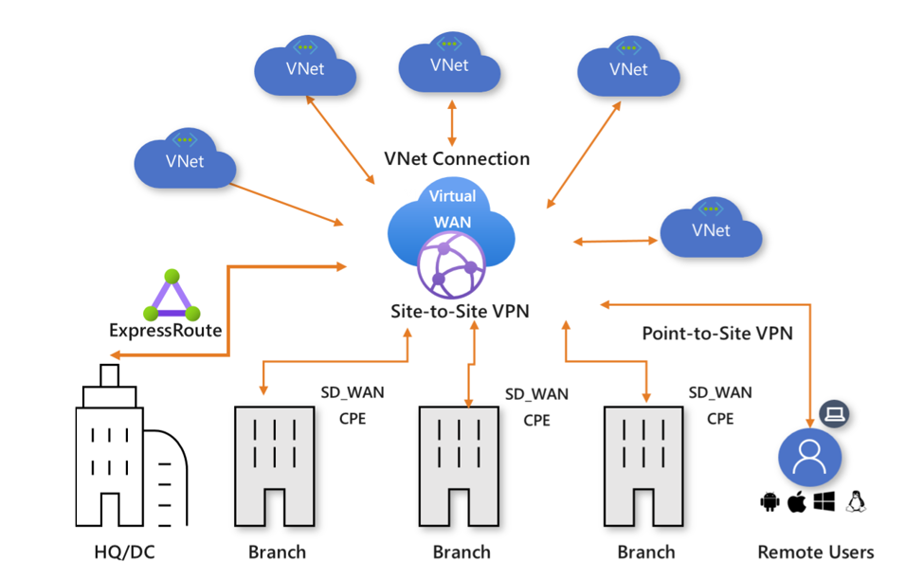
Virtual WANs
Brings together S2S, P2S, and ExpressRoute
Integrated connectivity using a hub-and-spoke connectivity model
Connect virtual networks and workloads to the Azure hub automatically
Visualize the end-to-end flow within Azure
Two types: Basic and Standard
Notes:
About Azure Virtual WAN - https://docs.microsoft.com/en-us/azure/virtual-wan/virtual-wan-about
Tutorial: Create a Site-to-Site connection using Azure Virtual WAN - https://docs.microsoft.com/en-us/azure/virtual-wan/virtual-wan-site-to-site-portal

Slide 30
Lesson 04: Module 05 Lab and Review

Slide 31
Lab 05 – Implement intersite connectivity
Lab scenario
Contoso has its datacenters in Boston, New York, and Seattle offices connected via a mesh wide-area network links, with full connectivity between them. You need to implement a lab environment that will reflect the topology of the Contoso's on-premises networks and verify its functionality
Objectives
Task 1:
Provision the lab environment
Task 2:
Configure local and global virtual network peering
Task 3:
Test intersite connectivity
Next slide for an architecture diagram
Notes:
LAB 05 - Implement Intersite Connectivity - ESTIMATED DURATION 30 MIN
GitHub Repository - https://microsoftlearning.github.io/AZ-104-MicrosoftAzureAdministrator/

Slide 32




Lab 05 – Architecture diagram
Region1
Task 1
az104-05-rg0
az104-05-vnet0 10.50.0.0/22
Region2
Subnet0 10.50.0.0/24
Task 2, Task 3
az104-05-rg2
az104-05-vm0
10.50.0.4
Global Peering
az104-05-vnet2 10.52.0.0/22
Subnet0 10.52.0.0/24
az104-05-rg1
Local Peering
Global Peering
az104-05-vm2
10.52.0.4
Subnet0 10.51.0.0/24
az104-05-vm1
10.51.0.4
az104-05-vnet1 10.51.0.0/22

Slide 33
Module Review
Module Review Questions
Microsoft Learn Modules (docs.microsoft.com/Learn)
Distribute your services across Azure virtual networks and integrate them by using virtual network peering
Connect your on-premises network to Azure with VPN gateway
Connect your on-premises network to the Microsoft global network by using ExpressRoute
Notes:
Learn - https://docs.microsoft.com/en-us/learn/browse/

Slide 34
End of presentation

