Slide 1
AZ-104T00A Module 06: Network Traffic Management

Slide 2
Module Overview
Lesson 01: Network Routing and Endpoints
Lesson 02: Azure Load Balancer
Lesson 03: Application Gateway
Lesson 04: Module 06 Lab and Review
Notes:
Module overview

Slide 3
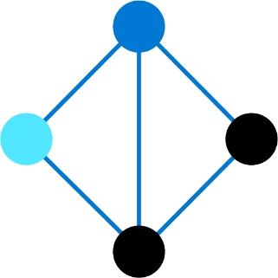
Lesson 01: Network Routing and Endpoints

Slide 4
Network Routing and Endpoints Overview
System Routes
Associate the Route Table
User Defined Routes
Demonstration – Custom Routing tables
Routing Example
Service Endpoints
Create a Routing Table
Service Endpoint Services
Create a Custom Route
Private Link
Notes:
Configure and manage virtual networking (30-35%)
Implement and manage virtual networking
• Configure private and public IP addresses, network routes, network interface, subnets, and virtual network

Slide 5
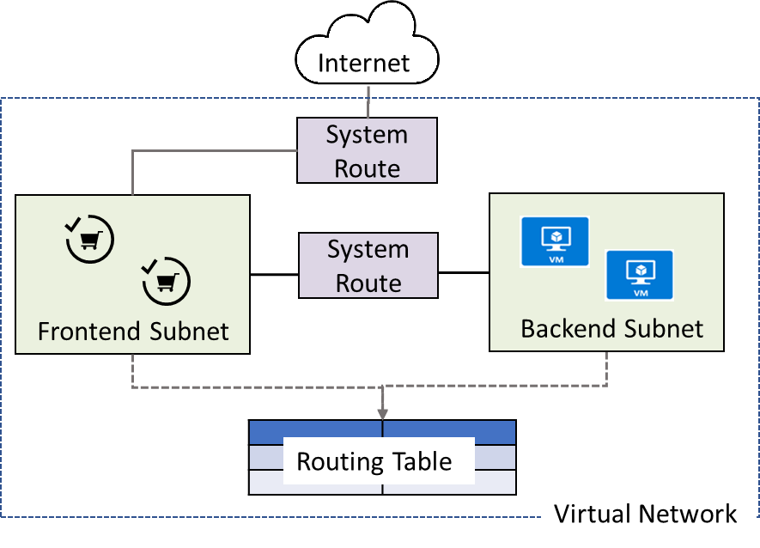
System Routes
System routes direct network traffic between virtual machines, on-premises networks, and the Internet:
Traffic between VMs in the same subnet
Between VMs in different subnets in the same virtual network
Data flow from VMs to the Internet
Communication between VMs using a VNet-to-VNet VPN
Site-to-Site and ExpressRoute communication through the VPN gateway
Notes:
System routes - https://docs.microsoft.com/en-us/azure/virtual-network/virtual-networks-udr-overview#system-routes

Slide 6
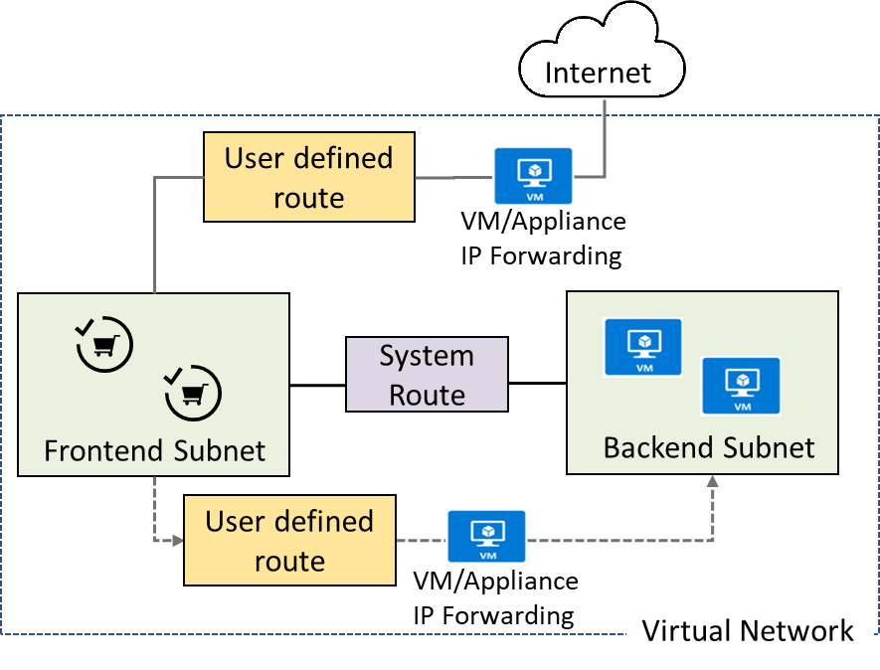
User Defined Routes
A route table contains a set of rules, called routes, that specifies how packets should be routed in a virtual network
User-defined routes are custom routes that control network traffic by defining routes that specify the next hop of the traffic flow
The next hop can be a virtual network gateway, virtual network, internet, or virtual appliance
Notes:
Virtual network traffic routing - https://docs.microsoft.com/en-us/azure/virtual-network/virtual-networks-udr-overview
✔ Each route table can be associated to multiple subnets, but a subnet can only be associated to a single route table. There are no additional charges for creating route tables in Microsoft Azure. Do you think you will need to create custom routes?

Slide 7
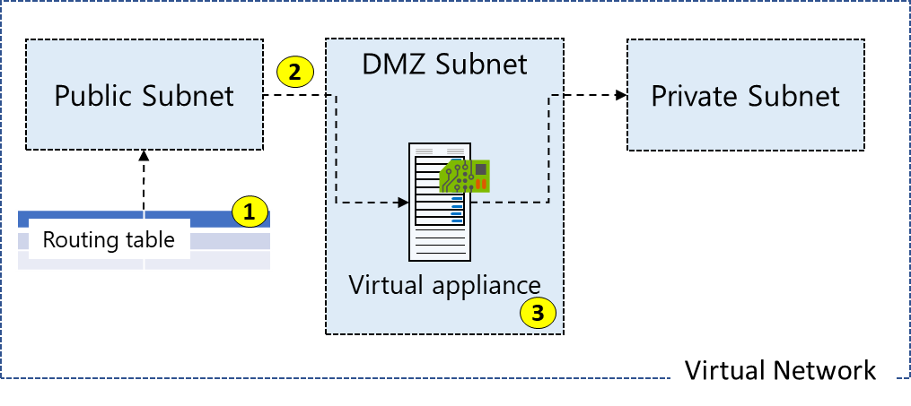
Routing Example
All traffic coming into the public subnet and headed for the private subnet must be go through the virtual network appliance
Create a routing table
Add a custom route that requires all private subnet traffic be directed to a network appliance
Associate the new route to the public subnet
Notes:
Manage and control traffic flow in your Azure deployment with routes - https://docs.microsoft.com/learn/modules/control-network-traffic-flow-with-routes/
The next three topics will cover this information.

Slide 8
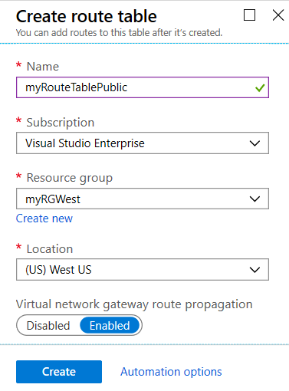
Create a Routing Table
A standard routing protocol is used to exchange routing and reachability information between two or more networks
Routes are automatically added to the route table of all subnets with virtual network gateway route propagation enabled
In most situations you will want to enable route propagation
Notes:
Overview of BGP with Azure VPN Gateways - https://docs.microsoft.com/en-us/azure/vpn-gateway/vpn-gateway-bgp-overview?toc=%2fazure%2fvirtual-network%2ftoc.json

Slide 9
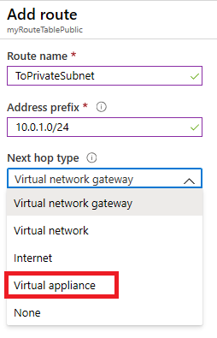
Create a Custom Route
When you create a route there are several Next hop types
In this example, any private subnet IP addresses will be sent to the virtual appliance
Other choices are Virtual network gateway, Virtual network, Internet, and None

Slide 10
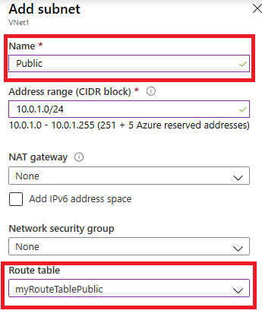
Associate the Route Table
Each subnet can have zero or one route table associated to it
In our example, the Public subnet will be associated with the routing table
Notes:
✔️ In this case the virtual appliance should not have a public IP address and IP forwarding should be enabled.

Slide 11
Demonstration – Custom Routing Tables
Create a route table
Add a route
Associate a route table to a subnet
Use PowerShell to view your routing information
Notes:
✔ Always consider having students walk-through the demonstrations themselves. Also, consider the overlap with the formal labs and your best use of time.

Slide 12
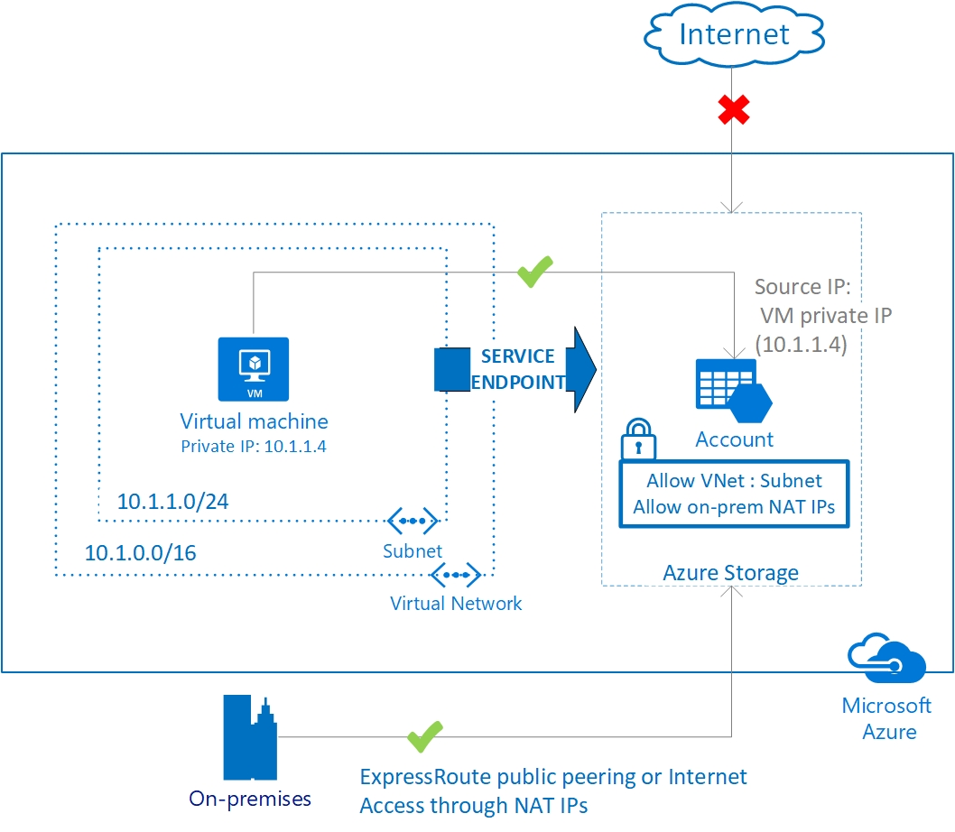
Service Endpoints
Endpoints limit network access to specific subnets and IP addresses
Improved security for your Azure service resources
Optimal routing for Azure service traffic from your virtual network
Endpoints use the Microsoft Azure backbone network
Simple to set up with less management overhead
Notes:
Virtual network service endpoints - https://docs.microsoft.com/en-us/azure/virtual-network/virtual-network-service-endpoints-overview
✔️ Can you see a use for service endpoints in your organization?

Slide 13
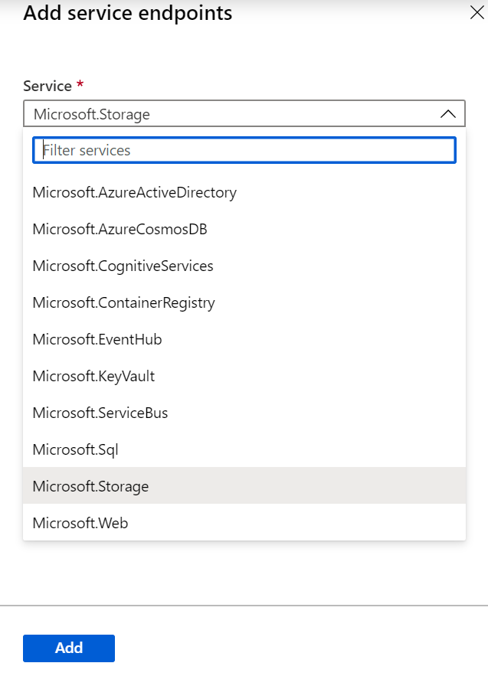
Service Endpoint Services
There are many types of service endpoints
Adding service endpoints can take up to 15 minutes to complete

Slide 14
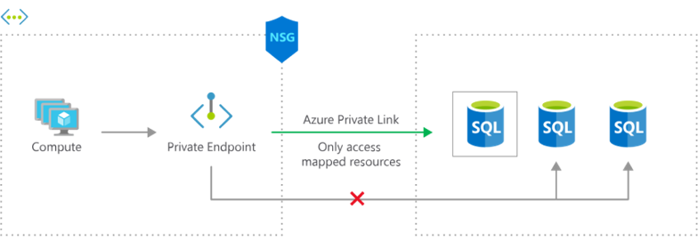
Private Link
Private connectivity to services on Azure. Traffic remains on the Microsoft network, with no public internet access
Integration with on-premises and peered networks
In the event of a security incident within your network, only the mapped resource would be accessible
Notes:
Private Link Documentation - https://docs.microsoft.com/en-us/azure/private-link/

Slide 15
Lesson 02: Azure Load Balancer

Slide 16
Azure Load Balancer Overview
Azure Load Balancer
Backend Pools
Public Load Balancer
Load Balancer Rules
Internal Load Balancer
Session Persistence
Load Balancer SKUs
Health Probes
Notes:
Configure and manage virtual networking (30-35%)
Configure load balancing
• Configure an internal load balancer
• Configure load balancing rules
• Configure a public load balancer

Slide 17
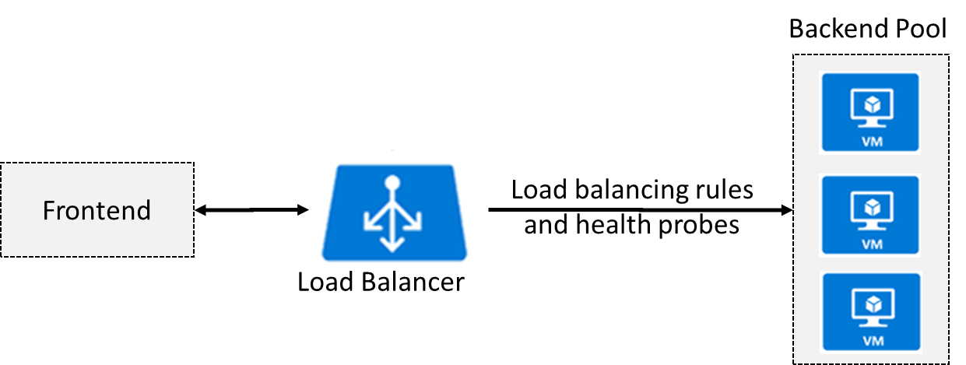
Azure Load Balancer
Distributes inbound traffic to backend resources using load-balancing rules and health probes
Can be used for both inbound/outbound scenarios
Two types: Public and Internal
Notes:
What is Azure Load Balancer? - https://docs.microsoft.com/en-us/azure/load-balancer/load-balancer-overview
Azure Load Balancer Components - https://docs.microsoft.com/en-us/azure/load-balancer/components
✔ Keep this diagram in mind since it covers the four components that must be configured for your load balancer: Frontend IP configuration, Backend pools, Health probes, and Load balancing rules.

Slide 18
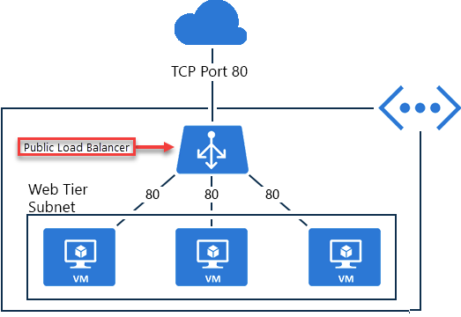
Public Load Balancer
Maps public IP addresses and port number of incoming traffic to the VM’s private IP address and port number, and vice versa
Apply load balancing rules to distribute traffic across VMs or services

Slide 19
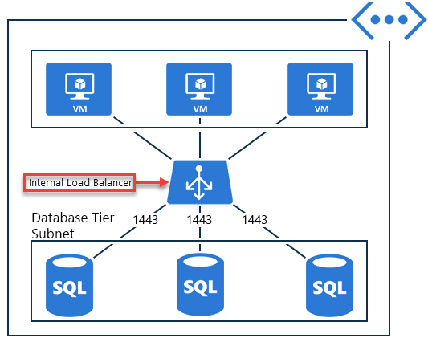
Internal Load Balancer
Directs traffic only to resources inside a virtual network or that use a VPN to access Azure infrastructure
Frontend IP addresses and virtual networks are never directly exposed to an internet endpoint
Enables load balancing within a virtual network, for cross-premises virtual networks, for multi-tier applications, and for line-of-business applications
Notes:
✔ Can you see how a public load balancer could be placed in front of the internal load balancer to create a multi-tier application.

Slide 20
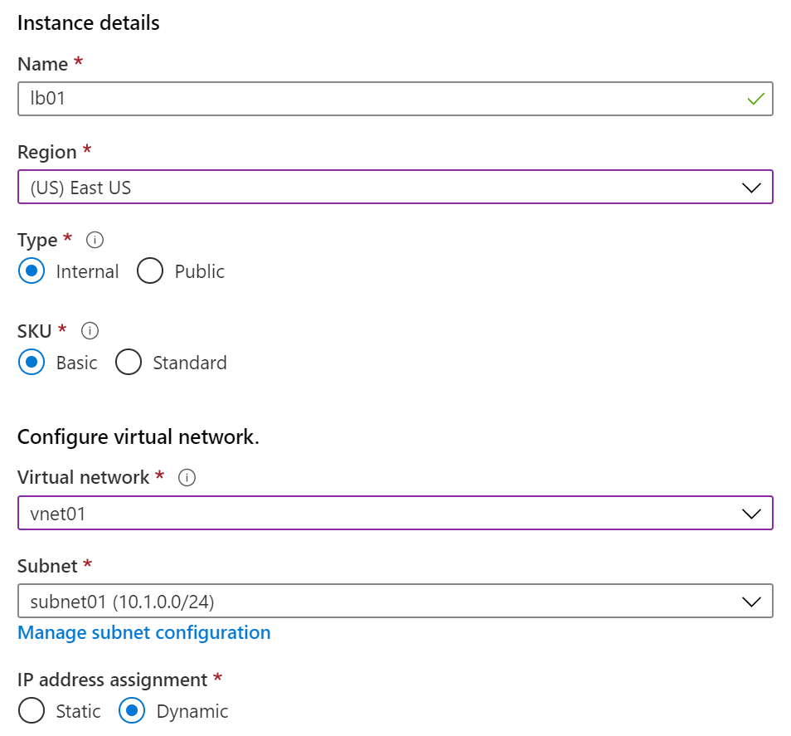
Load Balancer SKUs
Load balancer supports both Basic and Standard (newer) SKUs
SKUs are not mutable
Only Standard Load Balancer rules can span two virtual networks
No charge for the Basic Load Balancer SKU

Slide 21
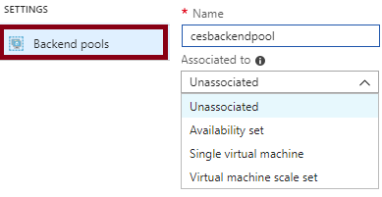
Backend Pools
SKU | Backend pool endpoints
Basic SKU | VMs in a single availability set or VM scale set
Standard SKU | Any VM in a single virtual network, including a blend of VMs, availability sets, and VM scale sets
To distribute traffic, a back-end address pool contains the IP addresses of the virtual NICs that are connected to the load balancer
Notes:
✔ In the Standard SKU you can have up to 1000 instances in the backend pool. In the Basic SKU you can have up to 100 instances.

Slide 22
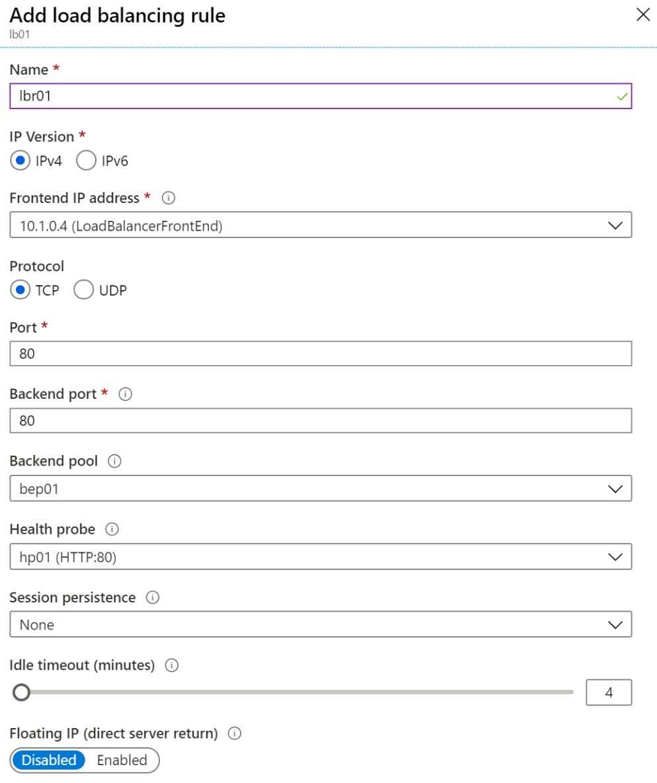
Load Balancer Rules
Maps a frontend IP and port combination to a set of backend IP addresses and port combination
Rules can be used in combination with NAT rules
A NAT rule is explicitly attached to a VM (or network interface) to complete the path to the target
Notes:
Tutorial: Load balance internet traffic to VMs using the Azure portal - https://docs.microsoft.com/en-us/azure/load-balancer/tutorial-load-balancer-standard-manage-portal
✔ Can you see the difference between load balancing rules and NAT rules? Remember, this approach should only be used when you need connectivity from the Internet. Most normal communications would occur from on-premises to Azure connections such as site-to-site VPN and ExpressRoute.

Slide 23
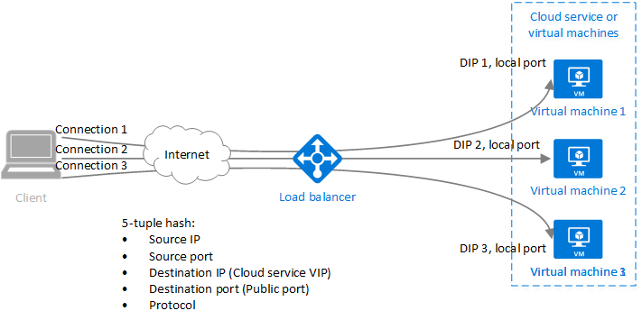
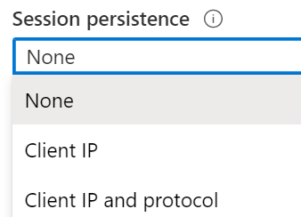
Session Persistence
Session persistence specifies how client traffic is handled
None (default) requests can be handled by any virtual machine
Client IP requests will be handled by the same virtual machine
Client IP and protocol specifies that successive requests from the same address and protocol will be handled by the same virtual machine
Notes:
✔Keeping session persistence information is very important in applications that use a shopping cart. Can you think of any other applications?

Slide 24
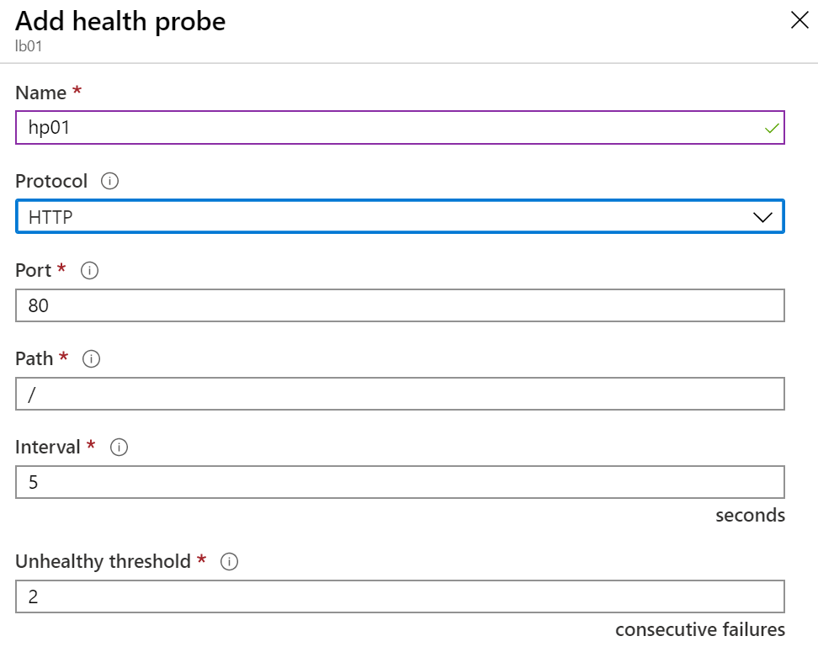
Health Probes
Allows the load balancer to monitor the status of an app
Dynamically adds or removes VMs from the load balancer rotation based on their response to health checks
HTTP custom probe (preferred) pings every 15 seconds
TCP custom probe tries to establish a successful TCP session
Notes:
Load Balancer health probes - https://docs.microsoft.com/en-us/azure/load-balancer/load-balancer-custom-probe-overview
✔ There is also a guest agent probe. This probe uses the guest agent inside the VM. It is not recommended when HTTP or TCP custom probe configurations are possible. Relate back to the original diagram to ensure all the components are covered.

Slide 25
Lesson 03: Azure Application Gateway

Slide 26
Application Gateway Overview
Application Gateway
Application Gateway Routing
Application Gateway Configuration
Notes:
Configure and manage virtual networking (30-35%)
Configure load balancing
• Configure Application Gateway

Slide 27
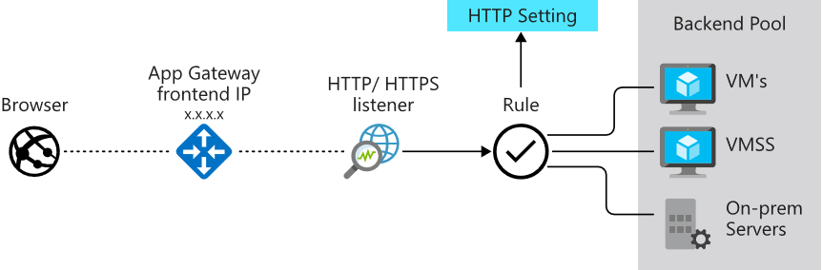
Application Gateway
Manages web app requests
Routes traffic to a pool of web servers based on the URL of a request
The web servers can be Azure virtual machines, Azure virtual machine scale sets, Azure App Service, and even on-premises servers
Notes:
Application Gateway configuration overview - https://docs.microsoft.com/en-us/azure/application-gateway/configuration-overview

Slide 28
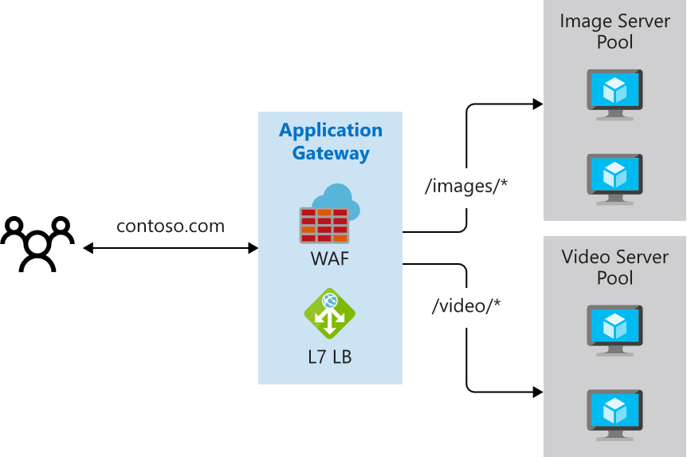
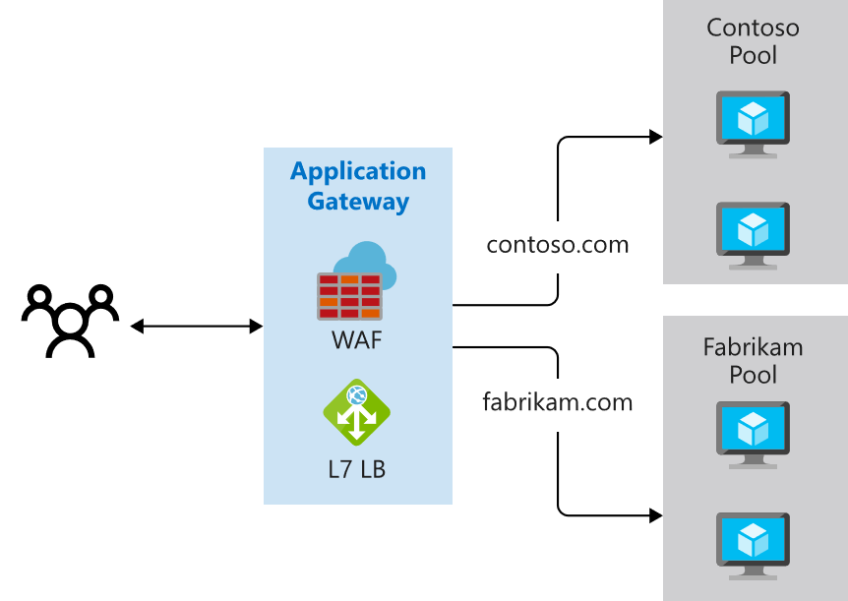
Application Gateway Routing
Path-based routing
Multiple-site routing
Notes:
QuickStart: Direct web traffic with Azure Application Gateway - Azure portal - https://docs.microsoft.com/en-us/azure/application-gateway/quick-create-portal

Slide 29
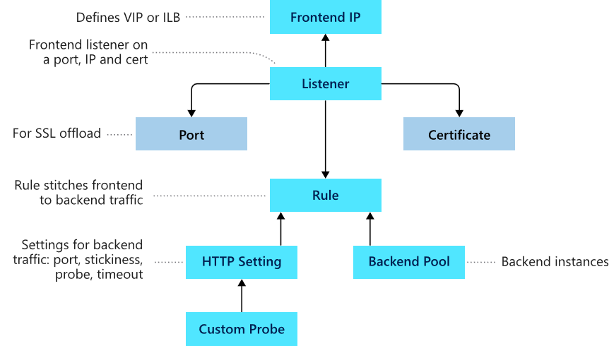
Application Gateway Components
Frontend IP
Listeners
Routing rules
Backend pools
Web application firewall (optional)
Health probes
Notes:
Load balance your web service traffic with Application Gateway - https://docs.microsoft.com/learn/modules/load-balance-web-traffic-with-application-gateway/

Slide 30
Lesson 04: Module 06 Lab and Review

Slide 31
Lab 06 – Implement traffic management
Scenario
You are tasked with implementing a hub spoke topology for network traffic. The topology should include an Azure Load Balancer and Azure Application Gateway.
Objectives
Task 1: Provision the lab environment
Task 2: Configure the hub and spoke network topology
Task 3: Test transitivity of virtual network peering
Task 4: Configure routing in the hub and spoke topology
Task 5: Implement Azure Load Balancer
Task 6: Implement Azure Application Gateway
Next slide for an architecture diagram
Notes:
LAB 06 - Implement Traffic Management - ESTIMATED DURATION 60 MIN
Lab Repository - https://microsoftlearning.github.io/AZ-104-MicrosoftAzureAdministrator/

Slide 32








Lab 06 – Architecture Diagram
Task6
Task1
az104-06-rg5
az104-06-rg1
az104-06-vnet01 10.60.0.0/22
Subnet0 10.60.0.0/24
Subnet1 10.60.1.0/24
Subnet-appgw 10.60.3.224/27
az104-06-appgw5
az104-06-vm0
10.60.0.4
az104-06-vm1
10.60.1.4
az104-06-pip5
Task2, Task3
Local
Peering
Local
Peering
Task4
Task5
Subnet0 10.63.0.0/24
Task4
Subnet0 10.62.0.0/24
az104-06-rt23
az104-06-vm2
10.62.0.4
az104-06-lb4
az104-06-vm3
10.63.0.4
az104-06-rt32
az104-06-vnet2 10.62.0.0/22
az104-06-pip4
az104-06-vnet3 10.63.0.0/22
az104-06-rg4
az104-06-rg2
az104-06-rg3
Notes:
Break down the explanation by reviewing the components in each of the three virtual networks.

Slide 33
Module Review
Module Review Questions
Microsoft Learn Modules (docs.microsoft.com/Learn)
Manage and control traffic flow in your Azure deployment with routes
Improve application scalability and resiliency by using Azure Load Balancer
Load balance your web service traffic with Application Gateway
Enhance your service availability and data locality by using Azure Traffic Manager
Notes:
Learn - https://docs.microsoft.com/en-us/learn/browse

Slide 34
End of presentation

