Slide 1
AZ-104T00A Module 08: Azure Virtual Machines

Slide 2
Module Overview
Lesson 01: Virtual Machine Planning
Lesson 02: Creating Virtual Machines
Lesson 03: Virtual Machine Availability
Lesson 04: Virtual Machine Extensions
Lesson 05: Module 08 Lab and Review​
Notes:
Module overview

Slide 3
Lesson 01: Virtual Machine Planning

Slide 4
Virtual Machine Planning Overview
IaaS Cloud Services
Virtual Machine Disks
Planning Checklist
Storage Options
Location and Pricing
Supported Operating Systems
Virtual Machine Sizing
Virtual Machine Connections
Notes:
Deploy and manage Azure compute resources (25-30%)
Create and configure VMs
VM sizes
Add data disks

Slide 5
IaaS Cloud Services
On-Premises
(Private Cloud)
Infrastructure
(as a Service)
Platform
(as a Service)
Software
(as a Service)
Data & Access
Data & Access
Data & Access
Data & Access
Applications
Applications
Applications
Applications
Runtime
Runtime
Runtime
Runtime
Operating System
Operating System
Operating System
Operating System
Virtual Machine
Virtual Machine
Virtual Machine
Virtual Machine
Compute
Compute
Compute
Compute
Networking
Networking
Networking
Networking
You Manage
Storage
Storage
Storage
Storage
Cloud Provider Manages
Test and development, website hosting, storage, backup, recovery, high-performance computing, big data analysis, and extended data center
Notes:
Infrastructure as a Service - https://azure.microsoft.com/en-us/overview/what-is-iaas/
Choose an Azure compute service for your application - https://docs.microsoft.com/en-us/azure/architecture/guide/technology-choices/compute-decision-tree

Slide 6
Planning Checklist
Start with the network
Understand the pricing model
Name the VM
Consider storage for the VM
Decide the location for the VM
Select an operating system
Determine the size of the VM
Notes:
Azure Virtual Machine Documentation - https://docs.microsoft.com/en-us/azure/virtual-machines/

Slide 7
Location and Pricing
Location:
Each region has different hardware and service capabilities
Locate Virtual Machines as close as possible to your users
Locate Virtual Machines to ensure compliance and legal obligations
Pricing:
Compute costs
Storage costs (consumption-based and reserved instances)
60+ Azure regions
Available in 140 countries

Slide 8
Virtual Machine Sizing
A Series - Entry-level for dev/test
G Series – Memory and storage optimized
B Series – Economical bursting
H Series - High performance computing
D Series – General purpose compute
L Series – Storage optimized
Dc Series – Protect data in use
M Series – Memory optimized
E Series – In-memory hyper-threaded applications optimized
Mv2 Series – Largest memory optimized
F Series – Compute optimized
N Series – GPU enabled
Notes:
Virtual Machine series - https://azure.microsoft.com/en-us/pricing/details/virtual-machines/series/
Sizes for Windows virtual machines in Azure - https://docs.microsoft.com/en-us/azure/virtual-machines/windows/sizes?toc=%2Fazure%2Fvirtual-machines%2Fwindows%2Ftoc.json#size-tables
Sizes for Linux virtual machines in Azure - https://docs.microsoft.com/en-us/azure/virtual-machines/linux/sizes?toc=%2fazure%2fvirtual-machines%2flinux%2ftoc.json
Resize a Windows VM - https://docs.microsoft.com/en-us/azure/virtual-machines/windows/resize-vm

Slide 9



Virtual Machine Storage
Each Azure VM has two or more disks:
OS disk
Temporary disk (contents can be lost)
Data disks (optional)
Azure VM (Windows)
OS and data disks reside in Azure Storage accounts:
Azure-based storage service
Standard (HDD, SSD) or Premium (SSD), or Ultra (SSD)
C:\
OS disk
D:\
Temporary disk
F:\
Data disk
When creating an Azure VM, you can choose between:
Managed disks (recommended)
Unmanaged disks
Azure blob
Notes:
Introduction to Azure managed disks - https://docs.microsoft.com/en-us/azure/virtual-machines/managed-disks-overview
Introduction to Azure managed disks - https://docs.microsoft.com/en-us/azure/virtual-machines/windows/managed-disks-overview
Convert a Windows virtual machine from unmanaged disks to managed disks - https://docs.microsoft.com/en-us/azure/virtual-machines/windows/convert-unmanaged-to-managed-disks

Slide 10
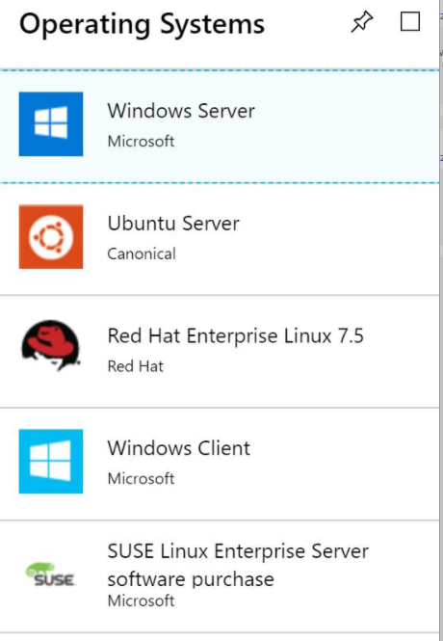
Supported Operating Systems
Windows Server includes many common products, requires a license, doesn’t support OS upgrades
Linux distributions are supported, upgrade of the OS is supported
Notes:
Microsoft server software support for Microsoft Azure Virtual Machines - https://support.microsoft.com/en-us/help/2721672/microsoft-server-software-support-for-microsoft-azure-virtual-machines
Linux on distributions endorsed by Azure - https://docs.microsoft.com/en-us/azure/virtual-machines/linux/endorsed-distros#supported-distributions–versions.

Slide 11
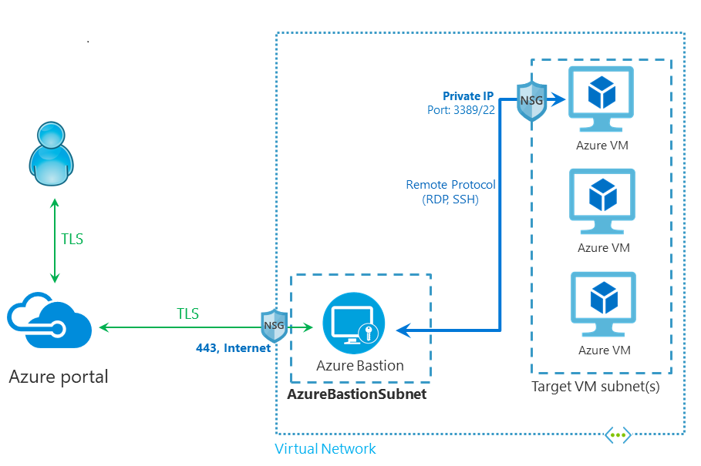
Virtual Machine Connections
Remote Desktop Protocol
for Windows-based Virtual Machines
Secure Shell Protocol for Linux based Virtual Machines
Bastion Subnet for RDP/SSH through the Portal over SSL
Notes:
How to connect and sign on to an Azure virtual machine running Windows - https://docs.microsoft.com/en-us/azure/virtual-machines/windows/connect-logon
How to use SSH keys with Windows on Azure - https://docs.microsoft.com/en-us/azure/virtual-machines/linux/ssh-from-windows
What is Azure Bastion? - https://docs.microsoft.com/en-us/azure/bastion/bastion-overview

Slide 12
Lesson 02: Creating Virtual Machines

Slide 13
Creating Virtual Machines Overview
Creating Virtual Machines in the Portal
Linux Virtual Machines
Windows Virtual Machines
Linux VM Connections
Windows VM Connections
Demonstration – Connect to Linux Virtual Machines
Demonstration – Creating a VM in the Portal
Notes:
Deploy and manage Azure compute resources (25-30%)
Automate deployment and configuration of VMs
Modify Azure Resource Manager (ARM) template
Deploy from template
Save a deployment as an ARM template

Slide 14
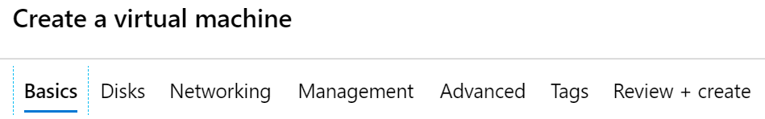
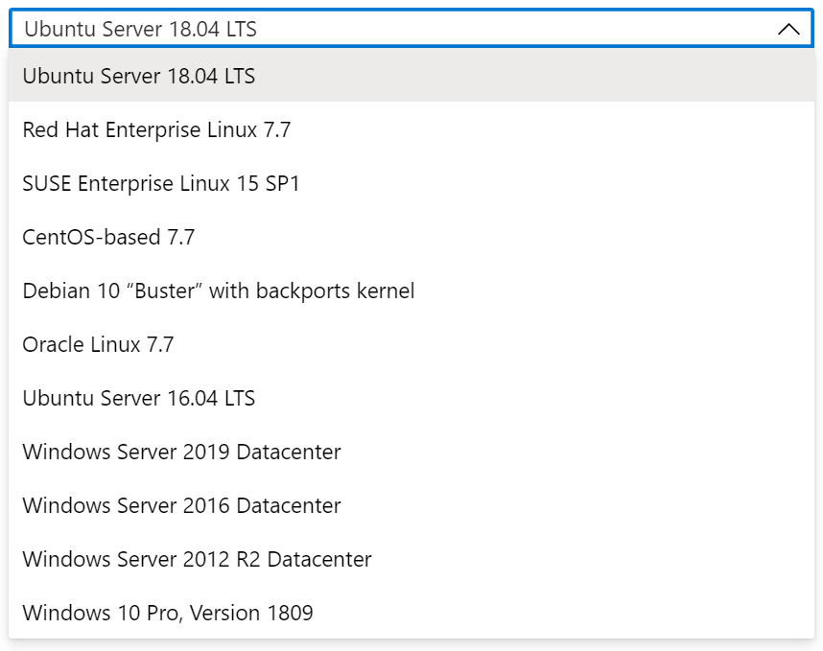
Creating Virtual Machines in the Portal
Basic (required) – Project details, Administrator account, Inbound port rules
Disks – OS disk type, data disks
Networking – Virtual networks, load balancing
Management – Monitoring, Auto-shutdown, Backup
Advanced – Add additional configuration, agents, scripts or applications
Notes:
QuickStart: Create a Windows virtual machine in the Azure portal - https://docs.microsoft.com/en-us/azure/virtual-machines/windows/quick-create-portal
QuickStart: Create a Linux virtual machine in the Azure portal - https://docs.microsoft.com/en-us/azure/virtual-machines/linux/quick-create-portal

Slide 15
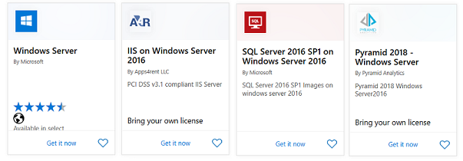
Windows Virtual Machines
Unique hybrid capabilities
Advanced multi-layer security
Faster innovation for applications
Unprecedented hyper-converged infrastructure
Notes:
Windows Virtual Machines Documentation - https://docs.microsoft.com/en-us/azure/virtual-machines/windows/
Create a Windows virtual machine from a Resource Manager template - https://docs.microsoft.com/en-us/azure/virtual-machines/windows/ps-template
Create a VM from a VHD by using the Azure portal - https://docs.microsoft.com/en-us/azure/virtual-machines/windows/create-vm-specialized-portal
Deploy Azure virtual machines from VHD templates (Learn) - https://docs.microsoft.com/en-us/azure/virtual-machines/windows/create-vm-specialized-portal

Slide 16
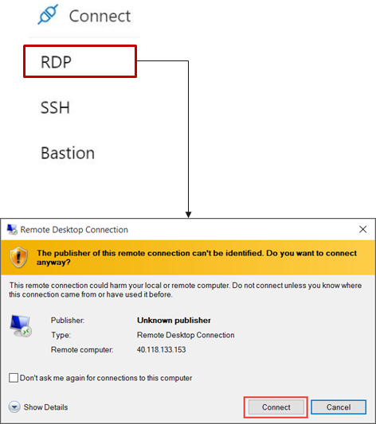
Windows VM Connections
Remote Desktop Protocol (RDP) creates a GUI session and accepts inbound traffic on TCP port 3389
WinRM creates a command-line session so can run scripts
Notes:
How to connect and sign on to an Azure virtual machine running Windows - https://docs.microsoft.com/en-us/azure/virtual-machines/windows/connect-logon

Slide 17
Demonstration – Creating a VM in the Portal
Create the virtual machine
Connect to the virtual machine
Install the Web Server role
View the IIS welcome page
Notes:
✔ Always consider having students walk-through the demonstrations themselves. Also, consider the overlap with the formal labs and your best use of time.

Slide 18
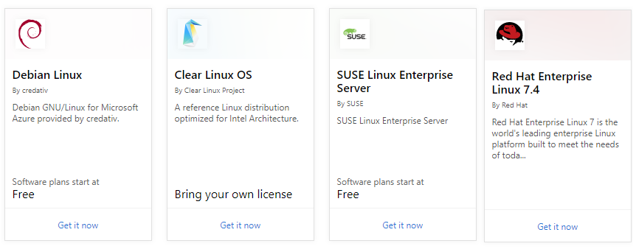
Linux Virtual Machines
Hundreds of community-built images in the Azure Marketplace
Linux has the same deployment options as for Windows VMs
Manage Linux VMs with many popular open-source DevOps tools
Notes:
How to use SSH keys with Windows on Azure - https://docs.microsoft.com/en-us/azure/virtual-machines/linux/ssh-from-windows
Linux Virtual Machines (Documentation) - https://docs.microsoft.com/en-us/azure/virtual-machines/linux/

Slide 19
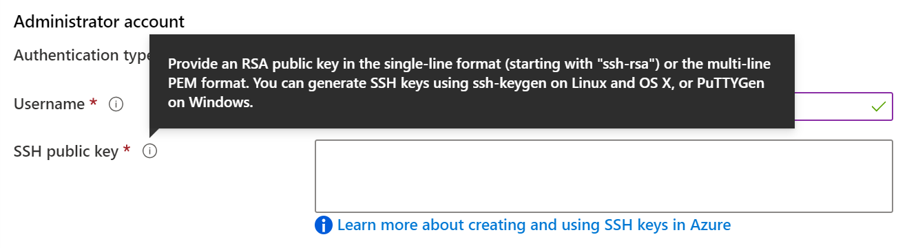
Linux VM Connections
Authenticate with a SSH public key or password
SSH is an encrypted connection protocol that allows secure logins over unsecured connections
There are public and private keys
Notes:
How to use SSH keys with Windows on Azure - https://docs.microsoft.com/en-us/azure/virtual-machines/linux/ssh-from-windows
How to create a Linux virtual machine with Azure Resource Manager templates - https://docs.microsoft.com/en-us/azure/virtual-machines/linux/create-ssh-secured-vm-from-template
✔️ Azure currently requires at least a 2048-bit key length and the SSH-RSA format for public and private keys.

Slide 20
Demonstration – Connect to Linux VMs
Create the SSH keys
Create the Linux machine and assign the public SSH key
Access the server using SSH
Notes:
✔ Always consider having students walk-through the demonstrations themselves. Also, consider the overlap with the formal labs and your best use of time.

Slide 21
Lesson 03: Virtual Machine Availability

Slide 22
Virtual Machine Availability Overview
Maintenance and Downtime
Scale Sets
Availability Sets
Implementing Scale Sets
Update and Fault Domains
Autoscale
Availability Zones
Implementing Autoscale
Scaling Concepts
Notes:
Deploy and manage Azure compute resources (25-30%)
Configure VMs for high availability and scalability
Configure high availability
Deploy and configure scale sets

Slide 23
Maintenance vs. Downtime
Unplanned Hardware Maintenance
Unexpected Downtime
Planned Maintenance
When the platform predicts a failure, it will issue an unplanned hardware maintenance event
Action: Live migration
Unexpected Downtime is when a virtual machine fails unexpectedly
Action: Automatically migrate (heal)
Planned Maintenance events are periodic updates made to the Azure platform
Action: No action
Notes:
Microsoft Azure Well-Architected Framework (Reliability) - https://docs.microsoft.com/en-us/learn/modules/azure-well-architected-reliability/
✔️ To reduce the impact of downtime due to one or more of these events, we recommend placing multiple virtual machines into an availability set (next topic).

Slide 24
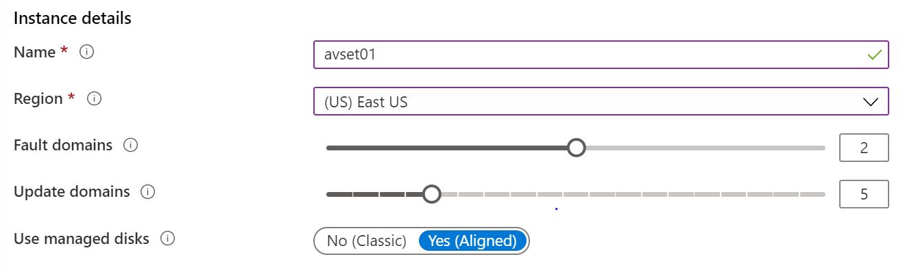
Availability Sets
Two or more instances in Availability Sets = 99.95% SLA
Configure multiple Virtual Machines in an Availability Set
Configure each application tier into separate Availability Sets
Combine a Load Balancer with Availability Sets
Use managed disks with the Virtual Machines
Notes:
Availability options for virtual machines in Azure - https://docs.microsoft.com/en-us/azure/virtual-machines/windows/availability
Configure multiple virtual machines in an availability set for redundancy - https://docs.microsoft.com/en-us/azure/virtual-machines/windows/manage-availability#:~:text=Availability%20sets%20are%20another%20datacenter,meets%20the%2099.95%25%20Azure%20SLA.
✔️ You can create a virtual machine and an availability set at the same time. A VM can only be added to an availability set when it is created. To change the availability set, you need to delete and then recreate the virtual machine.

Slide 25
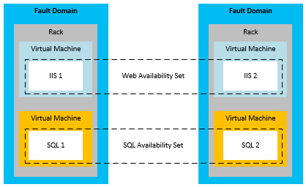
Update and Fault Domains
Update domains allows Azure to perform incremental or rolling upgrades across a deployment. During planned maintenance, only one update domain is rebooted at a time
Fault Domains are a group of Virtual Machines that share a common set of hardware, switches, that share a single point of failure. VMs in an availability set are placed in at least two fault domains
Notes:
✔️ Placing your Virtual Machines into an availability set does not protect your application from operating system or application-specific failures, it does limit the impact of potential physical hardware failures, network outages, or power interruptions. Can you see why this important and how this is implemented?

Slide 26
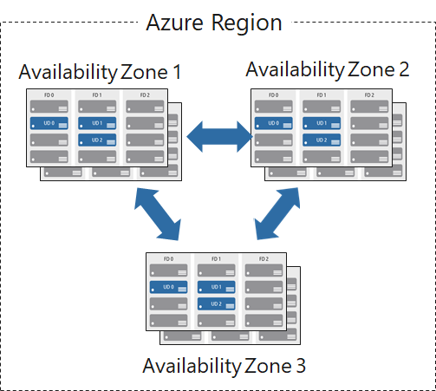
Availability Zones
Unique physical locations in a region
Includes datacenters with independent power, cooling, and networking
Protects from datacenter failures
Combines update and fault domains
Provides 99.99% SLA​
Notes:
Regions and Availability Zones in Azure - https://docs.microsoft.com/en-us/azure/availability-zones/az-overview

Slide 27
Scaling Concepts
Vertical scaling (scale up and scale down) is the process of increasing or decreasing power to a single instance of a workload; usually manual​
Horizontal scaling (scale out and scale in) is the process of increasing or decreasing the number of instances of a workload; frequently automated
Notes:
Autoscaling - https://docs.microsoft.com/en-us/azure/architecture/best-practices/auto-scaling

Slide 28
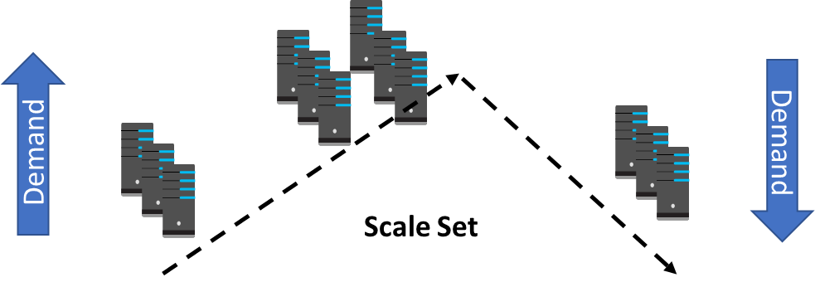
Scale Sets
Scale sets deploy a set of identical VMs
No pre-provisioning of VMs is required
As demand goes up VMs are added
As demand goes down VM are removed
The process can be manual, automated, or a combination of both
Notes:
What are virtual machine scale sets? - https://docs.microsoft.com/en-us/azure/virtual-machine-scale-sets/overview

Slide 29
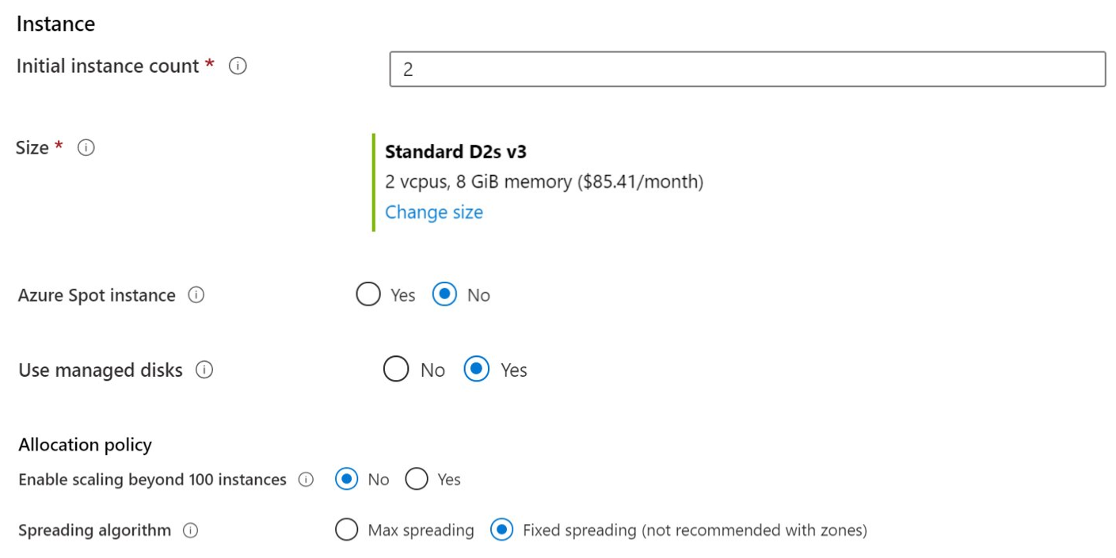
Implementing Scale Sets
Instance count. Number of VMs in the scale set (0 to 1000)
Instance size. The size of each virtual machine in the scale set
Azure Spot Instance. Unused capacity at a discounted rate
Use managed disks
Enable scaling beyond 100 instances
Notes:
QuickStart: Create a virtual machine scale set in the Azure portal - https://docs.microsoft.com/en-us/azure/virtual-machine-scale-sets/quick-create-portal

Slide 30
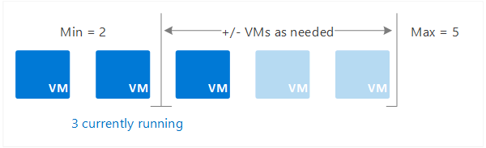
Autoscale
Define rules to automatically adjust capacity
Scale out (increase) the number of VMs in the set
Scale in (reduce) the number of VMs in the set
Schedule events to increase or decrease at a fixed time
Reduces monitoring and optimizes performance
Notes:
✔️ Autoscale minimizes the number of unnecessary VM instances that run your application when demand is low, while customers continue to receive an acceptable level of performance as demand grows and additional VM instances are automatically added.

Slide 31
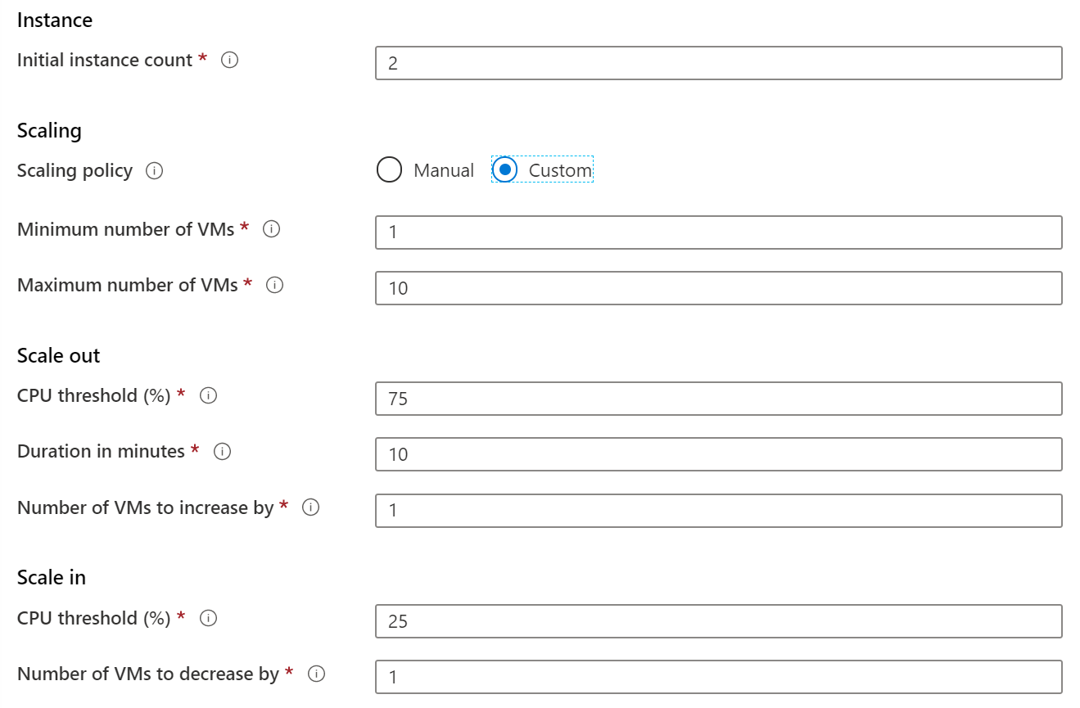
Implementing Autoscale
Define a minimum, maximum, and default number of VM instances
Create more advanced scale sets with scale out and scale in parameters
Notes:
Best Practices for Autoscale - https://docs.microsoft.com/en-us/azure/monitoring-and-diagnostics/insights-autoscale-best-practices

Slide 32
Lesson 04: Virtual Machine Extensions

Slide 33
Virtual Machine Extensions Overview
Virtual Machine Extensions
Custom Script Extensions
Desired State Configuration
Demonstration – Custom Script Extension
Notes:
Lesson overview

Slide 34
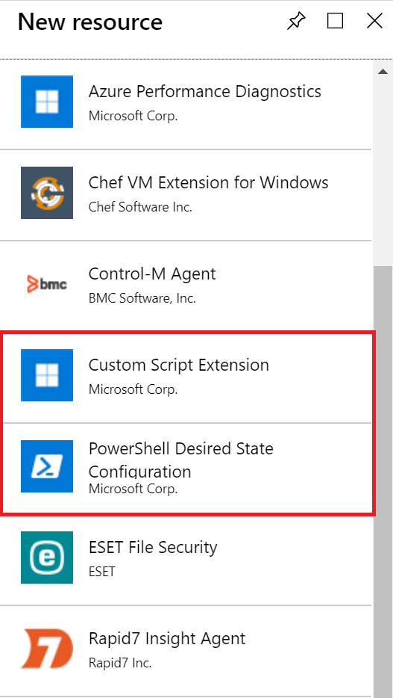
Virtual Machine Extensions
Extensions are small applications that provide post-deployment VM configuration and automation tasks
Managed with Azure CLI, PowerShell, Azure Resource Manager templates, and the Azure portal
Bundled with a new VM deployment or run against any existing system
Different for Windows and Linux machines
Notes:
Virtual machine extensions and features for Windows - https://docs.microsoft.com/en-us/azure/virtual-machines/extensions/features-windows?toc=%2Fazure%2Fvirtual-machines%2Fwindows%2Ftoc.json
Virtual machine extensions and features for Linux - https://docs.microsoft.com/en-us/azure/virtual-machines/extensions/features-linux

Slide 35
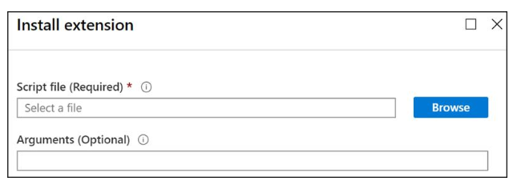
Custom Script Extensions
Extension scripts can be simple or complex
Extensions have 90 minutes to run
Double check dependencies to ensure availability
Account for any errors that might occur
Protect/encrypt sensitive information
Notes:
Custom Script Extension for Windows - https://docs.microsoft.com/en-us/azure/virtual-machines/extensions/custom-script-windows
Use the Azure Custom Script Extension Version 2 with Linux virtual machines - https://docs.microsoft.com/en-us/azure/virtual-machines/extensions/custom-script-linux
Protect your virtual machine settings with Azure Automation State Configuration (Learn) - https://docs.microsoft.com/learn/modules/protect-vm-settings-with-dsc/
✔ Can you think of any custom script extensions that you might want to create? For PowerShell use the Set-AzVmCustomScriptExtension command.

Slide 36
Desired State Configuration
configuration IISInstall
{
Node “localhost”
{
WindowsFeature IIS
{
Ensure = “Present”
Name = “Web-Server”
}
}
}
Configuration block(s) have a name
Node blocks define the computers or VMs that you are configuring
Resource block(s) configure the resource and its properties
There are many built-in configuration resources
Notes:
Introduction to the Azure Desired State Configuration extension handler - https://docs.microsoft.com/en-us/azure/virtual-machines/extensions/dsc-overview

Slide 37
Demonstration – Custom Script Extension
Verify the Web Server feature is available on a virtual machine
Create a PowerShell script file to install the Web Server
Configure an Extension in the Portal to run the script
Verify the Web Server feature was installed
Notes:
✔ Always consider having students walk-through the demonstrations themselves. Also, consider the overlap with the formal labs and your best use of time.

Slide 38
Lesson 05: Module 08 Lab and Review

Slide 39
Lab 08 – Manage Virtual Machines
Lab scenario
You are tasked with identifying different options for deploying and configuring Azure Virtual Machines
Objectives
Task 1: Deploy zone-resilient Virtual Machines in the Azure portal and with templates
Task 2: Configure Azure Virtual Machines by using virtual machine extensions
Task 3: Scale compute and storage for Azure Virtual Machines
Task 4: Deploy zone-resilient scale sets by using the Azure portal
Task 5: Configure Azure virtual machine scale sets by using extensions
Task 6: Scale compute and storage for Azure virtual machine scale sets
Next slide for an architecture diagram
Notes:
LAB 08 - Manage Virtual Machines - ESTIMATED DURATION 50 MIN
Lab Repository - https://microsoftlearning.github.io/AZ-104-MicrosoftAzureAdministrator/

Slide 40










Lab 08 – Architecture diagram
Task 1
Task 2
Task 3, Task 4, Task 5, Task 6, Task 7
az104-08-rg01
az104-08-rg02
az104-06-vnet01 10.80.0.0/20
az104-08-rg02-vnet 10.82.0.0/20
Subnet0 10.80.0.0/24
Subnet0 10.82.0.0/24
az10408rg01diag938
az104-08-vm0
10.80.0.4
az104-08-vm1
10.80.0.5
az10408vmss0
az10408vmss0-lb
Zone1
Zone2
scripts
az10408vmss0-nsg
az10408vmss0-ip
az104-08-install_IIS.ps1

Slide 41
Module Review
Module Review Questions
Microsoft Learn Modules (docs.microsoft.com/Learn)
Build a scalable application with virtual machine scale sets
Deploy Azure Virtual Machines from VHD templates
Choose the right disk storage for your virtual machine workload
Add and size disks in Azure Virtual Machines
Protect your virtual machine settings with Azure Automation State Configuration
Connect to virtual machines through the Azure portal by using Azure Bastion
Notes:
Learn - https://docs.microsoft.com/en-us/learn/browse

Slide 42
End of presentation

