Slide 1
AZ-104T00A Module 09: Serverless Computing

Slide 2
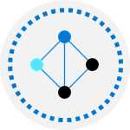
Module Overview
Lesson 01: Azure App Service Plans
Lesson 02: Azure App Services
Lesson 03: Container Services
Lesson 04: Azure Kubernetes Service
Lesson 05: Module 09 lab and review
Notes:
Module overview

Slide 3
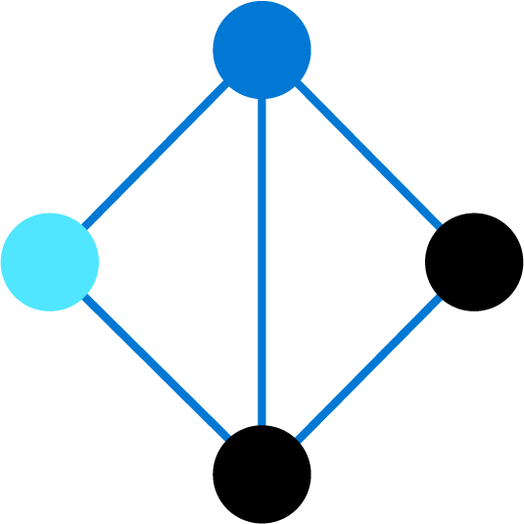
Lesson 01: Azure App Service Plans

Slide 4

Azure App Service Overview
Azure App Service Plans
App Service Plan Pricing Tiers
App Service Plan Scaling
App Service Plan Scale Out
Demonstration – Create an App Service Plan
Notes:
Deploy and manage Azure compute resources (25-30%)
Create and configure Web Apps
Create and configure App Service
Create and configure App Service Plans

Slide 5
Azure App Service Plans
Define a set of compute resources for a web app to run
Determines performance, price, and features
One or more apps can be configured to run in the same App Service plan
Region where compute resources will be created
Number of virtual machine instances
Size of virtual machine instances
Pricing tier (next slide)
Notes:
Azure App Service plan overview - https://docs.microsoft.com/en-us/azure/app-service/overview-hosting-plans

Slide 6
App Service Plan Pricing Tiers
Selected Features | Free | Shared (dev/test) | Basic (dedicated dev/test) | Standard (production workloads) | Premium (enhanced scale and performance) | Isolated (high-performance, security and isolation)
Web, mobile, or API apps | 10 | 100 | Unlimited | Unlimited | Unlimited | Unlimited
Disk space | 1 GB | 1 GB | 10 GB | 50 GB | 250 GB | 1 TB
Auto Scale | – | – | – | Supported | Supported | Supported
Deployment Slots | 0 | 0 | 0 | 5 | 20 | 20
Max Instances | – | – | Up to 3 | Up to 10 | Up to 30 | Up to 100
Shared compute (Free and Shared). Run apps on the same Azure VM as other App Service apps, and the resources cannot scale out
Dedicated compute (Basic, Standard, Premium). Run apps in the same plan in dedicated Azure VMs
Isolated. Runs apps on dedicated Azure VMs in dedicated Azure virtual networks
Notes:
App Service pricing - https://azure.microsoft.com/en-us/pricing/details/app-service/windows/

Slide 7
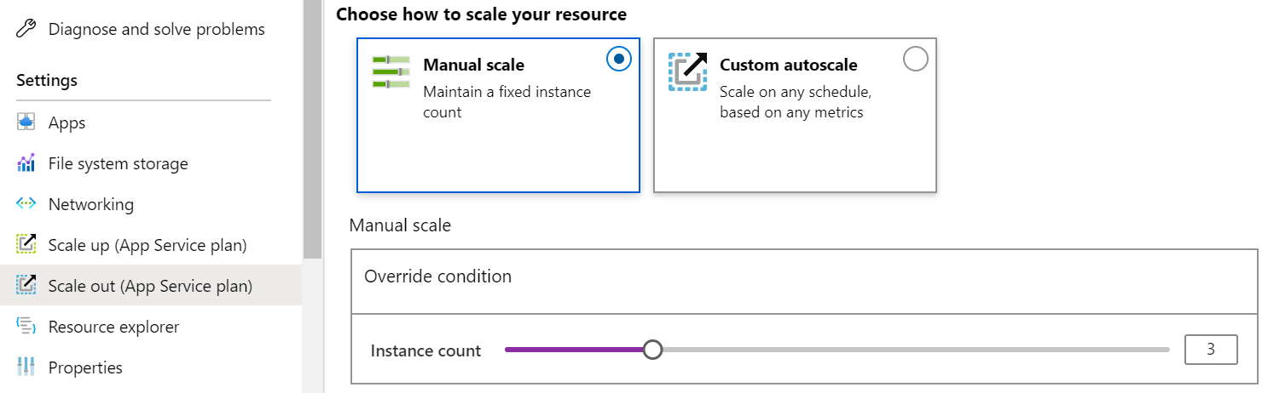
App Service Plan Scaling
Scale up (change the App Service plan):
More hardware (CPU, memory, disk)
More features (dedicated virtual machines, staging slots, autoscaling)
Scale out (increase the number of VM instances):
Manual (fixed number of instances)
Auto scale (based on predefined rules and schedules)
Notes:
Scale up an app in Azure App Service - https://docs.microsoft.com/en-us/azure/app-service/manage-scale-up

Slide 8
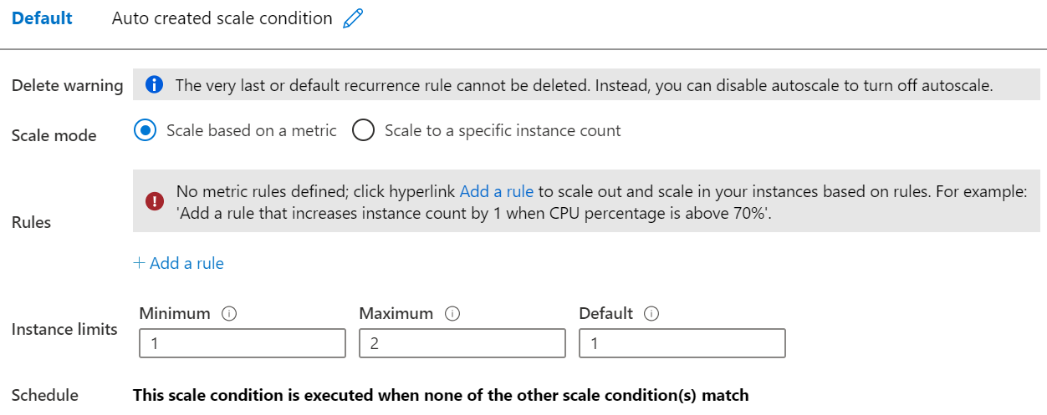
App Service Plan Scale Out
Adjust available resources based on the current demand
Improves availability and fault tolerance
Scale based on a metric (CPU percentage, memory percentage, HTTP requests)
Scale according to a schedule (weekdays, weekends, times, holidays)
Can implement multiple rules – combine metrics and schedules
Don’t forget to scale in
Notes:
Get started with Autoscale in Azure - https://docs.microsoft.com/en-us/azure/azure-monitor/platform/autoscale-get-started?toc=/azure/app-service/toc.json

Slide 9
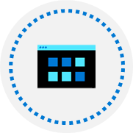
Demonstration – Create an App Service plan
Create an App Service Plan in the Azure Portal
Review Pricing Tiers
Configure Autoscaling
Notes:
✔ Always consider having students walk-through the demonstrations themselves. Also, consider the overlap with the formal labs and your best use of time.

Slide 10
Lesson 02: Azure App Services

Slide 11
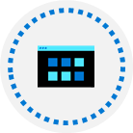


Managing App Services Overview
Azure App Service
Securing an App Service
Creating an App Service
Custom Domain Names
Continuous Deployment
Backup an App Service
Deployment Slots
Application Insights
Creating Deployment Slots
Demonstration –
Create an App Service
Notes:
Deploy and manage Azure compute resources (25-30%)
Create and configure Web Apps
Create and configure App Service
Create and configure App Service Plans

Slide 12
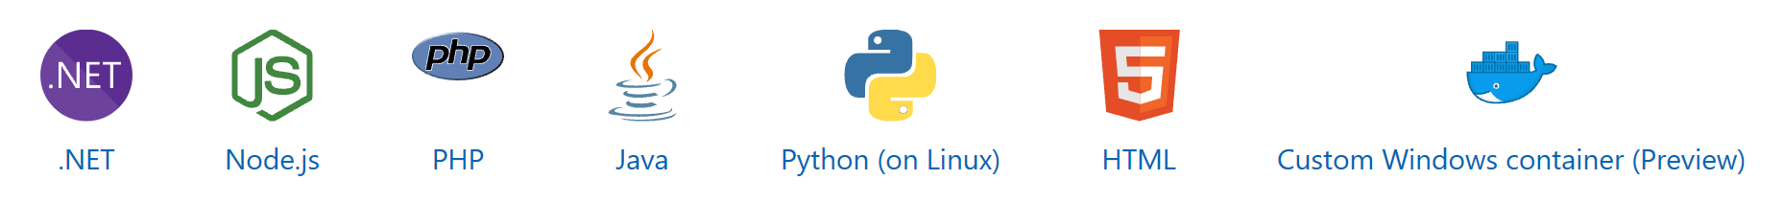
Azure App Service
Includes Web Apps API Apps, Mobile Apps, and Function apps
Fully managed environment enabling high productivity development
Platform-as-a-service (PaaS) offering for building and deploying highly available cloud apps for web and mobile
Platform handles infrastructure so developers focus on core web apps and services
Developer productivity using .NET, .NET Core, Java, Python and a host of others
Provides enterprise-grade security and compliance
Notes:
App Service - https://azure.microsoft.com/en-us/services/app-service/

Slide 13
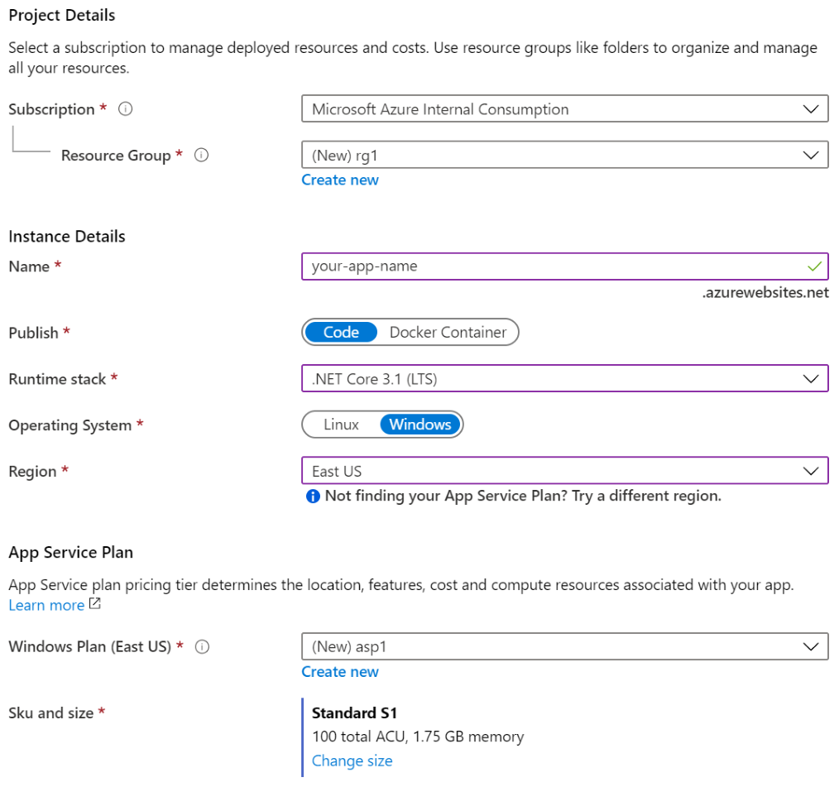
Creating an App Service
Name must be unique
Access using azurewebsites.net – can map to a custom domain
Publish Code (Runtime Stack)
Publish Docker Container
Linux or Windows
Region closest to your users
App Service Plan
Notes:
Manage an App Service plan in Azure - https://docs.microsoft.com/en-us/azure/app-service/app-service-plan-manage

Slide 14



Continuous Deployment
Work in a single source control
Continuous Deployment
Whenever code updates are pushed to the source control, then the website or web app will automatically pick up the updates
Developer 1
GitHub
A continuous deployment workflow publishes the most recent updates from a project
Website
Or similar single source control
Use the portal for continuous deployments from GitHub, Bitbucket, or Azure DevOps
Developer 2
Notes:
Continuous deployment - https://github.com/projectkudu/kudu/wiki/Continuous-deployment#setting-up-continuous-deployment-using-manual-steps

Slide 15


Deployment Slots
Service Plan | Slots
Free, Shared, Basic | 0
Standard | Up to 5
Premium | Up to 20
Isolated | Up to 20
Continuous Deployment with Stage Slot
Developer 1
GitHub
Swap
Staging
Production
Developer 2
Deploy to a different deployment slots (depends on service plan)
Validate changes before sending to production
Deployment slots are live apps with their own hostnames
Avoids a cold start – eliminates downtime
Fallback to a last known good site
Auto Swap when pre-swap validation is not needed
Notes:
Set up staging environments - https://docs.microsoft.com/en-us/azure/app-service/web-sites-staged-publishing?toc=%2Fazure%2Fapp-service%2Ftoc.json#add-a-deployment-slot
App Service Web App – block web access to non-production deployment slots - http://ruslany.net/2014/04/azure-web-sites-block-web-access-to-non-production-deployment-slots/
✔ Each App Service plan mode supports a different number of deployment slots. To find out the number of slots your app’s mode supports, see App Service Limits.

Slide 16
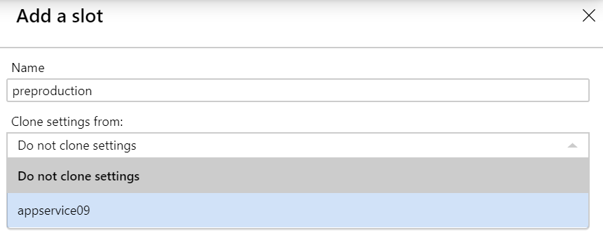
Creating Deployment Slots
A new slot can be empty or cloned
When you clone, pay attention to the settings:
Slot-specific app settings and connection strings
Continuous deployment settings
App Service authentication settings
Not all settings are sticky (endpoints, custom domain names, SSL certificates, scaling)
Review and edit your settings before swapping
Notes:
✔ You can configure app settings and connections to stick to a slot and not be swapped. This done in the App Settings blade. A developer can create new settings for the web app.

Slide 17
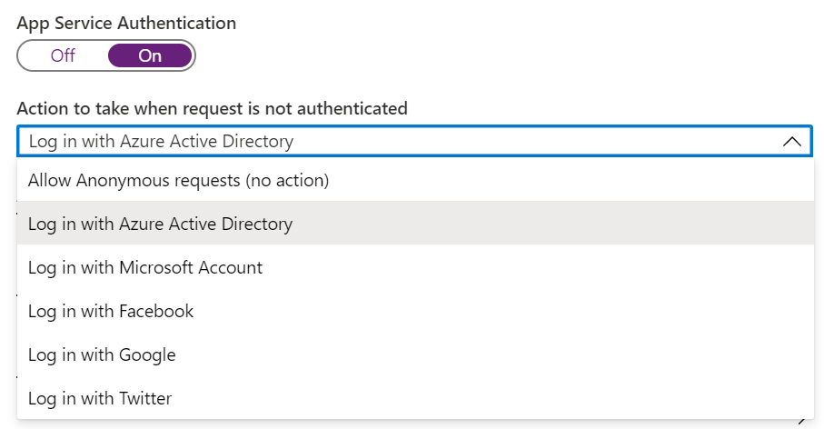
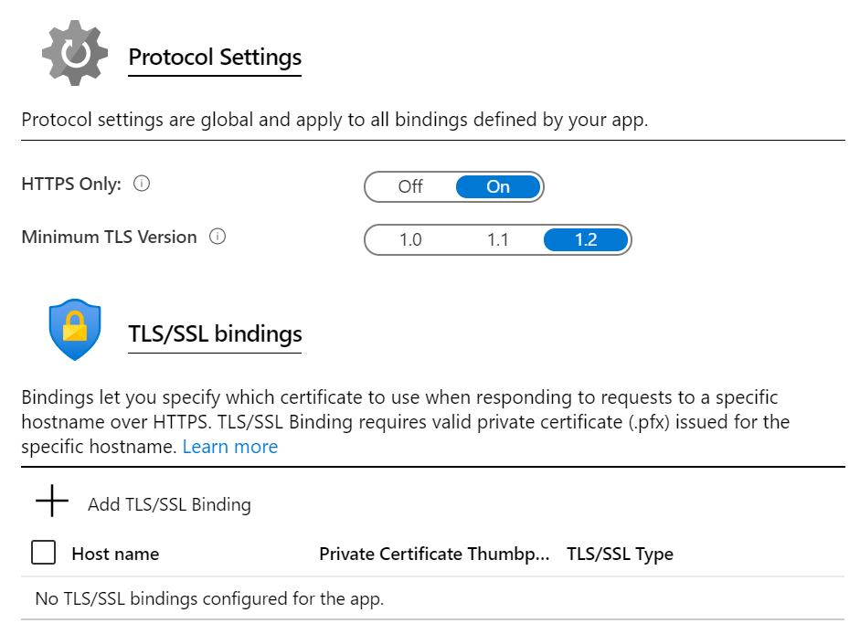
Securing an App Service
Authentication:
Enable authentication – default anonymous
Log in with a third-party identity provider
Security:
Troubleshoot with Diagnostic Logs – failed requests, app logging
Add an SSL certificate – HTTPS
Define a priority ordered allow/deny list to control network access to the app
Store secrets in the Azure Key Vault
Notes:
Security recommendations for App Service - https://docs.microsoft.com/en-us/azure/app-service/security-recommendations

Slide 18
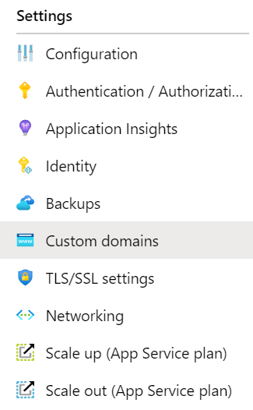
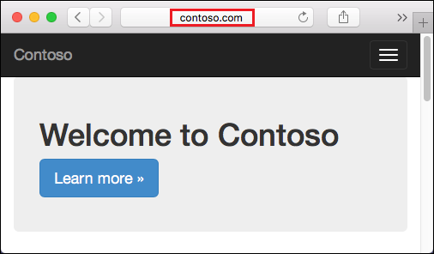
Custom Domain Names
Redirect the default web app URL
Validate the custom domain in Azure
Use the DNS registry for your domain provider – create a CNAME or A record with the mapping
Ensure App Service plan supports custom domains

Slide 19
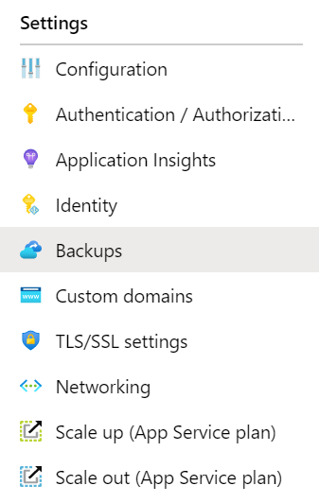
Backup an App Service
Create app backups manually or on a schedule
Backup the configuration, file content, and database connected to the app
Requires Standard or Premium plan
Backups can be up to 10 GB of app and database content
Configure partial backups and exclude items from the backup
Restore your app on-demand to a previous state, or create a new app
Notes:
Back up your App in Azure - https://docs.microsoft.com/en-us/azure/app-service/web-sites-backup
Configure partial backups - https://docs.microsoft.com/en-us/azure/app-service/web-sites-backup

Slide 20
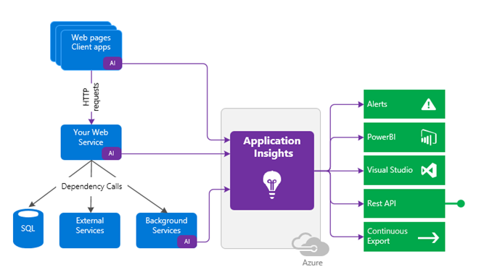
Application Insights
Request rates, deny rates, response time and failure rates
Page views and load performance
User and session counts
Performance counters
Diagnostics and Exceptions
Notes:
What is Application Insights? - https://docs.microsoft.com/en-us/azure/azure-monitor/app/app-insights-overview

Slide 21
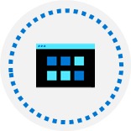
Demonstration – Create an app service
Create a Web App in the Azure Portal
Test the Web App
Configure Deployment Slots
Configure Backup
Notes:
✔ Always consider having students walk-through the demonstrations themselves. Also, consider the overlap with the formal labs and your best use of time.

Slide 22
Lesson 03: Container Services

Slide 23

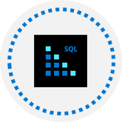
Container Services Overview
Containers vs. Virtual Machines
Azure Container Instances
Container Groups
Docker
Notes:
Deploy and manage Azure compute resources (25-30%)
Create and configure containers
Create and configure Azure Container Instances (ACI)

Slide 24
Containers vs Virtual Machines
Feature | Containers | Virtual Machines
Isolation | Typically provides lightweight isolation from the host and other containers but doesn’t provide as strong a security boundary as a virtual machine | Provides complete isolation from the host operating system and other VMs. This is useful when a strong security boundary is critical, such as hosting apps from competing companies on the same server or cluster
Operating system | Runs the user mode portion of an operating system and can be tailored to contain just the needed services for your app, using fewer system resources. | Runs a complete operating system including the kernel, thus requiring more system resources (CPU, memory, and storage)
Deployment | Deploy individual containers by using Docker via command line; deploy multiple containers by using an orchestrator such as Azure Kubernetes Service | Deploy individual VMs by using Windows Admin Center or Hyper-V Manager; deploy multiple VMs by using PowerShell or System Center Virtual Machine Manager
Persistent storage | Use Azure Disks for local storage for a single node, or Azure Files (SMB shares) for storage shared by multiple nodes or servers | Use a virtual hard disk (VHD) for local storage for a single VM, or an SMB file share for storage shared by multiple servers
Fault tolerance | If a cluster node fails, any containers running on it are rapidly recreated by the orchestrator on another cluster node | VMs can fail over to another server in a cluster, with the VM’s operating system restarting on the new server
Notes:
Containers vs. virtual machines - https://docs.microsoft.com/en-us/virtualization/windowscontainers/about/containers-vs-vm

Slide 25
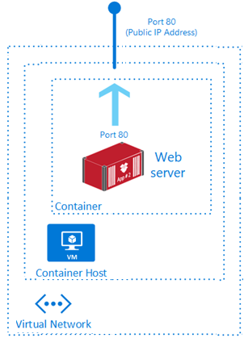
Azure Container Instances
PaaS Service
Fast startup times
Public IP connectivity and DNS name
Isolation features
Custom sizes
Persistent storage
Linux and Windows Containers
Co-scheduled Groups
Virtual network Deployment
Fastest way to run a container in Azure without provisioning a VM
Notes:
What is Azure Container Instances? - https://docs.microsoft.com/en-us/azure/container-instances/container-instances-overview

Slide 26
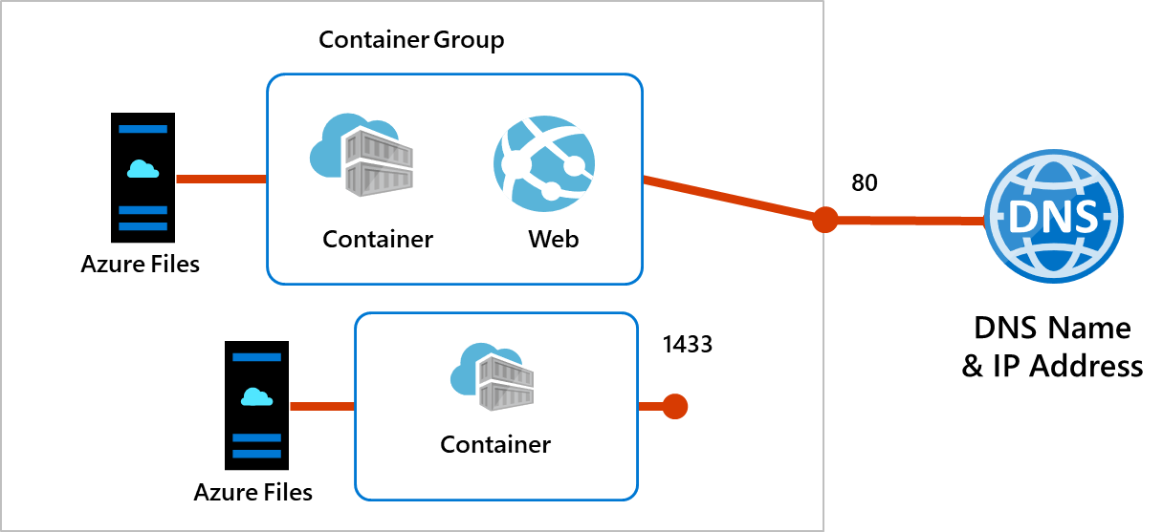
Container Groups
Top-level resource in Azure Container Instances
A collection of containers that get scheduled on the same host
The containers in the group share a lifecycle, resources, local network, and storage volumes
Notes:
Quickstart: Deploy a container instance in Azure using the Azure portal - https://docs.microsoft.com/en-us/azure/container-instances/container-instances-quickstart-portal

Slide 27
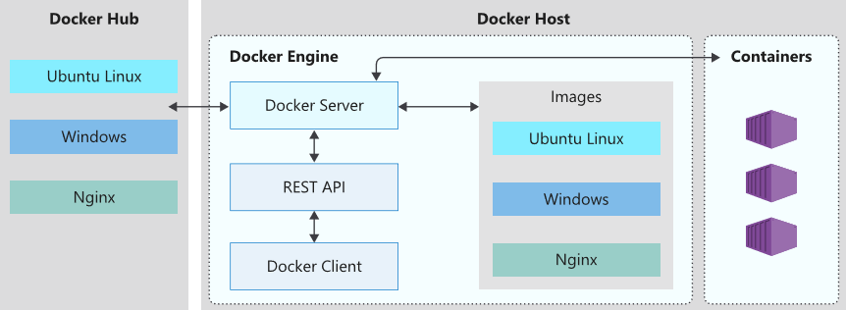
Docker
Enables developers to host applications within a container
A container is a standardized “unit of software“ that contains everything required for an application to run
Available on both Linux and Windows and can be hosted on Azure
Notes:
Docker on Azure - https://azure.microsoft.com/en-us/services/kubernetes-service/docker/

Slide 28
Lesson 04: Azure Kubernetes Service

Slide 29
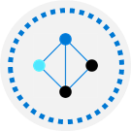
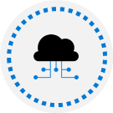

Azure Kubernetes Services Overview
Azure Kubernetes Services (AKS)
AKS and Azure Active Directory
AKS Terminology
AKS Scaling
AKS Clusters and Nodes
AKS Scaling to ACI
AKS Networking
Virtual Kubelet
AKS Storage
Demonstration – Deploy Azure Kubernetes Service
AKS Security
Notes:
Deploy and manage Azure compute resources (25-30%)
Create and configure containers
Create and configure Azure Kubernetes Service (AKS)

Slide 30
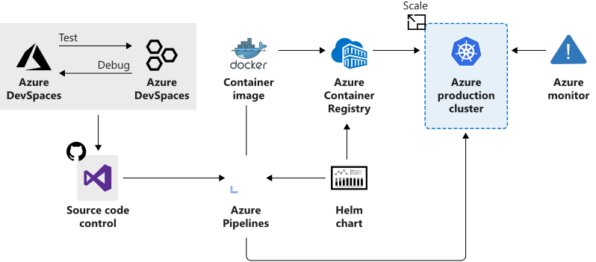
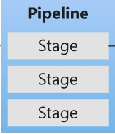
Azure Kubernetes Service
Manages health monitoring and maintenance
Performs simple cluster scaling
Enables nodes to be fully managed by Microsoft
You’re responsible only for managing the agent nodes
You pay only for the agent nodes
Notes:
What is Kubernetes - https://azure.microsoft.com/en-us/topic/what-is-kubernetes/

Slide 31
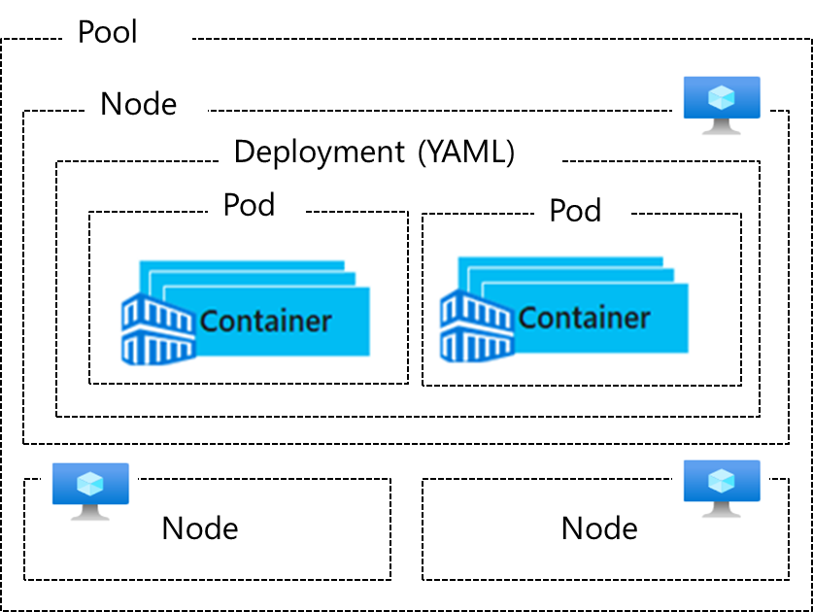
AKS Terminology
Term | Description
Pools | Groups of nodes with identical configurations
Nodes | Individual VM running containerized applications
Pods | Single instance of an application. A pod can contain multiple containers
Deployment | One or more identical pods managed by Kubernetes​
Manifest | YAML file describing a deployment
Notes:
Kubernetes core concepts for Azure Kubernetes Service (AKS) - https://docs.microsoft.com/en-us/azure/aks/concepts-clusters-workloads

Slide 32
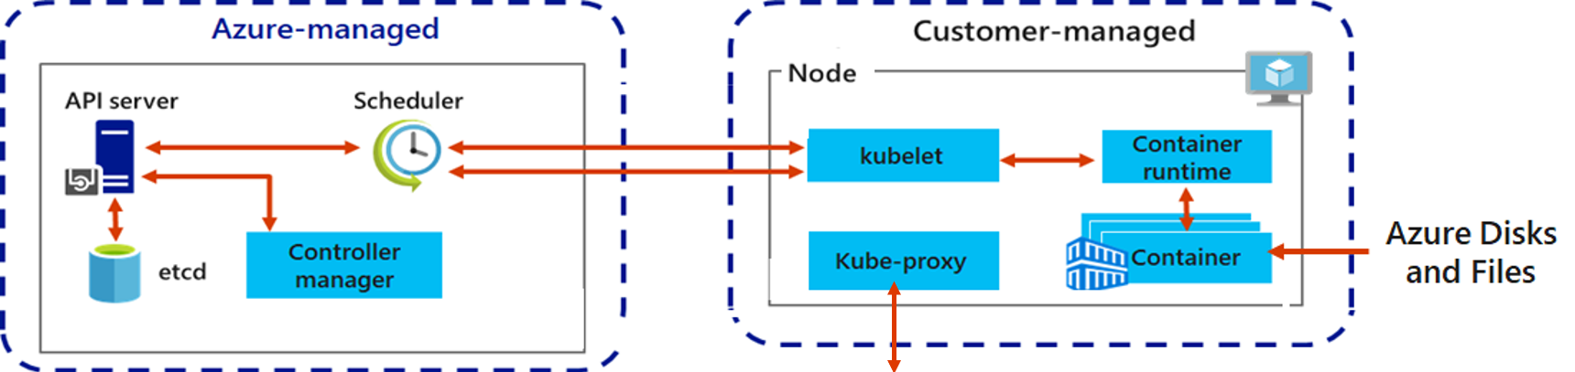
AKS Clusters and Nodes
Azure-managed node provides core Kubernetes services and orchestration
Customer-managed nodes run applications and supporting services
Each individual node is an Azure virtual machine
Notes:
Baseline architecture for an Azure Kubernetes Service (AKS) cluster - https://docs.microsoft.com/en-us/azure/architecture/reference-architectures/containers/aks/secure-baseline-aks

Slide 33
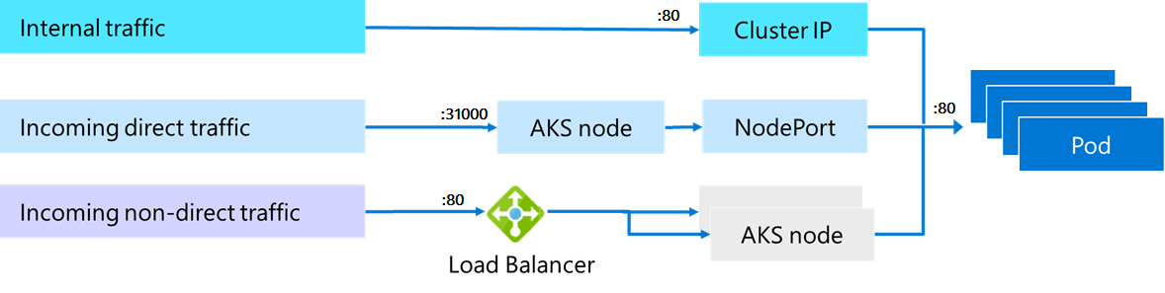
AKS Networking
Pods run an instance of your application
Services group pods together to provide network connectivity
Cluster IP provides internal traffic access
NodePort provides mapping for incoming direct traffic
Load balancer has external IP address for incoming non-direct traffic
Notes:
Network concepts for applications in Azure Kubernetes Service (AKS) - https://docs.microsoft.com/en-us/azure/aks/concepts-network

Slide 34
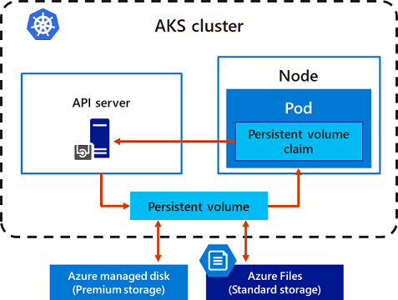
AKS Storage
Local storage on the node is fast and simple to use
Local storage might not be available after the pod is deleted
Multiple pods may share data volumes
Storage could potentially be reattached to another pod
Notes:
Storage options for applications in Azure Kubernetes Service (AKS) - https://docs.microsoft.com/en-us/azure/aks/concepts-storage

Slide 35
AKS Security
✓
Implement security across the entire AKS infrastructure
Managed service – Limit access with authorized IP ranges, create a private cluster, use RBAC and Azure AD access
Cluster upgrades – Upgrade the AKS cluster with cordon and drain
Node – Automatic OS security patches, Azure managed disks, pod security policies
Networks – Define ingress controllers with private internal IP addresses, filter the flow of traffic with network security groups
Data – Kubernetes secrets for credentials and keys
Notes:
Security concepts for applications and clusters in Azure Kubernetes Service (AKS) - https://docs.microsoft.com/en-us/azure/aks/concepts-security

Slide 36
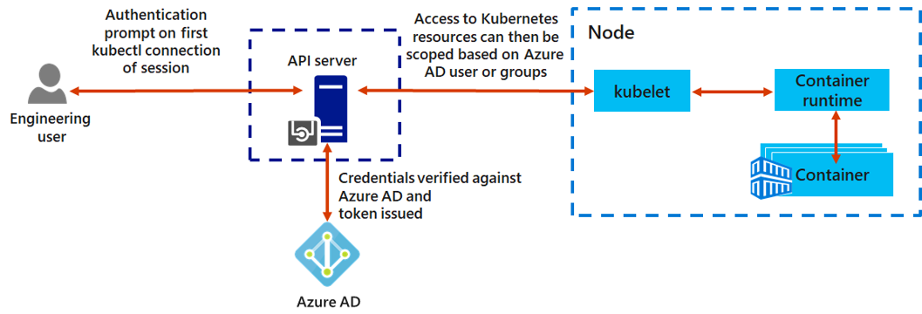
AKS and Azure Active Directory
Use Azure AD as an integrated identity solution
Use service accounts, user accounts, and role-based access control

Slide 37
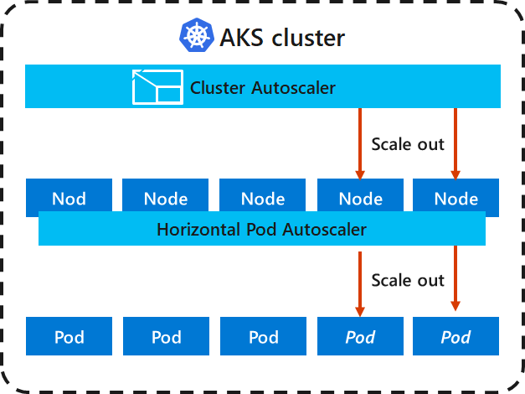
AKS Scaling
Applications might grow beyond the capacity of a single pod
Kubernetes has built-in autoscalers
Cluster autoscaler scales based on compute resources
Horizontal pod autoscaler scales based on metrics
Notes:
Scaling options for applications in Azure Kubernetes Service (AKS) - https://docs.microsoft.com/en-us/azure/aks/concepts-scale

Slide 38
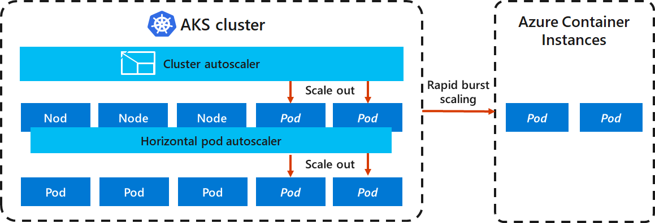
AKS Scaling to ACI
If you need to rapidly grow your AKS cluster, you can create new pods in Azure Container Instances

Slide 39
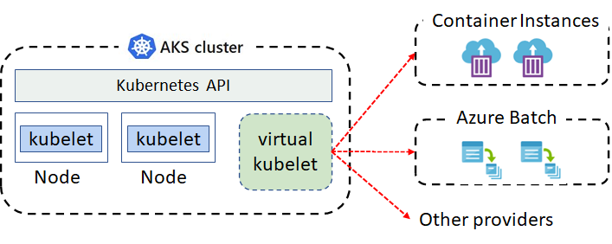
Virtual Kubelet
Virtual kubelet is an open-source Kubernetes kubelet implementation
The virtual kubelet registers itself as a node and allows developers to deploy pods and containers with their own APIs
Supported by an ecosystem of providers
Notes:
Virtual Kubelet Introduction - https://azure.microsoft.com/en-us/resources/videos/azure-friday-virtual-kubelet-introduction/

Slide 40
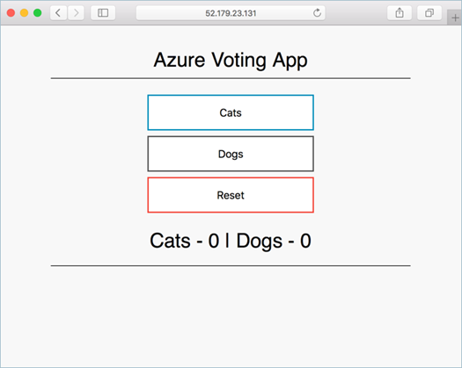
Demonstration – Deploy Azure Kubernetes Service
Create a Kubernetes service
Connect to the cluster
Test the applications
Notes:
QuickStart: Deploy an Azure Kubernetes Service (AKS) cluster using the Azure portal - https://docs.microsoft.com/en-us/azure/aks/kubernetes-walkthrough-portal
✔ Always consider having students walk-through the demonstrations themselves. Also, consider the overlap with the formal labs and your best use of time.

Slide 41
Lesson 06: Module Labs and Review

Slide 42
Lab 09a – Implement web apps
Lab scenario
You need to evaluate the use of Azure Web apps for hosting Contoso’s web sites, hosted currently in the company’s on-premises data centers. The web sites are running on Windows servers using PHP runtime stack. You also need to determine how you can implement DevOps practices by leveraging Azure web apps deployment slots
Objectives
Task 1: Create an Azure web app
Task 2: Create a staging deployment slot
Task 3: Configure web app deployment settings
Task 4: Deploy code to the staging deployment slot
Task 5: Swap the staging slots
Task 6: Configure and test autoscaling of the Azure web app
Next slide for an architecture diagram
Notes:
LAB 09a - Implement Web Apps - ESTIMATED DURATION 30 MIN
Lab Repository - https://microsoftlearning.github.io/AZ-104-MicrosoftAzureAdministrator/

Slide 43








Lab 09a – Architecture diagram
Task 1
az104-09a-rg1
AppService
AppServiceplan
Production slot
Task 6
Task 5
Swap the staging slot
Autoscale rule
Task 2
Staging slot
Task 4
Task 3
php-docs-hello-world
code
Local git
php-docs-hello-world
code

Slide 44
Lab 09b – Implement Azure Container Instances
Lab scenario
Contoso wants to find a new platform for its virtualized workloads. You identified several container images that can be leveraged to accomplish this objective. Since you want to minimize container management, you plan to evaluate the use of Azure Container Instances for deployment of Docker images
Objectives
Task 1: Deploy a Docker image by using the Azure Container Instance
Task 2: Review the functionality of the Azure Container Instance
Next slide for an architecture diagram
Notes:
LAB 09b - Implement Azure Container Instances - ESTIMATED DURATION 20 MIN
Lab Repository - https://microsoftlearning.github.io/AZ-104-MicrosoftAzureAdministrator/

Slide 45


Lab 09b – Architecture diagram
Task 1
Task 2
az104-09b-rg1
az104-9b-c1

Slide 46
Lab 09c – Implement Azure Kubernetes service
Lab scenario
Contoso has several multi-tier applications that are not suitable to run by using Azure Container Instances. To determine whether they can be run as containerized workloads, you want to evaluate using Kubernetes as the container orchestrator. To minimize management overhead, you want to test Azure Kubernetes Service, including its simplified deployment experience and scaling
Objectives
Task 1: Deploy an Azure Kubernetes Service cluster
Task 2: Deploy pods into the Azure Kubernetes Service cluster
Task 3: Scale containerized workloads in the Azure Kubernetes service cluster
Next slide for an architecture diagram
Notes:
LAB 09c - Implement Azure Kubernetes Service - ESTIMATED DURATION 40 MIN
Lab Repository - https://microsoftlearning.github.io/AZ-104-MicrosoftAzureAdministrator/

Slide 47









Lab 09c – Architecture diagram
Task 2
az104-09c-rg1
MC_az104-09c-rg1_az104-09c-aks1_region
az104-09c-aks1
Public IP address
Route table
Task 1
CloudShell
Task 3
Kubernetes Load Balancer
NSG
Register the Microsoft.Kubernetes and
Microsoft.KubernetesConfiguration resource providers
Ngnix pod
Task 4
Node Scale Set
AKS Vnet
…
Ngnix pod scale
Node
Node scale

Slide 48
Module Review
Module Review Questions
Microsoft Learn Modules (docs.microsoft.com/Learn)
Host a web application with Azure App service
Stage a web app deployment for testing and rollback by using App Service deployment slots
Scale an App Service web app to efficiently meet demand with App Service scale up and scale out
Dynamically meet changing web app performance requirements with autoscale rules
Capture and view page load times in your Azure web app with Application Insights
Build a containerized web application with Docker
Run Docker containers with Azure Container Instances
Introduction to the Azure Kubernetes Service
Notes:
Learn - https://docs.microsoft.com/en-us/learn/browse

Slide 49
End of presentation

