Slide 1
AZ-104T00A Module 10: Data Protection

Slide 2
Module Overview
Lesson 01: File and Folder Backups
Lesson 02: Virtual Machine Backups
Lesson 03: Module 10 Lab and Review
Notes:
Module overview

Slide 3
Lesson 01: File and Folder Backups

Slide 4
File and Folder Backups Overview
Azure Backup
Recovery Service Vault Backup Options
Demonstration – Backup Azure File Shares
Implementing On-premises File and Folder Backups
Microsoft Azure Recovery Services Agent
Demonstration – Backup Files and Folders
Notes:
Monitor and back up Azure resources (10-15%)
Implement backup and recovery
Configure Azure Backup reports
Perform backup and restore operations using the Azure Backup service
Create a recovery services vault
Create and configure backup policy
Perform site-to-site recovery using ASR

Slide 5
Azure Backup
Azure-based service used to back up and restore data in Microsoft cloud
Automatic Storage Management
Multiple storage options
Unlimited data transfer
Data encryption
Application consistent backup
Long-term retention
Notes:
Why use Azure Backup? - https://docs.microsoft.com/en-us/azure/backup/backup-introduction-to-azure-backup#why-use-azure-backup
✔️ What are some of the reasons your organization might choose Azure Backup?

Slide 6
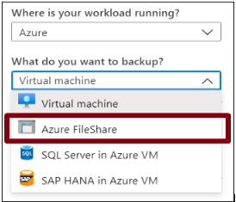
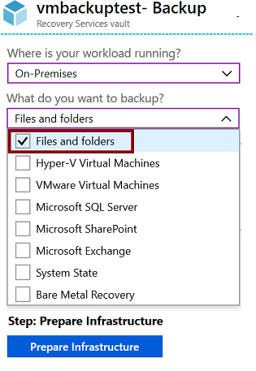
Recovery Services Vault Backup Options
Azure Workloads
On-Premises Workloads
Notes:
Recovery Services vaults overview - https://docs.microsoft.com/en-us/azure/backup/backup-azure-recovery-services-vault-overview
Create a Recovery Services vault - https://docs.microsoft.com/en-us/azure/backup/backup-create-rs-vault
Soft delete for virtual machines - https://docs.microsoft.com/en-us/azure/backup/soft-delete-virtual-machines

Slide 7
Demonstration – Backup Azure file shares
Configure a storage account with file share
Create a Recovery Services vault
Configure file share backup
Verify the file share backup
Notes:
✔ Always consider having students walk-through the demonstrations themselves. Also, consider the overlap with the formal labs and your best use of time.

Slide 8
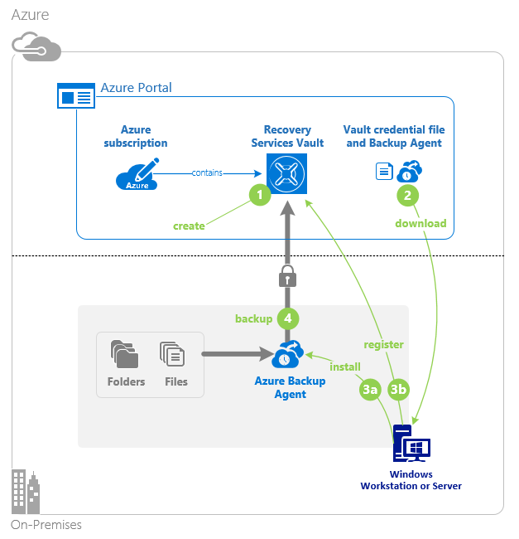
Implementing On-premises File and Folder Backup
Create the recovery services vault
Download the agent and credential file
Install and register agent
Configure the backup
Notes:
About Azure file share backup - https://docs.microsoft.com/en-us/azure/backup/azure-file-share-backup-overview
Back up Azure file shares - https://docs.microsoft.com/en-us/azure/backup/backup-afs

Slide 9
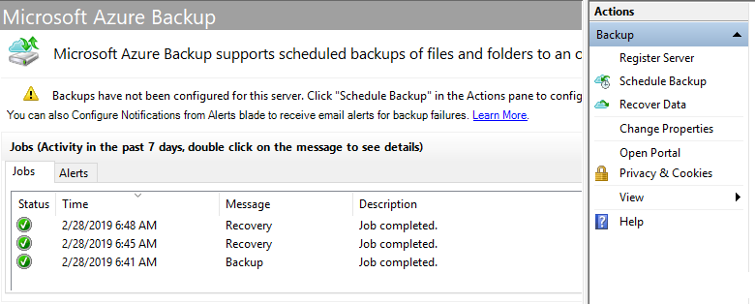
Microsoft Azure Recovery Services Agent
Backup or recover files and folders on physical or virtual Windows OS (VMs can be on-premises or in Azure)
No separate backup server required
Not application aware; file, folder, and volume-level restore only
No support for Linux
Notes:
Back up Windows Server files and folders to Azure -https://docs.microsoft.com/en-us/azure/backup/backup-windows-with-mars-agent

Slide 10
Demonstration – Backup files and folders
Create a Recovery Services vault
Backup files and folders
Configure the vault
Explore the recover settings
Install and register the agent
Explore the backup properties
Create the backup policy
Delete your backup schedule
Notes:
✔ Always consider having students walk-through the demonstrations themselves. Also, consider the overlap with the formal labs and your best use of time.

Slide 11
Lesson 02: Virtual Machine Backups

Slide 12



Virtual machine backups overview
Virtual Machine Data Protection​
Workload Protection Needs​
Virtual Machine Snapshots​
Recovery Services Vault VM Backup Options​
Implementing VM Backups​
Implementing VM Restore​
Azure Backup Server​
Backup Component Comparison​
Soft Delete​
Azure Site Recovery
Azure to Azure Architecture​
Notes:
Monitor and back up Azure resources (10-15%)
Implement backup and recovery
Configure Azure Backup reports
Perform backup and restore operations using the Azure Backup service
Create a recovery services vault
Create and configure backup policy
Perform site-to-site recovery using ASR

Slide 13
Virtual Machine Data Protection
Snapshots
Azure backup
Azure Site Recovery
Managed snapshots provide a quick and simple option for backing up VMs that use Managed Disks
Azure Backup supports application-consistent backups for both Windows and Linux VMs
Azure Site Recovery protects your VMs from a major disaster scenario when a whole region experiences an outage
Notes:
An overview of Azure VM backup - https://docs.microsoft.com/en-us/azure/backup/backup-azure-vms-introduction
✔️ Have you tried any of these backup methods? Do you have a backup plan?

Slide 14
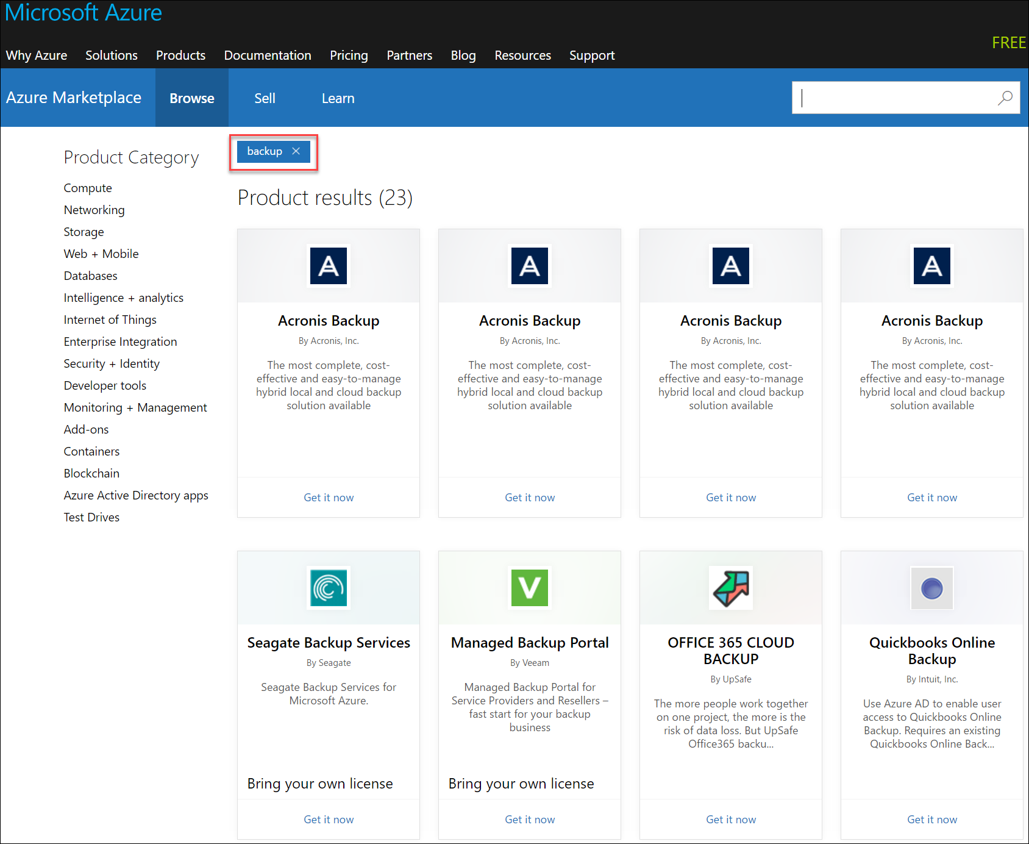
Workload Protection Needs
Many backup options are available
How the workload is being protected today?
How often is the workload is backed up?
What types of backups are being done?
Is disaster recovery protection in place?

Slide 15
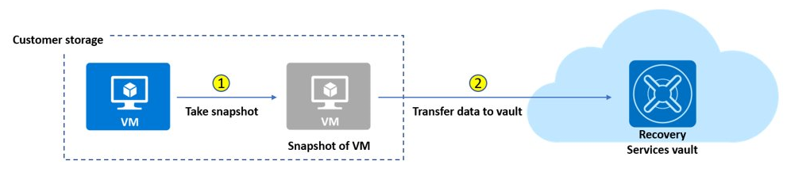
Virtual Machine Snapshots
Use snapshots taken as part of a backup job
Reduces recovery wait times – don’t wait for data transfer to the vault to finish
Configure Instant Restore retention (1 to 5 days)
Notes:
Create a snapshot - https://docs.microsoft.com/en-us/azure/virtual-machines/windows/snapshot-copy-managed-disk

Slide 16
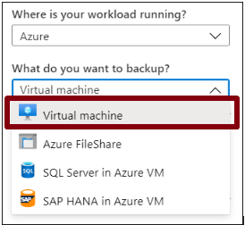
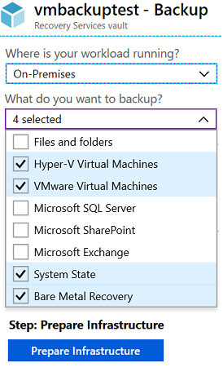

Recovery Services Vault VM Backup Options
Azure Workloads
On-Premises Workloads
Multiple servers can be protected using the same Recovery Services vault

Slide 17
Implementing VM Backups
Create a recovery services vault
Use the Portal to define the backup
Backup the virtual machine
1
2
3
Use a Recovery Services Vault in the region where you are performing your Virtual Machine backups and choose a replication strategy for Vault
Take snapshots (recovery points) of your data at defined intervals. These snapshots are stored in recovery services vaults
For the Backup extension to work, the Azure VM Agent must be installed on the Azure virtual machine
Notes:
Plan your VM backup infrastructure in Azure - https://docs.microsoft.com/en-us/azure/backup/backup-azure-vms-introduction
Tutorial: Back up and restore files for Windows virtual machines in Azure - https://docs.microsoft.com/en-us/azure/virtual-machines/windows/tutorial-backup-vms

Slide 18
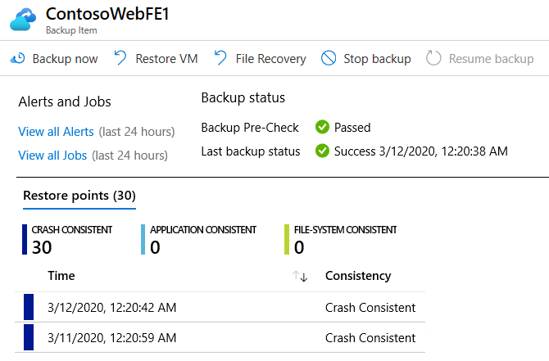
Implementing VM Restore
Once you trigger the restore operation, the Backup service creates a job for tracking the restore operation
The Backup service also creates and temporarily displays notifications, so you monitor how the backup is proceeding

Slide 19
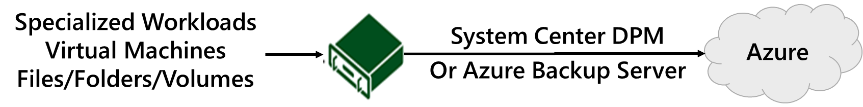
Azure Backup Server
App-aware backups, file/folder/volume backups, and machine state backups (bare-metal, system state)
Each machine runs the DPM/MABS protection agent, and the MARS agent runs on the MABS/DPM
Flexibility and granular scheduling options
Manage backups for multiple machines in a protection group

Slide 20
Backup Component Comparison
Component | Benefits | Limits | Protects | Backup Storage
Azure Backup (MARS) agent | Backup files and folders on physical or virtual Windows OS No separate backup server required | Backup 3x per day Not application aware File, folder, and volume-level restore only No support for Linux | Files Folders | Recovery services vault
Azure Backup Server (MABS) | App aware snapshots Full flex for when to backups Recovery granularity Linux support on Hyper-V and VMware VMs Backup and restore VMware VMs Doesn’t require a System Center license | Cannot backup Oracle workloads Always requires live Azure subscription No support for tape backup | Files Folders Volumes VMs Applications Workloads | Recovery services vault Locally attached disk

Slide 21
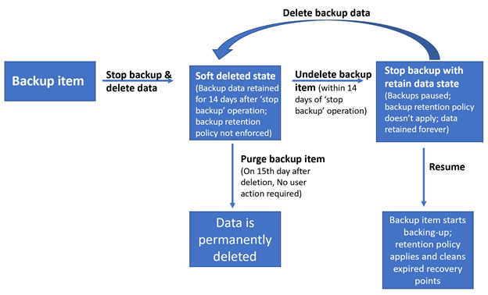
Soft Delete
Backup data is retained for 14 additional days
Recover soft deleted backup items using an ‘Undelete’ operation
Natively built-in for all the recovery services vaults
Notes:
Soft delete for virtual machines in Azure Backup - https://azure.microsoft.com/en-us/updates/soft-delete-virtual-machine-backup/

Slide 22
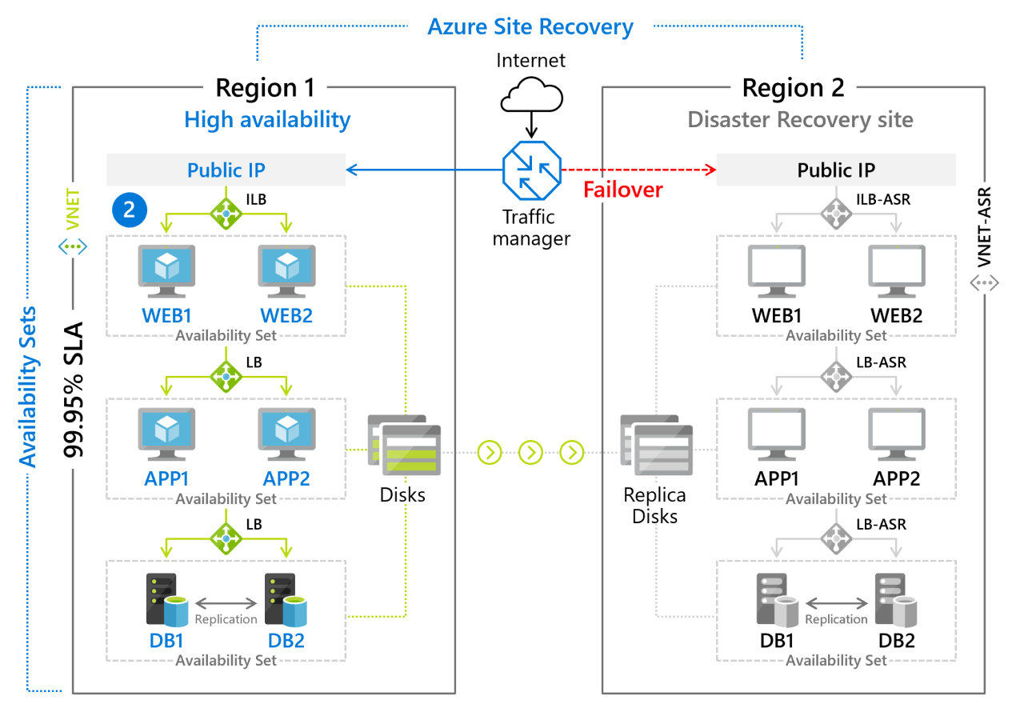
Azure Site Recovery
Replicate Azure VMs from one Azure region to another
Replicate on-premises VMware VMs, Hyper-V VMs, physical servers (Windows and Linux), Azure Stack VMs to Azure
Replicate AWS Windows instances to Azure
Replicate on-premises VMware VMs, Hyper-V VMs managed by System Center VMM, and physical servers to a secondary site
Notes:
Azure Site Recovery documentation - https://docs.microsoft.com/en-us/azure/site-recovery/
Concentrate on replication within Azure and not migration scenarios from on-premises.
Note: Physical servers replicated to Azure using Site Recovery can only fail back as VMware VMs. You need a VMware infrastructure in order to fail back. https://docs.microsoft.com/en-us/azure/site-recovery/physical-to-azure-failover-failback#prepare-for-reprotection-and-failback

Slide 23
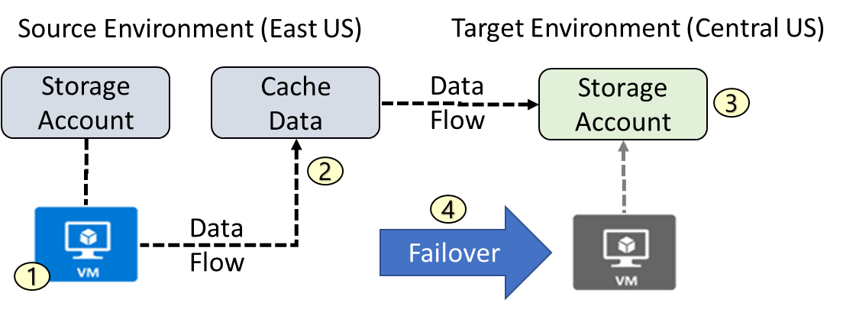
Azure to Azure Architecture
VM is registered with Azure Site Recovery
Data is continuously replicated to cache
Cache is replicated to the target storage account
During failover the virtual machine is added to the target environment

Slide 24
Lesson 03: Module 10 Lab and Review

Slide 25
Lab 10 – Backup virtual machines
Lab scenario
You have been tasked with evaluating the use of Azure Recovery Services for backup and restore of files hosted on Azure virtual machines and on-premises computers. In addition, you want to identify methods of protecting data stored in the Recovery Services vault from accidental or malicious data loss
Objectives
Task 1: Provision the lab environment
Task 2: Create a Recovery Services vault
Task 3: Implement Azure virtual machine-level backup
Task 4: Implement File and Folder backup
Task 5: Perform file recovery by using Azure Recovery Services agent
Task 6: Perform file recovery by using Azure virtual machine snapshots
Task 7: Review the Azure Recovery Services soft delete functionality
Next slide for an architecture diagram
Notes:
LAB 10 - Implement Data Protection - ESTIMATED DURATION 50 MIN
Lab Repository - https://microsoftlearning.github.io/AZ-104-MicrosoftAzureAdministrator/

Slide 26





Lab 10 – Architecture diagram
Task 1
Task 2
az104-10-rg0
az104-10-rg1
az104-10-vnet 10.0.0.0/24
Task 7
Subnet0 10.0.0.0/26
az104-10-rsv1
Task 3: Backup VM
Task 6: Recover File
az104-10-vm0
10.0.0.4
az104-10-vm0 Backup
Task 4: Backup File
Task 5: Recover File
az104-10-vm1
10.0.0.5
File Backup from az104-10-vm1
C:\Windows\System32\drivers\etc\hosts

Slide 27
Module Review
Module Review Questions
Microsoft Learn Modules (docs.microsoft.com/Learn)
Protect your virtual machines by using Azure Backup
Back up and restore your Azure SQL database
Protect your Azure infrastructure with Azure Site Recovery
Protect your on-premises infrastructure from disasters with Azure Site Recovery
Notes:
Learn - https://docs.microsoft.com/en-us/learn/browse

Slide 28
End of presentation

