Slide 1
AZ-104T00A Module 11: Monitoring

Slide 2

Module Overview
Lesson 01: Azure Monitor
Lesson 02: Azure Alerts
Lesson 03: Log Analytics
Lesson 04: Network Watcher
Lesson 05: Module 11 Lab and Review
Notes:
Module overview

Slide 3

Lesson 01: Azure Monitor

Slide 4





Azure Monitor Overview
Azure Monitor Service
Data Types
Key Capabilities
Activity Log
Monitoring Data Platform
Query the Activity Log
Log Data
Notes:
Monitor and back up Azure resources (10-15%)
Monitor resources by using Azure Monitor
Configure and interpret metrics
Configure Log Analytics
Query and analyze logs
Set up alerts and actions
Configure Application Insights

Slide 5
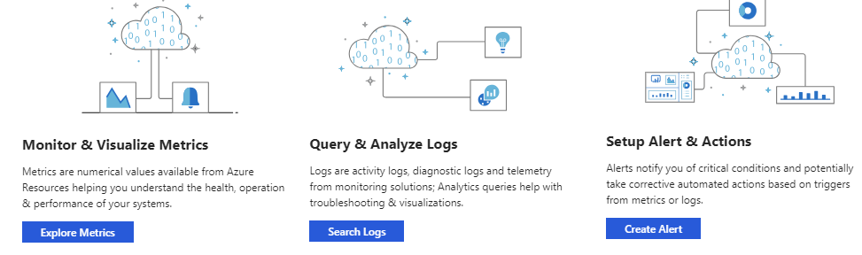
Key Capabilities
Core monitoring for Azure services
Collects metrics, activity logs, and diagnostic logs
Use for time critical alerts and notifications

Slide 6
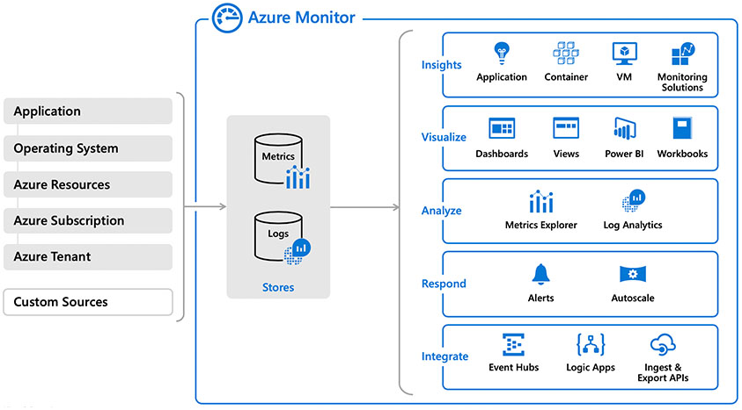
Azure Monitor Service
Notes:
What is Azure Monitor - https://docs.microsoft.com/en-us/azure/azure-monitor/overview

Slide 7
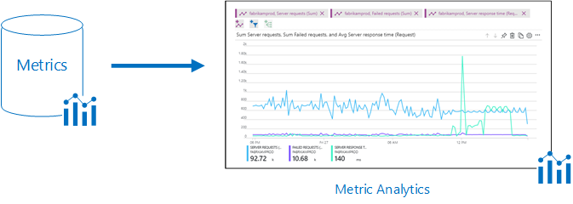
Monitoring Data Platform
Metrics are numerical values that describe some aspect of a system at a point in time. They are lightweight and capable of supporting near real-time scenarios
Logs contain different kinds of data organized into records with different sets of properties for each type. Telemetry such as events and traces are stored as logs in addition to performance data so that it can all be combined for analysis
Notes:
Quickstart: Monitor an Azure resource with Azure Monitor - https://docs.microsoft.com/en-us/azure/azure-monitor/learn/quick-monitor-azure-resource
Tutorial: Create a metrics chart in Azure Monitor - https://docs.microsoft.com/en-us/azure/azure-monitor/learn/tutorial-metrics-explorer

Slide 8
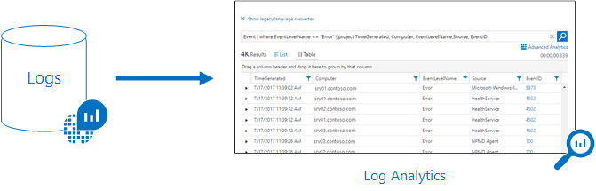
Log Data
Log data is stored in Log Analytics which includes a rich query language to quickly retrieve, consolidate, and analyze collected data
The Data Explorer query language that is suitable for simple log queries but also includes advanced functionality such as aggregations, joins, and smart analytics
Notes:
Tutorial: Collect and analyze resource logs from an Azure resource - https://docs.microsoft.com/en-us/azure/azure-monitor/learn/tutorial-resource-logs

Slide 9



Data Types
Application monitoring data – Performance and functionality of the code you have written, regardless of its platform
Guest OS monitoring – Azure, another cloud, or on-premises
Azure resource monitoring
Azure subscription monitoring – Operation and management of an Azure subscription, as well as data about the health and operation of Azure itself
Azure tenant monitoring – Operation of tenant-level Azure services, such as Azure Active Directory
Notes:
Sources of monitoring data for Azure Monitor - https://docs.microsoft.com/en-us/azure/azure-monitor/platform/data-sources

Slide 10
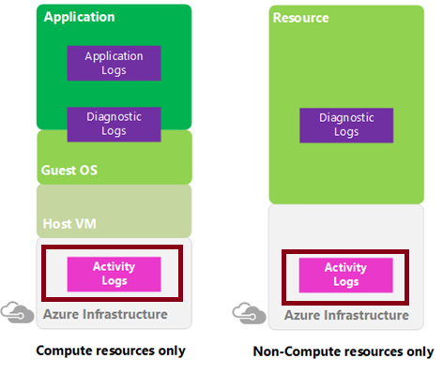
Activity Log
Send data to Log Analytics for advanced search and alerts
Query or manage events in the Portal, PowerShell, CLI, and REST API
Stream information to Event Hub
Archive data to a storage account
Analyze data with Power BI
Notes:
Azure Activity log - https://docs.microsoft.com/en-us/azure/azure-monitor/platform/activity-log
Send Azure Activity log to Log Analytics workspace using Azure portal - https://docs.microsoft.com/en-us/azure/azure-monitor/learn/quick-collect-activity-log-portal

Slide 11
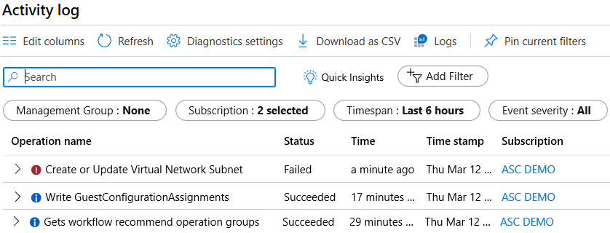
Query the Activity Log
Filter by Management group, Subscription, Timespan, and Event Severity
Add a filter, like Event Category (Security, Recommendations, Alerts)
Pin current filters and download as CSV
Notes:
Query the Activity Log in the Azure portal - https://docs.microsoft.com/en-us/azure/monitoring-and-diagnostics/monitoring-overview-activity-logs#query-the-activity-log-in-the-azure-portal

Slide 12
Lesson 02: Azure Alerts

Slide 13

Azure Alerts Overview
Azure Monitor Alerts
Creating Alert Rules
Action Groups
Demonstration – Alerts
Notes:
Monitor and back up Azure resources (10-15%)
Monitor resources by using Azure Monitor
Configure and interpret metrics
Configure Log Analytics
Query and analyze logs
Set up alerts and actions
Configure Application Insights

Slide 14
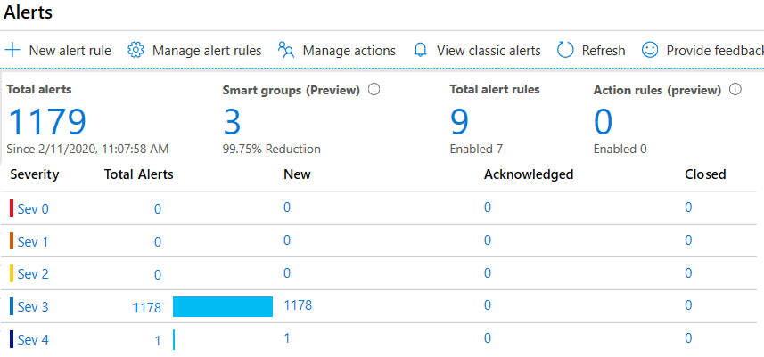
Azure Monitor Alerts
Unified authoring experience
Displayed by severity
Categorized by New, Acknowledged, and Closed
Notes:
The new alerts experience in Azure Monitor - https://docs.microsoft.com/en-us/azure/monitoring-and-diagnostics/monitoring-overview-unified-alerts

Slide 15
Creating Alert Rules
Scope: Target selection, Alert criteria, and Alert logic
Alert rule detailes: Alert rule name, description, and severity (0 to 4)
Action group: Notify your team via email and text messages or automate actions using webhooks and runbooks
Notes:
Respond to events with Azure Monitor Alerts - https://docs.microsoft.com/en-us/azure/azure-monitor/learn/tutorial-response
Create, view, and manage metric alerts using Azure Monitor - https://docs.microsoft.com/en-us/azure/azure-monitor/platform/alerts-metric

Slide 16
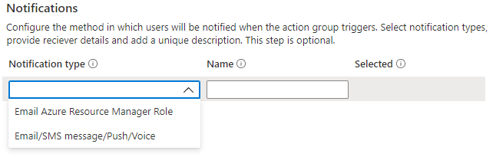
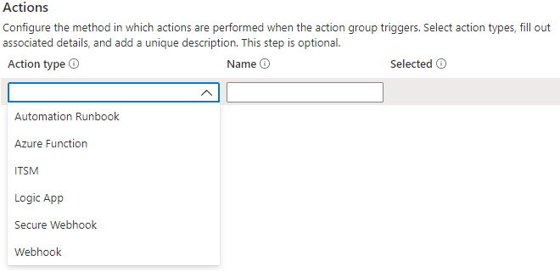
Action Groups
Configure the method in which users will be notified when the action group triggers
Configure the method in which actions are performed when the action group triggers
Notes:
Create and manage action groups in the Azure portal - https://docs.microsoft.com/en-us/azure/azure-monitor/platform/action-groups

Slide 17
Demonstration – Alerts
Create an alert rule
Explore alert targets
Explore alert conditions
Explore alert details
Notes:
✔ Always consider having students walk-through the demonstrations themselves. Also, consider the overlap with the formal labs and your best use of time.

Slide 18

Lesson 03: Log Analytics

Slide 19

Log Analytics Overview
Log Analytics Querying
Log Analytics
Query Language Syntax
Create a Workspace
Demonstration – Log Analytics
Connected Sources
Data Sources
Notes:
Monitor and back up Azure resources (10-15%)
Monitor resources by using Azure Monitor
Configure and interpret metrics
Configure Log Analytics
Query and analyze logs
Set up alerts and actions
Configure Application Insights

Slide 20
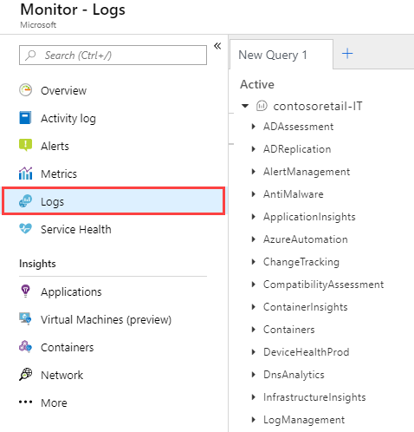
Log Analytics
A service that helps you collect and analyze data generated by resources in your cloud and on-premises environments
Write log queries and interactively analyze their results
Examples include assessing system updates and troubleshooting operational incidents
Notes:
Overview of Azure Monitor agents - https://docs.microsoft.com/en-us/azure/azure-monitor/platform/agents-overview

Slide 21
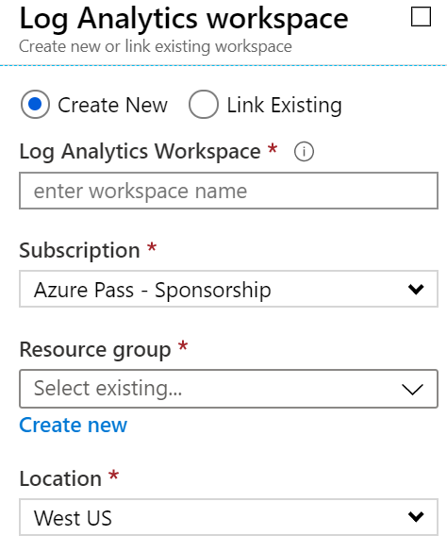
Create a Workspace
A workspace is an Azure resource and is a container where data is collected, aggregated, analyzed, and presented
You can have multiple workspaces per Azure subscription, and you can have access to more than one workspace
A workspace provides a geographic location, data isolation, and scope
Notes:
Create a Log Analytics workspace in the Azure portal -https://docs.microsoft.com/en-us/azure/azure-monitor/learn/quick-create-workspace

Slide 22
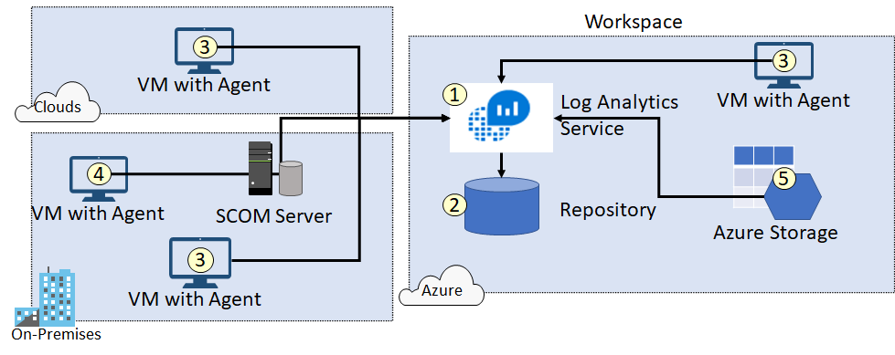
Connected Sources
Connected Sources generate data
Data can be collected from Windows, Linux, SCOM and Azure Storage

Slide 23
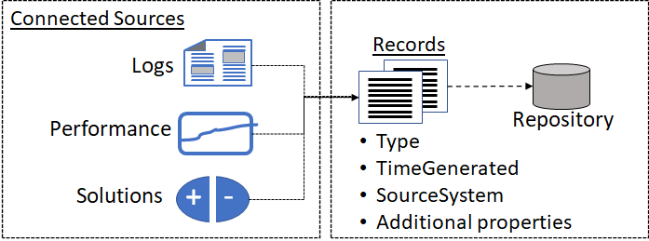
Data Sources
Data sources include: Windows Event Logs, Windows Performance Counters, Linux Performance Counters, IIS Logs, Custom Fields, Custom Logs, and Syslog
Each data source has additional configuration options
Notes:
Agent data sources in Azure Monitor - https://docs.microsoft.com/en-us/azure/azure-monitor/platform/agent-data-sources

Slide 24
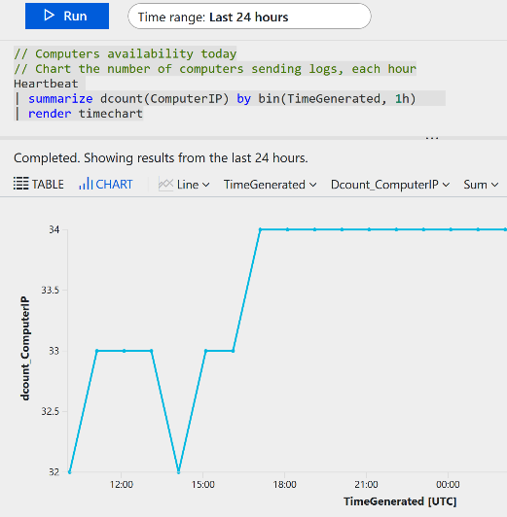
Log Analytics Querying
Log Analytics provides a query syntax
Quickly retrieve and consolidate data in the repository
Save or have log searches run automatically to create an alert
Export the data to Power BI or Excel
Notes:
Overview of log queries in Azure Monitor - https://docs.microsoft.com/en-us/azure/azure-monitor/log-query/log-query-overview
Get started with log queries in Azure Monitor - https://docs.microsoft.com/en-us/azure/azure-monitor/log-query/get-started-queries

Slide 25
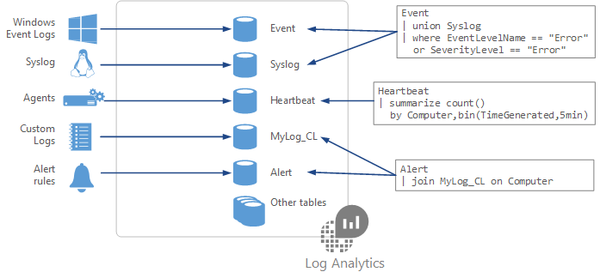
Query Language Syntax
Event
| where (EventLevelName == "Error")
| where (TimeGenerated > ago(1days))
| summarize ErrorCount = count() by Computer
| top 10 by ErrorCount desc
Notes:
Azure Monitor log queries - https://docs.microsoft.com/en-us/azure/azure-monitor/log-query/query-language
Azure Monitor log query examples - https://docs.microsoft.com/en-us/azure/azure-monitor/log-query/examples

Slide 26
Demonstration – Log Analytics
Access the demonstration environment
Use the Query Explorer
Notes:
✔ Always consider having students walk-through the demonstrations themselves. Also, consider the overlap with the formal labs and your best use of time.

Slide 27

Lesson 04: Network Watcher

Slide 28


Network Watcher Overview
Diagnostics – VPN Troubleshoot
Network Watcher
Network Watcher Diagnostics
Diagnostics – Packet Capture
Diagnostics – IP Flow Verify
Diagnostics – Connection Troubleshoot
Diagnostics – Next Hop
Logs – NSG Flow logs
Diagnostics – Effective Security Rules
Monitoring – Topology
Notes:
Configure and manage virtual networking (30-35%)
Monitor and troubleshoot virtual networking
Monitor on-premises connectivity
Use Network Performance Monitor
Use Network Watcher
Troubleshoot external networking
Troubleshoot virtual network connectivity

Slide 29
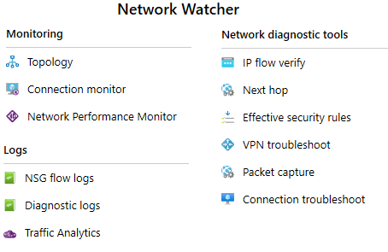
Network Watcher
A regional service that provides various network diagnostic and monitoring tools​
IP Flow Verify diagnoses connectivity issues
Next Hop determines if traffic is being correctly routed
VPN Diagnostics troubleshoots gateways and connections
NSG Flow Logs maps IP traffic through a network security group
Connection troubleshoot shows connectivity between source VM and destination
Topology generates a visual diagram of resources

Slide 30
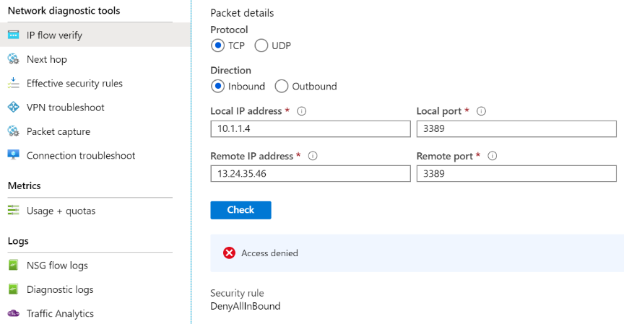
Diagnostics – IP Flow Verify
Diagnose connectivity issues from or to the internet and from or to the on-premises environment. Ideal for ensuring security rules are being correctly applied
Notes:
Introduction to IP flow verify in Azure Network Watcher - https://docs.microsoft.com/en-us/azure/network-watcher/network-watcher-ip-flow-verify-overview

Slide 31
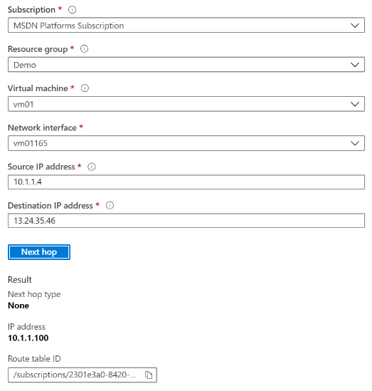
Diagnostics – Next Hop
Helps with determining whether traffic is being directed to the intended destination by showing the next hop
Notes:
Use next hop to diagnose virtual machine routing problems - https://docs.microsoft.com/en-us/azure/network-watcher/network-watcher-next-hop-overview

Slide 32
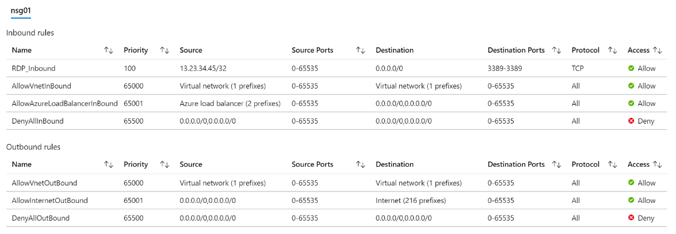
Diagnostics – Effective Security Rules
Details the Effective Security Rules (inbound and outbound) of the Network Interface card of a Virtual Machine
Notes:
Introduction to Effective security rules view in Azure Network Watcher - https://docs.microsoft.com/en-us/azure/network-watcher/network-watcher-security-group-view-overview

Slide 33
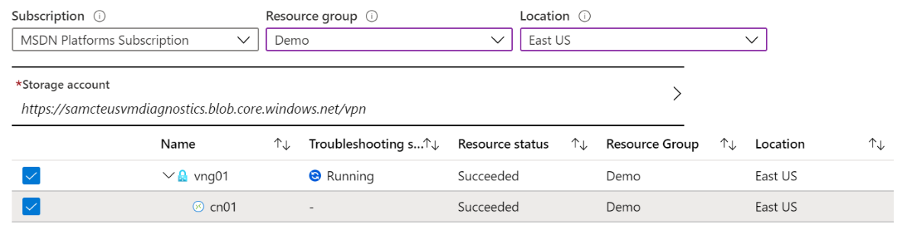
Diagnostics – VPN Troubleshoot
Helps you troubleshoot gateways and connections
Provides summary information and detailed information
Can troubleshoot multiple gateways or connections simultaneously
Notes:
Introduction to resource troubleshooting in Azure Network Watcher - https://docs.microsoft.com/en-us/azure/network-watcher/network-watcher-troubleshoot-overview

Slide 34
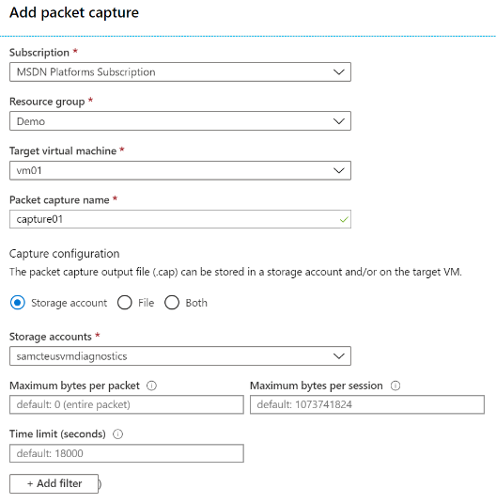
Diagnostics – Packet Capture
Captures inbound and outbound traffic from a Virtual Machine
Saves data to a storage account, a local file, or both
Notes:
Introduction to variable packet capture in Azure Network Watcher - https://docs.microsoft.com/en-us/azure/network-watcher/network-watcher-packet-capture-overview

Slide 35
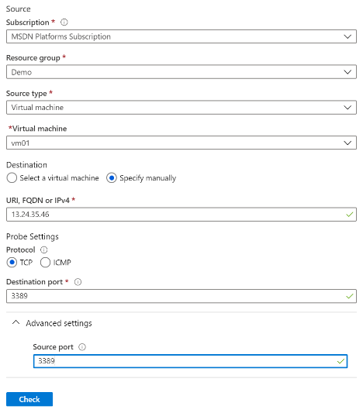
Diagnostics – Connection Troubleshoot
Check connectivity between source VM and destination
Identify configuration issues that are impacting reachability
Provide all possible hop by hop paths from the source to destination
Review hop by hop latency – min, max, and average between source and destination
View a graphical topology from your source to destination
Notes:
Troubleshoot connections with Azure Network Watcher using the Azure portal - https://docs.microsoft.com/en-us/azure/network-watcher/network-watcher-connectivity-portal

Slide 36
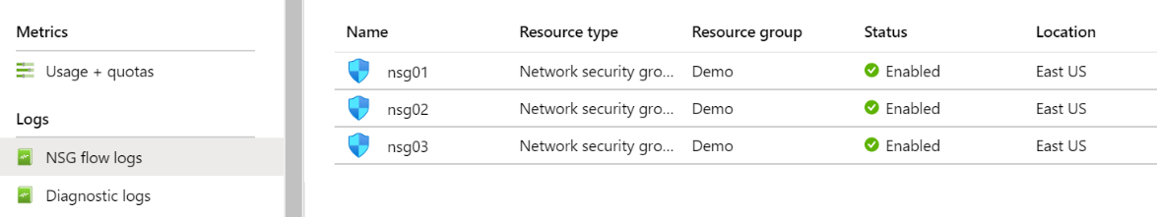
Logs – NSG Flow Logs
View information about ingress and egress IP traffic through an NSG
Flow logs are written in JSON format and show outbound and inbound flows on a per rule basis
The JSON format can be visually displayed in Power BI or third-party tools like Kibana
Notes:
Introduction to flow logging for network security groups - https://docs.microsoft.com/en-us/azure/network-watcher/network-watcher-nsg-flow-logging-overview

Slide 37
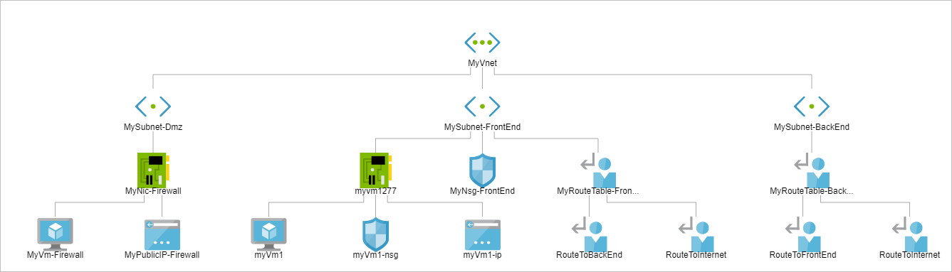
Monitoring – Topology
Provides a visual representation of your networking elements
View all the resources in a virtual network, resource to resource associations, and relationships between the resources
The Network Watcher instance in the same region as the virtual network
Notes:
View the topology of an Azure virtual network - https://docs.microsoft.com/en-us/azure/network-watcher/view-network-topology

Slide 38
Lesson 05: Module 11 Lab and Review

Slide 39
Lab 11 – Implement monitoring
Lab scenario
You need to evaluate Azure functionality that would provide insight into performance and configuration of Azure resources, focusing on Azure virtual machines. To accomplish this, you intend to examine the capabilities of Azure Monitor, including Log Analytics
Objectives
Task 1: Provision the lab environment
Task 2: Create and configure an Azure Log Analytics workspace and Azure Automation-based solutions
Task 3: Review default monitoring settings of Azure virtual machines
Task 4: Configure Azure virtual machine diagnostic settings
Task 5: Review Azure Monitor functionality
Task 6: Review Azure Log Analytics functionality
Next slide for an architecture diagram
Notes:
LAB 11 - Implement Monitoring - ESTIMATED DURATION 45 MIN
Lab Repository - https://microsoftlearning.github.io/AZ-104-MicrosoftAzureAdministrator/

Slide 40








Lab 11 – Architecture diagram
Task 1
az104-11-rg0
az104-11-vnet 10.0.0.0/24
Task 3
Subnet0 10.0.0.0/26
az104-11-rg0
Task 6
Task 4, Task 5
Task7
Azure Monitor
az104-11-vm0
10.0.0.4
LogAnalyticsWorkspace
New alert rule
Task 2
AutomationAccount
CloudShell
Register the Microsoft.Insights and Microsoft.AlertsManagement resource providers

Slide 41
Module Review
Module Review Questions
Microsoft Learn Modules (docs.microsoft.com/Learn)
Analyze your Azure infrastructure by using Azure Monitor logs
Improve incident response with alerting on Azure
Monitor the health of your Azure virtual machine by collecting and analyzing diagnostic data
Monitor, diagnose, and troubleshoot your Azure storage
Monitor and troubleshoot your end-to-end Azure network infrastructure by using network monitoring tools
Design a holistic monitoring strategy on Azure
Monitor performance of virtual machines by using Azure Monitor for VMs
Notes:
https://docs.microsoft.com/en-us/learn/

Slide 42
End of presentation

